Slide 1
ADVANCES IN DRUG DELIVERY ROUTES AND THEIR APPLICATION (From Passive to Predictive: The Era of Smart and Personalized Delivery)
Dr. Shanila Akhter
10-02-2026

Slide 2
Drug Delivery
Definition
The appropriate administration of drugs through various routes in the body for the purpose of improving patient compliance
It is highly interdisciplinary
It has recently evolved to take into consideration
Drug physico-chemical properties
Body effects and interactions
Improvement of drug effect
Patient comfort and well being
Controlled
Drug Delivery

Slide 3
Drug Delivery
Conventional
Controlled
Enteral
Sustained
Extended
Parenteral
Site-specific
Other

Slide 4
Equipment's for Nanoparticles
Homogenizer
Ultra Sonicator
Mills
Spray Milling
Supercritical Fluid Technology
Electrospray
Ultracentrifugation
Nanofiltration

Slide 5
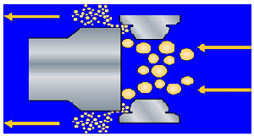
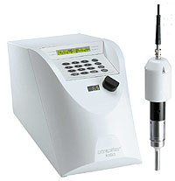
Homogenizer & Ultra Sonicator

Slide 6
Oral Administration
Advantages
Patient: Convenience, not invasive, higher compliance
Manufacture: well established processes, available infrastructure
Disadvantages
Unconscious patients cannot take dose
Low solubility
Low permeability
Degradation by GI enzymes or flora
First pass metabolism
Food interactions
Irregular absorption

Slide 7
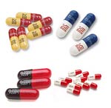

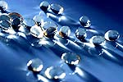
Oral Administration
Traditional oral delivery systems
Tablets
Capsules
Soft gelatin capsules
Suspensions
Elixirs

Slide 8

Buccal/Sublingual
Advantages
By-pass First pass metabolism
Rapid absorption
Low enzymatic activity
Disadvantages
Discomfort during dissolution
Probability of swallowing- lost of effect
Small doses
Traditional delivery system/devices
Tablets
Chewing gum

Slide 9
Rectal
Advantages
By-pass first pass metabolism
Useful for children
Disadvantages
Absorption depends on disease state
Degradation by bacterial flora
Uncomfortable
Traditional delivery system/devices
Suppository
Enema

Slide 10

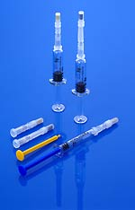
Intravenous (IV)
Advantages
Drug 100% bioavailable
Rapid response
Total control of blood concentration
Maximize incorporation of degradable drugs
By-pass FPM
Disadvantages
Invasive
Trained personnel
Possible toxicity due to incorrect dosing
sterility
Traditional delivery system/devices
Injection-bolus
IV bag - infusion

Slide 11
Subcutaneous
Advantages
Patient self-administration
Slow, complete absorption
By-pass FPM
Disadvantages
Invasive
Irritation, inflammation
Maximum dose volume - 2mL

Slide 12
Intramuscular
Advantages
Patient can administer the drug himself
Larger volume than subcutaneous
By-pass first pass metabolism
Disadvantages
Invasive – patient disconfort
Irritation, inflamation
May require some training

Slide 13
Inhalers
Advantages
By-pass FPM
Gases are rapidly absorbed
Disadvantages
Solids and liquids can be absorbed if size is below 0.5um

Slide 14


Transdermal
Advantages
Local effect
Ease of administration
Disadvantages
Low absorption for some drugs
May cause allergic reactions
Requirements
Low dosage <10 mg/mL
MW< 1,000

Slide 15
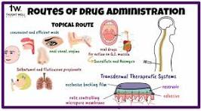
Limitations of Conventional Routes
• Oral: First-pass metabolism, low bioavailability
• Parenteral: Invasive, poor compliance
• Topical: Limited penetration

Slide 16
Factors Influencing the Selection of the Drug Delivery Route
Drug physico-chemical properties
Drug molecular size (molecular weight)
Half-life
Chemical stability
Loss of biological activity in aqueous solution
Proteins
Denaturation, degradation

Slide 17
Factors Influencing the Selection of the Delivery Route
Solubility in aqueous solution (hydrophobicity/hydrophilicity)
pH
pKa - ionization
Temperature
Concentration
Crystalinity
Particle size
State of hydration

Slide 18
Factors Influencing the Selection of the Delivery Route
Drug biological interactions
Sensitive to FPM
Low membrane permeabiltiy
Efflux pumps (MRP, MDR) – cancer drugs
Hydrophilicity
High-density charge
Enzymatic degradation
Bacterial degradation
Half-life
Side effects
Irritation

Slide 19
Factors Influencing the Selection of the Delivery Route
Desired pharmacological effect
Local
topical, vaginal
Systemic
oral, buccal, IV, SC, IM, rectal, nasal
Immediate response
IV, SC, IM, nasal
Dose size
Drug molecular size

Slide 20
Pharmacokinetics and Pharmacodynamics
Pharmacokinetics
Pharmacodynamics
Design
of dosage regimen
Where?
How much?
How often?
How long?
Plasma
Concentration
Effects
Plasma refers to the clear supernatant fluid that results from blood after the cellular components have been removed

Slide 21
Plasma Concentration
Toxicity
Plasma concentration
(mg/mL)
Therapeutic window
No therapeutic effect
Time (min)

Slide 22
Unsuccessful
therapy
Plasma concentration
(mg/mL)
Successful
therapy
Time (min)

Slide 23
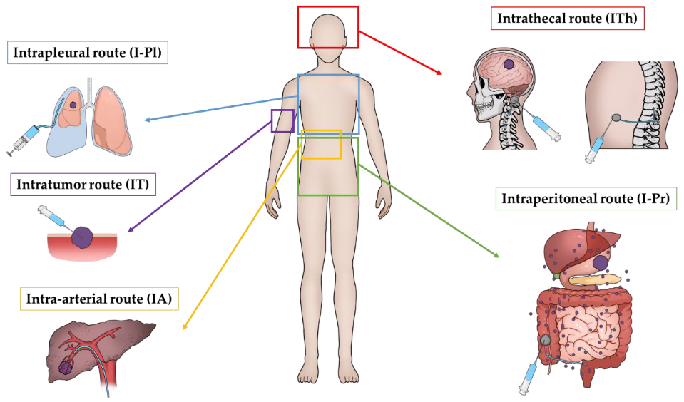
Advanced Drug Delivery Routes
• Pulmonary delivery
• Transdermal & microneedles
• Nasal (nose-to-brain)
• Ocular, buccal & sublingual
• Targeted & smart systems

Slide 24
The Evolution of Drug Delivery
Transition from 1st Gen (Immediate Release)
2nd Gen (Controlled Release)
3rd Gen (Targeted/Smart Systems).

Slide 25
Pulmonary Drug Delivery
• Drug administration via inhalation
• Rapid onset of action
• Avoids first-pass metabolism
• Used in
Asthma
COPD
insulin delivery

Slide 26
Transdermal Drug Delivery
• Drug permeation through skin
• Controlled and sustained release
• Examples:
Nicotine
fentanyl patches

Slide 27
Microneedle Drug Delivery
• Minimally invasive
• Suitable for biologics and vaccines
• Improves patient compliance

Slide 28
Nasal Drug Delivery (Nose-to-Brain)
• Bypasses blood–brain barrier
• Rapid CNS drug delivery
• Used in
Alzheimer’s, disease
Parkinson’s disease

Slide 29
Ocular Drug Delivery
• Challenges: tear drainage, low bioavailability
Advanced systems: in-situ gels, nanoparticles

Slide 30
Targeted Drug Delivery Systems
• Passive targeting (EPR effect)
• Active targeting (ligand-receptor)
• Examples: Liposomes, nanoparticles

Slide 31
Smart & Stimuli-Responsive Systems
• Drug release triggered by pH, temperature, enzymes
• On-demand and site-specific delivery

Slide 32
Gene & RNA Drug Delivery
• Viral and non-viral vectors
• Lipid nanoparticles
• Example:
mRNA vaccines

Slide 33
Clinical Translation Challenges
• Scale-up issues
• Regulatory hurdles
• Safety and cost concerns

Slide 34
PRIORITY AREAS
Cancer Nanotechnology
Lynozyfic (Bispecific antibody) and the rise of next-gen Antibody-Drug Conjugates (ADCs).
(i) Diagnosis using Quantum
Dots
(ii) Tumor Targeted Delivery
(iii) Imaging
(iv) Cancer Gene Therapy

Slide 35
Cont…
Metabolic Disease (GLP-1s and Beyond)
New indications for Semaglutide (CKD/MASH) and oral formulations that bypass gastric degradation.
Cell & Gene Therapy Delivery
Non-viral vectors (LNPs) replacing viral vectors for safer CRISPR-Cas9 delivery in vivo.

Slide 36
CONT..
Infectious Disease: Smart Antibiotics
Nanotech that targets bacteria specifically, leaving the gut microbiome unharmed.
Green Chemistry in LNP synthesis and the push for recyclable/biodegradable inhalers and pens.

Slide 37
Role of Artificial intelligence in drug designing
Artificial Intelligence (AI plays a transformative role in drug design by accelerating discovery, improving accuracy, and reducing costs. It helps identify drug targets, generate novel molecules, predict interactions, and optimize candidates far faster than traditional methods.

Slide 38
Role of Artificial intelligence in drug designing
Target Identification & Validation
AI analyzes massive biological datasets (genomics, proteomics) to identify potential drug targets.
Machine learning models detect disease-related proteins and pathways more efficiently than manual methods.

Slide 39
Role of Artificial intelligence in drug designing
Molecule Generation & Design
Deep learning algorithms can design novel drug-like molecules from scratch (de novo design).
Generative models (e.g., GANs, variational autoencoders) propose new chemical structures with desired properties.

Slide 40
Role of Artificial intelligence in drug designing
Virtual Screening & Docking
AI speeds up virtual screening by predicting which compounds are most likely to bind to a target.
Reduces the need to test millions of molecules experimentally.

Slide 41
Role of Artificial intelligence in drug designing
Optimization of Drug Candidates
AI predicts ADMET properties (Absorption, Distribution, Metabolism, Excretion, Toxicity).
Helps refine molecules for better efficacy, safety, and pharmacokinetics.

Slide 42
Role of Artificial intelligence in drug designing
Drug Repurposing
AI identifies new uses for existing drugs by analyzing clinical and molecular data.
Example: repurposing antivirals for COVID-19 treatment.

Slide 43
Role of Artificial intelligence in drug designing
Clinical Trial Design
AI models predict patient responses and help design smarter, faster trials.
Improves patient recruitment and reduces trial failures.

Slide 44
Challenges & Limitations OF AI IN DRUG DESIGN
Data quality: AI models depend on large, high-quality datasets.
Interpretability: Many AI models are “black boxes,” making results hard to explain.
Validation: Predictions must still be confirmed experimentally.
Ethical concerns: Data privacy and bias in training datasets.

Slide 45


