Slide 1
ADVANCES IN THERAPEUTIC CLINICAL TRIAL AND CLINICAL AUDIT
Course Code = TCC
Credit Hour = 2
Presented by Dr. Shanila Akhter

Slide 2
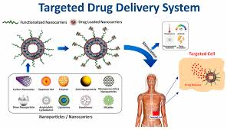
Targeted Drug Delivery Systems
Nano medicines
Nanoparticles
Liposomes
Micelles

Slide 3
What is Targeted Drug Delivery?
Delivery of drug to specific site of action
Minimizes systemic toxicity
Improves therapeutic index
The Therapeutic Index (TI) is the ratio between the toxic dose and the effective dose.
Lower Total Dose: Because the drug is delivered directly to the target, you often need a much smaller total amount of the drug to see results.

Slide 4
Difference between conventional and targeted Delivery System
Feature | Conventional Delivery | Targeted Delivery
Distribution | Whole body (non-specific) | Specific organ/cell
Side Effects | High (e.g., hair loss, nausea) | Minimal to none
Required Dose | High (to ensure enough reaches the site) | Low
Drug Protection | Minimal | High (encapsulated)
Release Pattern | Rapid/Burst | Controlled/Sustained

Slide 5
Introduction
Targeted Drug Delivery Systems
Smart Bomb of medicine
Nanoparticles : means microscopic particles that has atleat 1 into 100 dimensions
Nanomedicine is the medical application of nanotechnology. It involves using these tiny particles to diagnose, treat, and monitor diseases at the molecular level

Slide 6
Classification of Targeted Drug Delivery System
1- Passive targeted (EPR effect)
2- Active targeting (ligand–receptor)
3- Physical targeting ( pH, Temperature)

Slide 7
Passive Targeted Drug Delivery System
This method doesn't use "GPS" to find the target; it simply exploits the natural environment of the diseased tissue
EPR Effect (Enhanced Permeability and Retention):
e.G This is the gold standard for cancer targeting.
Physiological Targeting: Using the body's natural processes, such as targeting the liver or spleen because they naturally filter out foreign particles

Slide 8
Active Targeted Drug Delivery System
Active targeting is a key for a specific lock. In this system, the surface of a drug carrier is modified with "ligands
Ligands: These are molecules (like antibodies, peptides, or sugars) that recognize and bind to specific receptors on the surface of the target cell
Monoclonal Antibodies (mAbs): These are engineered to stick to specific proteins overexpressed in diseases like cancer (e.g., HER2 in breast cancer).

Slide 9
Active Targeted Drug Delivery System
Aptamers: Often called "chemical antibodies," these are small sequences of DNA or RNA that fold into specific shapes to bind to targets.
Example
Liposomal Amphotericin B
Liposomal Doxorubicin formulations
Transdermal patches
Scopolamine, Clonidine, Nitroglycerin

Slide 10
Physical Targeted Drug Delivery System
This is "just-in-time" delivery. The drug stays locked inside its carrier until it experiences a specific "trigger" at the target site.
pH-responsive: Cancer tissues and some cell compartments (lysosomes) are more acidic. Carriers are designed to dissolve only when the pH drops.
Enzyme-responsive: The drug is released only when it encounters an enzyme produced by the target tissue.

Slide 11
Levels of Targeting
1- First-Order: Targeting a specific organ (e.g., the liver).
2- Second-Order: Targeting specific cells within that organ (e.g., tumor cells but not healthy hepatocytes).
3- Third-Order: Targeting specific parts inside the cell (e.g., the nucleus or mitochondria). This is crucial for gene therapies like CRISPR.

Slide 12
Common Delivery Vehicles (The Carriers)
Drugs are usually packed into one of these "shipping containers":
Carrier Type | Description
Liposomes | Fatty bubbles (lipid bilayers) that can carry both water-soluble and oil-soluble drugs.
Nanoparticles | Solid particles (polymeric or inorganic) often used for slow, controlled release.
Micelles | Simple clusters of soap-like molecules that hide hydrophobic drugs in their core.

Slide 13
Nanomedicines in Clinical Trial
ThermoDox®
Composition: Doxorubicin encapsulated in thermosensitive liposomes
Indication: Hepatocellular carcinoma (liver cancer)
Clinical status: Phase III clinical studies (using heat to trigger drug release locally

Slide 14
Nanomedicines in Clinical Trial
EndoTAG-1
Composition: Paclitaxel-based liposomal formulation
Indication: Breast and pancreatic cancers
Clinical status: Ongoing clinical trials (Phase II/III)

Slide 15
Nanomedicines in Clinical Trial
NK105
Type: Polymeric micelle incorporating paclitaxel
Indication: Metastatic/advanced cancers (e.g., breast cancer)
Status: Has progressed through Phase II/III studies

Slide 16
Nanomedicines in Clinical Trial
Aurimune® (Gold Nanoparticles + TNF)
Composition: Colloidal gold nanoparticles conjugated with TNF
Indication: Solid tumors
Status: Phase I clinical trials

Slide 17
Nanomedicines in Clinical Trial
CRLX101
Composition: Camptothecin linked to a cyclodextrin-based polymer nanoparticle
Indication: Advanced solid tumors
Clinical status: Phase I/IIa trials have been conducted in patients with advanced cancers

Slide 18
Advantages of Nanoparticles
Improved bioavailability
Targeted delivery
Reduced dose frequency

Slide 19
Applications of Nanoparticles/ nanomedicines
Cancer therapy
Gene delivery
Vaccine delivery

Slide 20
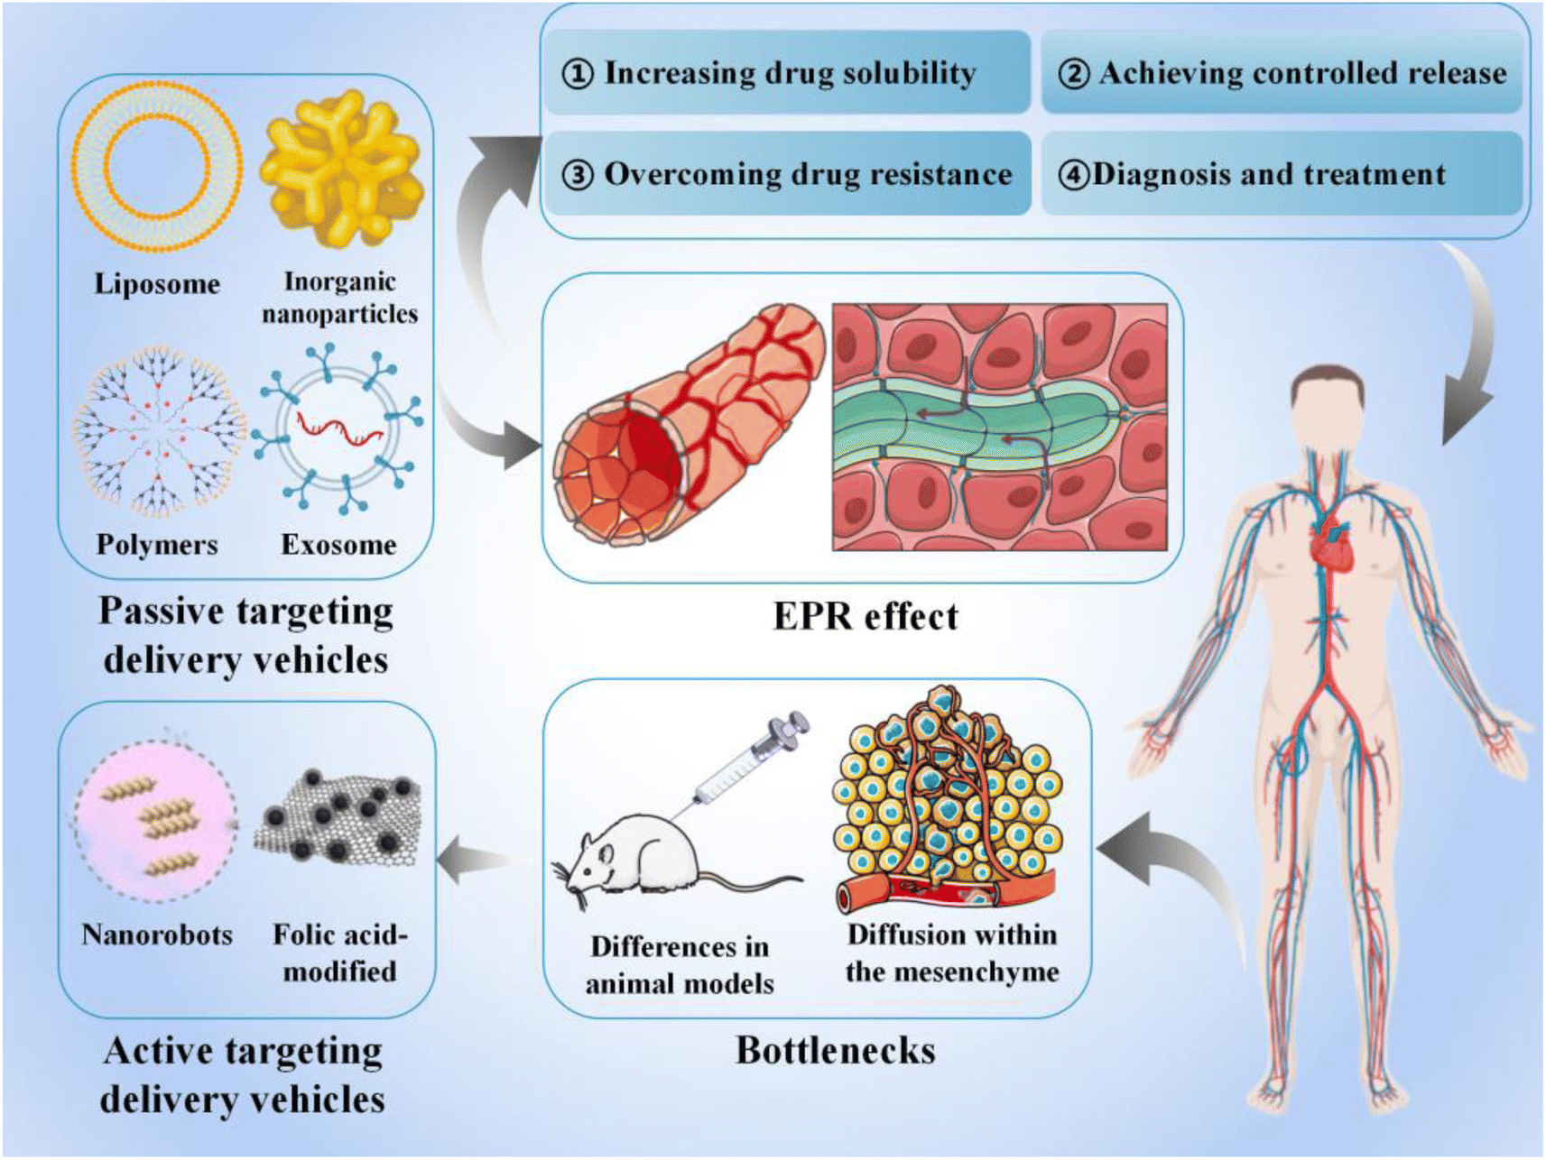

Slide 21
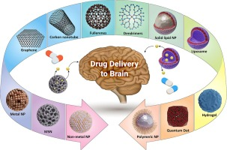
Challenges in Targeted Drug Delivery
Stability issues
Scale-up and manufacturing
Regulatory hurdles

Slide 22
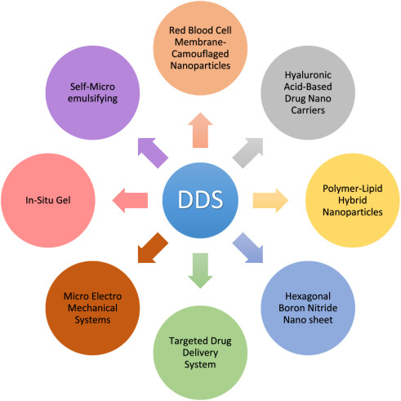
Future Perspectives
AI-Driven "De Novo" Nanoparticle Design
Traditionally, finding the right nanoparticle for a drug was trial and error. In the coming years, Generative AI will design nanoparticles from scratch.
Predictive Modeling: Instead of testing 1,000 lipid combinations for a vaccine, AI will predict the exact molecular structure needed for a specific patient's genetic profile.

Slide 23
MCQs
The main objective of a targeted drug delivery system is to:
A. Increase drug solubility B. Reduce dosing frequency C. Deliver drug selectively to the site of action D. Enhance drug taste

Slide 24
MCQs
Which of the following is a first-generation targeted drug delivery system?
A. Monoclonal antibody–drug conjugates B. Liposomes C. Gene-targeted nanoparticles D. siRNA-loaded nanocarriers

Slide 25
MCQs
The Enhanced Permeability and Retention (EPR) effect is most commonly exploited in:
A. Oral controlled-release formulations B. Transdermal patches C. Tumor-targeted nanomedicines D. Intranasal drug delivery

Slide 26
MCQs
Which carrier system is commonly used to reduce cardiotoxicity of doxorubicin?
A. Niosomes B. Solid lipid nanoparticles C. Liposomes D. Microspheres

Slide 27
MCQs
Active targeting in drug delivery involves:
A. Passive diffusion of drug B. pH-dependent release C. Ligand–receptor interaction D. Sustained drug release

Slide 28
MCQs
Which of the following is an example of ligand used in active targeting?
A. Polyethylene glycol B. Cholesterol C. Folic acid D. Lactose

Slide 29
MCQs
ThermoDox® is best described as:
A. pH-sensitive nanoparticle B. Thermosensitive liposomal formulation C. Antibody-drug conjugate D. Gene-based nanotherapy

Slide 30
MCQs
Which drug delivery system uses antibodies for site-specific drug delivery?
A. Liposomes B. Nanocrystals C. Antibody–drug conjugates (ADCs) D. Transdermal patches

Slide 31
MCQs
Passive targeting mainly depends on:
A. Enzyme specificity B. Ligand binding C. Pathophysiological conditions D. Antibody affinity

Slide 32
MCQs
Which of the following is a disadvantage of targeted drug delivery systems?
A. Reduced systemic toxicity B. Improved therapeutic index C. High production cost D. Enhanced efficacy

Slide 33
MCQs
Solid tumors are ideal targets for nanoparticle-based drug delivery because of:
A. High lymphatic drainage B. EPR effect C. Rapid drug metabolism D. Low vascular permeability

Slide 34
MCQs
A 55-year-old patient with hepatocellular carcinoma is treated with a liposomal formulation of doxorubicin combined with local radiofrequency ablation. The drug is released only when the tumor temperature rises above 40°C. Which drug delivery principle is being utilized?
A. pH-dependent targeting B. Enzyme-activated release C. Thermosensitive liposomal targeting D. Antibody-mediated targeting E. Osmotically controlled release

Slide 35
MCQs
A chemotherapeutic drug encapsulated in nanoparticles accumulates preferentially in tumor tissue due to leaky vasculature and poor lymphatic drainage, without the use of ligands or antibodies. Which targeting mechanism explains this phenomenon?
A. Active targeting B. Receptor-mediated endocytosis C. Enzyme-specific delivery D. Passive targeting via EPR effect E. Cellular uptake targeting

Slide 36
MCQs
A patient receiving conventional doxorubicin develops cardiotoxicity. The oncologist switches to a liposomal formulation that significantly reduces cardiac adverse effects while maintaining antitumor efficacy. The reduced toxicity is primarily due to:
A. Increased renal clearance B. Reduced drug solubility C. Altered tissue distribution D. Enzyme-dependent activation E. Faster hepatic metabolism

Slide 37


