Slide 1


How to Run a Clinical Trial?
Dr. Tehreem Zahid
Assistant Director
Clinical Trials Unit
Rawalpindi Medical University

Slide 2

Patient Recruitment
What we see
Conceptualization
Ethics
Laboratory negotiations
MoU/Contracts
The actual background work
Infrastructure development
Logistics
Budget
Referral Networking

Slide 3
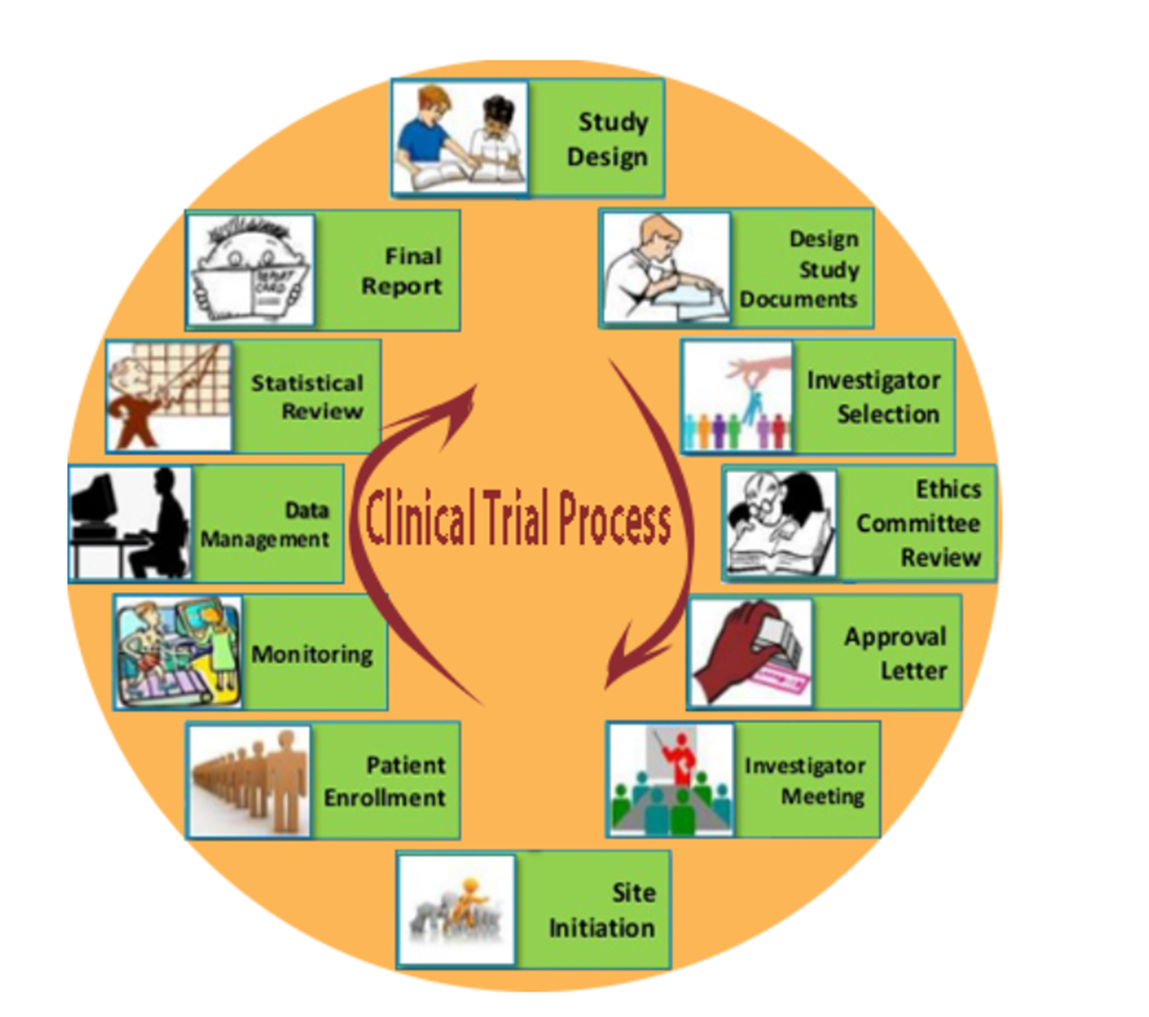

Slide 4
What do we need to start any project?
3+3Ms
Men (human resource)
Money (funds)
Materials (stationery, software, chemicals etc)
Machines (equipment)
Methods (protocol, rules, SOPs)
Market (to sell end product)

Slide 5
Scenario: A first year orthopedic resident wants to see if operating for midshaft clavicle fractures is better than not operating

Slide 6
What is a research question?
A clear, focused question that defines what a study wants to find out.
Usually structured like a question with a ? at the end and starting with what/when/why/how/does etc.

Slide 7
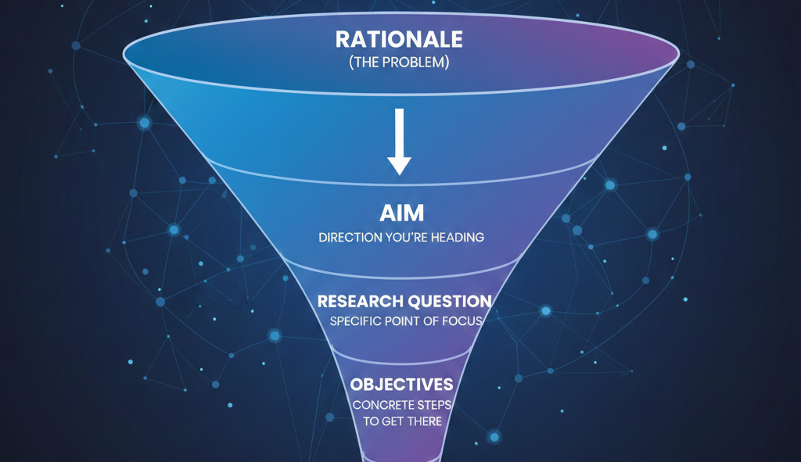
Hierarchy of Logic

Slide 8
Component | Definition | Focus | Question it Answers
Rationale | The justification for doing the study in the first place. | The Background | Why do this study? What gap is this filling?
Aim | The broad, long-term impact of the study. Big picture (not usually achieved) | The Intent | What is the ultimate goal?
Research Question | A clear, focused, and concise question that the study will answer. | The Uncertainty | Does A work better than B?
Objective | The specific, measurable steps you will take to achieve the Aim. | The Metric | How will you measure it?

Slide 9
Component | Example
Rationale | "Surgery is expensive and risky; we need to know if it's truly better than a sling in our setting."
Aim | "To improve the clinical outcomes and recovery speed of trauma patients."
Research Question | "In adults, does operating result in better outcomes at 6 months than conservative management/sling?"
Objective | "To compare the union rates between groups at 24 weeks."

Slide 10
Why the distinction matters:
The Rationale gets you through the Introduction.
The Aim defines your Conclusion.
The Research Question determines your Study Design.
The Objectives dictate your Statistical Analysis Plan.

Slide 11
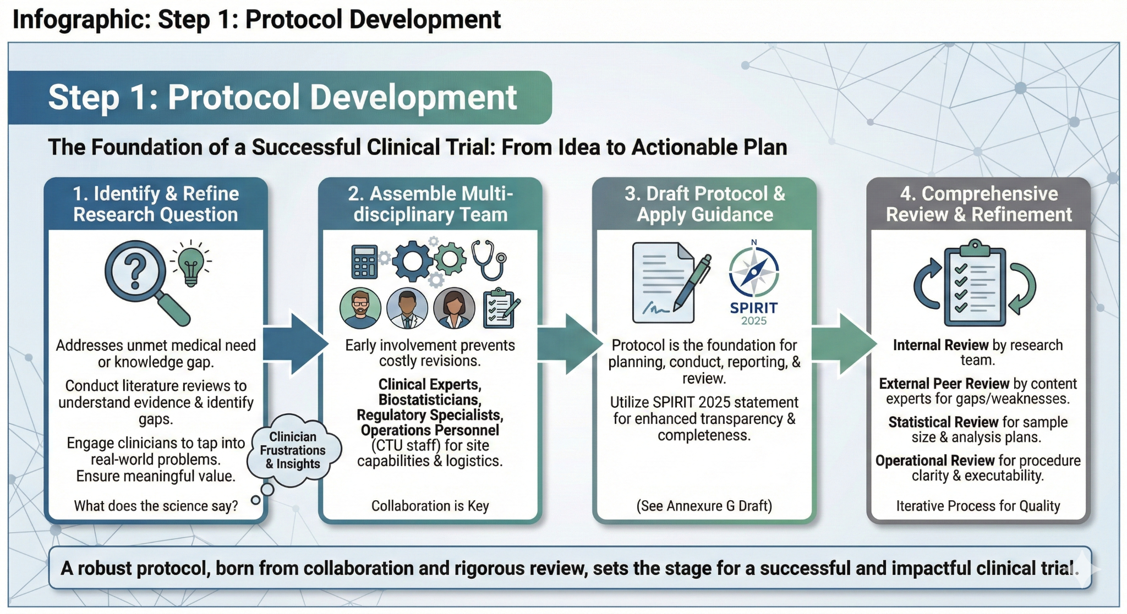
Apply FINER to see if the question is CAN and SHOULD be answered!
FINER
Feasible
Interesting
Novel
Ethical
Relevant

Slide 12
Feasible: Do you have enough patients, time, money, and technical expertise?
Interesting: Does it actually excite the clinical community (and you)?
Novel: Does it provide new findings or just replicate what we already know?
Ethical: Can it be done without causing undue harm?
Relevant: Will the results change clinical practice or health policy?

Slide 13
Apply FINER to this Scenario:
A first year orthopedic resident wants to design a trial to see if operating for midshaft clavicle fractures is better than not operating

Slide 14
Criteria | The Researcher's Question | Action
F – Feasible | Do we see enough clavicle fractures in our trauma bay to reach a sample size of 60 patients in one year? | Talk to the statistician- calculate sample size Get data on numbers of clavicle fracture
I – Interesting | Is there still a debate about "to plate or not to plate"? | Literature review : Identify GAP
N – Novel | Are we just repeating a 2010 study? | Literature review + Talk to supervisor (what can we do differently)
E – Ethical | Is it safe to randomize these patients? | CTU, Research Office, ERB. Supervisor
R – Relevant | Will this change our department's surgical indications? | Supervisor, departmental discussion

Slide 15
Criteria | The Reality Check
F – Feasible | If the hospital only sees one a month, the trial isn't feasible for a resident’s timeline.
I – Interesting | Yes; orthopedists still argue about union rates versus surgical complications (scars, hardware irritation).
N – Novel | Ensure you add a new element, like comparing a specific "minimally invasive" technique versus traditional ORIF.
E – Ethical | Since both sling and surgery are accepted standards of care, "clinical equipoise" exists, making it ethical.
R – Relevant | If the trial shows surgery returns patients to work 4 weeks faster, it directly impacts how you treat patients

Slide 16

FINER
Feasible
Interesting
Novel
Ethical
Relevant

Slide 17
Apply PICO: Gold standard to structure research question- Makes it MEASURABLE
PICO
P (Population)
I (Intervention)
C (Comparison)
O (Outcome)

Slide 18
Apply PICO: Gold standard to structure research question
PICO
P (Population): Who are the patients?
I (Intervention): What is the new treatment or test?
C (Comparison): What are you comparing it to?
O (Outcome): What are you measuring? What do we want to see?

Slide 19
Apply PICO to this Scenario:
A first year orthopedic resident wants to design a trial to see if operating for midshaft clavicle fractures is better than not operating

Slide 20
PICO
P (Population): Active adults (ages 18–60) with displaced, non-comminuted midshaft clavicle fractures.
I (Intervention): Open Reduction Internal Fixation (ORIF) with plate and screws.
C (Comparison): Non-operative management (Sling immobilization and early physical therapy).
O (Outcome): Functional recovery at 6 months, measured by the DASH (Disabilities of the Arm, Shoulder, and Hand) score.

Slide 21
Who can you ask for help?
Yourself (Read similar studies - methods section)
AI (Claude, ConnectedPapers.com, Jenni AI)- Avoid Chat GPT
Supervisor
Colleagues
Research department

Slide 22
Focus and Narrow the Scope
Don’t try to save the world with one study!
One Primary Question
Every trial should have one main "Yes/No" question. Secondary questions are fine, but don't let them dilute the primary goal.
Avoid "Fishing"
Don't just gather data and hope to find something interesting. Start with a specific hypothesis.

Slide 23
Scenario: A first year orthopedic resident wants to design a trial to see if operating for midshaft clavicle fractures is better than not operating
"In active adults with displaced midshaft clavicle fractures, does ORIF with plate fixation lead to superior DASH scores at 6 months compared to non-operative management?"

Slide 25
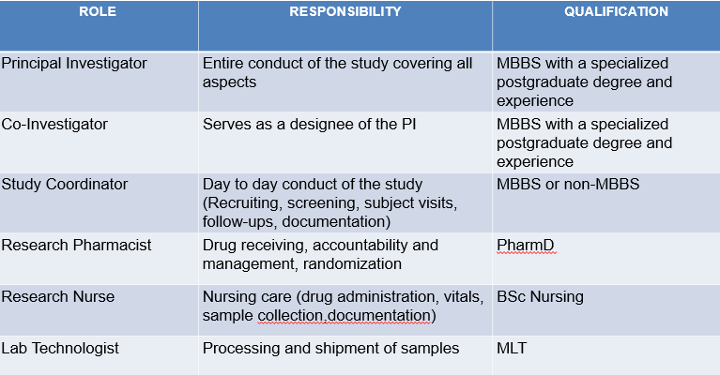
What does a trial team look like?

Slide 26
SPIRIT Checklist:
https://www.consort-spirit.org/
Gives you an overview of all essential components required
Go through all and see what you require
Liaise with other departments

Slide 27
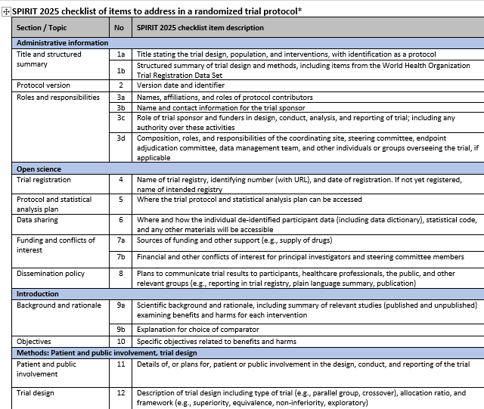

Slide 28
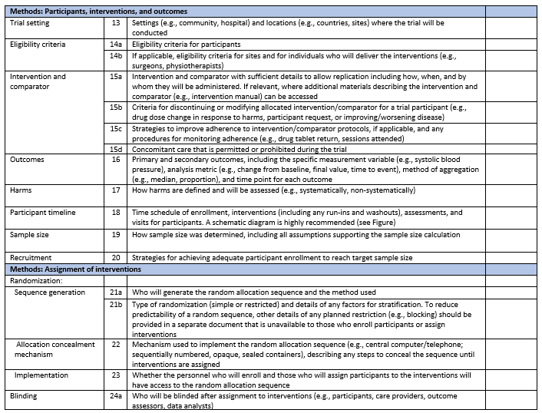

Slide 29
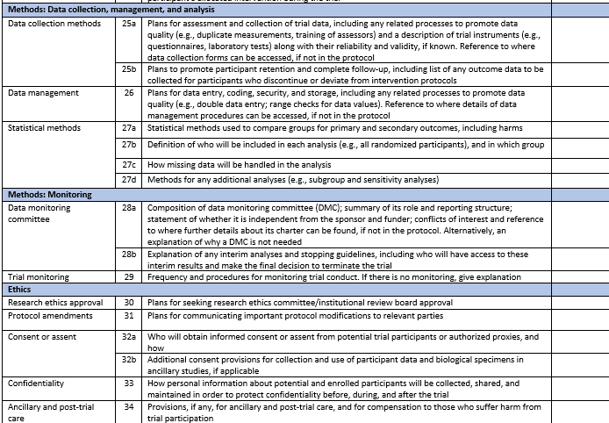

Slide 31
Step 2: Securing Funding
Grants
National: Pakistan Health Research Council (PHRC)
Higher Education Commission (HEC)
ORIC (Office of Research, Innovation & Commercialization)
International: Gates Foundation, Wellcome Trust etc
Pharmaceutical Industry
Can fund either whole study, drug/devices/implants
In-kind cost

Slide 32
Key Points:
No research is free.
Trials require $$$
Trials generate $$$$$$$$, very lucrative business
Protocol needs to be final before generating budget

Slide 33
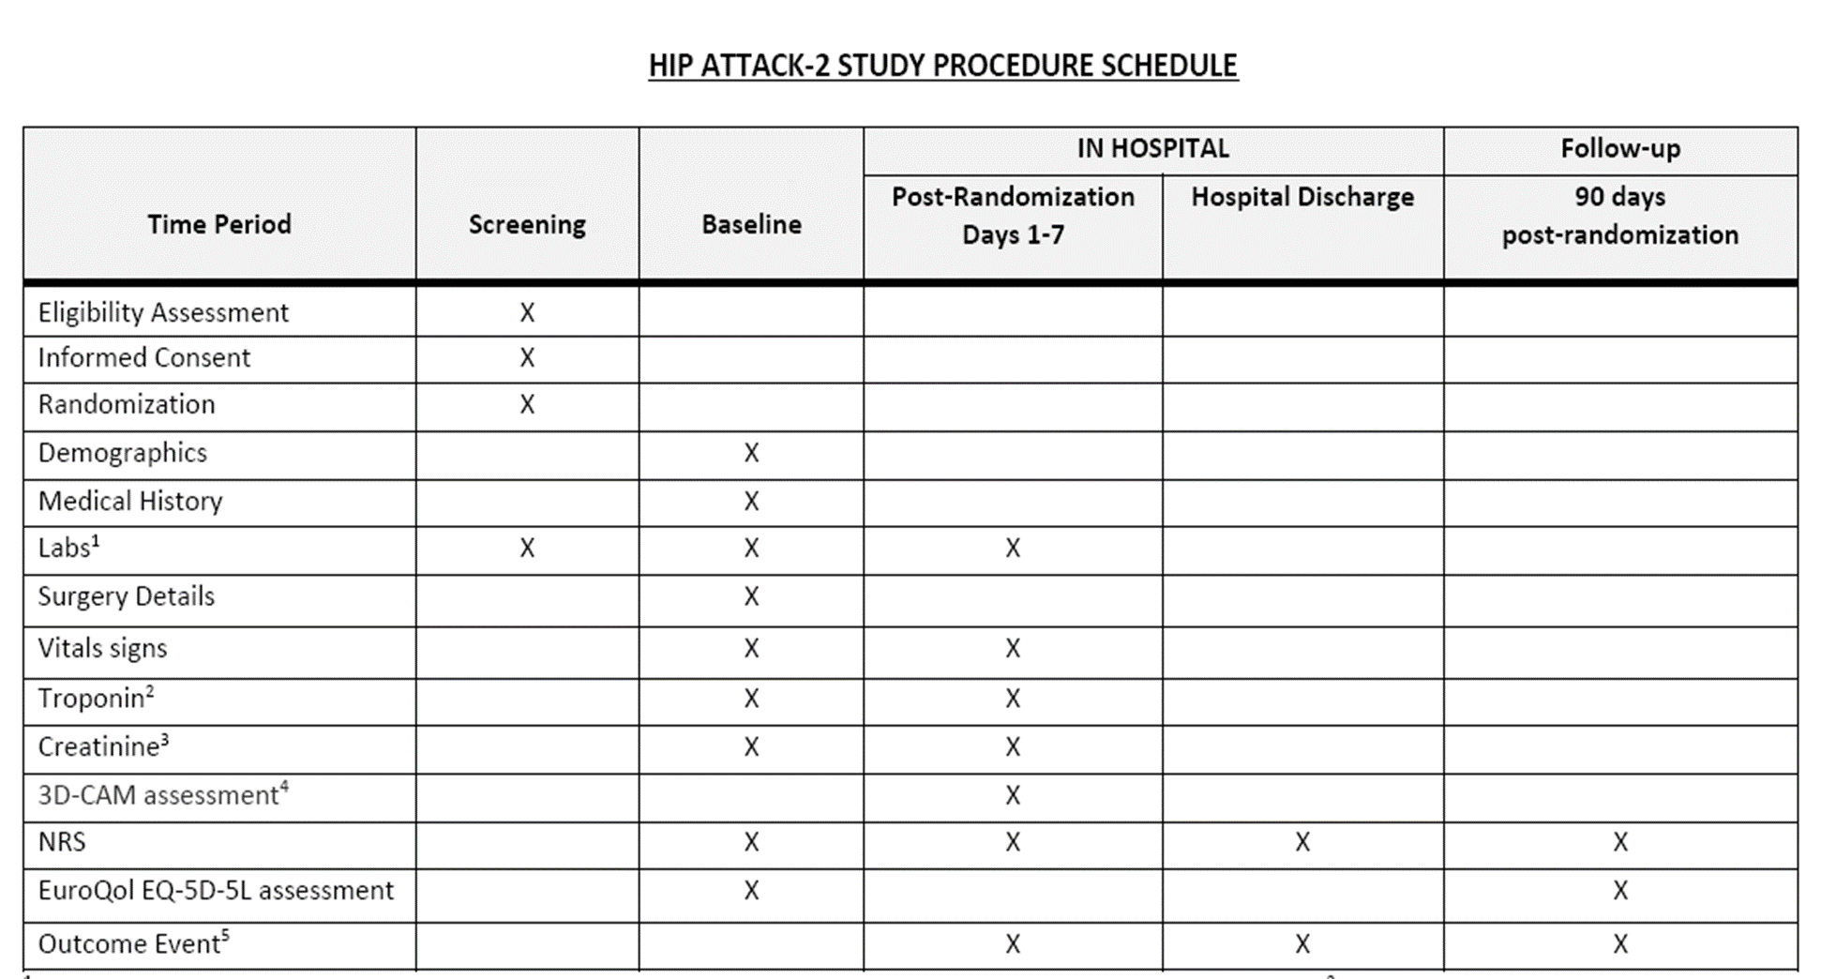

Slide 34
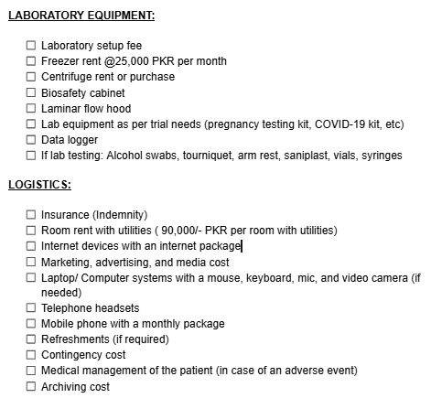
What should be included in the budget?

Slide 35
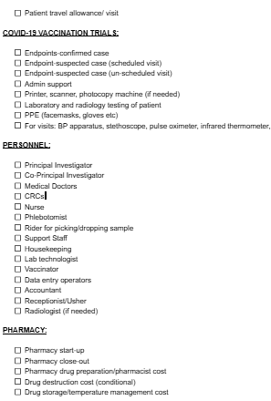
ADDITIONAL COSTS:
Overhead (20-26% of total budget)
Site start-up cost
(Conditional): Medical devices needed for procedures: BP apparatus, thermometer, weight machine, measuring tape,

Slide 36
Category | Item Description | Estimated Unit Cost | No of units per patient | No of patients | Total Units | Total Cost (Unit cost x total units)
Consumables | Surgical Plate & Screws (Fixation Set) | 60,000 PKR | 0.5 | 60 | 30 | 1800,000
Diagnostics | Follow-up X-rays (Weeks 2, 6, 12, 24) | 4,000 PKR | 4 | 60 | 240 | 960,000
Patient Support | Travel Reimbursement for 2 follow-up visits | 3,000 PKR | 2 | 60 | 120 | 360,000
 |  |  |  |  |  | 31,20,000

Slide 37
Must add:
Overhead cost (10-25%)
Contingency cost
Medical management cost (for private hospitals)
Important to adjust for inflation

Slide 38
Step 3: Contract/ Agreements
Documents describing the broad outlines of an agreement between two or more parties
MoU - not legally binding/gentleman’s agreement
Clinical Trial Agreement - legally binding/businessman’s agreement
Usually handled by Clinical Trials Unit/Research Department/ Administration
Legal advisers at every institution
Can start at the time of budget negotiation but finalized after budget is approved (included as a screenshot in the agreement)

Slide 39
Step 4: Institutional Ethical Approvals
DRB
IRB/ERB
BASR

Slide 40
DRB
IRB
BASR
TRIAL REGISTRATION
NBC (if applicable)
DRAP (if applicable)
Enrollement
Budget
Contract

Slide 41
Step 5: Trial Registration
Registration is the process of making the details of your study public in an official, central database before you actually start the work
“birth certificate of a trial”
Why Must We Register?
Ethical Duty: Publication bias/ P-hacking/ Outcome switching
Journal Requirements
Avoid Duplication

Slide 42
Where to Register?
ClinicalTrials.gov: The largest global database (managed by the US National Library of Medicine).
WHO ICTRP: The World Health Organization International Clinical Trials Registry Platform.
Regional Registries: (e.g., EU Clinical Trials Register or Pan African Clinical Trial Registry).

Slide 43
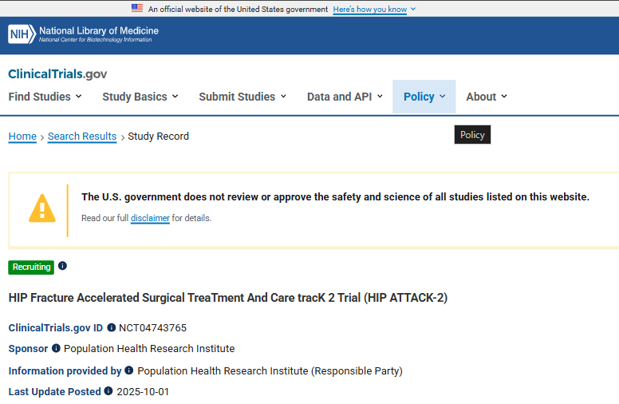

Slide 44
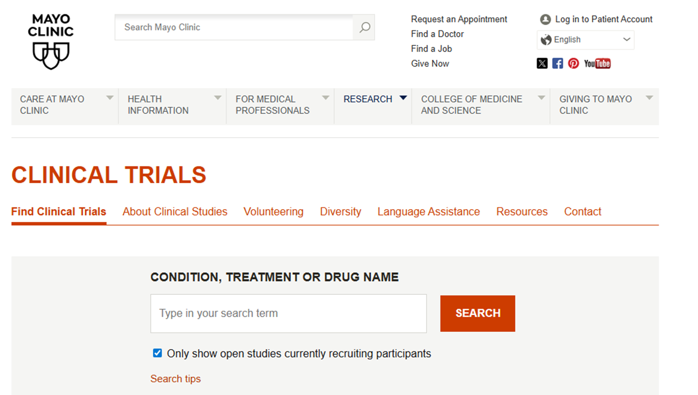

Slide 45
Step 6: National Ethical/Regulatory Approvals
National Bioethics Committee
Drug Regulatory Authority

Slide 46
Your trial is now approved by DRB, IRB, BASR and NBC
What now?

Slide 47
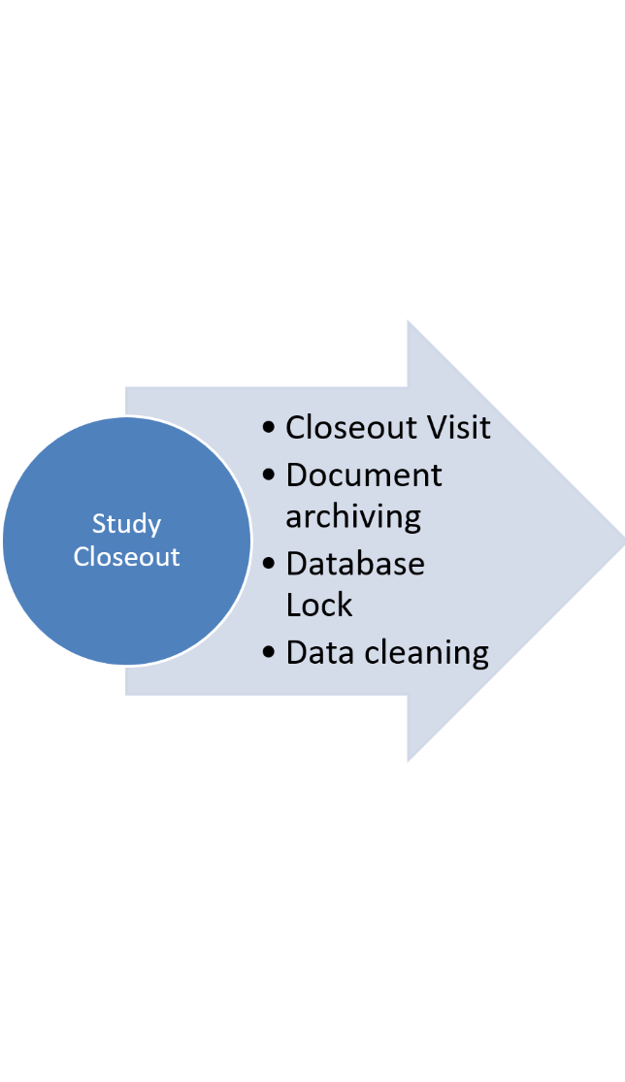
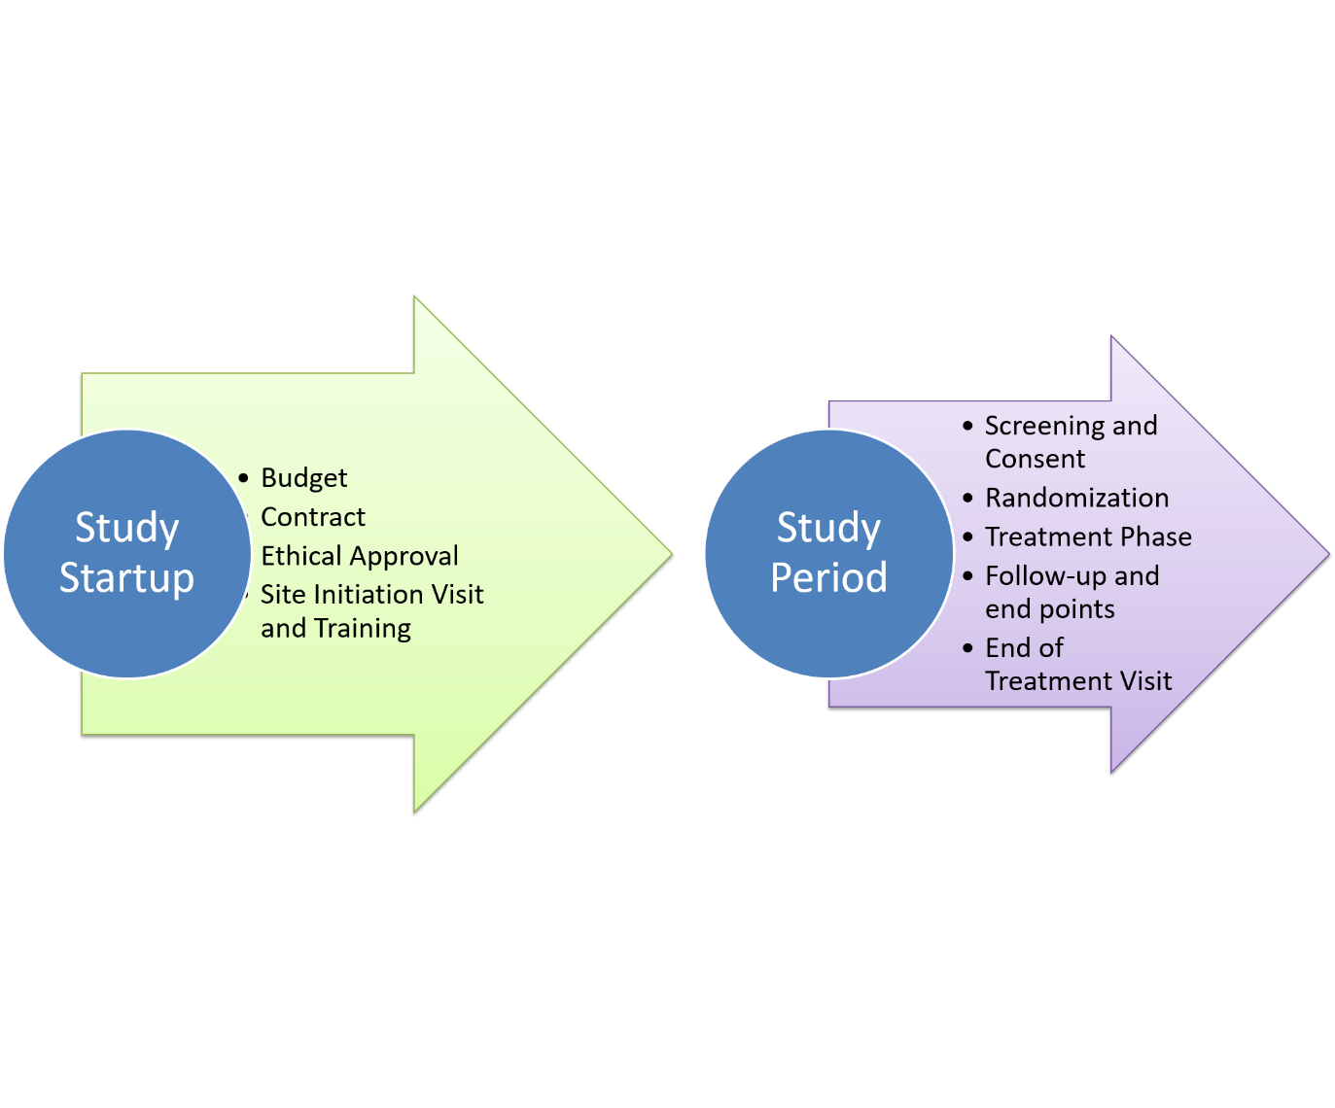

Slide 48
Site Preparation and Initiation
With all approvals secured, the focus shifts to preparing sites for participant enrollment.
Train everyone on data entry systems and trials (https://gcp.nidatraining.org/)
Verify facilities/equipment
Establish communication between all teams
Make Investigator Site File (ISF)/Trial Master File

Slide 49
What is inside a Trial Master File?
1 1.1 1.2 1.3 1.4 1.5 | Study Team Documents: Delegation of Duties Log CVs GCP certificates Medical License Training Logs
2 2.1 2.2 2.3 2.4 2.5 2.6 2.7 2.8 2.9 | Study Start-Up ERB Application Form Final Budget Signed Contract ERB Approval Letter Final Study Protocol/Synopsis Approved Informed Consent Form (Urdu/English) Other patient-facing materials (participant card, participant diary, participant information sheet Approved Case Report Form

Slide 50
3 3.1 3.3 | Participant Information Screening Logs Serious/Adverse Event Forms
4 4.1 4.2 4.3 | Drug Record Drug Receiving Record Drug Dispensing/Accountability Record Drug Information
5 | Audit and Inspection Reports

Slide 51
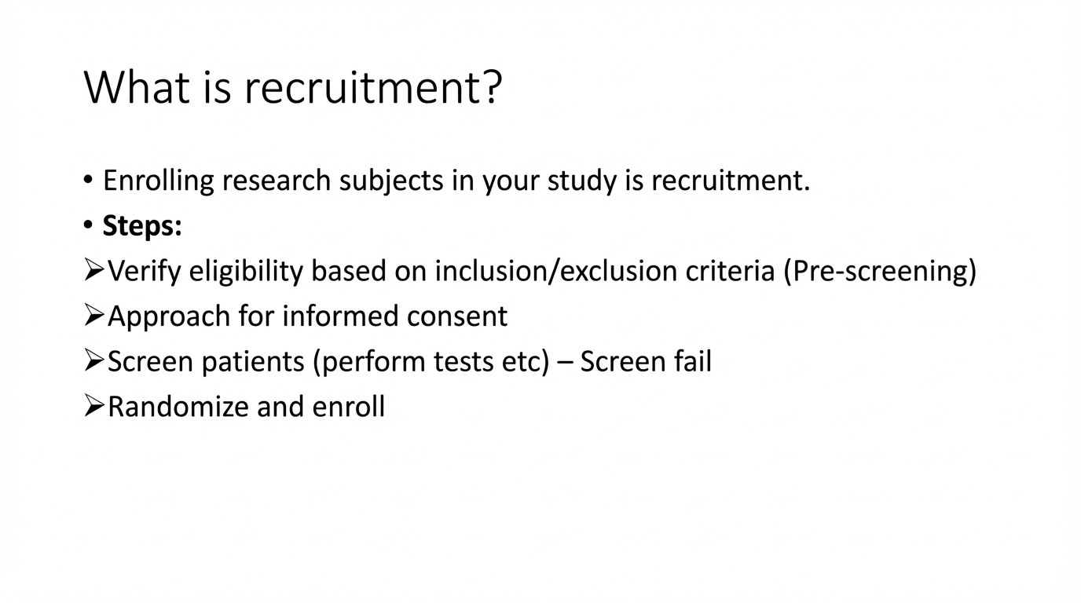

Slide 52
How to gather patients for your trial?
Word of mouth (café, gatherings)
Hand out brochures /one pagers (whatsapp)
Canvassing (clinics, meetings, general public –metro stations etc)
Mass communication (text messages, emails, intranet, social media, TV advertisements)
Research center websites
Standees
Hospital registries/data centers/lab records/radiology

Slide 53

Institution name
Basic eligibility
Easy and Local Language
Clear contact details

Slide 54

Important:
All advertising materials also require approval from IRB/NBC/DRAP

Slide 55
Informed Consent in an art!
(clinical and research consents are poles apart)
Good professional setting, no interruption
Introduce : Focus on research/trial experience – personal and institutions, mention regulatory bodies, show licenses (displayed), ask about their educational background
Make sure you introduce yourself as part of caregiving circle!
Better if treating physician introduces you
What is trial: Basics on phases, generic vs brand names,
Introduce study: Objective, sponsor, approvals, other hospitals, countries
Intervention: Safety, efficacy, alternates, indemnity insurance, followups, placebo, chance of screen fail, randomization, TADA

Slide 56
Do not underestimate the patient esp on education/income level
• All caregivers want the best- no condescending remarks if patient is refusing consent
• Simple language- simple comparisons
• Dignified response always – no patient owes you research participation
• Not convinced- use better rationale, involve treating physician, give reading material and time (come back next day)
• NO COERCION or MONETARY BENEFITS
• Standard of care will not be affected
Give consent form, ask them to read and come next day to decide - dont ask for same day consent if time allows

Slide 57
In a nutshell:
Daleel = Strong (good grip on protocol and ethics)
Awaz= Soft (keep emotions in check, dont take refusal personal)
Remember: A patient refusing trial consent says more about you than them.
A well-executed consent discussion almost always results in a yes (improve your skills rather than dehumanizing the patient)

Slide 58
Phase | Action | Goal
Recruitment | Identifying a potential candidate. | To build a "pool" of candidates.
Screening | Checking Eligibility (Inclusion/Exclusion). | To ensure safety and scientific validity.
Enrollment | Signing Consent + Randomization. | To officially start the study protocol.

Slide 59
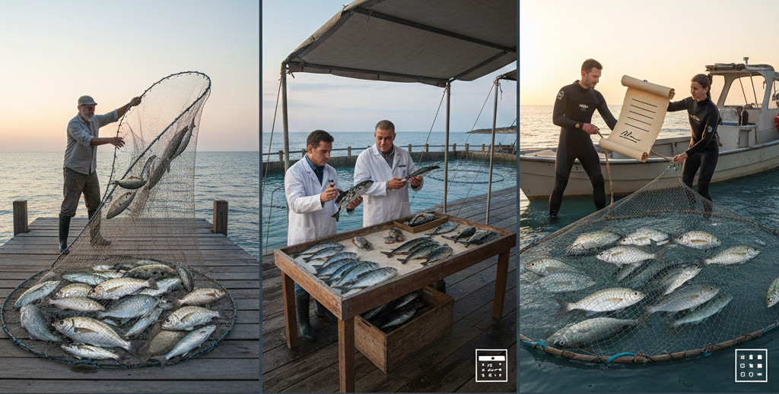

Slide 60
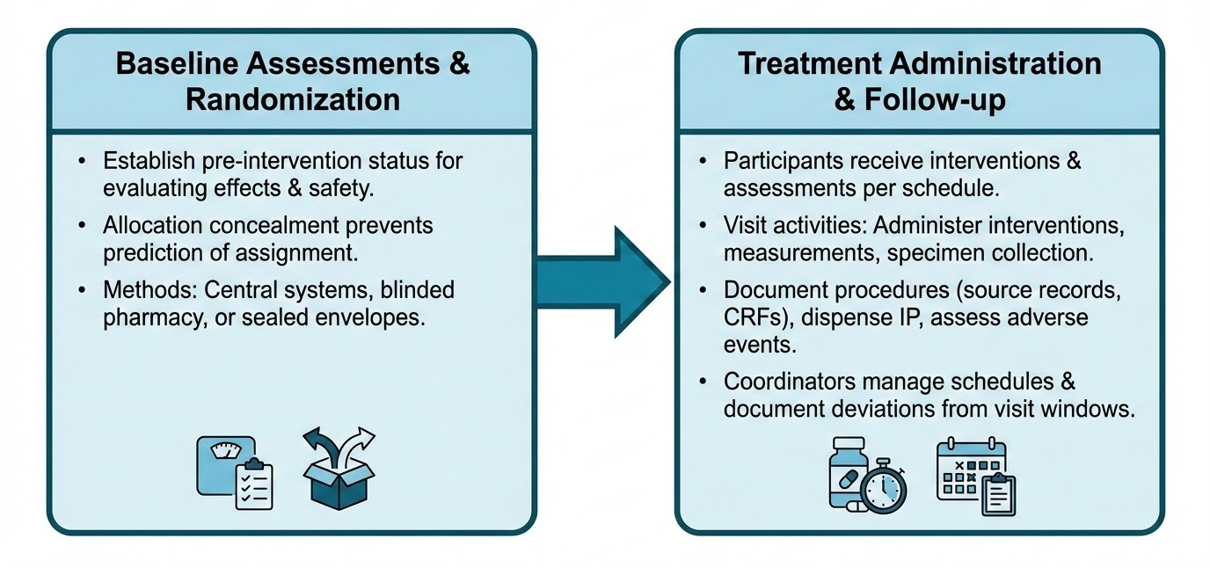

Slide 61
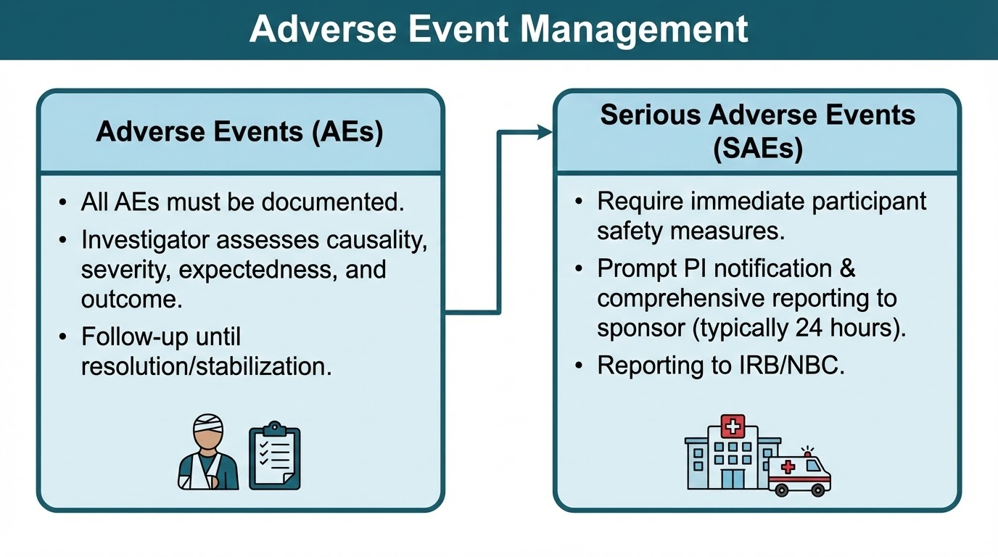

Slide 62
SAE
Death
Life-Threatening illness
Inpatient Hospitalization
Persistent or Significant Disability
Congenital Anomaly / Birth Defect

Slide 63
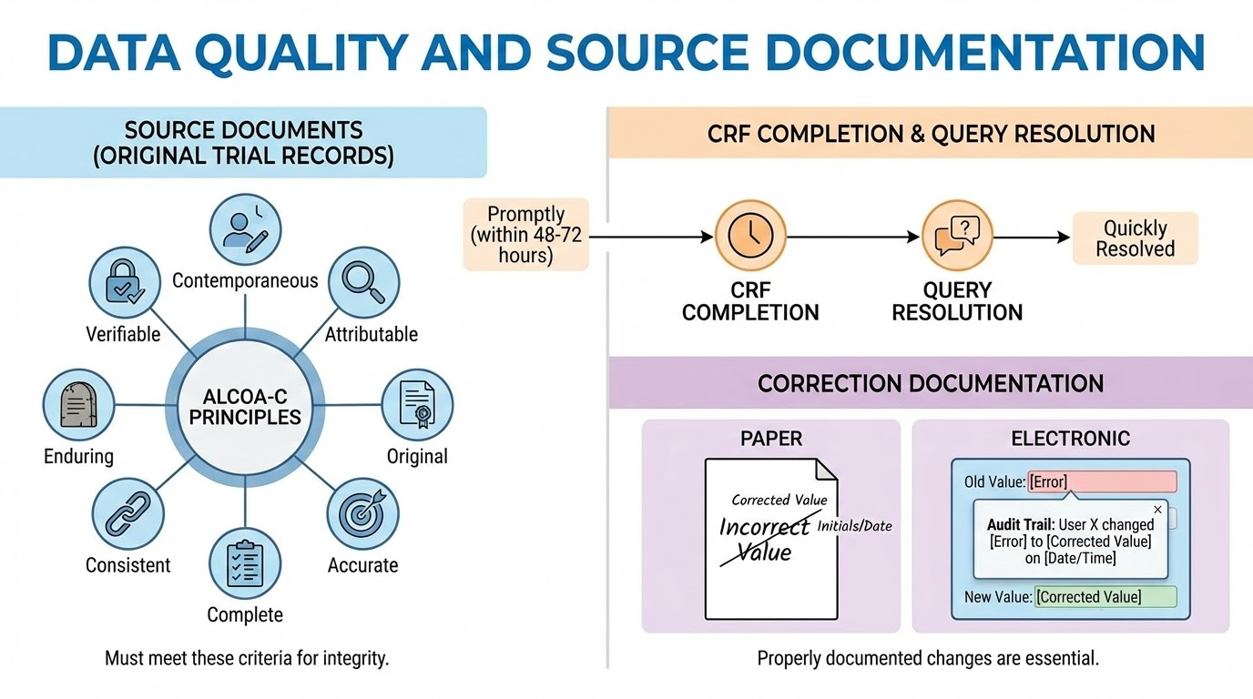
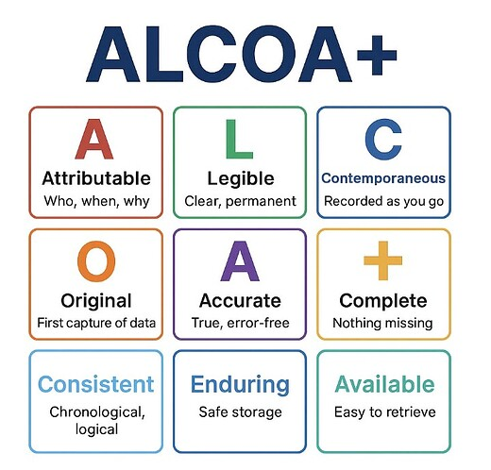

Slide 64
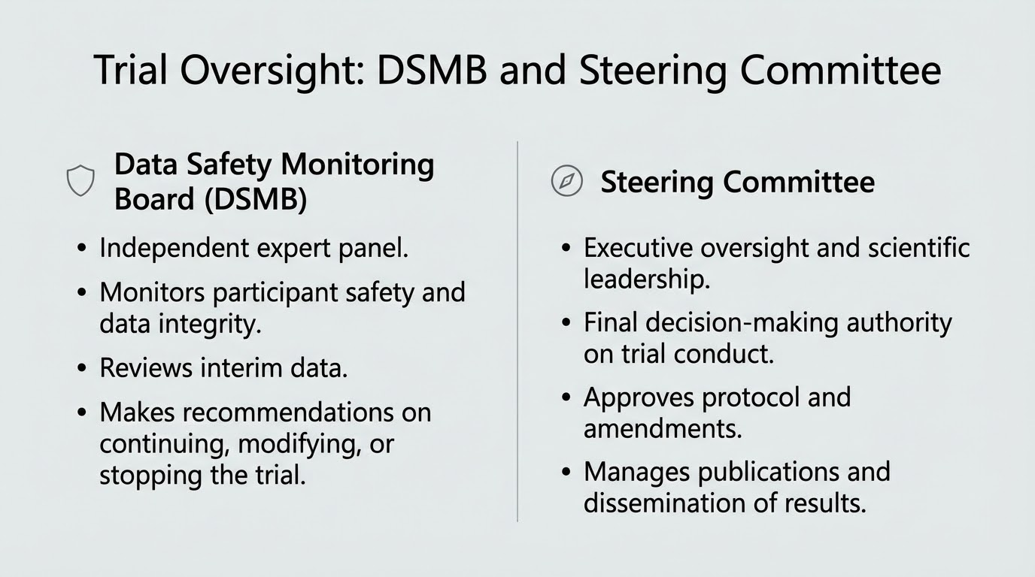

Slide 65
Other Processes:
Monitoring and Quality Oversight
Protocol Deviations and Violations
Study Completion and Closeout
Site Closeout Visit
Financial reconciliation
Final Reporting to Regulatory Bodies
Data Analysis and Manuscript Preparation
Archiving Essential Documents

Slide 66
Thank You

