Slide 1


Ethical and Regulatory Aspects of Clinical Trials
Dr. Tehreem Zahid
Assistant Director
Clinical Trials Unit
Rawalpindi Medical University

Slide 2
If all doctors swear upon the Hippocratic Oath, why do we need ethics committees?

Slide 3
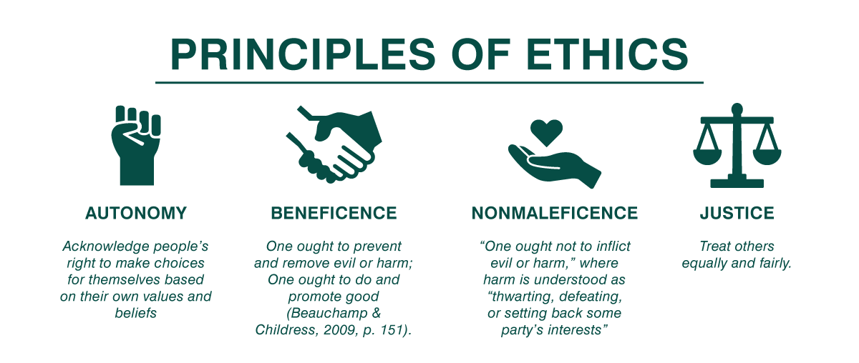

Slide 4
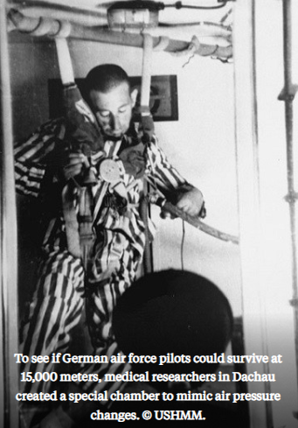
THE DARK HISTORY OF TRIALS
Nazi Medical Experiments (1930s-40s):
Nazi physicians conducted medical experiments on concentration camp prisoners without their consent.
These experiments included exposure to:
extreme temperatures
high-altitude testing
forced sterilizations
injection of lethal pathogens to study disease progression.

Slide 5
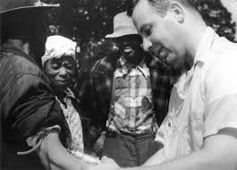
Tuskegee Syphilis Study (1932-1972):
A 40-year-long unethical research study conducted by the U.S. Public Health Service
Enrolled 600 African American men, some with untreated syphilis under the false pretense of receiving free healthcare.
However, the men were never informed of their diagnosis, and effective treatment (penicillin, available by the 1940s) was deliberately withheld to observe the natural course of syphilis.

Slide 6
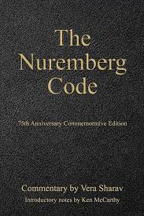
As a result of the Nazi experiments:
Nuremberg Trials prosecuted doctors responsible
Nuremberg Code (1947) stablished 10 key principles, including:
Voluntary consent
Research benefits must outweigh risks.
Avoid harm
Right to withdraw at any time.
Improved in the form of Declaration of Helsinki (1964)

Slide 7
Ethical Approval Pathway at RMU
Departmental Review Board
Ethical Review Board
Board of Advanced Studies

Slide 8
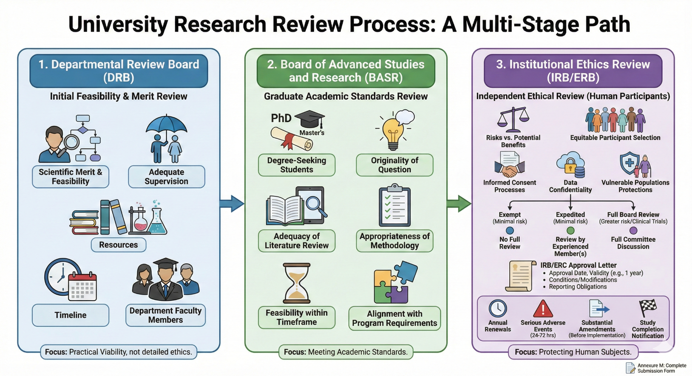

Slide 10
Step 3: Institutional Review Board
Also known as
ERB= Ethical Review Board
IRF= Institutional Research Forum
EC= Ethics Committee
REU= Research Evaluation Unit

Slide 11
What are Institutional Review Boards?
A committee that reviews, approves, and monitors research involving human subjects to ensure ethical compliance.

Slide 12
Who are they?
Minimum 5 members
Diverse (Scientific, non-scientific, basic sciences, clinical sciences)
Vulnerable population represented (pregnant women, old, prisoners, children)
Some members outside of institution
In Pakistan: may include lawyers, ulema etc
NO CONFLICT OF INTEREST

Slide 13
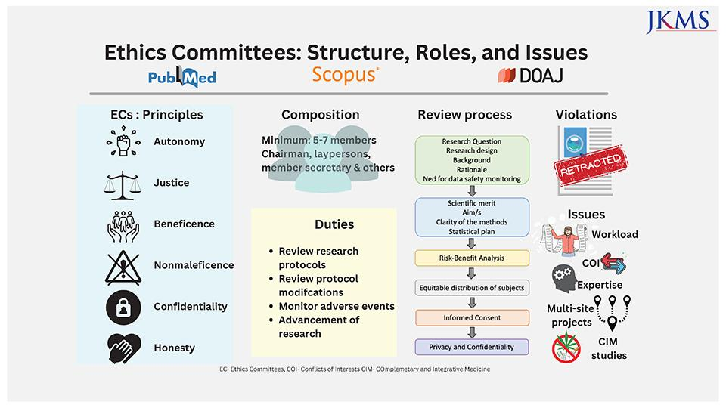

Slide 14
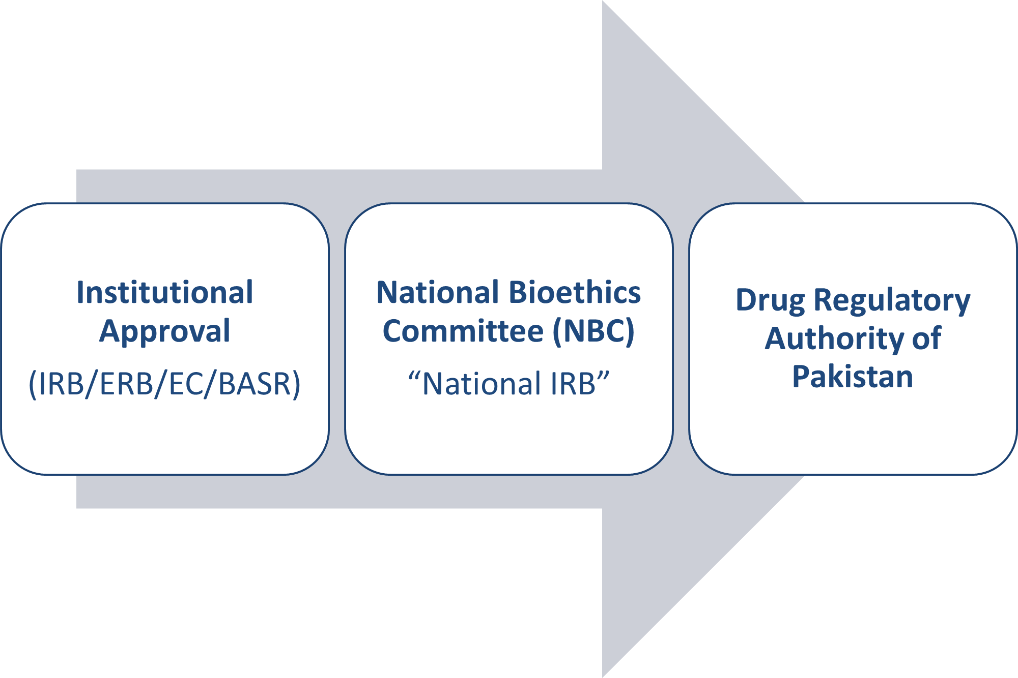

Slide 15
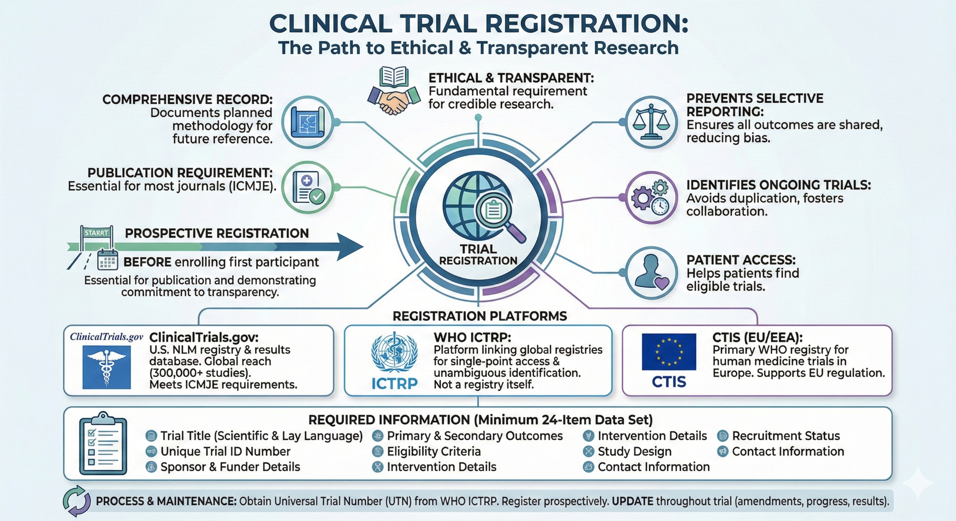
Step 3: Trial Registration

Slide 16
Step 3: Trial Registration

Slide 17
Step 4: National Bioethics Committee (NBC)
All IRBs are overseen by a “national IRB” = NBC
The official advisory body to the Government of Pakistan on all bioethical issues
Hosted at the Health Research Institute (HRI), National Institute of Health (NIH), Islamabad.
Provides national-level ethical oversight
Institutional ethics committees must be registered with NBC

Slide 18
Step 4: National Bioethics Committee (NBC)
Includes medical professionals, bioethicists, legal experts, religious scholars and social scientists.
Includes the Director General Health, CEO of DRAP, and President of PM&DC.

Slide 19
Step 4: National Bioethics Committee (NBC)
Approves:
All clinical trials (single-center or multi-center, regardless of nature of intervention)
Any research conducted in Pakistan that receives international funding
Research projects being conducted across more than one province.
Any study that needs shipment of any human specimens abroad
Research involving fetal material, embryos, or tissues from the living or recently deceased

Slide 20
Step 5: Drug Regulatory Authority of Pakistan
Ensures that all "Therapeutic Goods" (drugs, biologicals, medical devices) are quality-assured, safe, and efficacious.
Regulatory Scope
Pharmaceuticals: Human and veterinary drugs and clinical trials
Biologicals: Vaccines, sera, and blood products.
Medical Devices: Classified from Class A (low risk) to Class D (high risk).
Alternative Medicines: Ayurvedic, Homeopathic, and Health & OTC products.

Slide 21
Approves
Trials that use drugs or devices NOT surgical trials
Trial sites (hospitals)
Protocols and amendments

Slide 22
Thank You

