Slide 1
Drug Design for Targeted Therapy
Dr. Shanila Akhter
14-02-26

Slide 2
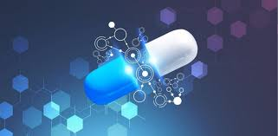
Drug Design
Drug design is the systematic and rational process of discovering and developing new medications based on the knowledge of a specific biological target involved in disease.

Slide 3
Drug Design
It involves designing molecules that can:
Bind selectively to a target (e.g., enzyme, receptor, ion channel)
Modify its activity (activate or inhibit)
Produce a therapeutic effect with minimal toxicity

Slide 4
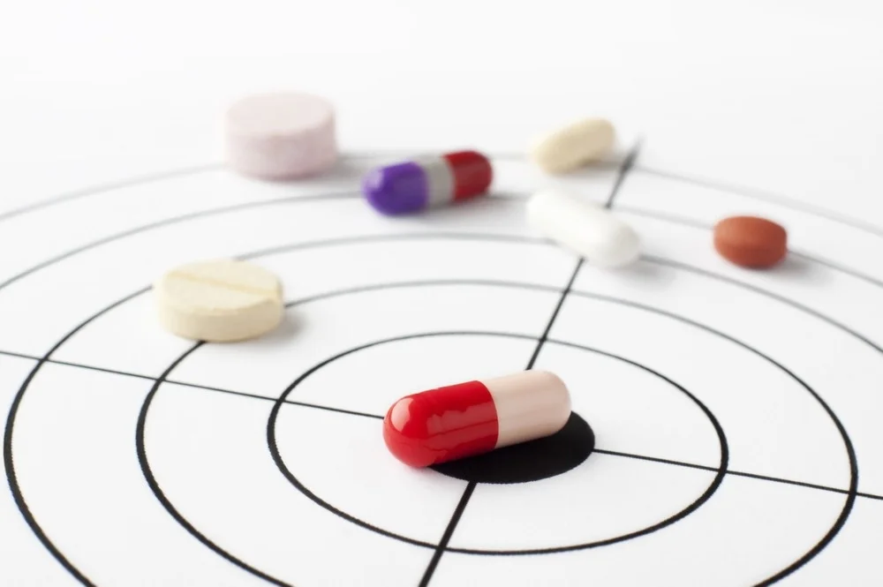
Drug targets
A drug target is usually a biomolecule such as:
Enzymes
Receptors
Ion channels
Transport proteins
DNA/RNA
These targets are involved in disease pathways.

Slide 5
Terminologies used in drug designing
Ligand: A ligand is a molecule that binds specifically to a biological target (usually a receptor, enzyme, ion channel, or protein) to produce a biological response.
Pharmacophore : is a group of atoms in the molecule of a drug responsible for drug action
Lead: A lead compound is a “prototype molecule” identified during drug discovery that can be modified and optimized into a clinically useful drug.

Slide 6
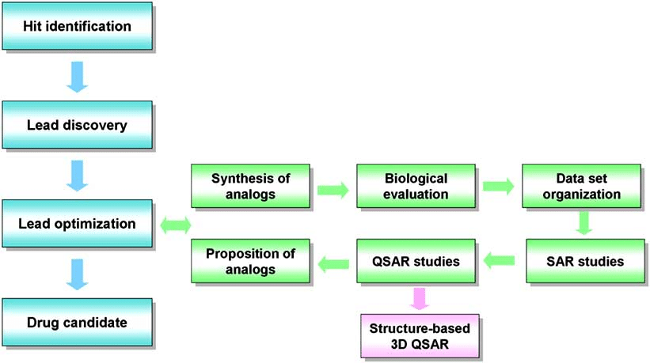

Slide 7
Characteristics of a Good Lead Compound
✔ Moderate to high potency ✔ Reasonable selectivity ✔ Acceptable preliminary ADME profile ✔ Synthetic feasibility ✔ Low toxicity

Slide 8
Lead Optimization
After identification, medicinal chemists modify:
Functional groups
Lipophilicity (LogP)
Molecular weight
Hydrogen bond donors/acceptors
Goal → Improve:
Potency
Bioavailability
Stability
Safety

Slide 9
Lipinski’s Rule of Five
Christopher A. Lipinski rule predicting oral bioavailability:
Molecular weight < 500
LogP < 5
H-bond donors ≤ 5
H-bond acceptors ≤ 10

Slide 10
Approaches in drug designing
Ligand-Based Drug Design (LBDD)
Structure-Based Drug Design (SBDD)

Slide 11
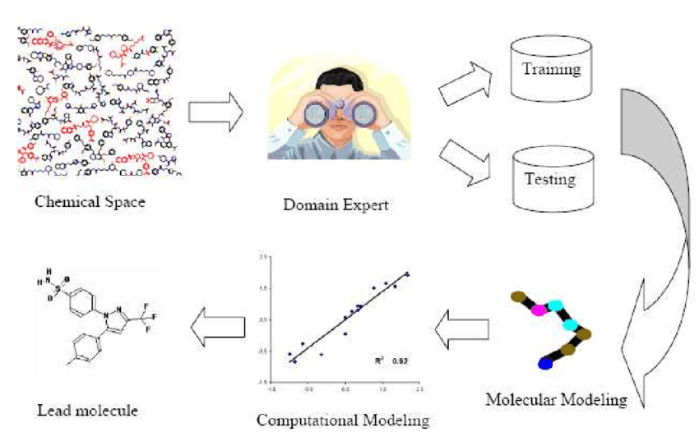
Ligand Based Drug Design
Used when target structure is unknown
Based on known active molecules
Uses QSAR, pharmacophore modeling
E.g Designing analogs of existing antibiotics

Slide 12
Ligand-Based Design Techniques
Bioisosteric replacement
Designing rigid analogs
Chain homologation or stereochemistry alteration
Bond disconnections and pharmacophore distance changes

Slide 13
Structure-Based Drug Design (SBDD)
Uses the 3D structure of the target protein
Molecules are designed to fit into the active site
Uses molecular docking & computational modeling
Example: Designing kinase inhibitors in cancer therapy

Slide 14
Computer-Aided Drug Design (CADD)
• Virtual Screening: Sifting through millions of compounds digitally.
• Benefits: Reduces cost, saves time, and minimizes animal testing.
• Tools: ADMET prediction (Absorption, Distribution, Metabolism, Excretion, Toxicity).

Slide 15
Summary
Term | Meaning
Drug Target | Disease-related biomolecule
Ligand | Molecule that binds to target
Pharmacophore | Essential activity features
Lead | Optimizable active compound
SAR | Structure vs activity relation
QSAR | Mathematical SAR model
Docking | Computer-based binding prediction
ADME | Pharmacokinetic properties

Slide 16
FDA 2025 Targeted Drug Approvals (with Mechanism / Target)
1- Telisotuzumab vedotin‑tllv (Emrelis)
Type: Antibody‑drug conjugate (ADC)
Target: c‑Met protein overexpression in cancer cells
Indication: Locally advanced or metastatic non‑small cell lung cancer with high c‑Met expression
Mechanism: Delivers cytotoxic payload directly to c‑Met‑positive cells
Approval: May 14, 2025

Slide 17
FDA 2025 Targeted Drug Approvals (with Mechanism / Target)
2- Datopotamab deruxtecan (Datroway)
Type: Antibody‑drug conjugate
Target: TROP‑2 antigen
Indication: HR‑positive, HER2‑negative breast cancer; also expanded in 2025 for EGFR‑mutated NSCLC
Mechanism: Antibody‑driven delivery of deruxtecan cytotoxic agent to TROP‑2‑expressing cells
Approval: January 17, 2025

Slide 18
FDA 2025 Targeted Drug Approvals (with Mechanism / Target)
Zongertinib (Hernexeos)
Type: Small‑molecule kinase inhibitor
Target: HER2 tyrosine kinase domain mutations
Indication: Metastatic nonsquamous NSCLC with HER2 activating mutations
Mechanism: Selective HER2 inhibition
Approval: August 8, 2025 (accelerated)

Slide 19
Clinical Landmark Approvals (2025-2026)
Drug Name | Target / Mechanism | Indication
Modeyso | H3 K27M Mutation | Diffuse Midline Glioma (Brain)
Inluriyo | ESR1 Selective Degrader | ER+/HER2- Breast Cancer
Komzifti | Menin Inhibitor | NPM1-mutant AML
Datroway | TROP2 ADC | EGFR+ Lung Cancer

Slide 20
Registration of Drug For Clinical Trial in Pakistan
DRAP Act 2012

Slide 21
Step 1: Preclinical/Non-Clinical Evaluation
Before registering a drug for clinical trials:
Conduct preclinical studies (in vitro, in vivo) to assess:
Pharmacodynamics (PD)
Pharmacokinetics (PK)
Toxicology
Prepare Non-Clinical Study Reports for submission.

Slide 22
Step 2: Regulatory Consultation
Contact DRAP for guidance.
Determine type of clinical trial:
Phase I (first-in-human)
Phase II (efficacy & safety)
Phase III (confirmatory)
Confirm if drug is already marketed abroad or investigational.

Slide 23
Step 3: Preparation of Dossier
Prepare the Clinical Trial Application (CTA) dossier, including:
1- Administrative Documents:
Cover letter
Sponsor details
Ethics Committee approval (IEC/IRB)

Slide 24
Cont..
2- Clinical Trial Protocol:
Study design
Objectives, endpoints
Inclusion/exclusion criteria
Dose selection & rationale
3 - Investigator’s Brochure (IB):
Summary of all preclinical and clinical data
Safety profile

Slide 25
Cont..
4- Quality Documentation:
Drug composition & manufacturing info (GMP certificates)
Stability data
5- Informed Consent Form (ICF)

Slide 26
Step 4: Submission to DRAP
Submit the Clinical Trial Application (CTA) to DRAP.
Include all supporting documents, fees, and proof of ethics approval.
DRAP evaluates:
Safety and scientific validity
Compliance with GCP, GMP, GLP

Slide 27
Step 5: Review by Institutional Ethics Committee (IEC)
Every clinical trial must have approval from a registered IEC at the trial site.
The IEC reviews:
Protocol safety & ethics
Consent form
Investigator qualifications

Slide 28
Step 6: DRAP Evaluation
DRAP evaluates the submission under Clinical Trials Rules, 2019, considering:
Preclinical safety data
Clinical trial protocol
Investigator & site credentials
Risk–benefit assessment
Timeline: Usually 90–120 days for review.

Slide 29
Step 7: Approval and Clinical Trial Authorization
After review, DRAP issues:
Clinical Trial Authorization (CTA) or
Conditional approval with queries
Only after CTA, the trial can start in Pakistan.

Slide 30
Step 8: Registration of Investigational Drug
Register the investigational drug (if not already registered) with DRAP.
Usually requires:
Import license for investigational product (if imported)
Labeling per DRAP guidelines

Slide 31
Step 9: Conduct of Clinical Trial
Follow Good Clinical Practice (GCP) guidelines.
Report adverse events (AE/SAE) to DRAP.
Keep accurate trial records.

Slide 32
Step 10: Post-Trial Submission
After trial completion:
Submit Clinical Study Report (CSR) to DRAP.
Apply for marketing authorization if the drug shows safety and efficacy.
Update trial registry (like PACTR) with results.

Slide 33
Important
All clinical trials must comply with:
DRAP Clinical Trials Rules, 2019
International Conference on Harmonisation (ICH-GCP) guidelines
Multi-center trials need DRAP approval for each site.
Imported drugs require import permit from DRAP.

Slide 34
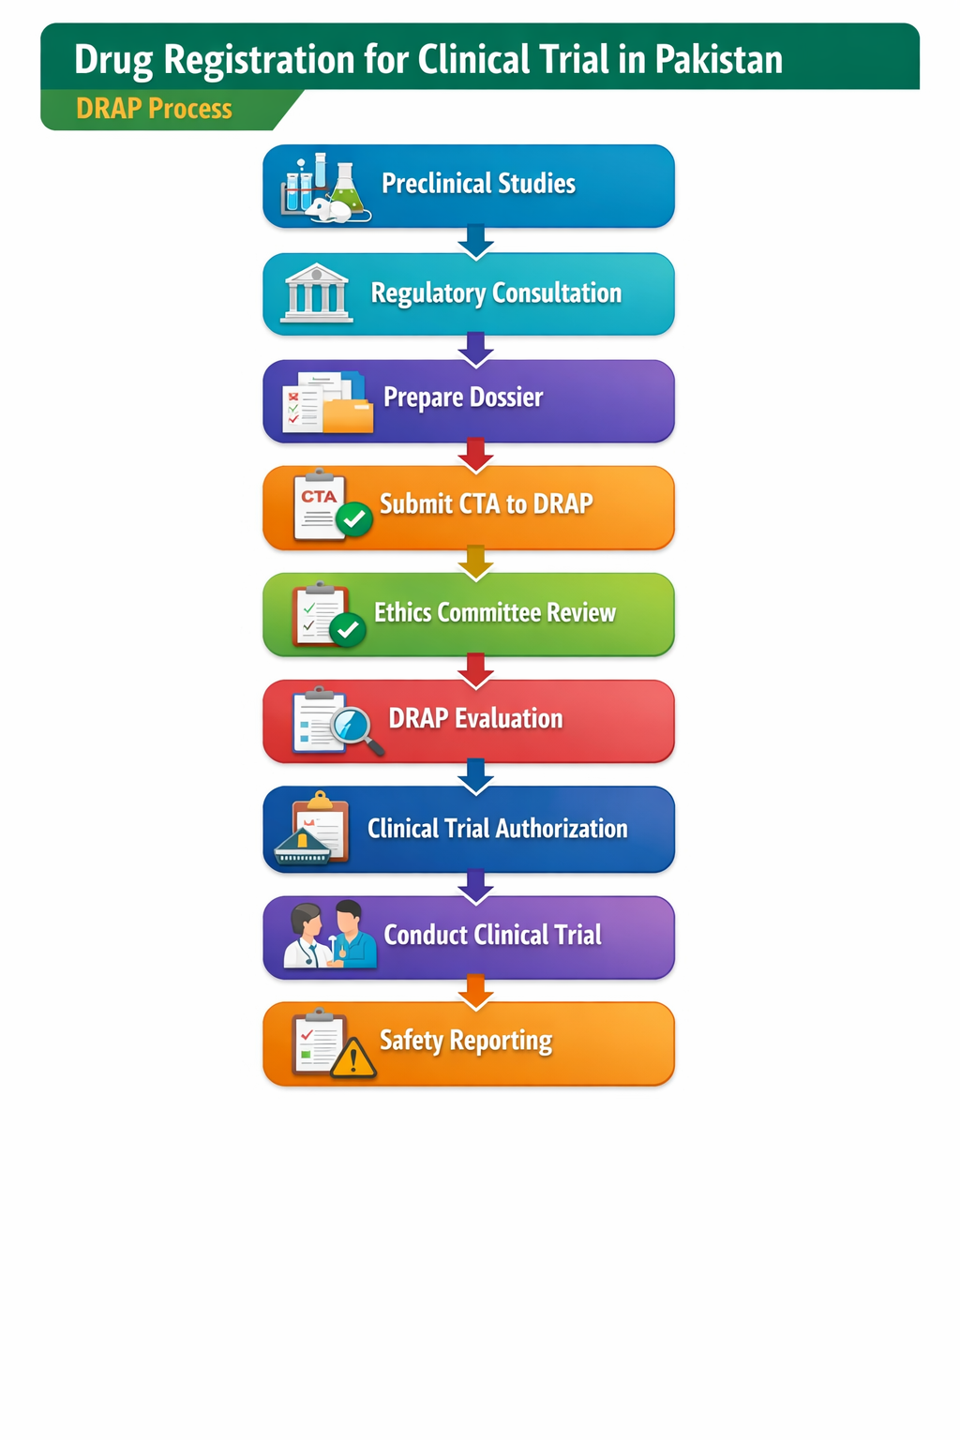

Slide 35


