Slide 1


Introduction to Clinical Trial Methodology
Dr. Tehreem Zahid
Assistant Director
Clinical Trials Unit
Rawalpindi Medical University

Slide 2
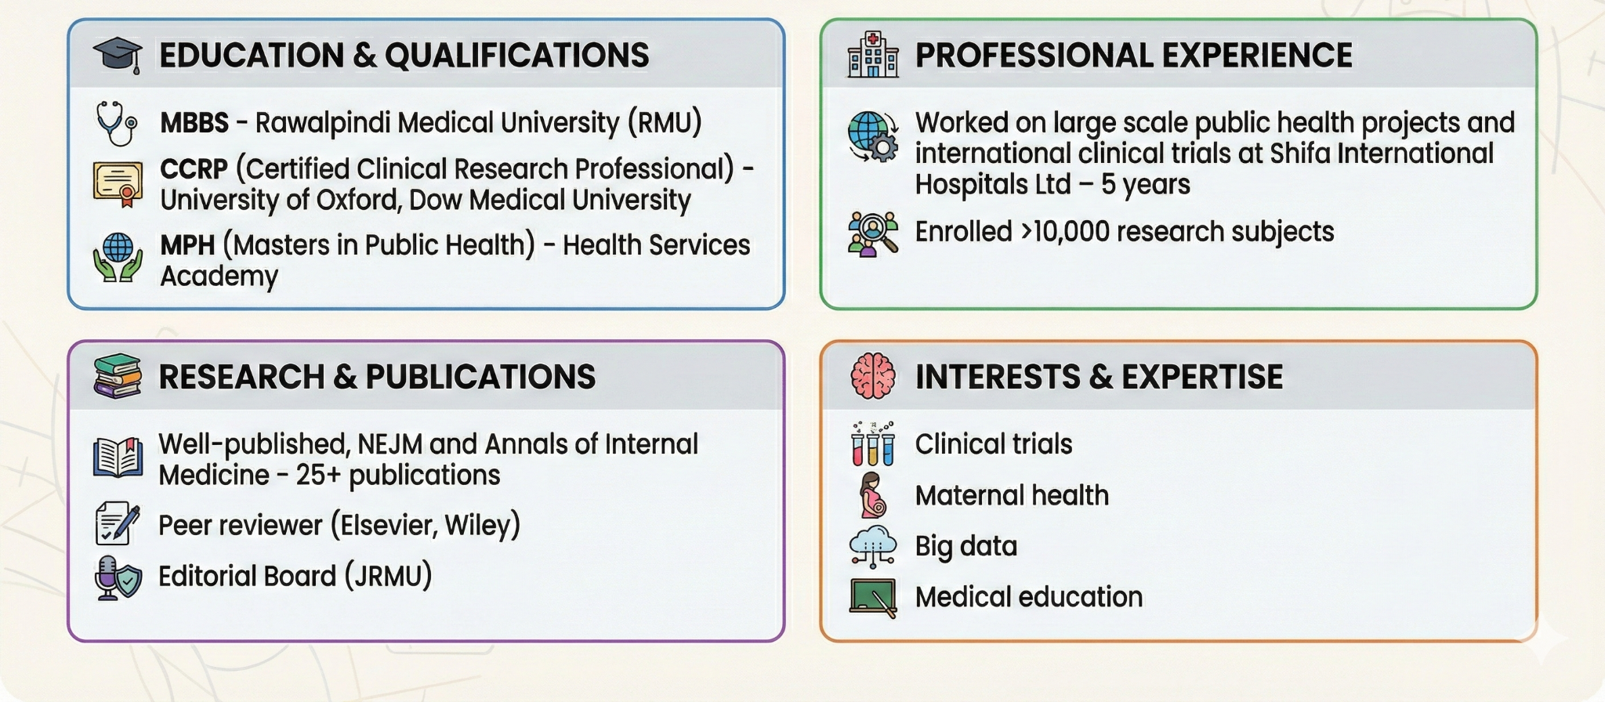
ABOUT ME

Slide 3


















Notable Collaborators:

Slide 4

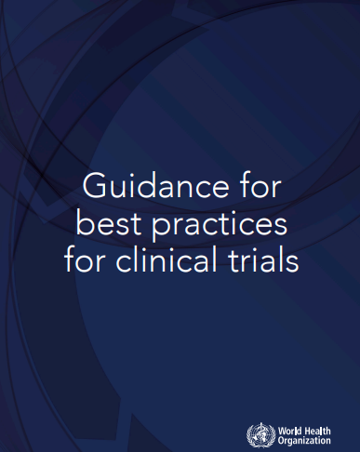
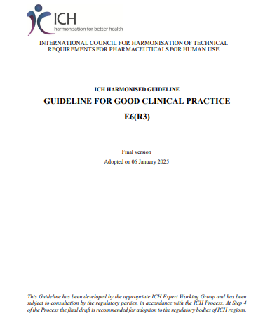
Resources for this Course:
RMU Clinical Trial Guide (Available on RMU Website and Researchgate)
https://www.who.int/health-topics/clinical-trials
https://database.ich.org/sites/default/files/ICH_E6%28R3%29_Step4_FinalGuideline_2025_0106.pdf

Slide 5
Q: What are clinical trials and why are they important?

Slide 6
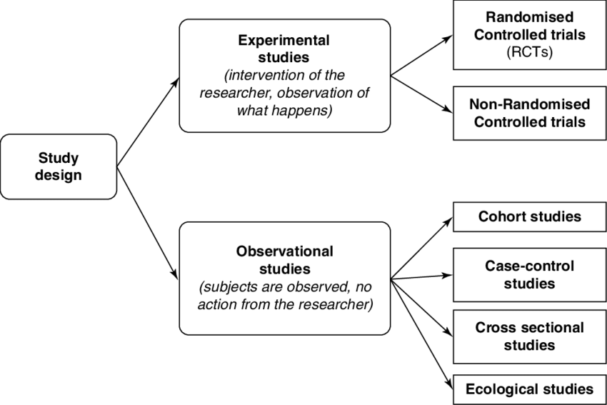

Slide 7
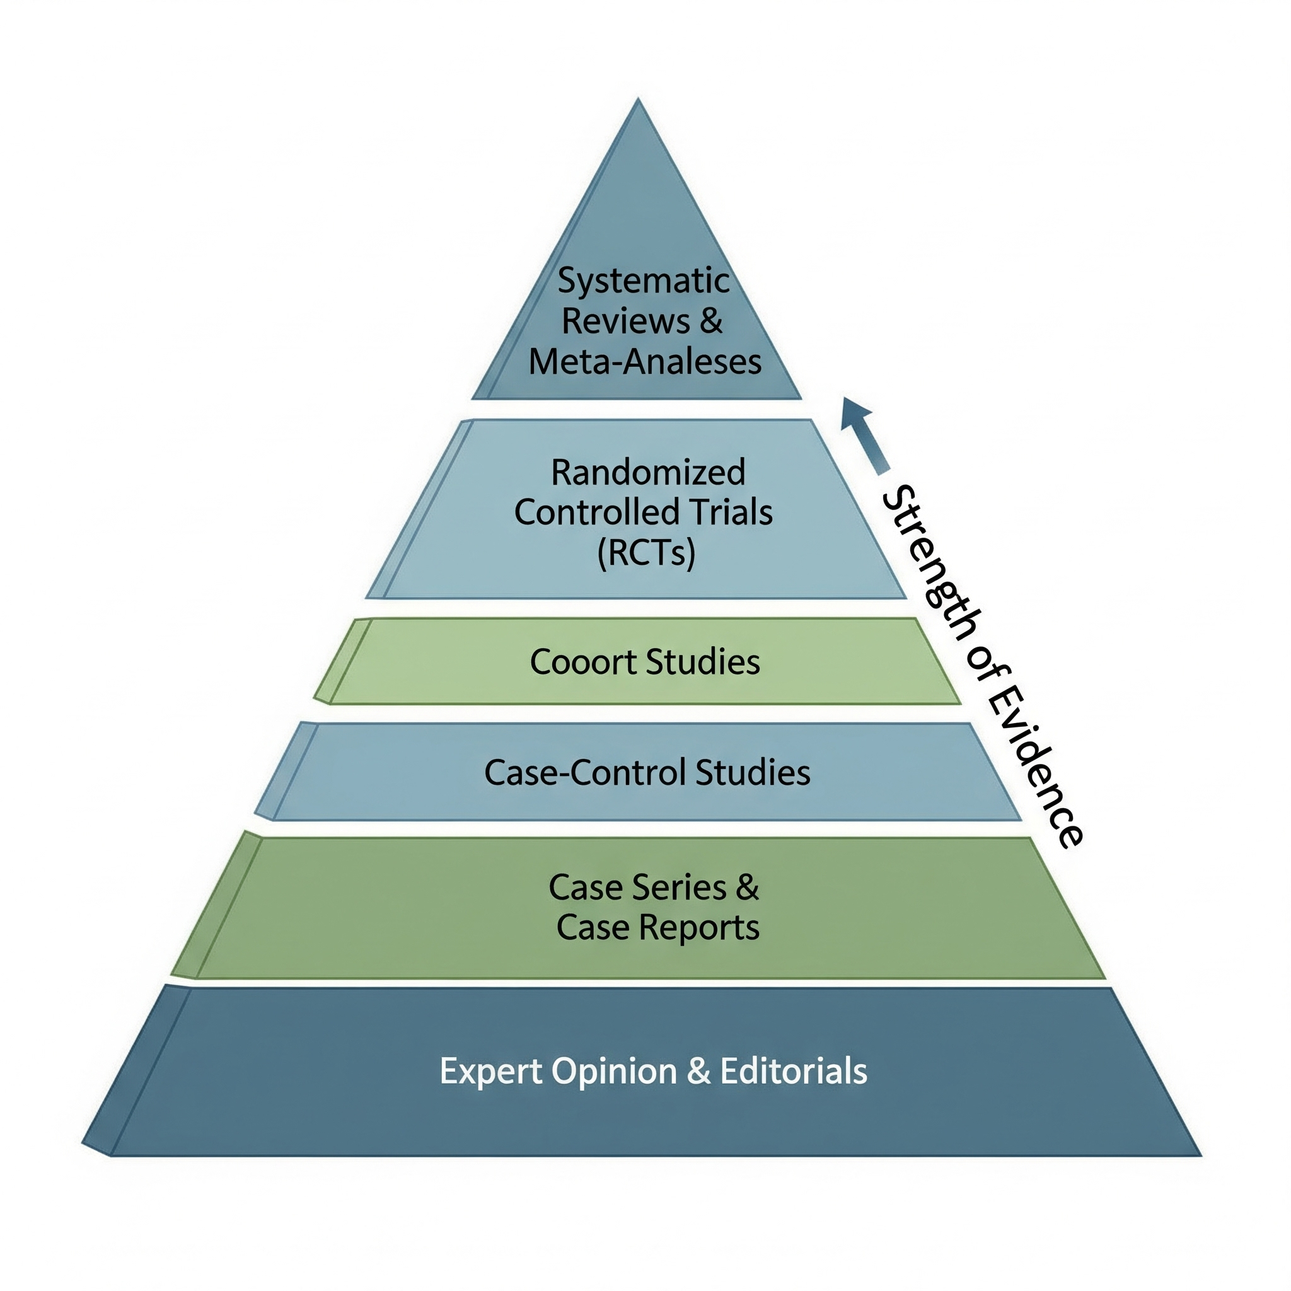
HIERARCHY OF EVIDENCE
Better
Evidence

Slide 8
WHAT ARE CLINICAL TRIALS?
A type of clinical study where an intervention is compared against a comparator to test the safety and efficacy of new interventions

Slide 9
Clinical trials answer a simple question:
Will this intervention be beneficial for my patient and also be safe at the same time, compared to another intervention?

Slide 10
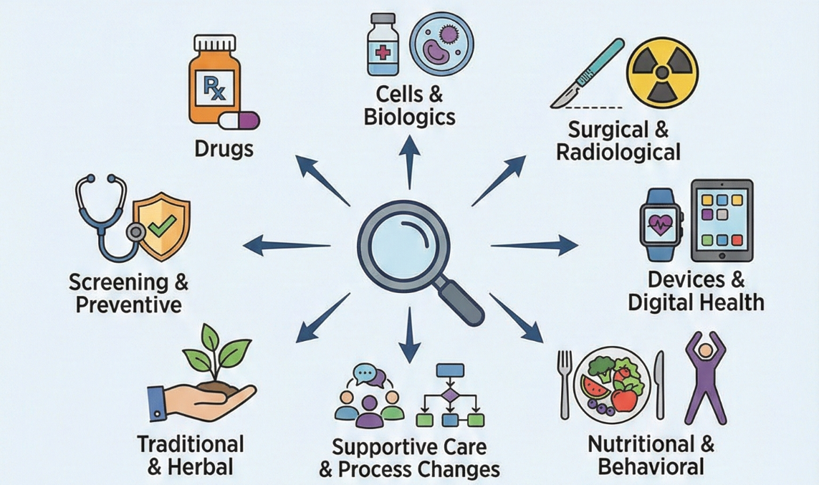
Types of Interventions and Comparators

Slide 11
Placebo:
An inactive substance or treatment
Looks, tastes and administered like the experimental treatment
No active therapeutic ingredients
Used as a control to measure the true effect of the active drug
Placebo Effect—a phenomenon where patients experience perceived or actual improvements in their condition simply because they believe they are receiving treatment

Slide 12
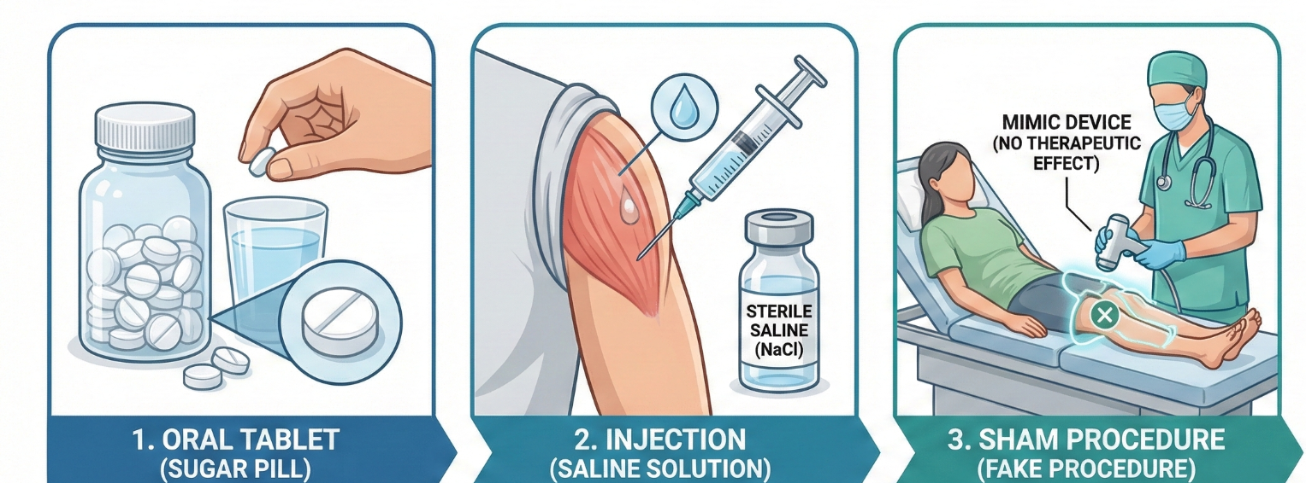

Slide 13
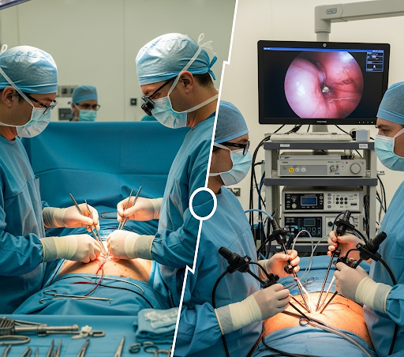
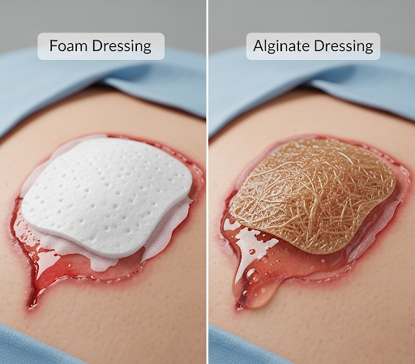
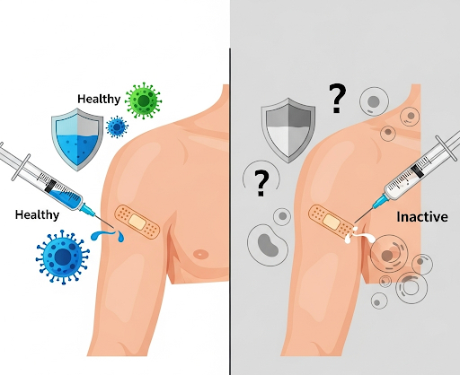
What can a trial look like?
Open surgery
Laparoscopic surgery
Types of dressings
Vaccine vs Placebo

Slide 14
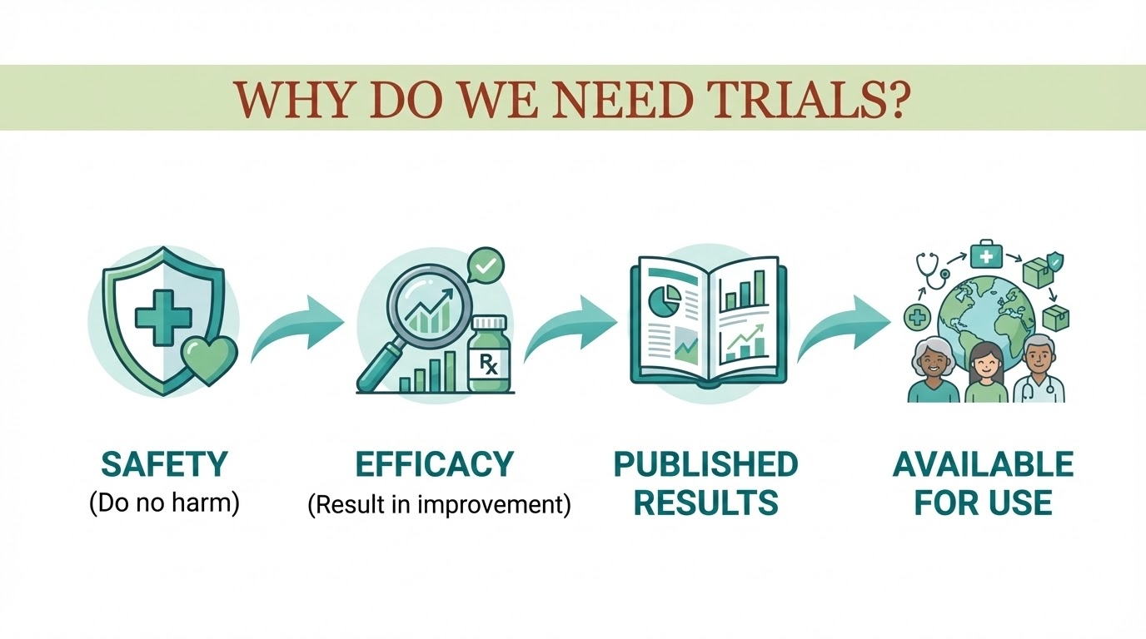

Slide 15

Trials can take place anywhere- at any level

Slide 16
How are new interventions discovered?

Slide 17
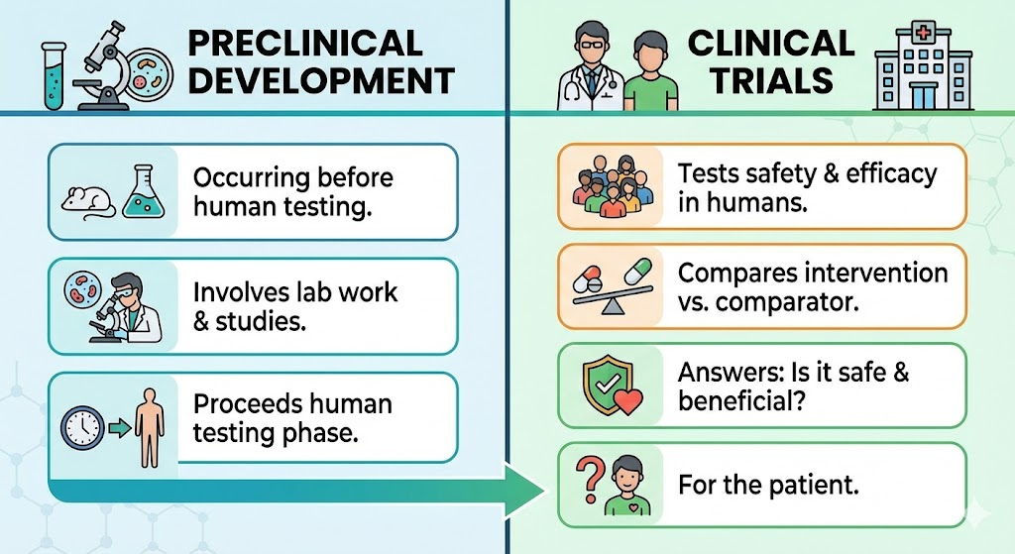

Slide 18
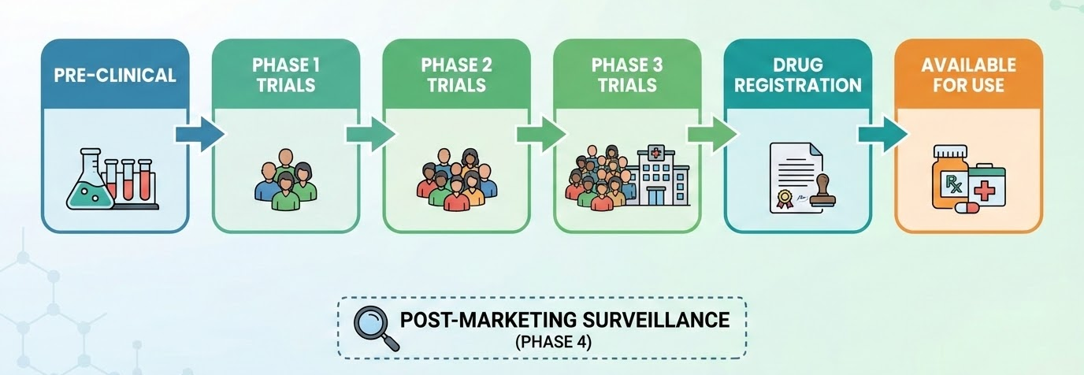

Slide 19
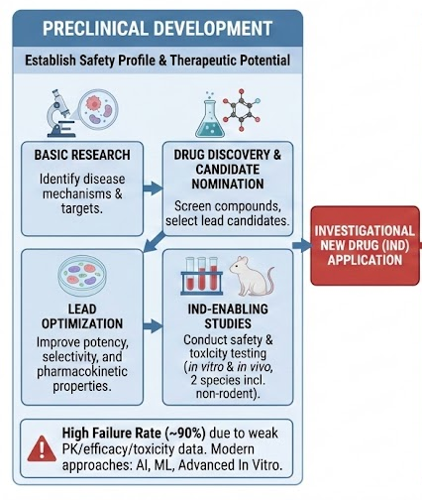
Pre-clinical development:
All the processes BEFORE testing on humans

Slide 20
Phase 1 Trials

Slide 21
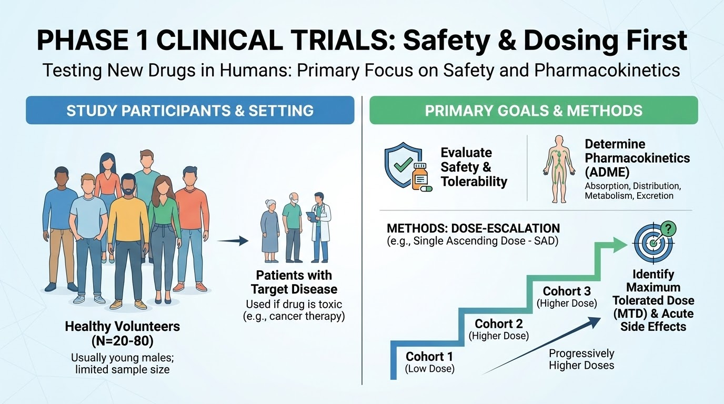

Slide 22
Phase 2 Trials

Slide 23
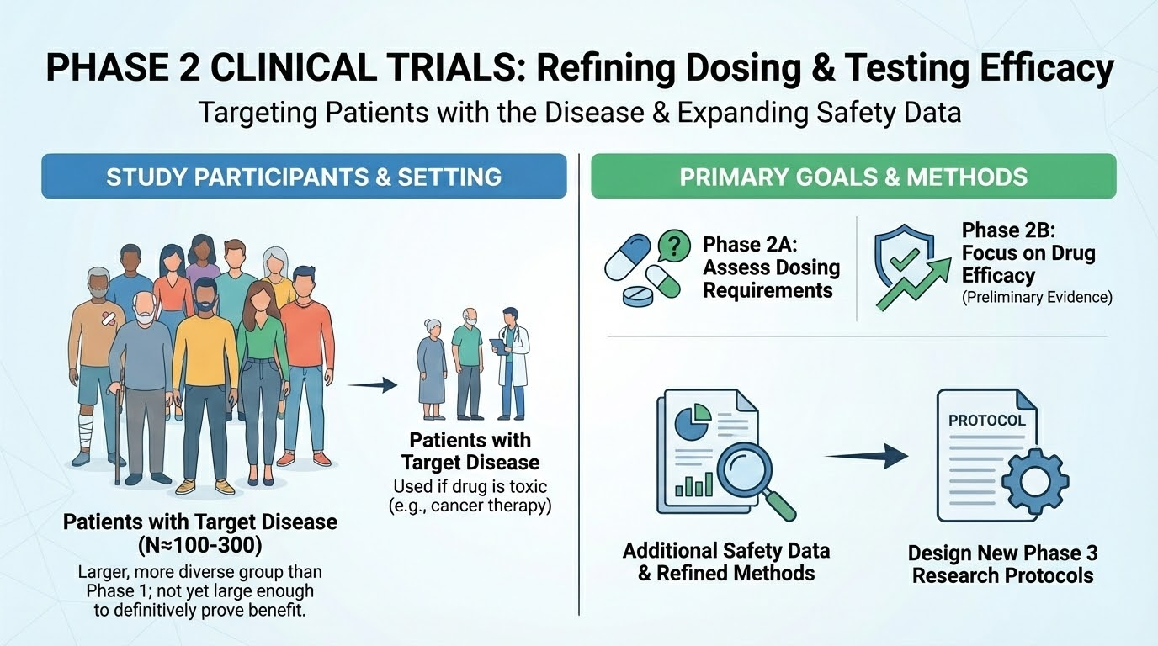

Slide 24
Phase 3 Trials

Slide 25
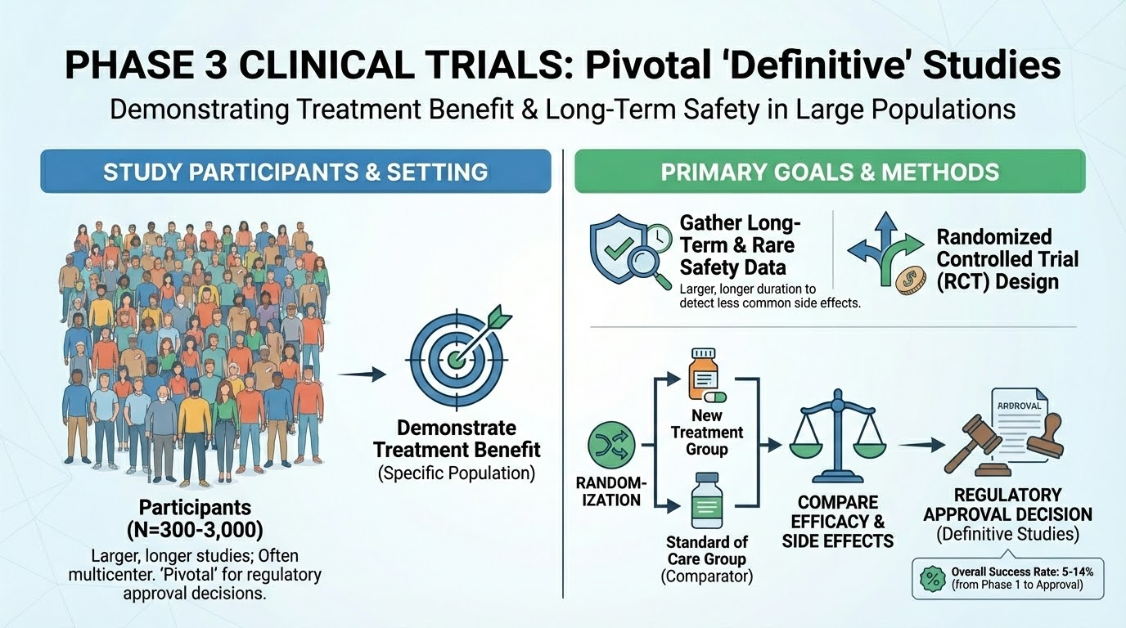

Slide 26
Phase 4 Trials

Slide 27
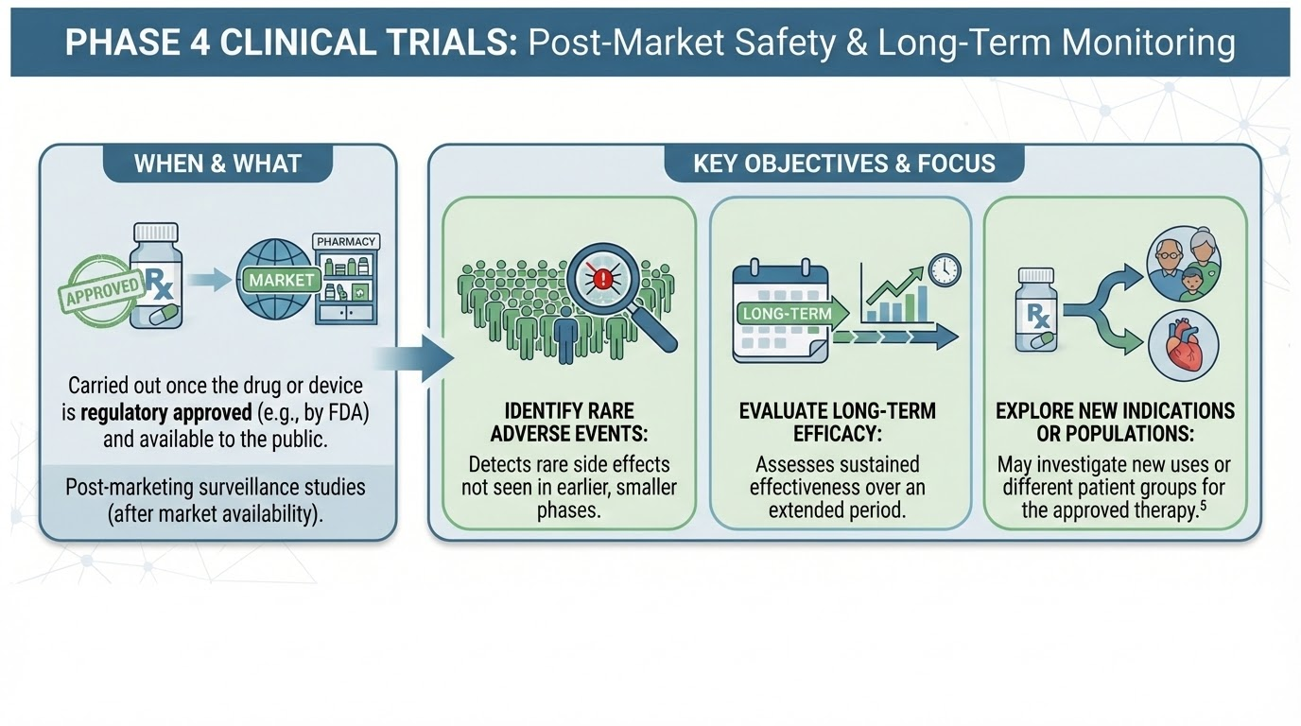

Slide 28
Situation in Pakistan:
Need licence by DRAP to conduct trials
Most hospitals (including RMU) = Phase 3 and 4 license
Phase 1 and 2 require expertise and equipment, limited hospitals in Pakistan

Slide 29
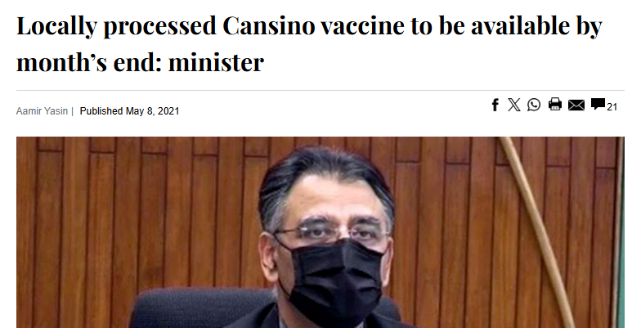
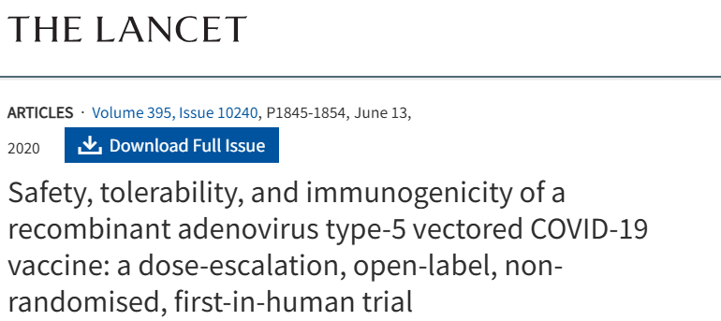

Q: Which trial phases do these snippets represent?

Slide 30
Types of Clinical Trials
Trials can be divided based on:
Randomization (Randomized vs non-randomized)
Funding (Academic/Investigator-initiated vs Pharmaceutical/Industry-sponsored)
Nature of Intervention (Therapeutic, Screening, Diagnostic and Prevention)
Number of Interventional Arms (Parallel, Cross-over, Factorial etc)
Hypothesis testing (Superiority, non-inferiority, equivalence)
Statistical analysis (Per-protocol, Intention-to-treat etc)

Slide 31
 | Non- Randomized Controlled Trials/ Quasi Experimental Studies | Randomized Controlled Trials
Randomization | NO | Yes
Groups Divided by | Physician Decision Patient preference Availability Of Treatment Time Sequence Geographical Location Date Of Birth (Odd Vs Even) | Simple randomization/coin toss Sealed envelopes Computer-based randomization Block Randomization Stratified Sampling
Pros | Easy Quick | GOLD STANDARD of evidence Known and unknown confounders are evenly distributed (high internal validity)
Cons | Bias Confounding Lower in hierarchy of evidence | Expensive Time consuming Ethical concerns

Slide 32
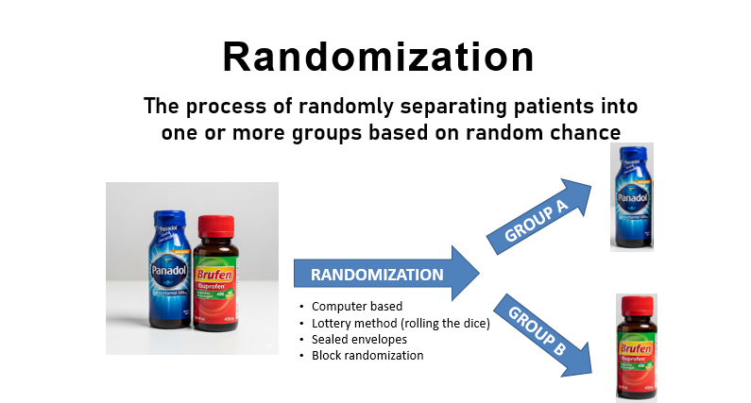

Slide 33
Why randomize?
To eliminate selection bias and ensure that study groups are comparable at the start of the trial.
Every participant has an equal chance of being assigned to any given arm of the study.
A successful technique ensures that the next assignment cannot be predicted by the researchers or participants (allocation concealment)

Slide 34
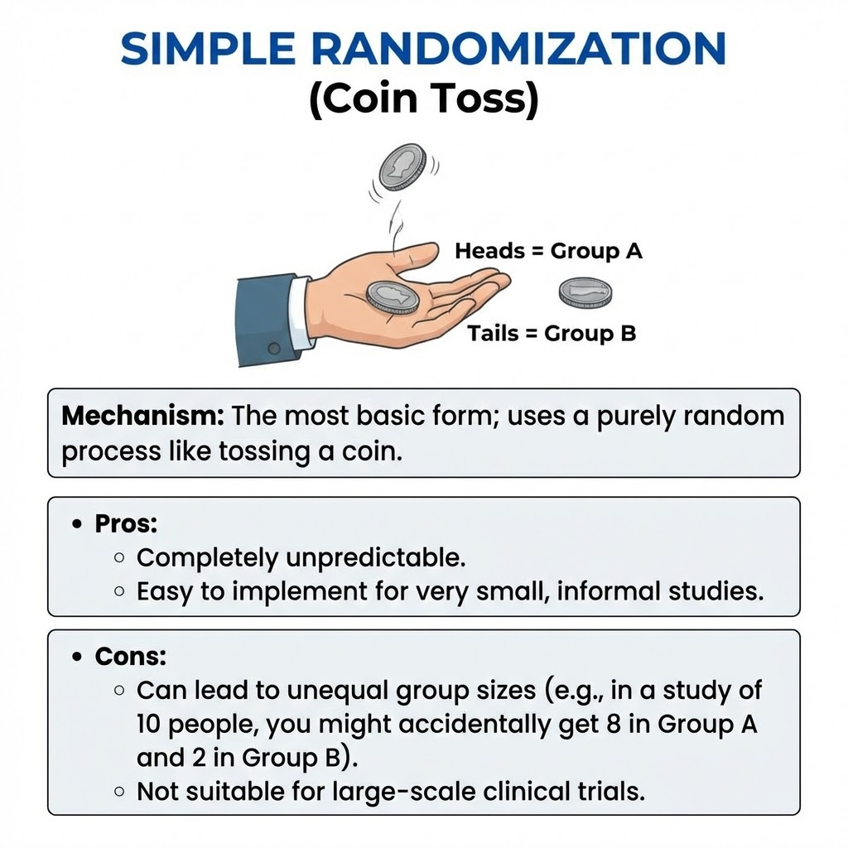

Slide 35
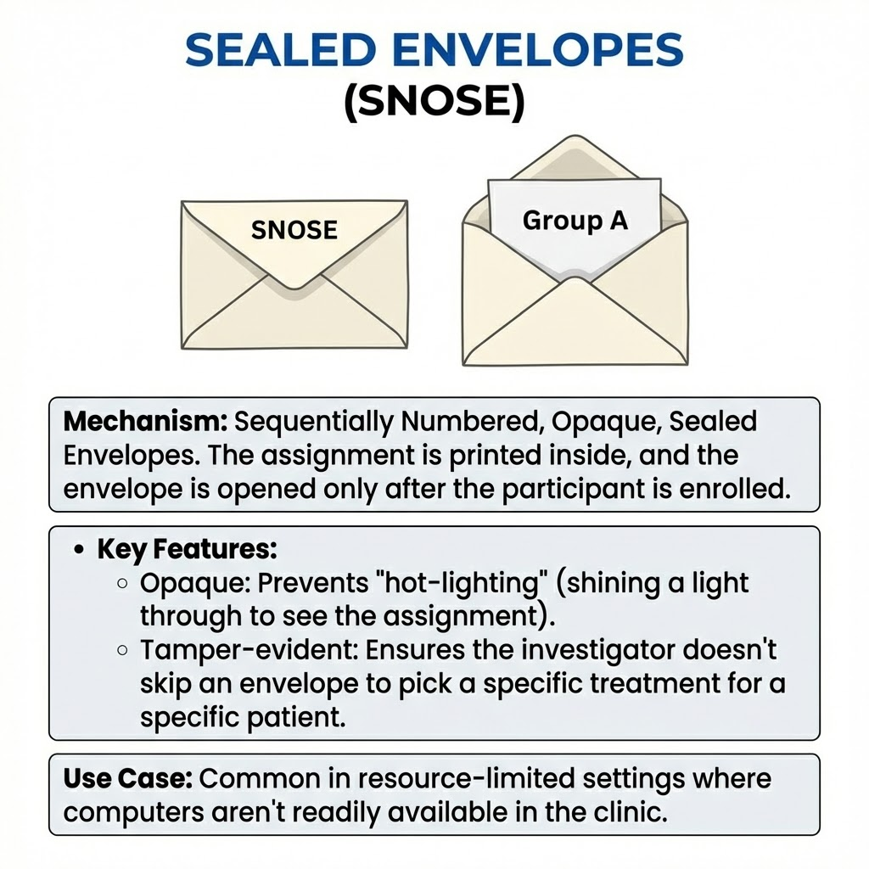

Slide 36
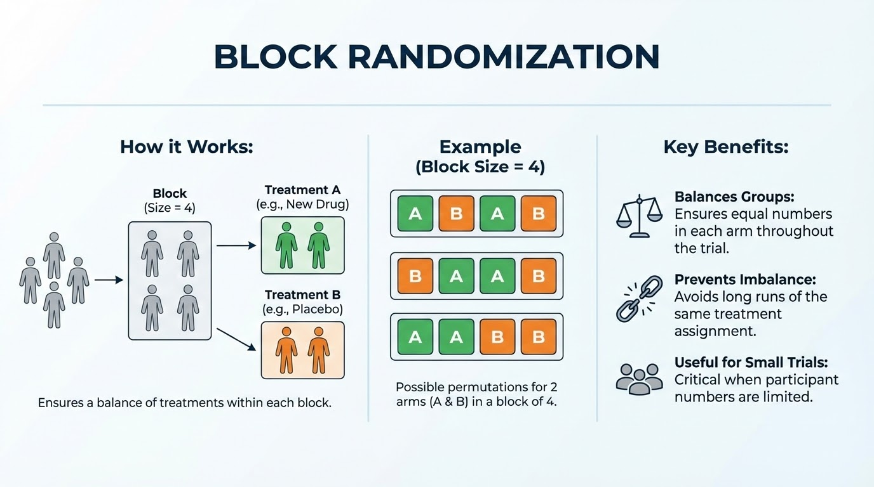

Slide 37
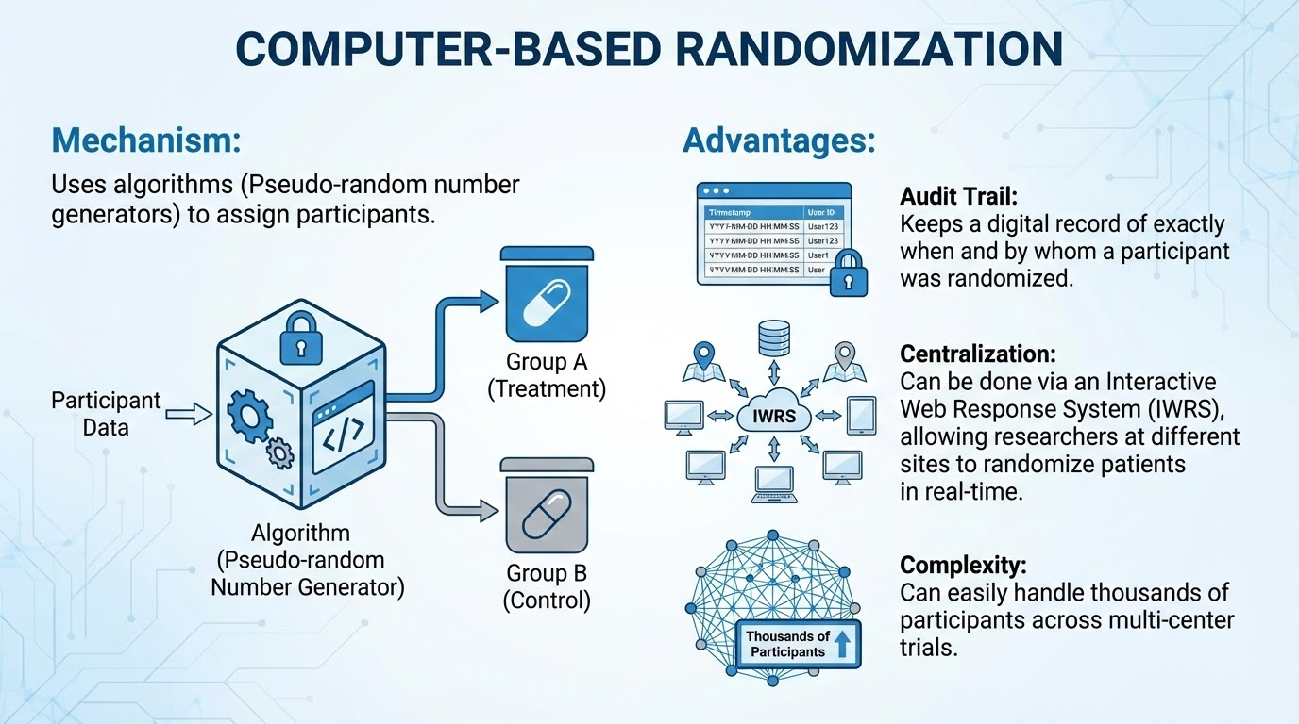

Slide 38
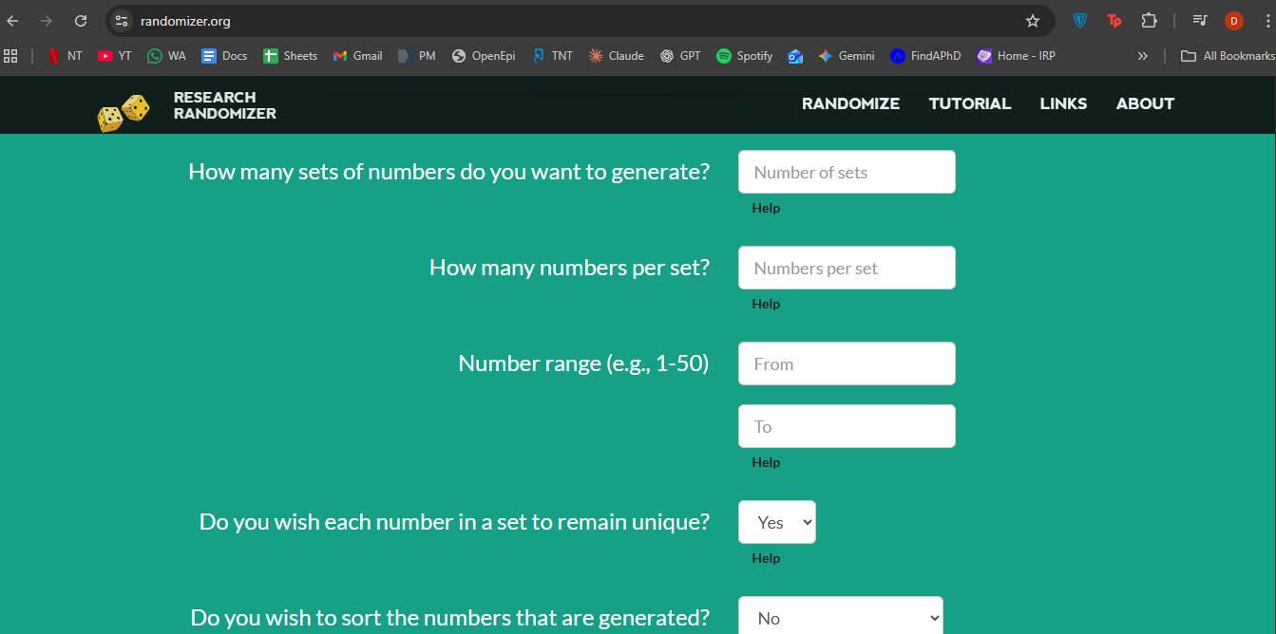
www.randomizer.org

Slide 39
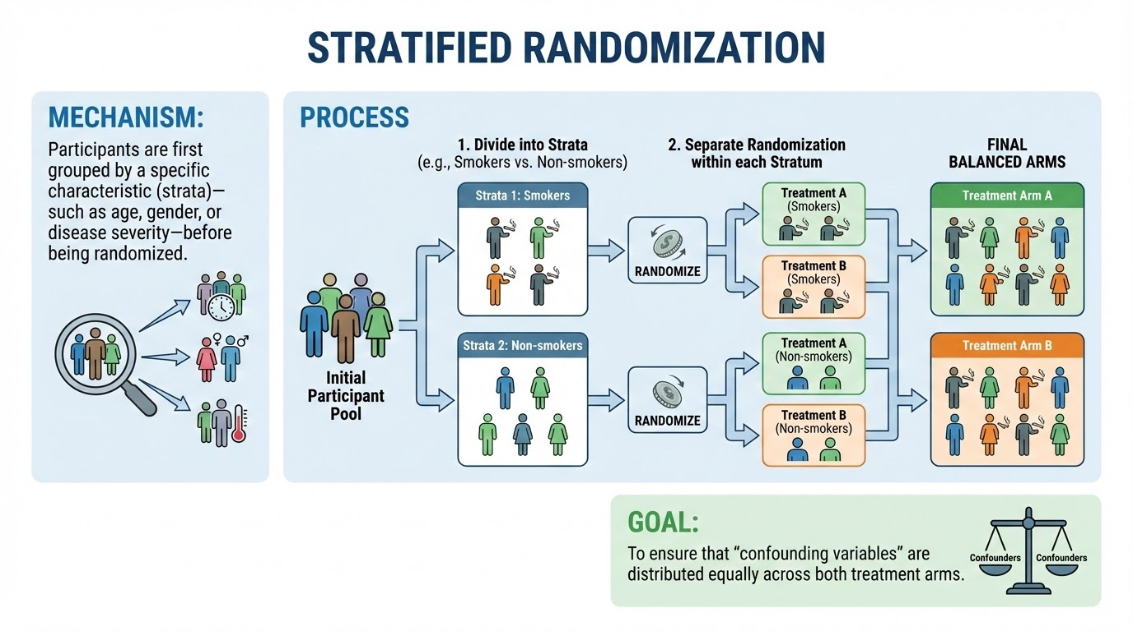

Slide 40
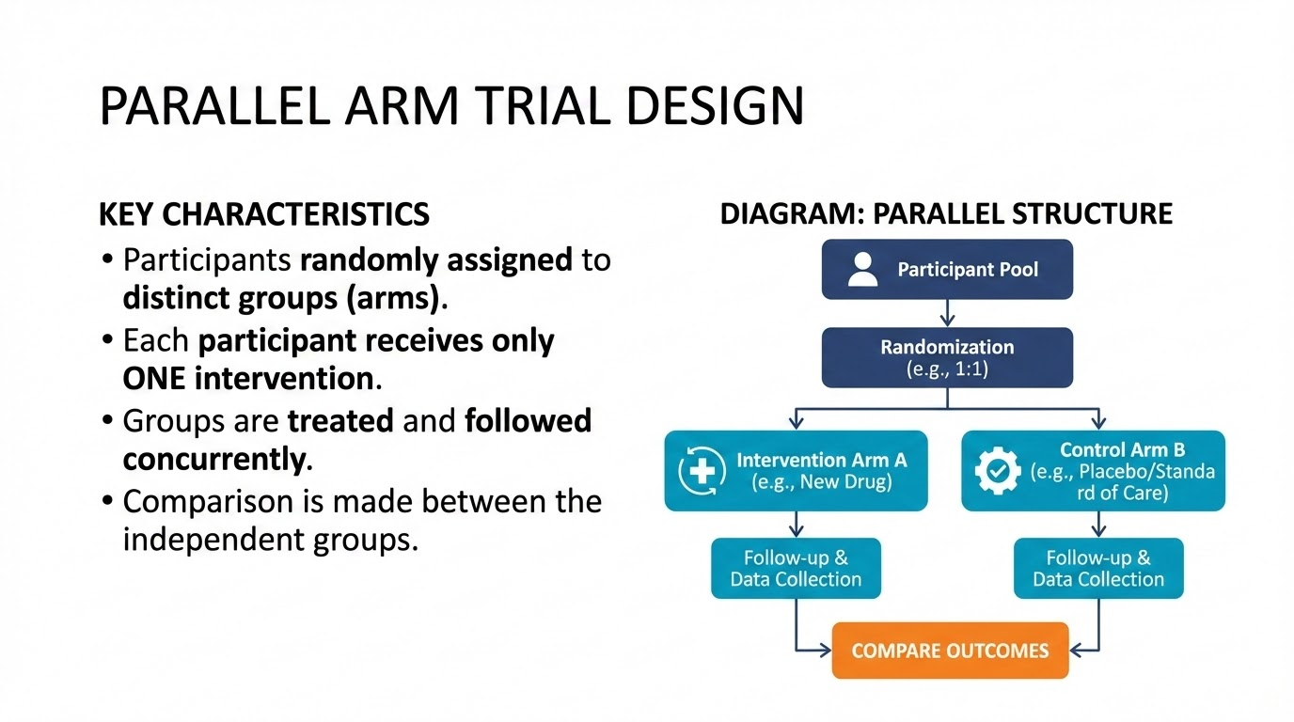

Slide 41
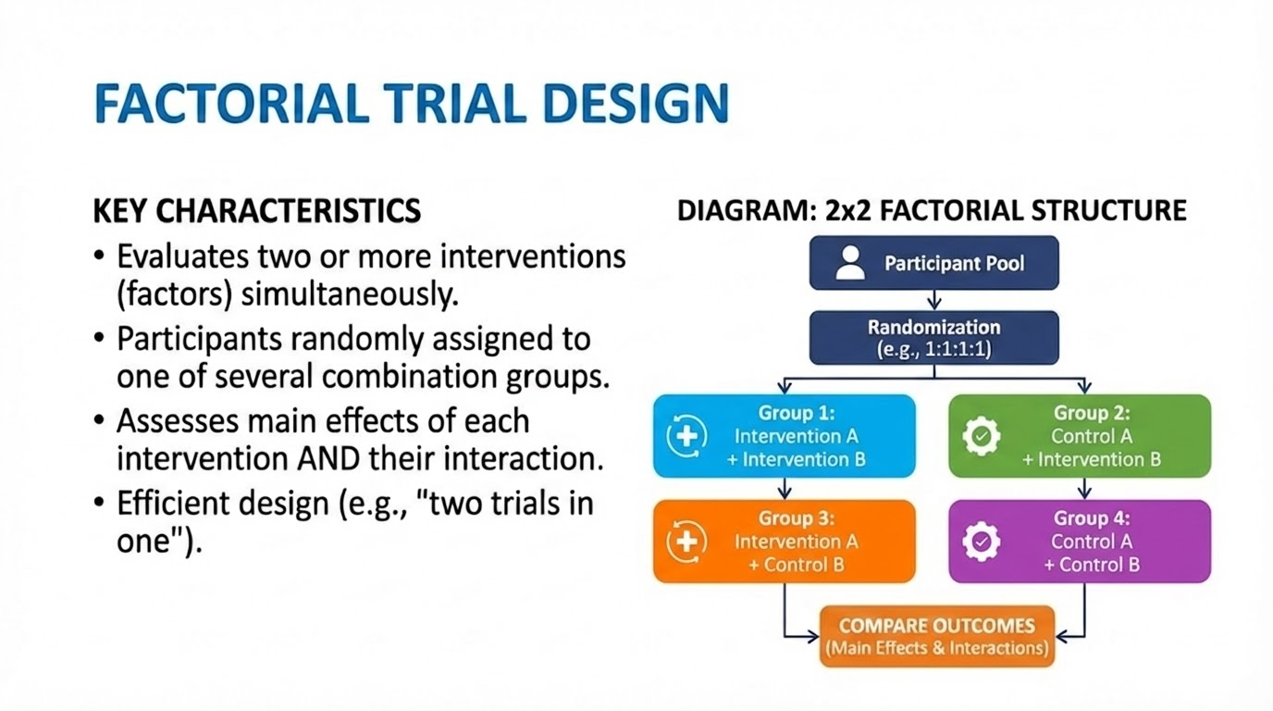

Slide 42
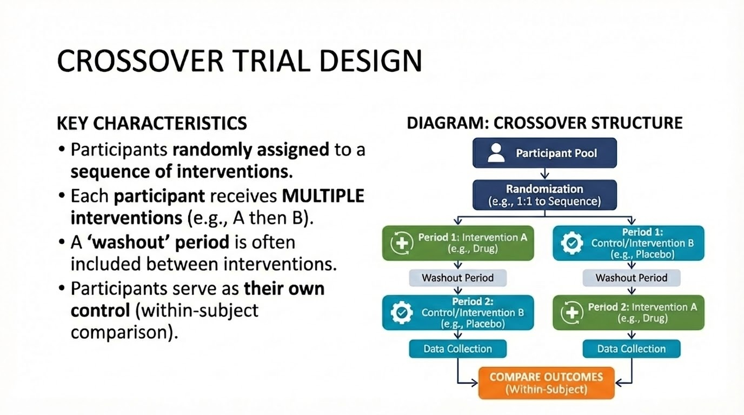

Slide 43
What is Blinding?
Technique used in clinical trials where information about the treatment allocation is withheld to prevent bias.
1. Performance Bias (differential treatment or care)
2. Detection Bias (differences in outcome assessment)
3. Placebo Effect (psychological effects of treatment expectation)
4. Reporting Bias (reporting of symptoms and outcomes)

Slide 44
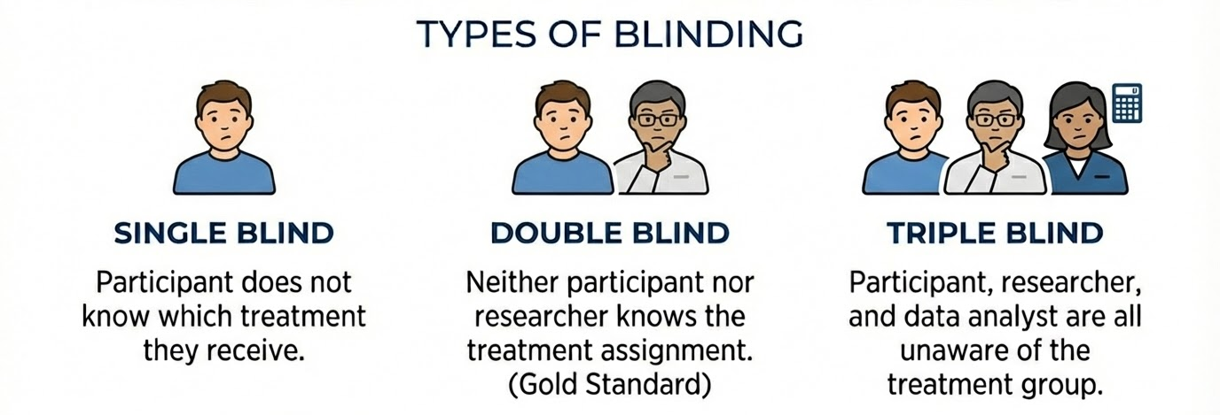

Slide 45
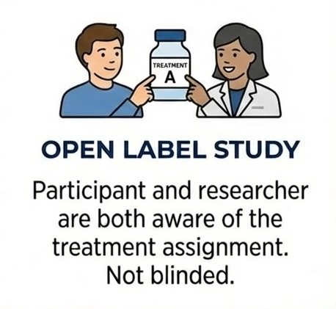
Sometimes, blinding may not be possible

Slide 46
Situations where blinding is difficult or impossible:
Surgical Interventions (though sham surgery possible)
Behavioral Interventions (psychotherapy, exercise programs, dietary modifications)
Obvious Side Effects (e.g., hair loss with chemotherapy)
Emergency Situations
Use outcome assessor blinding when participant/provider blinding is impossible (PROBE design)

Slide 47
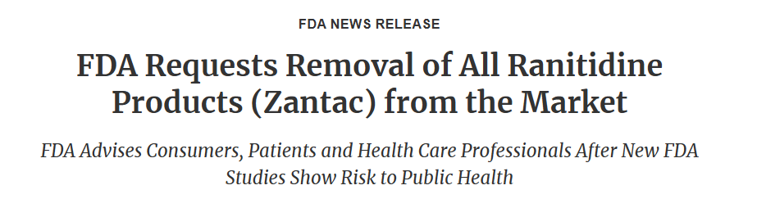
Does A Trial Ever End?
3rd most prescribed GI drug
Used for over 40 years worldwide
Traces of NDMA found in particle- carcinogenic
Banned in 2020 - reformulated and approved again in Nov 2025

Slide 48
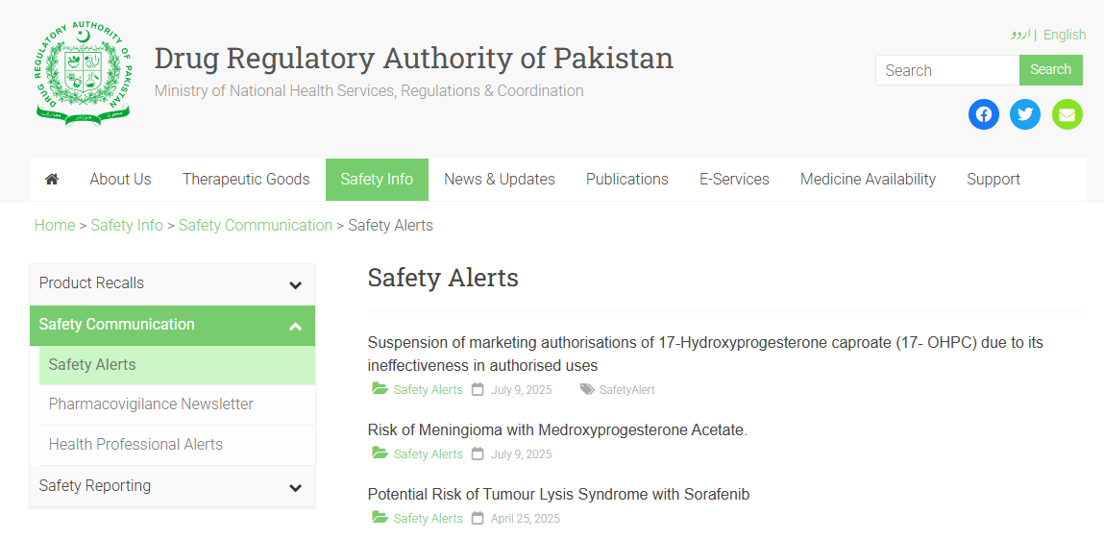

Slide 49
THANK YOU

