Slide 1
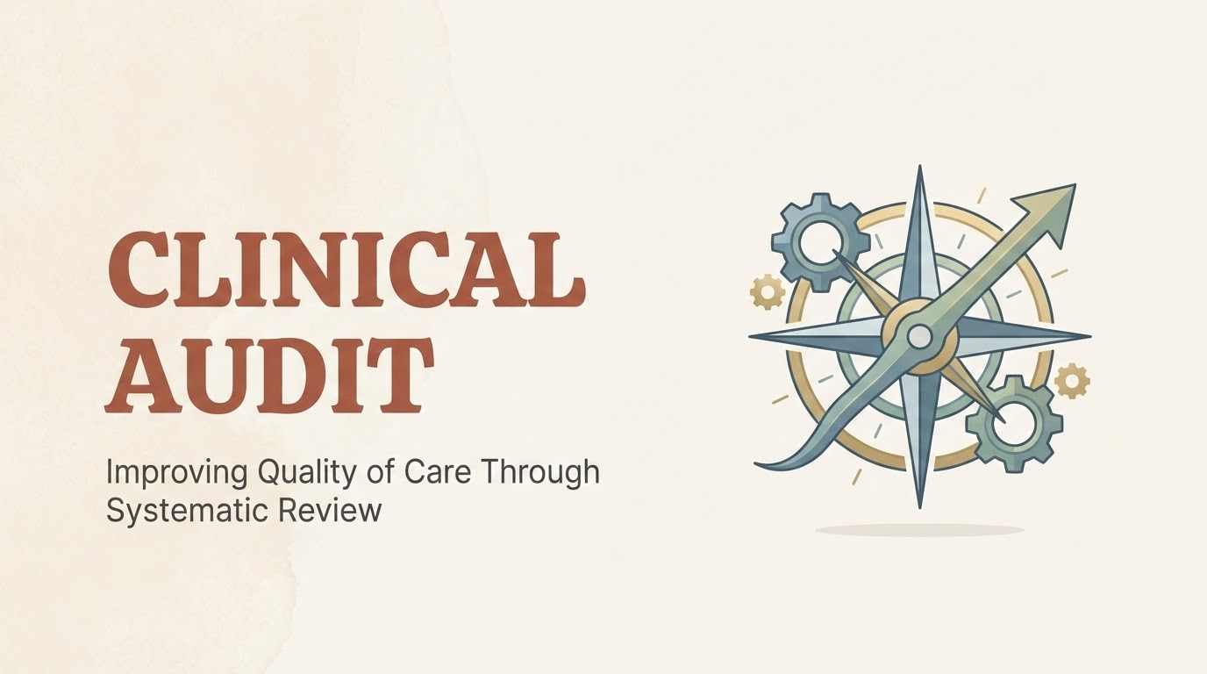

Slide 2
A quality improvement process that seeks to improve patient care and outcomes through systematic review of care against explicit criteria.
Audits answer these questions:
Are we following the rules?
If not, why?
How can we do better?

Slide 3
Feature | Clinical Audit | Research
Purpose | To improve the delivery of care. | To discover new knowledge.
Standard | Compares practice to a standard. | No pre-determined standard.
Question | "Are we doing what we said we'd do?" | "What is the best thing to do?"

Slide 4
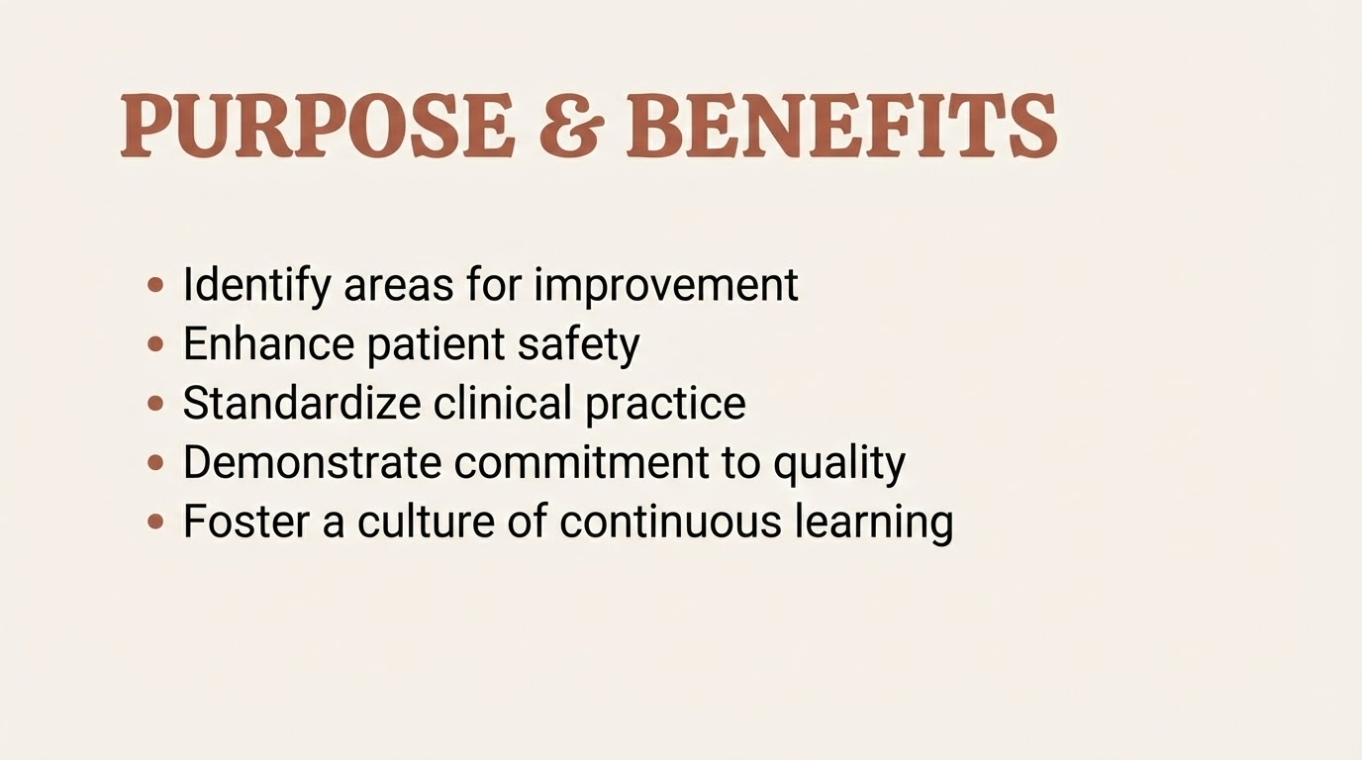

Slide 5
The Clinical Audit Cycle
Complete Audit = Measure baseline (Audit 1) → Compare → Change/Intervention (QIP) → Re-measure (Audit 2).

Slide 6
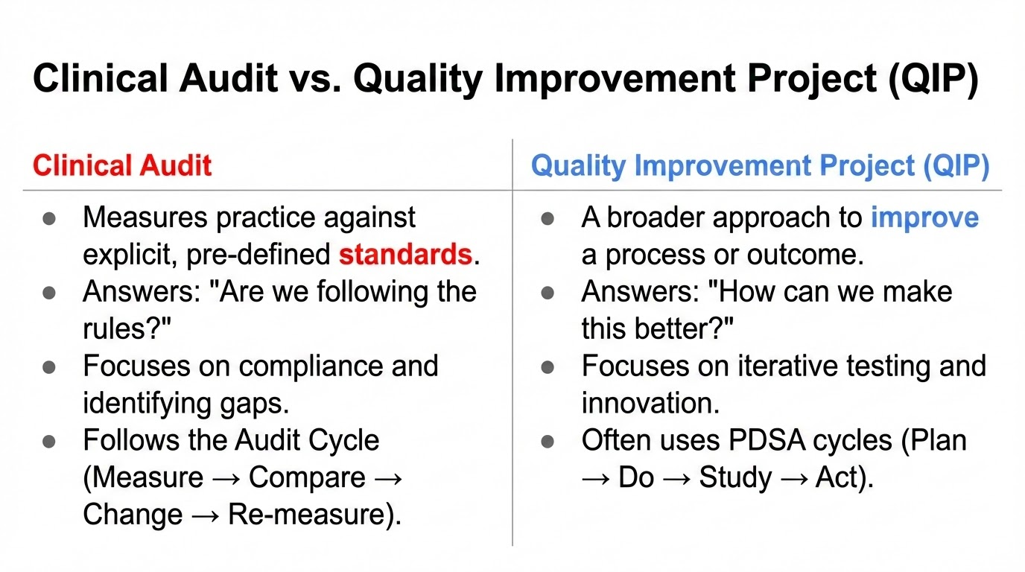

Slide 7
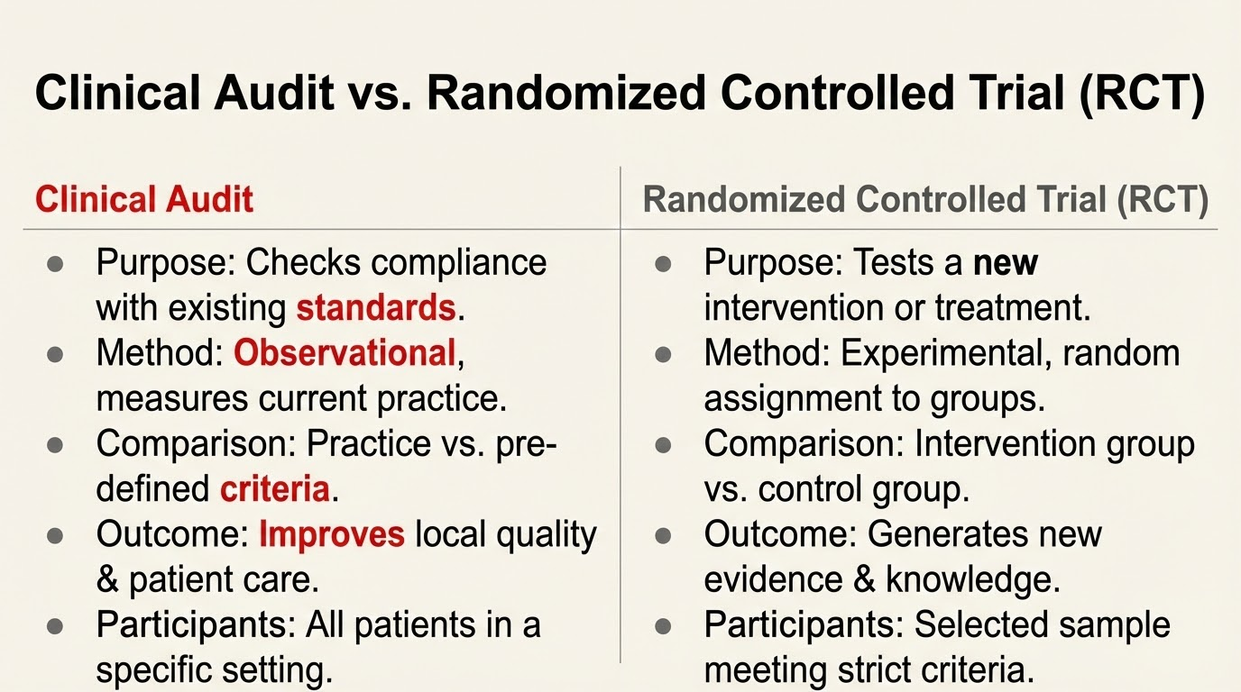

Slide 8
The Clinical Audit Cycle
Identify the Issue: Pick a topic (e.g., "Are we giving antibiotics on time?").
Set Standards: What is the "Gold Standard"? (e.g., "100% of patients should receive them within 1 hour").
Collect Data: Look at patient charts or records.
Compare: Did we meet the standard?
Implement Change: Fix the problems found.
Re-audit: Check again later to see if the fix worked.

Slide 9
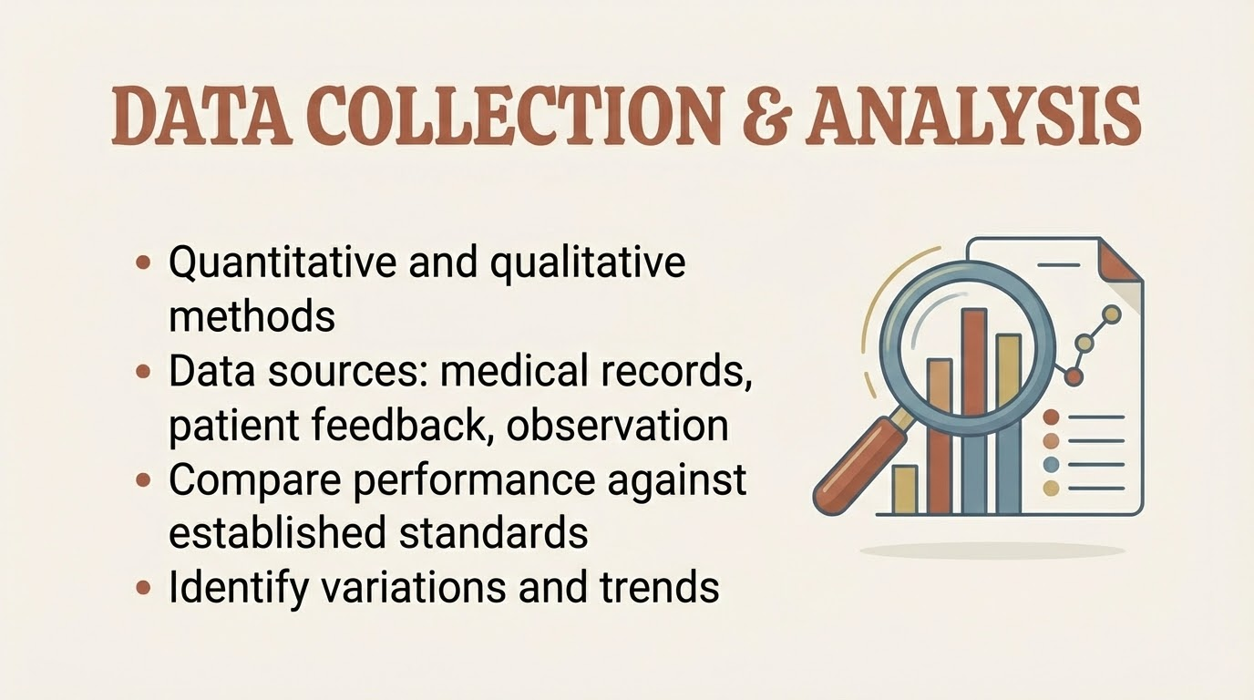

Slide 10
Standards for Comparison:
NICE Guidelines (UK)
WHO Guidelines
Royal College Guidelines
Joint Commission International

Slide 11
When you write down the standards you've chosen for your audit, ensure they are SMART:
Specific: Clearly defined (e.g., "All patients over 65").
Measurable: Can you actually count or track this in the records?
Agreed: Does the whole team agree this is a fair standard?
Relevant: Does this actually affect patient safety or care?
Theoretically Sound: Is there evidence (like a clinical study) to back this up?

Slide 12
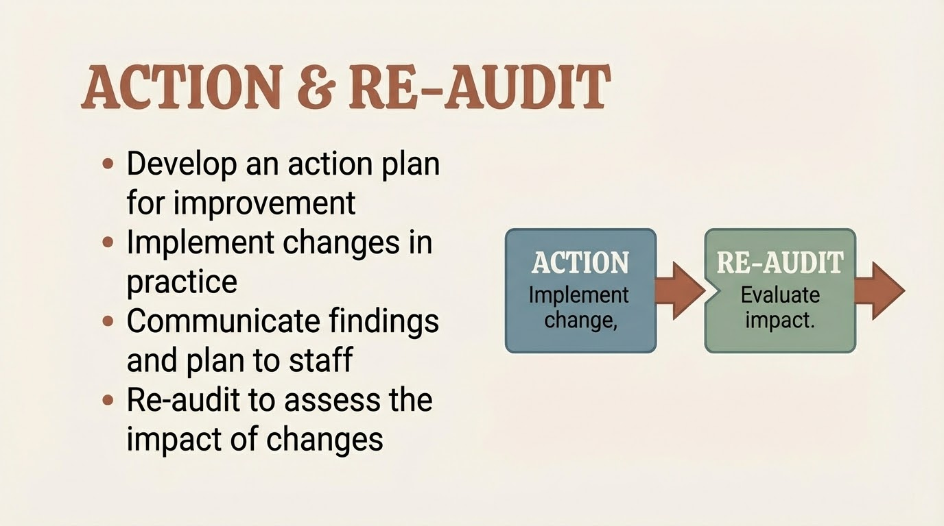

Slide 13
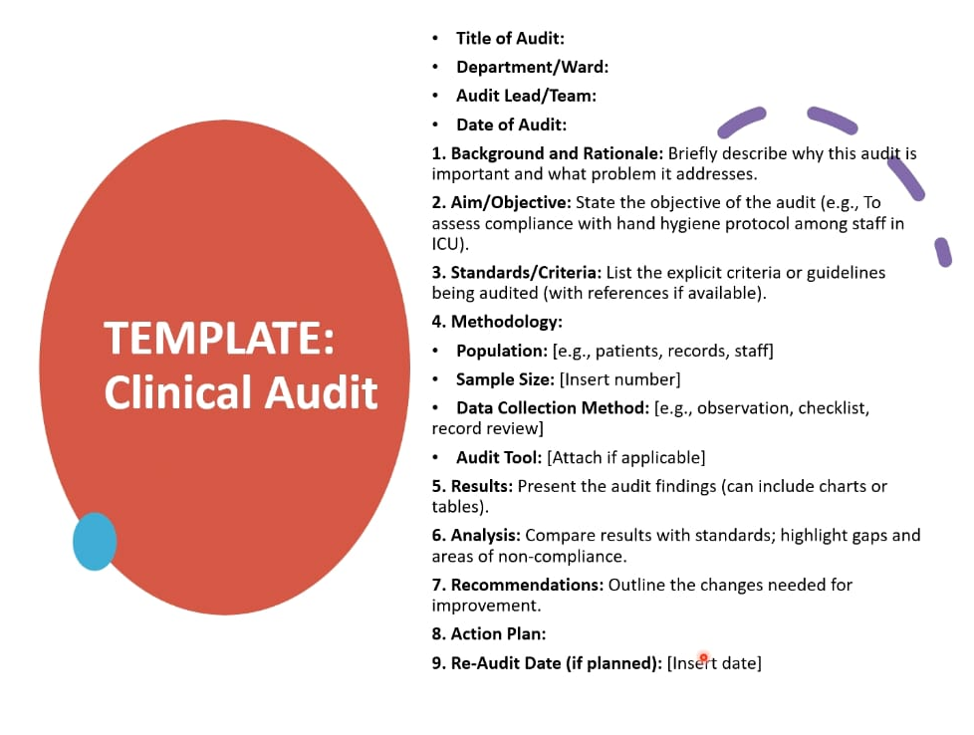

Slide 14
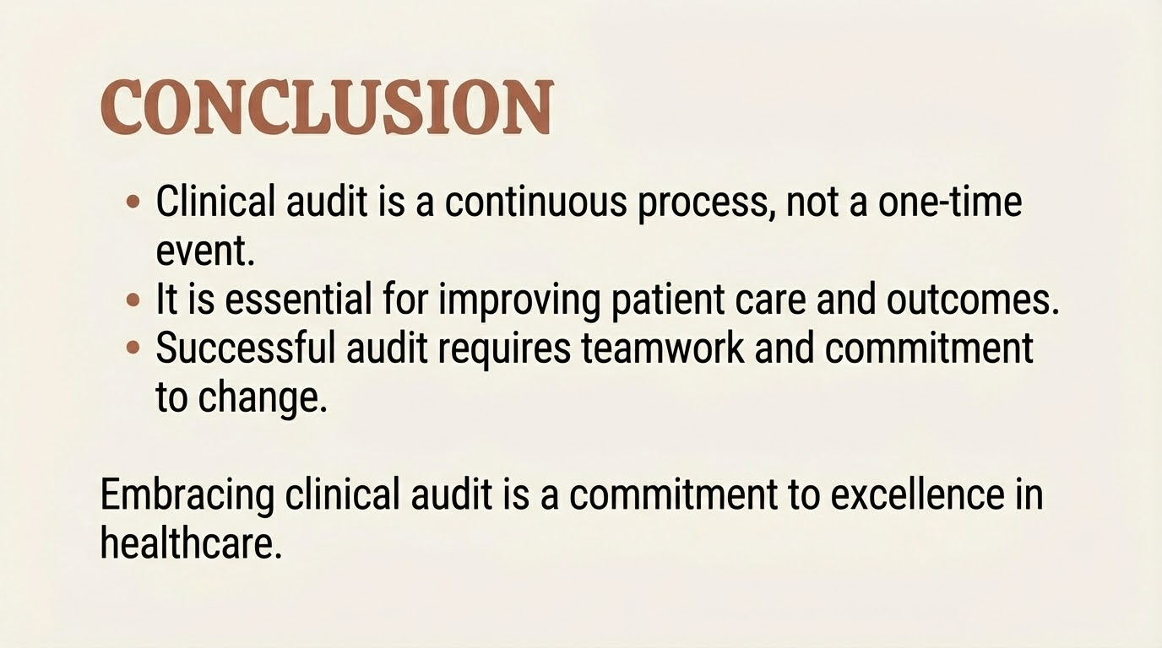

Slide 15
THANK YOU

