Slide 1
Anorectal Surgical Pathologies
Family Medicine Program
Dr. Iffat Noureen
SR-SU-II, BBH

Slide 2
Learning Objectives
Define and classify common anorectal surgical pathologies
Recognize clinical presentations and red flag symptoms
Differentiate benign from serious conditions
Outline initial management in primary care
Identify indications for surgical referral

Slide 3
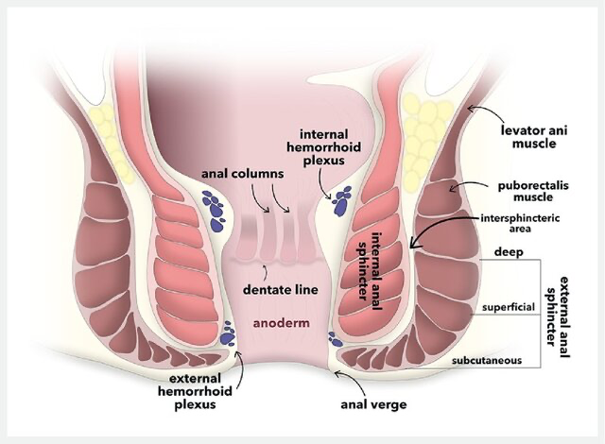
Anorectal Anatomy

Slide 4
Common Anorectal Pathologies
Hemorrhoids (Internal & External)
Anal Fissure
Perianal Abscess
Fistula-in-ano
Pilonidal Disease
Rectal Prolapse

Slide 5
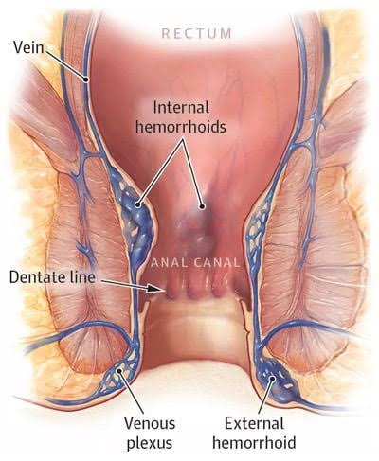
Hemorrhoids
Notes:
Dilated vascular cushions in anal canal
Internal (above dentate line) – painless bleeding
Grading I–IV for internal hemorrhoids
External (below dentate line) – painful if thrombosed

Slide 6
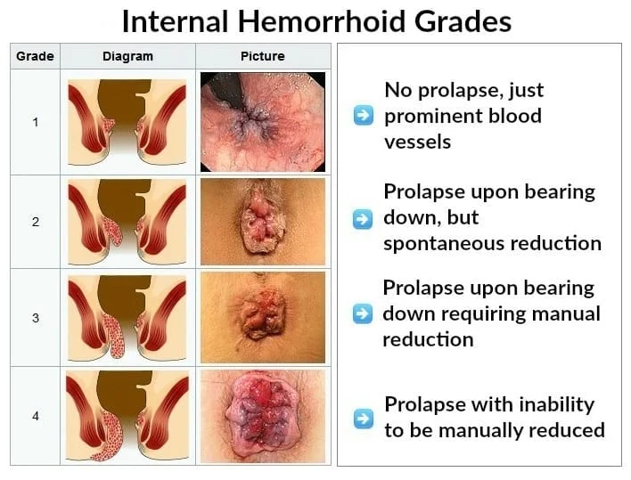
Hemorrhoids

Slide 7
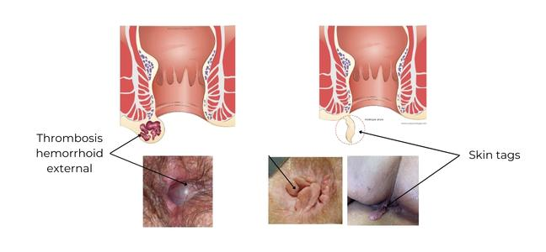
Hemorrhoids

Slide 8
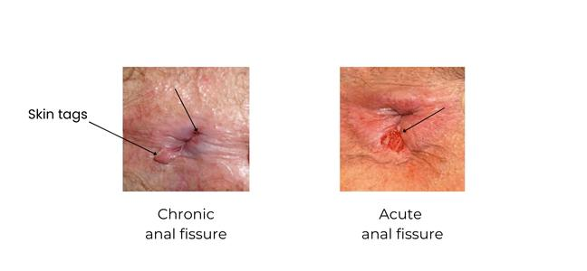
Anal Fissure

Slide 9
Anal Fissure
Linear tear in anoderm (usually posterior midline)
Severe pain during and after defecation
Bleeding (streaks on stool)
Chronic fissure: sentinel pile, exposed sphincter fibers

Slide 10
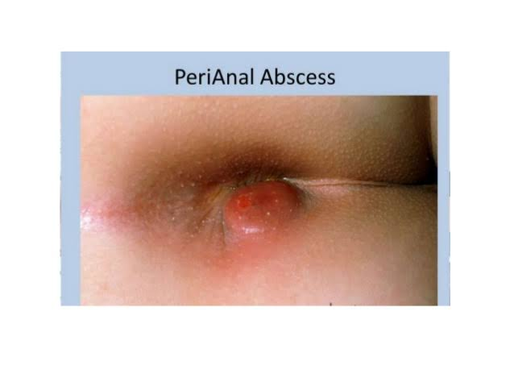
Perianal Abscess
Acute infection of anal glands
  Severe throbbing pain, fever
  Tender, fluctuant swelling
  Requires urgent drainage

Slide 11
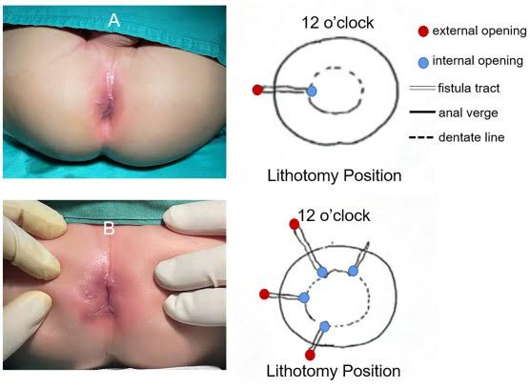
Fistula-in-ano

Slide 12
Fistula-in-ano
Abnormal tract between anal canal and perianal skin
  Persistent discharge
  History of previous abscess
  Simple vs complex fistula

Slide 13
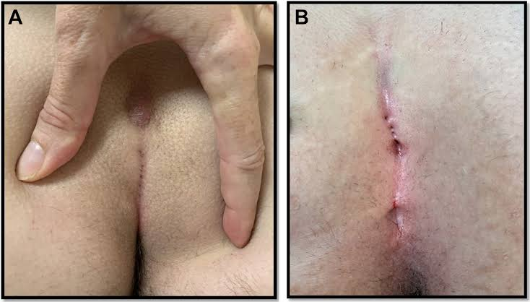
Pilonidal Disease

Slide 14
Pilonidal Disease
Hair-containing sinus in natal cleft
  Painful swelling with discharge
  Common in young adults
  Recurrent if not properly managed

Slide 15
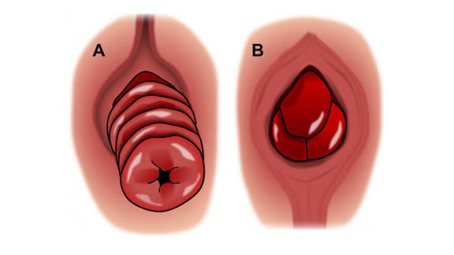
Rectal Prolapse

Slide 16
Rectal Prolapse
Full thickness protrusion of rectum
  Mucosal vs complete prolapse
  Incontinence, mucus discharge
  Common in elderly women

Slide 17
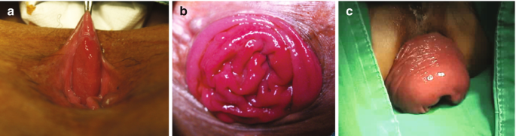
Rectal Prolapse

Slide 18
Red Flag Symptoms
Unexplained weight loss
Persistent bleeding >40 years age
Anemia
Change in bowel habits
Suspicious mass on DRE

Slide 19
Focused History
Pain (character, relation to defecation)
Bleeding (color, quantity)
Discharge (pus, mucus)
Bowel habits
Comorbidities (IBD, TB, malignancy)

Slide 20
Examination
Inspection (position: left lateral)
  Digital Rectal Examination (DRE)
  Proctoscopy if available
  Examine inguinal nodes

Slide 21
Differentiating Benign vs Serious
Painless bleeding – consider hemorrhoids but rule out cancer
Severe pain – fissure or abscess
Multiple external openings – consider Crohn’s
Irregular indurated ulcer – suspect malignancy

Slide 22
Basic Investigations
CBC (anemia, infection)
Blood sugar (for abscess)
Colonoscopy if red flags present
MRI for complex fistula (specialist level)

Slide 23
Initial Management in Primary Care
Pain relief (NSAIDs, topical anesthetics)
Stool regulation (fiber, laxatives)
Sitz bath
Antibiotics only when indicated
Patient counseling

Slide 24
When to Refer
All abscesses (urgent)
Recurrent or complex fistula
Grade III–IV hemorrhoids
Chronic fissure not responding to treatment
Any suspicion of malignancy

Slide 25
Preventive Strategies
High fiber diet
Adequate hydration
Avoid straining
Bowel habit training
Weight management

Slide 26
Key Take Home Messages
Most anorectal conditions are benign
Careful history and DRE are essential
Recognize red flags early
Timely referral prevents complications

