Slide 1
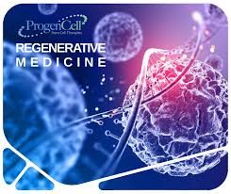
REGENERATIVE MEDICINE
From Biological Repair to Engineering Human Regeneration

Slide 2
Conceptual Foundations of Regenerative Medicine
1. WHAT IS REGENERATIVE MEDICINE?
Classical definition:
Regenerative medicine aims to restore, replace, or regenerate damaged cells, tissues, or organs to normal function.
Expanded definition:
Regenerative medicine is an interdisciplinary science that integrates developmental biology, stem cell science, biomaterials, systems biology, and translational medicine to induce functional self-repair.

Slide 3
2. REPAIR VS REGENERATION
Feature Repair Regeneration
Outcome Scar formation Functional tissue
Cellular behavior Fibroblast-driven Stem/progenitor-driven
Architecture Disorganized Native-like
Example Myocardial fibrosis Liver regeneration
Key insight:
Most adult human tissues repair — they rarely regenerate.

Slide 4
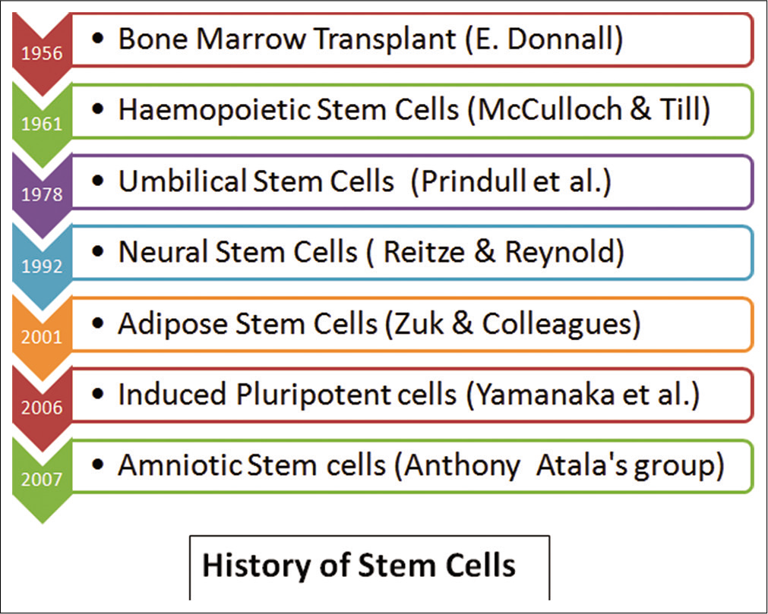
3. HISTORICAL EVOLUTION
Ancient era: Tissue healing (Hippocrates)
20th century: Organ transplantation
1990s: Stem cell discovery
2000s: Tissue engineering
2010s: iPSCs, organoids
2020s: Gene editing + AI-guided regeneration

Slide 5
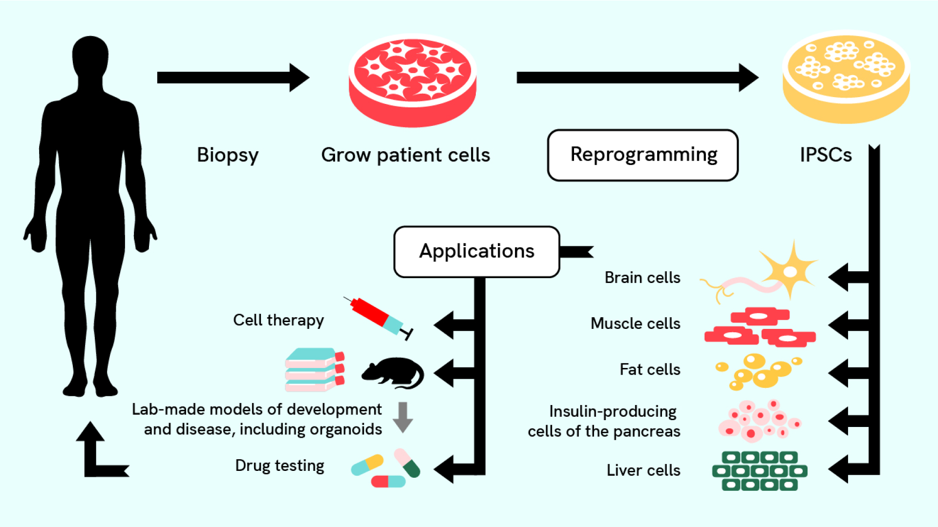
STEM CELLS – THE BIOLOGICAL ENGINE

Slide 6
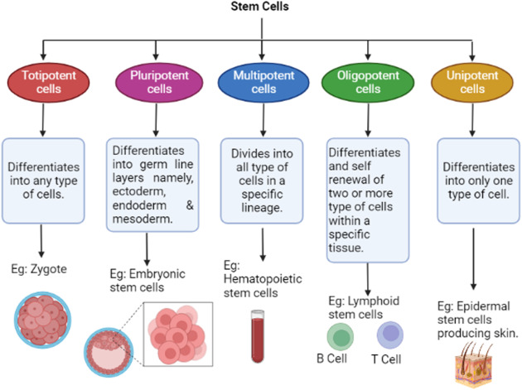
4. STEM CELL HIERARCHY
A. POTENCY CLASSIFICATION
Type Example Potency
Totipotent Zygote Entire organism
Pluripotent ESCs, iPSCs All body tissues
Multipotent HSCs, MSCs Lineage- restricted
Unipotent Epidermal stem cells Single lineage

Slide 7
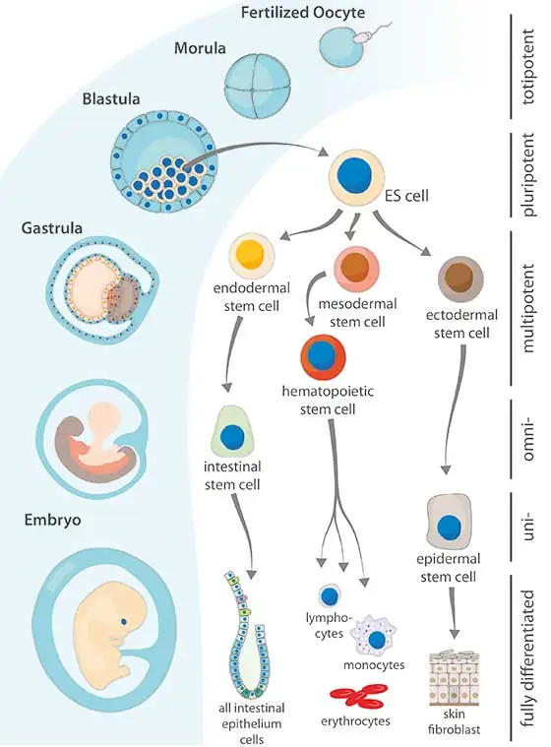
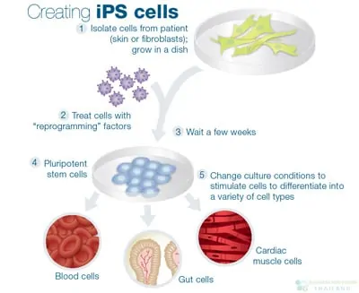
B. EMBRYONIC STEM CELLS (ESCS)
Derived from inner cell mass
Unlimited self-renewal
Ethical and immunological concerns
C. INDUCED PLURIPOTENT STEM CELLS (IPSCS)
Somatic cell → reprogrammed (Oct4, Sox2, Klf4, c-Myc)
Nobel Prize (Yamanaka)
Advantages:
Patient-specific
No ethical embryo destruction
Limitations:
Epigenetic memory
Tumorigenicity

Slide 8
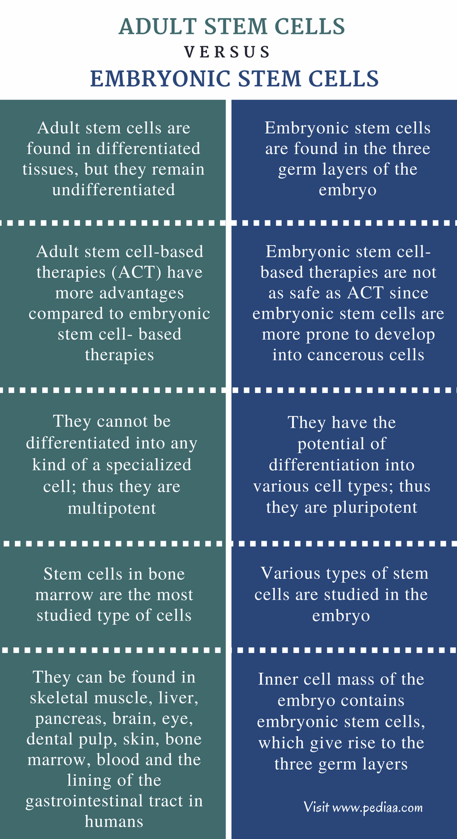
D. ADULT STEM CELLS (MSCS, HSCS)
Bone marrow, adipose tissue, umbilical cord
Paracrine rather than replacement effect

Slide 9
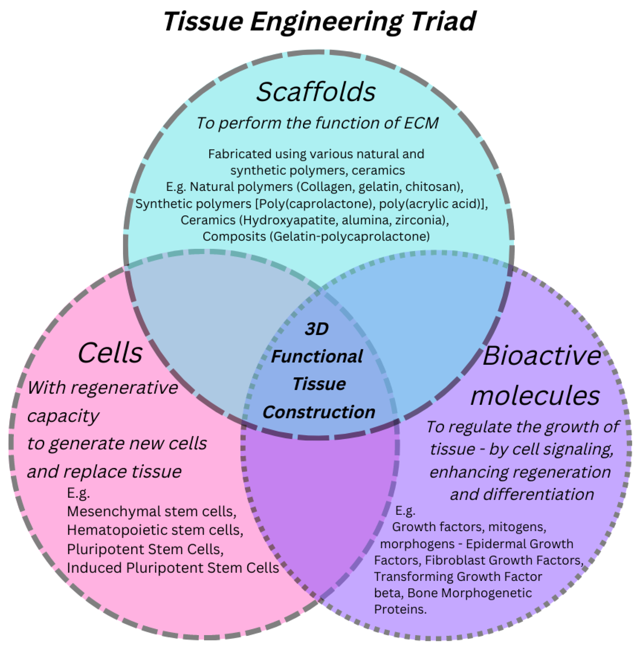
Tissue Engineering Triad
5. The Regenerative Triad
Cells + Scaffolds + Signals

Slide 10
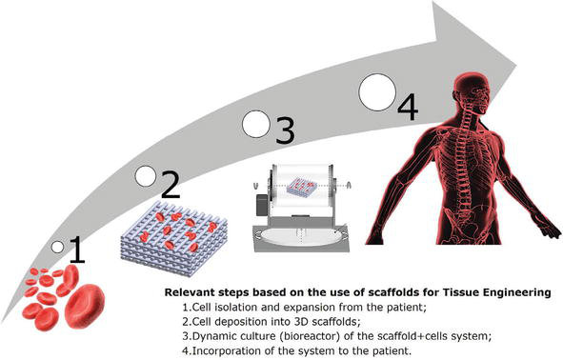
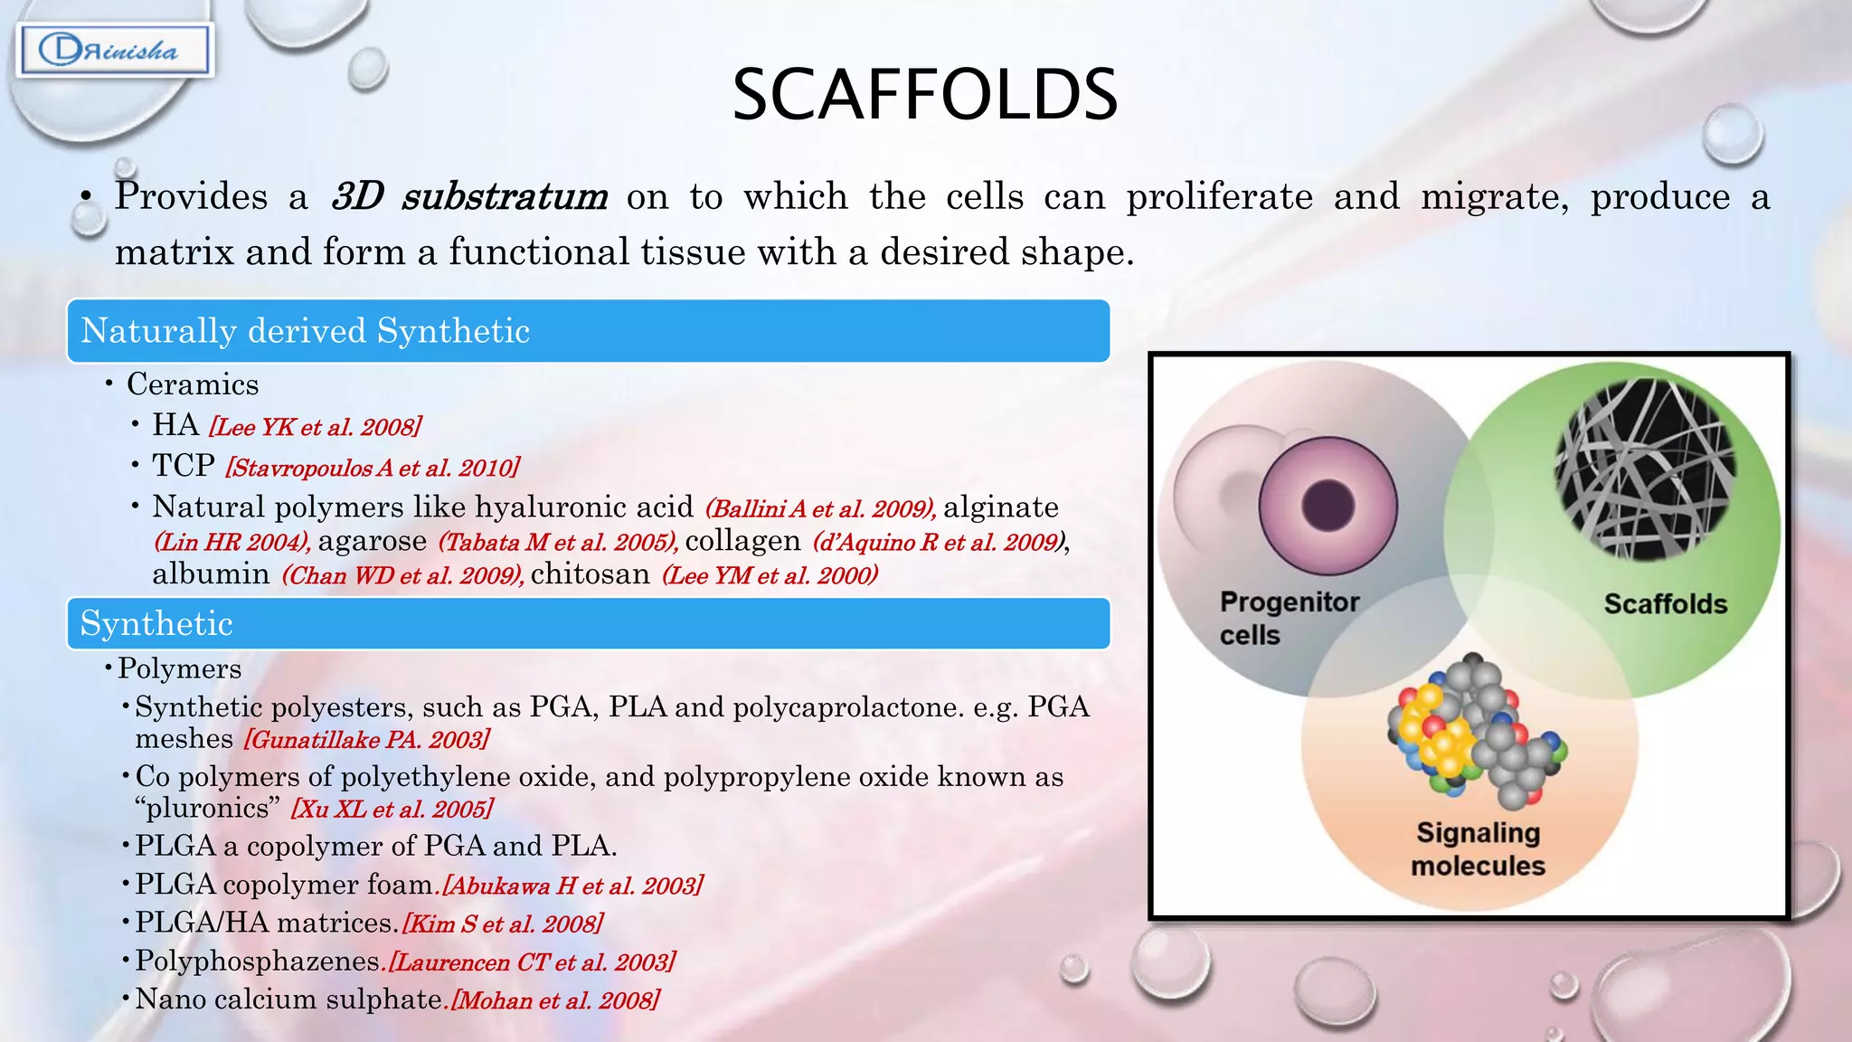
A. CELLS
• Stem cells
• Progenitor cells
• Genetically modified cells
B. SCAFFOLDS (BIOMATERIALS)
Property Importance
Biocompatibility Avoid immune rejection
Biodegradability Match tissue growth
Porosity Nutrient diffusion
Mechanical strength Load-bearing tissues
Types:
• Natural (collagen, fibrin)
• Synthetic (PLGA, PEG)
• Smart materials (stimuli-responsive)

Slide 11
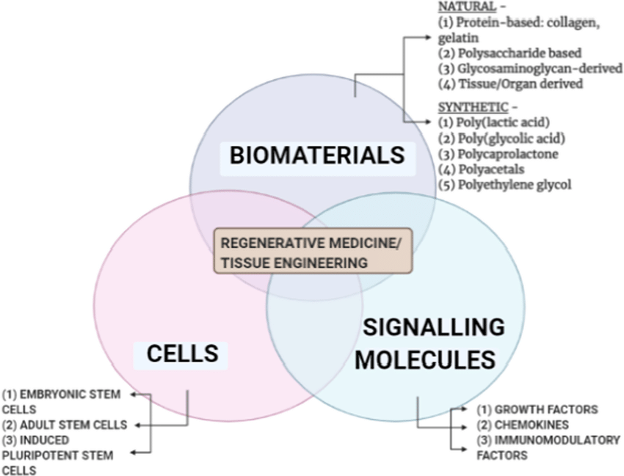
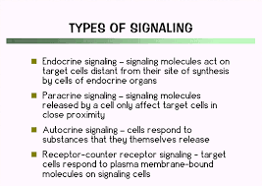
C. SIGNALING MOLECULES
Growth factors (VEGF, BMP, FGF)
Cytokines
Mechanical signals
Electrical cues (neural tissues)

Slide 12
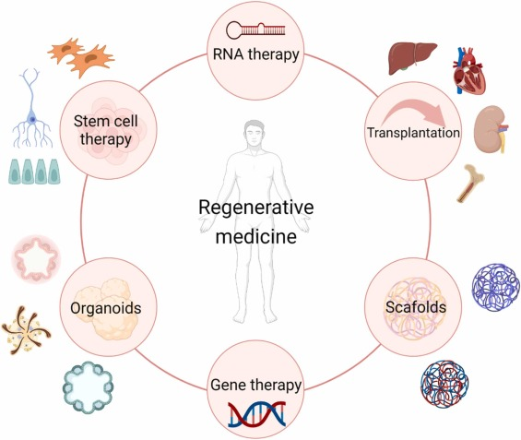
ADVANCED REGENERATIVE PLATFORMS

Slide 13
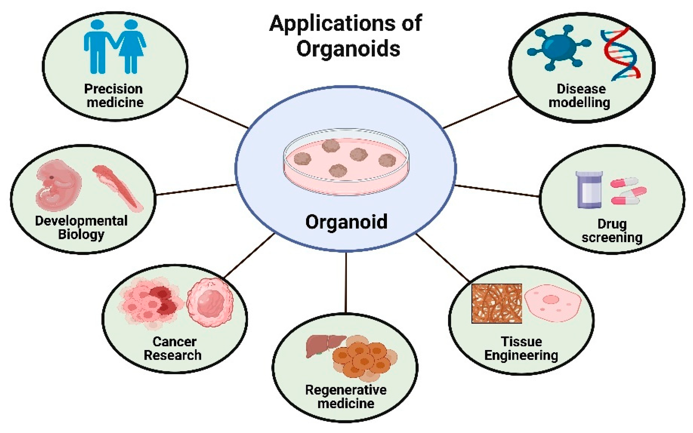
Organoids are self-organizing, 3D miniature versions of organs, grown in a lab from stem cells (like embryonic, adult, or iPSCs) or tissue cells, that mimic the structure, cellular complexity, and functions of real organs. These tiny tissues, like mini-brains, guts, or kidneys, serve as powerful models for studying human development, disease (like cancer), testing new drugs, and advancing personalized medicine, offering insights beyond traditional 2D cultures or animal models.
6. ORGANOIDS
Miniature 3D tissue models
Derived from iPSCs or adult stem cells
Examples: Brain, gut, liver organoids
Applications:
Disease modeling
Drug testing
Personalized medicine
Limitation:
Lack of vascularization and immune integration

Slide 14
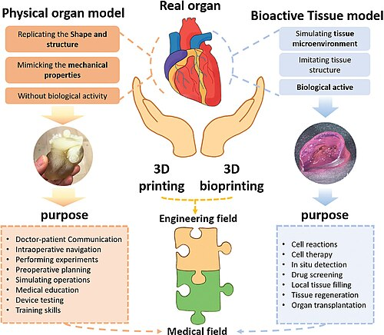
7. 3D BIOPRINTING
Layer-by-layer deposition of:
  Cells
  Bioinks
  Growth factors
Challenges:
Cell viability
Vascular complexity
Functional maturation
3D bioprinting revolutionizes tissue engineering by using layer-by-layer additive manufacturing to precisely deposit living cells, growth factors, and biomaterials (bio-inks) to create complex, functional tissues and organs

Slide 15
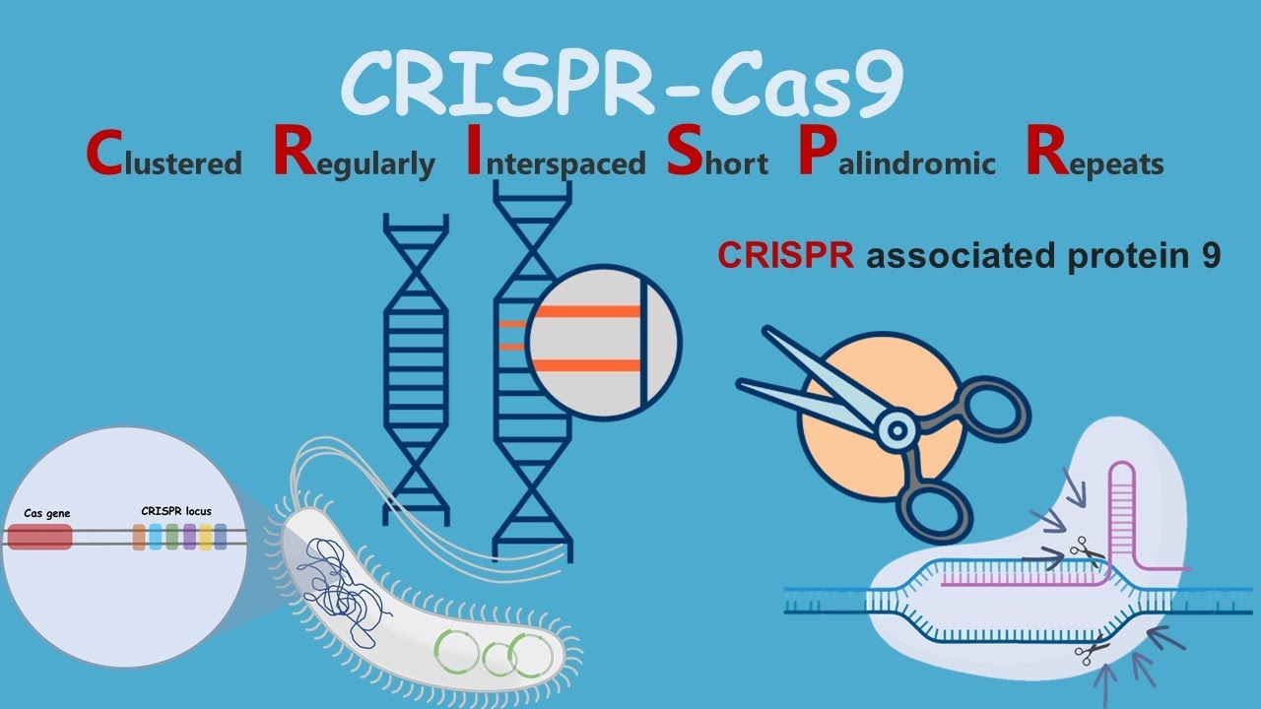
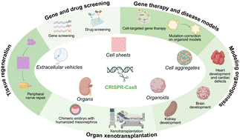
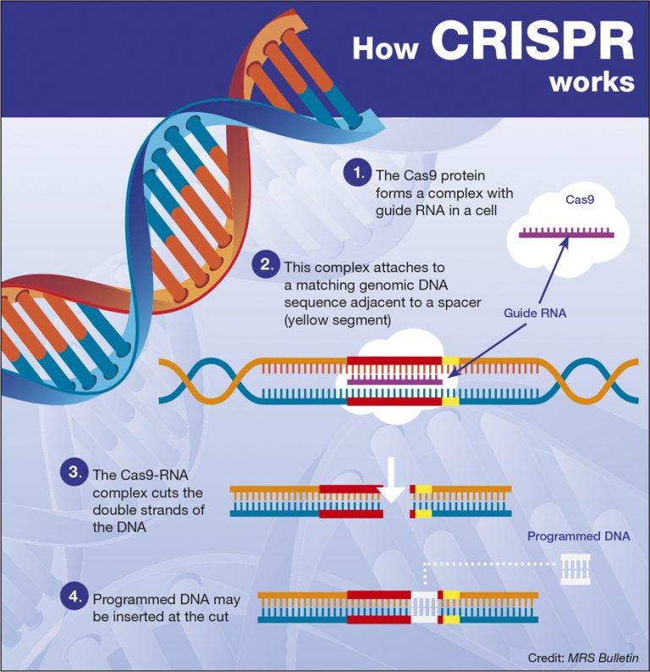
8. GENE EDITING & REGENERATION
CRISPR-Cas9
Gene correction
Activation of regenerative pathways
Example:
Editing dystrophin gene in muscular dystrophy

Slide 16
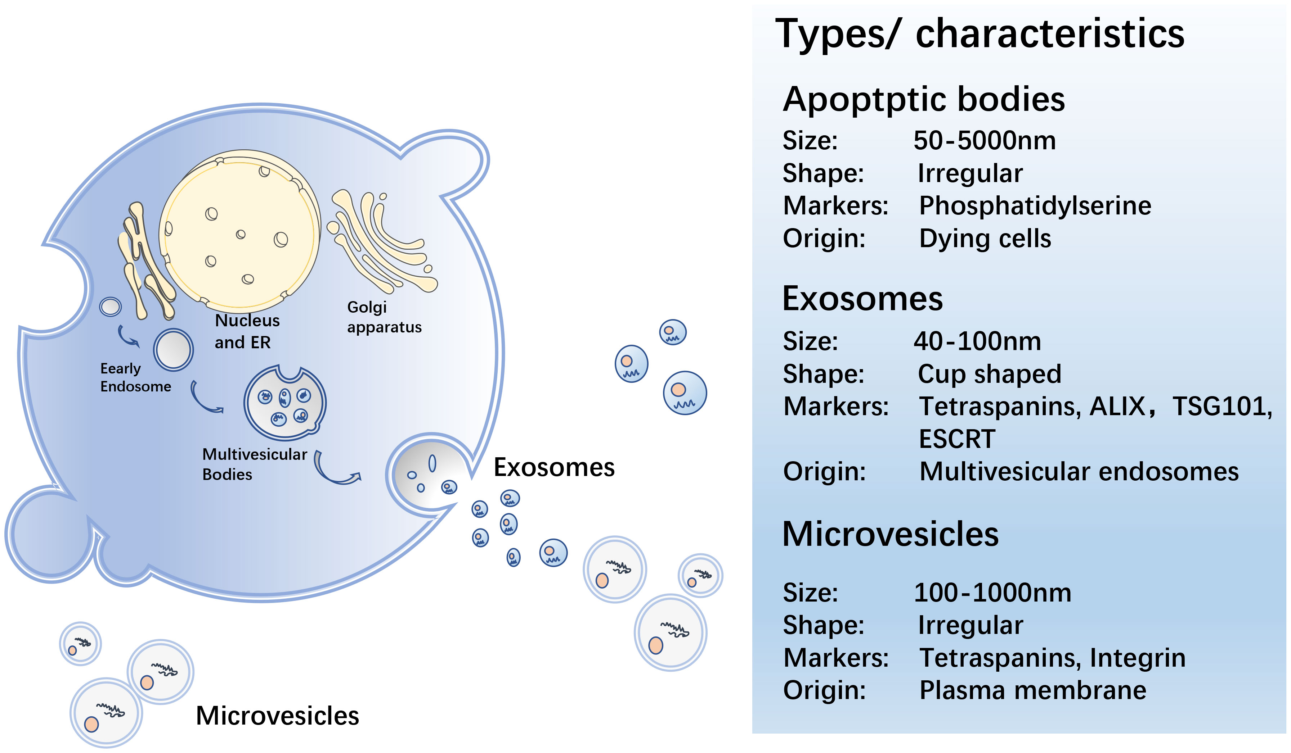
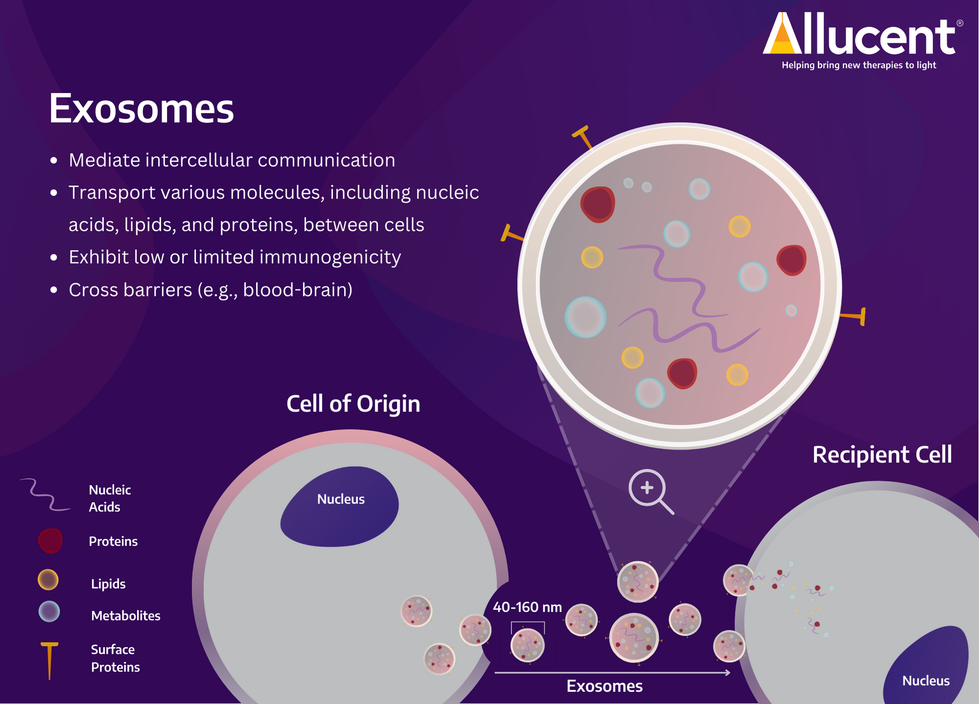
9. EXTRACELLULAR VESICLES & EXOSOMES
Stem cell secretome
Carry miRNA, proteins
Cell-free regeneration
Future trend:
Replacing stem cell therapy with exosome therapy
Extracellular vesicles (EVs) are tiny, natural, membrane-bound packages released by virtually all cells, acting as crucial messengers to transfer bioactive molecules (proteins, lipids, nucleic acids like mRNA, miRNA) to other cells, influencing their function in both healthy and diseased states, and are classified by their origin into exosomes (internal budding), microvesicles (direct budding), and apoptotic bodies (dying cells)

Slide 17
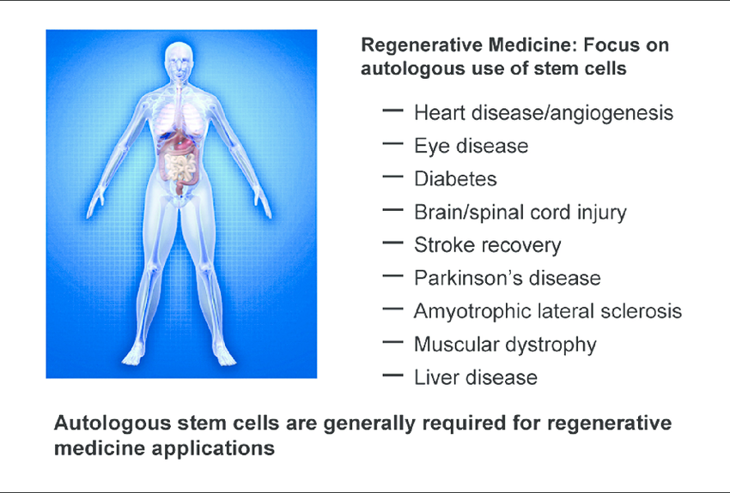
CLINICAL TRANSLATION & ETHICS

Slide 18
10. CLINICAL APPLICATIONS
• Hematopoietic stem cell transplantation
• Skin regeneration (burns)
• Cartilage repair
• Corneal regeneration
• Cardiac patches
11. BARRIERS TO TRANSLATION
Barrier Explanation
Tumor risk Uncontrolled proliferation
Immune rejection Allogenic cells
Cost GMP manufacturing
Regulation Long approval timelines

Slide 19
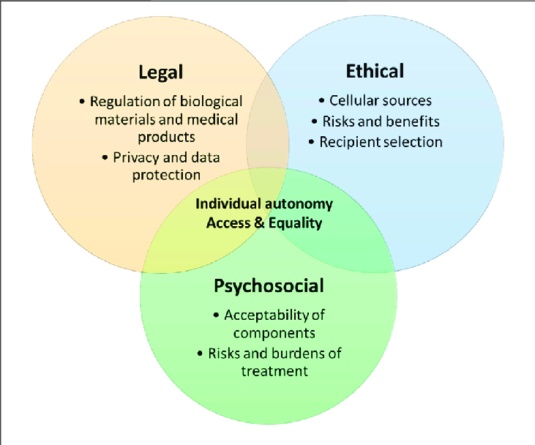
12. ETHICAL, LEGAL & SOCIAL ISSUES
Stem cell tourism
Unproven therapies
Informed consent
Equity of access

