Slide 1
Immunotherapy: Principles, Progress & Future Directions
Dr. Muhammad Mujeeb Khan
PhD Scholarships
Department of Infectious Diseases

Slide 2
Learning Objectives
Understand major immunotherapy strategies
Explore mechanisms & applications
Recognize complications
Discuss future technologies

Slide 3
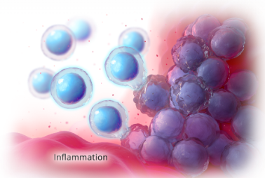
What is Immunotherapy?
Modifies Immune System
Immunotherapy
Boosts or suppresses response
Uses: cancer, autoimmune, Infections

Slide 4
Why Cancer Evades Immunity
MHC downregulation
PD-L1 expression
Tumor microenvironment suppression

Slide 5
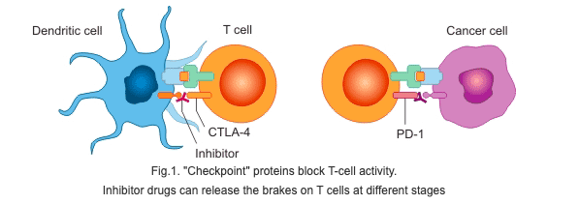
Immune Checkpoints
CTLA-4, PD-1, PD-L1
Blocking removes inhibitory brakes

Slide 6
Key Drugs
PD-1 Inhibitors
Nivolumab, Pembrolizumab, Cemiplimab, Camrelizumab, Sintilimab
PD-L1 Inhibitors
Atezolizumab, Durvalumab, Avelumab
CTLA-4 Inhibitors
Ipilimumab, Tremelimumab

Slide 7
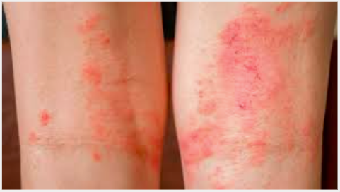
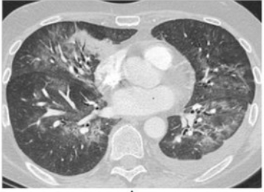
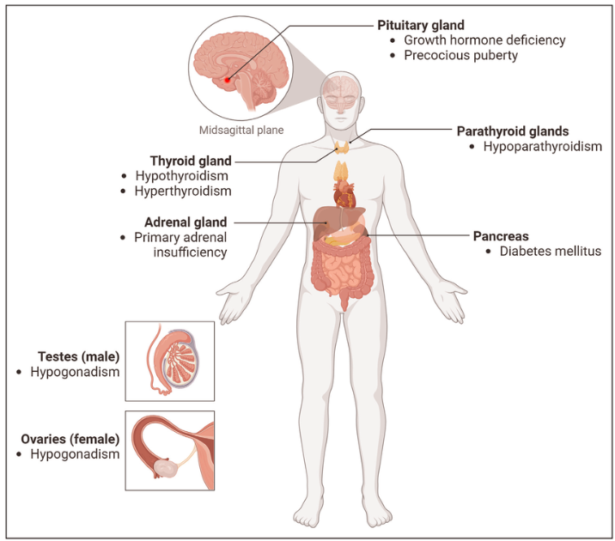
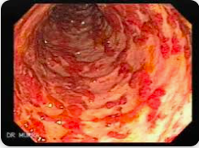
Immune-related Adverse Events
Dermatitis
Pneumonitis
Endocrinopathies
Colitis

Slide 8
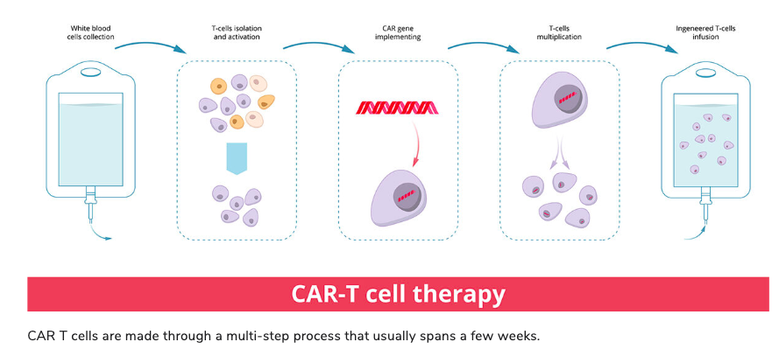
CAR-T Therapy
Engineered T cells
Used in B-cell cancers

Slide 9
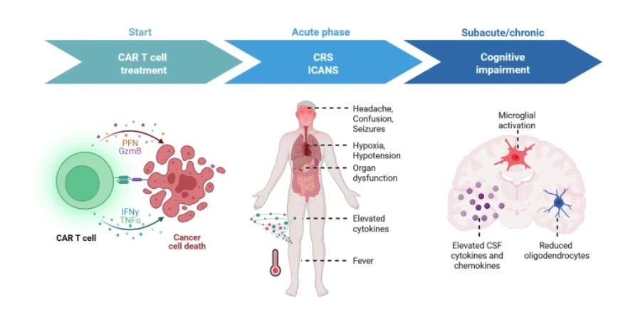
CAR-T Complications

Slide 10
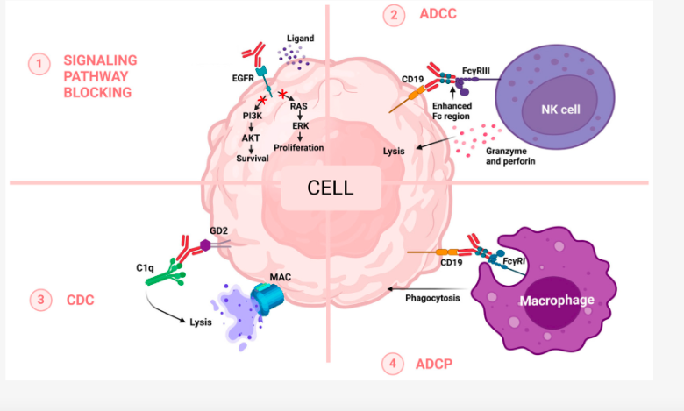
Monoclonal Antibodies
Examples: Rituximab, Infliximab

Slide 11
Cytokine Therapies
IFN-α
IL-2
Hairy cell leukemia, Follicular Lympoma, Kaposi Sarcome
Metstatic melanoma, Advanced renal cell carcinoma
Cytokines like G-CSF stimulate blood cell production

Slide 12
Cancer Vaccines
Preventive vaccine
Human papilloma Virus
Hepatitis B Vaccine
BCG
Sipuleucel-T (Provenge)
Talimogene laherparepvec (T-VEC):
Therapeutic vaccine

Slide 13
Oncolytic Viral Therapy
Tumor lysis & immune activation
T-VEC

Slide 14
Immunotherapy in Infectious Diseases
TB reactivation
Immunotherapy
mAbs in COVID
HIV cure research

Slide 15
Biomarkers for Response
TMB
MSI-high
PD-L1

Slide 16
Challenges
Personalized vaccines
Nanotechnology
Cost

Slide 17
Future Directions
Personalized vaccines
Nanotechnology
Universal CAR-T

Slide 18
Summary
Multiple modalities
Future promising
Transformative field

Slide 19
Discussion
Which modality will dominate the next decade?

Slide 20
Question -1
The primary goal of immunotherapy is to?
Directly destroy cancer cells using cytotoxic drugs
Suppress all immune responses
Modify the immune system to fight disease
Replace surgical treatment
Eliminate genetic mutations

Slide 21
Question - 2
Which immune checkpoint is most commonly targeted in cancer immunotherapy?
CD28
PD-1
CD40
IL-2 receptor
TLR-4

Slide 22
Question - 3
PD-L1 expression on tumor cells primarily leads to
Increased antibody production
Activation of macrophages
T-cell exhaustion
Enhanced antigen presentation
Complement activation

Slide 23
Question - 4
CAR-T cell therapy involves
Passive transfer of antibodies
Vaccination against tumor antigens
Genetic modification of patient T-cells
Suppression of immune checkpoints
Cytokine administration

Slide 24
Question - 5
The most common and serious complication of CAR-T cell therapy is
Neutropenia
Tumor lysis syndrome
Anaphylaxis
Autoimmune arthritis
Cytokine release syndrome

Slide 25
Question - 6
Which malignancy has shown the most consistent response to CAR-T therapy
Breast cancer
Pancreatic cancer
Glioblastoma
Acute lymphoblastic leukemia
Prostate cancer

Slide 26
Question - 7
Immune-related adverse events (irAEs) occur because
Immunotherapy suppresses immunity
Chemotherapy toxicity overlaps
Immune checkpoints are blocked
Pathogens are reactivated
Tumors mutate rapidly

Slide 27
Question - 8
Which of the following is an example of immune checkpoint inhibitor therapy?
Pembrolizumab
Palivizumab
Rituximab
Infliximab
Interferon-α

Slide 28
Question - 9
Immunotherapy in sepsis is based on the concept of
Suppressing inflammation at all stages
Enhancing immune function in late sepsis
Eliminating bacterial toxins
Blocking cytokines permanently
Replacing antibiotics

Slide 29
Question - 10
A major ethical concern regarding immunotherapy is:
Lack of effectiveness
Overuse of antibiotics
High cost and limited access
Short duration of action
Poor immune memory

Slide 30
Answer Key
Question 1: C
Question 2: B
Question 3: C
Question 4: C
Question 5: E
Question 6: D
Question 7: C
Question 8: A
Question 9: B
Question: 10: C

