Slide 1
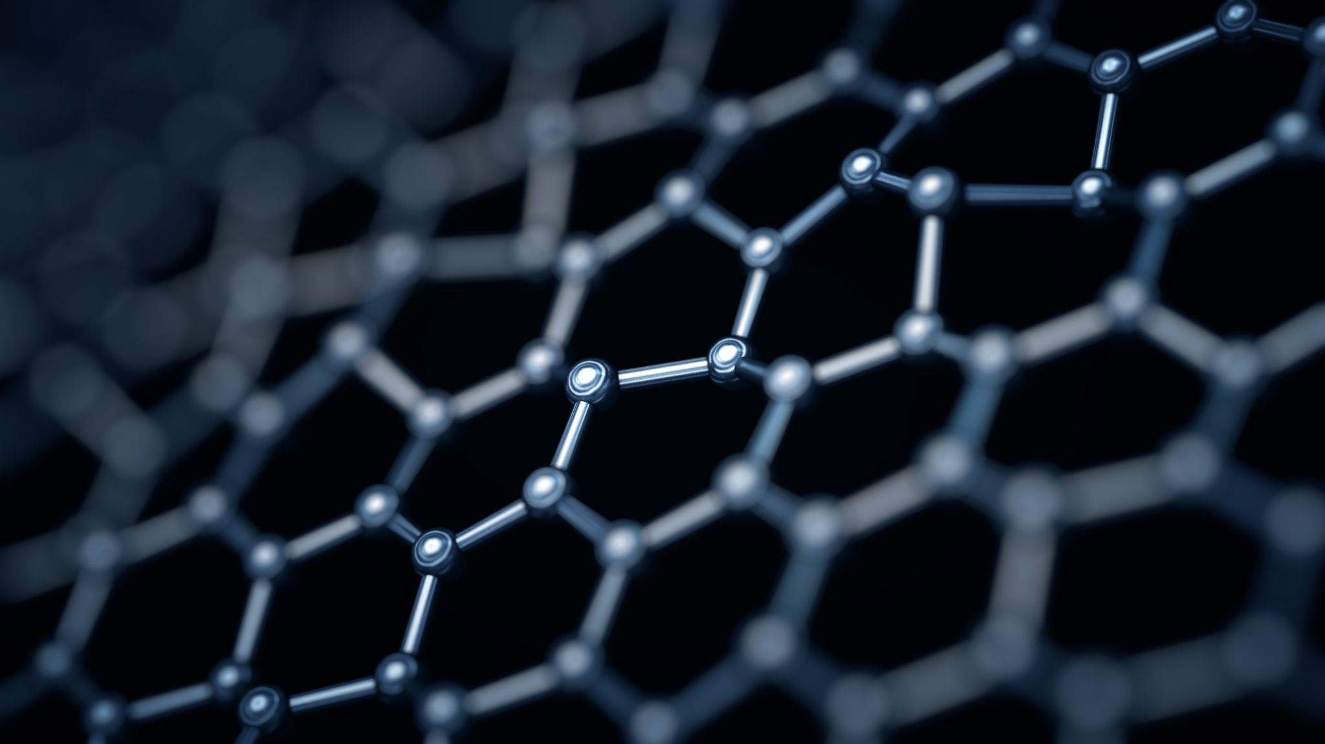
Nanotechnology
Dr Sadaf Saleem
MBBS, MHPE, PhD Scholar

Slide 2



Do not edit How to change the design
What comes to mind when you hear ‘nanotechnology’?
The Slido app must be installed on every computer you’re presenting from

Slide 3

Learning Objectives
Describe key concepts and applications of nanotechnology in healthcare.
Analyze the implications of nanotechnology for medical education and future clinical practice.

Slide 4
Introduction
1959 - Physicist Richard Feynman presented a presentation on making things at the atomic and molecular levels.
Regarded as the most promising technology of the twenty first century.

Slide 5
Definitions
NANOSCIENCE: Study of materials in the 1-100nm range
NANOTECHNOLOGY: Engineering of materials/ devices at the nanoscale for useful applications
NANOMEDICINE: Medical use of nanotechnology for diagnostics, therapy, imaging, etc.

Slide 6
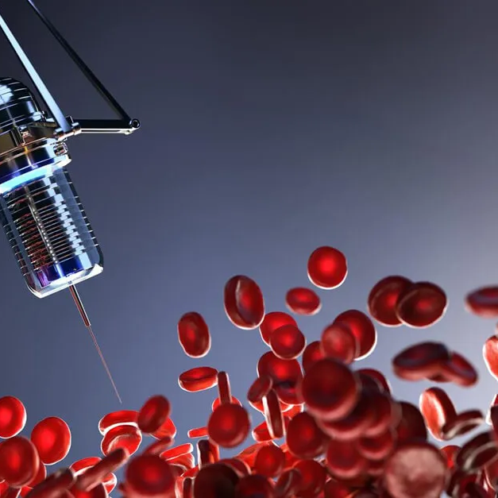
What is Nanotechnology?
Study, design, manipulation, and application of materials and devices at the nanoscale, typically 1–100 nanometers (nm).
At this scale, materials exhibit unique physicochemical, mechanical, optical, and biological properties that do not appear at the macro or microscale.
Notes:
nanoscale behaves differently due to quantum effects, increased surface-to-volume ratio; these differences are exploited in nanomedicine.

Slide 7
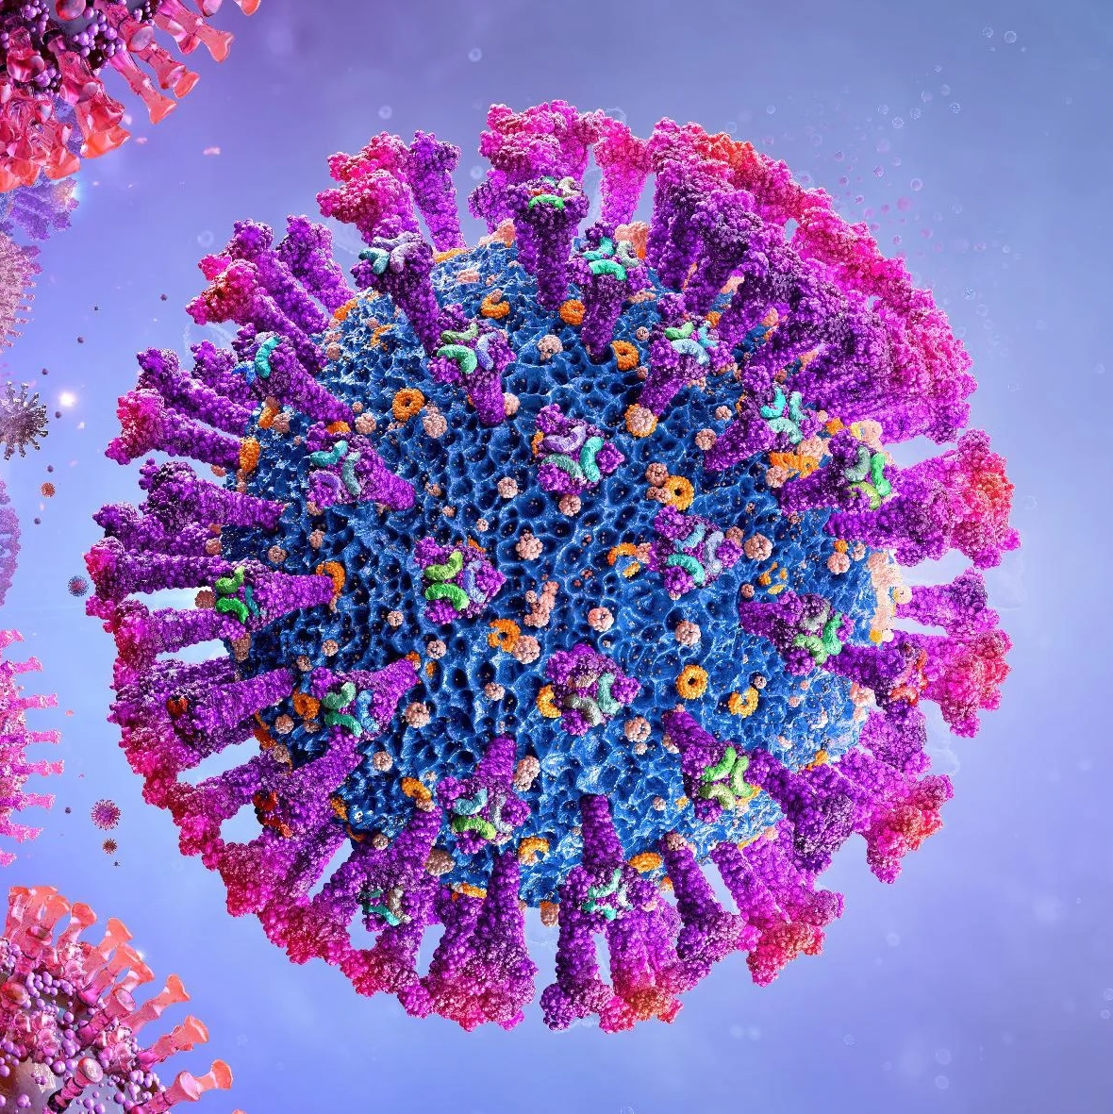
Nanomedicine
Application of nanotechnology for diagnosing, monitoring, treating, and preventing diseases. It encompasses:
Nano-enabled drug delivery systems
Nano-diagnostics and biosensors
Nano-therapeutics, nano-imaging agents, and nanovaccines
Nanotechnology-based regenerative medicine and tissue engineering
Nanomedicine aims to improve precision, reduce toxicity, and enhance therapeutic efficacy beyond the capabilities of conventional medical interventions.

Slide 8
WHERE TECNOLOGY MEETS MEDICINE
Drug delivery
Diagnostics
Imaging

Slide 9
Drug delivery | Diagnostics | Imaging
Targeting capability: Passive targeting (enhanced permeability and retention: EPR in tumors) Active targeting (ligand-modified NPs bind to specific receptors) | Increased sensitivity and specificity Examples: nanosensors detecting minute biomarker concentrations. | Nanoparticles enhance imaging modalities: Magnetic iron oxide nanoparticles improve MRI contrast Gold nanoparticles improve CT and photoacoustic imaging Quantum dots provide high-resolution cellular imaging
Enhanced drug solubility and stability: Protects drugs from degradation Improves pharmacokinetic profile | Rapid point-of-care detection Nano-biosensors for infectious diseases Early cancer detection tools | Clinically, nano-imaging agents support: Tumor delineation Sentinel lymph node mapping Monitoring drug distribution
Controlled and sustained release: Reduces dosing frequency Minimizes systemic toxicity | Molecular imaging enhancements Quantum dots for fluorescent imaging Magnetic nanoparticles for high-resolution MRI
Ability to cross biological barriers: Blood–brain barrier (BBB) Gastrointestinal mucosa Placental barrier (in research models) | Nanodiagnostics enable earlier detection, real-time monitoring, and lower detection limits than conventional tools.

Slide 10
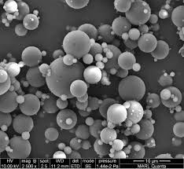
WHAT ARE NANOPARTICLES?

Slide 11
Nanoparticles are ultrafine particles with dimensions typically ranging from 1 to 100 nanometers (nm).
A nanometer is one-billionth of a meter. At this extremely small scale, materials begin to exhibit unique physical, chemical, optical, and biological properties that differ significantly from the same materials in bulk form.

Slide 12
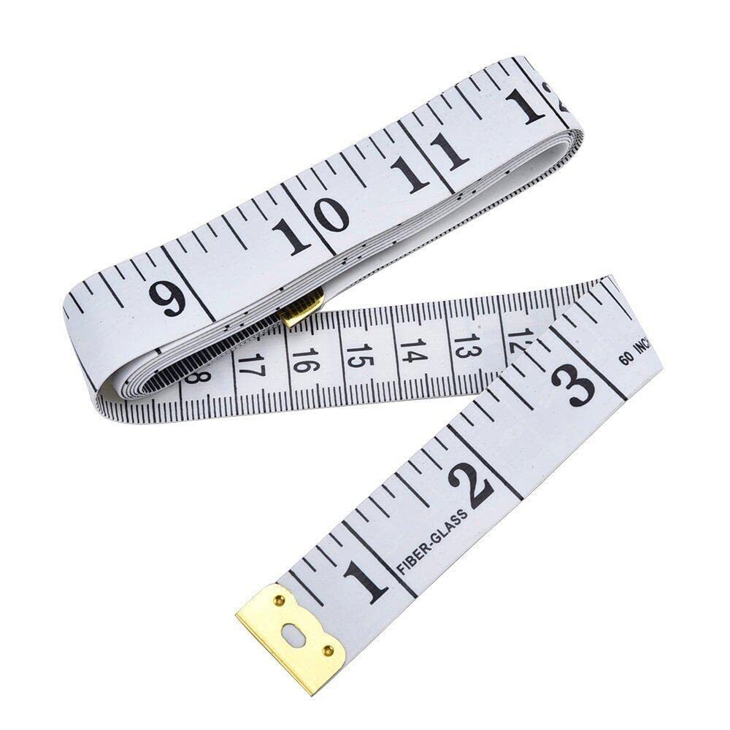
Size in Nanoscales (1-100nm)
This scale is comparable to biological structures such as:
DNA (2 nm)
Proteins (5–50 nm)
Viruses (20–300 nm)
Because nanoparticles operate at the same scale as biomolecules, they can interact with cells, membranes, receptors, and enzymes with high precision.

Slide 13
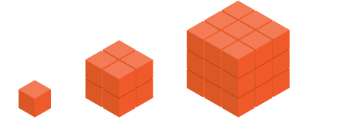
Large Surface Area-to-Volume Ratio
As particle size decreases, the surface area relative to volume increases dramatically.
This leads to:
Increased binding capacity
Improved drug loading
Enhanced interaction with biological tissues
Greater catalytic activity
This is a fundamental reason nanoparticles are powerful in medicine.

Slide 14
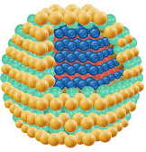
Unique Physiochemical Properties
Nanoparticles often demonstrate:
Enhanced reactivity
Quantum effects (altered optical/electronic behavior)
Magnetic properties (magnetic iron oxide NPs)
Surface plasmon resonance (gold NPs)
Fluorescent properties (quantum dots)
Such features enable applications in imaging, diagnostics, biosensing, and targeted therapy.

Slide 15
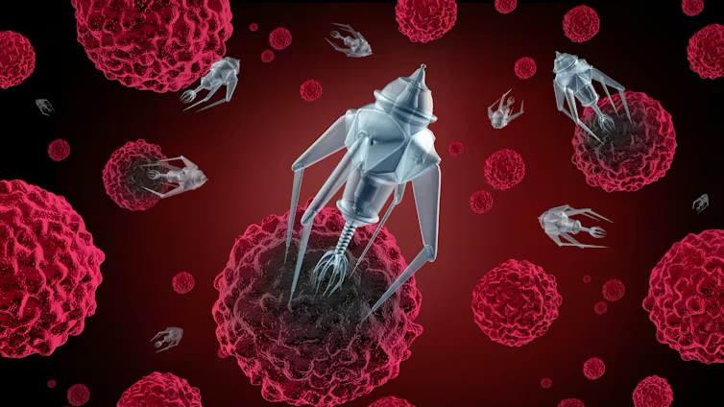
Properties That Make Nanoparticles Powerful

Slide 16

1. Large Surface Area to Volume Ratio
Allows high drug-loading capacity
Promotes rapid interactions with cells and biomolecules
Enhances catalytic and binding efficiency

Slide 17
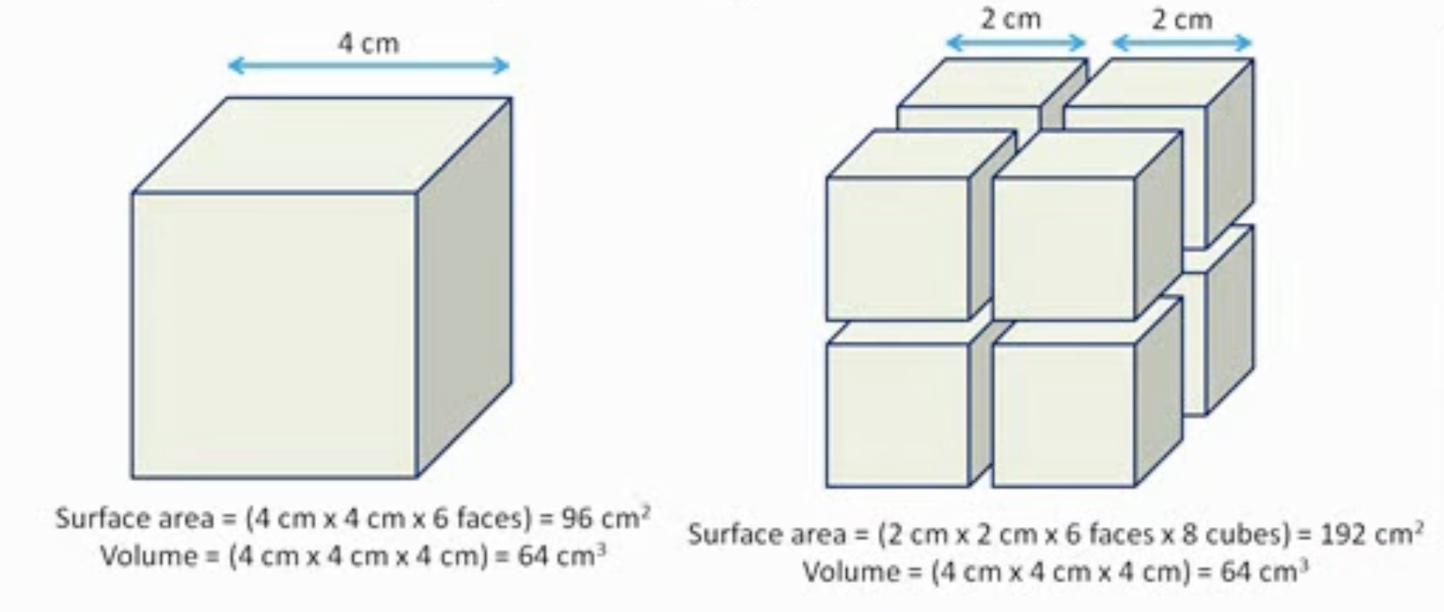

Slide 18
2. Increased Chemical And Biological Reactivity
Enhanced cellular uptake
Improved binding to target molecules
Tunable surface chemistry for attaching ligands, antibodies, peptides

Slide 19
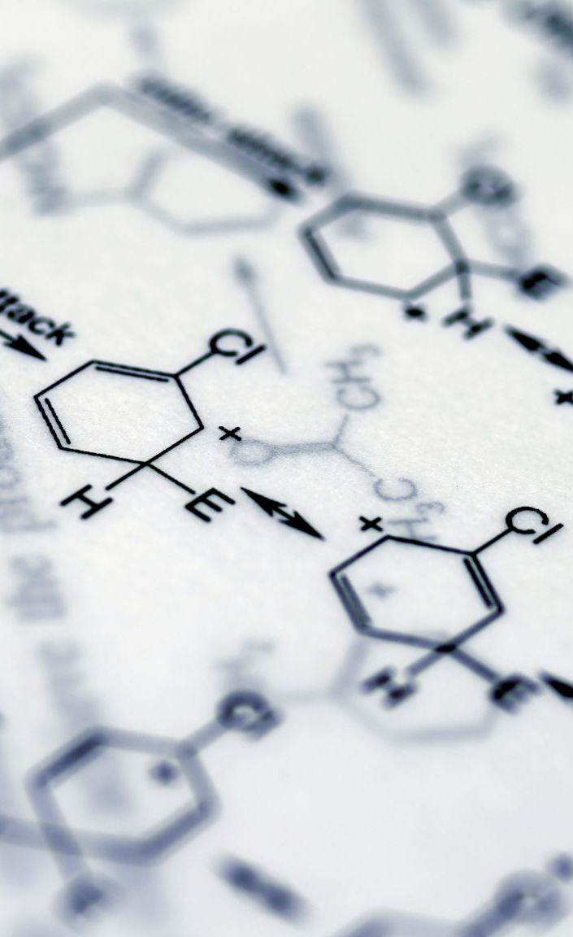
3. Ability to Functionalize Surfaces
Surface modifications allow nanoparticles to:
Target specific tissues or receptors
Evade immune clearance
Respond to stimuli (pH, temperature, enzymes)

Slide 20
4. Size-Dependent Optical, Magnetic, and Electrical Properties
Gold nanoparticles demonstrate a surface plasmon resonance, enabling photothermal therapy
Magnetic nanoparticles enable MRI contrast and hyperthermia treatment
Quantum dots emit tunable fluorescent light

Slide 21
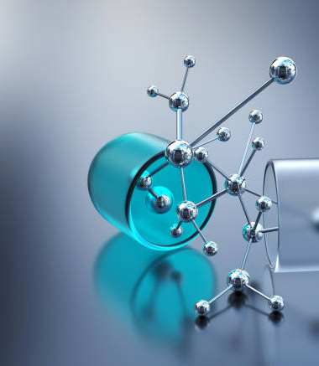
5. Enhanced Permeability and Retention (EPR) Effect
Tumor vasculature allows nanoparticles to preferentially accumulate in tumors, improving cancer treatment efficacy.

Slide 22
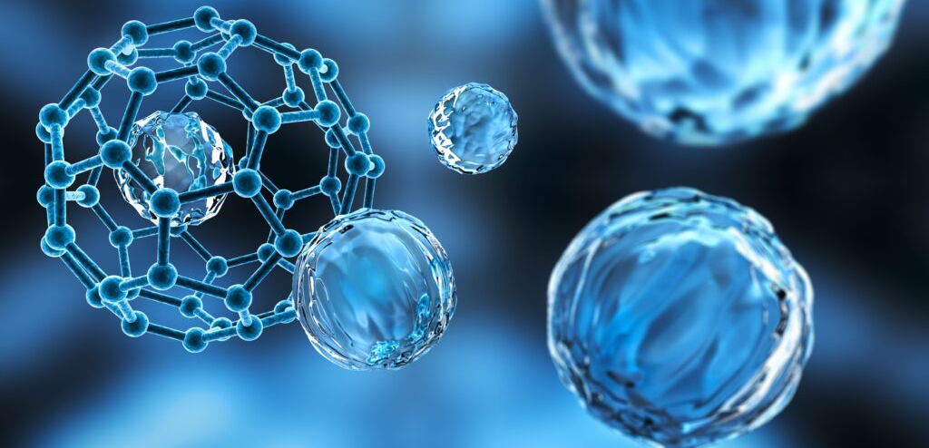
Types of Nanoparticles
Nanoparticles fall into three broad categories, each with specific biomedical applications.

Slide 23
Inorganic
Carbon based
Organic

Slide 24
Metallic Metal oxide Magnetic
Fullerenes Carbon nanotubes graphene & graphene oxide
Liposomes Dendrimers Polymeric

Slide 25
Activity-1
A 55-year-old male with recurrent glioblastoma multiforme (GBM) after chemoradiation. Imaging shows a progressive lesion with surrounding edema. Conventional therapy options are limited due to blood–brain barrier (BBB) penetration issues and high systemic toxicity.
Task:
Each participant will share:
Their chosen nanoparticle
Mechanism of targeting
One major risk

Slide 26
Organic Nanoparticles
Liposomes | Dendrimers | Polymeric
Spherical vesicles with phospholipid bilayers Encapsulate hydrophilic (in core) and hydrophobic (in bilayer) drugs | Branched, tree-like polymeric structures | Examples: PLGA, PEGylated nanoparticles
Clinically used examples: Liposomal doxorubicin (Doxil) Liposomal amphotericin B | Precise molecular architecture Multivalency allows attachment of drugs, targeting ligands, or imaging probes | Biodegradable and FDA-approved materials Enable controlled release and enhanced drug stability
Benefits: biocompatible, low toxicity, modifiable surfaces | Applications: targeted drug delivery, gene therapy | Applications: cancer therapies, vaccines, CNS drug delivery

Slide 27
Inorganic Nanoparticles
Metallic | Metal Oxide | Magnetic
Includes gold, silver, platinum nanoparticles | Includes zinc oxide (ZnO), titanium dioxide (TiO₂), cerium oxide | Examples: iron oxide (Fe₃O₄) nanoparticles Used in MRI as contrast agents
Gold NPs: photothermal therapy, imaging Silver NPs: antimicrobial activity | Applications: biosensing, imaging, antimicrobial coatings TiO₂ used in photodynamic therapy | Allow targeted drug delivery using external magnetic fields Used experimentally in magnetic hyperthermia for cancer
Advantages: unique optical/electronic properties

Slide 28
Carbon based Nanoparticles
Fullerenes | Carbon Nanotubes (CNTs) | Graphene & Graphene Oxide
Soccer-ball–shaped carbon molecules (C60) Antioxidant properties | Single-walled or multi-walled tubes High tensile strength Excellent electrical conductivity | Single-layer carbon sheets High surface area, conductivity
Research uses: drug delivery, antiviral agents | Biomedical uses: biosensors, neural stimulation, drug delivery Require special attention due to potential toxicity | Applications: tissue scaffolds, biosensors, drug carriers Ability to load multiple therapeutic molecules simultaneously

Slide 29
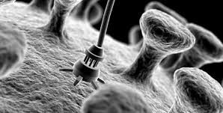
TOXICITY CONCERNS & ETHICAL ISSUES

Slide 30
Toxicity Issues
Unique safety challenges because nanoparticles interact with biological systems at a molecular level.
Size, surface charge, shape, and composition determine how they behave inside the human body.

Slide 31
1. Organ Accumulation
Mechanism
Nanoparticles may not be fully eliminated by renal or hepatic pathways. Particles smaller than 6 nm can undergo renal clearance, but most clinically used nanoparticles (10–200 nm) tend to accumulate in:
Liver (Kupffer cells)
Spleen (reticuloendothelial system / RES)
Lymph nodes
Bone marrow
Lungs (if inhaled)
Brain (if BBB is bypassed or disrupted)
Consequences
Hepatotoxicity: chronic inflammation, oxidative stress, fibrosis
Splenic accumulation: impaired immune filtering, granuloma formation
Pulmonary toxicity: inflammation, granulomas (CNTs are known examples)
Bio-persistence: metallic and metal oxide nanoparticles may remain for months to years

Slide 32
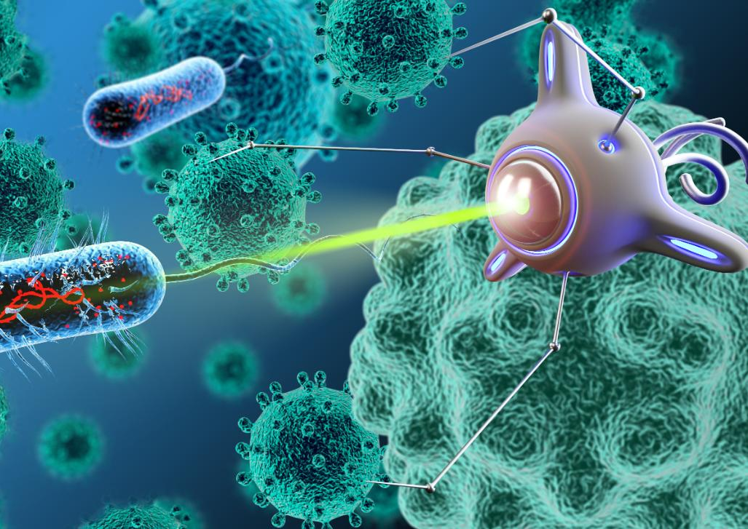
Accumulation depends on particle size, charge, hydrophobicity, coating (e.g., PEGylation), and the body’s clearance capacity. This necessitates long-term biodistribution studies before clinical approval.

Slide 33

2. Long-Term Unknowns
The Core Issue
Nanomedicine is progressing faster than long-term toxicology research. Many nanoformulations have short term safety data but no decades-long evidence.
Uncertainties Include:
Chronic accumulation of metallic NPs
Potential to cross the placenta or the BBB unintentionally
Effects on genomic stability, DNA repair, and mutagenicity
Interference with cell signaling pathways
Potential for delayed carcinogenicity
Environmental persistence leading to secondary exposure

Slide 34
Clinical Concern:
Nanomaterials operate at the same length scale as DNA, proteins, and cellular membranes. This raises the possibility of unpredictable bio–nano interactions over long durations.

Slide 35
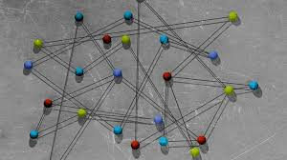
3. Immune Interactions
Mechanisms of Interaction
Nanoparticles interact with the immune system through:
Complement activation
Macrophage uptake
Dendritic cell stimulation
Cytokine release
Protein corona formation, which may alter immunogenicity

Slide 36
Immune-Related Risks
Complement Activation-Related Pseudo-Allergy (CARPA): Notably reported with liposomal formulations (e.g., Doxil).
Hypersensitivity reactions
Chronic inflammation
Immune suppression or immune overstimulation
Alteration of innate vs adaptive immune balance
Accelerated blood clearance phenomenon (seen after repeated injections of PEGylated nanoparticles)

Slide 37
Immune interactions are influenced by nanoparticle shape, surface chemistry, dose, and corona formation. Clinicians and researchers must anticipate both protective and harmful immune responses.

Slide 38
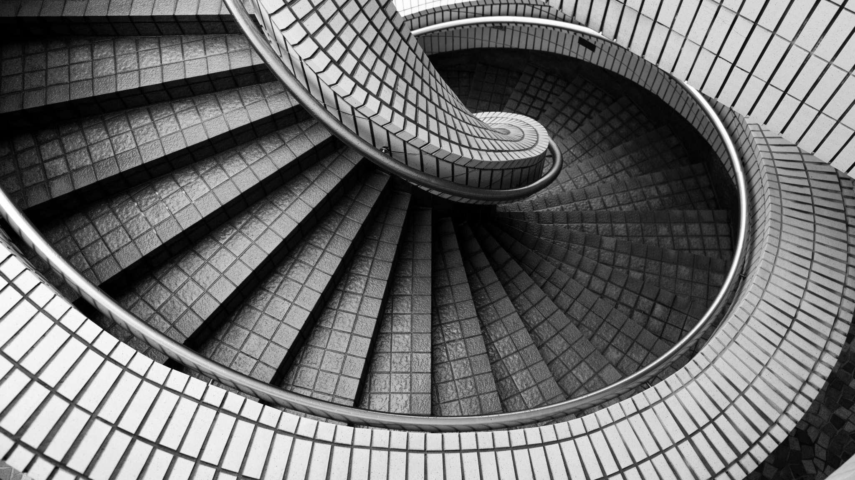
Ethical Issues

Slide 39
Access & Equity
High cost
Rural–urban healthcare gaps
Limited availability of specialized equipment
Unless proactively planned, nanomedicine may worsen disparities, creating a “technology elite” in healthcare.

Slide 40
Regulatory Ambiguity
Regulatory frameworks evolve slowly.
Lack of clear classification: drug? device? biologic? all three?
Difficulty standardizing toxicity assays or safety parameters.
No universally accepted guidelines for:
Long-term monitoring
Environmental disposal
Manufacturing purity standards
Approval processes (FDA, EMA) are not tailored for nano–bio interactions, leading to delays and inconsistencies.
Potential for off-label uses without safety evidence.

Slide 41
Responsible Innovation
Safety-by-design: integrating toxicology early in nanoparticle development.
Transparency: sharing complete information on materials, coatings, and long-term effects.
Environmental responsibility: preventing nanoparticle contamination of water, soil, and air.
Avoiding hype: ensuring realistic claims to avoid misleading clinicians or patients.
Ensuring technology does not enable surveillance misuse or unethical human enhancement.

Slide 42
Nanomedicine should advance human health without compromising ethics, environment, or societal values.

Slide 43
Activity 2- Designing a PhD Question
Present a simple framework:
Identify a clinical problem
Map nano-enabled solution
Identify population
Choose outcome
Evaluate feasibility/ethics

Slide 44
Combining AI & Nanotechnology
AI Function | Nano-Diagnostics | Nano-Therapeutics | Nano-Research
Pattern recognition | Detects nano-enhanced signals | Identifies therapeutic patterns | Analyses high-throughput data
Computer vision | Interprets nano-imaging | Monitors treatment delivery | Examines nano-material images
Predictive modelling | Predicts disease from nano-markers | Predicts biodistribution & toxicity | Predicts nano-material performance
Optimization | — | Optimizes nano-drug design | Optimizes nano-material synthesis
Simulation | — | Simulates drug release | Models nano–cell interactions
NLP | — | — | Extracts evidence from literature

Slide 45
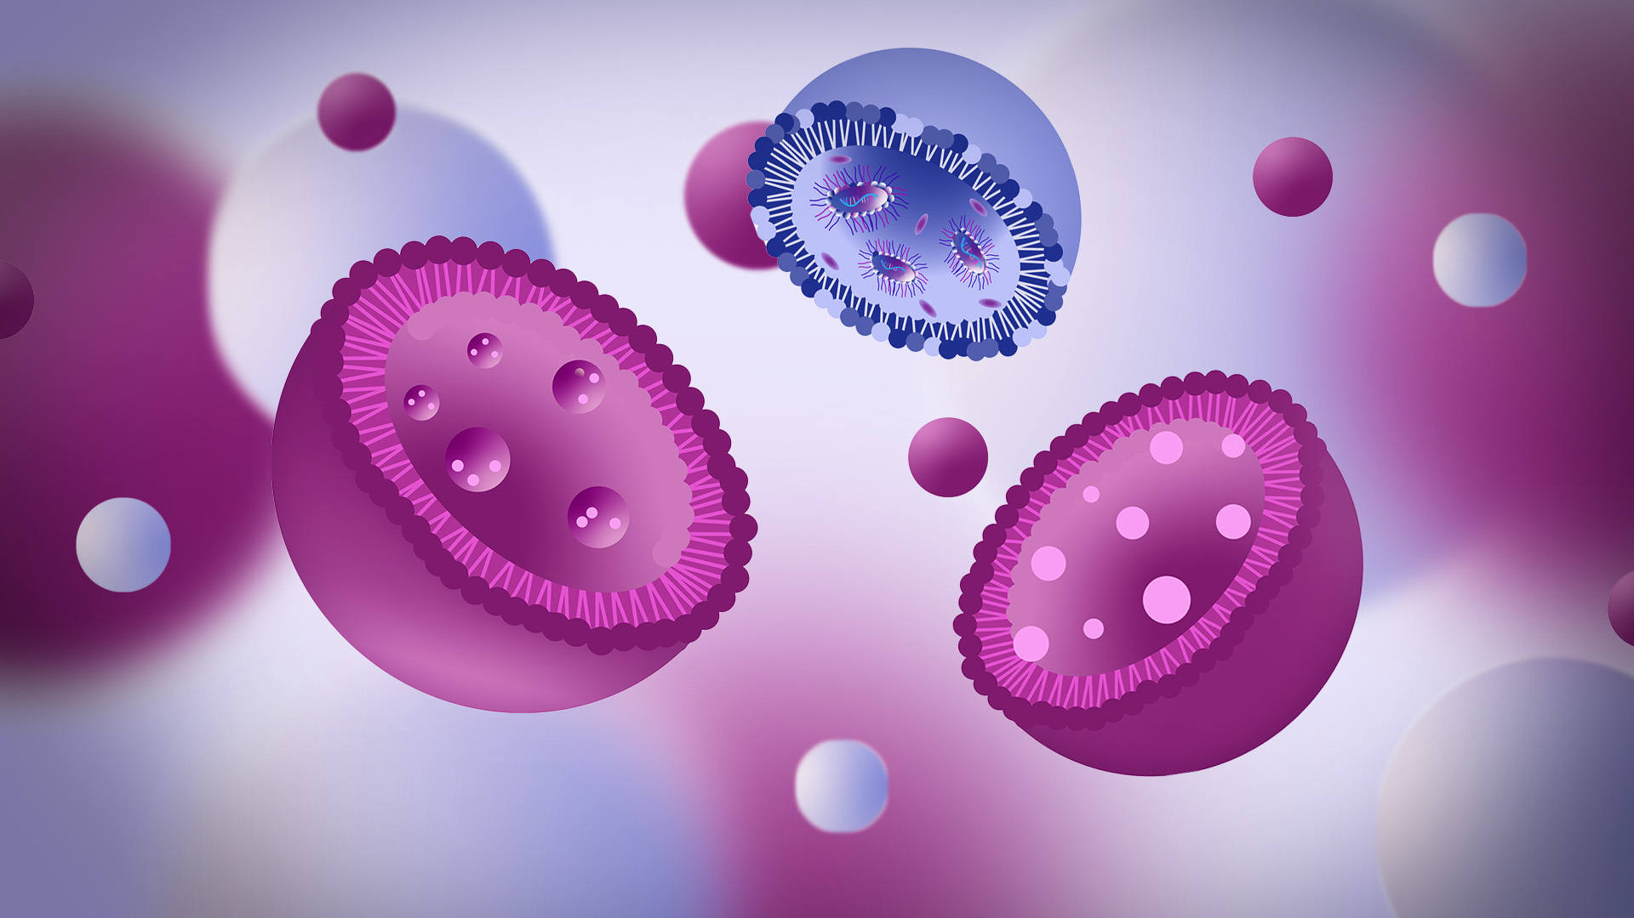
Thank you
Thank you

