Slide 1
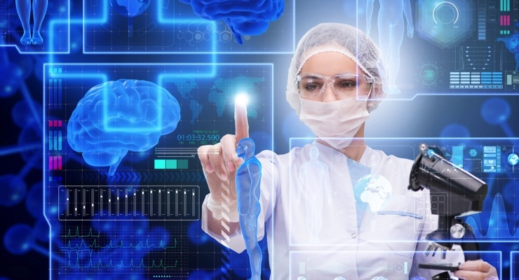
Artificial Intelligence & Machine Learning in Healthcare

Slide 2
Artificial Intelligence & Machine Learning in Healthcare
Define key concepts: Differentiate between traditional programming, AI, ML, deep learning, and natural language processing (NLP).
Understand data's role: Describe the impact of "big data" in healthcare and the processes involved in data mining, management, and analysis for AI/ML application

Slide 3
Learning Objectives
Clinical Application and Integration
Learners should gain the ability to:
Identify relevant problems: pinpoint healthcare challenges that AI and ML are well-suited to solve, such as optimizing resource allocation or predicting disease outbreaks.

Slide 4
Learning Objectives
Assess ethical implications: Recognize the ethical challenges and potential biases inherent in AI/ML systems that could exacerbate health disparities or impact patient privacy.
Ensure responsible use: List strategies for mitigating bias, ensuring transparency, and maintaining accountability in the use of AI tools in clinical settings.

Slide 5
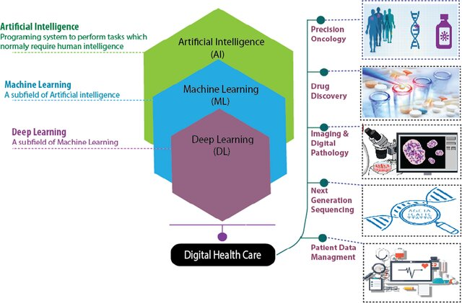

Slide 6
What is AI?
Field of computer science that enables machines to perform tasks requiring human intelligence
Key capabilities:
Learning from data
Reasoning
Decision-making
Pattern recognition

Slide 7
What is Machine Learning?
A subset of AI focused on algorithms that learn from data
System performance improves over time without explicit programming
Examples: classification, regression, clustering, neural networks

Slide 8
Why Healthcare Needs AI
Increasing workload on hospitals
Shortage of doctors and specialists
Complexity of diagnostic data
Rising healthcare costs
Personalized medicine demand

Slide 9
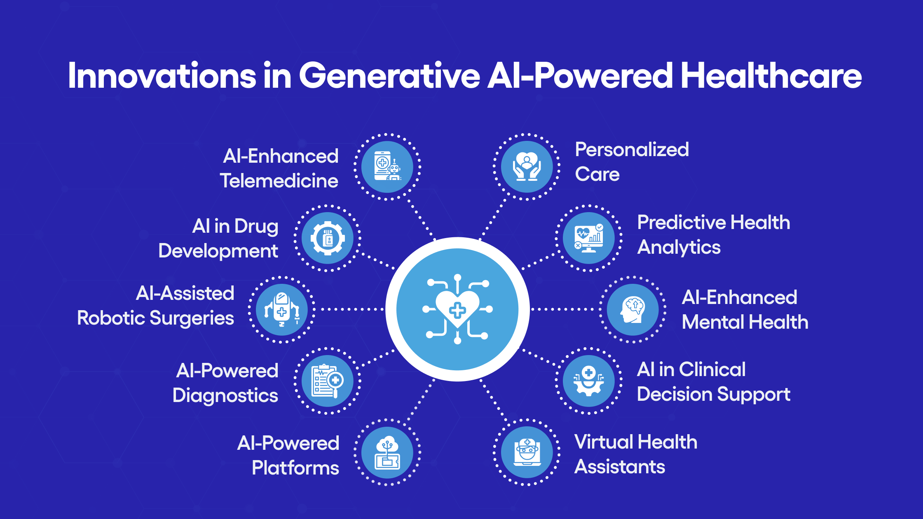

Slide 10
Major AI Applications in Healthcare
Disease diagnosis
Radiology and medical imaging
Drug development
Predictive analytics
Clinical decision support
Patient monitoring
Administrative automation

Slide 11
AI for Diagnosis
Pattern recognition on large medical datasets
Early detection of diseases:
Cancer
Diabetes
Heart disease
AI models often match or exceed human accuracy

Slide 12
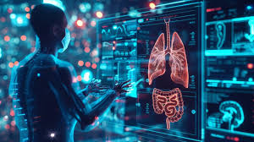
AI in Medical Imaging
MRI, CT, X-ray interpretation
Detecting abnormalities:
Tumors
Lesions
Fractures
Advantages:
Faster processing
High precision
Consistency

Slide 13
Machine Learning in Drug Discovery
Predict molecule effectiveness
Faster clinical trials
Simulating biological interactions

Slide 14
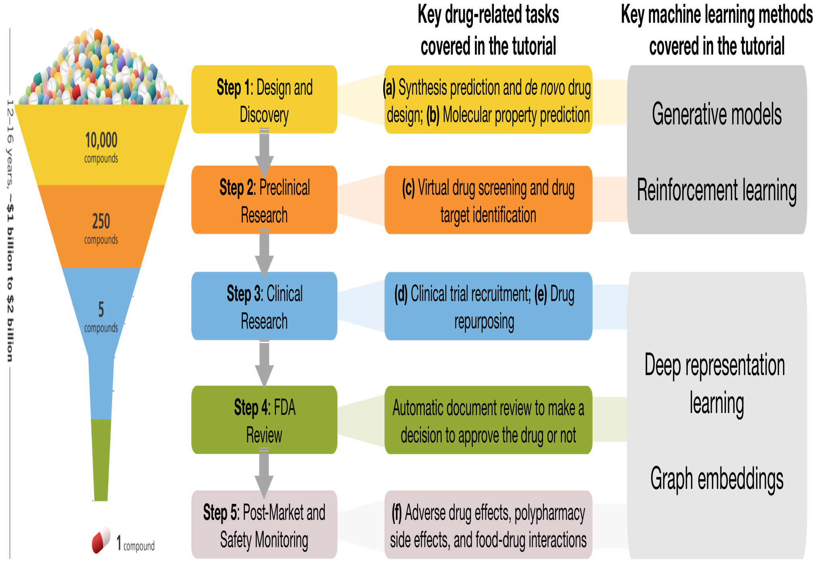

Slide 15
Predictive Analytics in Healthcare
Predict patient outcomes
Forecast disease spread
Predict hospital readmission
AI in population health

Slide 16
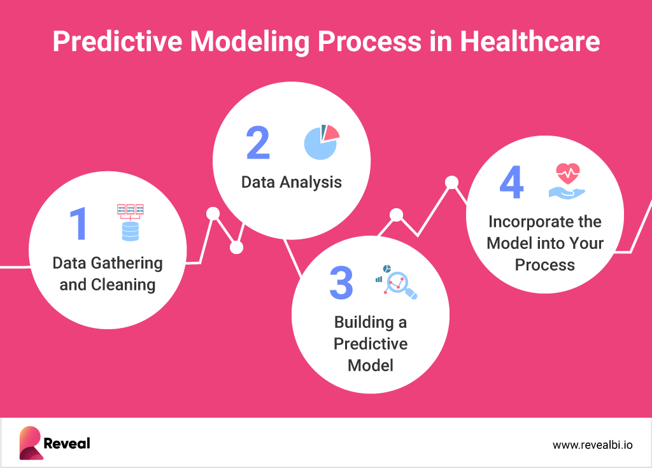

Slide 17
AI in Personalized Medicine
Tailored treatment plans
Genomics + ML = precision treatment
Oncology and chronic disease care

Slide 18
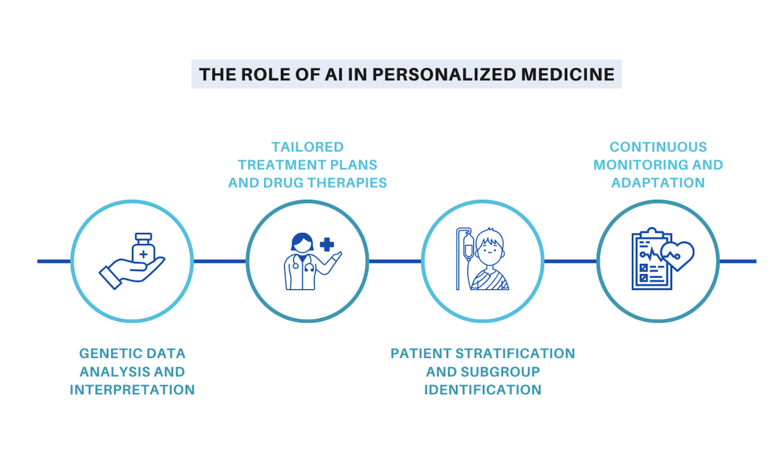

Slide 19
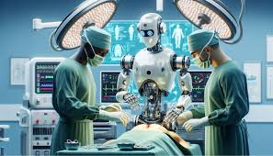
AI in Hospital Operations
Scheduling
Reducing waiting time
Supply chain & logistics
EHR automation

Slide 20
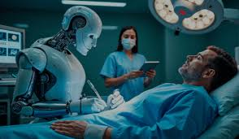
Deep Learning in Healthcare
Neural networks and CNNs for imaging
RNNs for time-series data
Transformers for clinical text

Slide 21
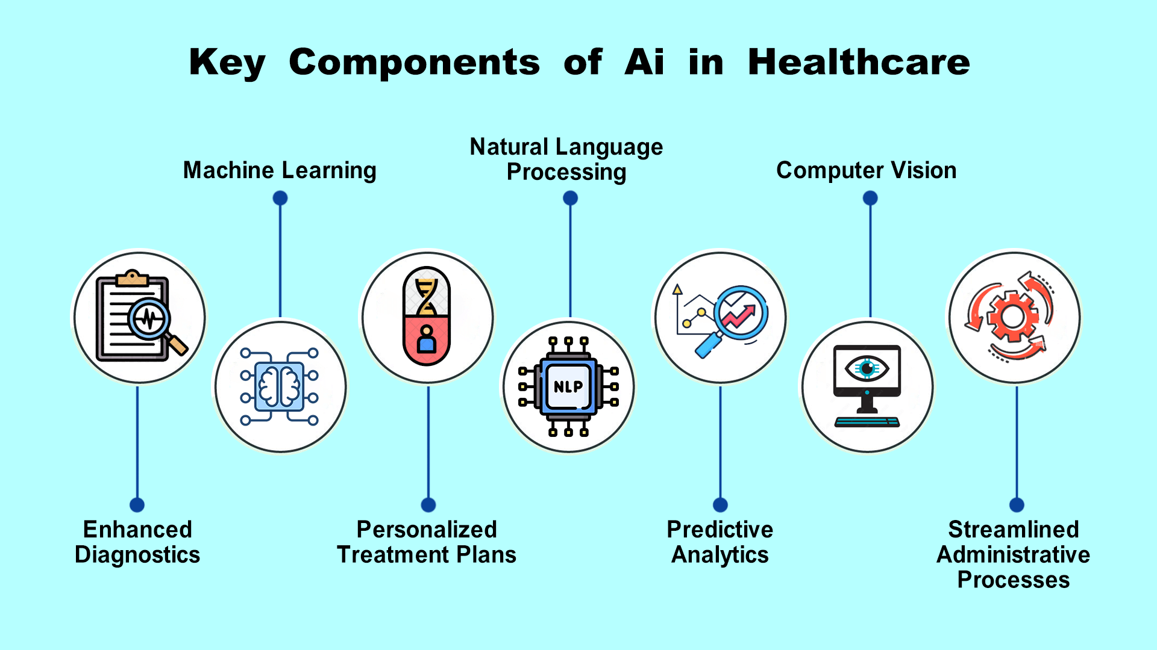

Slide 22
Example AI Tools in Healthcare
Chatbots for medical advice
Robotic surgery
Remote monitoring
Virtual nursing assistants

Slide 23
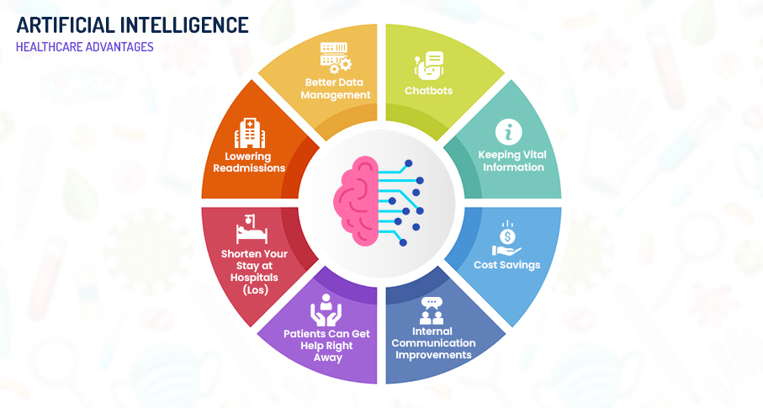

Slide 24
Benefits
Faster analysis
Reduced errors
Improved decision-making
Cost savings
Increased accessibility

Slide 25
Challenges
Data privacy + security
Bias in datasets
Interpretability problems (“black box”)
Integration with hospitals
Regulation + ethics

Slide 26
Ethical + Legal Issues
Who is responsible for wrong predictions?
Patients’ data ownership
Approved by authorities?
Trust and transparency

Slide 27
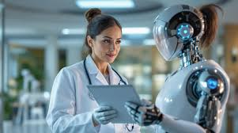
The Future of AI in Healthcare
AI-assisted doctors
Continuous personalized monitoring
Smart hospitals
Global telehealth expansion

Slide 28
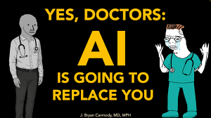
Discussion Questions
Will AI replace doctors or assist them?
How do we solve data privacy issues?
Which healthcare fields will benefit most?

Slide 29
Summary
AI and ML are transforming healthcare by:
Enhancing accuracy
Improving efficiency
Reducing costs
Saving lives

Slide 30
Thank You
Questions?

