Slide 1
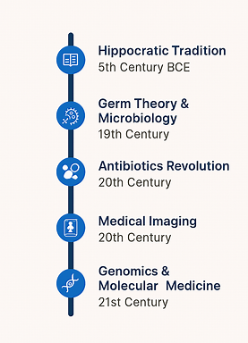
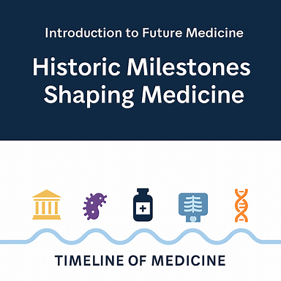
From Observation to Personalization
Dr. Tayyab Saeed Akhter, PhD Scholar, RMU

Slide 2
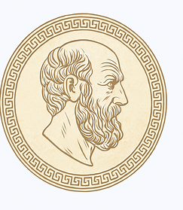
Rational Medicine & Ethics (5th Century BCE)
  Shift from supernatural → rational observation
  Hippocratic Oath → ethics in practice
  Clinical reasoning foundations
“Why was separating medicine from superstition revolutionary?”

Slide 3
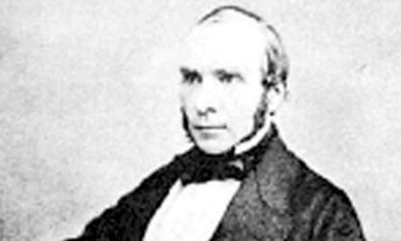
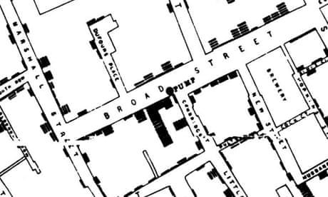
The Invisible World Revealed (19th Century)
  Pasteur & Koch → microorganisms as disease agents
  Public health revolution: sanitation, hygiene
  Epidemiology foundations
  Case Example: John Snow’s cholera map (1854).
“How did germ theory shift medicine from reactive to preventive?”
Notes:
How often does a map change the world? In 1854, one produced by Doctor John Snow, altered it forever.
In the world of the 1850s, cholera was believed to be spread by miasma in the air, germs were not yet understood and the sudden and serious outbreak of cholera in London's Soho was a mystery.
So Snow did something data journalists often do now: he mapped the cases. The map essentially represented each death as a bar, and you can see them in the smaller image above.
It became apparent that the cases were clustered around the pump in Broad (now Broadwick) street.
There were some outliers though and Snow wrote that:
In some of the instance , where the deaths are scattered a little further from the rest on the map, the malady was probably contracted at a nearer point to the pump
One 59-year-old woman sent daily for water from the Broad street pump because she liked its taste. Wrote Snow:
I was informed by this lady's son that she had not been in the neighbourhood of Broad Street for many months. A cart went from broad Street to West End every day and it was the custom to take out a large bottle of the water from the pump in Broad Street, as she preferred it. The water was taken on Thursday 31st August., and she drank of it in the evening, and also on Friday. She was seized with cholera on the evening of the latter day, and died on Saturday

Slide 4
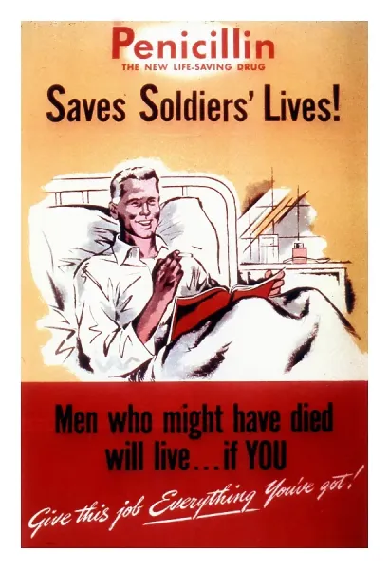
From Fatal to Treatable (20th Century)
  Fleming’s penicillin discovery (1928)
  WWII mass production → millions saved
  Pneumonia, syphilis transformed
“What parallels exist between antibiotics and today’s search for new therapies?”

Slide 5
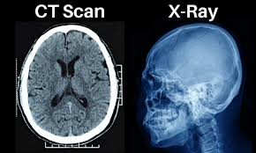
Seeing Inside the Body (20th Century)
  Röntgen’s X‑rays (1895) → CT, MRI, ultrasound
  Non‑invasive precision diagnosis
  Stroke & trauma care revolutionized
“How did imaging change the physician’s diagnostic identity?”

Slide 6
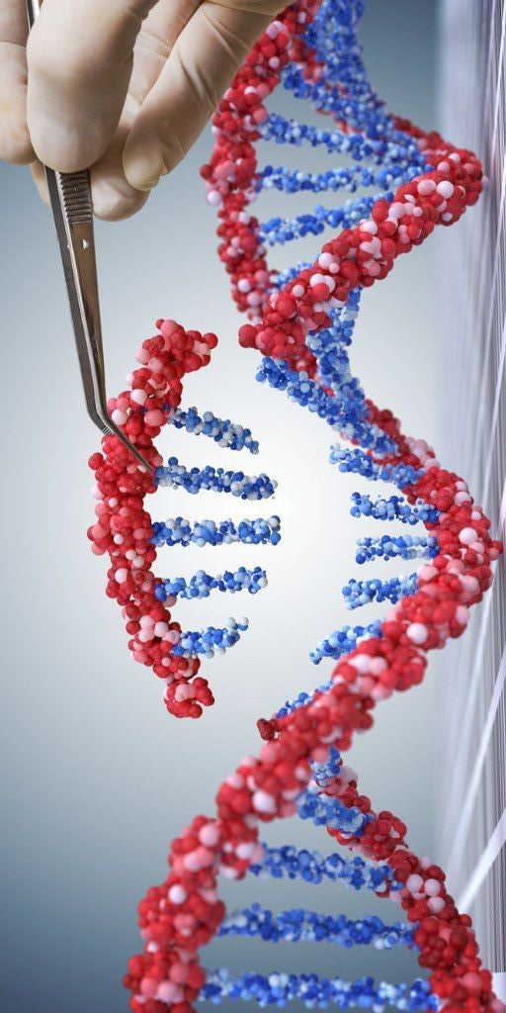
Personalization Era (21st Century)
  Human Genome Project (2003)
  Predictive & preventive strategies
  BRCA gene testing → cancer prevention
“What ethical challenges arise with personalized medicine?”

Slide 7
Continuum of Progress
Observation
Rotted in Hippocratic tradition and clinical reasoning
Causation
Germ theory and microbiology revealing disease mechanism
Cure
Antibiotics revolution transforming treatment paradigm
Visualization
Medical imaging enabling non-invasive diagnosis
Personalization
Genomics and molecular medicine tailoring care to individual profiles
  Observation → causation → cure → visualization → personalization
  Each milestone reshaped physician identity & patient expectations
“Which milestone most radically changed the patient‑doctor relationship?”

Slide 8

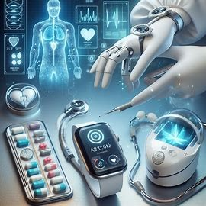
From Past to Future
  Past milestones → foundation for current paradigms
  Next: patient‑centered care, preventive strategies, digital health
“What lessons from history should guide our approach to future medicine?”

Slide 9
Activity
10 minutes

Slide 10
Time Line Analysis
Please formulate 2 groups
Each group selects one milestone and discusses:
  What problem did it solve
  How does it still influence practice today?

Slide 11
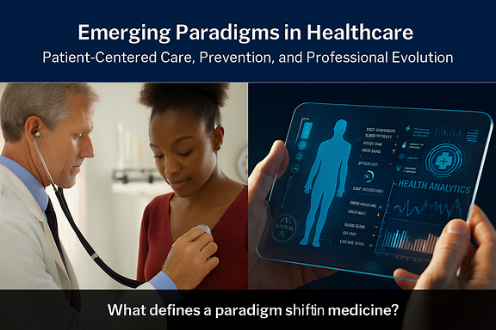
Emerging Paradigms in Healthcare
Patient-Centered Care, Prevention, and Professional Evolution
“What defines a paradigm shift in medicine?”

Slide 12

From Authority to Partnership
  Emphasis on patient values, preferences, and autonomy
  Shared decision-making and co-created care plans
  Rise of digital health records and telemedicine
“How does patient-centered care challenge traditional clinical hierarchies?”

Slide 13
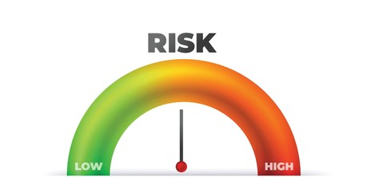
Proactive Over Reactive
  Lifestyle interventions and behavioral coaching
  Predictive analytics and population health tools
  Integration of screening and early detection
“What barriers exist to implementing preventive strategies in low-resource settings?”

Slide 14
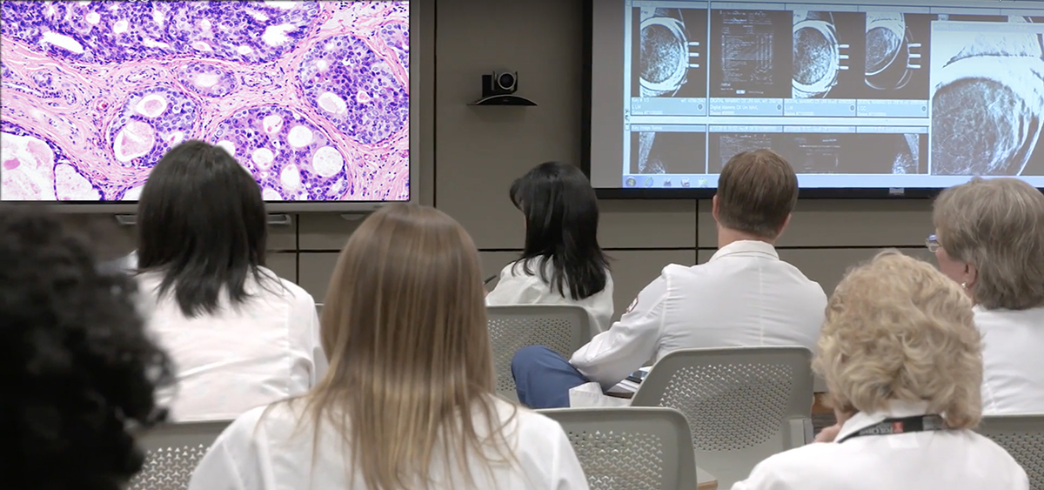
From Diagnostician to Navigator
  Physicians as facilitators, educators, and team leaders
  Interdisciplinary collaboration and digital fluency
  Ethical stewardship of technology
“Is digital empowerment always beneficial for patients?”

Slide 15
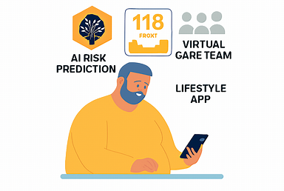
Case Scenario: Metabolic Syndrome in a Digital Era
A 45-year-old patient with metabolic syndrome is managed through AI-driven risk prediction, lifestyle coaching via a mobile app, and regular virtual check-ins with a care team.
“How does this model differ from traditional care delivery?”

Slide 16

Group Discussion
  What competencies must physicians develop for this model?
  What ethical concerns arise with AI and remote monitoring?
  How do we ensure equity in digital care?
“What would you change in this model to make it more inclusive?”

Slide 17

Reflection: Your Role in Future Medicine
“In one sentence, describe how your role as a physician will evolve in the next decade.”

Slide 18

From Paradigm to Practice
  Patient-centered care and prevention are not trends—they’re structural shifts
  Physicians must adapt roles, skills, and mindsets
  Future medicine demands ethical, inclusive, and tech-savvy leadership
“What one skill must every future physician master?”

Slide 19
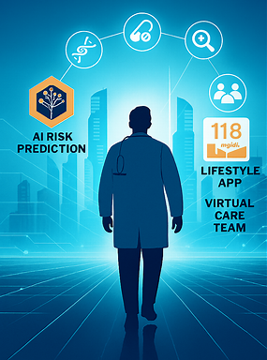
The Future Trajectory of Medicine
Innovation, Challenges, and Opportunities
“What kind of physician will the future demand?”

Slide 20
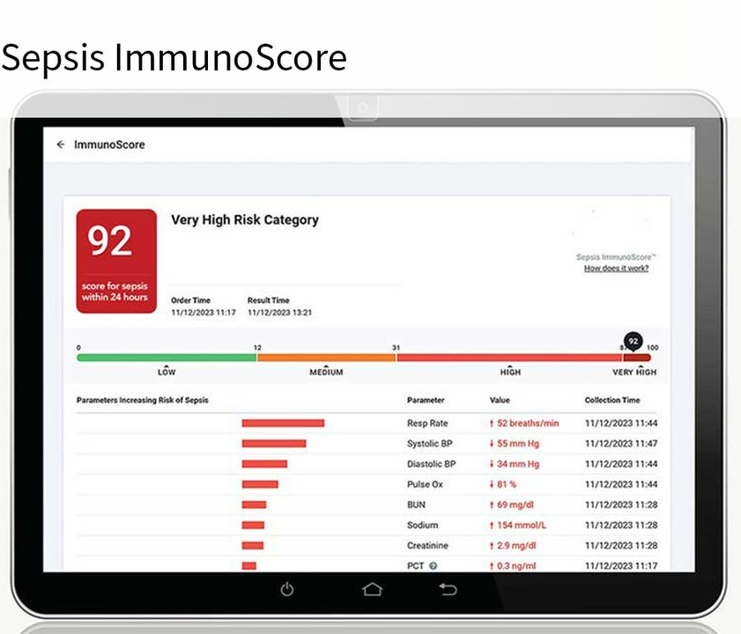
AI as Clinical Partner
  Early detection & risk stratification
  Decision support systems
  Example: AI predicting sepsis before clinical signs
“How should physicians ethically apply machine-generated insights?”

Slide 21
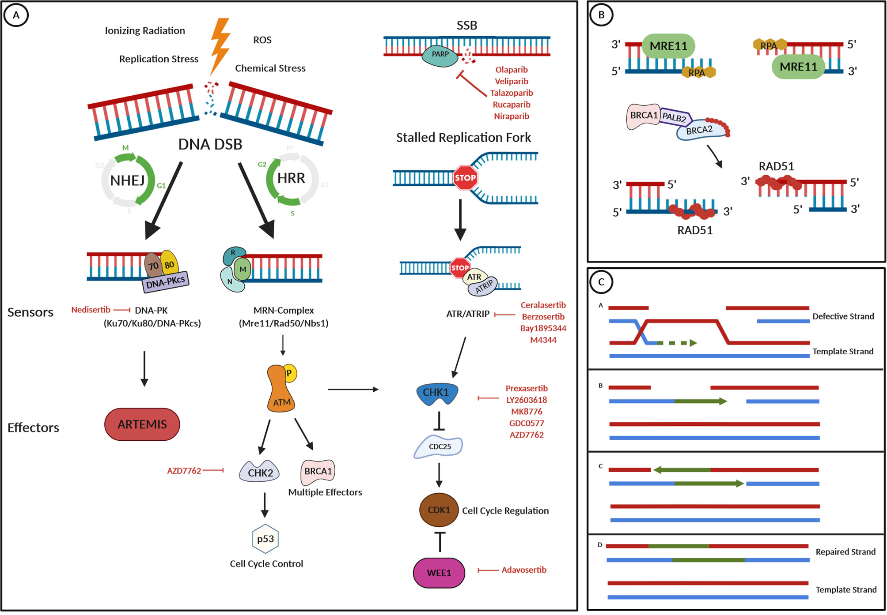
From Population to Individual Blueprint
  Genomic profiling for prevention & treatment
  Pharmacogenomics guiding drug selection
  Example: BRCA testing for cancer prevention
“What risks accompany tailoring medicine to individual genomes?”

Slide 22
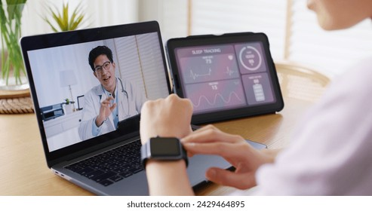
Continuous, Decentralized Care
Virtual & Remote Care Models
  Telemedicine & wearables
  Remote monitoring for chronic disease
  Example: Virtual ICUs, lifestyle apps
“Does remote care risk depersonalizing medicine?”

Slide 23
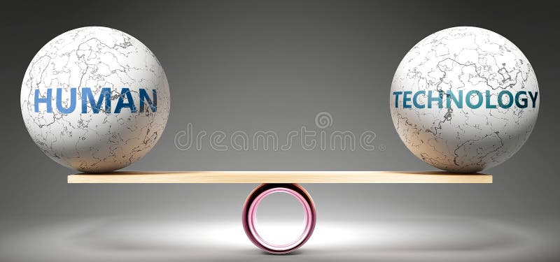
Who Benefits, Who is Left Behind?
Ethical & Equity Concerns
  Data ownership & privacy
  Algorithmic bias
  Digital exclusion in low-resource settings
“How do we ensure inclusivity in digital health?”

Slide 24

Physician as System Integrator
  Digital literacy & adaptive leadership
  Interdisciplinary collaboration
  Re-skilling challenges
“What new competencies must physicians master?”

Slide 25
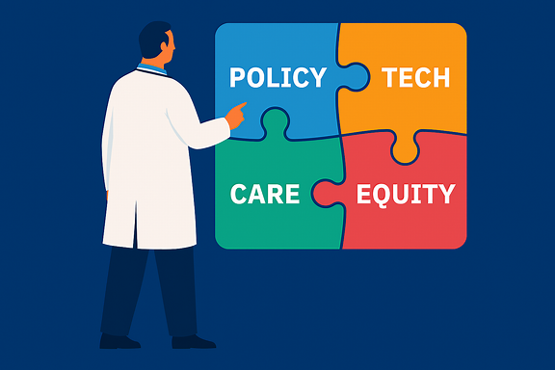
Innovation Meets Reality
Systemic Integration & Policy Gaps
  Regulatory lag & reimbursement barriers
  Siloed(isolated) data systems
  Need for agile, interoperable ecosystems
“What policy reforms are most urgent for future medicine?”

Slide 26
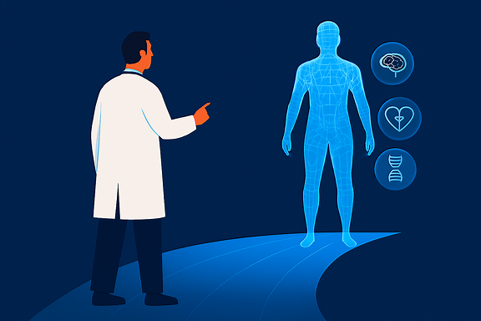
Values Drive the Future
  Technology must align with ethics & adaptability
  Physicians as navigators of health ecosystems
  Future medicine = predictive, personalized, participatory
“What one principle should guide healthcare redesign in the next decade?”

