Slide 1

Dr. Tayyab Saeed Akhter
PhD Scholar
Clinical Sciences (Medicine)

Slide 2
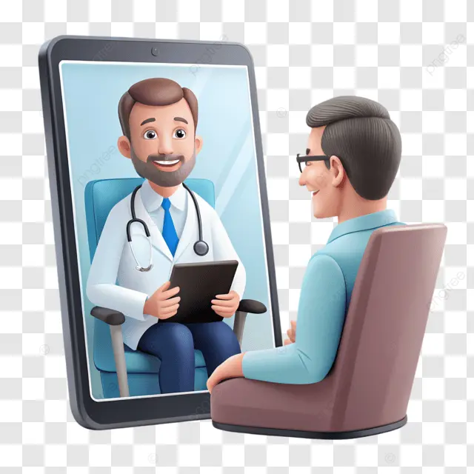
Defining Telemedicine
Delivery of healthcare services using ICT.
Includes diagnosis, treatment, prevention, and education remotely.
Enables doctor ↔ patient interaction via video call.
“How would you define telemedicine in your own specialty?”
ICT: Information & Communication Technology

Slide 3
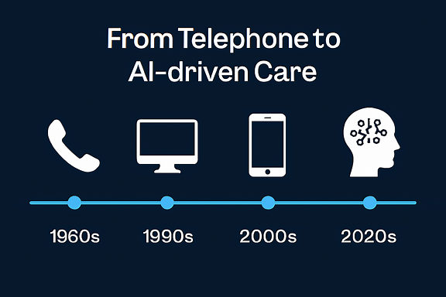
Evolution Timeline From telephone to AI-driven care
1960s: NASA remote astronaut monitoring.
1990s: Phone/fax consultations.
2000s: Internet-enabled video consultations.
2020s: COVID-19 acceleration, AI integration.

Slide 4

Benefits of Telemedicine Why Telemedicine Matters
Accessibility for rural/underserved populations.
Cost-effectiveness and reduced travel burden.
Continuity of care for chronic diseases.
“Which benefit resonates most with your practice?”

Slide 5

Challenges of Telemedicine Barriers & Limitations
Digital divide: internet access and literacy.
Data privacy and cybersecurity risks.
Medico-legal liability and licensing issues.
“What challenge do you see as most critical in Pakistan’s context?”

Slide 6
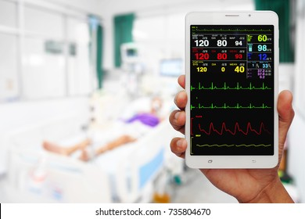
Applications in Clinical Practice
Remote consultations (e.g., chronic disease follow-up).
Tele-ICU monitoring.
Virtual surgical procedures (robot-assisted telesurgery).

Slide 7

Discussion Prompt
Reflective Question:
"How did the COVID-19 pandemic reshape perceptions of telemedicine in your clinical practice?"

Slide 8
Looking Ahead
We’ve explored the foundations.
Next, we’ll dive into the future of telemedicine and digital health.

Slide 9
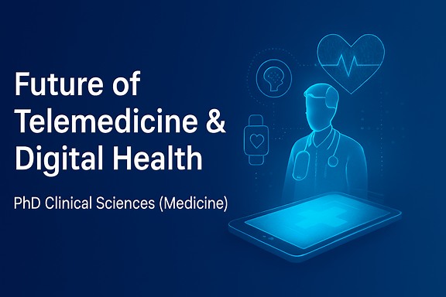

Slide 10
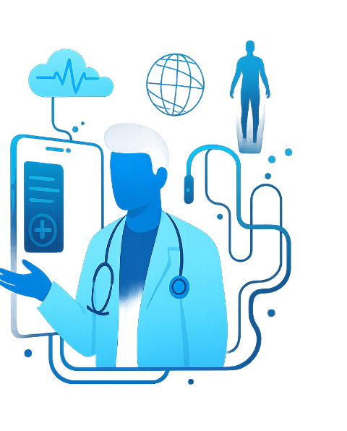
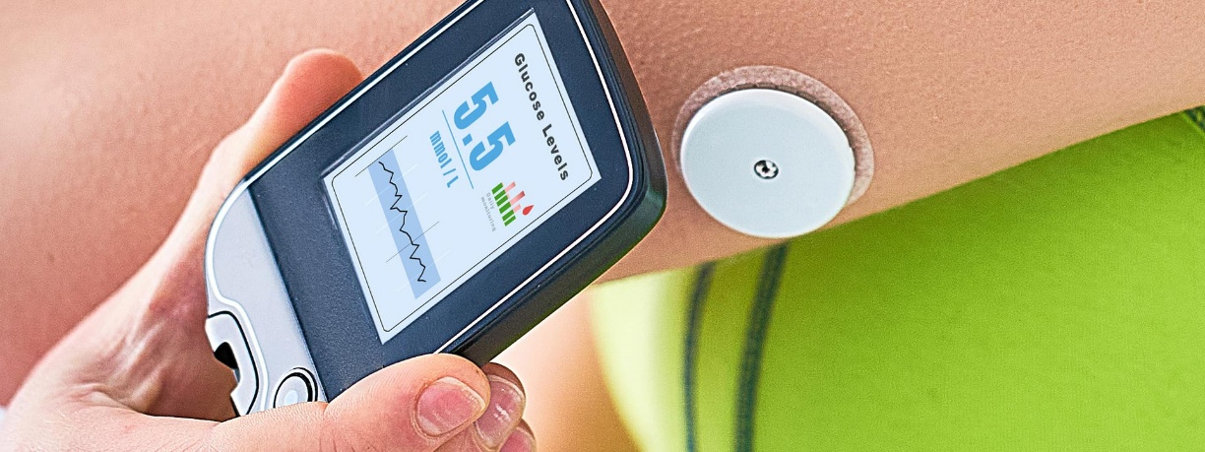
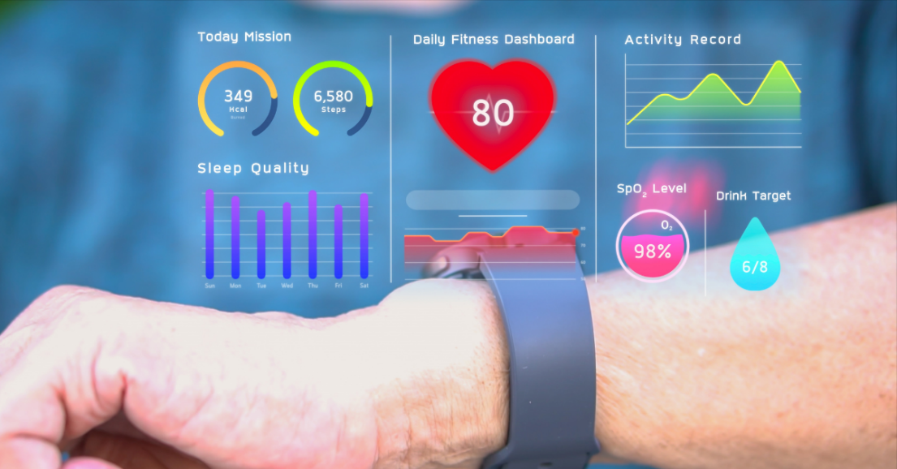
Digital Health Innovations Emerging Technologies
AI-driven diagnostics (radiology, pathology).
Wearable monitoring (continuous glucose, cardiac telemetry).
Blockchain for secure health records.
“Which of these technologies could most transform your specialty?”

Slide 11
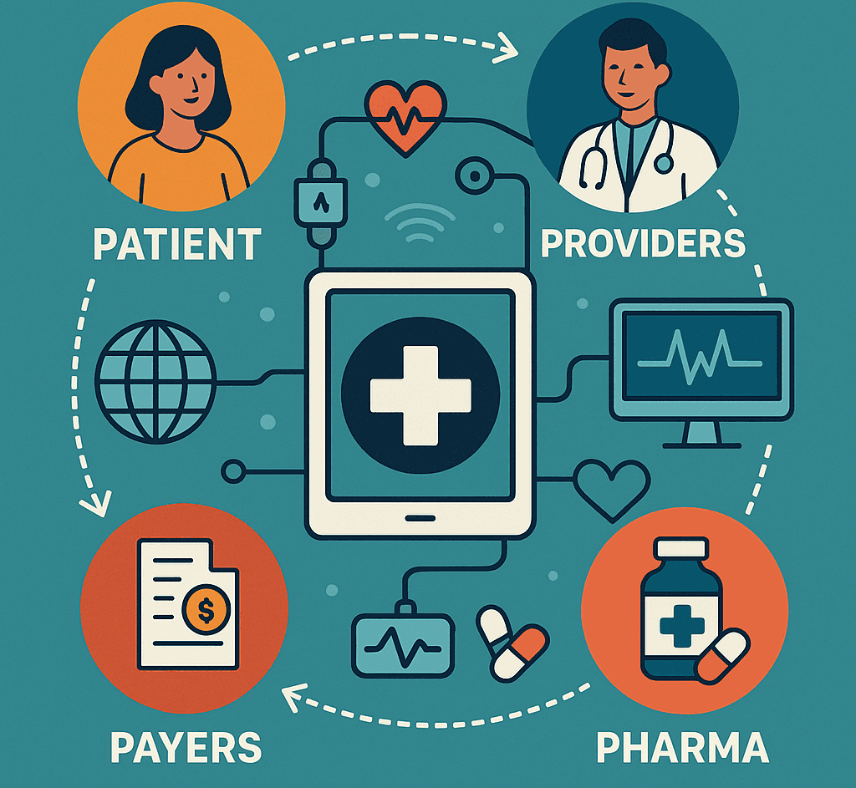
Transforming Care Delivery Potential Impact on Healthcare Systems
Efficiency gains (reduced hospital visits, faster triage).
Equity challenges (urban vs rural access).
Personalization of care (precision medicine).

Slide 12

Governance & Policy Regulatory Considerations
Licensing across borders.
Data protection laws (GDPR, HIPAA, local equivalents).
Liability in AI-driven decisions.
“How should regulators balance innovation with patient safety?”
HIPAA: Health insurance Portability and Accountability Act of US Law to protect sensitive patient health information

Slide 13

Ethics in Digital Health
Informed consent in AI-assisted care.
Algorithmic bias and fairness.
Patient autonomy vs automation.

Slide 14
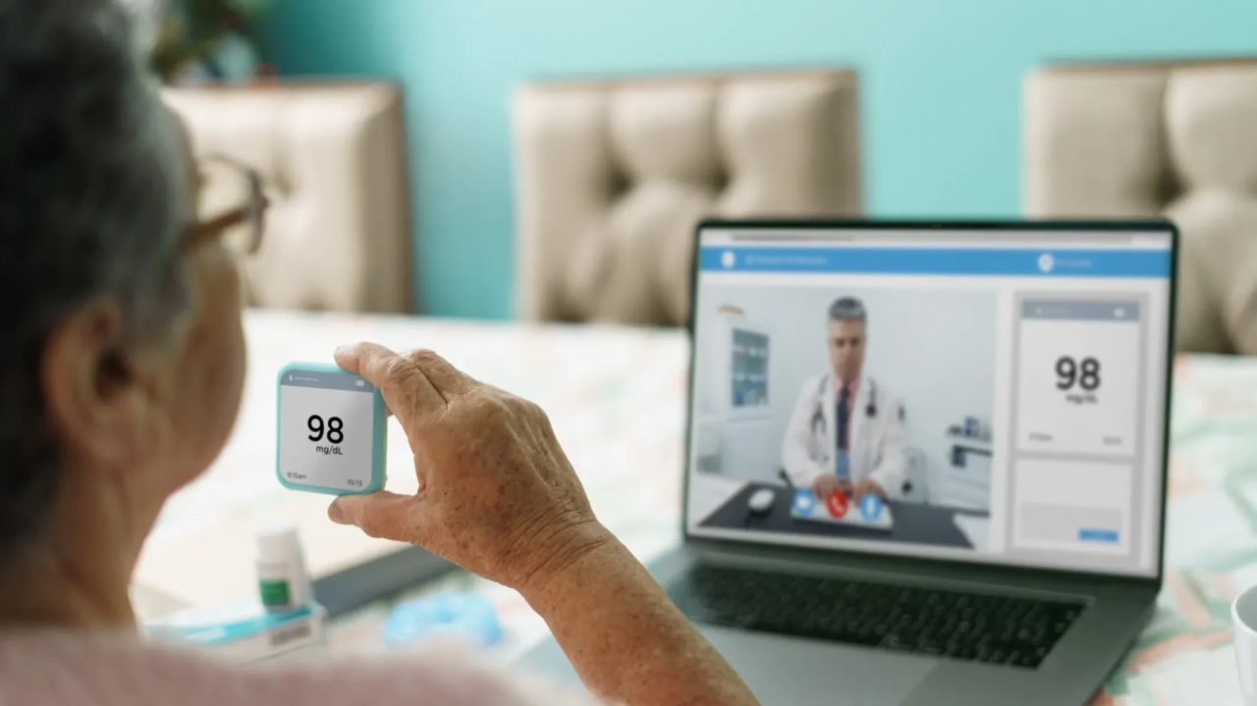
Case Scenario
Patient with chronic liver disease, DM and NTN monitored via wearable + AI alerts.
Remote intervention triggered by predictive analytics.
“Would you trust AI to initiate clinical action without human oversight?”

Slide 15
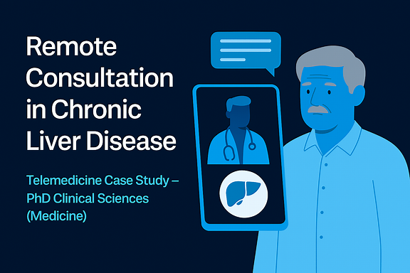
Remote Consultation in Chronic Liver Disease
Telemedicine Case Study – PhD Clinical Sciences (Medicine)

Slide 16
Patient Profile
Name: Mr. I**** Qureshi
Age: 58
Location: Bhakkar, Punjab
Diagnosis: Compensated cirrhosis due to Hepatitis C (treated)
Comorbidities: Type 2 Diabetes, Hypertension
Follow-up Needs: Monitoring for hepatic decompensation, HCC screening, medication adherence(for DM and HTN)

Slide 17

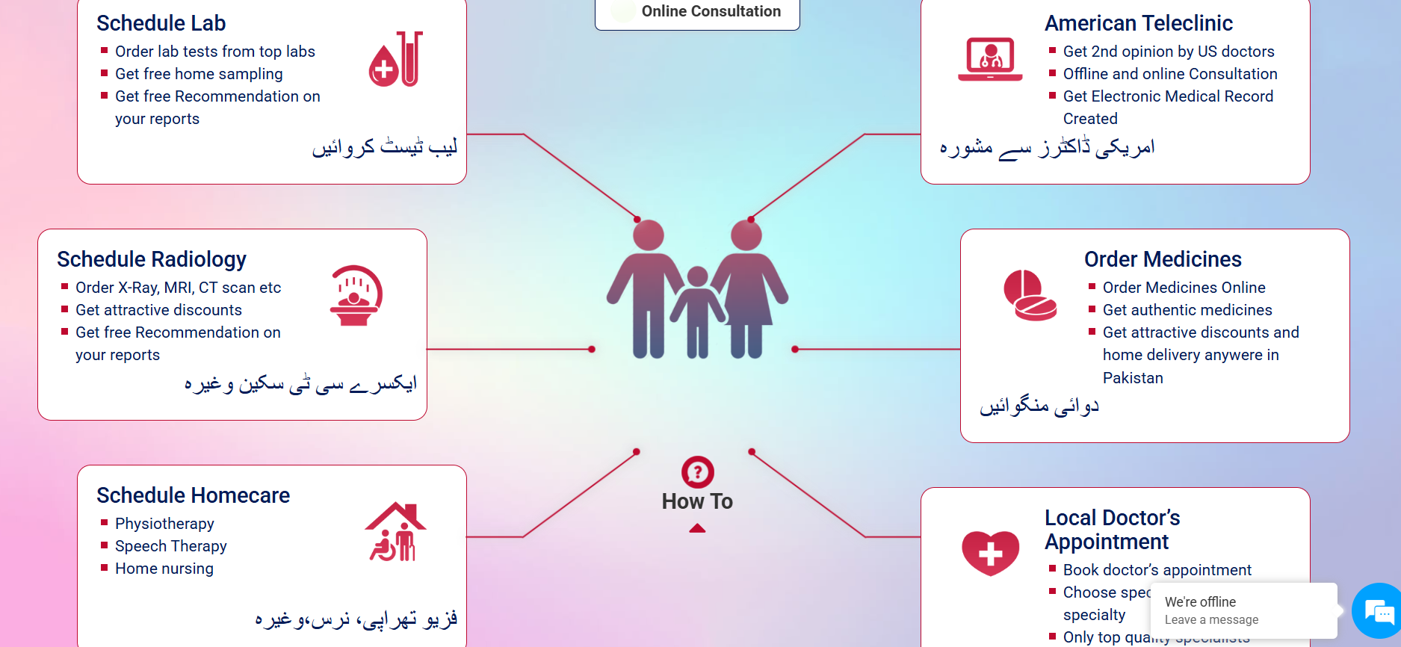
Telemedicine Setup
Platform: Government/Corporate telehealth portal
Frequency: Every 3 months
Local Support: DHQ hospital labs and ultrasound
Digital Tools: Smartphone, wearable device, AI chatbot

Slide 18
Clinical Encounter Summary
Chief Complaint: Mild fatigue
Vitals: BP 130/85, HR 78, glucose 140 mg/dL
Labs: ALT/AST stable, Platelets 110,000, AFP normal
Ultrasound: No focal lesion, mild splenomegaly
Plan: Lifestyle advice, medication adjustment, HCC screen in 6 months

Slide 19
Discussion Prompts – Clinical Reasoning
Limitations of remote follow-up
Surveillance gaps if ultrasound missed
Infrastructure needs for rural scaling
AI triage and digital literacy
Informed consent in remote care

Slide 20
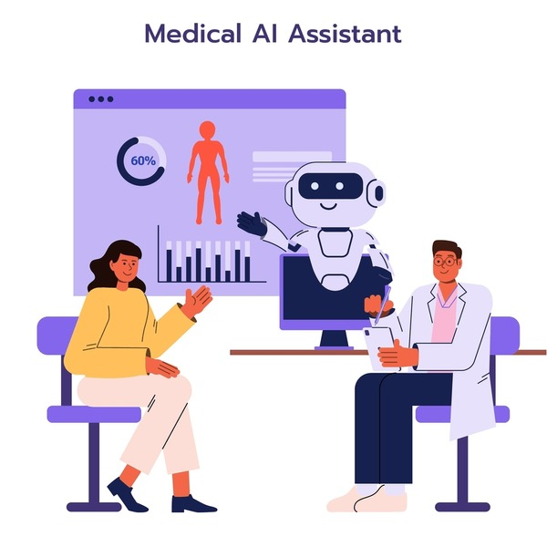
Critical Thinking Exercise
“What is one opportunity and one risk you foresee in digital health for your specialty?”

Slide 21

From Lecture to Debate
Now we’ll explore the following issues through group debate:
Rapid Adoption
vs
Cautious Regulation.

Slide 22
Impact, Regulation, and Ethics in Telemedicine & Digital Health
Mini Lecture – PhD Clinical Sciences (Medicine)
Dr. Tayyab Saeed Akhter
PhD Scholar
Clinical Sciences (Medicine)

Slide 23
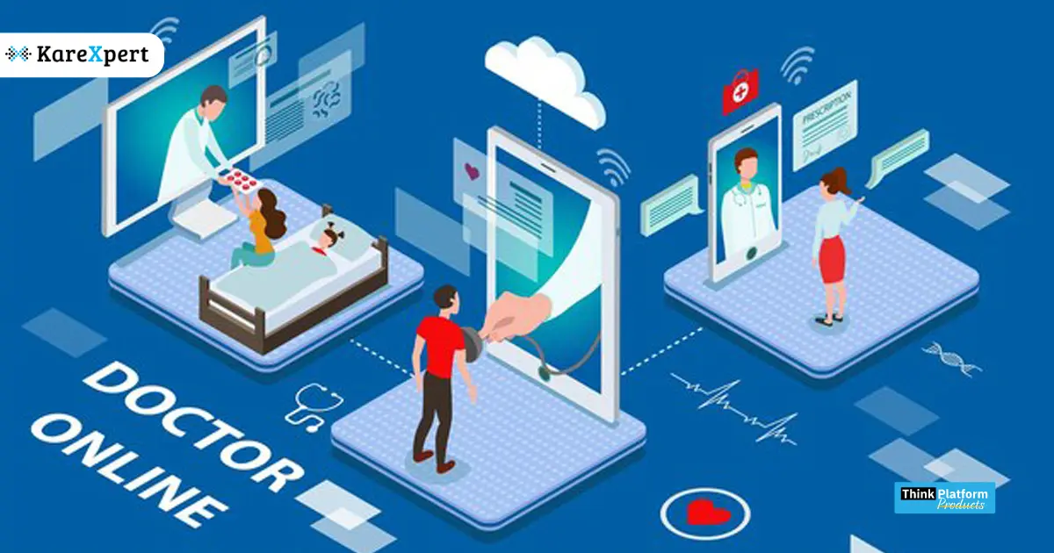
Impact on Healthcare Systems
Efficiency gains: reduced hospital visits, faster triage, chronic disease management
Equity challenges: digital divide, socioeconomic disparities
Personalization: AI-driven precision medicine, wearable monitoring
Transformation: shift to patient-centric care

Slide 24
Example – Chronic Liver Disease Monitoring
Remote monitoring reduces admissions
Requires reliable connectivity

Slide 25
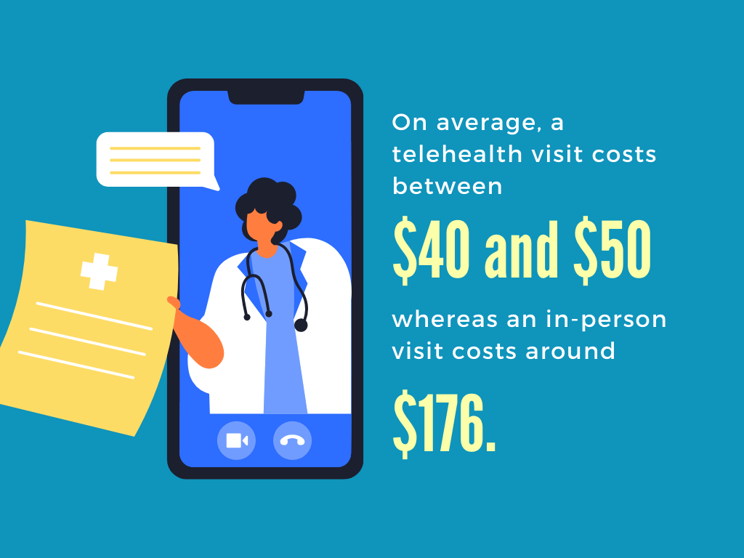
Discussion Prompt – Impact
Question:
Will telemedicine reduce healthcare costs in LMICs, or shift costs to patients?

Slide 26
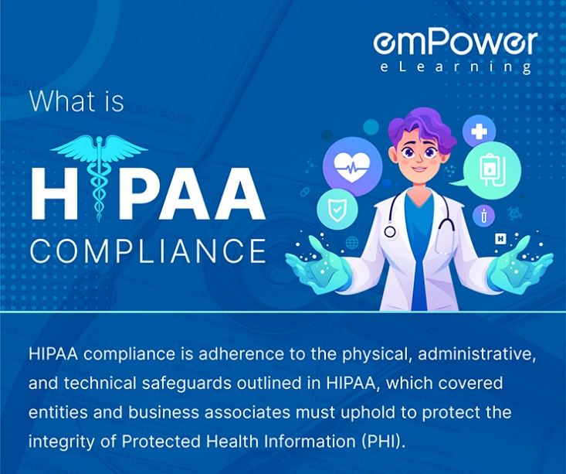

Regulatory Considerations
Licensing & jurisdiction across borders
Data protection laws (GDPR, HIPAA, local equivalents)
Liability in AI-driven decisions
Adaptive regulation: sandbox models
Notes:
The adaptive regulations: sandbox model is a governance innovation where a regulator provides a controlled, time-bound, live testing environment for new products, services, or business models, with the goal of fostering innovation while simultaneously learning how to adapt existing laws and create fit-for-purpose future regulations.

Slide 27
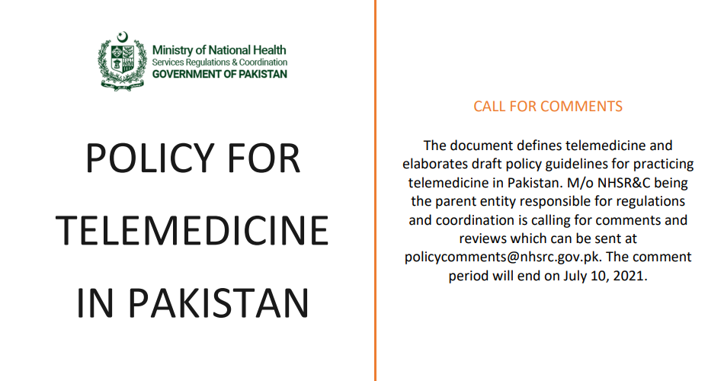
Example – Pakistan Telemedicine Guidelines
Physician accountability emphasized
Lack of clarity on AI-driven decisions

Slide 28

Discussion Prompt – Regulation
Question: Should regulators prioritize innovation or patient safety?

Slide 29
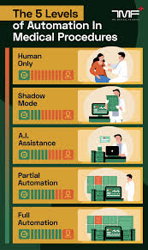
Ethical Implications
Informed consent challenges with AI
Algorithmic bias risks
Autonomy vs automation
Equity in access

Slide 30
Example – AI Triage in Non-English Patients
Misinterpretation risks
Leads to inequitable care

Slide 31

Discussion Prompt – Ethics
Question: Is it ethical to deploy AI triage in populations with low digital literacy?

Slide 32
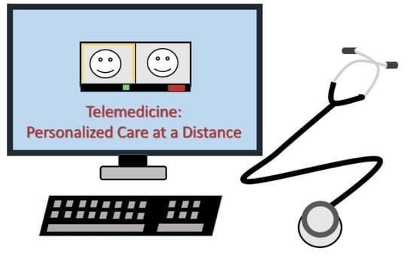
Integration & Reflection
Telemedicine promises efficiency but risks inequity
Ethical frameworks must evolve
Patient-centered care as guiding principle

Slide 33

Assignment: Reflective Exercise
Learners write: One opportunity and one ethical risk in digital health for your own speciality specialty

