Slide 1
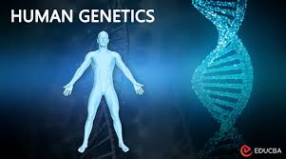
INTRODUCTION TO GENOMIC MEDICINE
DEFINITION
Genomic medicine is the emerging discipline that
uses an individual’s genomic information—DNA sequence,
gene expression, epigenetic patterns—to guide clinical care
across prevention, diagnosis, and treatment.
It expands traditional genetics by analyzing entire genomes,
multi-omics, and population-scale data,
not just single-gene disorders.

Slide 2
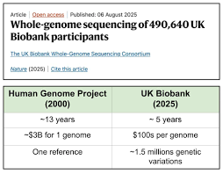
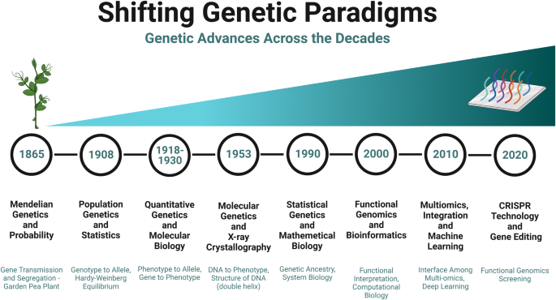
Why genomic medicine now?
Cost drop in genome sequencing (from $3 billion → <$300).
Large biobanks (e.g., UK Biobank, All of Us).
Rapid advances in computational biology & AI.
Recognition that complex diseases (COPD, sepsis outcomes,
ARDS susceptibility) have genomic determinants.
Shifting medical paradigms
From “one-size-fits-all” → precision therapy
From reactive care → predictive and preventive care
From trial-and-error prescribing → pharmacogenomics
-guided regimens

Slide 3
FOUNDATIONAL PRINCIPLES OF GENOMIC MEDICINE
Human Genome Architecture
~3.2 billion base pairs.
Protein-coding genes = ~20,000 (<2% of genome).
Remainder: regulatory regions, introns, noncoding RNAs (miRNA, lncRNA).
Key concept: Regulation matters more than the number of genes. Most disease risk arises from variants affecting gene expression.

Slide 4
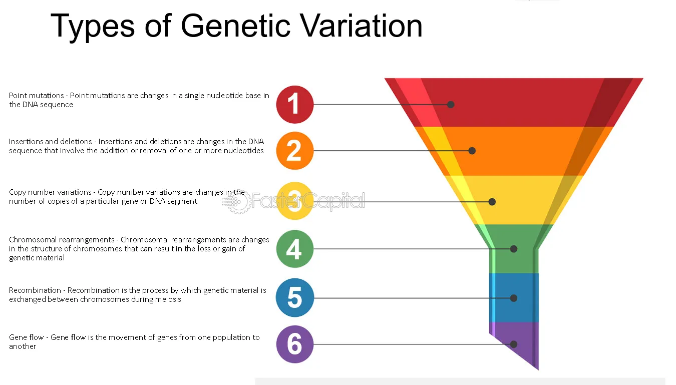
B. Genetic Variation
Core types:
Single nucleotide variants (SNVs/SNPs)
Most abundant; used in GWAS.
Insertions/Deletions (Indels)
Copy number variations (CNVs)
Structural variations
Epigenetic modifications
DNA methylation
Histone modifications
Noncoding RNA regulation
Clinical relevance examples:
Alpha-1 antitrypsin deficiency (SERPINA1 mutations) → early-onset COPD
CYP2C19 variants → altered clopidogrel response
BRCA1/2 → hereditary breast/ovarian cancer

Slide 5
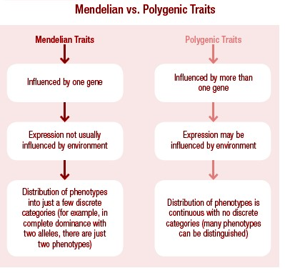
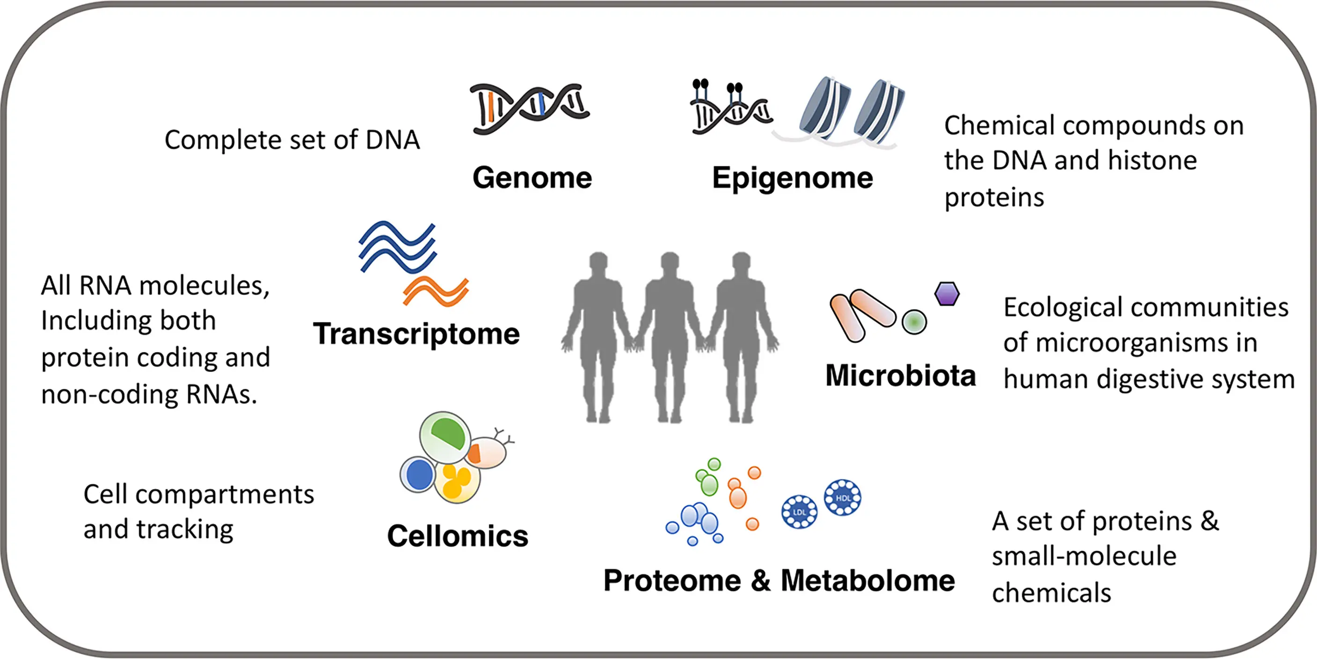

Slide 6
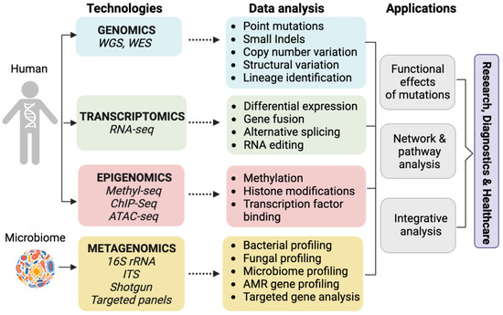

Slide 7
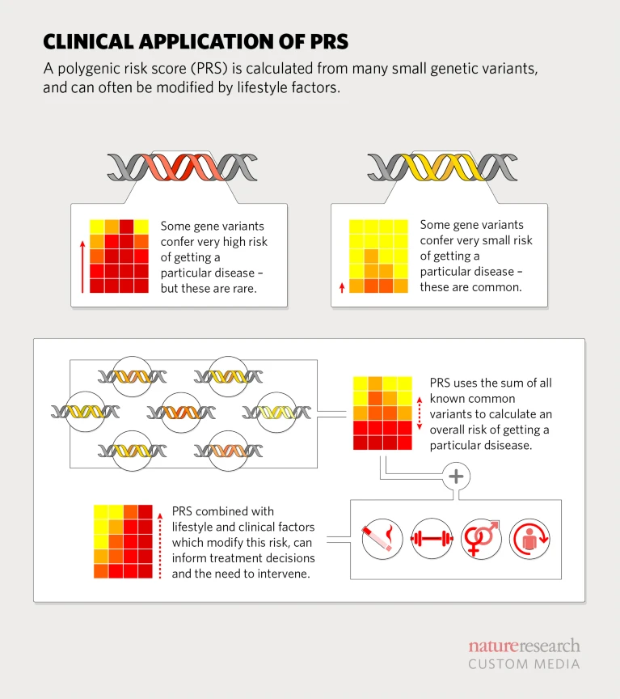
Clinical Applications of Genomic Medicine
A. Risk Prediction & Prevention
Polygenic Risk Scores (PRS)
Aggregate many small-effect variants
Predict risk for asthma, CAD, T2DM, COPD progression
Helps identify high-risk individuals for early intervention
Carrier screening
CFTR (cystic fibrosis)
Hemoglobinopathies
Metabolic disorders
Population genomics
Screening newborns using genome sequencing
Predict predisposition to sepsis severity or ARDS risk (ongoing research)

Slide 8
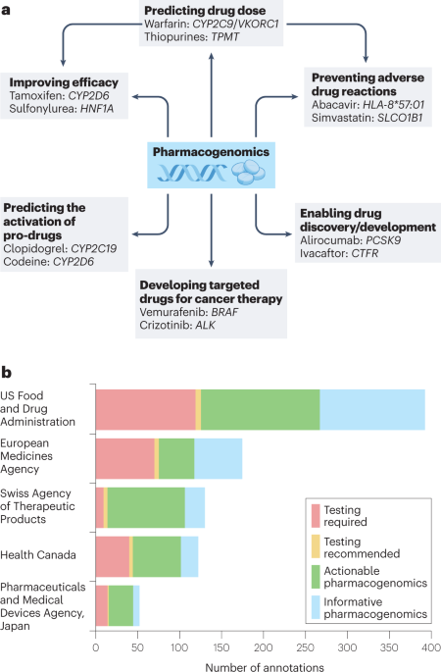

Slide 9
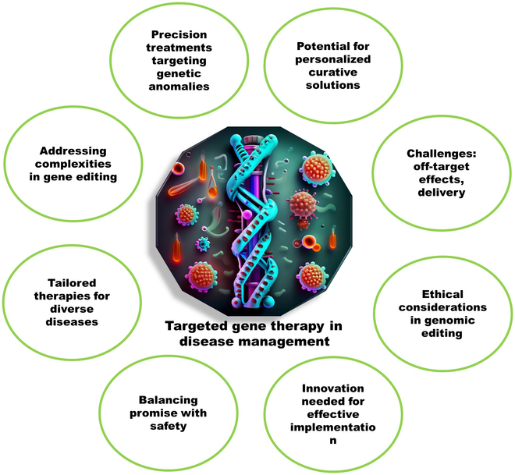

Slide 10
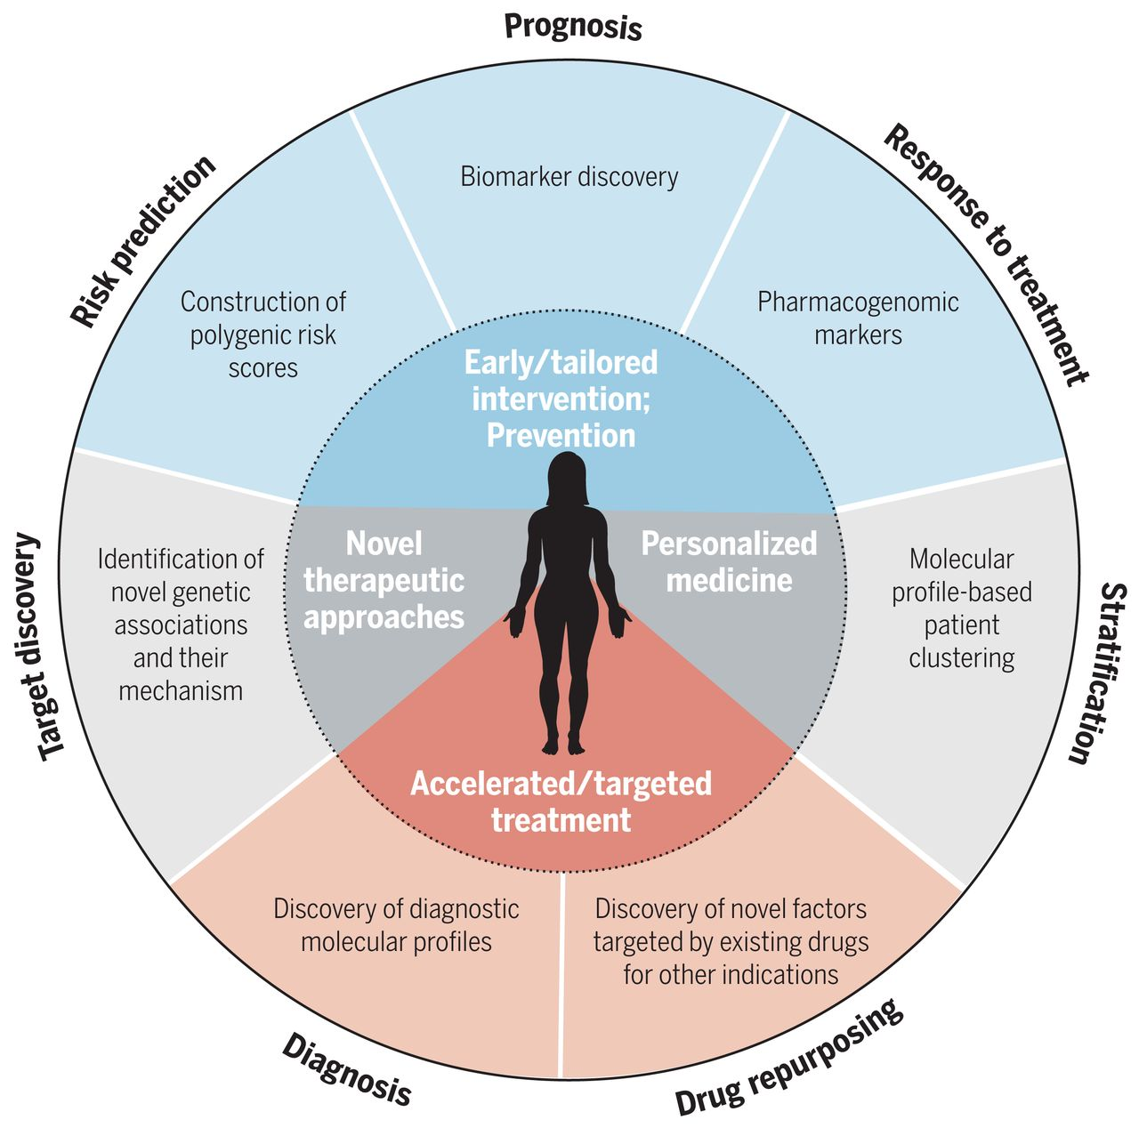
F. Precision Monitoring & Prognostication
Minimal residual disease detection using circulating tumor DNA (ctDNA)
Transcriptomic biomarkers for ARDS risk stratification
AI-powered genomic risk calculators for ICU mortality

Slide 11
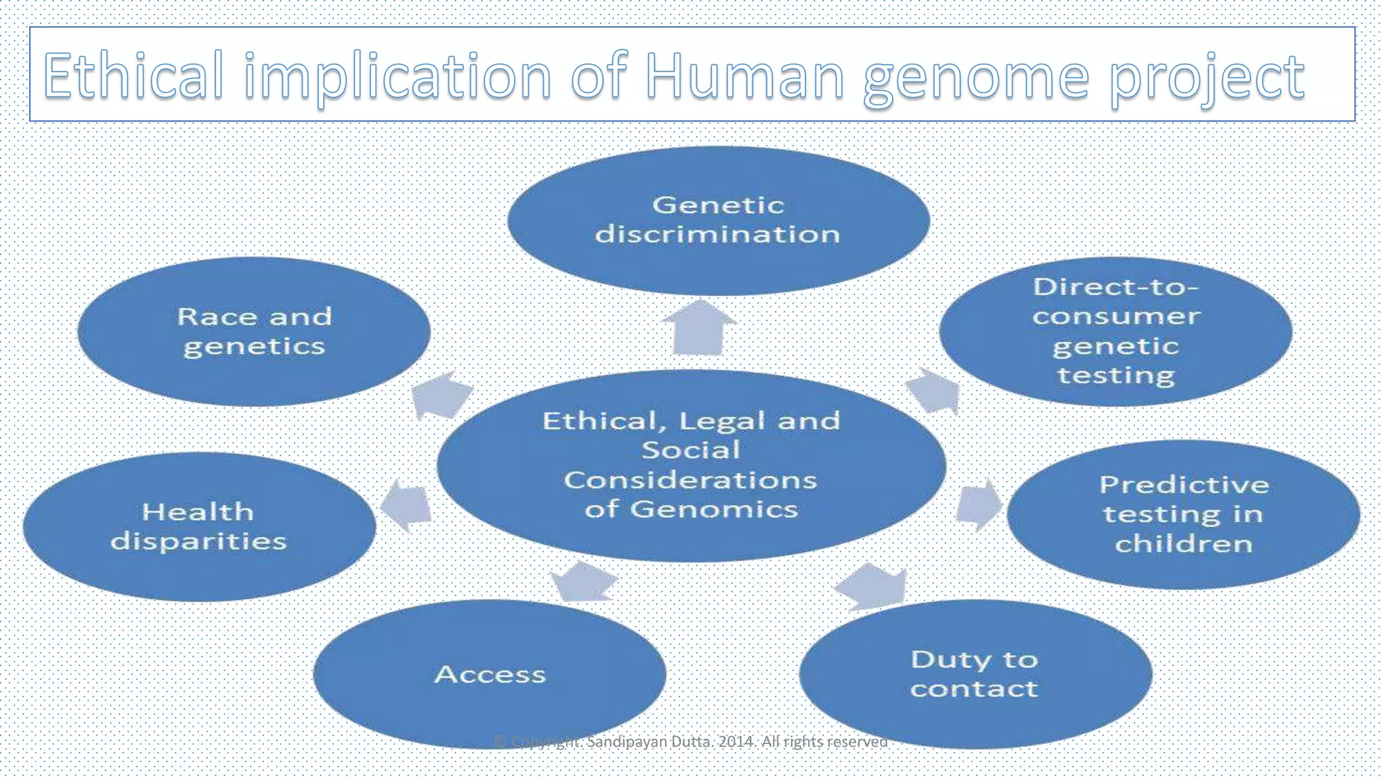
CHALLENGES, LIMITATIONS & ETHICAL CONSIDERATIONS
Key issues:
1. Equity and representation
Most genomic data comes from European ancestry
2. Data privacy & consent
Genomic data → lifelong identifiers
Variants of unknown significance (VUS)
Clinical interpretation gap
Cost, access, and infrastructure
Potential for genetic discrimination

Slide 12
Conclusion
Genomic medicine is transforming healthcare, enabling prediction, prevention, precision diagnostics, personalized therapy, and dynamic monitoring. Integration of genomics into pulmonology, critical care, oncology, and infectious diseases is accelerating rapidly.
To harness its full potential, clinicians and scientists must understand its principles, tools, limitations, and ethical frameworks.

Slide 13
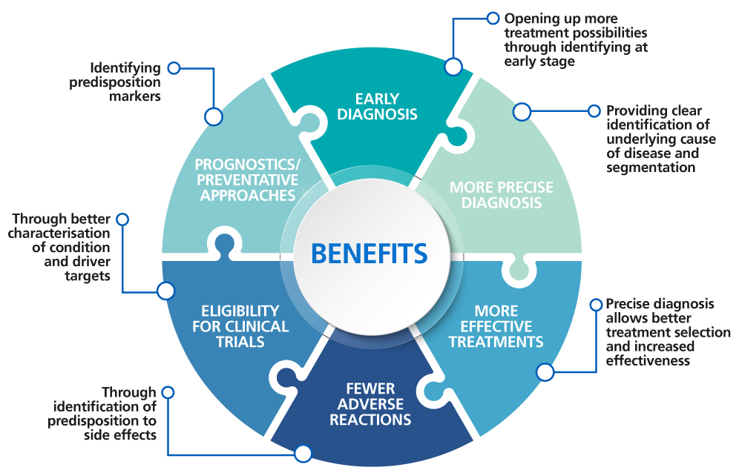
THE FUTURE IMPACT OF GENOMIC MEDICINE
GENOMIC MEDICINE IN THE NEXT DECADE – TRANSFORMATIVE POTENTIAL AND ETHICAL FRONTIERS
Introduction: The Genomic Era Ahead
In the past decade, genomic medicine has moved from a conceptual framework to tangible clinical reality. With the advent of high-throughput sequencing, machine learning, digital health technologies, and CRISPR-based editing, our ability to interrogate and manipulate the human genome has expanded exponentially.
Today's lecture examines how genomic medicine will reshape healthcare in the future and what ethical considerations must accompany this transformation. This future is not hypothetical—it is unfolding in real time and will redefine preventive medicine, diagnostics, therapeutics, and global public health.

Slide 14
2. Transformative Effects of Genomic Medicine on Healthcare
A. Precision Diagnosis and Disease Classification (5 minutes)
Traditionally, diseases are diagnosed based on phenotype—symptoms, imaging, and laboratory markers. Genomic medicine will shift us toward genotype-first diagnosis.
Rare diseases:
Whole-genome sequencing can diagnose ~40–60% of previously unexplained rare disorders.
Earlier diagnosis means earlier intervention and reduced healthcare costs.
Cancer genomics:
Tumors will increasingly be classified by molecular signatures instead of anatomical origin.
Liquid biopsies will allow noninvasive monitoring and early detection.
Polygenic risk scores:
Complex diseases like diabetes, coronary artery disease, asthma, and psychiatric disorders will be risk-stratified using large genomic datasets.
Clinical algorithms will integrate genomic and lifestyle factors to personalize care.
Impact: More precise, earlier, and more accurate diagnosis; reduction in diagnostic odysseys.

Slide 15
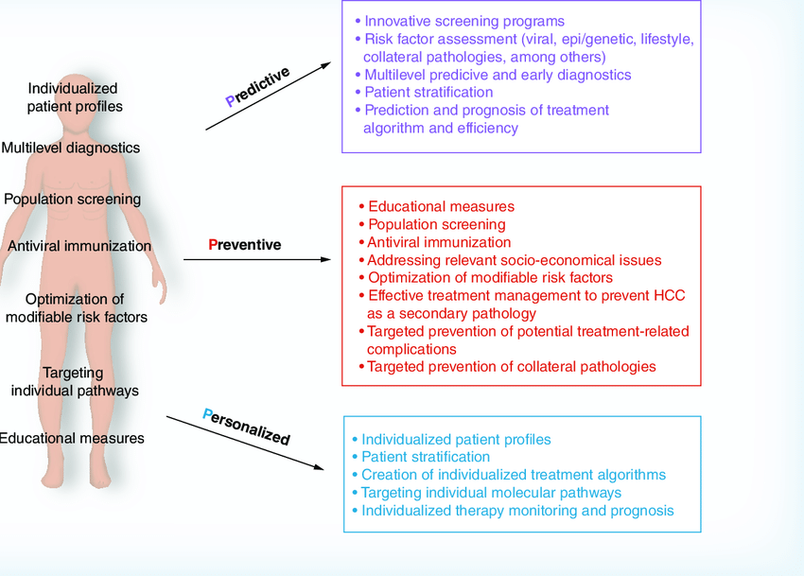

Slide 16
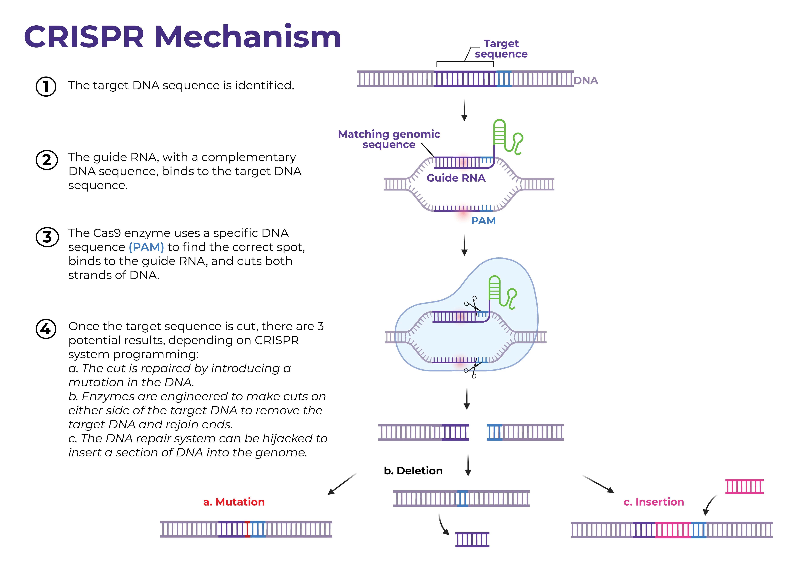
D. Gene Editing and Genomic Therapeutics
CRISPR-Cas9 and newer tools (base editing, prime editing) are reshaping therapeutics.
Somatic gene editing:
Treatment of hemoglobinopathies (sickle cell disease, β-thalassemia).
Potential applications in metabolic disorders, blindness, muscular dystrophies.
mRNA therapeutics & epigenome editing:
Modulate gene expression without altering DNA sequence.
Will contribute to personalized cancer vaccines and rare disease treatments.
Cell-based therapies:
CAR-T cells engineered for immunotherapy.
Induced pluripotent stem cells (iPSCs) for personalized regenerative medicine.
Impact: Curative therapies for previously untreatable diseases.

Slide 17
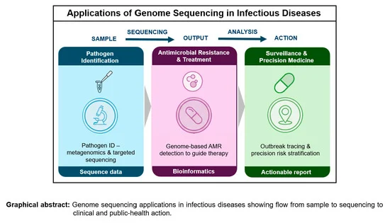
E. Infectious Disease Genomics
The COVID-19 pandemic highlighted the value of pathogen sequencing.
Rapid variant tracking will become a standard tool in outbreak response.
Genomic epidemiology will enable real-time surveillance.
Metagenomic sequencing may become routine in diagnosing unknown infections.
Impact: Faster containment, targeted vaccines, antimicrobial stewardship.

Slide 20
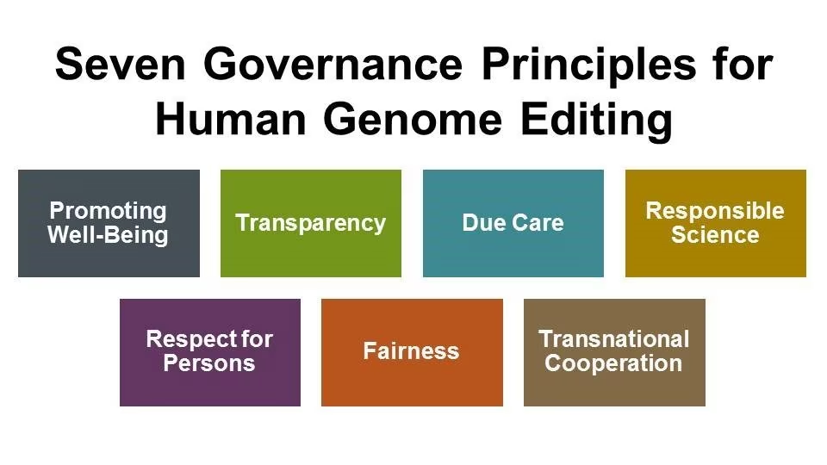
E. Human Germline Editing and Moral Boundaries
Perhaps the most debated ethical issue.
Germline editing affects future generations.
Possibility of “designer babies” and enhancement vs. therapy debates.
Global regulatory differences create “genomic tourism.”
Future direction: Strict regulation, transparent ethical frameworks, international consensus.

Slide 21
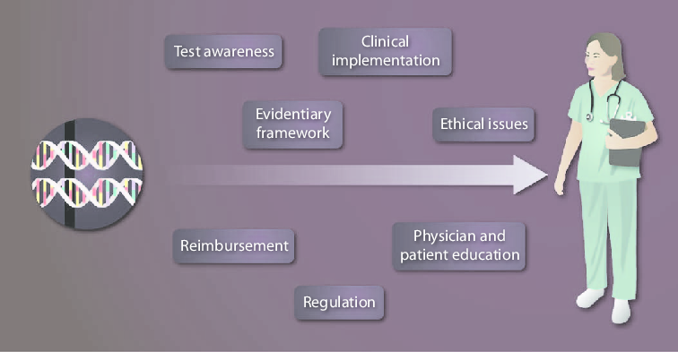
4. Challenges, Opportunities, and Policy Needs
Major Challenges
Integrating genomics into routine clinical workflows.
Interpreting massive genomic datasets using AI responsibly.
Cost, access, and insurance coverage.
Need for physician and workforce training in genomics.
Opportunities
Population-wide genome sequencing programs.
AI-driven variant interpretation.
Global databases for rare diseases.
Personalized therapeutics and regenerative medicine.
Policy Frameworks
Standardized guidelines for genomic testing.
Legal safeguards against discrimination.
Ethical governance for gene editing applications.
International collaborations for genomic equity.

Slide 22
5. Conclusion and Closing Summary
Genomic medicine promises a revolution in how we diagnose, prevent, and treat disease. Its transformative impact will influence every domain of medicine—from oncology to infectious disease to primary care. However, with great promise comes profound responsibility.
To shape the future intelligently, we must:
Embrace the scientific innovation.
Build ethical, equitable, and secure frameworks.
Ensure genomic benefits reach all populations.
Engage policymakers, clinicians, scientists, and society.
The next decade will define the balance between innovation and ethics in genomic medicine.

