Slide 1


Slide 2
Endocrine Dysregulation and Functional ovarian cyst: A case from Adolescent Gynaecology
Dr Kehkashan Iqbal
Post-Graduate Trainee Ob/Gyn
Rawalpindi Teaching Hospital

Slide 3
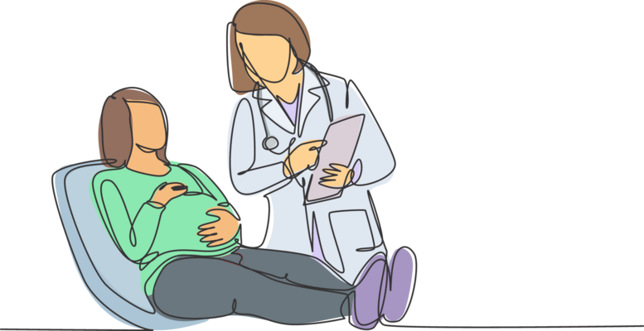
Profile Details
Name Miss XYZ
Age 21years
Occupation Student
Education M.A
Marital status Unmarried
Address Rawalpindi
Mode of admission OPD
Date of admission 11 April 2025

Slide 4

Presenting Complaints
Known hypothyroidism 3 yrs
Menstrual irregularities 2 yrs
Lower abdominal pain 2 yrs
Aggravation of pain 7 days

Slide 5
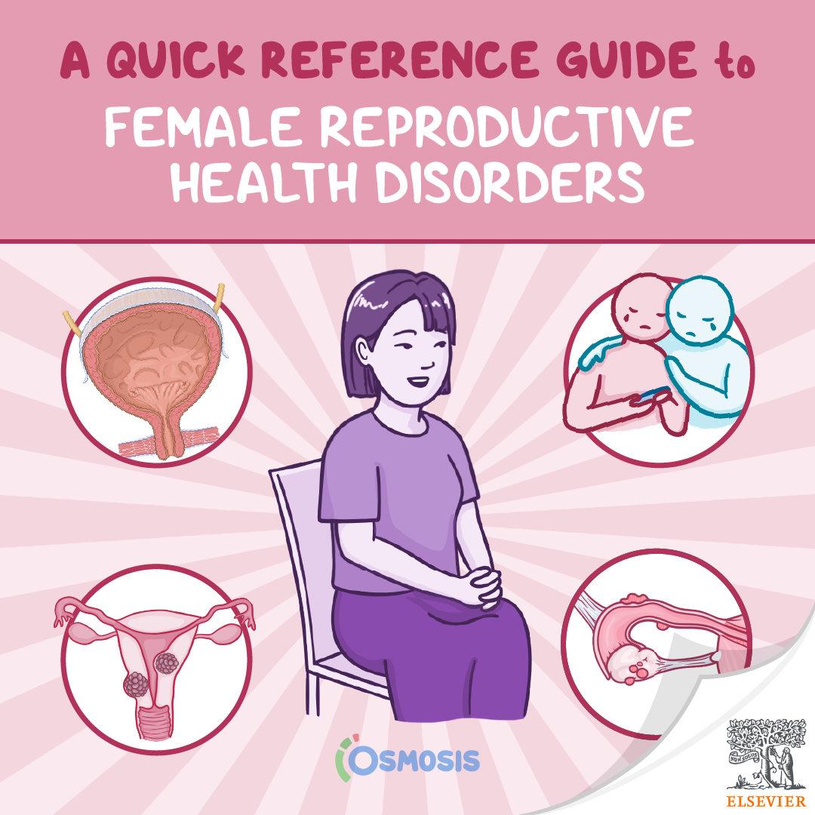
History of Present illness
Menstrual irregularities
M/C 5-6/40-60 days Scanty flow
Chronic lower abdominal pain
Dull mild non radiating. pain aggravated 7 days
Weight gain ++
No acne, hirsutism, galactorrhea, cold intolerance, constipation
No urinary and bowel symptoms

Slide 6

Menstrual History
Age of Menarche 13 years
M/C Regular 5/28
LMP 12-01-2025

Slide 7

History Details
Medical History Hypothyroidism -3yrs
Thyroxine 50mcg/day
Surgical History Not significant
Social History Low middle class
Family History Not significant

Slide 8

General Physical Examination
Young girl , well oriented
Pulse 106/min
Temp 98.6 8°F
B.P 100/60 mmHg
R.R 18/ mins
BMI 29.8 kg/m2
Breast normal
Thyroid not palpable

Slide 9
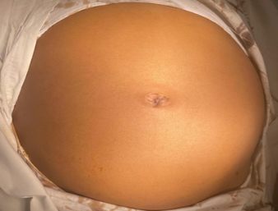
Abdominal Examination
Abdomen Protuberant, no scar marks
Umbilicus Central
Size 20cm mass arising from pelvis
Filling hypogastrium, iliac region
Firm Non-tender
Mobility Restricted
Margins Irregular
Percussion Dull , no fluid thrill
Liver, Spleen, Kidney Not palpable

Slide 10

Systemic Examination
Cardiovascular System S1 + S2 + 0
Respiratory System Normal vesicular breathing
Central Nervous System Intact

Slide 11
Differential Diagnosis
Malignant ovarian
Germ cell tumour
Benign non ovarian
Paratubal cyst
Peritoneal pseudocyst
hydrosalpinx
Benign ovarian
Functional cyst
Endometroima
Mucinous/ serous cystadenoma
Mature teratoma

Slide 12

Investigations
Blood group B +
Blood CP
Hb 10.1g/dl
TLC 6800 /µl
Plt 306,000/µl
MCV 85fL (80–100 Fl)
MCH 30pg (27.5 - 33.2 pg)
MCHC 34 g/dL (33.4–35.5 g/dL)
Urine R/E Normal
BSR 112mg/dl
HbSAg, Anti HCVAb Negative

Slide 13
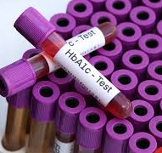
Specific Investigation
Liver Function Tests
Bilirubin 0.3 mg/dl, ALT 27 u/l
Alkaline phosphatase 141 u/
Renal Function Tests
Urea 15mg/dl ,
Creatinine 0.6 mg/dl
l

Slide 14

Tumor Markers
CA-125 18.4 IU/ml (<35.4IU/ml)
B-HCG. < 1 IU/ml (<5 mIU/ml)
Alpha fetoprotein 5 IU/ml (<14.4IU/ml)

Slide 15
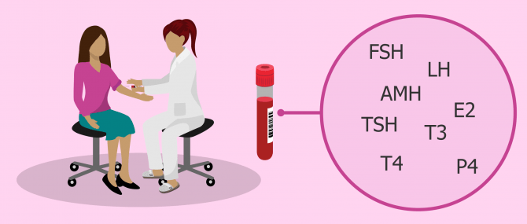
Hormonal profile
TSH 41 mIU/L (0.5 to 5.0 mIU/L
LH 5 IU/L (5-25IU/L)
FSH 4 IU/L (0-4IU/L)
Prolactin 20 µg/L (<25µg/L)
X-Ray Chest unremarkable

Slide 16
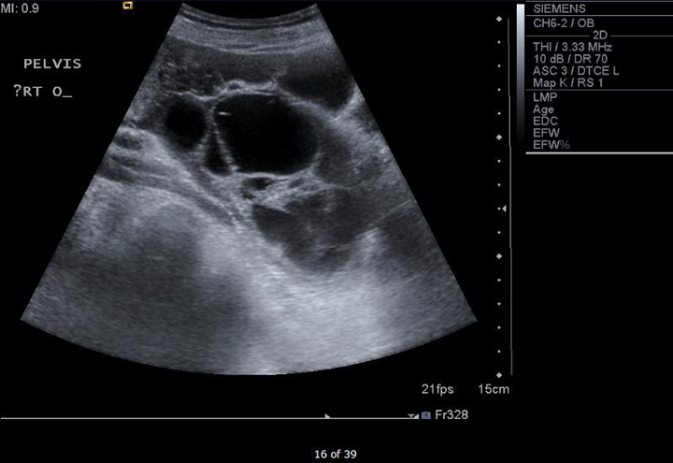
Pelvic Ultrasound
  Huge Bilateral multi locular cysts
  Site Adnexal region
  touching each other above the
  uterine fundus
  Right cyst (16x11x4 cm)
  Left cyst (10X11X5cm)
  Uterus Normal size

Slide 17
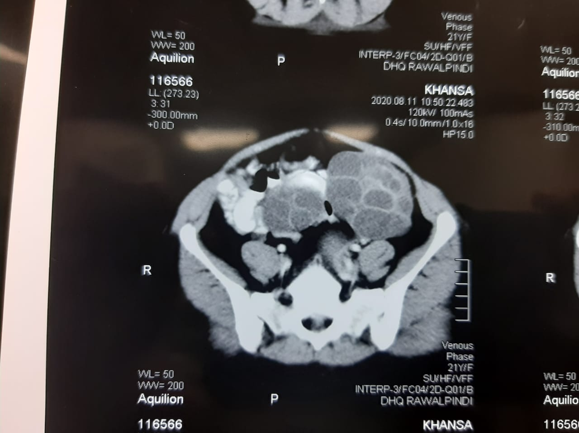
C-T scan Abdomen Pelvis
Bilateral adnexal complex mass
Multiloculated
Multiple septations
Intact interfaces.
Size
Left cyst 10x11x5 cm
Right cyst 16x11x4 cm
Ascitis mild
No lymphadenopathy

Slide 18

Management
Reassurance and counselling
Informed consent
Consultation with Endocrinologist /Physician

Slide 19

During admission in the ward pain aggravated
Pulse 110/min
Abdomen Tense, Tender
Suspicion of cyst accident
Emergency laparotomy

Slide 20
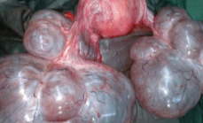
Operative Findings
Right ovary multilocular cyst ( 16 x16cm )with multiple hemorrhagic areas
Left ovary multilocular largest cyst 13x14cm
Bilateral cystectomy with conservation of both ovaries
Biopsy taken both right and left ovaries from hemorrhagic areas and omentum
Hemostasis secured

Slide 21
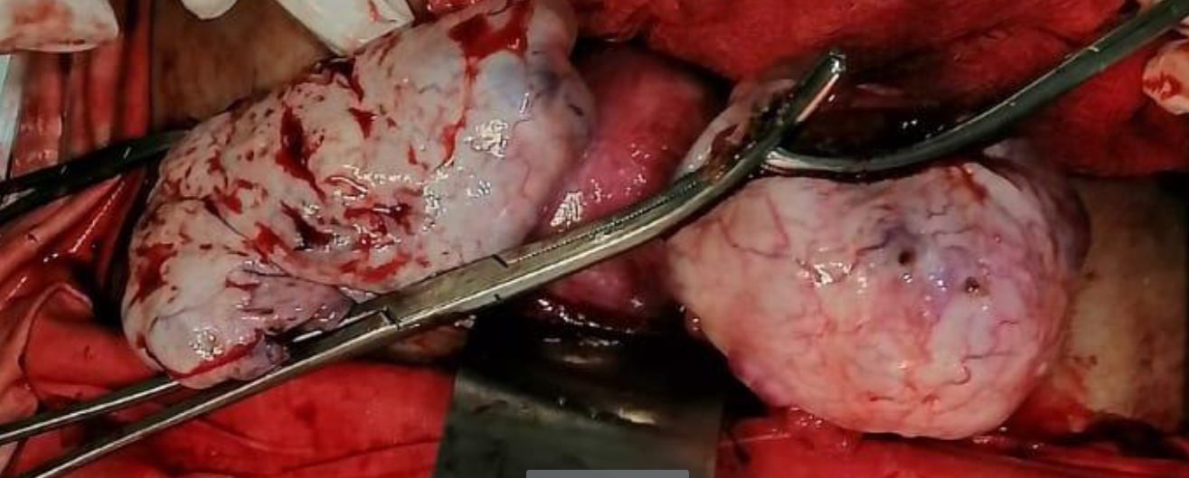
Gross Appearance

Slide 22

Post Op Recovery
Recovery Uneventful
Tab levothyroxine 100µgm OD ( as adv medicine specialist)

Slide 23

Histopathology
Bilateral ovarian tissue with cysts lined by granulosa and theca cells , consistent with corpus luteal cyst of both ovaries
Omental biopsy, peritoneal washings and fluid aspirated from both cyst showed no malignant cells

Slide 24
Corpus Luteal Cysts

Slide 25

Follow up - 3months
Ultrasound normal ovaries
Regular menstrual cycle now
TSH levels 4mIU/L

Slide 26

LITERATURE REVIEW
Dr Tabinda Khalid
Senior Registrar
Ob/Gyn
Rawalpindi Teaching Hospital

Slide 27
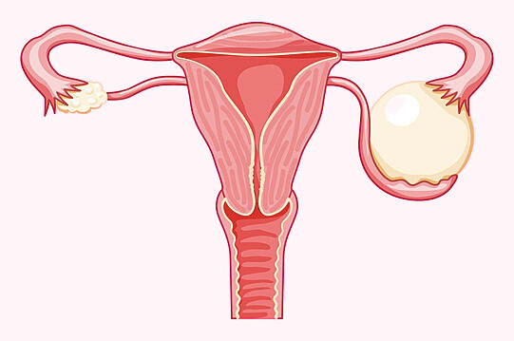
Ovarian Cysts
Definition
semisolid or fluid filled sac
within the ovary.
<3cm - Follicle
>3cm - Cyst

Slide 28
Types of Ovarian Cysts
Follicular cyst
Corpus luteal cyst
Theca lutein cyst
Epithelial inclusion cyst
Para ovarian cyst
Endometrioid cyst

Slide 29
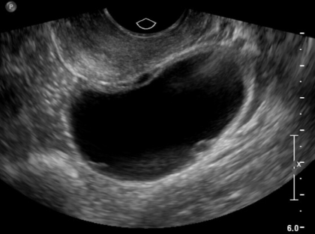
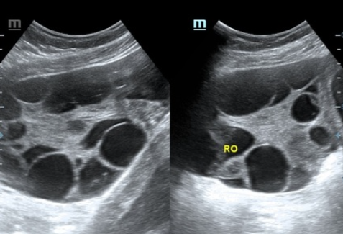
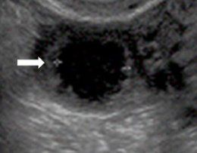
Types of Cysts
Follicular Cysts
Theca-Lutein Cysts
Corpus luteal cysts

Slide 30
Epidemioplogy
Incidence 33%
Follicular cysts - 46.7%
Corpus luteal cysts -13-17%
Theca lutein cysts varies 25-60%
Incidence increases with age
Peak 31.3% by age 15.
1. J. Evid. Based Med. Healthc., pISSN- 2349-2562, eISSN- 2349-2570/ Vol. 3/Issue 78/Sept. 29, 2016
Ovarian Cyst. Sadia mobeen, Radu Apostol StatPearls Publishing; 2025 Jan.2023 Jun 5.

Slide 31
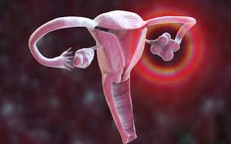
Functional Ovarian Cysts
Develop as part of menstrual cycle
Hypothyroidism - rare
Usually short lived ,harmless
Most common in reproductive age,
Seen in children and young adolescents

Slide 32
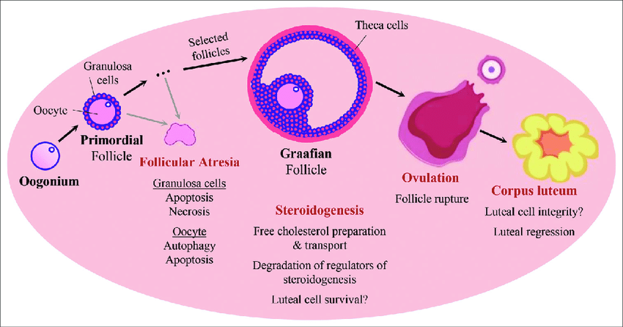
Physiology of normal ovarian cycle

Slide 33

Pathophysiology of Hypothyroidism and Functional Ovarian Cyst
DR. MARIAM TARIQ
Senior Registrar
Medicine Department
RTH Rawalpindi

Slide 34
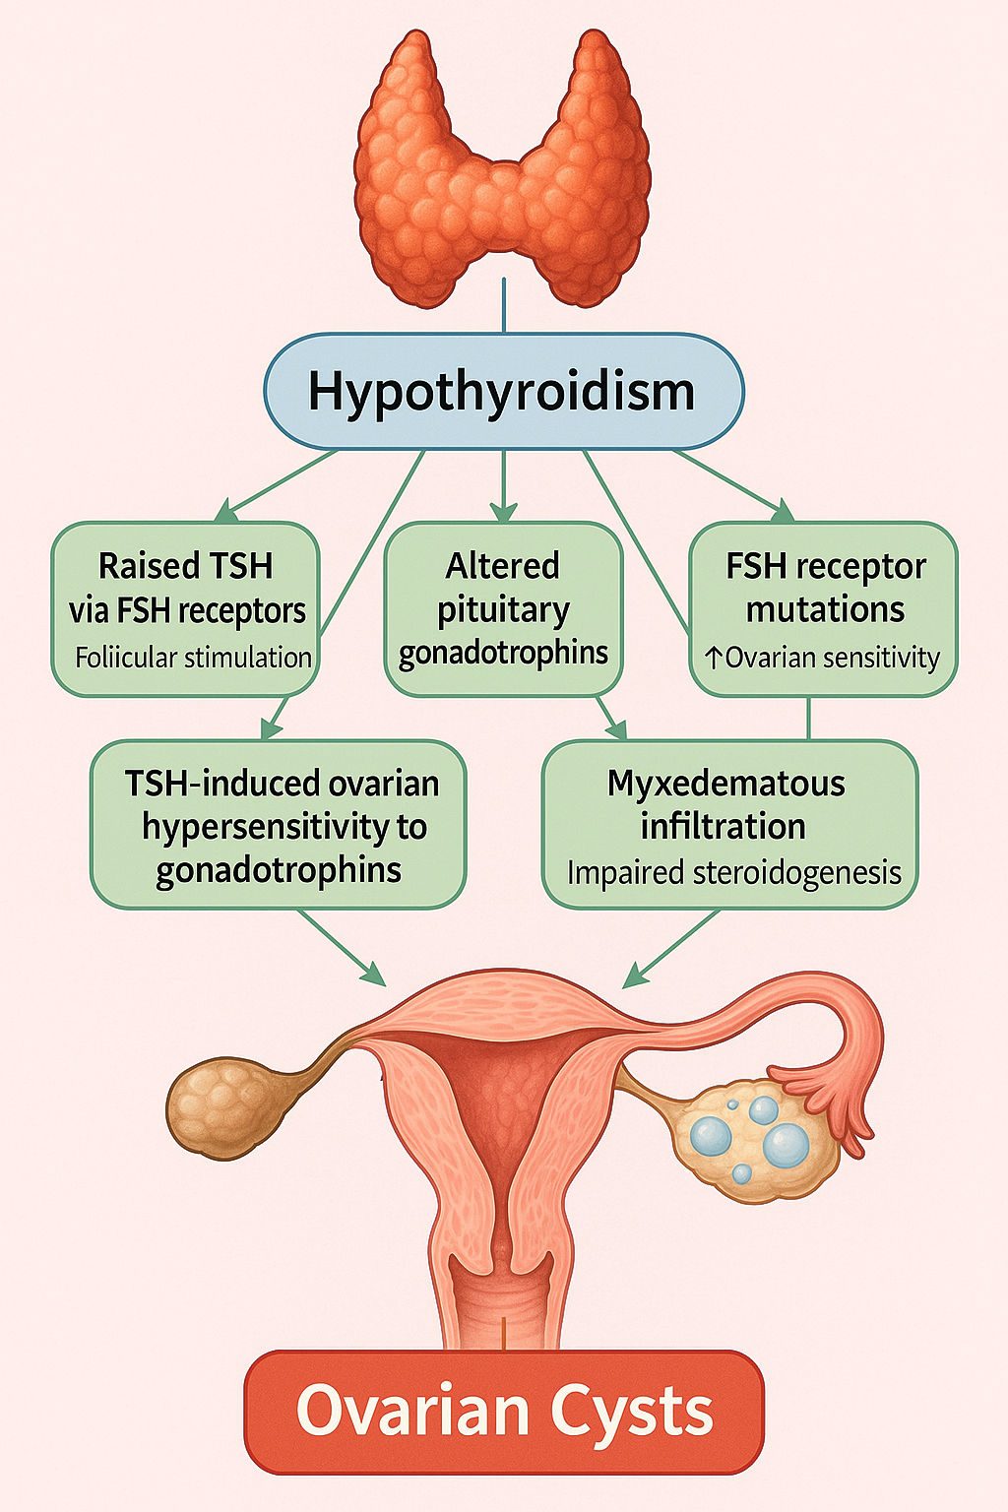

Slide 35
Clinical Features
Asymptomatic
Menstrual irregularities , amenorrhea
Abdominal pain
Palpable mass
Large cysts →Acute abdomen

Slide 36

Diagnosis
Clinical Assessment
Biochemical investigations
Thyroid function tests
Tumour markers
Radiological- USG
C.T scan- when indicated

Slide 37
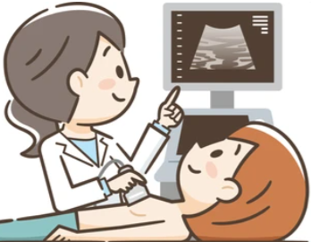
RADIOLOGICAL INVESTIGATIONS FOR OVARIAN MASSES
Dr. Fizza Batool
Senior Registrar
Radiology dept
Rawalpindi Teachiing Hospital

Slide 38
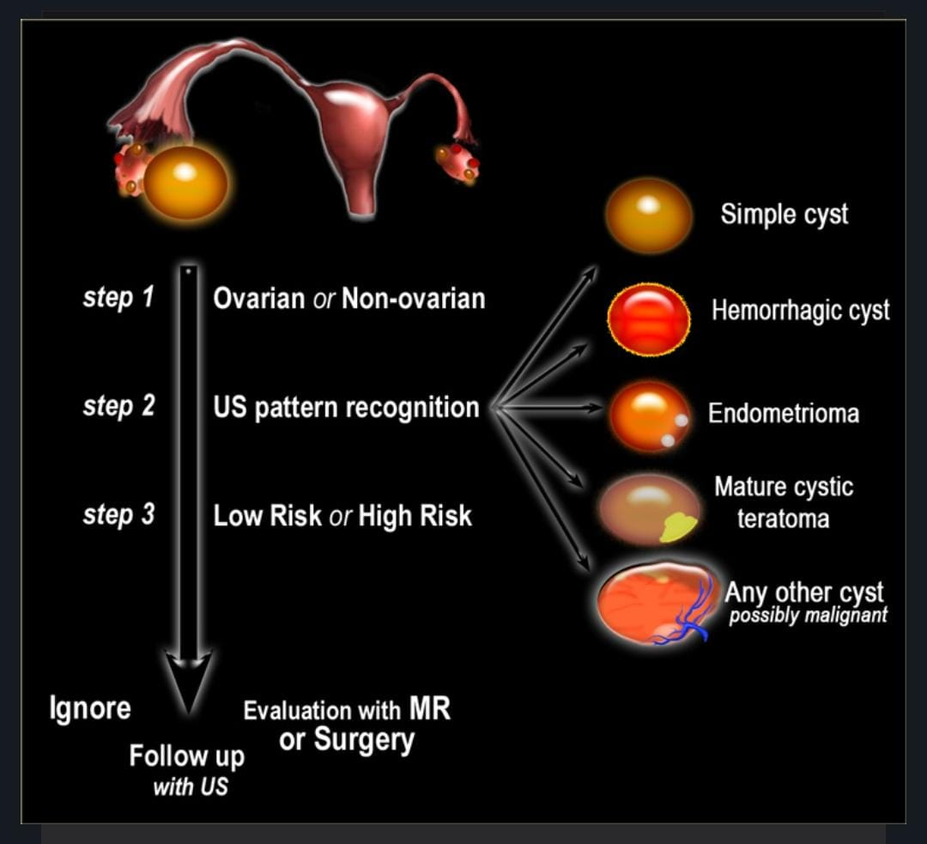

Slide 39
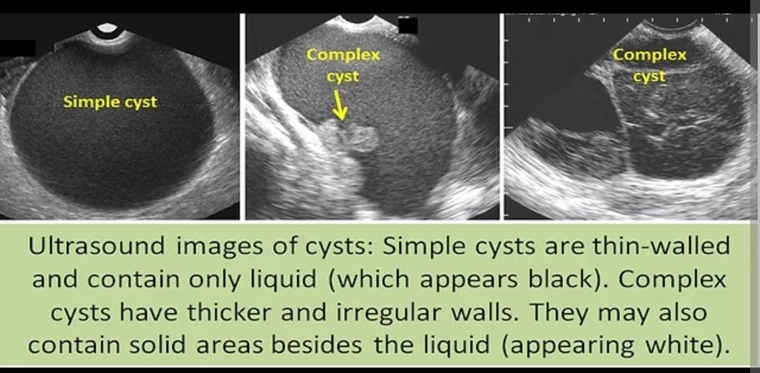

Slide 40
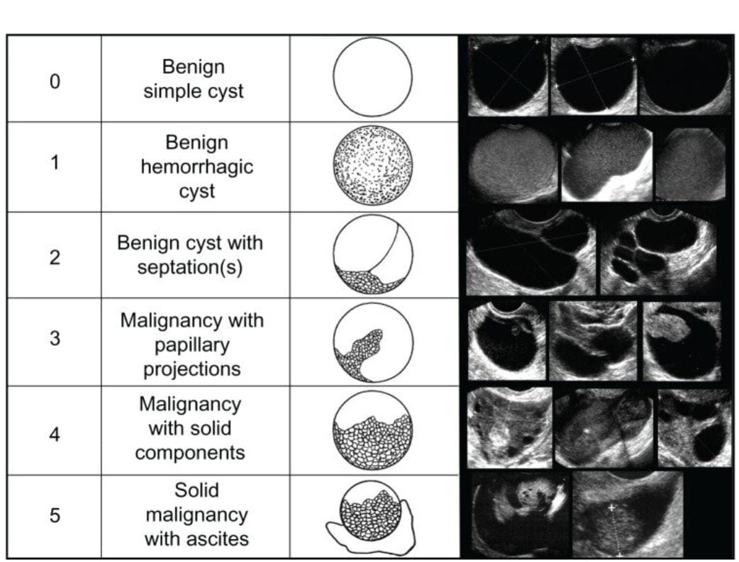

Slide 41
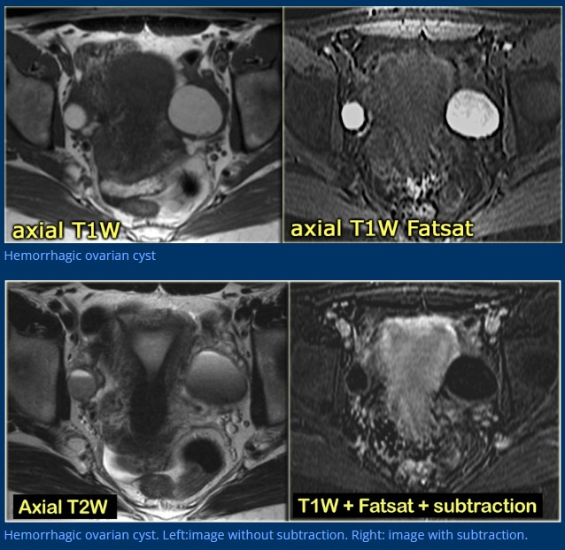

Slide 42
IOTA Group Ultrasound ‘rules’ to classify masses
B -RULE | M- RULE
Unilocular cysts | Irregular solid tumour
solid component <7mm | Ascites
Presence of acoustic shadowing | four papillary structures
Smooth multilocular tumour >10cm | Irregular multilocular solid tumour with largest diameter ≥10cm
No blood flow | Very strong blood flow

Slide 43
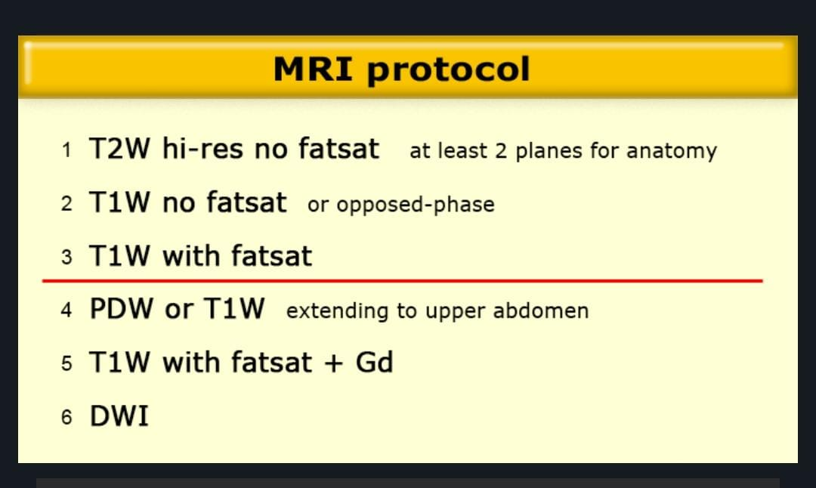

Slide 44
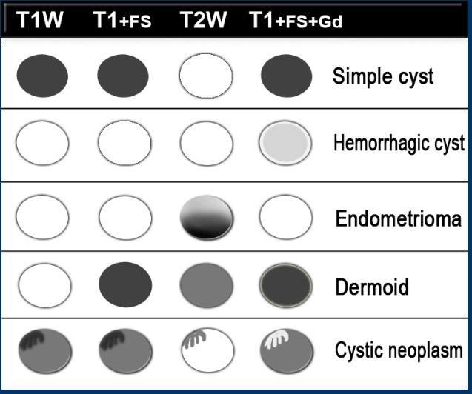

Slide 45
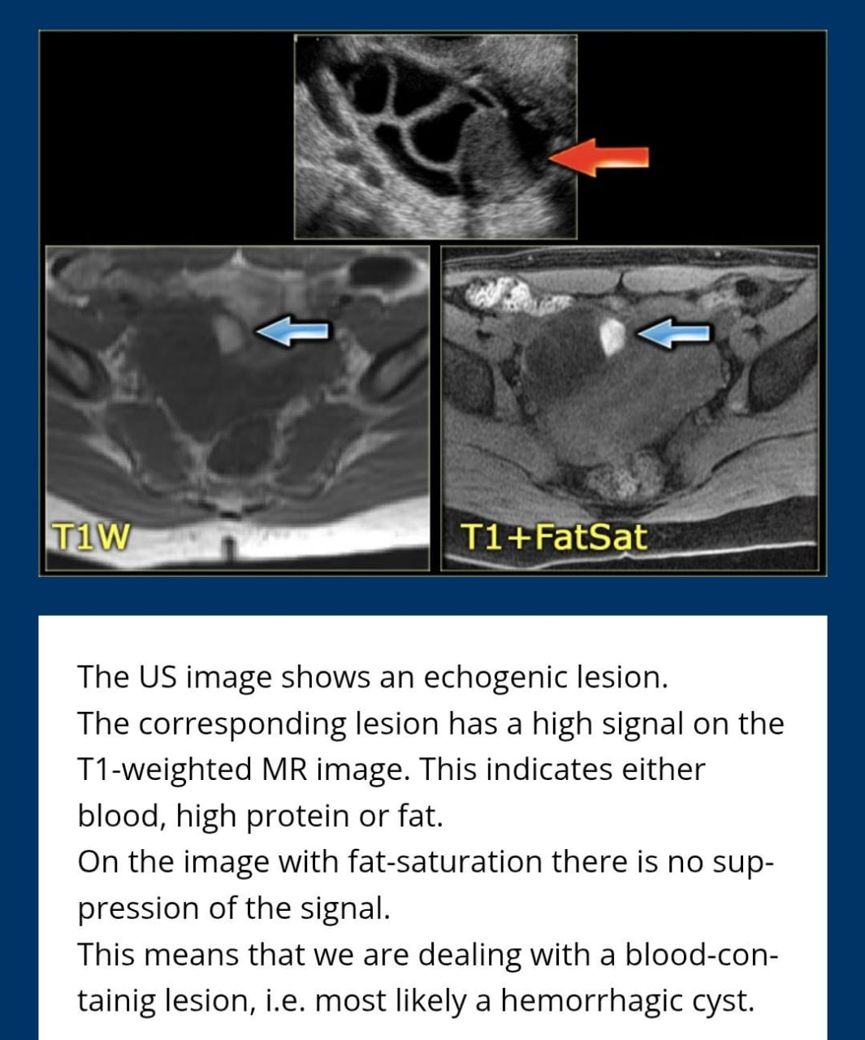

Slide 46
Complications of Ovarian Cysts
Torsion
Haemorrhage
Rupture
Infection

Slide 47
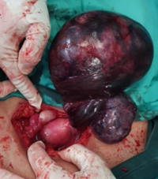
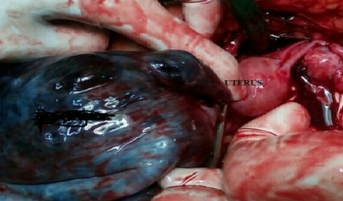
Complications

Slide 48

Management

Slide 49

Multidisciplinary Team Approach
Gynaecologist
Endocrinologist
Radiologist

Slide 50

Counseling and Reassurance
Benign
Self limiting

Slide 51


Medical Treatment
Levothyroxine replacement

Slide 52
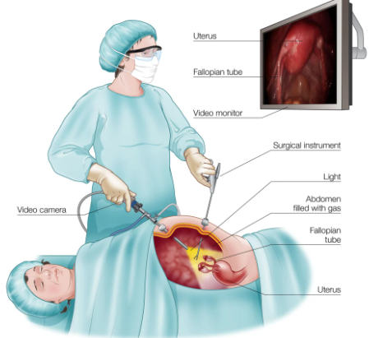
Surgical Management
Laparotomy
Laparoscopy

Slide 53

Monitoring and Follow up
Clinical assessments for symptoms
Imaging for size regression
Thyroid function tests- 4-6weeks

Slide 54

Literature Search

Slide 55
Author/journal/year | Key Points
Shu, J. et al. Ignored adult primary hypothyroidism presenting chiefly with persistent ovarian cysts: a need for increased awareness. Reprod Biol Endocrinol 9, 119 (2011). | 23-year-old with recurrent ovarian cysts had severe autoimmune hypothyroidism; levothyroxine normalized hormones, menstruation, and regressed ovarian enlargement within seven months.
Tresa, A.,et.al. (2021). Hypothyroidism Presenting as Ovarian Cysts-a Case Series. Indian journal of surgical oncology, 12(Suppl 2), 343–347 | Three women with ovarian masses mimicking malignancy had severe hypothyroidism; thyroxine produced rapid symptom relief and imaging resolution, highlighting thyroid evaluation to prevent unnecessary surgery.
Kavya J, (2022) Ovarian Torsion: Acute Surgical Emergency in Primary Hypothyroidism. Clin Pediatr. 7:221. | 10-year-old with severe untreated hypothyroidism (TSH >150) presented with acute abdomen; imaging showed right ovarian torsion/infarction with bilateral polycystic ovaries. Treated with hydrocortisone, levothyroxine, and emergency right salpingo-oophorectomy.

Slide 56
Author/Journal Year | Key Points
Gupta, A. et al. (2024). Aversion of surgical exploration in patients with complex ovarian cysts secondary to overthypothyroidism: A series of three cases. BMJ case reports, 17(3), | Three patients with overt hypothyroidism and bilateral complex ovarian cysts, were initially considered for surgery. Elevated TSH prompted levothyroxine, leading to complete cyst regression and symptom improvement highlighting thyroid evaluation before operative management.
Sultan, A., Velaga, M. R., Fleet, M., & Cheetham, T. (2006). Cullen's sign and massive ovarian enlargement secondary to primary hypothyroidism in a patient with a normal FSH receptor. Archives of disease in childhood, 91(6), 509–510 | 12-year-old hypothyroid girl with ovarian enlargement resolved after thyroxine therapy.
Jain, D., & Jain, S. (2024). Huge Bilateral Ovarian Cysts With Concurrent Hypothyroidism: A Case Report. Cureus, 16(4), | 19-year-old short-statured girl with low IQ, huge abdominopelvic mass, markedly elevated TSH; thyroxine therapy resolved mass in 3 months.

Slide 57
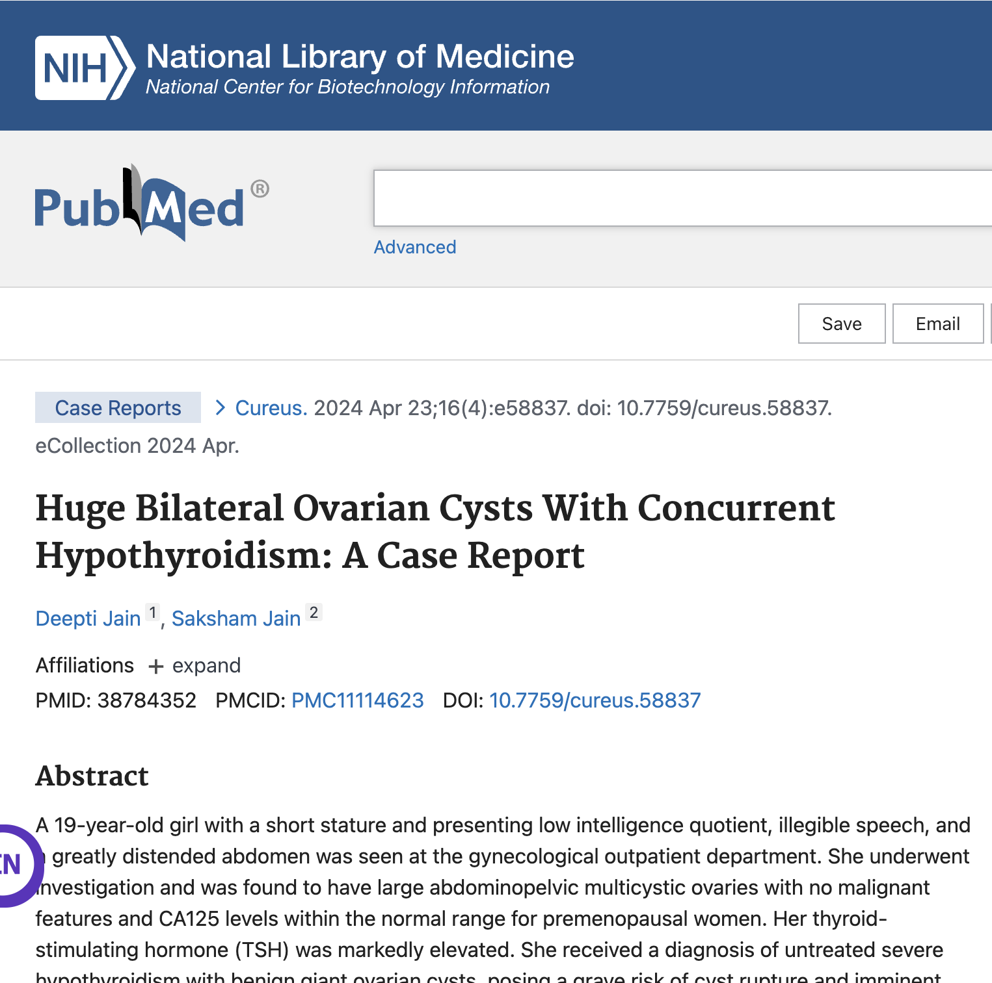
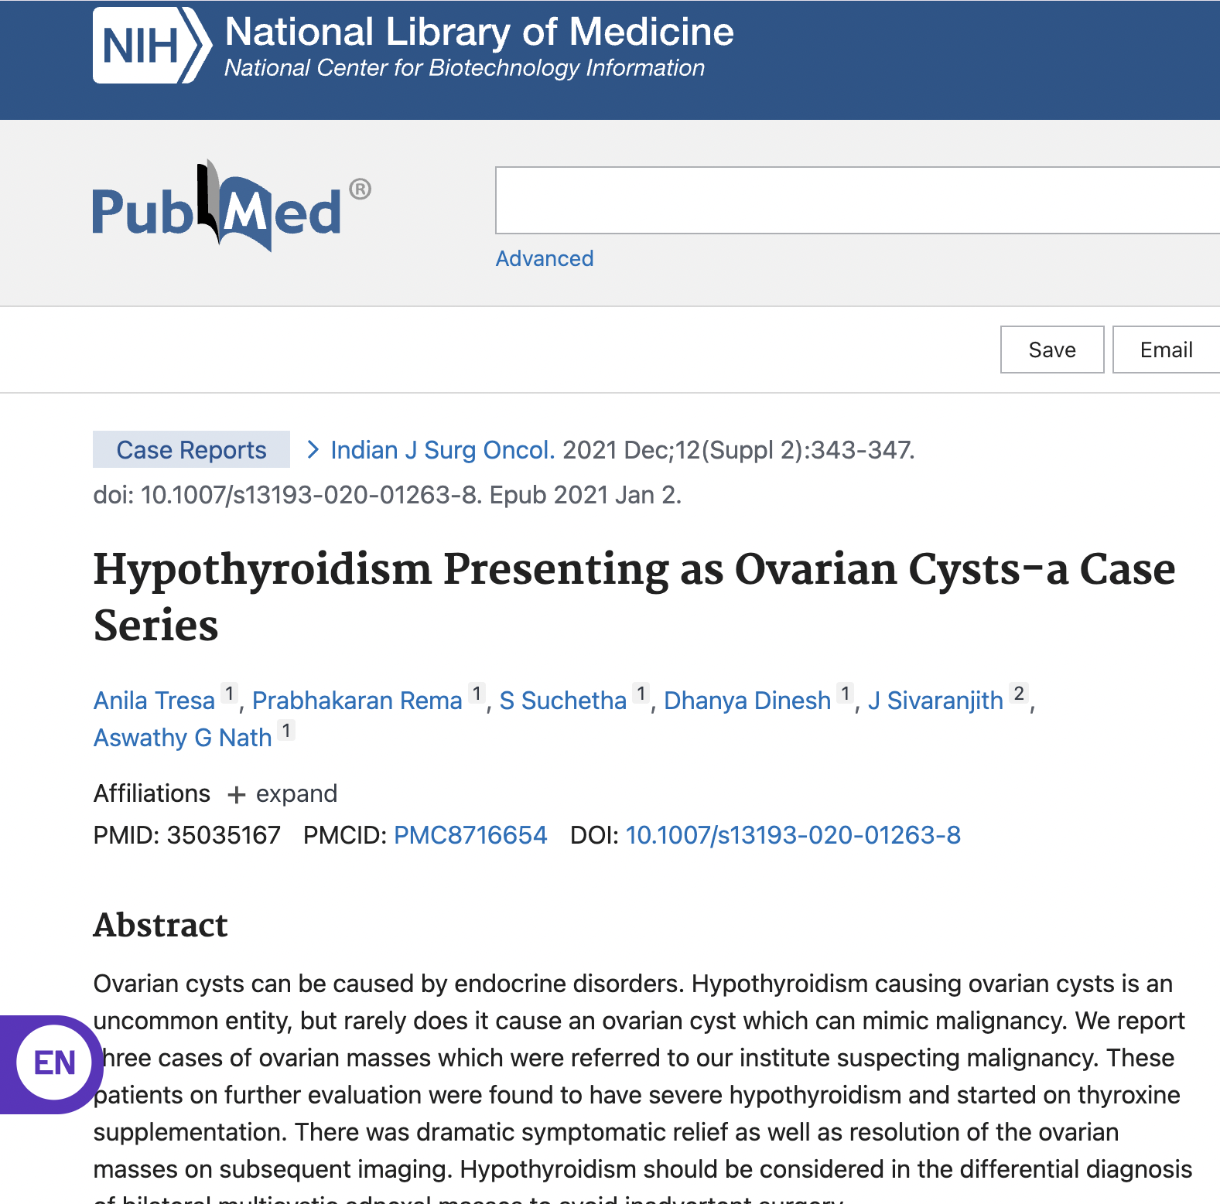
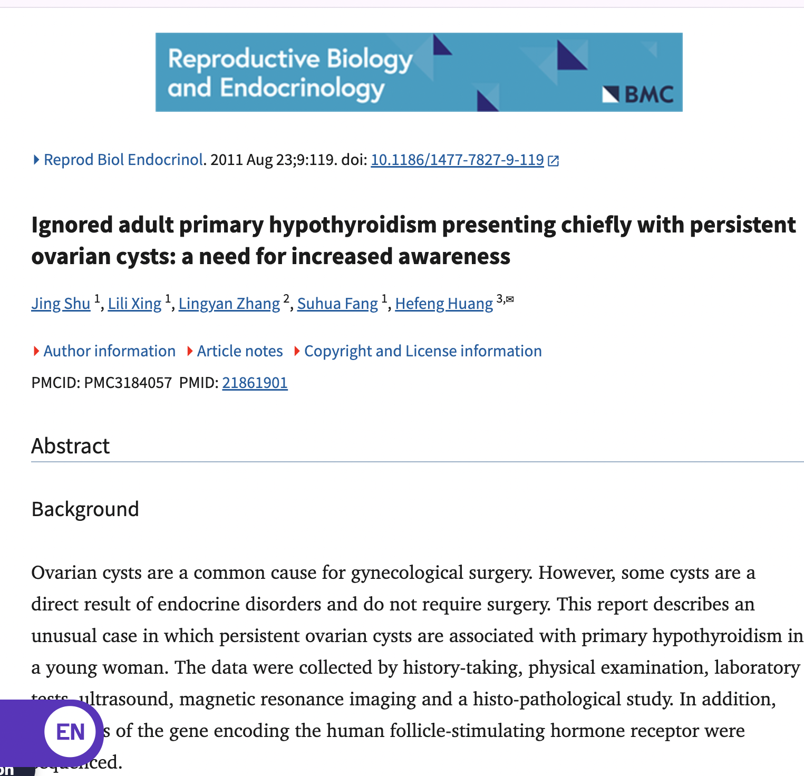

Slide 58

Key Points
Functional cysts can occur in all ages
Less than 3cm are not cysts
Most regress spontaneously
Hypothyroidism should be ruled out
Aim of Treatment
Resolution of symptoms
Preservation of ovarian tissue for future fertility

Slide 59

Take Home Message
Health care providers, including gynecologists, surgeons and physicians should consider hypothyroidism in the diagnosis of young females presenting with multiloculated ovarian cysts to avoid unnecessary and catastrophic ovarian resection.

Slide 60
REFERENCES
Bilateral ovarian masses due to primary hypothyroidism: a case report. J Family Med Prim Care .2025 June 30;14(6):2569-2571.
A case of primary hypothyroidsm complicated with pitutary adenoma and chronic adnexal torsion.Cyprus J Med Sci 2024:9(6):450-453.
Age- specific frequencies and characteristics of ovarian cysts in children and adoloscents.Hamdi Cihan Emeksiz,Oksan Derinoz J Clin Res pediatr Endocrinol 2017 1;9(1):58-62
Huge Bilateral Ovarian cysts with concurrent Hypothroidism: Case report. April 2024. Cureus 16(4)DOI :10.7759.
Tresa, A., Rema, P., Suchetha, S., Dinesh, D., Sivaranjith, J., & Nath, A. G. (2021). Hypothyroidism Presenting as Ovarian Cysts-a Case Series. Indian journal of surgical oncology, 12(Suppl 2), 343–347. https://doi.org/10.1007/s13193-020-01263-8

Slide 61


Slide 62
THANKYOU

