Slide 2
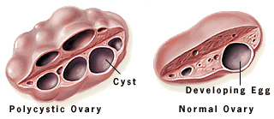
Polycystic Ovarian Syndrome (PCOS)
Dr. Nighat naheed
Assisstant. Professor
Obstetrics & Gynaecology
Rawalpindi Medical College
Rawalpindi

Slide 3
To impart evidence-based research-oriented medical education. To provide the best possible patient care. To inculcate the values of mutual respect and ethical practice of medicine

Slide 4
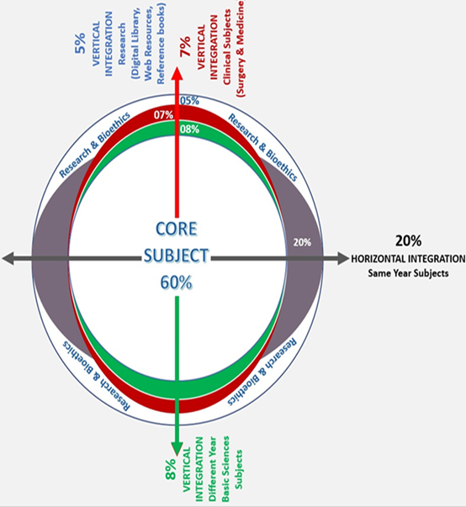
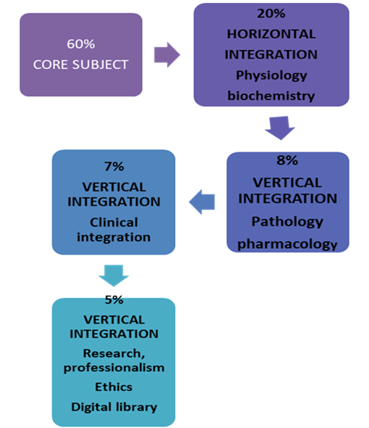

Slide 5
Question 1
When assessing a patient’s serum hormone levels, what would be consistent with PCOS?
Decreased testosterone and decreased estrogen
Increased testosterone and LH, decreased FSH
Decreased testosterone and decreased prolactin
Decreased LH and Increased FSH
Increased LH and increased FSH
✓

Slide 6
Question 2
Polycystic Ovarian Syndrome (PCOS) confers an increased risk of:
a. Endometrial cancer
b. Ovarian cancer
c. Ovarian cysts
d. Type 2 diabetes mellitus
e. Breast Cancer
✓

Slide 7
Question 3
Which of the following on ultrasound can make the diagnosis of Polycystic Ovarian according to Rotterdam criteria?
a. ≥10 antral follicles per ovary
b. ≥12 antral follicles per ovary
c. ≥20 antral follicles per ovary
d. ≥25 antral follicles per ovary
e. ≥30 antral follicles per ovary
✓

Slide 8
Question 4
What is the first line management of menstrual irregularity in women with PCOS and BMI of 29kg/m2?
COCP
Weight reduction and life style modification
Metformin
Myo-inositol
✓

Slide 9
Question 5
A 22 year old woman with PCOS complaining of excessive facial hair growth. What is the best way to manage her problem?
COCP ( Diane 35)
Clomephine citrate
Metformin
Myo-inositol
Clomephine + metformin
✓

Slide 10
Question 6
A 33-year-old woman presented with secondary infertility. Her BMI is 31kg/m2 with irregular cycle. Her husband’s semen analysis was normal. She is keen to conceive. What treatment would you recommend for her?
Ovarian drilling
Clomephine citrate alone
Metformin
Myo-inositol
Clomephine + metformin
✓

Slide 11
Question 7
What is the best way to address insulin resistant in a patient with PCOS?
Life style modification
Clomephine citrate
Metformin
Myo-inositol
Life style modification + metformin
✓

Slide 12
Question 8
How many times a year should a patient with PCOS bleed in a year in order to prevent endometrial hyperplasia and ultimately endometrial cancer?
Once a year
Twice a year
Three times per year
Four times per year
At least 6 months per year
✓

Slide 13
Question 9
Levels of which of the following hormones is reduced in a woman with PCOS leading to increased in testosterone and estrogen
a. Insulin
b. FSH/LH ratio
c. SHBG
d. Progesterone
e. Prolactin
✓

Slide 14
Question 10
What does presence of Acanthosis nigricans in a patient with PCOS indicate?
a. Due to obesity friction
b. Metabolic syndrome
c. Excess sex hormones
d. Elevated cortisol levels
e. Reduced prolactin levels
✓

Slide 15
LEARNING OBJECTIVES
By the end of this session students will be able to:
Discuss the pathophysiology of PCO’S.
Explain diagnostic criteria of PCO’S
Describe clinical features of PCO’S
Enlist investigations of patient with PCO’S.
Discuss the management options of PCO’S.

Slide 16
POLYCYSTIC OVARIAN SYNDROME
PCOS is the commonest endocrine disturbance to affect women during their reproductive years
Prevalence in general population
20% – 33%
PREVALENCE IN South Asian : 52%
GENETIC INHERITANCE
24 % of all mothers
33% of all sisters
Rodin et al Clin. Endocrinol. 49, 91, 1998
Adam Balen, “PCOS: diagnosis, prevalence and ethnic differences” Gynecology Forum Volume 18, No. 4, 2013

Slide 17
HYPOTHALAMIC PITUITARY OVARIAN AXIS

Slide 18
ETIOLOGY
Lifestyle and inherited risk factors
Hormonal changes exacerbated by obesity
High androgen levels
Insulin resistance
Hirsutism
Acne
Alopecia
Oligo-anovulation menstrual irregularity and subfertility
Metabolic syndrome
Increased CV risk factors
T2DM
Adverse effect on quality of life and mental health
Ref: S.Shorakae et.al., “Polycystic ovary syndrome: a common hormonal condition with major metabolic sequlae that
physicians should know about”, Internal Medicine Journal 44 (2014), Royal Australian College of Physicians, 720-726

Slide 19
PATHOPHYSIOLOGY

Slide 20
DIAGNOSIS

Slide 21
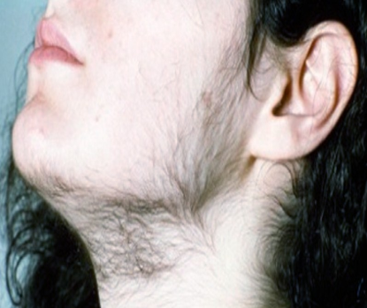
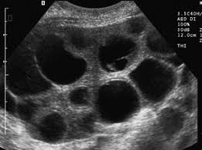
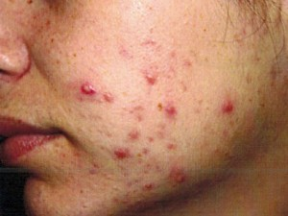
CLINICAL FEATURES
Oligomenorrhea/amenorrhea
Hirsutism
Subfertility
Obesity
Acanthosis nigricans

Slide 22
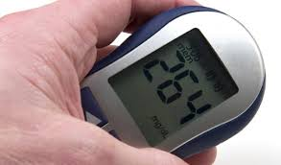
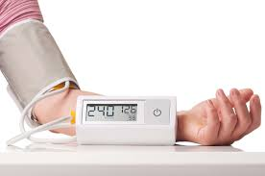
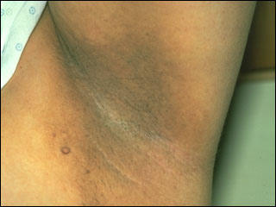
CLINICAL FEATURES
Metabolic syndrome (MetS)
Obesity (38-60%)
Diabetes mellitus
Hypertension
Dyslipidemias
Acanthosis nigricans

Slide 23
DIAGNOSTIC CRITERIA
ESHRE/ASRM (Rotterdam, Netherlands)
Rotterdam criteria : 2 of the 3 features required for
diagnosis
anovulation /oligomenorrhoea
Hyperandrogenism (clinical / biochemical)
Polycystic ovaries on ultrasonography
(peripheral distribution of follicles,
≥12 follicles, 2-9 mm and ovarian volume >10 cm³)
ESHRE/ ASRM-sponsored PCOS Workshop Group
Human Reprod. 19, 41, 2004

Slide 24
INVESTIGATIONS
↑ Fasting insulin
↑ Androgens
Reversed FSH/LH ratio
↓ SHBG
↑ Oestradiol
↑ Prolactin

Slide 25
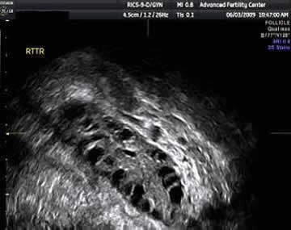
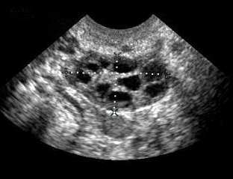
RADIOLOGICAL INVESTIGATIONS
New criteria
Presence of at least one
criterion:
Enlarged ovaries (>10 cm3)
Increased number of follicles (at least 12 between 2-20 mm diameter)
It is sufficient that only one ovary is enlarged

Slide 26
MANAGEMENT

Slide 27
MULTI DISCIPLINARY APPROACH
Fauser, Bart CJM, et al. "Consensus on women’s health aspects of polycystic ovary syndrome (PCOS): the Amsterdam ESHRE/ASRM-
Sponsored 3rd PCOS Consensus Workshop Group." Fertility and Sterility 97.1 (2012): 28-38.

Slide 28
LONG TERM HEALTH RISKS
Ovarian Disease
Metabolic Disease
15 years
Hyperandrogenism
Oligo-anovulation
25 - 40 years
Infertility
Hyperandrogenism
Pregnancy complications
45 years
Hyperandrogenism
Glucose intolerance
55 years
Cardiovascular
Type 2 diabetes
Endometrial CA
Endocrinologist
Gynecologist
Cardiologist
Diabetologist
Gynecologist
Maeliss Peigne, et. al. “Long term health risks of PCOS”, Gynecology Forum Volume 18, No. 4, 2013

Slide 29
LIFE STYLE MODIFICATION

Slide 30
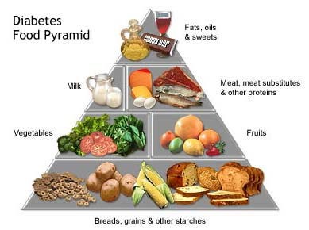
OBESITY
Weight reduction (BMI < 30 kg/m²)
Diet
Exercise
Drugs

Slide 31
MENSTRUAL IRREGULARITY
Without hyperandrogenism
Combined oral contraceptives.
Progesterone
With hyperandrogenism
Cyproterone acetate
Drosperinone

Slide 32
HIRSUTISM
Physical treatment
Medical treatment

Slide 33
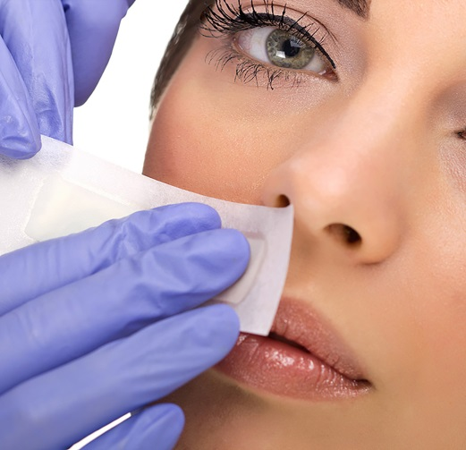
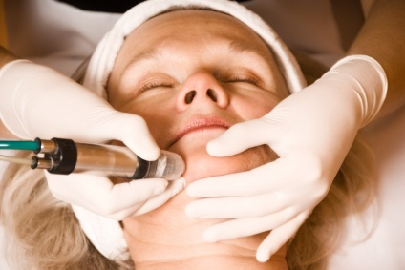
PHYSICAL TREATMENT
Waxing
Electrolysis
Bleaching
Laser
Photothermolysis
Vaneeka cream

Slide 34
MEDICAL TREATMENT
Estrogen/progestogen combination with antiandrogenic properties
Non-steroidal antiandrogens (Spironolactone, Flutamide, Finasteride)
Alone
Combined
Insulin sensitizing drugs (Metformin)
Alone
Combined

Slide 35
HYPERINSULINAEMIA
METFORMIN
Ameliorates hyperinsulinaemia and
hyperandrogenism
No effect on weight loss
Dose: 850 mg bid / 500 mg tid
Recommended for adolescent PCOS

Slide 36
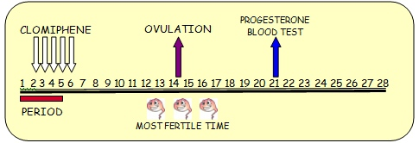
INFERTILITY
Life style modification
Ovulation Induction
Surgical

Slide 37
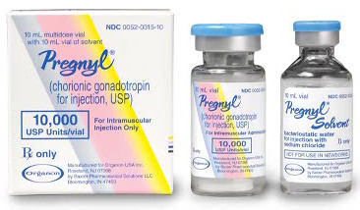
OVULATION INDUCTION
Antiestrogens (Clomiphene citrate)
Aromatase inhibitors (Letrazole)
Gonadotrophins (hMG, hCG, FSH)

Slide 38
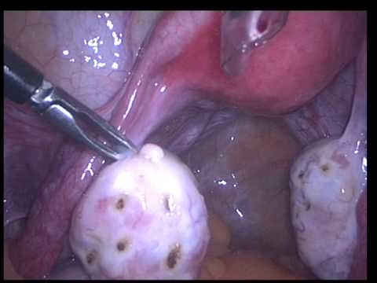
SURGICAL TREATMENT
Ovarian diathermy
Ovarian wedge resection

Slide 39
LONG TERM HEALTH RISKS DUE TO ANOVULATION
Chronic anovulation and prolonged exposure to unopposed estrogen can lead to endometrial hyperplasia and endometrial cancer
Risk of endometrial cancer was 5.3 times higher in women with PCOS and 6.1 times higher in obese women with PCOS
To prevent endometrial hyperplasia, at least four induced withdrawal bleeds per year are recommended
Maeliss Peigne, et. al. “Long term health risks of PCOS”, Gynecology Forum Volume 18, No. 4, 2013

Slide 40
RECENT ADVANCES
Ref: Long term Consequences of Polycystic Ovarian Syndrome, Green Top Guidelines No. 33, 2014 RCOG

Slide 41
ROLE OF VITAMIN D IN PCOS
The prevalence of vitamin D deficiency in women with PCOS is about 67-85% with serum concentrations of 25(OH)D <20 ng/ml³
Low 25(OH)D levels may exacerbate the symptoms of PCOS
There is inverse correlation between Vitamin D levels and metabolic risk factors
Lin & Wu: The role of vitamin D in polycystic ovar y syndrome, Indian J Med Res 142, September 2015, pp 238-240
Sur and Chakravorty, The Relationship between Vitamin D, Insulin Resistance and Infertility in PCOS Women, Gynecology & Obstetrics, 2015

Slide 42
ROLE OF INOSITOL
Myo inositol
D-chiro-inositol
Two inositol Stereoisomers in a plasma ratio of 40:1

Slide 43
BENEFICENCE
The principle of beneficence is the obligation of physician.
To act for the benefit of the patient.
Support a number of moral rules to protect and defend the right of others.
Prevent harm, remove conditions that will cause harm.
Help persons with disabilities, and rescue persons in danger.

Slide 44
BIOMEDICAL ETHICS
Importance of awareness of a healthy lifestyle.

Slide 45
CONCLUSION
PCO syndrome is a COMPLEX clinical entity and should be dealt with according to the problems of the patients

Slide 46
Hope we all have a better tomorrow
Thank You

