Slide 1
Secondary Amenorrhea
Dr Sadia Khan
Professor OBS/GYN Benazir Bhutto Hospital Rawalpindi Medical University

Slide 2
MOTTO
To impart evidence- based research oriented medical education
To provide best possible patient care
To inculcate the values of mutual respect and ethical practice of medicine

Slide 3
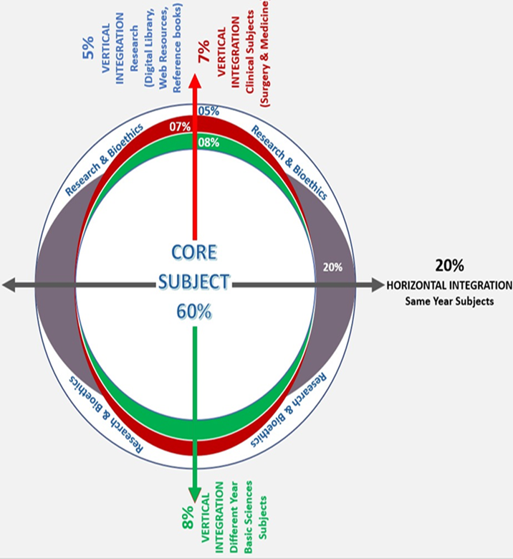

Slide 4
Multiple Choice Questions
Q1. What is the minimum duration of absent menstruation to be diagnosed as a case of secondary amenorrhea?
a) 1 month b) 2 months c) 3 months d) 6 months
e)12 months
✓

Slide 5
Multiple Choice Questions
Q2.Which of the following is a common hormonal cause of secondary amenorrhea?
a) Hyperprolactinemia b) Endometriosis c) Polycystic Ovary Syndrome (PCOS) d) Hyperprolctinemia and PCOS
e)Hyperthyroidism
✓

Slide 6
Multiple Choice Questions
Q3.Which of the following treatments is used to induce menstruation in women with secondary amenorrhea?
a) Metformin b) Clomiphene Citrate c) Progesterone therapy d) Letrazole
e)SERMS
✓

Slide 7
Multiple Choice Questions
Q4.Which lifestyle change can help manage or prevent secondary amenorrhea?
a) Increased caffeine intake b) Extreme weight loss c) Stress management d) Sedentary lifestyle
e)Reduce smoking
✓

Slide 8
Multiple Choice Questions
Q5.Which of the following is the most common cause of secondary amenorrhea in women of reproductive age?
a) Menopause b) Pregnancy c) Hypothalamic Dysfunction d) Thyroid Disorders
e)Hypogonadotrophic Hypogonadism
✓

Slide 9
Multiple Choice Questions
Q6 An 18-year-old national gymnastic player, has long periods of amenorrhea with only two-three periods per year. Her BMI is 16kg/m2 and shes preparing for Olympics. What will you offer her?
a. COCP
b. Withdrawal bleed with progesterone
c. GnRH analogue
d. Reassure her and review
e. Metformin
✓

Slide 10
Multiple Choice Questions
Q7. A 28-year-old woman presented with complaint of secondary amenorrhea for past 6 months, she tried COCP after her USG was normal but did not respond and came for follow-up. Now shes complaining of white discharge form her breast and visual disturbance. What could be the cause of her amenorrhea ?
a. Cushing syndrome
b. Hyper-prolactinaemia
c. Increased progestrone and estrogen levels
d. PCOS
e. Pregnancy
✓

Slide 11
Multiple Choice Questions
Q8. A 33-year-old woman presented with amenorrhea for 5 months, her UPT is negative. She had a miscarriage 6 months back followed by D&C in a private setup and another 4 months back followed by D&C again. She wants to conceive. What could be the cause of her amenorrhea?
a. Prolactinoma
b. Sheehan Syndrome
c. Premature ovarian failure
d. PCOS
e. Asherman syndrome
✓

Slide 12
Multiple Choice Questions
Q9. A 22-year-old female delivered via spontanous vaginal delivery of a 4kg baby which needed instrumental delivery and was followed by severe PPH, managed with packing and blood transfusion 9 months back. She couldn’t breast feed her baby, and complained of amenorrhea since her delivery.
a. Prolactinoma
b. Sheehan Syndrome
c. Premature ovarian failure
d. PCOS
e. Asherman syndrome
✓

Slide 13
Multiple Choice Questions
Q10. A 33-year-old female with P3+0 complained of secondary amenorrhea for last 2 years, her last conceived birth was 2.5 year back via normal delivery with no complications. She took progesterone injections for contraception after delivery. She’s worried about her lack of period. What is the cause of her amenorrhea ?
a. Cervical stenosis
b. Sheehan Syndrome
c. Premature ovarian insufficiency
d. PCOS
e. Iatrogenic/drug induced
✓

Slide 14
Learning Objectives
By the end of this presentation, the students should be able to:
Define secondary amenorrhea
Enlist its important causes
Discuss clinical features and its diagnostic criteria
Discuss the management options

Slide 15
Definition
Absence of menstruation for more than 6 months in a normal female in reproductive age that is not due to pregnancy lactation or menopause

Slide 16
Causes of Secondary Amenorrhea
1
Hypothalamic disorders
⬇ FSH, LH releasing hormones ⬇ HPO axis
2
Pituitary disorders
⬇ FSH,LH
Ovarian disorders
⬆ LH:FSH 3:1
3
4
Endometrial disorders
FSH, LH and pituitary hormones normal

Slide 17
Secondary amenorrhea
Rule out pregnancy urine test/USG
FSH, LH, Prolactin, TSH, Testosterone
Raised FSH
Normal FSH/LH
Low FSH/LH
Premature ovarian failure
Asherman’s syndrome
Hysterectomy
Cervical stenosis
Hypothalamic / pituitary Stress prolactinoma

Slide 18
Summary of causes
MOST COMMON
LESS COMMON
RARE CAUSES
Pregnancy/lactation
Hypothalamic (Stress, exercise)
Pituitary (Prolactinomas)
Androgen disorders (PCOS)
Adult onset adrenal hyperplasia
Premature Ovarian failure
Asherman syndrome
Sheehan’s syndrome
Drug induced amenorrhea
Chronic illness e.g. diabetes, cushing disease, cirrhosis
Infections (T.B)
CKD
Malnutrition
Irradiation /chemotherapy

Slide 19
Most common causes presenting with secondary amenorrhea

Slide 20
Diagnosis
Progesterone Challenge test B-hCG is negative,
TSH+prolactin normal
Positive PCT
Negative PCT
Withdrawal bleed is diagnostic Of anovulation.
Absence of withdrawal = inadequate estrogen or outflow tract obstruction
Ovarian Failure
⬆ FSH
EPCT
Give 21 days of oral estrogen followed by 7 days of MPA Withdrawal bleed present
Absence of withdrawal–AS
HP insufficiency
⬇ FSH

Slide 21
OVARIAN CAUSES OF SECONDARY AMENORRHOEA

Slide 22
Polycystic ovarian syndrome
Ovarian dysfunction with hyperandrogenism and polycystic ovarian morphology
Prevalence : around 25%-30% of all women on ultrasound but not always associated with the full syndrome
5–10% of women of reproductive age
Associated with an increased risk of type 2 diabetes and cardiovascular events.
Etiology : Not completely clear
Frequent familial trend points to a genetic cause.
Notes:
Heterogenous collection of s/s that form a spectrum of disorders of reproductive , endocrine and metabolic function

Slide 23
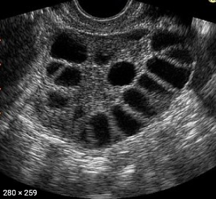
Diagnostic criteria
Rotterdam criteria: two out of the three
1. Anovulation/Oligo-ovulation
2. Clinical or biochemical hyperandrogenism
3. Polycystic ovaries on USG

Slide 24
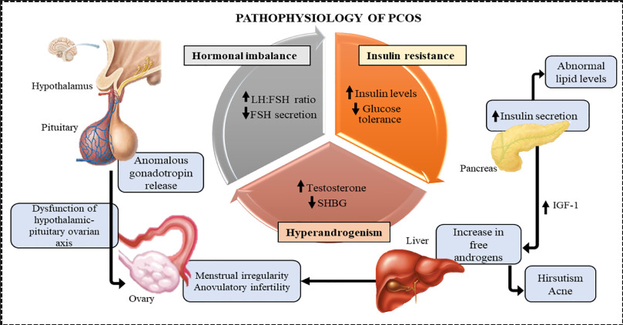
Pathophysiology

Slide 25
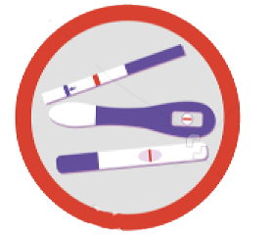
Clinical Features
Oligomenorrhea/amenorrhea - 75%
Hirsutism
Subfertility 75%
Obesity 45%
Acanthosis nigricans
Acne

Slide 26
Investigations
↑ Fasting insulin(OGTT)
↑ Androgens (testosterone and androstenedione)
↑ or normal LH, normal FSH (LH : FSH )
↓ SHBG, results in elevated free androgen index
↑ Estradiol, estrone
↑ Prolactin

Slide 27
Management
1. Lifestyle Modifications (exercise, weight loss)
2. Metformin (insulin resistance)
Fertility required
Fertility not required
3. Ovulation induction
4.Cyclical progestogens
5.COCP

Slide 28
Premature Ovarian Failure
Definition
Secondary amenorrhea for at least 4 months with raised FSH level on 2 separate occasions, raised FSH/ LH ratio and low E2 Level before the age of 40 years

Slide 29
Clinical features
Hot flushes & sweating 75%
Reduced libido
Vaginal dryness
Urinary incontinence
Mood swings
Spectrum of menopausal symtoms

Slide 30
Investigations
Hormone profile ( FSH levels >40mIU/L)
Decreased E2 levels
Thyroid profile
Blood sugar
USG

Slide 31
Management
Manage any treatable cause
Steroid therapy if autoimmune cause
Menopausal Hormonal Therapy (MHT)
Counselling

Slide 32
PITUITARY CAUSES OF SECONDARY AMENORRHOEA

Slide 33
Hyperprolactinemia
Causes
1. Medication Antipsychotic/antidepressants
2. Pituitary Adenomas
3. Hypothyroidism - Increased Thyrotropin level leads to increased Prolactin levels

Slide 34
Treatment of Hyperprolactinemia
Medical management
Bromocriptine 2.5 mg - 20mg/ day
Cabergoline 0.25-1mg twice weekly
In case of pituitary tumour <1cm medical treatment with bromocriptine
Surgical management
> 1cm tumour surgical treatment by Trans-sphenoidal adenectomy

Slide 35
HYPOTHALAMIC CAUSES OF SECONDARY AMENORRHOEA

Slide 36
Hypothalamic causes
Primary Hypothalamic Leisions
Secondary Hypothalamic Leisions
Craniopharyngiomas
Germinomas
Gliomas
Dermoid cysts
Sarcoidosis
Tuberculosis
Head injury
Cranial irradiation
Sheehans syndrome

Slide 37
Sheehans Syndrome
Definition
It is the result of profound and prolonged hypotension on the sensitive pituitary gland enlarged by pregnancy
Cause
Postpartum haemorrhage

Slide 38
Sheehans Syndrome
Investigations
Assess pituitary function
Treatment
Hormonal Replacement Therapy

Slide 39
GENITAL TRACT ABNORMALITIES

Slide 40
Asherman Syndrome
It is a condition characterized by the formation of scar tissue (adhesions) within the uterine cavity, which can lead to partial or complete obliteration of the uterine cavity.

Slide 41
Aetiology and Pathogenesis
Post-Surgical Scarring
Most commonly occurs after uterine surgery, particularly after dilation and curettage (D&C) following miscarriage, abortion, or postpartum haemorrhage.

Slide 42
Clinical Features
Hypomenorrhea or Amenorrhea:
Decreased menstrual flow or complete absence of menstruation is common due to the reduced surface area of the endometrium.

Slide 43
Aetiology and Pathogenesis
Infection: Pelvic infections like tuberculosis or severe pelvic inflammatory disease (PID) can also lead to adhesions.
Trauma: Other uterine surgeries, such as myomectomy or caesarean sections, can also contribute to the development of adhesions.

Slide 44
Clinical Features
Infertility: Adhesions can prevent implantation or disrupt the normal functioning of the endometrium, leading to infertility.
Recurrent Pregnancy Loss: Difficulty in maintaining a pregnancy due to an inadequate endometrial environment.

Slide 45
Diagnosis
Hysterosalpingography (HSG): X-ray imaging with contrast that can reveal the extent and location of adhesions within the uterine cavity.
Hysteroscopy: The most definitive diagnostic tool, allowing direct visualization of adhesions and assessment of their severity.
Ultrasound: May show a distorted uterine cavity or absent endometrial echo, but it is less sensitive than hysteroscopy.

Slide 46
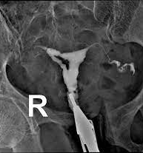
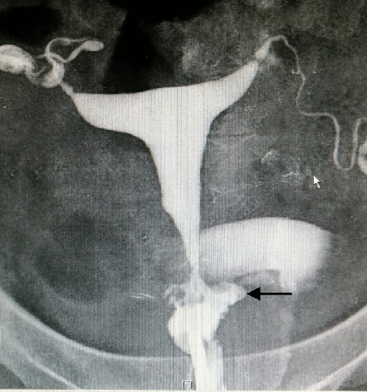
HSG in Asherman syndrome
HSG of normal uterus

Slide 47
Management
Hysteroscopic adhesiolysis:
The treatment of choice, involving the cutting and removal of adhesions using a hysteroscope. It’s often followed by hormonal therapy to promote healing and prevent reformation of adhesions.

Slide 48
Thank you

