Slide 1
CASE VIGNETTE
A 37-year-old female presented to the emergency room reporting of palpitations, shortness of breath and headache. While all symptoms were sudden in onset, the patient had never experienced palpitations or any difficulty breathing in the past. She was being managed in an outpatient setting for hypokalemia and hypertension since 2009.
On physical examination, her heart rate was 110 bpm while the blood pressure was 170/110 mm Hg. Cardiac, abdominal, neurological and musculoskeletal examinations were unimpressive with no signs of clubbing or oedema. Initial investigations revealed normal hematological and renal parameters but showed sodium 135 mmol/L and potassium 2.5 mmol/L.

Slide 2
PRIMARY HYPERALDOSTERONISM
Dr. Muhammad Mujeeb Khan
FCPS (Medicine)
Dip. DM (UK), Dip. Nutrition (Pak),
MSc. Infectious Diseases (UK)
Associate Professor
Rawalpindi Medical University, Rawalpindi

Slide 4
LECTURE CONTENT ANALYSIS
CORE CONTENT | 60%
HORIZONTAL INTEGRATION | 20%
VERTICAL INTEGRATION | 15%
RESEARCH & ETHICS | 5%

Slide 5
LEARNING OBJECTIVES
At the end of this lecture students should be able to:
Define Primary and Secondary Hyperaldosteronism.
Describe the pathophysiology and Etiology of Hyperaldosteronism.
Describe the clinical features of Hyperaldosteronism.
Numerate the Laboratory investigations for the diagnosis of Hyperaldosteronism.
Describe the management plan.

Slide 6
DEFINITION
Primary Aldosteronism (PA) is caused by excessive secretion of aldosterone from the adrenal glands.
Secondary Aldosteronism is increased adrenal production of aldosterone in response to nonpituitary, extra-adrenal stimuli such as renal hypoperfusion.

Slide 7
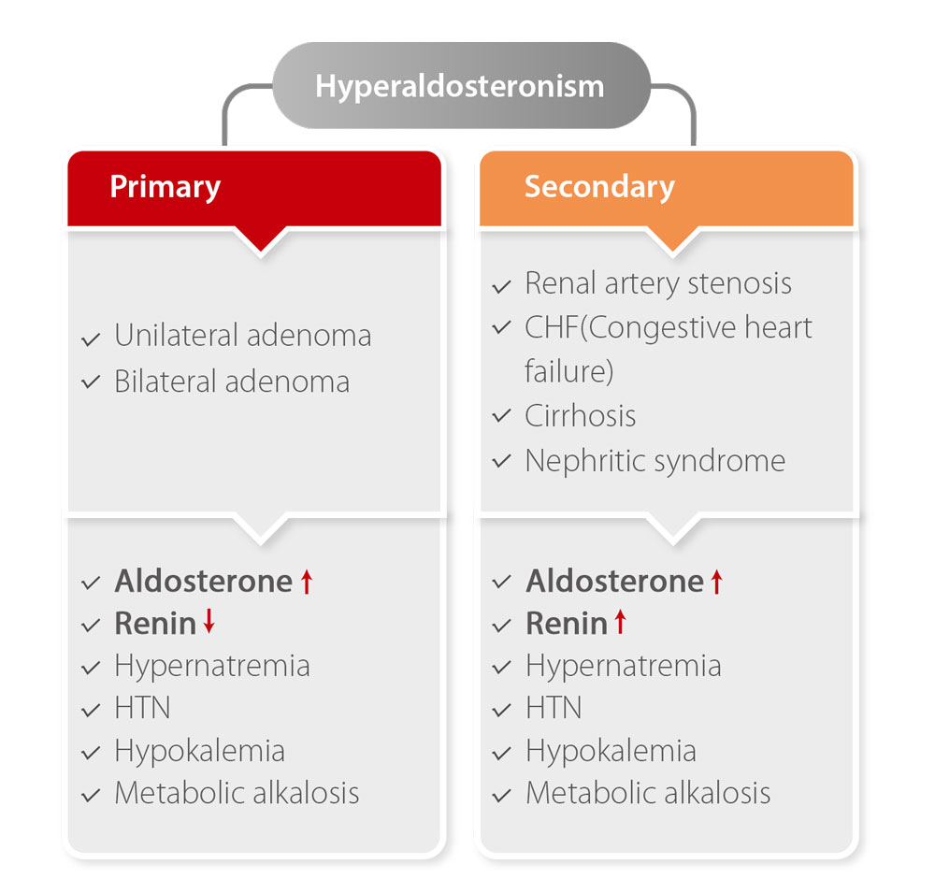

Slide 8
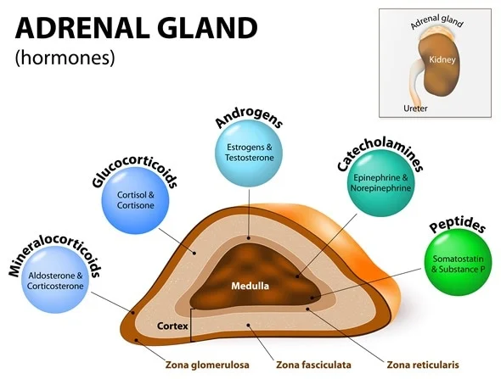
STRUCTURE OF ADRENAL GLAND

Slide 9
NORMAL FUNCTION OF ALDOSTERONE

Slide 10
ETIOLOGY OF PRIMARY HYPERALDOSTERONISM
Causes of Primary hyperaldosteronism Frequency (%)
Idiopathic hyperaldosteronism 65
Aldosterone-producing adenoma 30
Primary unilateral adrenal hyperplasia 3
Aldosterone-producing adrenocortical carcinoma <I
Aldosterone-producing ovarian tumor <I
Familiar hyperaldosteronism <I

Slide 11
EPIDEMIOLOGY OF HYPERALDOSTERONISM

Slide 12
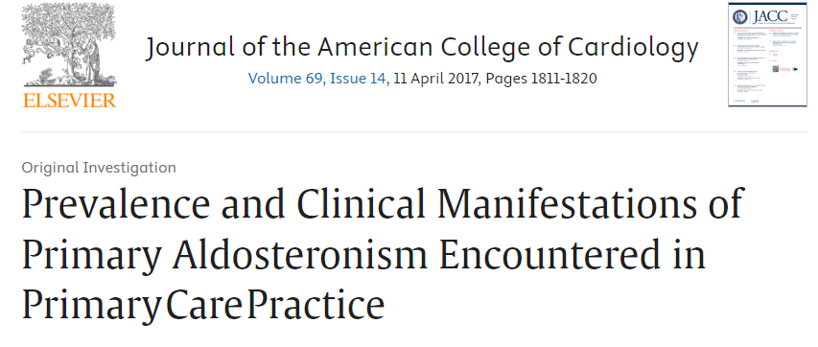
A total of 1,672 primary care patients with hypertension (569 newly diagnosed and 1,103 patients already diagnosed with arterial hypertension) were included in the study. A total of 99 patients (5.9%) were diagnosed with PA

Slide 13
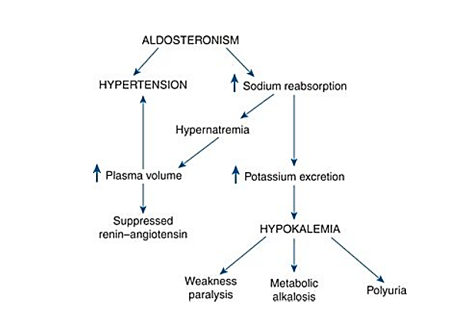
PATHOPHYSIOLOGY OF HYPERALDOSTERONISM

Slide 14
CLINICAL FEATURES
Uncontrolled hypertension
Severe muscle weakness
Palpitations
Fatigue HYPOKALEMIA
Muscle cramps
Polyuria and polydipsia

Slide 15
SCREENING CRITERIA FOR PRIMARY HYPERALDOSTERONISM
Resistant Hypertension
Hypertension associated with hypokalemia.
Hypertension before the age of 40.
Adrenal incidentaloma

Slide 16
LABORATORY INVESTIGATION FOR DIAGNOSIS
Screening test: Aldosterone/plasma renin activity.
Confirmation of diagnosis: Failure to suppress aldosterone in face of sodium/volume loading.
Saline Infusion test
Fludrocortisone suppression test
Dietary Sodium loading test

Slide 17
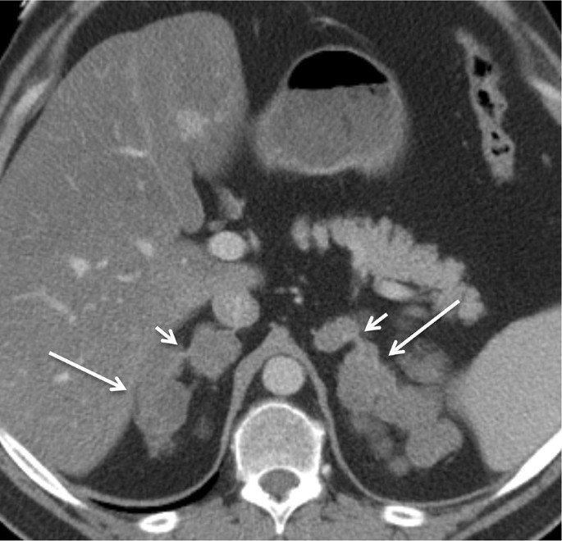
IMAGING FOR FINDING THE UNDERLYING CAUSE
Adrenal Adenoma
Bilateral Adrenal Hyperplasia

Slide 18
MANAGEMENT
Surgical Intervention: Adrenalectomy Adrenal Adenoma
Medical treatment: Bilateral Adrenal Hyperplasia
Mineralocorticoid receptor antagonist, e.g., Spironolactone.

Slide 19
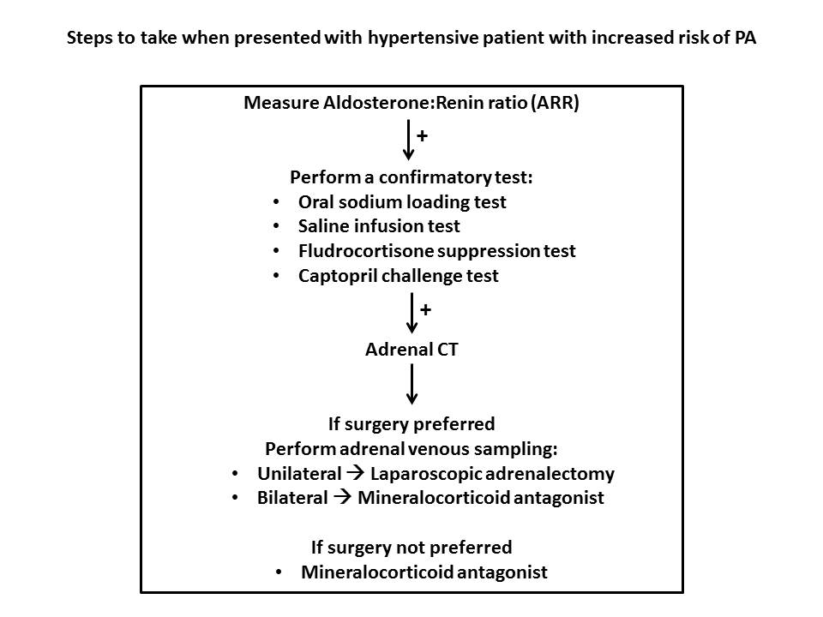

Slide 20
RECENT ADVANCES

Slide 21
ETHICAL ISSUES
Ethical Issue | Key Concerns
Informed Consent and Patient Education | Educating patients understand the chronic nature of PHA, available treatments (e.g., adrenalectomy, mineralocorticoid receptor antagonists), and potential complications
Diagnostic Uncertainty and Misdiagnosis | Ethical challenges in differentiating PHA from essential hypertension; risks of delayed or incorrect diagnosis.
Equity in Access to Care | Ensuring availability of diagnostic tests (e.g., aldosterone-renin ratio, adrenal vein sampling) and treatment options across all populations.
Overtreatment and Harm Prevention | Avoiding unnecessary interventions or long-term medication use in patients with borderline or subclinical cases.

Slide 22
Thank you

