Slide 1
CASE VIGNETTE
A 50-year-old housewife complains of progressive weight gain of 10 Kgs in 1 year, fatigue, slight memory loss, slow speech, dry skin, constipation, and cold intolerance. Vital signs include a temperature 96.8 F, pulse 58/minute and regular, BP 140/100. She is moderately obese and speaks slowly and has a puffy face, with pale, cool, dry, and thick skin. The thyroid gland is slightly enlarged, firm, not nodular, mobile, and not tender. The deep tendon reflex time is delayed.

Slide 2
HYPOTHYROIDISM
Dr. Muhammad Mujeeb Khan
FCPS (Medicine)
Dip. DM (UK), Dip. Nutrition (Pak),
MSc. Infectious Diseases (UK)
Associate Professor
Rawalpindi Medical University, Rawalpindi

Slide 4
LECTURE CONTENT ANALYSIS
CORE CONTENT | 60%
HORIZONTAL INTEGRATION | 20%
VERTICAL INTEGRATION | 15%
RESEARCH AND ETHICS | 5%

Slide 5
LEARNING OBJECTIVES
At the end of this lecture, students should be able to:
Define hypothyroidism and describe its etiology.
Explain the pathophysiology of hypothyroidism.
Describe the clinical features and signs of hypothyroidism.
Describe the laboratory investigations used in the diagnosis of hypothyroidism.
Differentiate between primary, secondary, and subclinical hypothyroidism based on laboratory findings.
Recognize the potential complications of untreated hypothyroidism.
Outline the management of hypothyroidism.

Slide 6
STRUCTURE OF THYROID GLAND

Slide 7
PHYSIOLOGY OF THYROID HORMONE PRODUCTION

Slide 8
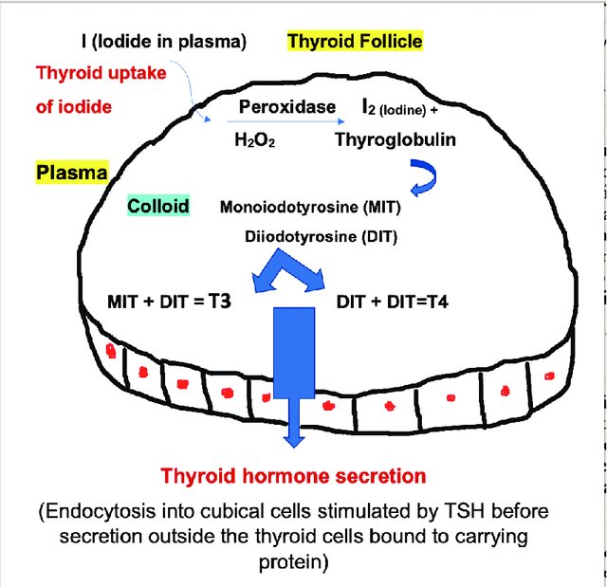
SYNTHESIS AND SECRETION OF THYROID HORMONES

Slide 9
FUNCTIONS OF THYROID HORMONE
Cardiac output, and resting heart rate increase through positive chronotropic and inotropic effects.
Increase in BMR, thermogenesis.
Resting respiratory rate and minute ventilation.
Promote fetal growth, skeletal maturation.
T3 stimulates the nervous system resulting in increased wakefulness, alertness, and responsiveness to external stimuli.
Increase gut motility.
Increase serum glucose, promote growth hormone, catecholamine synthesis, and inhibit prolactin synthesis.

Slide 10
DEFINITION
Hypothyroidism is a common endocrine disorder resulting from deficiency of thyroid hormone.

Slide 11
ETIOLOGIES OF HYPOTHYROIDISM

Slide 12
ETIOLOGIES OF HYPOTHYROIDISM
Primary hypothyroidism is defined as low levels of blood thyroid hormone due to destruction of the thyroid gland.
Secondary hypothyroidism, also known as central hypothyroidism is caused by a defect in the hypothalamic-pituitary axis.

Slide 13
ETIOLOGIES OF HYPOTHYROIDISM
PRIMARY HYPOTHYROIDISM
Chronic autoimmune thyroiditis Iodine deficiency Thyroidectomy Therapy with radioactive iodine External radiotherapy. Drugs Thyroid agenesis or dysgenesis.

Slide 14
ETIOLOGIES OF HYPOTHYROIDISM
SECONDARY HYPOTHYROIDISM
Pituitary adenomas History of pituitary surgery or radiotherapy History of head trauma History of pituitary apoplexy Hypothalamic or suprasellar tumors History of hypothalamic surgery or radiotherapy

Slide 15
CLINICAL SYMPTOMS AND SIGNS

Slide 16
CLINICAL FEATURES
Fatigue
Lethargy
Constipation
Cold intolerance
Somnolence
Weight gain
Dry skin
Hair loss
Deep hoarse voice
OSA
Dull expression less face, sparse hair, periorbital puffiness
Depression, Psychosis
Menorrhagia
Macroglossia
Bradycardia
Delayed relaxation of tendon reflexes

Slide 17
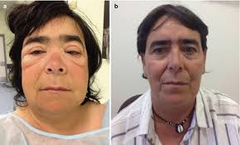
CLINICAL FEATURES

Slide 18
LABORATORY INVESTIGATIONS

Slide 19
DIAGNOSTIC TEST FOR HYPOTHYROIDISM
PRIMARY HYPOTHYROIDISM | SECONDARY HYPOTHYROIDISM | SUBCLINICAL HYPOTHYROIDISM
TSH T3 T4 | TSH normal or T3 T4 | TSH T3 normal T4 normal

Slide 20
ABNORMAL LAB INVESTIGATIONS
IN HYPOTHYROIDISM
Antibodies: TPO, TG, TSH receptor antibodies
Anemia, Hyponatremia, Hypoglycemia
Increased TG levels, Increased CK level

Slide 21
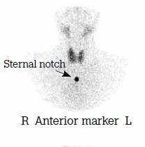
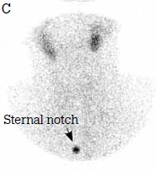
ABNORMAL IMAGING IN HYPOTHYROIDISM
NORMAL
HYPOTHYROID
THYROID SCAN

Slide 22
COMPLICATIONS

Slide 23
COMPLICATIONS OF HYPOTHYROIDISM
Myxedema Coma
Cardiomyopathy
Pericardial effusion
Infertility
Depression and Psychosis
Congenital hypothyroidism
Altered mental status
Hypothermia
Hypotension
Hyponatremia
Hypoglycemia
Hypoventilation
Bradycardia

Slide 24
MANAGEMENT

Slide 25
MANAGEMENT OF HYPOTHYROIDISM
Levothyroxine (oral T4 hormone)
Dose 1.6 to 1.8 ug/kg/day.
TSH levels are monitored to assess the response to the therapy.

Slide 26
ETHICAL ISSUES
Ethical Issue | Key Concerns
Informed Consent and Patient Education | Educating patients about lifelong levothyroxine therapy, potential side effects, and the need for regular monitoring.
Patient Autonomy | Respecting patient decisions regarding treatment, particularly in subclinical hypothyroidism or alternative therapies.
Equity in Access to Care | Ensuring access to thyroid function tests, medications, and follow-up care for patients from low-resource settings.
Overtreatment and Harm Prevention | Preventing excessive thyroid hormone replacement, which can cause osteoporosis, atrial fibrillation, and cardiovascular issues.
Special Populations (Pregnancy, Elderly, Pediatrics) | Ethical considerations in managing hypothyroidism in vulnerable populations with distinct therapeutic requirements.
Research and Innovation | Adhering to ethical standards in research involving new formulations or personalized therapies for hypothyroidism.
Healthcare Provider Responsibility | Ensuring accurate diagnosis and avoiding mislabeling patients with non-specific symptoms as hypothyroid.

Slide 27
THANK YOU

