Slide 1
CASE VIGNETTE
A 21-year-old female, presented in medical OPD with the complaints of decrease sleep, anxiety , heat intolerance, increase frequency of defecation and palpitations for the last 2 months. According to the patient she has lost 5 kgs of her weight over the period of a month.
On examination: pulse 120/min and BP 140/100 mmHg. Patient has a staring gaze and a midline swelling in the neck which moves with swallowing.

Slide 2
HYPERTHYROIDISM AND GRAVES’ DISEASE
Dr. Muhammad Mujeeb Khan
FCPS (Medicine)
Dip. DM (UK), Dip. Nutrition (Pak),
MSc. Infectious Diseases (UK)
Associate Professor
Rawalpindi Medical University, Rawalpindi

Slide 4
LECTURE CONTENT ANALYSIS
CORE CONTENT | 60%
HORIZONTAL INTEGRATION | 20%
VERTICAL INTEGRATION | 15%
RESEARCH & ETHICAL ISSUES | 5%

Slide 5
LEARNING OBJECTIVES
At the end of the lecture students should be able to:
Define hyperthyroidism and Graves' disease, elucidating their underlying pathophysiology.
Describe the clinical manifestations and signs of hyperthyroidism including Graves diseases.
Explain the laboratory investigations used in the diagnosis of hyperthyroidism.
Describe extrathyroidal manifestations of Graves' disease.
Describe the management options for hyperthyroidism.
Differentiate between hyperthyroidism and hypothyroidism.

Slide 6
DEFINITION
Thyrotoxicosis: clinical, physiological, and biochemical findings that result when tissues are exposed to excess thyroid hormone irrespective of the underlying etiology.
Hyperthyroidism: conditions in which hyperfunction of the thyroid gland leads to thyrotoxicosis.

Slide 7
EPIDEMIOLOGY
10 times more common in females than in males in the UK.
Prevalence is approximately 2 % of the female population.
Annual incidence is 3 cases per 1,000 females.

Slide 8
CLASSIFICATION OF THE ETIOLOGY OF THYROTOXICOSIS
Associated with Hyperthyroidism
Excessive thyroid stimulation Graves disease
TSH pituitary adenoma
Thyroid nodules with autonomous Toxic MNG
function Toxic solitary nodule

Slide 9
CLASSIFICATION OF THE ETIOLOGY OF THYROTOXICOSIS
Not Associated with Hyperthyroidism
Thyroid inflammation Postpartum, Sub-acute thyroiditis
Drug Induced thyroiditis
Ectopic thyroid tissue Strauma ovarii
Metastatic thyroid cancer

Slide 10
CLINICAL SYMPTOMS AND SIGNS OF THYROTOXICOSIS
Symptoms
Hyperactivity, Irritability, insomnia
Heat intolerance, sweating
Fatigue
Weight loss, increased appetite
Increase stool frequency
Oligomenorrhea, loss of libido

Slide 11
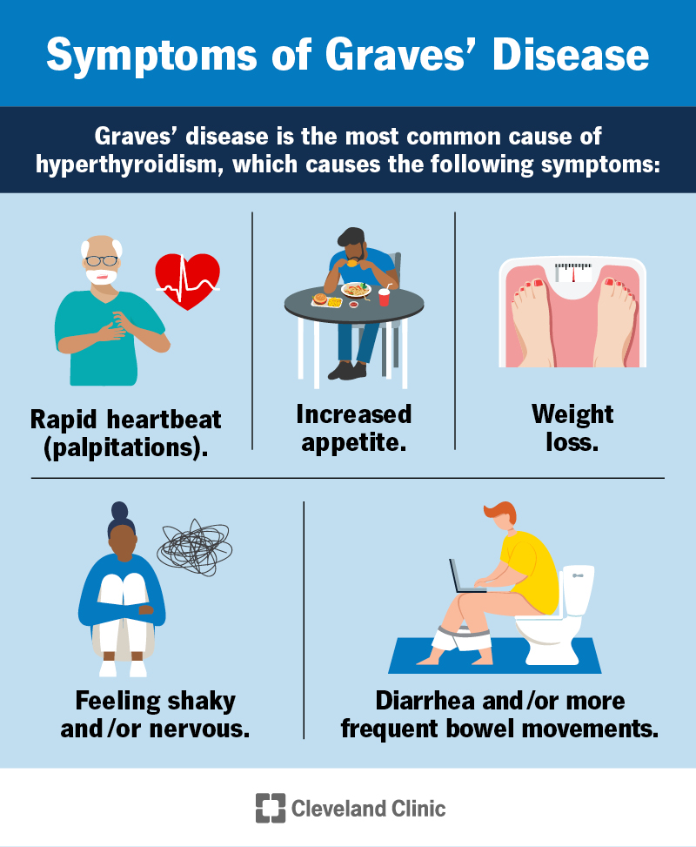

Slide 12
CLINICAL SYMPTOMS AND SIGNS OF THYROTOXICOSIS
Signs
Sinus tachycardia, Atrial fibrillation
Fine tremors, Hyperreflexia
Warm and moist skin
Palmer erythema
Hair loss
Muscle weakness
Congestive heart failure
Hypokalemic periodic paralysis

Slide 13
GRAVES DISEASE
Autoimmune disorder, antibodies production against TSH receptors.
Thyroid stimulating antibodies bind to TSH receptors, acts as analog.
Genetic predisposition: CTLA-4, HLA- DR 3.
More common in females.
Association with other autoimmune disorders.

Slide 14
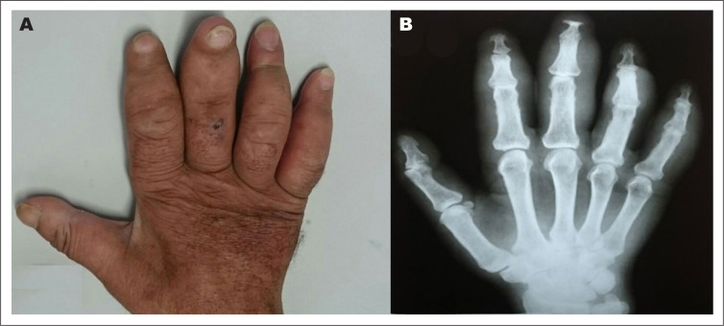
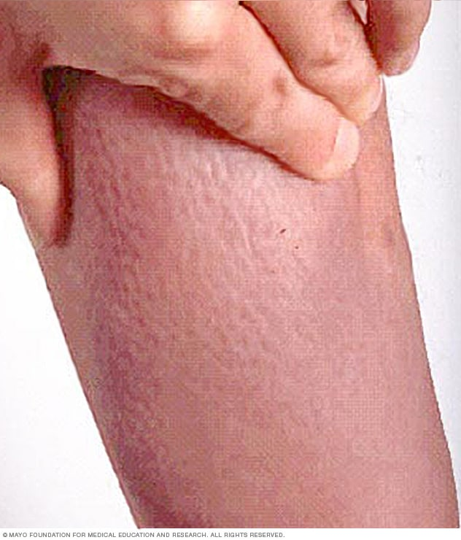
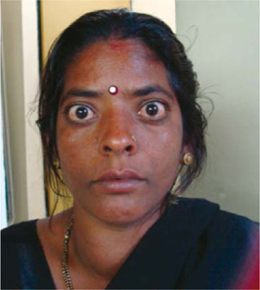
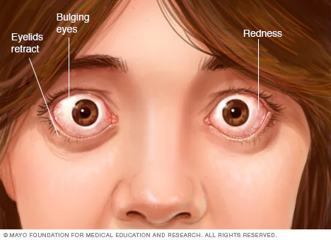
ARCHOPACHY
THYROID DERMOPATHY
DIFFUSE GOITER
OPHTHALMOPATHY

Slide 15
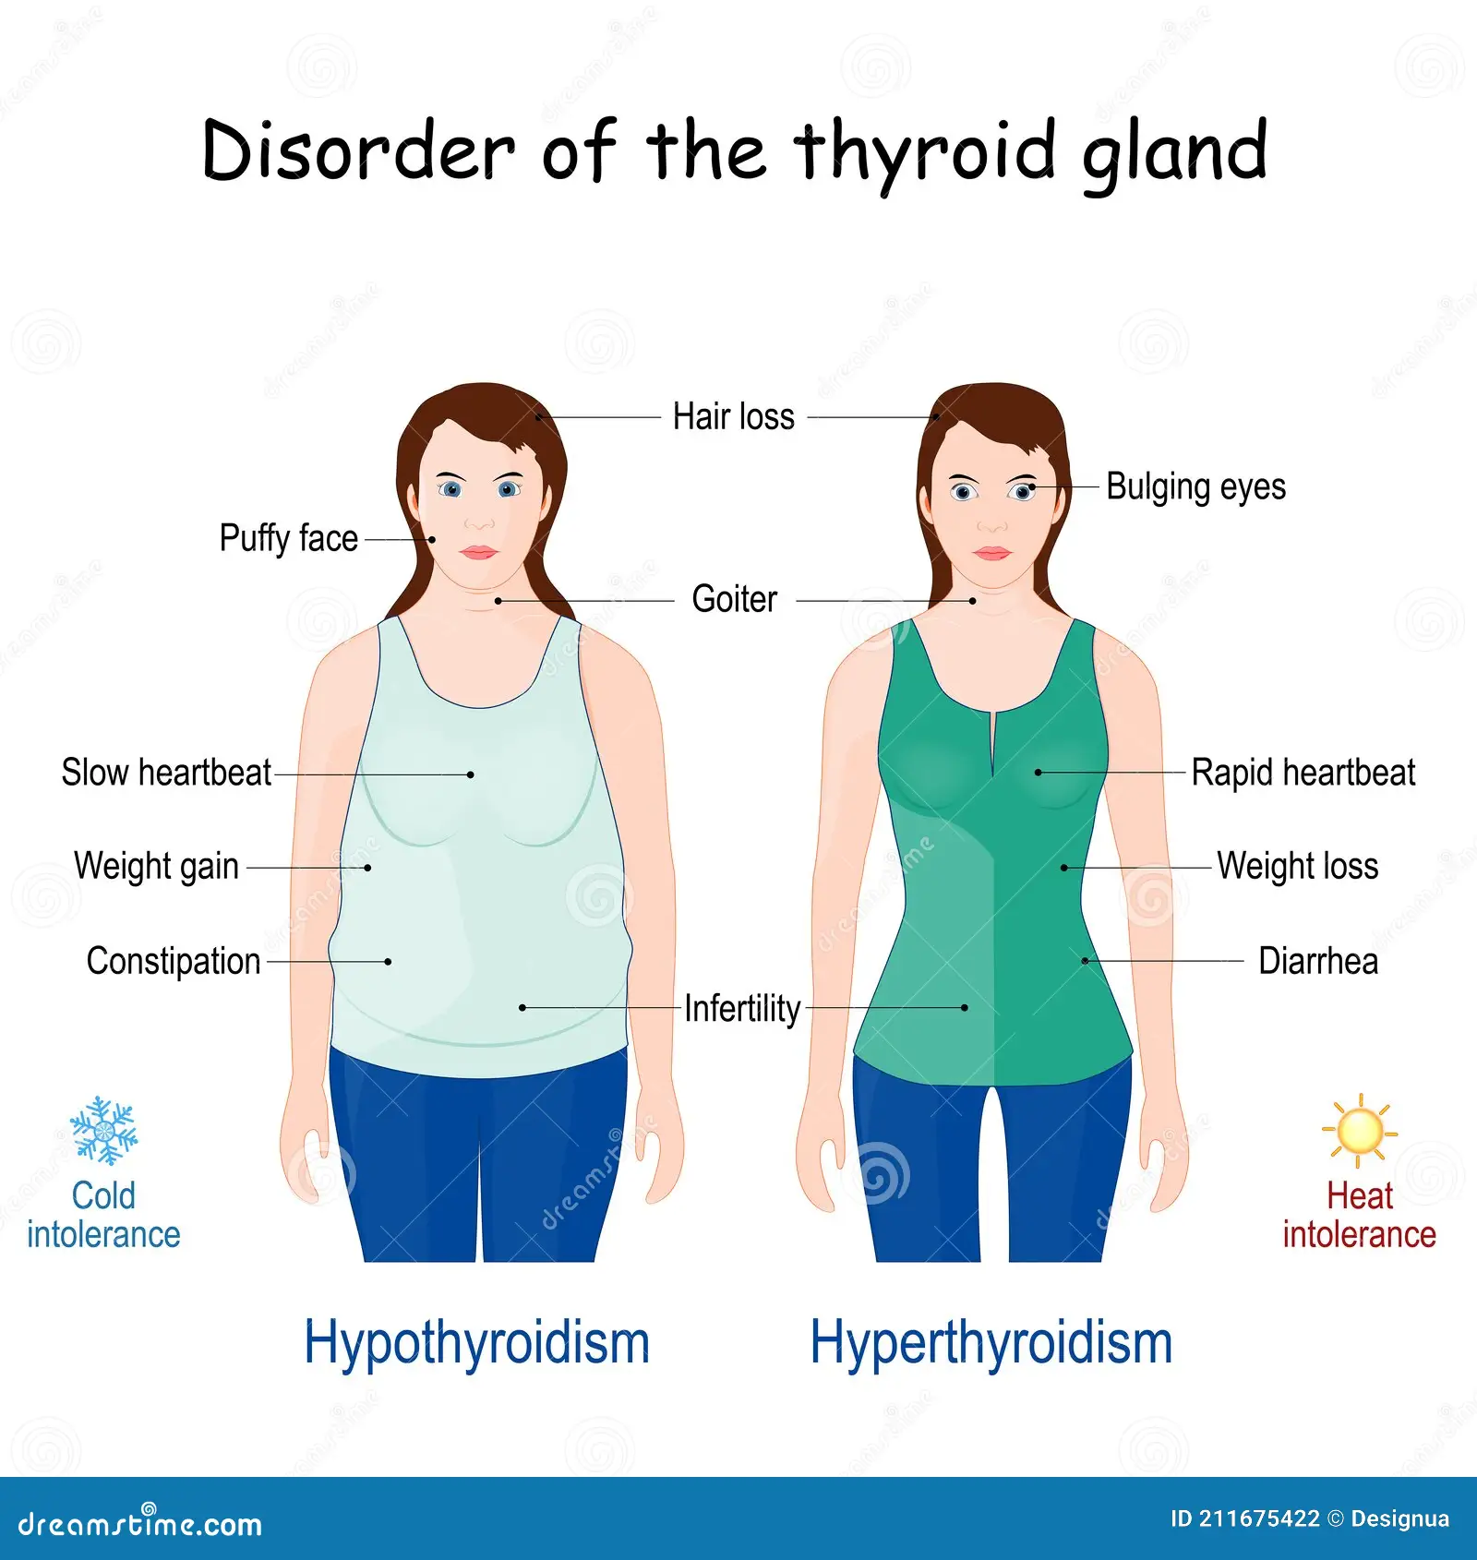

Slide 16
DIAGNOSTIC TEST FOR HYPERTHYROIDISM

Slide 17
THYROID FUNCTION TEST
Condition | TSH | T3 | T4
Primary Hyperthyroidism | Undetectable
Subclinical Hyperthyroidism |  | Normal | Normal
Secondary Hyperthyroidism | Normal or

Slide 18
THYROID ANTIBODIES
Condition | Anti- TPO | Antithyroglobulin | TSH receptor
Graves Disease | 70 to 80% | 30 to 50 % | 70 to 100 %

Slide 19
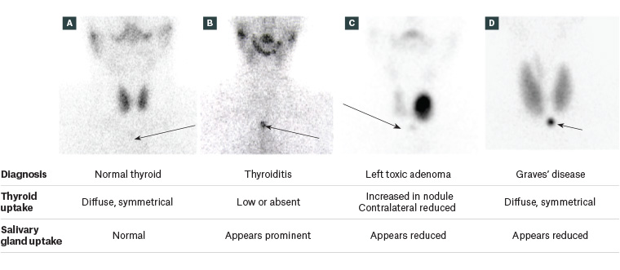
THYROID SCAN

Slide 20
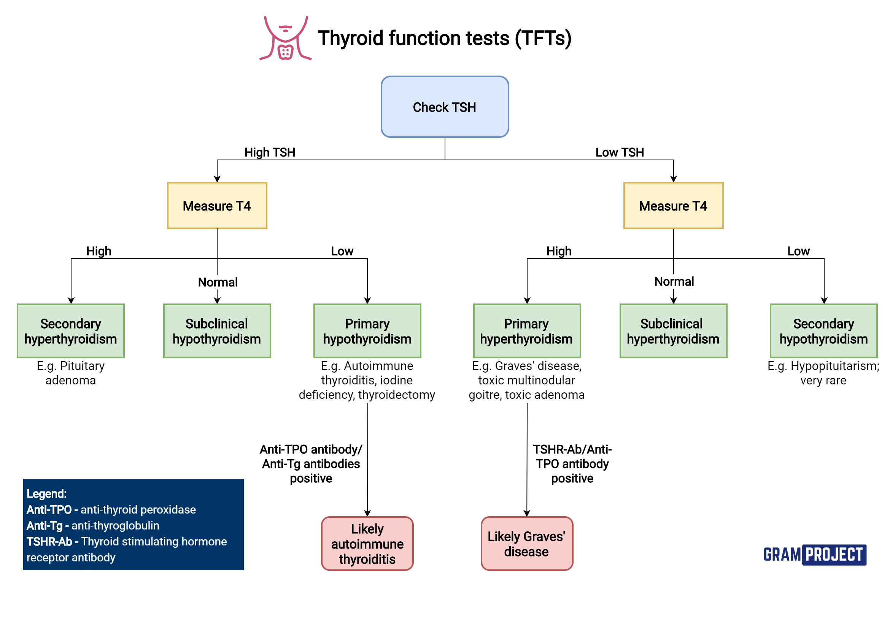

Slide 21
MANAGEMENT OF HYPERTHYROIDISM

Slide 22
1:Antithyroid drugs: Carbimazole, Propylthiouracil
2: Radioactive Iodine
3: Thyroidectomy

Slide 23
COMPLICATION OF HYPERTHYROIDISM

Slide 24
1: Thyroid storm: A severe, potentially fatal, hypermetabolic condition triggered by an overabundance of thyroid hormones (THs) in individuals experiencing thyrotoxicosis.
2: Risk factors: untreated or undertreated thyrotoxicosis, Surgery, Infection, Radioactive iodine therapy
3: Clinical Features: Tachycardia, Hyperthermia, Hypertension, Severe agitation, Confusion, and Loss of consciousness
4: Management: IV propranolol, Thionamide, Iodine Solution, Glucocorticoid.

Slide 25
RESEARCH

Slide 26
ETHICAL ISSUES
Ethical Issue | Key Concerns
Informed Consent and Education | Ensuring patients understand treatment options (e.g., antithyroid drugs, radioactive iodine, surgery) along with potential complications like hypothyroidism.
Patient Autonomy | Respecting patient decisions regarding treatment choices, especially when opting out of recommended therapies.
Risk of Overtreatment | Avoiding excessive suppression of thyroid function, which may lead to iatrogenic hypothyroidism.
Equity in Access to Care | Ensuring access to diagnostic tests (e.g., thyroid function tests) and treatment across different socioeconomic groups.
Management During Pregnancy | Ethical considerations when managing hyperthyroidism in pregnancy, ensuring fetal safety while treating maternal hyperthyroidism.
Research Ethics | Ensuing ethical conduct in research on new treatments, including clear communication of risks and benefits to participants.
Thyrotoxic Crisis (Thyroid Storm) | Ethical dilemmas in emergency settings, particularly when a patient lacks the capacity to consent to treatment.

Slide 27
Thank You

