Slide 1
Ovarian Malignancy
Dr Sadia Khan
Professor OB/Gyn BBH
Rawalpindi Medical University

Slide 2

MOTTO
To impart evidence based research oriented medical education.
To provide best possible patient care.
To inculcate the values of mutual respect and ethical practice of medicine
VISION,THE DREAM TOMORROW

Slide 3
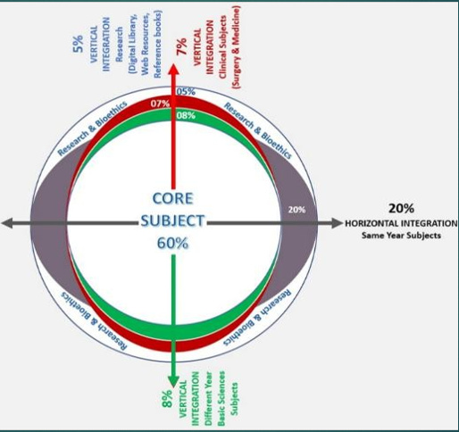
PROF UMER MODEL OF INTEGRATED LECTURE

Slide 4
LEARNING OUTCOMES
01
02
03
04
05
Enlist the types of malignant ovarian tumours
Enumerate their risk factors and tumor markers
Describe clinical features of the disease
Discuss FIGO staging of ovarian cancer
Know the diagnostic criteria, management, follow up and
5 year survival rate

Slide 5
Question 1:
What is the initial investigations for ovarian cyst?
CA-125
CT Abdomen and pelvis
MRI
Transvaginal ultrasound with Doppler studies
Transvaginal ultrasound
✔

Slide 6
Question 2:
Which tumor marker is most commonly associated with ovarian cancer?
A. CA 19-9
B. CA 125
C. AFP
D. CEA
E. HCG
✔

Slide 7
Question 3:
Which of the following is a risk factor for ovarian cancer?
A) Early menopause
B) Use of oral contraceptives
C) Nulliparity
D) High parity
E) Smoking
✔

Slide 8
Question 4:
What is the most common site of metastasis in ovarian cancer?
A) Liver
B) Lungs
C) Peritoneum
D) Bones
E) Brain
✔

Slide 9
Question 5:
Which genetic mutation is strongly associated with ovarian cancer?
A) BRCA1/BRCA2
B) TP53
C) KRAS
D) APC
E) PTEN
✔

Slide 10
Question 6
Endometrioid tumours belong to which group of ovarian tumours
Epithelial cell tumours
Sex cord tumours
Germ cell tumours
Metastatic tumours
Unclassified tumours
✔

Slide 11
Question 7
Which ovarian tumor is most often associated with elevated alpha-fetoprotein (AFP)?
A) Serous carcinoma
B) Endometrioid carcinoma
C) Dysgerminoma
D) Yolk sac tumor
E) Brenner tumor
✔

Slide 12
Question 8
The RMI index (Risk of malignancy index) is calculated with the following criteria
Age of pt, BMI, USG features of ovarian mass
Menopausal status, USG features of ovarian mass, CA-125 level
Age of pt, menopausal status, USG features, CA-125 level
Age of pt, BMI, menopausal status, USG features of ovarian mass
Age of pt, BMI, menopausal status, USG features of ovarian mass and CA-125 level
✔

Slide 13
Question 9
In stage 3a of ovarian cancer the following features are noted
Tumour involves one or both ovaries with capsule rupture and ascites
Tumour involves uterus and fallopian tubes
Tumour is spread to the adjacent pelvic organs
Tumour has microscopic extra-pelvic involvement
Tumour has macroscopic extra-pelvic involvement
✔

Slide 14
Question 10
What is a common protective factor against ovarian cancer?
A) Hormone replacement therapy
B) Late childbirth
C) Use of oral contraceptive pills
D) Early menarche
E) Smoking
✔

Slide 15
SPIRAL INTEGRATION WITH ANATOMY

Slide 16
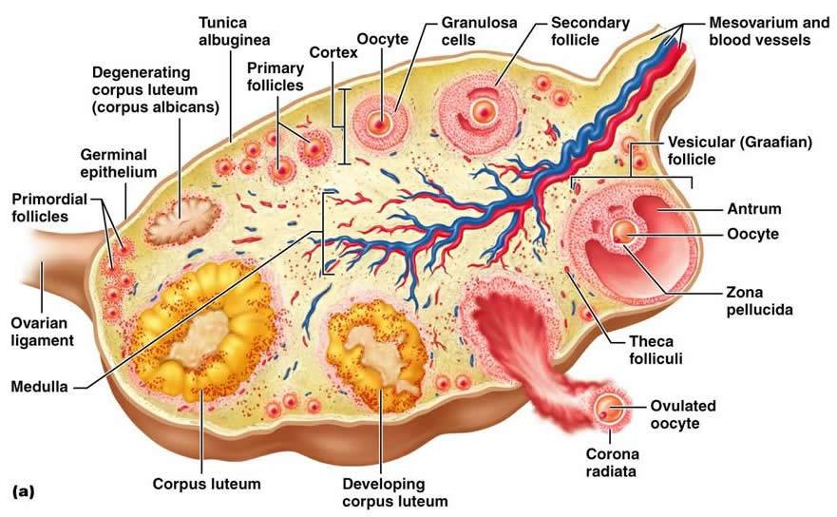
OVARIES ANATOMY

Slide 17
Ovarian cancer is the second most common gynaecological cancer and cause of death.

Slide 18
Prevalence
7000
4000
New Cases/yr
Deaths/yr

Slide 19
Cumulative risk for breast & ovarian cancer
Normal population ➠ Ovarian 1.4% ( 1 / 70)
1 in 20 5% ⬆
If one family member affected
BRCA 1
80%
40-50%
BRCA 2
15%
If two first degree family affected
Ovarian
45%

Slide 20
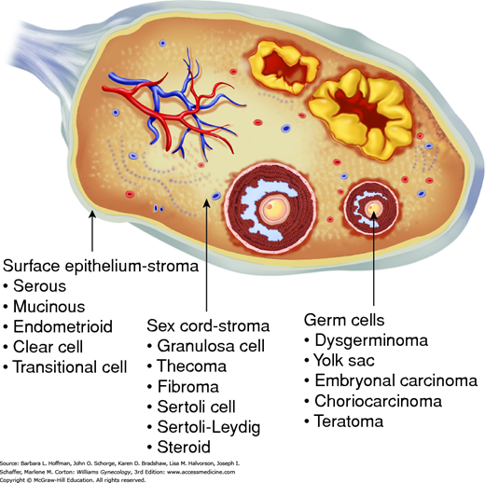

Slide 21
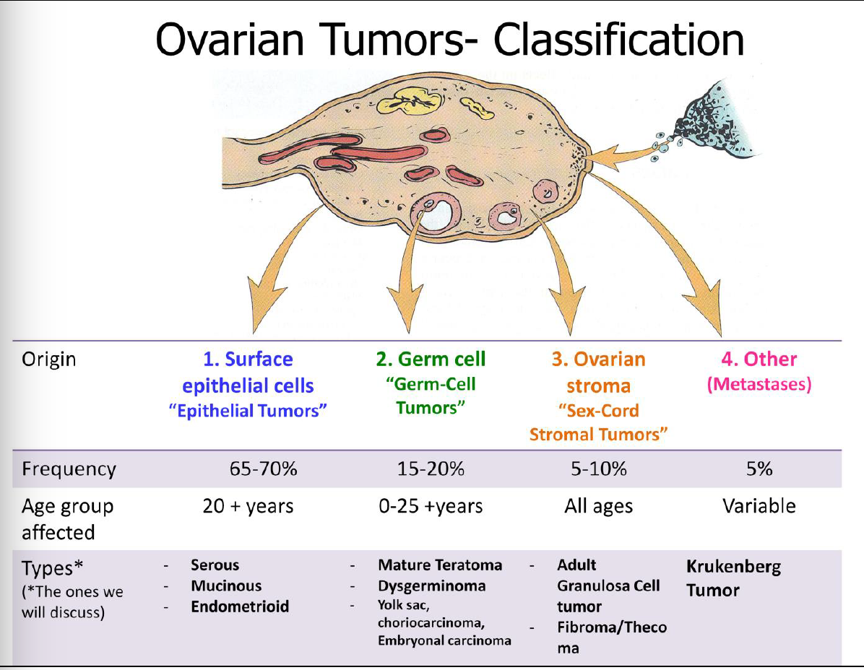
Classification of Ovarian Tumors

Slide 22






Risk of ovarian cancer : Decreasing risk
Multiparity
COCP
Tubal ligation
Salpingectomy
Hysterectomy
Breastfeeding

Slide 23






Risk of ovarian cancer : Increasing risk
Nulliparity
IUD
Endometriosis
Smoking
Obesity
BRCA1/BRCA2

Slide 24
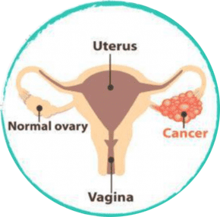






Clinical features Silent killer
Increased abdominal girth/bloating
Loss of appetite
Lump detection
Weight loss
Abdominal pain
Digestive disorders

Slide 25
Clinical features
Non-specific symptoms often vague
Difficulty in clinical diagnosis (75% - stage 3 , 4)
↪ Other symptoms:
change in bowel habit
urinary symptoms
back ache
irregular bleeding
fatigue

Slide 26
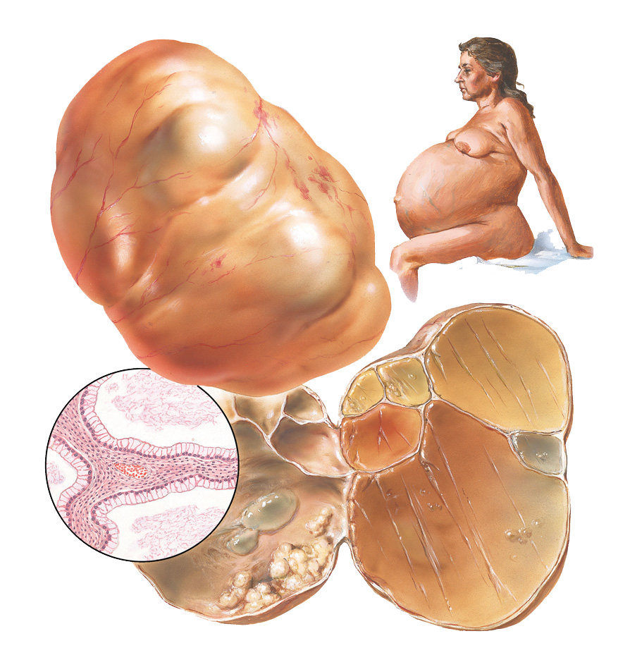
Epithelial tumours
Histological types
High grade serous
Endometrioid
Clear cell
Mucinous
Seromucinous
Low grade serous
Precursor ➜ serous intra-epithelial carcinoma
10% Borderline
75% High grade serous -most common

Slide 27
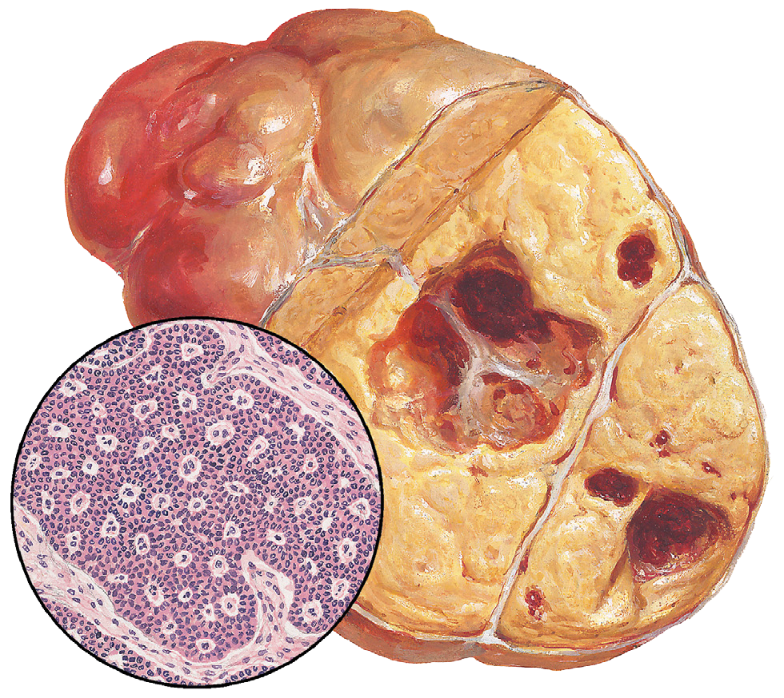
Sex cord stromal tumours
10% of ovarian tumours
Low malignant potential,
Good long-term prognosis
Peak incidence - menopause
Juvenile granulosa cell tumour –
girls under 10yr ➨ precocious puberty
Granulosa cell tumour

Slide 28
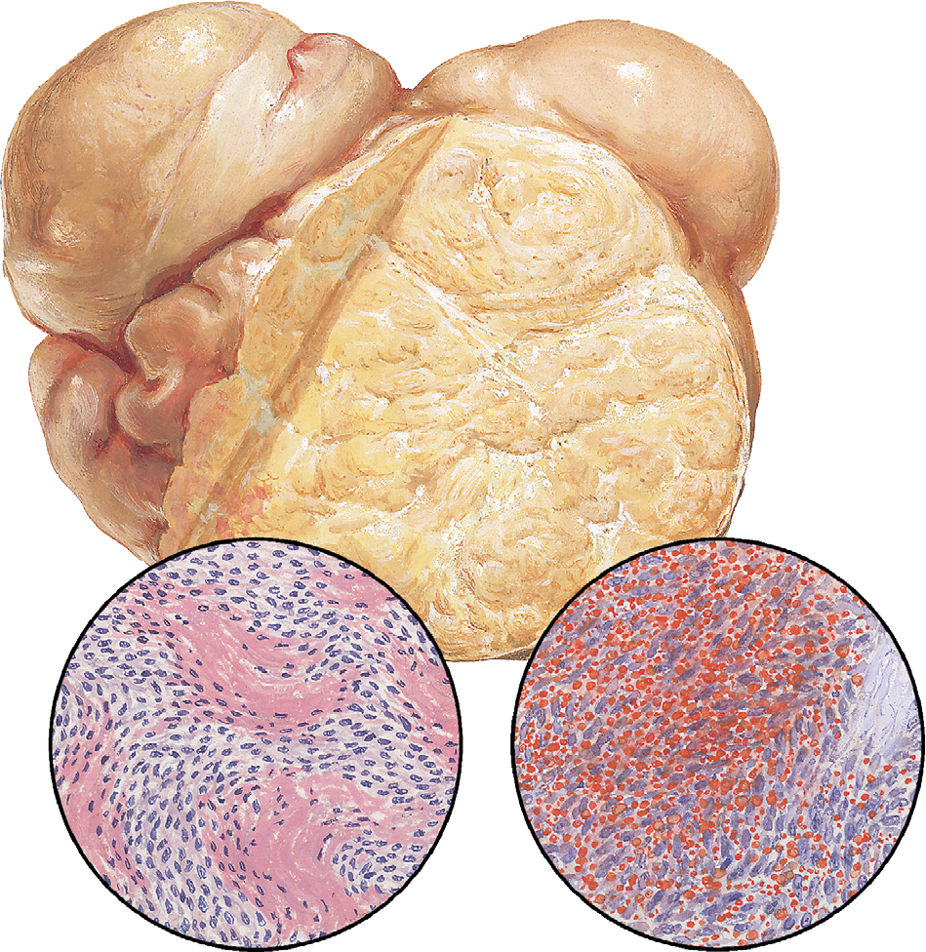
Sex cord stromal tumours
Clinical Features:
Hormonal manifestations ex. Irregular bleeding, PMB, Precocious puberty
Large pelvic mass or with pain due to torsion/haemorrhage
Sertoli–Leydig cell tumours ⬆ androgens in > 50%
of cases = virilization
Unilateral
Tumour - solid with areas of haemorrhage/
cut surface yellow ( ⬆steroid)

Slide 29
Sex cord stromal tumours
Treatment:
Age —- Wish to preserve fertility
Young patients, unilateral salpingo-oophorectomy + endometrial sampling and staging.
Older patients Full surgical staging
Surgery is the mainstay of treatment - no effective chemotherapy regime.

Slide 30
Germ cell tumours
Young women
10% of ovarian tumours —- from primordial germ cells
Clinical Features:
Solid pelvic mass 10% torsion, haemorrhage
Dysgerminomas 50% Bilateral BhCG, LDH
Endodermal sinus yolk sac tumours is second commonest- 15%, AFP
Immature teratomas 15–20% ⅓ secrete AFP
70% - stage 1 Spread – lymphatics or blood borne.

Slide 31
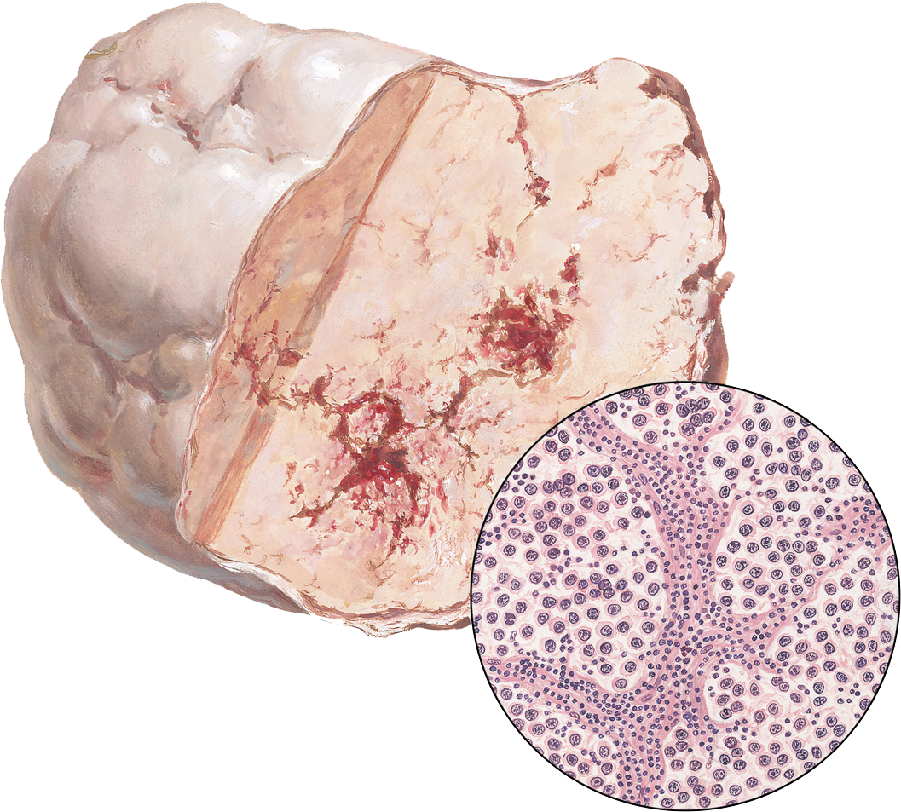
Germ cell tumours
Treatment
dysgerminoma
Fertility-sparing treatment
Exploratory laparotomy to remove the
tumour and assess spread to the other ovary,
if present should be removed.
Peritoneal biopsies/washing & sampling of enlarged
pelvic or para-aortic nodes.
Debulking surgery for metastatic disease
Intraoperative frozen sections may be required to assess nodal status.

Slide 32
Germ cell tumours
Chemotherapy:
Stage 1 dysgerminomas and low-grade teratomas - surgery alone
5-year survival > 90%
For advanced stages chemotherapy is used
Common regime used = bleomycin, etoposide and cisplatin (BEP),
given as a course of three to four treatments, 3 weeks apart.
Long-term cure rates over 90% and also preserves fertility if required

Slide 33
Tumour Markers
Epithelial ovarian tumour
Ca-125
Mucinous
ovarian tumour
CEA
Embryonal
Carcinoma
B-hCG

Slide 34
Tumour Markers
Inhibin A
Inhibin B
Granulosa cell
tumour
Dysgerminoma
LDH
Endodermal
Sinus Tumour
AFP

Slide 35
Histological classification
01 | Epithelial 60-65% | High grade serous ,Endometroid Clear cell,Mucinous Low grade serous -borderline
02 | Sex cord stroma 8% | Granulosa -cell Sertoli Leydig cell Gyandroblastoma
03 | Germ cell 30% | Dysgerminoma Endodermal sinus -yolk sac Teratoma,Choriocarcinoma
04 | Metastatic | Metastatic (Krukenburg tumors)

Slide 36
Staging of ovarian cancer ( FIGO)
Stage 1 | Confined to ovary
Stage 1 A | Limited to one ovary,no ext disease, capsule intact, no ascites
Stage 1 B | Limited to both ovaries, no ext disease, capsule intact, no ascites
Stage 1 C | Tumour limited to one or both
1C1 | Surgical spill
1C2 | Capsule rupture before surgery/ tumor on ovarian surface
1C3 | Malignant cells in ascites or peritoneal washings

Slide 37
Staging of ovarian cancer (FIGO)
Stage 2 | Tumour in one / both ovaries +pelvic extension (below pelvic brim)
Stage 2 A | Extension to uterus and fallopian tubes
Stage 2 B | Extension to other intraperitoneal tissues
Stage 2 C | II A / II B + positive peritoneal washings

Slide 38
Staging of ovarian cancer FIGO
Stage 3 | Tumour in one or both ovaries with cytological or histological confirmed spread to peritoneum outside the pelvis / metastasis to retroperitoneal lymph nodes
Stage 3 A A1 i ii A2 | Microscopic metastasis beyond pelvis Positive retroperitoneal lymph nodes < 10 mm >10 mm Microscopic extra pelvic peritoneal involvement
Stage 3 B | Macroscopic extra pelvic peritoneal metastasis < 2cm +ve retroperitoneal lymph nodes/ extending to capsule liver, spleen
Stage 3 C | Macroscopic extra pelvic peritoneal metastasis >2cm +ve retroperitoneal lymph nodes/ extending to capsule liver, spleen

Slide 39
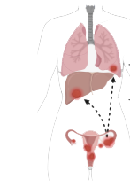
Staging of ovarian cancer (FIGO)
Stage 4 A | Distant metastasis - Pleural effusion +ve cytology
Stage 4 B | Hepatic /splenic parenchymal metastasis

Slide 40
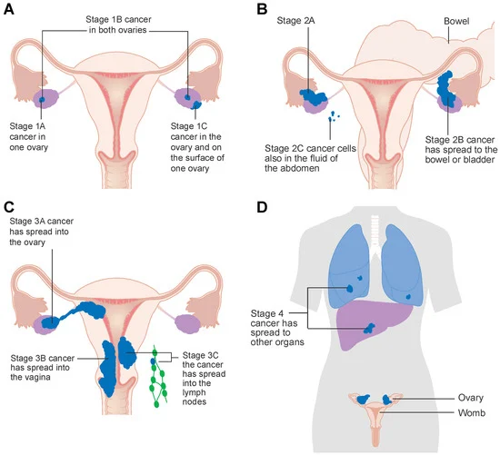
Staging of ovarian cancer(FIGO)

Slide 41
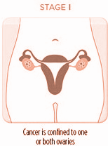
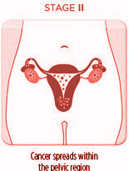
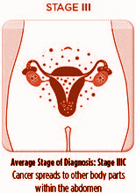
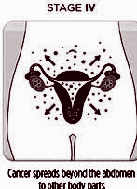
Staging of ovarian cancer(FIGO)
1
02
03
04
t

Slide 42
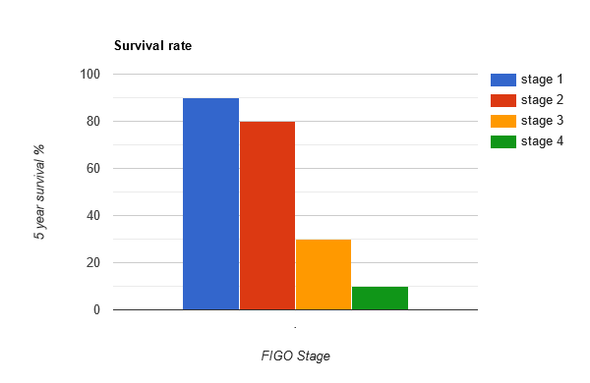
70-90%
80%
30%
10%
Stage 1
Stage 2
Stage 3
Stage 4

Slide 43

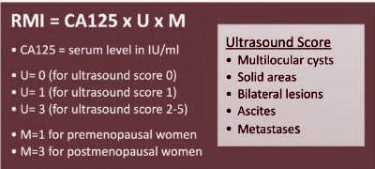
Risk of malignancy index

Slide 44
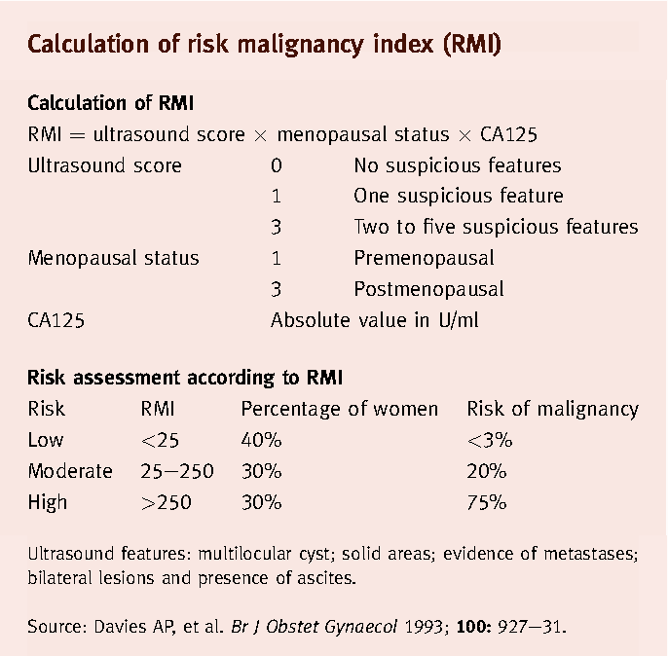

Slide 45
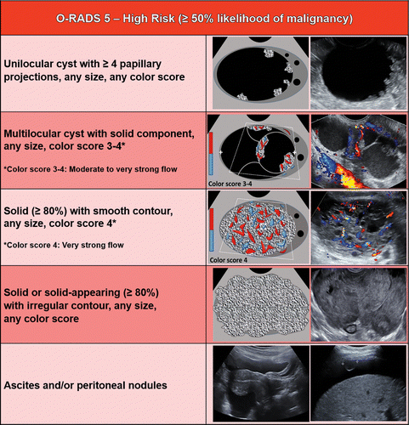

Slide 46
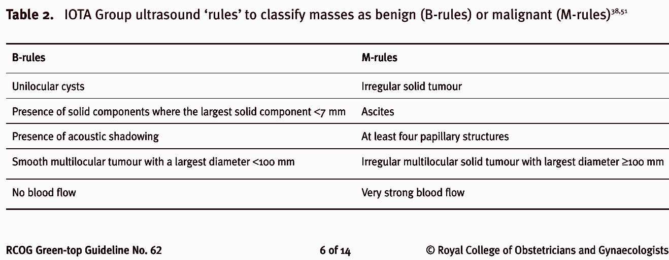
Benign or Malignant

Slide 47




Spread of ovarian cancer
Direct spread
Transcoelomic spread
Lymphatic spread
Haematological spread

Slide 48
Management
Surgical treatment:
↪ Surgical staging: diagnosis, staging and treatment
↪ Objective: stage accurately the disease and remove all
visible tumour
↪ Three cycles of neoadjuvant chemotherapy followed by
interval debulking surgery = ⬇ morbidity

Slide 49
Fertility sparing
01
Unilateral salpingo-oophorectomy
Early disease
Family complete?
02
Management
TAH + BSO
01
TAH + BSO
Debulking + chemo
Late disease
02
Neoadjuvant chemotherapy
Interval debulking

Slide 50
Prerequisites for surgery
Informed consent
USG, CT scan, MRI
Chest Xray ECG
Tumour markers
Special
investigations
Preoperative antibiotics
CP,ABO,RBS,Urine R/E,Pt+aPtt,LFT, RFT, Hep profile
Baseline
investigations
Bowel preparation
Anesthesia fitness

Slide 51
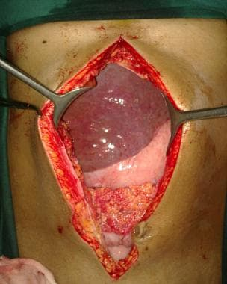
Steps for surgery:
A vertical incision is required to gain access to all areas of the abdomen.
Ascites or peritoneal washings are sampled
TAH and BSO performed along with an omentectomy.
Debulking may be required in order to remove all tumour

Slide 52
Chemotherapy
First-line treatment ➜ platinum compound with paclitaxel
Outpatient 3 weeks apart for six cycles
Platinum compounds - most effective chemotherapeutic agents in ovarian cancer e.g Carboplatin.
Paclitaxel causes peripheral neuropathy, neutropenia , myalgia, alopecia

Slide 53

Counselling
Presence of a relative / support
Empathy
Diagnosis
Treatment modalities
Advantages and risks

Slide 54
RESEARCH
Artificial Intelligence in Ultrasound Diagnoses of Ovarian Cancer: A Systematic Review and Meta-Analysis S Mitchell, M Nikolopoulos, A El-Zarka, D Al-Karawi… - Cancers, 2024 - mdpi.com
Risk-prediction models in postmenopausal patients with symptoms of suspected ovarian cancer in the UK (ROCkeTS): a multicentre, prospective diagnostic S Sundar, R Agarwal, C Davenport, K Scandrett… - The Lancet …, 2024 - thelancet.com

Slide 55
BIOMEDICAL ETHICS
Autonomy: Respect the patient’s right to make informed decisions.
Beneficence & Non-maleficence: Act in the patient’s best interest while minimizing harm.
Justice: Ensure equitable access to treatment and resources.
End-of-Life Care: Prioritize dignity and quality of life.
Cultural Sensitivity: Respect diverse values and beliefs in decision-making.

Slide 56
FAMILY MEDICINE
“The current guidance for primary care providers seeing women with symptoms suspicious of ovarian cancer recommends abdominopelvic examination, transvaginal ultrasound ,serum CA 125 test .If any of these are abnormal referral of patient to the local gynecology service “

Slide 57
LEARNING RESOURCES
GNAECOLOGY by Ten Teachers, 20th EDITION
Dewhurst’s Textbook Of Obstetrics & Gynaecology, 9th EDITION
Google scholar
Google images

Slide 58
How To Access Digital Library
Go to the website of HEC National Digital Library.
On Home Page, click on the INSTITUTES.
A page will appear showing the universities from Public and Private Sector and other Institutes which have access to HEC National Digital Library HNDL.
Select your desired Institute.
A page will appear showing the resources of the institution
Journals and Researches will appear
You can find a Journal by clicking on JOURNALS AND DATABASE and enter a keyword to search for your desired journal.

Slide 59


