Slide 1
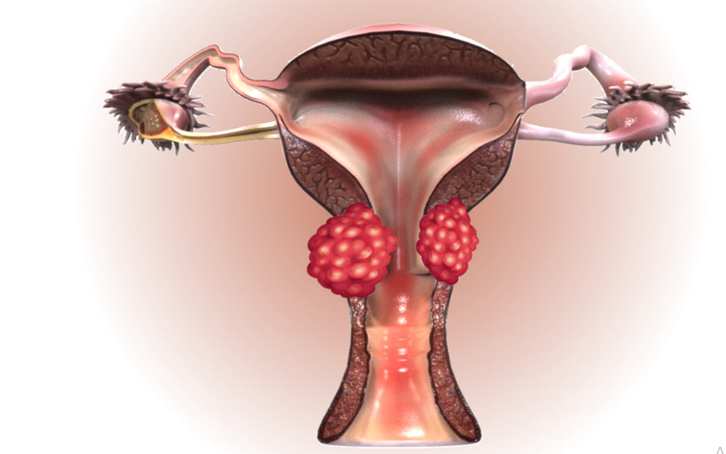
Malignant Diseases Of Cervix
Dr Hina Gul
Assistant Professor
Benazir Bhutto Hospital
Rawalpindi Medical University

Slide 2
MOTTO
To impart evidence based research oriented medical education. To provide best possible patient care. To inculcate the values of mutual respect and ethical practice of medicine
VISION,THE DREAM TOMORROW

Slide 3
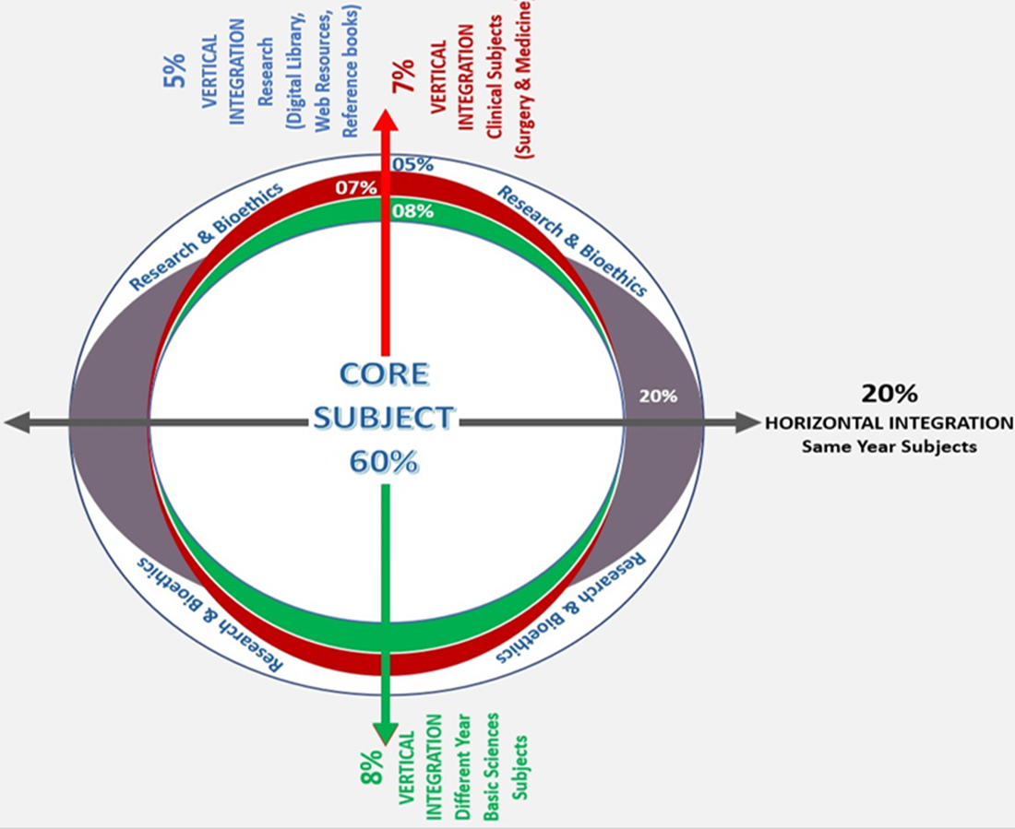
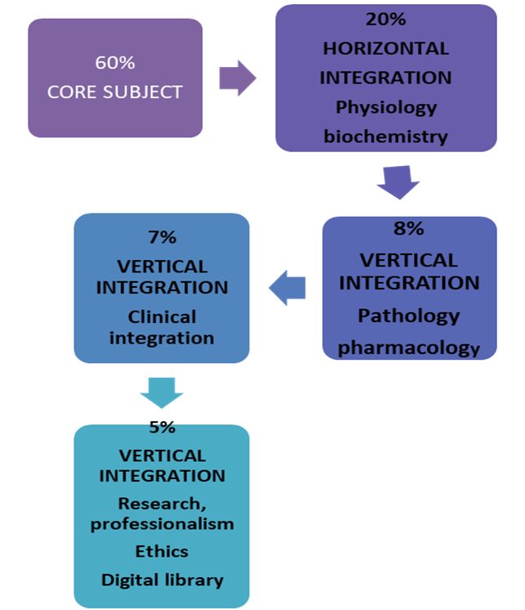

Slide 4
LEARNING OUTCOMES
01
02
03
04
05
To describe the epidemiology of cervical cancer
Enumerate their risk factors
Enlist the clinical features of the disease
Explain FIGO staging of cervical cancer
Discuss the management and follow up

Slide 5
Question1
What is the primary cause of cervical cancer?
A) Smoking
B) HPV infection
C) HIV infection
D) Chronic pelvic inflammatory disease
E) Hormonal imbalance

Slide 6
Question 2
Which HPV types are most commonly associated with cervical cancer?
A) 6 and 11
B) 16 and 18
C) 31 and 33
D) 45 and 52
E) 58 and 59

Slide 7
Question:3
Which screening test is used for the early detection of cervical cancer?
A) Mammogram
B) Pap smear
C) Transvaginal ultrasound
D) Colposcopy
E) HPV DNA test

Slide 8
Question 4
What is the FIGO stage of cervical cancer confined to the cervix?
A) Stage I
B) Stage II
C) Stage III
D) Stage IV
E) Stage 0

Slide 9
Question 5
Which vaccine is used for the prevention of cervical cancer?
A) Hepatitis B vaccine
B) HPV vaccine
C) MMR vaccine
D) Influenza vaccine
E) Varicella vaccine

Slide 10
Question 6
What is the most appropriate treatment option for a woman diagnosed with Stage IB1 cervical cancer who wishes to preserve fertility?
A)Total abdominal hysterectomy
B) Chemotherapy
C) Radical trachelectomy
D)Radiotherapy
E) Chemotherapy + radiotherapy

Slide 11
Question 7
What is the recommended treatment for a woman diagnosed with Stage IB1 cervical cancer who has completed childbearing?
Simple trachelectomy
Radical hysterectomy
Cone biopsy
Radical trachelectomy
Chemotherapy

Slide 12
Question:8
Patient 43 years old P3, BMI 35 diagnosed with early-stage cervical cancer and not fit for anesthesia, which treatment modality is better for her in terms of survival and disease control?
Pelvic radiotherapy
B) Radical surgery
C) surgery and radiotherapy
D) Chemotherapy
E) Chemotherapy + radiotherapy

Slide 13
Question 9
In FIGO Stage 1B1 cervical cancer, the tumor is:
Less than 4 cm in size and confined to the cervix
Larger than 4 cm but confined to the cervix
Invasive and extends beyond the cervix into the uterus
Invasive, but involves the vagina or pelvic wall
Less than 2 cm but confined to the cervix

Slide 14
Question 10
Which of the following best describes Stage 3A cervical cancer?
Tumor confined to the cervix, no spread beyond the uterus
B) Tumor has spread to the pelvic wall, and/or involves the ureters
C) Tumor has spread to the lower third of the vagina
Tumor has spread to distant organs such as the liver or lungs
Tumor has spread to the upper half of the vagina

Slide 15
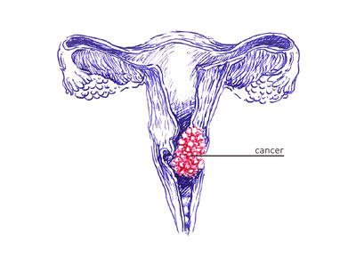
CA cervix

Slide 16
Epidemiology
Second commonest female malignancy
Seventh most frequent cancer world wide
Accounts for 6 percent of all the malignancies in women.
Lifetime risk of developing ca cervix 0.6%
Incidence and mortality decreased due to population based screening programs

Slide 17
Classification
Histological Subtypes
Squamous cell
(80-85%)
Adenocarcinoma
(10-15%)
Adenosquamous
(05%)
Other rare types
(05%)

Slide 18
Classification
Squamous Cell Carcinoma
Adenocarcinoma
More common (80-85%)
Ectocervix (TZ)
Pap smear
Better prognosis
Incidence decreased
Proliferative/cauliflower like growth
Ovarian metastasis 1%
Less common (10-15%)
Endocervix (glandular cells)
HPV DNA test (HPV 18)
Poorer prognosis
Incidence increased
Barrel shaped enlargement
Ovarian metastasis 10%

Slide 19
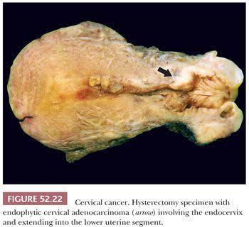
Gross Appearance

Slide 20
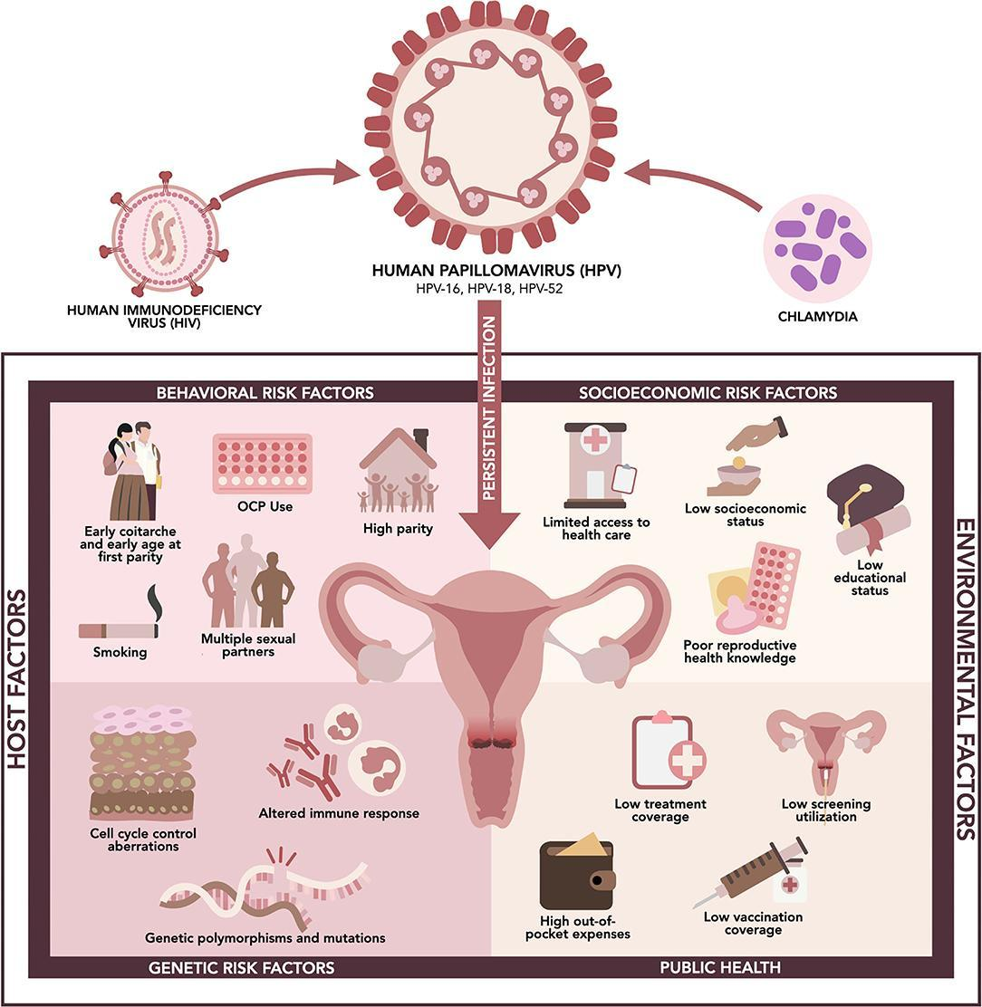
Risk Factors

Slide 21
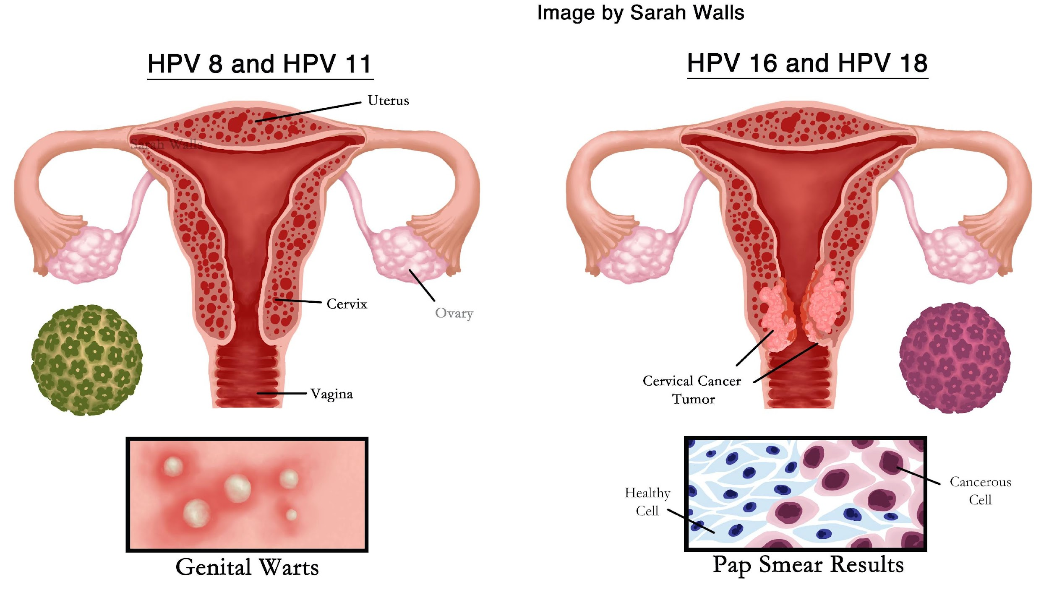
Human Papillomavirus
Primary etiologic infectious agent
More than 200 subtypes
Low risk : HPV-6,HPV11
High risk : HPV 16,HPV-18,
Other : HPV 31, HPV-33 ,
HPV-45 ,HPV -56

Slide 22
Life time acquiring HPV infection exceeds 80%

Slide 23
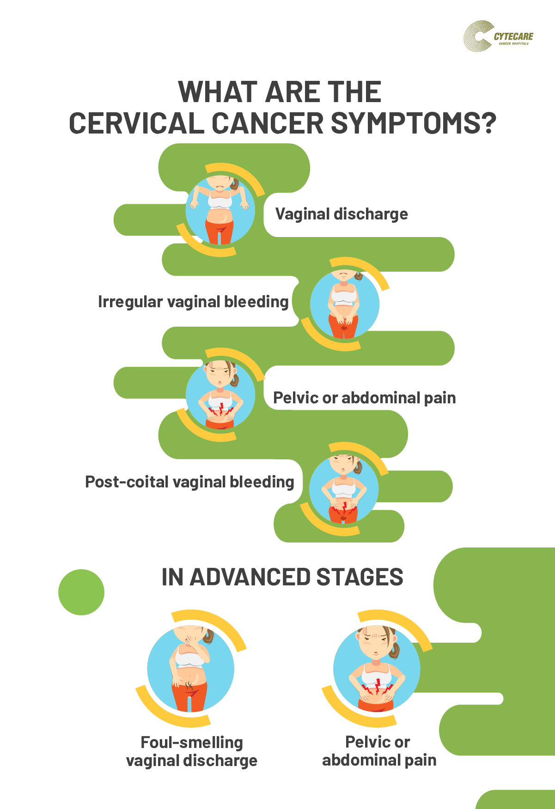
Vaginal discharge
Pelvic pain,
Urinary incontinence
Obstructive uropathy.
Anemia,
Weight loss

Slide 24
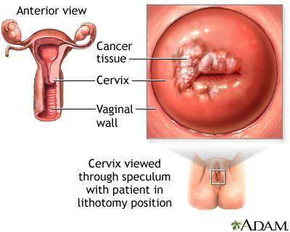
Pelvic Examination
Speculum examination
- Lesions: e.g. proliferative, cauliflower-like, vascular, friable growth which bleed on touch , ulcerative lesions with flat indurated areas
- Offensive vaginal smell
Bimanual examination :Feels firm with palpable nodules - Bulky uterus due to pyometra , fornices induration is felt

Slide 25
Pelvic Examination
Rectal examination : Nodules or masses, which indicate the possibility of locally invasive disease .
Thickening and induration of uterosacral ligaments .

Slide 26
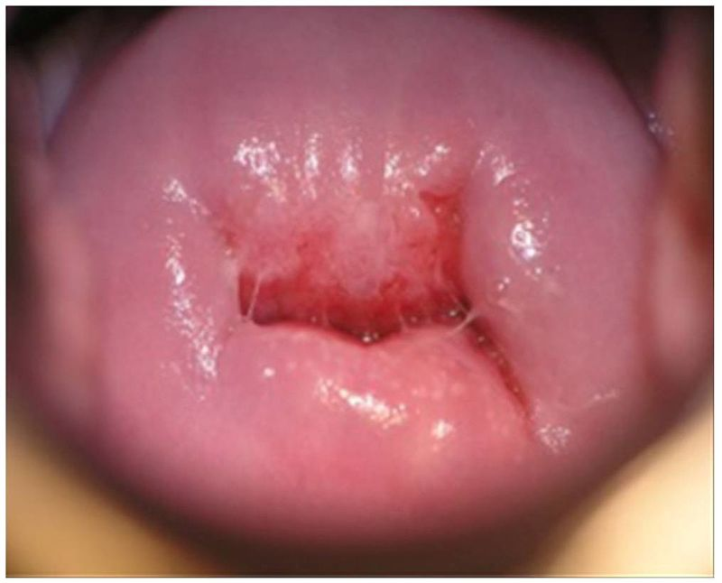
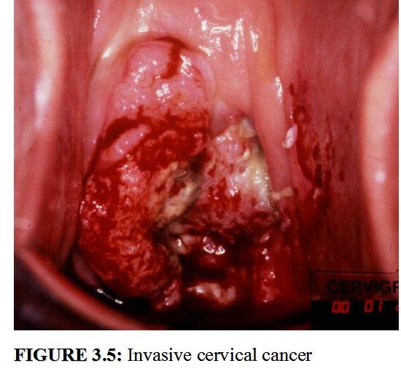
Normal cervix
Invasive Ca Cervix

Slide 27
Staging Procedures
Examination Under Anesthesia with rectovaginal examination , Cystoscopy & proctoscopy
MRI
CT SCAN
PET –CT
Chest x-ray
Intravenous urography

Slide 28
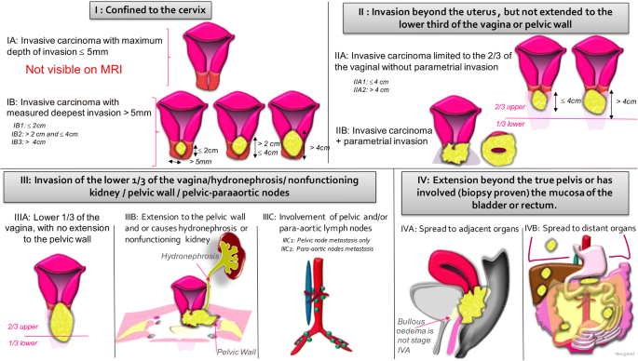
Staging Primarily clinical

Slide 29
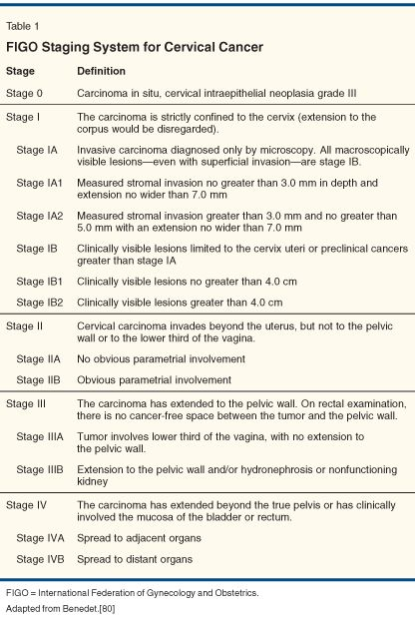

Slide 30
Tumour Spread
Direct spread into the cervical stroma, parametria and beyond, into the vagina, body of the uterus, bladder and rectum.
Lymphatic spread into parametrial, pelvic side wall and para aortic nodes.
Blood-borne spread is unusual.

Slide 31
Management
Depends on
Stage of the disease
Requirement for future fertility
Patients condition
Should be discussed with MDT

Slide 32
Management
Surgery
Radiotherapy
chemotherapy

Slide 33
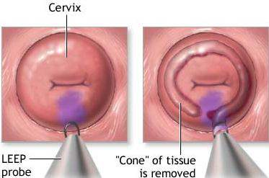
Pre-clinical Lesions-stage IA
Usually incidental after loop excision for precancerous disease
Local excision with good clear margins
Simple hysterectomy

Slide 34
Stage IB
Surgery and pelvic radiotherapy has similar success
Surgery includes:
Radical hysterectomy +involves bilateral Pelvic node dissection (Wertheim’s hysterectomy )

Slide 35
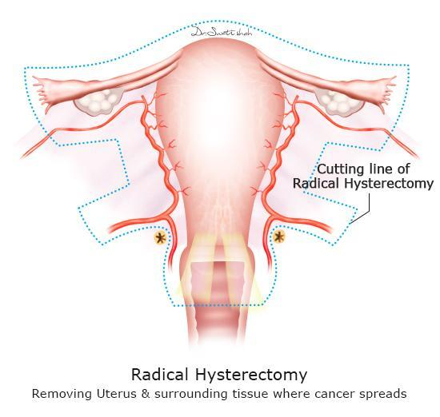
Radical hysterectomy includes:
Removal of cervix , upper third of vagina , uterus and para cervical tissue

Slide 36
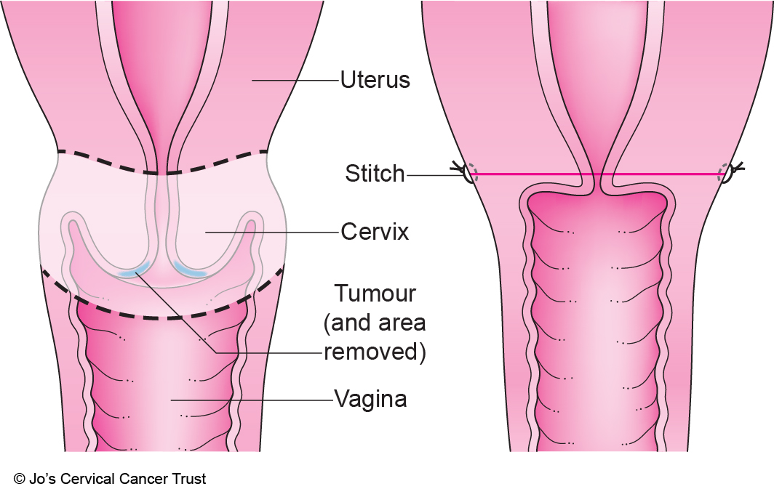
Stage IB (fertility preserving)
Radical trachelectomy bilateral pelvic node dissection
Surgical removal of cervix and upper part of vagina

Slide 37
Stage II-IV
Radiotherapy with or without chemotherapy
Incomplete excision requires adjuvant postoperative radiotherapy
Combined treatment leads to high complication rates
As an oncologist rule it is not wise to cut through cancer

Slide 38
Radiotherapy
External beam radiotherapy (teletherapy)
Internal radiotherapy (brachytherapy)

Slide 39
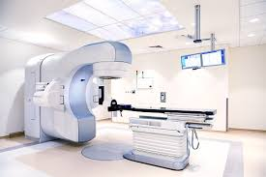
External Beam Radiotherapy
Linear acceleration
Radiation delivered to pelvis from a distance
Given for 20-30 days
Time of each fraction no more than 10 min
Followed by brachytherapy

Slide 40
Brachytherapy
Source of radiation is selenium
Rods inserted into uterus/vagina by EUA , attached to radiotherapy source
Targeted only 5mm from the rod

Slide 41
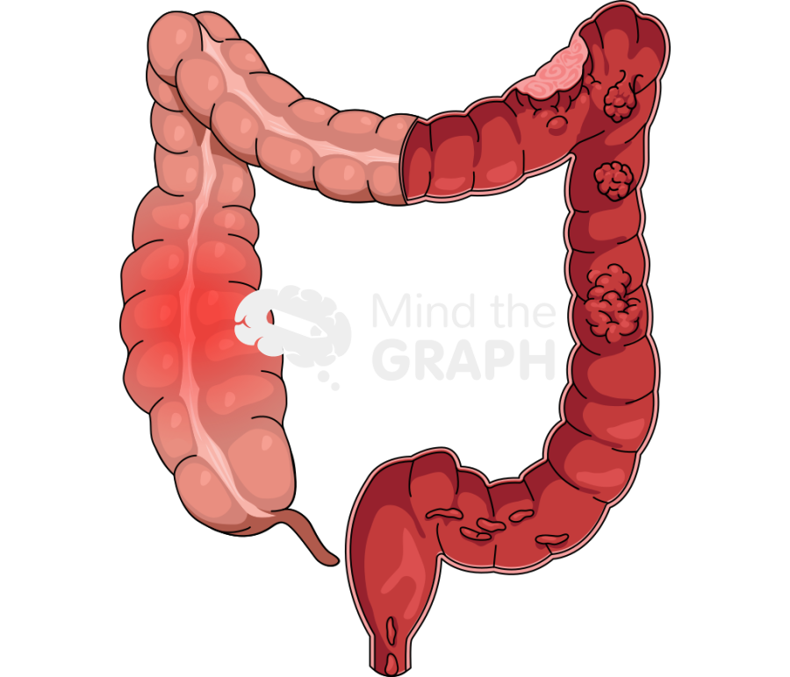
Complications of Radiotherapy
Lethargy
Skin erythema
Bowl & bladder urgency
Hematuria
Bowl perforation
Malabsorption and diarrhea
Radiotherapy induced menopause
vaginal stenosis

Slide 42
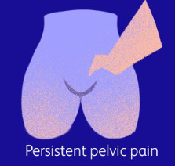
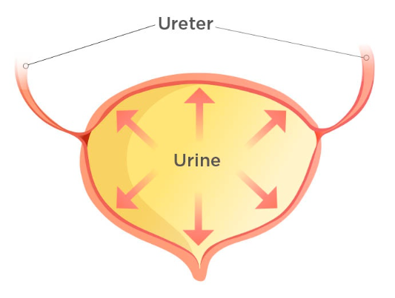
Complications Of Surgery
Immediate
Late
Hemorrhage
Atonic bladder
Pulmonary embolism
Bowel obstruction
Pelvic/wound infection
Fistula formation
Bladder dysfunction
Lymphedema
Premature menopause
sexual dysfunction

Slide 43
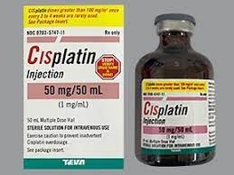
Chemotherapy
Cisplatin
Enhances effect of radiotherapy
Also address micro-metastases that are outside radiotherapy field

Slide 44
Neoadjuvant Chemotherapy
Before definitive surgical treatment or radiotherapy.
Could be used to shrink disease and allow resectability of the tumour prior to radical surgery in inoperable cases
Use of neoadjuvant chemotherapy in bulky tumours prior to fertility-sparing techniques with good results.

Slide 45
Management of recurrent disease
Women treated initially with surgery should be considered for radiotherapy.
If the disease is apparently confined to the pelvis, radical chemoradiotherapy is curative in 40-50% of cases.
If already undergone radiotherapy, the only potentially curative option is pelvic exenteration in some cases, provided the recurrence is central with no distant recurrence.

Slide 46
Prevention

Slide 47
Prognostic Factors
Stage
Size ,volume and depth of invasion
Grade of tumour
Histological type
Lymphatic spread
Parametrial invasion
Status of resection margins

Slide 48
Prognosis
STAGE OF DISEASE | 5 YEAR SURVIVAL RATE (%)
Stage I | 83
Stage II | 65
Stage III | 36
Stage IV | 10

Slide 49
Biomedical ethics
Training of medical staff to early diagnose the disease.
Timely decision to refer the patient to a tertiary care hospital.
Education of the patient and awareness of the disease.

Slide 50
Beneficence
The principle of beneficence is the obligation of physician.
To act for the benefit of the patient.
Support a number of moral rules to protect and defend the right of others.
Prevent harm, remove conditions that will cause harm.
Help persons with disabilities, and rescue persons in danger.

Slide 51
Learning Resources:
Crosbie, Emma J., and Louise C. Kenny, editors. Gynaecology by Ten Teachers. 21st ed., CRC Press, 2024.
Arroyo Mühr LS, Gini A, Yilmaz E, Hassan SS, Lagheden C, Hultin E, Garcia Serrano A, Ure AE, Andersson H, Merino R, Elfström KM. Concomitant human papillomavirus (HPV) vaccination and screening for elimination of HPV and cervical cancer. Nature Communications. 2024 May 1;15(1):3679.
https://www.nature.com/articles/s41467-024-47909-x

Slide 52
THANK YOU

