Slide 1
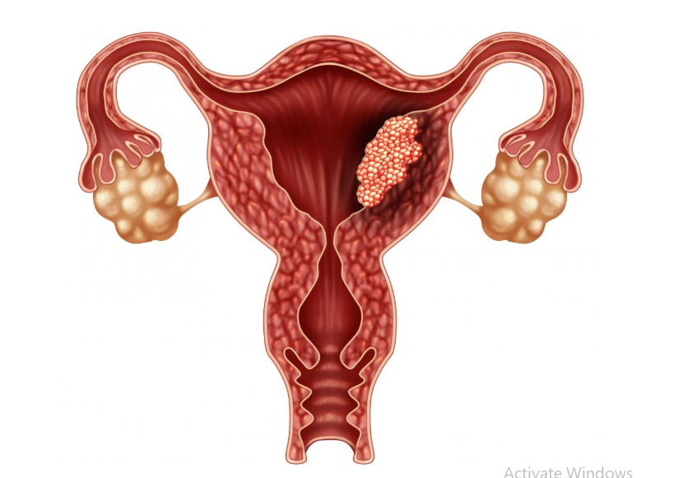
Endometrial carcinoma
Dr Nighat Naheed
Assistant Professor
Benazir Bhutto Hospital
Rawalpindi Medical University

Slide 2
MOTTO
To impart evidence based research oriented medical education. To provide best possible patient care. To inculcate the values of mutual respect and ethical practice of medicine
VISION,THE DREAM TOMORROW

Slide 3
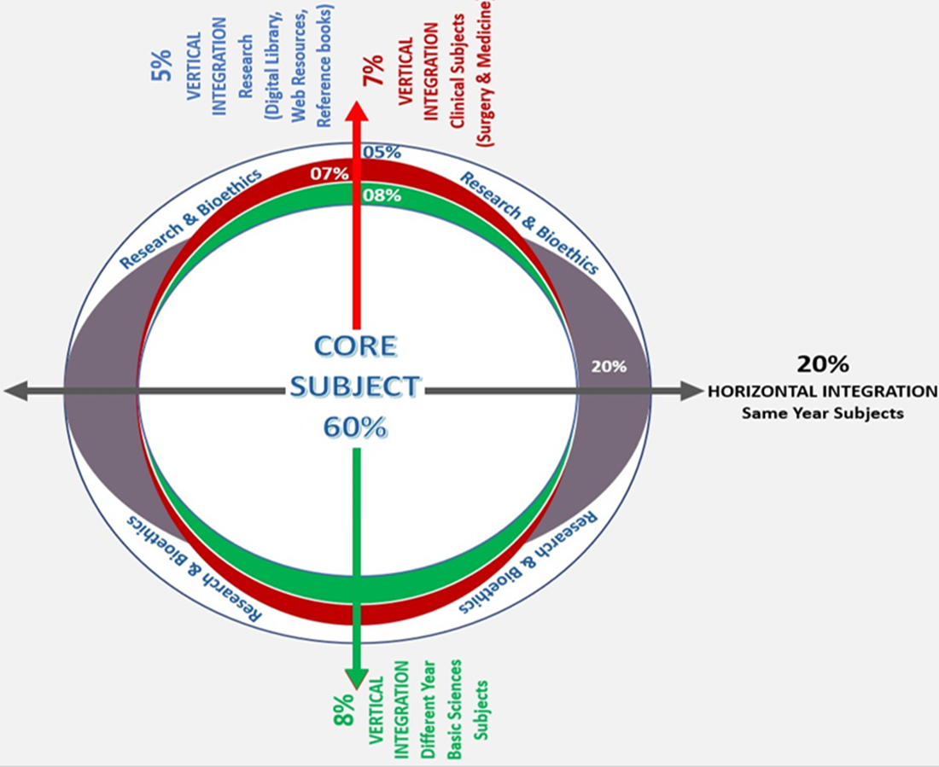
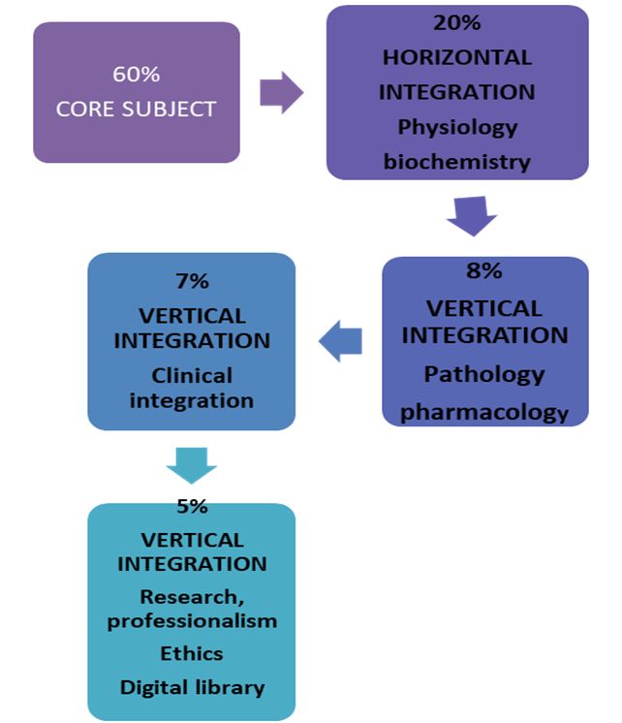

Slide 4
Question:1
A 65-year-old woman with a BMI of 32 presents with abnormal uterine bleeding. Endometrial biopsy confirms endometrioid adenocarcinoma. Which of the following is a known risk factor for endometrial cancer in this patient?
A. Obesity
B. Multiparity
C. Early menopause
D. Smoking
E. COCPs

Slide 5
Question:2
What is the most common presenting symptom of endometrial cancer?
A) Pelvic pain
B) Postmenopausal bleeding
C) Abdominal distension
D) Weight loss
E) Vaginal discharge

Slide 6
Question:3
What is the most common histological type of endometrial cancer?
A) Serous carcinoma
B) Clear cell carcinoma
C) Endometrioid adenocarcinoma
D) Mucinous carcinoma
E) Squamous cell carcinoma

Slide 7
Question:4
A 63-year-old postmenopausal woman presents with vaginal bleeding for the past four months. Her medical history includes type 2 diabetes and chronic hypertension. She is not on hormone replacement therapy. Physical examination is unremarkable. What is the most appropriate next step in management?
A. Initiate hormonal replacement therapy
B. Perform a transvaginal ultrasound and endometrial biopsy
C. Schedule a follow-up in six months
D. Prescribe antibiotics for possible infection
E. Schedule a follow-up in three months

Slide 8
Question:5
A 57-year-old woman presents with postmenopausal bleeding. Transvaginal ultrasound reveals an endometrial thickness of 5 mm. What is the next best step in management?
A. Reassurance and routine follow-up
B. Endometrial biopsy
C. Initiate progesterone therapy
D. Repeat ultrasound in six months
E. Initiate estrogen therapy

Slide 9
Question:6
A 70-year-old woman is diagnosed with FIGO stage III endometrial cancer. What is the recommended treatment approach?
A. Total hysterectomy and bilateral salpingo-oophorectomy alone
B. Chemotherapy alone
C. Radiation therapy alone
D. Surgery followed by adjuvant chemotherapy and/or radiation therapy
E. Radiotherapy & chemotherapy combined

Slide 10
Question:7
What is the FIGO stage of endometrial cancer confined to the uterus?
A) Stage I
B) Stage II
C) Stage III
D) Stage IV
E) Stage 0

Slide 11
Question:8
A 58-year-old woman has postmenopausal bleeding. Biopsy shows endometrioid carcinoma. MRI reveals invasion into the cervical stroma, but no spread beyond the uterus.
What is the FIGO stage?
A. Stage I
B. Stage II
C. Stage IIIA
D. Stage IIIB

Slide 12
Question:9
Which of the following is a protective factor against endometrial cancer?
A) Nulliparity
B) Combined oral contraceptives
C) Tamoxifen use
D) High-fat diet
E) Diabetes mellitus

Slide 13
Question:10
What is the most common site of metastasis in endometrial cancer?
A) Liver
B) Lungs
C) Bones
D) Ovaries
E) Brain

Slide 14
Incidence
4th most common malignancy in females (breast, lung, bowel)
Most common gynaecological malignancy in UK
Age related : 95/ 100,000
Life time risk: 1 in 46
Mean age : 62
Approximately 25% occur before menopause

Slide 15
Classification
Type-1
Type- 2
Associated with hyperestrogenism
Associated with hyperplasia
Perimenopause
Estrogen & progesterone receptors
Endometrioid & mucinous
Prognosis better
Not related to hyperestrogenism
Atrophic endometrium
Postmenopausal
Estrogen & progesterone receptors uncommom
Serous & clear cell
Prognosis: poor/aggressive

Slide 16
Adenocarcinoma/ endometrioid: most common
80%
Adenosquamous : 15%
Papillary serous, clear cell carcinoma: 3-4%

Slide 17
Spread
Direct
Lymphatics
Transtubal
Haematogenous (lungs)

Slide 18
RISK FACTORS
Obesity
Diabetes
Nulliparity
Early menarche and late menopause
Unopposed estrogen therapy
Tamoxifen therapy
Family history colorectal & endometrial Ca
PCOS : nearly 3 times increased risk for EC

Slide 19
PROTECTIVE FACTORS
Hysterectomy
COCP
Progestin- based contraception
IUCD & LNG-IUS
Pregnancy
Smoking
Increased coffee intake
Vegetable diet
Complex carbohydrates intake

Slide 20
Clinical Presentation
Postmenopausal bleeding or red flag : 5-10% 0f PMB have malignancy
Pre-menstrual: heavy, irregular, IMB
Advanced: abdominal pain, urinary dysfunction, bowel and respiratory symptoms
Cervical smear: abnormal glandular cytology

Slide 21
Asymptomatic : < 5%
Abnormal bleeding
Postmenopausal
Menorrhagia
Post-coital
Intermenstrual
Vaginal discharge
Blood stained
Excessive
Purulent

Slide 22
Signs: Pallor
Pelvic examination:
Speculum
Cervix: normal looking
vaginal discharge
Bimanual
uterus: Size (atrophic , normal, enlarged )
Mobility: mobile unless advanced stage
Per-rectal
Regional lymph node
Breast examination

Slide 23
Diagnosis
History
Physical examination
Pelvic examination
Transvaginal ultrasound
Hysteroscopy & endometrial biopsy
MRI
Pap smear : not for diagnosis
Abnormal pap smear : 1-5% cases of EC
Abnormal glandular cells of unknown significance (AGCUS)

Slide 24
Transvaginal ultrasound : suggestive finding
Endometrial thickness > 4 mm (Post menopausal)
Hyper-echogenic endometrium with irregular outline
Increased vascularity with low vascular resistance
Intrauterine fluid

Slide 25
Pre-operative evaluation
Blood CBC, BSR, Urea & electrolytes, RFTs, LFTs
Urine: protein, sugar, pus cells
ECG
Chest X-Ray
Pelvic USG
Abdomin—pelvic USG
MRI
PET

Slide 26
Classification
The goals of the new FIGO 2023 staging system are to better define prognostic groups and create substages that indicate more appropriate surgical, radiation, and systemic therapies.
The changes incorporated in the new staging system provide a more evidence-based context for treatment recommendations and for the more refined future collection of outcome and survival data.

Slide 27
The updated 2023 staging of endometrial cancer includes the following components
HISTOLOGICAL TYPE
TUMOUR GRADE
MYOMETRIAL INVASION
LYMOHOVASCULAR SPACE INVASION (LVSI)
CERVICAL STROMAL INVASION
ADNEXAL INVOLVEMENT
UTERINE SEROSAL INVOLVEMENT
LYMPH NODE STATUS
MOLECULAR CLASSIFICATION

Slide 28
Histopathological findings are central features of the 2023 revision of the FIGO staging of endometrial carcinoma. It is an important prognostic predictor in endometrial carcinoma.
Non-aggressive histological types
Aggressive histological types
Endometroid carcinoma (EEC), of low grade (Grades 1 and 2)
Endometroid carcinoma of high grade (Grades 3 and 4)
Serous carcinoma
Clear cell carcinoma
Mixed carcinoma
Undifferentiated carcinoma
Carcinosarcoma
Other unusual types such as mesonephric and gastrointestinal mucinous type carcinomas

Slide 29
STAGE 1

Slide 30
STAGE 2

Slide 31
STAGE 3

Slide 32
STAGE 4

Slide 33
GRADES
Well differentiated adenocarcinoma: less than 5% solid growth, ( with easily recognizable glandular pattern ), superficial invasion with little propensity for nodal spread.
Moderately differentiated adenocarcinoma: with partly solid growth <50%, showing well formed glands mixed with solids sheets of malignant cells.
Poorly differentiated adenocarcinoma : with predominantly solid growth >50%( solid sheets of cell with barely recognizable gland with greater degree of nuclear atypia and mitotic activity), often deeply invasive and metastatic.
All non-endometrioid carcinoma classified as grade-3 irrespective of histological pattern.

Slide 34
Treatment
Treatment according to stages.
Stage 1 & 2
Surgery is the main stay of treatment.

Slide 35
Stage 1 & 2
Stage 1-A
TLH + BSO > TAH +BSO
Sentinel LN biopsy can be taken.
Stage 1-B
TLH + BSO > TAH +BSO
Sentinel LN biopsy should be taken.
Stage 1-C
Staging laparotomy
Pelvic lymphadenectomy should be done.
Infracolic Omentatomy
Radiotherapy should be given.
TAH + BSO

Slide 36
Stage 2
Staging Laparotomy
Pelvic lymphadenectomy should be done.
Radiotherapy should be given.
TAH + BSO

Slide 37
Stage 3
Maximum debulking surgery/Chemotherapy/Radiotherapy
Pelvic + para - aortic lymphadenectomy should be done.
Cure rate 30%

Slide 38
Stage 4
Maximum debulking surgery / palliative treatment / Chemotherapy / Radiotherapy / Hormone therapy.
Pelvic + para - aortic lymphadenectomy should be done.
Cure rate 20%

Slide 39
Role of Radiotherapy
Women e- intermediate or high risk early stage disease considered to be increased risk of recurrence are often given postoperative adjuvant radiotherapy
Moderate and high risk pt include:
Ib, G3
Type ( serous papillary, clear cell) with myometrial invasion.

Slide 40
Grade 3 ,> 60 years with any myometrial invasion.
>50% myometrial invasion, grade 1/2 ,> 60 years.
Stage ll ( any grade).
Vault brachytherapy is used to prevent vault recurrence.
External beam therapy is used to treat parametrium and Pelvic side walls.

Slide 41
Role of Chemotherapy
Triple regimen, carboplatin, paclitaxel and doxorubicin is used for treatment of stage III and IV endometrial cancer.

Slide 42
Role of Hormonal Therapy
In exceptional circumstances where, due to extreme comorbidities or pt. choice, surgery or radiotherapy cannot be used, consideration may be given to the use of hormone treatment.
For advanced Endometrial Carcinomas especially those that are well differential, showing strong progesterone positivity and metastatic to lungs hormonal therapy is reasonable choice and should always be considered.

Slide 43
The most commonly used agent is medroxy progesterone in high doses such as 200mg B.D or TDS fluid retention and heart failure are recognized complications. Other hormonal agents such as aromatase inhibitors have used with some efficacy.

Slide 44
Palliative Care
Palliation for women with endometrial cancer should be approached with MDT.
High dose progesterone and radiotherapy is used with palliative intent.

Slide 45
Recurrence of Endometrial Cancer
Most common site of relapse is vaginal vault.
If previous surgery only then radiotherapy is the treatment.
If previous surgery + Radiotherapy then Surgery (pelvic exenteration is treatment)
For distant Metastasis (lungs) hormonal > chemotherapy.
The prognosis for distant metastatic endometrial cancer is poor and management concentrates on symptoms control.

Slide 46
Biomedical ethics
Training of medical staff to early diagnose the disease.
Timely decision to refer the patient to a tertiary care hospital.
Education of the patient and awareness of the disease.

Slide 47
Beneficence
The principle of beneficence is the obligation of the physician.
To act for the benefit of the patient.
Support a number of moral rules to protect and defend the right of others.
Prevent harm, remove conditions that will cause harm.
Help persons with disabilities, and rescue persons in danger.

Slide 48
Learning Resources:
Crosbie, Emma J., and Louise C. Kenny, editors. Gynaecology by Ten Teachers. 21st ed., CRC Press, 2024.
Baker-Rand H, Kitson SJ. Recent advances in endometrial cancer prevention, early diagnosis and treatment. Cancers. 2024 Mar 1;16(5):1028.
https://www.mdpi.com/2072-6694/16/5/1028

Slide 49
Thank You

