Slide 1
DIABETES AND HYPOGLYCEMIA
Dr. Muhammad Mujeeb Khan
FCPS (Medicine)
Dip. DM (UK), Dip. Nutrition (Pak),
MSc. Infectious Diseases (UK)
Associate Professor
Rawalpindi Medical University, Rawalpindi

Slide 3
LECTURE CONTENT ANALYSIS
CORE CONTENT | 60%
HORIZONTAL INTEGRATION | 20%
VERTICAL INTEGRATION | 15%
RESEARCH AND ETHICS | 5%

Slide 4
LEARNING OBJECTIVES
At the end of this lecture students should be able to :
Define Diabetes Mellitus
Describe the diagnostic criteria of Diabetes and classification of DM.
Enlist micro and macro vascular complications of diabetes.
Define hypoglycemia.
Identify clinical features of hypoglycemia.
Outline management plan for hypoglycemia.

Slide 5
DIABETES MELLITUS
Diabetes mellitus, disorder of carbohydrate metabolism characterized by impaired ability of the body to produce or respond to insulin.

Slide 6
BURDEN OF THE DISEASE
422 million people worldwide have diabetes.
1.5 million deaths are directly attributed to diabetes each year.
26.7% prevalence of diabetes in adults in Pakistan.
32,964,500 total cases of diabetes in adults in Pakistan.

Slide 7
NORMAL FUNCTION OF INSULIN
Insulin Function
Liver | Adipose Tissue | Muscle
↓ glycogenolysis | ↓ lipolysis | ↓ protein catabolism
↓gluconeogenesis | ↑ glycerol formation | ↓ amino acid oxidation
↓ ketogenesis | ↑ fatty acid formation | ↑ amino acid uptake
↑ glycogen synthesis | ↑ glucose uptake | ↑ glucose uptake
↑ fatty acid synthesis |  | ↑ protein synthesis
 |  | ↑ glycogen synthesis

Slide 8
Pathophysiology of Diabetes Mellitus

Slide 9
CLASSIFICATION OF DIABETES MELLITUS
Type | Comment
Insulin dependent Diabetes Mellitus | Autoimmune β-cell destruction
Insulin independent Diabetes Mellitus | Non-autoimmune progressive loss of adequate β-cell insulin secretion.
Gestational DM | Diabetes diagnosed in the second or third trimester of pregnancy.
Other forms | Monogenic syndromes, diseases of the exocrine pancreas, and drug-induced diabetes

Slide 10
Symptoms of Diabetes Mellitus

Slide 11
DIAGNOSTIC CRITERIA OF DM
FPG ≥126 mg/dL (7.0 mmol/L)
OR
2-h PG ≥200 mg/dL (11.1 mmol/L) during OGTT
OR
A1C ≥6.5% (48 mmol/mol)
OR
With classic symptoms of hyperglycemia, a random plasma glucose ≥200 mg/dL (11.1 mmol/L).

Slide 12
COMPLICATIONS OF DIABETES MELLITUS
Tomic, D., Shaw, J.E. & Magliano, D.J. The burden and risks of emerging complications of diabetes mellitus. Nat Rev Endocrinol 18, 525–539 (2022). https://doi.org/10.1038/s41574-022-00690-7

Slide 13
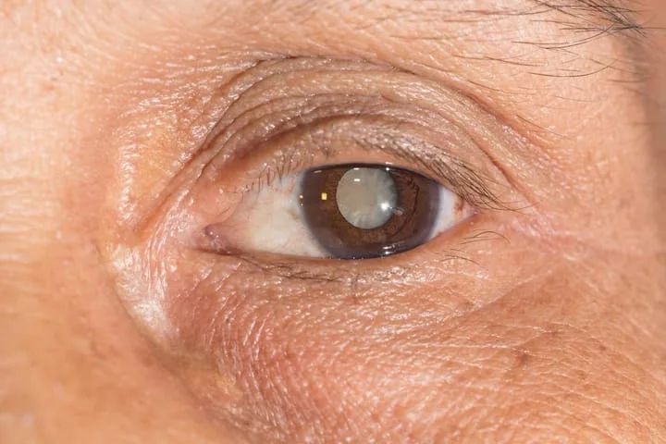
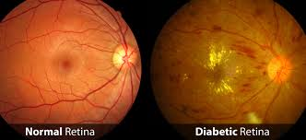
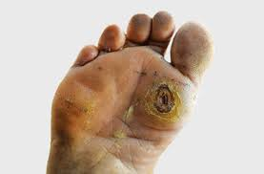
Cataract
Diabetic foot ulcer

Slide 14
CASE VIGNETTE
The 29-year-old man experienced diaphoresis with tremor, chest pain, dizziness, and shortness of breath in the early morning, four days before his admission. He was unable to recognize his older brother when he was taken to the hospital, his blood sugar levels was checked and found to be 20 mg per dL. The symptoms were relieved after administration of intravenous dextrose water.

Slide 15
DEFINITION OF HYPOGLYCEMIA
Blood glucose below 70mg/dl with symptoms that are relieved promptly after the administration of glucose.

Slide 16
CLASSIFICATION OF HYPOGLYCEMIA
 | Glycemic criteria/description
Level 1 | Glucose <70 mg/dL
Level 2 | Glucose <54 mg/dL
Level 3 | Severe event characterized by altered mental and/or physical status requiring assistance for treatment of hypoglycemia, irrespective of glucose level.

Slide 17
SYMPTOMS OF HYPOGLYCEMIA
Autonomic | Neuroglycopenic | General
Sweating | Confusion | Headache
Palpitation | Drowsiness | Nausea
Shaking | Irritability
Hunger | Speech difficulty
 | Coma
 | Seizures

Slide 18
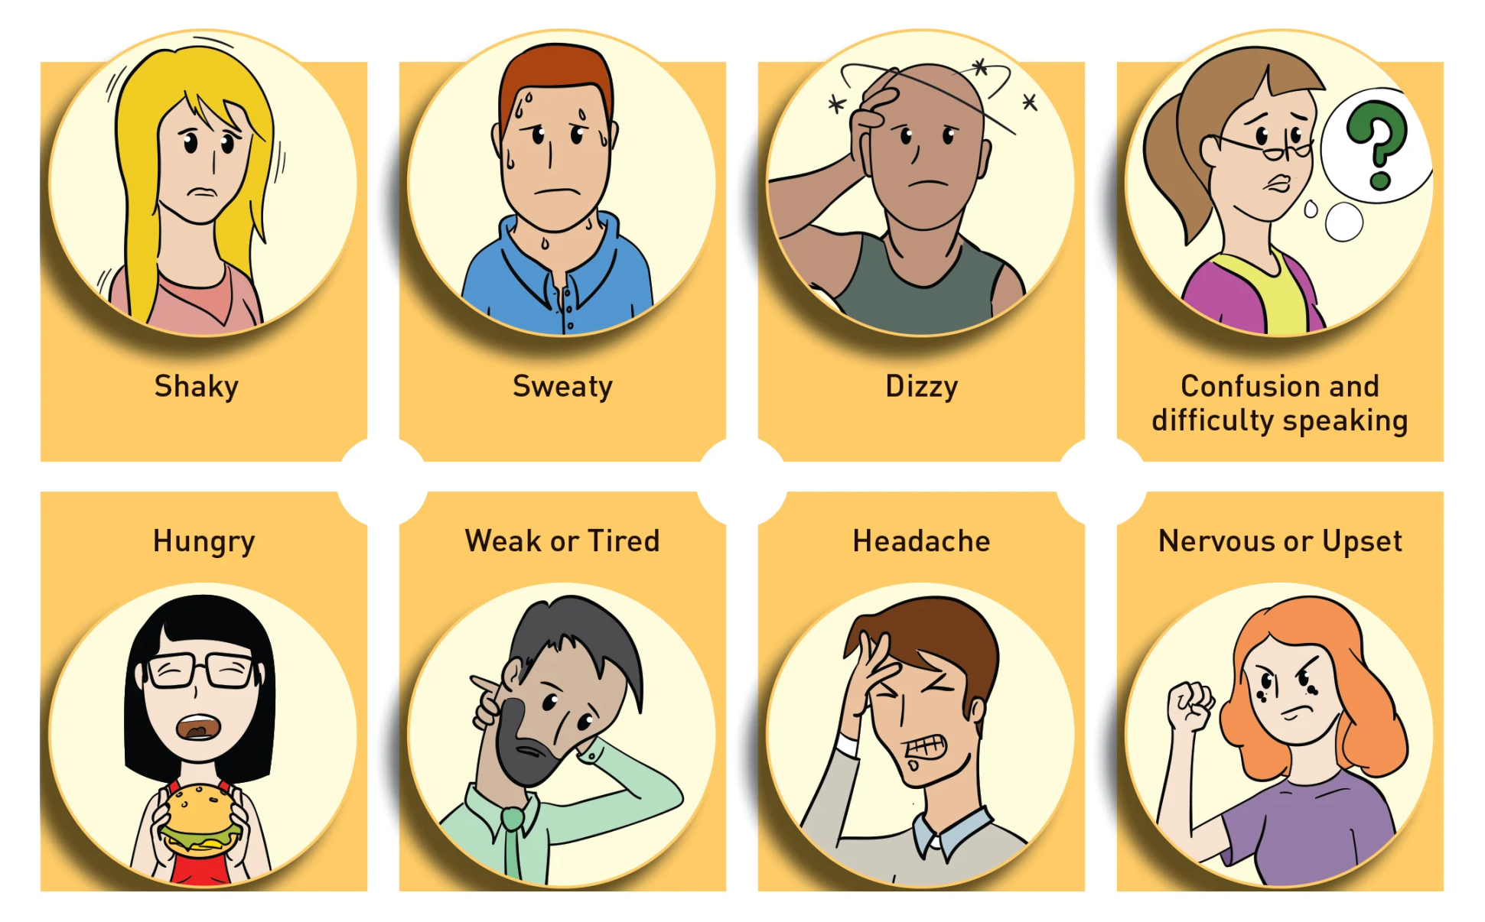

Slide 19
RISK FACTORS FOR HYPOGLYCEMIA
Intensive Insulin therapy
Old age
Longer duration of diabetes
Chronic kidney disease
Chronic liver disease
Dementia
Fasting

Slide 20
MANAGEMENT OF HYPOGLYCEMIA
Give 15- 20g of quick acting carbohydrates.
Recheck BSR after 15 mins.
BSR > 72 mg/dl, give 15g of long-acting CHO.
1. Administer 20ml of 50% dextrose
OR
2. Inj Glucagon 1mg IM
Patient able to eat
Patient not able to eat

Slide 21
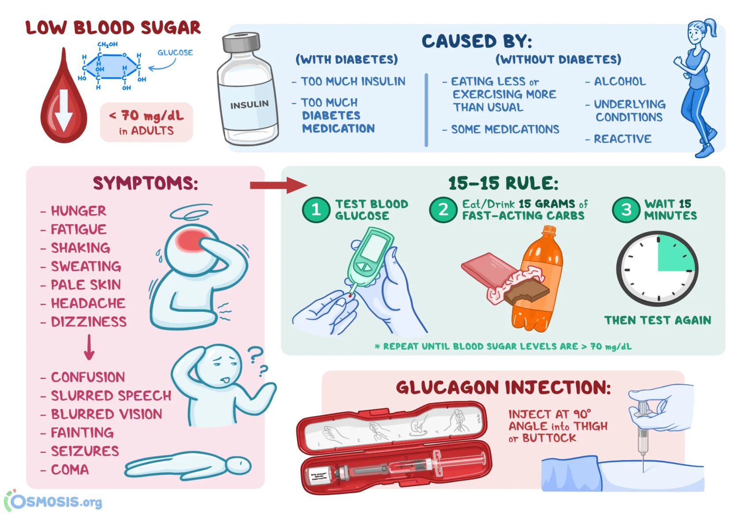

Slide 22
READING RESOURCES
Glycemic Goals and Hypoglycemia: Standards of Care in Diabetes—2024 https://doi.org/10.2337/dc24-S006

Slide 23
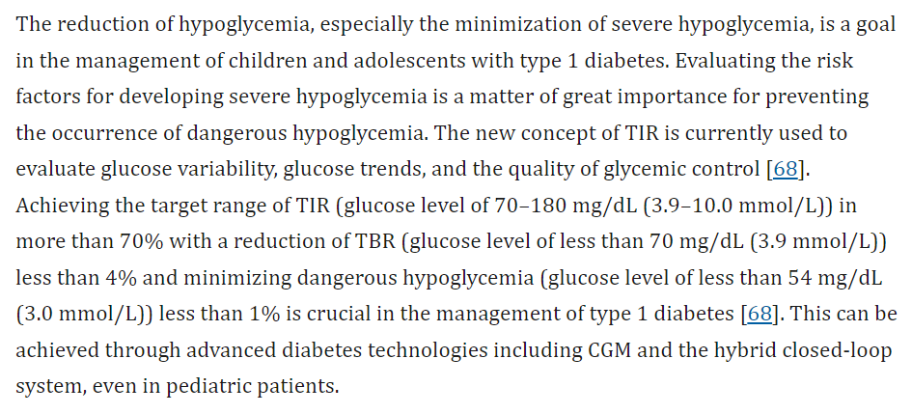
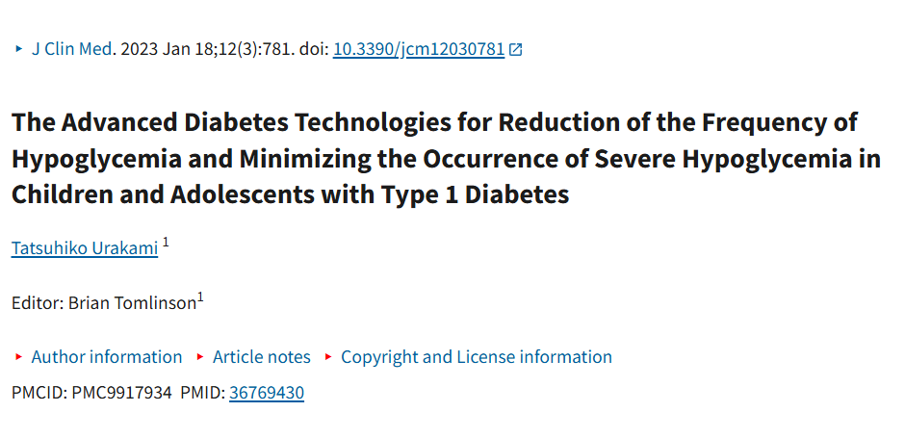

Slide 24
ETHICAL ISSUES
Ethical Issue | Key Concerns
Patient Autonomy and Informed Consent | Educating patients on risks, treatment and self-management, concerns with cognitively impaired patients.
Overtreatment and Harm Prevention | Balancing tight glycemic control with risk of hypoglycemia, especially in elderly and critically ill patients.
Equity in Access to Care | Disparities in access to CGM, insulin pumps; and emergency treatments ensuring affordable care.
Duty to Warn vs. Patient Confidentiality | Balancing patient privacy with public safely in cases of recurrent severe hypoglycemia (e.g. driving risks).
Ethical Considerations in Research | Minimizing hypoglycemia risks in clinical trials; ensuring vulnerable populations are protected.

Slide 25
Thank You

