Slide 1
CASE VIGNETTE
A 32-year-old male with type 1 diabetes since the age of 14 years was taken to the emergency room because of drowsiness, fever, cough, diffuse abdominal pain, and vomiting.
Fever and cough started 2 days ago, and the patient could not eat or drink water. He has been treated with an intensive insulin regimen. On examination he was tachypneic, his temperature was 39° C (102.2° F), pulse rate 104 beats per minute, respiratory rate 24 breaths per minute, blood pressure 100/70 mmHg; he also had dry mucous membranes, poor skin turgor, and rales in the right lower chest. He was slightly confused.

Slide 2
CASE VIGNETTE
Rapid hematology and biochemical tests showed hematocrit 48%, hemoglobin 14.3 g/dl, white blood cell count 18,000/ μ l, glucose 450 mg/dl, urea 60 mg/dl (10.2 mmol/L), creatinine 1.4 mg/dl, Na+ 152 mEq/L, K+ 5.3 mEq/L, and Cl− 110 mmol/L. Arterial pH was 6.9, PO2 95 mmHg, PCO2 28 mmHg, HCO3 9 mEq/L, and O2 sat 98%. The result of the strip for ketone bodies in urine was strongly positive.

Slide 3
DIABETIC EMERGENCY (DIABETIC KETOACIDOSIS)
Dr. Muhammad Mujeeb Khan
FCPS (Medicine)
Dip. DM (UK), Dip. Nutrition (Pak),
MSc. Infectious Diseases (UK)
Associate Professor
Rawalpindi Medical University, Rawalpindi

Slide 5
LECTURE CONTENT ANALYSIS
CORE CONTENT | 70%
HORIZONTAL INTEGRATION | 20%
VERTICAL INTEGRATION | 5%
RESEARCH & ETHICS | 5%

Slide 6
LEARNING OBJECTIVES
At the end of this lecture students should be able to:
Define Diabetes Ketoacidosis.
Describe pathophysiology of Diabetic Ketoacidosis.
Describe diagnostic criteria and clinical features of DKA.
Enlist the laboratory investigations required for the diagnosis of DKA.
Outline the management plan for the patient of DKA.

Slide 7
DEFINITION
Diabetic ketoacidosis is a medical emergency due to profound deficiency of insulin in the body and is characterized by hyperglycemia, ketosis, acidosis, and dehydration.

Slide 8
PATHOPHYSIOLOGY OF DKA

Slide 9
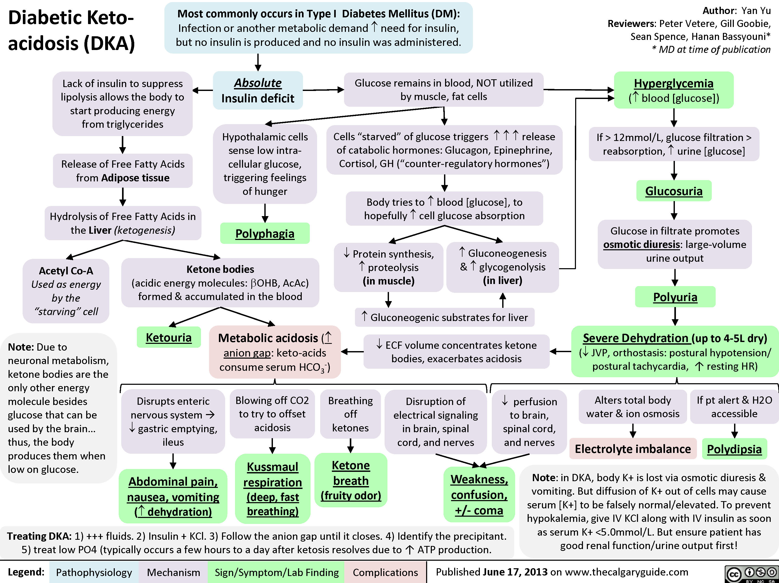

Slide 10
DIAGNOSTIC CRITERIA FOR DKA
All of these must be present to make the diagnosis
The ‘D’ – a blood glucose concentration of >11.0 mmol/L ( > 200mg/dl) or known to have diabetes mellitus.
The ‘K’ – a capillary or blood ketone concentration of >3.0 mmol/L or
significant ketonuria (2+ or more on standard urine sticks)
The ‘A’ – a bicarbonate concentration of <15.0 mmol/L and/or venous pH <7.3.

Slide 11
RISK FACTORS
Infections
Infarction
Ischemia
Ignorance, e .g., poor compliance to Insulin 5Is
Intoxication, e.g., Alcohol

Slide 12
CLINICAL FEATURES
Symptoms
Thirst
Polyuria
Fatigue
Weight loss
Nausea, vomiting
Abdominal pain
Blurred vision
Leg cramps

Slide 13
CLINICAL FEATURES
Signs
Dehydration
Hypotension
Tachycardia
Reduced skin turgor
Kussmaul breathing
Acetone smell
Cold peripheries
Confusion and drowsiness (10%)

Slide 15
LABORATORY INVESTIGATIONS
Complete Blood Count (CBC)
Blood Sugar Random(BSR)
Renal Function test
Serum Electrolytes
C-Reactive Protein (CRP)
Blood Culture/Sensitivity
Arterial Blood Gases (ABGs)
Serum Ketones
ECG

Slide 16
PILLARS OF DKA MANAGEMENT
Volume resuscitation.
Insulin to correct anion gap.
Correction of electrolyte abnormalities.
Treatment of precipitating cause.

Slide 17
STEP 1: FLUID REPLACEMENT
0.9% NaCl 1Liter at 0 hour.
0.9% sodium chloride 1L over 2 hours
0.9% sodium chloride 1L over next 2 hours
0.9% sodium chloride 1L over next 4 hours
Add 10% glucose 125ml/hr if blood glucose falls below 250 mg/dl.

Slide 18
STEP 2: INSULIN REPLACEMENT
Insulin Regular infusion @ 0.1IU/kg/hr.

Slide 19
STEP 3: POTASSIUM REPLACEMENT
Potassium level (mmol/L) | Intravenous Potassium replacement
> 5.5 | NIL
3.5 to 5.5 | 40 mmol/hr
< 3.5 | Additional Potassium replacement

Slide 20
THE RECOMMENDED TARGETS ARE
• Reduction of the blood ketone concentration by 0.5 mmol/L/hour
• Increase the venous bicarbonate by 3.0 m/L/hour
• Reduce capillary blood glucose by 54 mg/L/hour
• Maintain potassium between 4.0 and 5.5 mEq/L/hour

Slide 21
COMPLICATIONS
Hypoglycemia
Hypokalemia
Cerebral edema
Thromboembolic phenomenon
Acute Kidney injury
Cardiac arrythmias

Slide 22
READING RESOURCES
http://www.diabetes.org.uk/joint-british-diabetes-society
https://calgaryguide.ucalgary.ca/diabetic-ketoacidosis-dka/

Slide 23
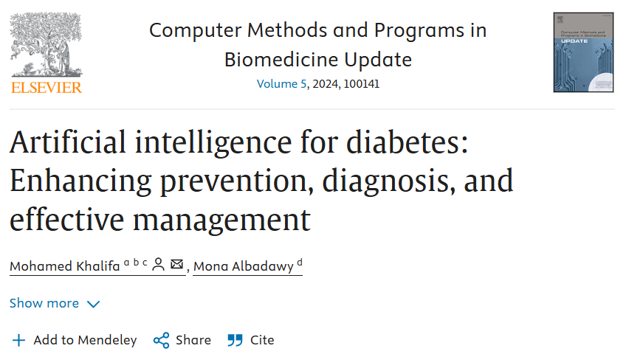
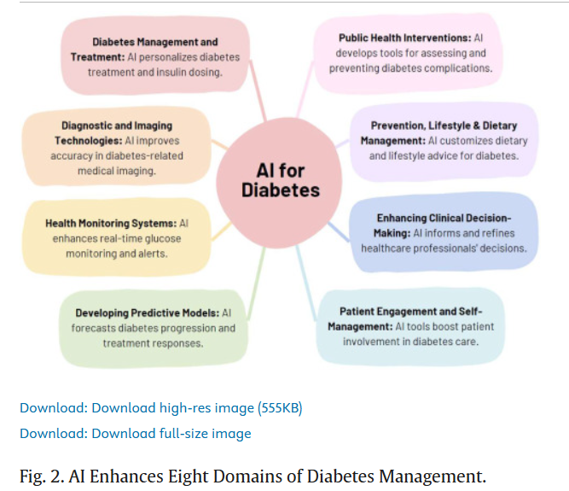

Slide 24
ETHICAL ISSUES
Ethical Issue | Key Concerns
Informed Consent and Capacity | Ensuring patients, especially those with altered mental status, provide valid consent when possible.
Resource Allocation | Prioritizing ICU beds and critical care resources during high-demand periods (e.g., mass casualty events).
Patient Autonomy | Respecting patient choices while ensuring life-saving interventions in emergencies.
Equity in Healthcare Access | Ensuring equal access to insulin, monitoring devices and critical care for all socioeconomic groups.
End-of-Life Care Decisions | Ethical challenges when managing DKA in terminally ill or elderly patients with multiple comorbidities.
Research and Innovation Ethics | Adhering to ethical principles in clinical trials for new DKA treatments, including informed consent.
Confidentiality and Stigma | Maintaining privacy, especially in patients with recurrent DKA due to psychosocial issues like eating disorders.

Slide 25
Thank you

