Slide 1
ADDISON’S DISEASE & CUSHING SYNDROME
Dr. Muhammad Mujeeb Khan
FCPS (Medicine)
Dip. DM (UK), Dip. Nutrition (Pak),
MSc. Infectious Diseases (UK)
Associate Professor
Rawalpindi Medical University, Rawalpindi

Slide 3
LECTURE CONTENT ANALYSIS
CORE CONTENT | 60%
HORIZONTAL INTEGRATION | 20%
VERTICAL INTEGRATION | 15%
RESEARCH AND ETHICS | 5%

Slide 4
LEARNING OBJECTIVES
Definition of Addison disease and Cushing syndrome
Underlying Pathophysiology & Etiology
Clinical Features
Laboratory Diagnosis
Management
Recent advances

Slide 5
DEFINITION
Addison disease: A hormonal disorder caused by chronic cortisol (and often aldosterone) deficiency, leading to fatigue, weight loss, and low blood pressure
Cushing syndrome: A hormonal disorder caused by chronic cortisol excess, leading to obesity, hypertension, and metabolic disturbances.

Slide 6
CLINICAL SCENARIO
A 35-year-old HIV-positive man, evaluated for weight loss and weakness has been found to have disseminated tuberculosis.
On examination, he is hypotensive and has hyperpigmentation of the mucosa, elbows and skin creases.
Is this Cushing syndrome or Addison disease.

Slide 7
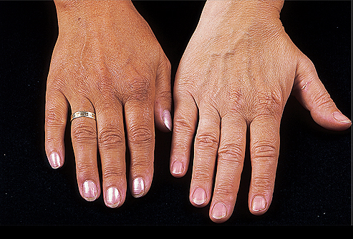
ADDISON’S DISEASE
Develops when the level of adrenal cortex hormone is low due to hypo-secretion.

Slide 8
HORMONES INVOLVED
Adrenocorticotropic (ACTH)
Glucocorticoids (cortisol)
Mineralocorticoids (aldosterone)

Slide 9
PATHOPHYSIOLOGY
Anterior pituitary
ACTH to adrenal cortex
release of Glucocorticoids or Mineralocorticoids
When their functions are completed
Target tissue release feedback hormones towards hypothalamus
This represents a negative feedback loop in which the mechanism fluctuates around homeostasis

Slide 10
NEGATIVE FEEDBACK LOOP IN ADDISON’S DISEASE
Anterior pituitary
Excessive but ineffective ACTH to adrenal cortex
no release of Glucocorticoids or Mineralocorticoids
Bronzing of skin (ACTH is linked to melanin production)
Lack of glucose, Na & water
Dehydration, unable to manage stressful situations

Slide 11
ADRENAL INSUFFICIENCY
Arises when cortisol levels are not sufficient to meet the needs of the body
Cortisol aids in maintaining vascular tone, hepatic gluconeogenesis, and in maintaining glycogen
Inadequate cortisol in times of stress can lead to hypotension, shock, and hypoglycemia
Mineralocorticoid deficiency typically leads to renal wasting of sodium, retention of potassium, and reduced intravascular volume

Slide 12
PRIMARY ADRENAL INSUFFICIENCY
Autoimmune etiology, resulting from chronic destruction of the adrenal cortex
Lymphocytic infiltration
Antibodies to adrenal cortical antigens are present early in the disease process

Slide 13
SECONDARY ADRENAL INSUFFICIENCY
Caused by pituitary failure of ACTH secretion
Etiologies:
Any cause of primary or secondary hypopituitarism
Exogenous Glucocorticoid Therapy
Megestrol, which has some glucocorticoid therapy

Slide 14
CLINICAL PRESENTATION
Acute adrenal insufficiency (Adrenal Crisis) should be expected in any patient acute, unexplained volume depletion and shock
Hyperkalemia, acidosis, and hypoglycemia may also be accompanying

Slide 15
Symptoms may include weakness, weight loss, nausea, vomiting, anorexia, and postural hypotension
Skin pigmentation seen with primary adrenal insufficiency secondary to MSH activity associated with ACTH
Hyponatremia and Hyperkalemia may develop secondary to a lack of aldosterone

Slide 16
DIAGNOSIS
Early morning baseline Cortisol and ACTH levels:
A morning cortisol level of <3 mg/dL is virtually diagnostic
A level of <10 mg/dL is highly suspicious
A level of >18 mg/dL should rule out Adrenal Insufficiency except in the setting of a critically ill patient

Slide 17
DIAGNOSIS
ACTH Stimulation Test
Measure morning cortisol level (pre-test level)
Administer 250 ug dose ACTH
Measure a second cortisol level 30 minutes after ACTH administration
Normal response demonstrates a level of greater than 500 nmol/L after ACTH
Patients with both primary and secondary adrenal insufficiency will not demonstrate appropriate response

Slide 18
DIAGNOSIS
Further determination of primary vs. secondary adrenal insufficiency will be based upon ACTH level
High ACTH level expected in primary insufficiency

Slide 19
TREATMENT: ACUTE ADRENAL INSUFFICIENCY
Treat Acute Adrenal Insufficiency with Hydrocortisone 50-100 mg IV 8 hrs
In addition, volume resuscitate with Normal Saline

Slide 20
TREATMENT: CHRONIC ADRENAL INSUFFICIENCY
Hydrocortisone 20-30 mg orally daily
Typically divide dose 2/3 in am, 1/3 in pm
May use Prednisone 5 mg orally daily instead
Fludrocortisone 0.05-0.1 mg orally
Not necessary in patients with secondary adrenal insufficiency
Provide instruction for periods of acute illness or increased stress

Slide 21
RECENT ADVANCES IN ADDISON’s DISEASE
Optimized Glucocorticoid Replacement Therapy:
Better understanding of the body's cortisol needs has led to more precise dosing regimens to mimic natural cortisol production.
Personalized Dosing:
Tailored treatment plans consider individual patient factors, such as age, weight, activity level, and stressors, to optimize dosing for each person.

Slide 22
Modified-Release Hydrocortisone Formulations: New medications provide more stable cortisol levels throughout the day, reducing the risk of both over- and under-replacement.
Research into Immunomodulatory Agents: Ongoing studies explore the potential of medications that modulate the immune system to address the autoimmune component of Addison's disease, potentially offering new treatment options in the future.

Slide 23
CLINICAL SCENARIO
41 years old woman presents with the complaint of generalized weakness.
Patient states that she has been irritable lately and finds it difficult to concentrate at work.
She has been amenorrheic for 12 months and feels her symptoms might be related to early menopause.
O/E: blood pressure is 160/90 mm Hg. The patient has a moon face and a buffalo hump.
Abdominal examination reveals purple striae. Her extremities appear to be atrophied. Her fingerstick glucose is 210 mg/dL.

Slide 24
CUSHING SYNDROME

Slide 25
CUSHING’S SYNDROME DEFINITIONS
Cushing’ Syndrome:
A state of chronic glucocorticoid excess leading to of symptoms and signs of hypercortisolism.
Cushing’s Disease:
The specific type of Cushing’s syndrome due to excessive ACTH secretion from a pituitary tumor.
Ectopic ACTH syndrome:
Type of Cushing’s syndrome due to ACTH secretion by nonpituitary tumor.

Slide 26
CUSHING’S SYNDROME
Most common cause is iatrogenic due to chronic use of glucocorticoid.
Overproduction of cortisol by the adrenal glands.
Mostly due to Bilateral Adrenal Hyperplasia
The most frequent age of onset is 3rd to 4th decade.

Slide 27
CUSHING’S SYNDROME: DIFFERENTIAL DIAGNOSIS
ACTH-dependent
Pituitary adenoma (Cushing’s disease)
Non-pituitary neoplasm (ectopic ACTH)
ACTH-independent
Iatrogenic (glucocorticoid, megestrol acetate)
Adrenal neoplasm (adenoma, carcinoma)
Nodular adrenal hyperplasia
Primary pigmented nodular adrenal disease.
Massive macronodular adrenonodular hyperplasia
Food-dependent (GIP-mediated)
Factitious

Slide 28
TUMORS CAUSING ECTOPIC ACTH SYNDROME
Small cell carcinoma of the lung (50% of ectopic ACTH cases).
Pancreatic islet cell tumors.
Carcinoid tumors (lung, thymus, gut, pancreas, ovary).
Medullary carcinoma of the thyroid.
Pheochromocytoma and related tumors.

Slide 29
PATHOLOGY OF CUSHING’S SYNDROME
Adrenocortical Hyperplasia
Bilateral hyperplasia of adrenal cortex.
Results from chronic ACTH hypersecretion.
There are 3 types of adrenocortical hyperplasia:
Simple Adrenocortical Hyperplasia (Cushing’s disease)
Ectopic ACTH syndrome
Bilateral Nodular Hyperplasia

Slide 30
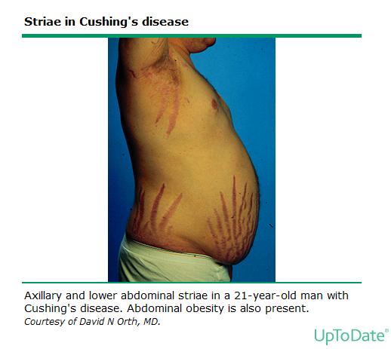
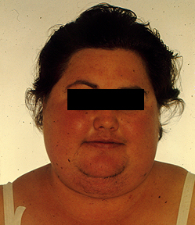
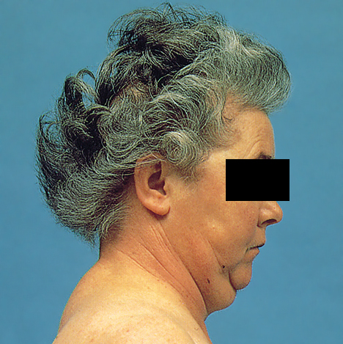
CLINICAL MANIFESTATIONS
OF CUSHING’S SYNDROME
Facial Plethora i.e. “Moon Facies”
Dorsocervical fat pad i.e. “buffalo hump”
Notes:
Source Images:UpToDate: sections on cushing’s syndrome
Epidemiology and clinical manifestations of Cushing’s syndrome
Establishing the diagnosis of Cushing’s syndrome
Establishing the cause of Cushing’s Syndrome

Slide 31
CLINICAL FEATURES
Obesity
Increased adipose tissue w/moon facies, buffalo hump and supraclavicular fat pads
Central obesity with increased fat in mediastinum and peritoneum, and visceral fat on CT.
Skin
Facial plethora
Violaceous striae on abdomen, buttocks, lower back, upper thighs, upper arms, and breasts
Telangiectasias and purpura.
Cutaneous atrophy with exposure of subcutaneous vasculature tissue and tenting of skin
Increased lanugo facial hair.
Acanthosis nigricans, insulin resistance and hyperinsulinism.

Slide 32
Cardiovascular and Renal
Hypertension and possibly edema
Gastroenterologic
Peptic ulceration particularly if patients are given high doses of glucocorticoids (rare in endogenous hypercortisolism).
Endocrine
Galactorrhea
Signs of hypothyroidism
Decreased testicular volume
Skeletal/Muscular
Proximal muscle weakness
Osteoporosis, fractures, kyphosis, height loss, axial skeletal bone pain.
Avascular necrosis of the hip is also possible from glucocorticoid excess.

Slide 33
PHYSICAL FEATURES

Slide 34
LAB PARAMETERS
Leukocytosis
Hyperglycemia
Hypokalemic metabolic alkalosis due to activation of the renal mineralocorticoid receptor

Slide 35
DIAGNOSIS OF CUSHING’S SYNDROME
Cushing’s syndrome suspected
Overnight 1mg Dexamethasone suppression test
High AM cortisol (≥ 3µg/dL)
Low AM cortisol (< 3µg/dL)
24-hour urine free cortisol
Normal
Normal
Elevated
Repeat screening tests if highly suspected
Hypercortisolism is confirmed
Needs differential diagnosis

Slide 36
CUSHING’S SYNDROME ESTABLISHED
ACTH (by IRMA)
<5 pg/mL
>10 pg/mL
CT adrenals
MRI pituitary
Bilateral Enlargement
IPSS
Normal
Abnormal
Unilateral Mass
CRH test
IPS/P<1.8
IPS/P>2.0
Peak ACTH <10 pg/mL
Peak ACTH >20 pg/mL
Pituitary Surgery
Adrenal Surgery
Ectopic ACTH

Slide 37
DEXAMETHASONE SUPPRESSION TEST
Inhibit secretion of hypothalamic CRH and pituitary ACTH but does not directly affect adrenal cortisol production or ectopic production

Slide 38
Undetectable plasma ACTH (<5pg/ml) with simultaneously elevated serum cortisol is diagnostic of ACTH-independent Cushing syndrome -> usually adrenal adenoma or carcinoma
Measurements of adrenal androgen production, DHEAS and 24-hour urinary 17-ketosteroid can confirm adrenal tumor

Slide 39
ACTH >10-20 = dependent
8mg overnight dexamethasone suppression test and 48hr high-dose dexamethasone suppression test can differentiate pituitary from ectopic ACTH
CRH administration will increase pituitary-driven ACTH and cortisol, but not affect ectopic sources

Slide 40
RADIOLOGICAL INVESTIGATIONS
Not until biochemical testing performed given 10% prevalence of incidentalomas.
Abdominal CT to eval for primary adrenal
Pituitary MRI
Chest CT for lung CA w/ectopic secretion
Octreotide scintigraphy can localize some ectopic ACTH tumors

Slide 41
INFERIOR PETROSAL SINUS SAMPLING
Can identify a pituitary source of ACTH not revealed by MRI by measuring ACTH secretion in response to CRH in serum and petrosal samples and comparing the values
Bilateral sampling can actually lateralize a microadenoma

Slide 42
TREATMENT
Stop exogenous glucocorticoid
Surgery
Medication to control hypercortisolism
Mitotane, ketoconazole, metyrapone, aminoglutethimide, trilostane, and etomidate
Often fail
Radiation if surgery not possible
Must have stress-dose steroids pre-, intra-, post-op

Slide 43
RECENT ADVANCES IN CUSHING DISEASES
Following are the recent advances made in treatment of Cushing’s disease
Ketoconazole blocks the activity of several enzymes required for cortisol production in the adrenal glands, including 21-hydroxylase, 17-alpha-hydroxylase, & 11-beta-hydroxylase. By doing so, the therapy can lower cortisol levels, thereby helping to ease Cushing's symptoms.

Slide 44
Pasireotide is a treatment for Cushing's disease that works by reducing the release of hormones. It's administered monthly by a trained healthcare professional, and is an option for adults who can't have surgery or have had surgery that wasn't curative.
At high doses, mifepristone blocks cortisol at the glucocorticoid receptor, thus simultaneously increasing the amount of circulating cortisol, which controls hyperglycemia in patients with Cushing syndrome.
While the use of combination therapy is on the increase and has the potential advantage of improving drug treatment efficacy while reducing side effects

Slide 45
Thank you

