Slide 1
CASE VIGNETTE
A 35-year-old African American man with a history of hypertension, carpal tunnel syndrome, and osteoarthritis of the knee, was scheduled for removal of keloids found in the occipital region of his head. His medications include amlodipine, hydrochlorothiazide, lisinopril, and cholecalciferol. He was 1.85 m (73 inches) tall, weighed 134 kg with a body mass index of 39. An airway examination on the day of surgery showed a prominent mandible, limited mouth opening, macroglossia, and positive prognathism. He also had other distinct skeletal features that included prominent supraciliary arches and nose bridge, as well as large hands and feet.

Slide 2
ACROMEGALY
Dr. Muhammad Mujeeb Khan
FCPS (Medicine)
Dip. DM (UK), Dip. Nutrition (Pak),
MSc. Infectious Diseases (UK)
Associate Professor
Rawalpindi Medical University, Rawalpindi

Slide 4
LECTURE CONTENT ANALYSIS
CORE CONTENT | 60%
HORIZONTAL INTEGRATION | 20%
VERTICAL INTEGRATION | 15%
RESEARCH AND ETHICS | 5%

Slide 5
LEARNING OBJECTIVES
Definition of Acromegaly & Difference between Acromegaly and Gigantism
Underlying Pathophysiology & Etiology
Clinical Features
Laboratory Diagnosis
Management

Slide 6
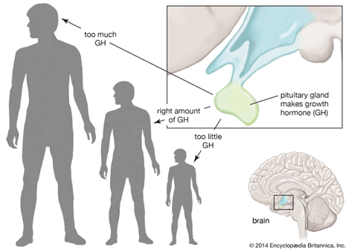
DEFINITION
Acromegaly:
A condition in which the pituitary gland makes too much growth hormone after normal growth of the skeleton is finished. This causes the bones of the hands, feet, head, and face to grow larger than normal.
Gigantism:
An abnormally large linear growth due to excessive growth hormone production during childhood, during growth plates close.

Slide 7
EPIDEMIOLOGY OF ACROMEGALY
Rare. Equal sex distribution
Prevalence: 40 to 86 cases/million population.
Insidious onset, Delay between onset of clinical features and diagnosis.
Age at the time of diagnosis 40 to 60 years.

Slide 8
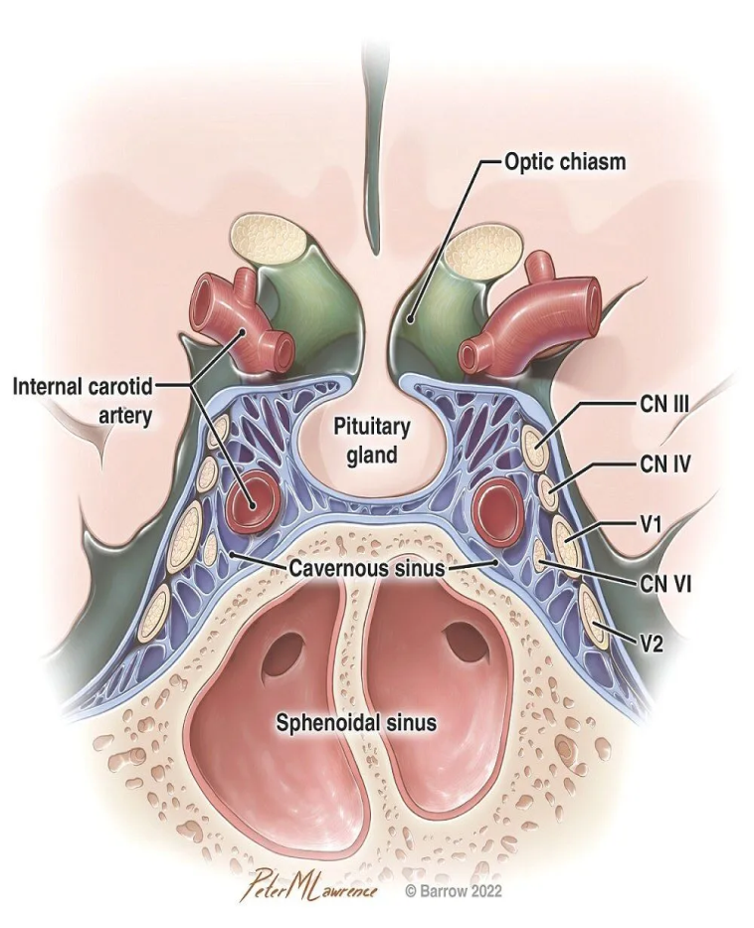
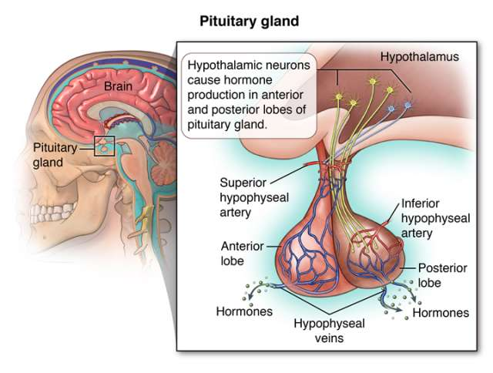
STRUCTURE OF PITUITARY GLAND

Slide 9
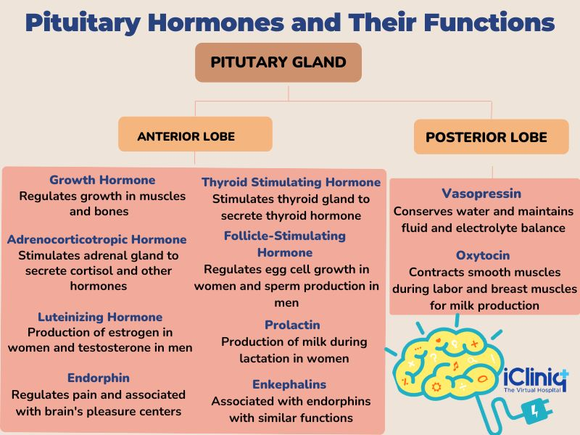
PITUITARY GLAND AND ITS FUNCTIONS

Slide 10
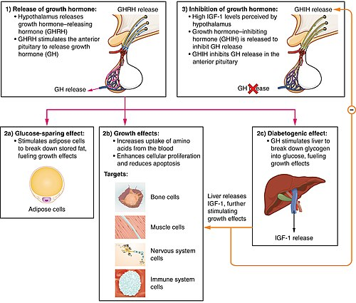
GROWTH HORMONE FUNCTION

Slide 11
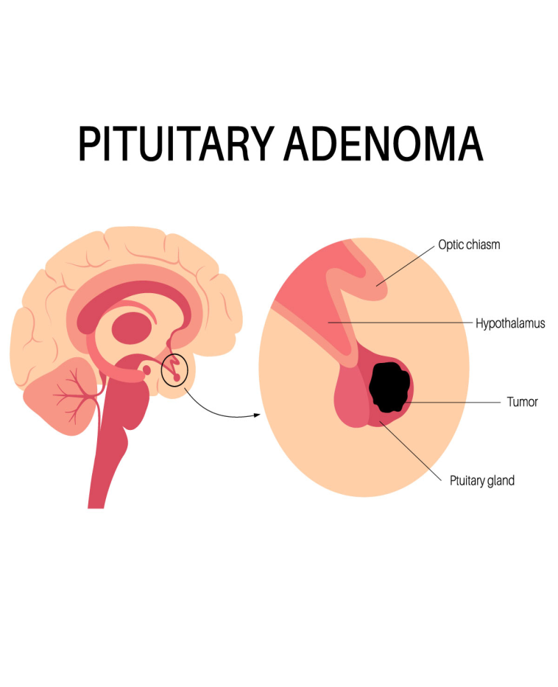
ETIOLOGY OF ACROMEGALY
Pituitary Adenoma ( > 99% of cases)
GHRH secretion:
Hypothalamic secretion.
Ectopic GHRH production
Ectopic Growth Hormone production

Slide 12
CLINICAL FEATURES
Symptoms:
Increased Sweating
Headaches
Tiredness and lethargy
Joint pains
Change in ring or shoe size.

Slide 13
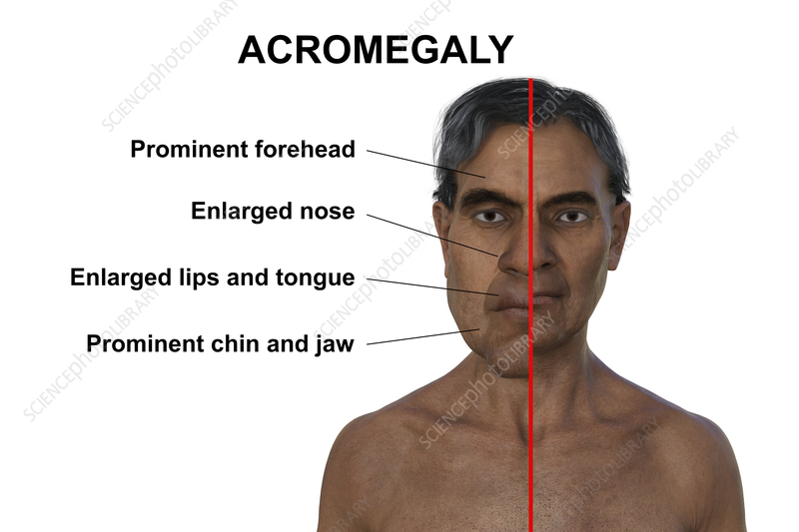
CLINICAL FEATURES
Signs:
Facial appearance
Deep voice
Tongue enlargement
Musculoskeletal changes
Soft tissue swelling
Organomegaly

Slide 14
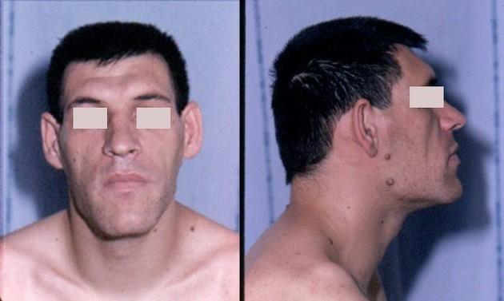
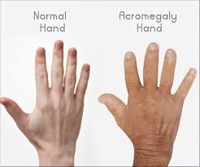
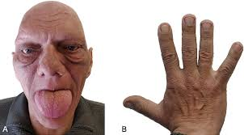

Slide 15
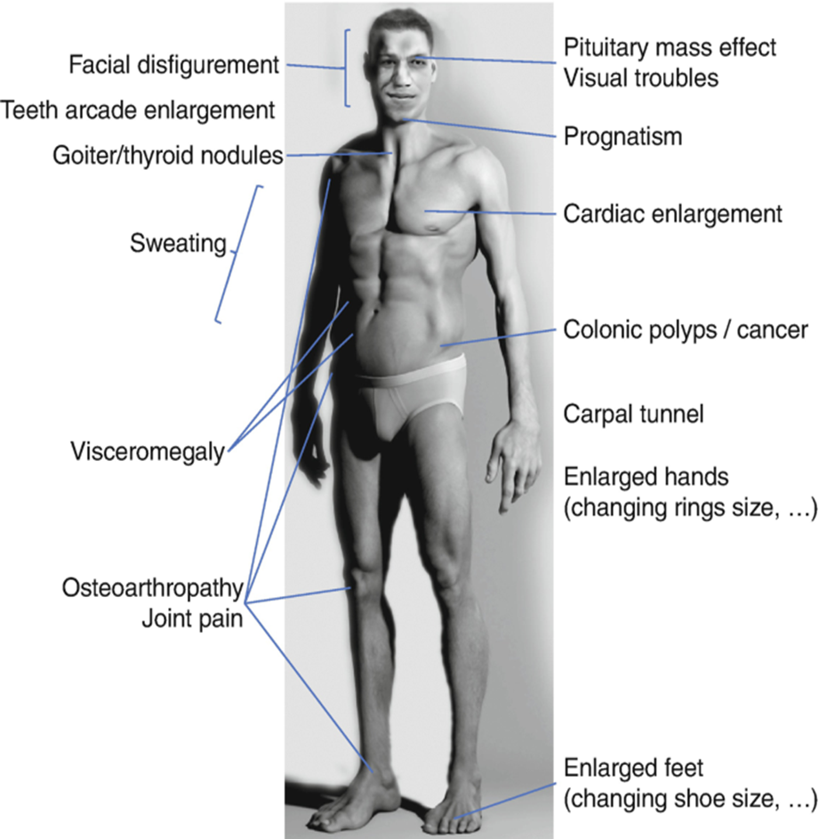
COMPLICATIONS
Hypertension 40%
Impaired Glucose tolerance / DM 20%
OSA
Increased risk of colonic polyp and Colonic CA
IHD
Aortic regurgitation
Visual field defects
Hypopituitarism

Slide 16
INVESTIGATIONS OF ACROMEGALY
INVESTIGATIONS | COMMENT
Oral Glucose Tolerance Test (OGTT) | Failure to suppress GH in response to a 75g glucose load.
Insulin like Growth Factor -1 | Elevated in Acromegaly
MRI Pituitary Gland | GH secretory tumor detected in 90% of the cases.

Slide 17
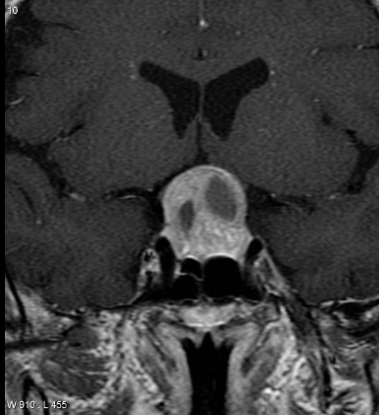
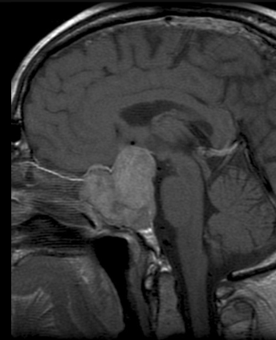
CORONAL VIEW OF MRI BRAIN SHOWING PITUITARY ADENOMA
SAGITAL VIEW OF MRI BRAIN PITUITARY ADENOMA

Slide 18
MANAGEMENT OF ACROMEGALY
OPTIONS | COMMENT
Surgery | Transsphenoidal surgery to remove pituitary adenoma.
Radiotherapy | In patient not responding to surgery.
Drugs | Somatostatin analogs, Dopamine agonists, GH receptor antagonists

Slide 19
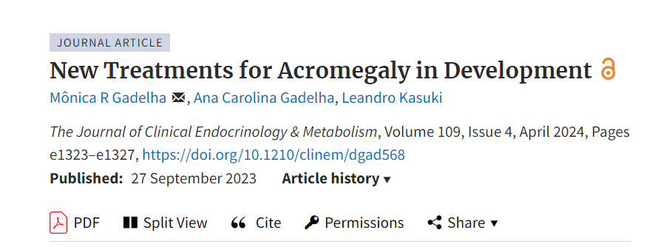
Paltusotine
Octreotide Subcutaneous Depot (CAM2029)

Slide 20
EHICAL ISSUES
Access to Treatment: High costs of GH antagonists (e.g., Pegvisomant), surgical interventions, and radiotherapy create financial disparities.
Informed Consent: Patients must understand long-term treatment requirements, risks of surgery, and potential complications.
Equity in Healthcare: Delayed diagnosis due to lack of awareness and access to diagnostic facilities.
Ethical responsibility of healthcare providers to ensure early detection and proper referrals.
4. Psychosocial Impact: Body image concerns, depression, and stigma related to facial and physical changes. Ethical obligation to provide counseling and mental health support.

Slide 21
Thank you

