Slide 1
RADIOLOGY (LGIS) MEDICAL IMAGING OF ABDOMEN -I By. Dr. Humaira Riaz consultant Radiologist BBH, Rawalpindi

Slide 2
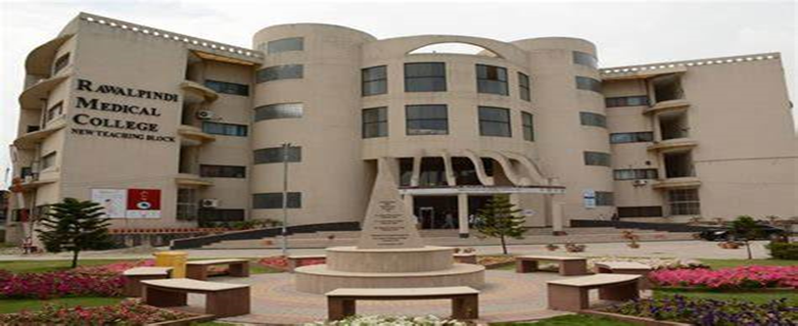
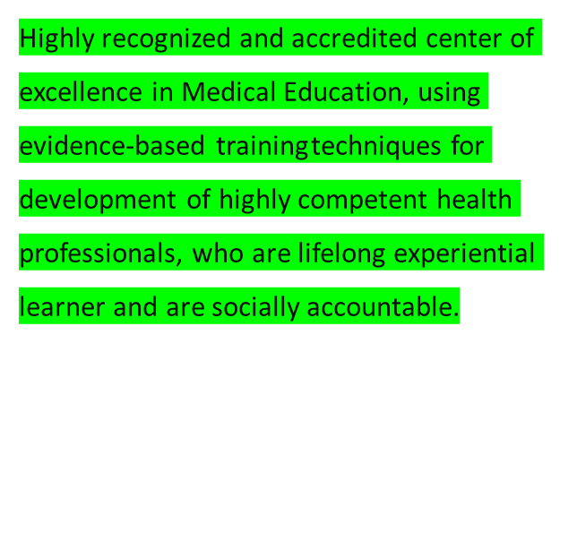
VISION AND VALUES
To impart evidence-based research-oriented health professional education in order to provide best possible patient care and inculcate the values of mutual respect, ethical practice of healthcare and social accountability.

Slide 4
LEARNING OBJECTIVES
Upon completion of the session, students will be able to
To enlist indications of performing abdominal radiograph/ x-ray
To be aware of importance of technical parameters of abdominal radiograph and importance of patient’s identity, age, sex and date.
To identify basic film projections
To recognize and differentiate between different radiological densities
To outline normal solid soft tissue organs, intestines and the bones
To differentiate between normal and abnormal radiological shadows
To identify common abdominal emergencies requiring urgent treatment
To understand the importance of rapid recognition of emergencies on plain radiograph helping them save their patients from complications and unnecessary investigations

Slide 5
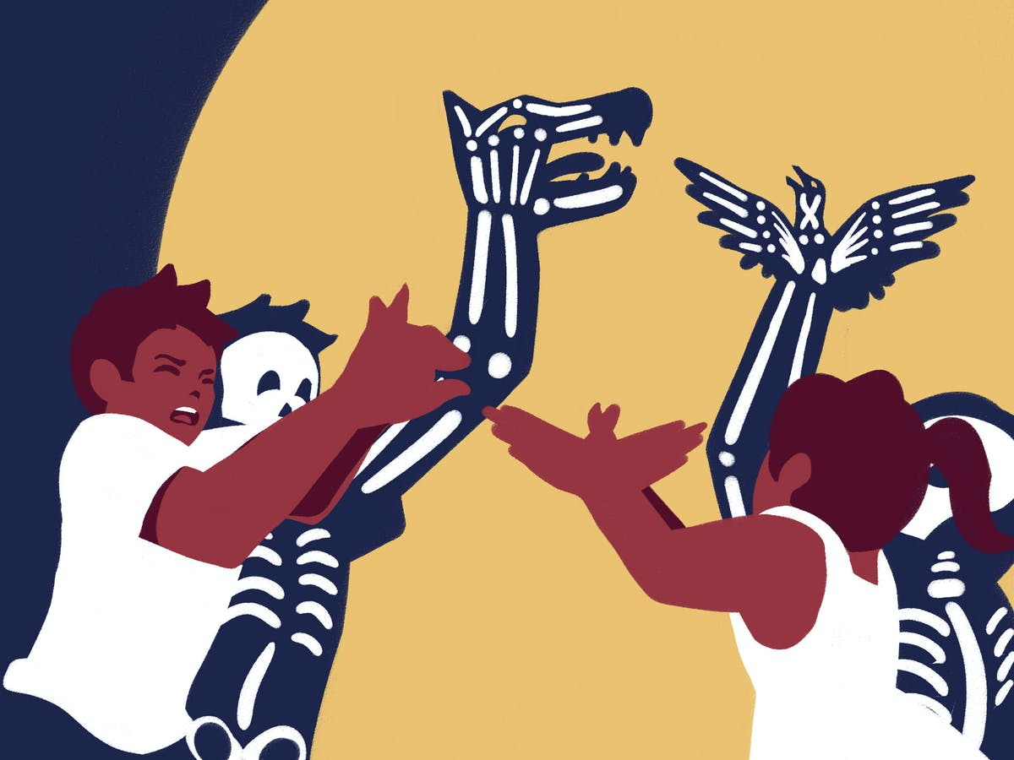
WHAT DOES PICTURE SHOW???????

Slide 6
XRAYS ALSO FORM SHADOWS!!!!

Slide 7
VARIOUS RADIOLOGICAL MODALITIES
ABDOMINAL RADIOGRAPHY
ULTRASONOGRAPHY
BARIUM STUDIES
CT
MRI

Slide 8
ABDOMINAL RADIOGRAPHY

Slide 9
INDICATIONS
Preliminary evaluation of bowel gas in an emergent setting
evaluation of radiopaque tubes and lines
evaluation for radiopaque foreign bodies
evaluation for post procedural intra peritoneal & retroperitoneal free gas
monitoring the amount of bowel gas in postoperative ileus
Evaluating renal or biliary calculi & intra abdominal calcifications

Slide 10
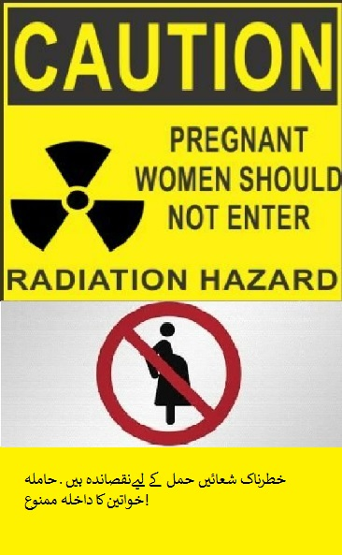
CONTRAINDICATIONS
Pregnancy
Non-ionizing studies (e.g. ultrasound or MRI)
should be tried first

Slide 11
PROJECTIONS
Standard projections
AP supine view
Stand alone or as series of acute abdomen
PA erect view
often taken with the supine view, when used together it is a valuable projection in assessing air-fluid levels, and free air in the abdominal cavity.

Slide 12
ADDITIONAL PROJECTIONS
lateral decubitus view
performed as an alternative to the PA erect view to assess for free gas in the abdominal cavity
lateral view
often used as a problem-solving view during the identification and localisation of foreign bodies
PA prone view
dorsal decubitus view
used when it is unsafe to perform both a PA erect or a lateral decubitus view, this projection requires no patient movement.
oblique views
used in barium studies and the location of foreign bodies

Slide 16
INTERPRETATION OF ABDOMINAL FILM
Gas pattern
Calcification
Soft tissues
Bones
Everything else

Slide 17
GAS PATTERN
NORMAL
Bowel loop air/fluid level < 3cm for small bowel, larger for colon
Air in stomach, rectum & cecum

Slide 20
ABNORMAL GAS PATTERN
Obstruction
ileus

Slide 21
0BSTRUCTION
Small bowel
dilated loops > 3 cm
Air/fluid levels
Non distended colon
Large bowel
small bowel obstruction as above
distended large bowel

Slide 22
SMALL BOWEL OBSTRUCTION

Slide 23
SMALL BOWEL OBSTRUCTION

Slide 24
LARGE BOWEL OBSTRUCTION

Slide 25
LARGE BOWEL OBSTRUCTION

Slide 26
CAUSES OF SMALL BOWEL OBSTRUCTION
adhesions (most common)
Hernia
intussusseption
CAUSES OF LARGE BOWEL OBSTRUCTION
Mass/ tumor (most common)
Volvulus
Hernia
inflammation

Slide 27
ILEUS
Localized (sentinel Loop)
Adjacent inflammatory process causing localized irritation/dilatation
Pancreatitis, appendicitis, diverticulitis, ulcer
Generalized
Post operative
Gas in small/large bowel

Slide 28
ILEUS DUE TO APPENDICITIS (SENTINEL LOOP)

Slide 29
POST OPERATIVE ILEUS

Slide 30
CALCIFICATIONS
Urinary stones
kidney, ureter & bladder
Gall stones
Vascular
Aortic wall, aneuryms, phleboliths
Masses

Slide 31
URINARY STONES

Slide 32
GALL BLADDER CALCULI

Slide 33
GALL BLADDER WALL CALCIFICATION

Slide 34
AORTIC CALCIFICATION

Slide 35
CALCIFIED AORTIC ANEURYSM

Slide 36
CALCIFIED FIBROID

Slide 37
DERMOID

Slide 38
SOFT TISSUES
Hepatomegaly/splenomegaly
Ascites (bulging flanks)
Mass effect (displced bowel loops)
Psoas sign (loss of psoas shadow)

Slide 39
HEPATOMEGALY

Slide 40
ASCITES

Slide 41
MASS EFFECT

Slide 42
FREE AIR (PNEUMOPERITONEUM)
Usually perforated viscus
Post op…..upto a week
Need only few cc to be visible
Air under diaphragm (over liver margin)

Slide 43
PNEUMOPERITONEUM

Slide 46
BARIUM STUDIES
Barium swallow
Barium Meal
Barium Meal and Follow through
Small Bowel Enema
Barium Enema

Slide 47
BARIUM
Barium Sulphate
Barium carbonate is toxic
Atomic number 56
Inert/ water insoluble
Non absorbable/non toxic
Additives (saccharine, Nacitrate, carboximethylcellulose)

Slide 48
GASTROGRAFFIN
Ionic iodinate contrast
Barium is contraindicated in perforations and post operative leaks
However gastrograffin is not to be used if there is suspicion of aspiration.
In infants we use non ionic iodinated contrast like omnipaque

Slide 49
SINGLE VERSUS DOUBLE CONTRAST

Slide 50
BARIUM SWALLOW

Slide 54
Types of VARICES???

Slide 64
ULTRASONOGRAPHY

Slide 68
CT

Slide 71
RECOMMENDED BOOKS:
1. Aids to Radiological Differential Diagnosis by Chapman S. and Nakielny R. 4th ed. Elsevier Science Limited; 2003.
2. Online Journals and Reading Materials through HEC Digital Library Facility.

