Slide 1
THYROID DISORDERS
Dr SAIMA AMBREEN
Associate professor MU1

Slide 3
OUTLINE
Physiology of Thyroid Gland
Clinical manifestations of hyperthyroidism
Evaluation of a patient with hyperthyroidism
Management of hyperthyroidism
Grave's Disease
Multinodular Goiter
Evaluation of a patient with hypothyroidism
Management of hypothyroidism
Myxedema coma
Throid Nodules

Slide 5
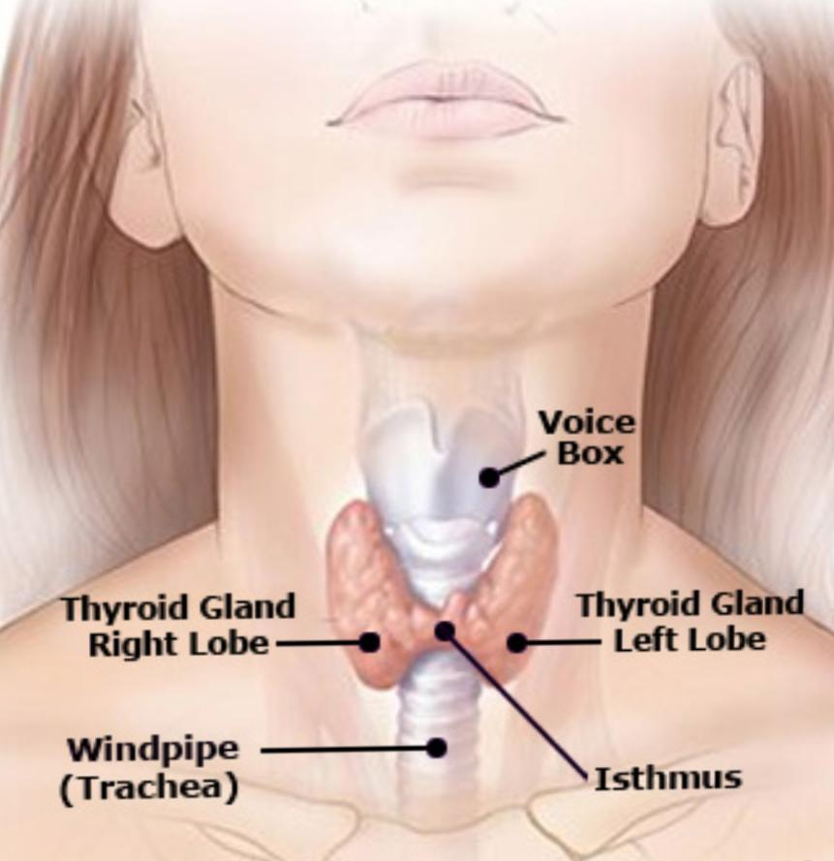
INTRODUCTION
Largest endocrine gland
located in anterior neck just below larynx
Consist of two lobes joined in middle by portion of gland
Consists of microscopic sacs known as thyroid follicles Interior filled with colloid, a protein rich fluid ( thyroglobulin)
Between thyroid follicles are epithelial cells called parafollicular cells( c- cells) producing hormone called calcitonin.

Slide 6
Hypothalamic pituitary Thyroid Axis:

Slide 7
Physiology
Trapping
Oxidation
Organification
Coupling
Storage
Secretion

Slide 8
Function
Fetal brain development
Skeletal maturation
Increase basal metabolic rate
Inotropic & chronotropic effects
Increase sensitivity to catecholamine's
Stimulate gut motility
Increase bone turnover
Increase serum glucose
Decrease serum cholesterol
Conversion of carotene to vitamin A
Play a role in thermal regulation

Slide 9
Hyperthyroidism
Increase T3 and T4, decrease TSH
Thyrotoxicosis v/s hyperthyroidism
Hyperthyroidism is a condition in which thyroid gland produces and secrets excessive amounts of free thyroid hormones.
Thyrotoxicosis:Hypermetabolic clinical syndrome which occurs when there are elevated serum T3 or T4
Thyrotoxicosis can also occur without hyperthyroidism.

Slide 10
Signs and Symptoms of Hyperthyroidism

Slide 11
Graves Disease
Also called Toxic diffuse goiter,
An Autoimmune disease and most common cause of hyperthyroidism.
Causes
Family history
Genetic factors
Stress
infections
Autoimmune disease(type1 DM , Addison disease)
Smoking.
Pathogenesis
Production of immunoglobulin IgG antibodies(Thyroid stimulating immunoglobulin and TSH receptors antibodies TRAb) directed against TSH receptors .

Slide 12
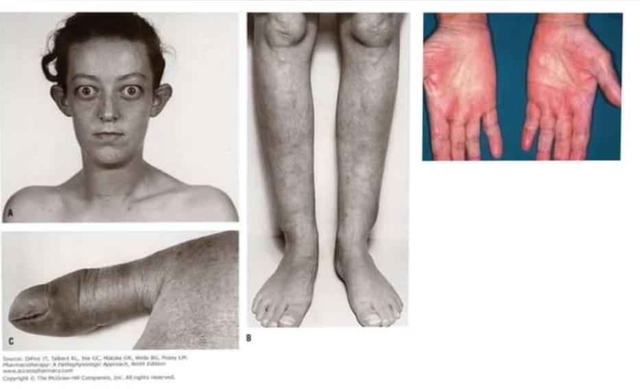
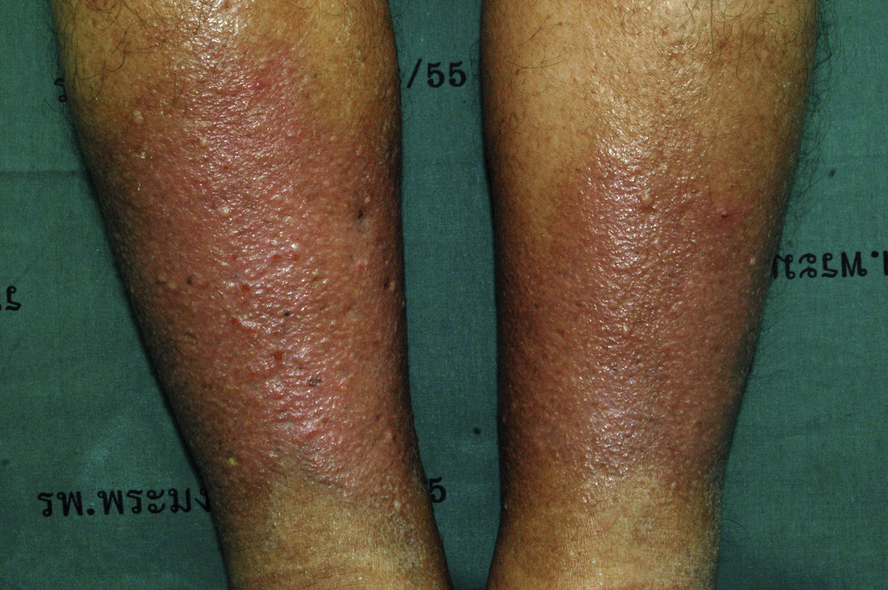
Features:
Skin is warm and moist, palms are moist and hyperemic.
Plummer's nails are seen
Thyroid Dermopathy:
Pretibial myxedema
Alopecia and vitiligo.
Eye signs:
VON GRAEFE'S SIGN-Lid lag
JOFFROY'S SIGN-Absence of wrinkling on looking up.
STELLWEG'S SIGN-Decreased frequency of blinking.
MOBIUS SIGN-Absence of convergence.
DALRIMPLE'S SIGN-Lid retraction exposing upper sclera

Slide 13
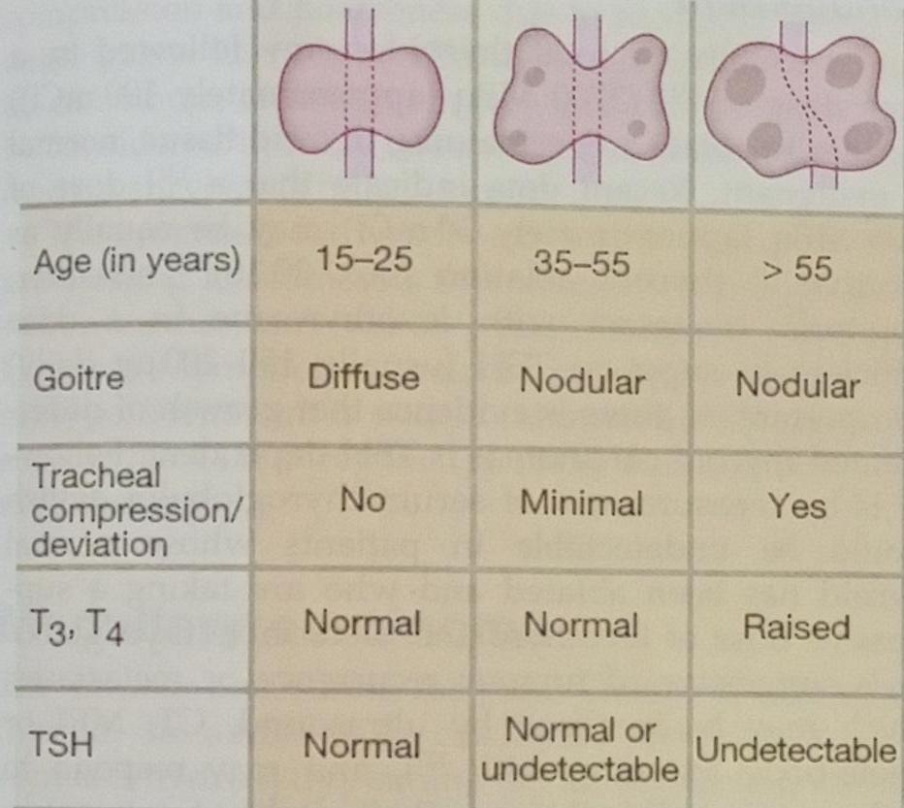
Multinodular Goitre.
Excess production of thyroid hormone from autonomous thyroid nodules which donot require stimulation from TSH-
Second common cause-Occurs in individuals over 60 years of age and females are most affected
Symptoms:-
Large goitre with or without tracheal compress
Goitre is nodular or lobulated,often palpable
Large goitre causes mediastinal compression with stridor,dyspnea,obstruction of superior vena cava and Hoarseness

Slide 14
Subacute (de Quervains) Thyroiditis
Most common cause of painful thyroid gland.
Hyperthyroidism occur initially,sometimes followed by hypothyroidism.
Cause by viral infections like Coxsackie virus, EBV,mumps, measles, echovirus and influenza.
Workup: TSH and T4
Two other test that may be helpful are
1:Raised Serum thyroglobulins
2:Raised ESR
Treatment: NSAIDS and Prednisolone 40 mg for 3-4 weeks.

Slide 15
Approach to a patient with thyroid disease.
History :-
WHAT TO INCLUDE IN HISTORY TAKING
Unexplained weight loss OR weight gain even with good appetite
Excessive sweating especially at night
low tolerance to heat OR cold
Excitability, irritability, tremulousness
Palpitations
Any pressure symptoms such as dysphagia, dyspnea
Family history of thyroid disease
Smoking

Slide 16
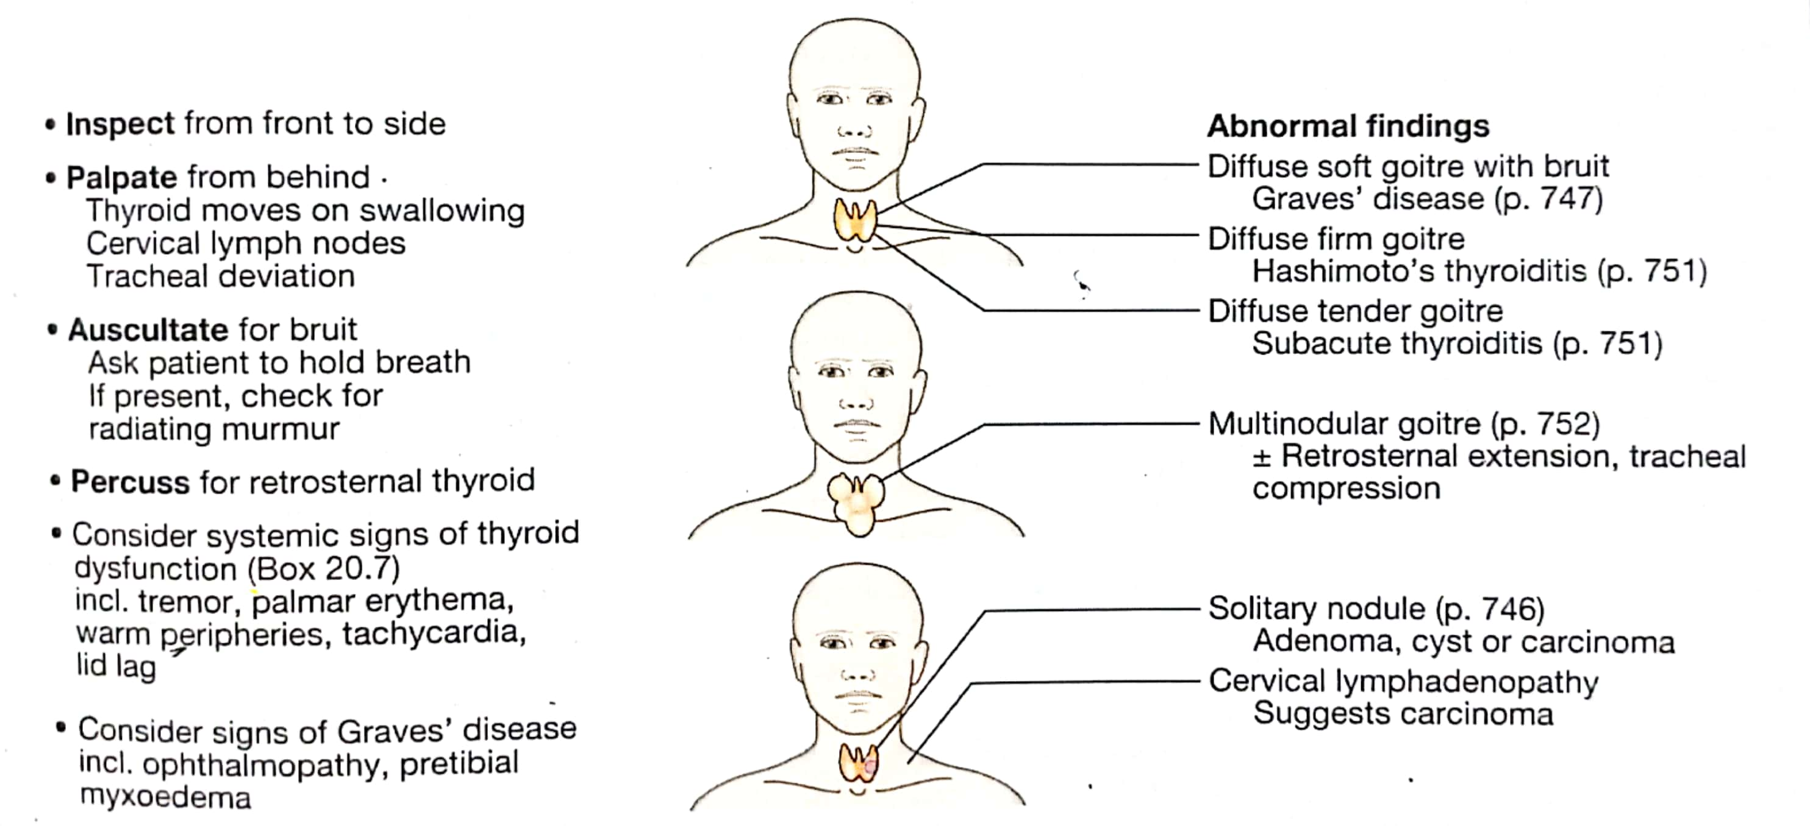
EXAMINATION:

Slide 17
Examination in Grave’s Opthalmopathy:

Slide 18
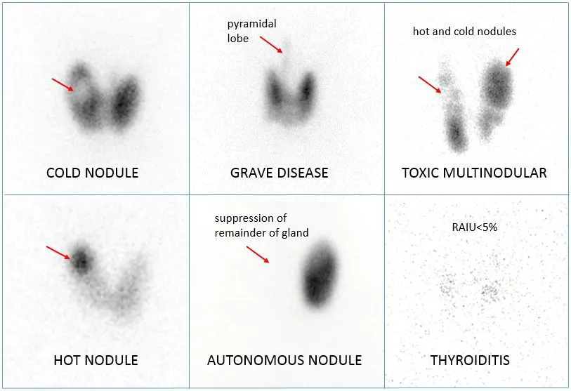
Investigations
Serum TSH ,T3 and FT4
USG neck
Thyroid autoantibodies
RadioactiveThyroid uptake scan
Plain x ray neck
FNAC

Slide 19
Evaluation of patient with Hyperthyroidism

Slide 20
Management of Hyperthyroidism.
Management
Immediate control: Propranolol 40mg/6hr orally
long term control:
Anti thyroid drugs - Carbimazole 15mg tid initially and then reducing it to 5mg tid for12-18 months.
Radio iodine ablation - Postmenopausal women and elderly men
Surgery - Presence of large goiter,Graves disease with opthalmopathy,cosmetic reasons.
Exopthalmos: Corticosteroids and Tarsorrhaphy.Orbital decompression.
Crdiac arrythmias: B- blockers. In euthyroid state,cardioversion is done.

Slide 21
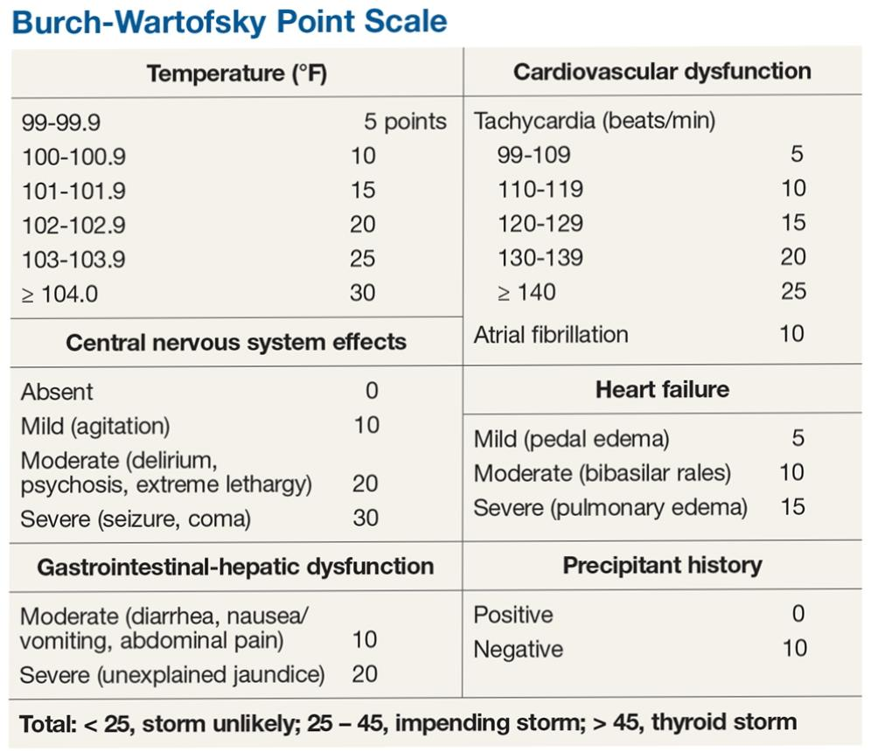
Thyroid storm:
Thyroid Storm is a Life threatening syndrome
Decompensated hyperthyroidism
■ Symptoms
Hyperthyroid symptoms with agitation, confusion, delirium, psychosis
Gastrointestinal: Nausea/Vomiting, Abdominal pain
Tachycardia associated with CHFT
Thyroid Storm Treatment
Antithyroids
PTU 200-400mg po/NG q4-8h or
Methimazole 60-120mg/d PO/NG divided q6-8h
Potassium Iodide 2-5 drops PO/NG q6h or
Lugol Solution-Strong lodine 10 drops po TID
Glucorticoids: block conversion of T4 to T3
Hydrocortisone succinate 100-200mg
BB : Esmolol: 500mcg/kg/min or
Propranolol 20-80mg/dose PO/NG q4-6h

Slide 22
Hypothyroidism
Insufficiency of synthesis of thyroid hormones
Low T3 and T4 with high TSH levels
Primary hypothyroidism:Thyroid can’t produce hormones Pituitary call for.
Secondary hypothyroidism:Thyroid isn’t being stimulated by pituitary to produce hormones.

Slide 23
Causes:

Slide 24
Signs and symptoms of hyporthyroidism

Slide 25
Hashimotos thyroiditis.
Autoimmune disease
Destructive lymphoid infiltration of thyroid leading to fibrosis and thyroid enlargement
Sign and symptoms:Weight gain,Depression, Fatigue, Enlarge thyroid
Diagnosis:T3 and T4 levels,TSH
TPO antibodies
Tg antibodies
Positive ANF
Treatment:Levothyroxine

Slide 26
Investigations.
Classical findings of primary hypothyroidism are reduced levels of T3 and T4 and increased levels of TSH
Secondary hypothyroidism T3, T4, TSH all are reduced, along with other pituitary hormones.
Other abnormal investigations are
Anemia macrocytic or microcytic (mennoraghia).
ECG-bradycardia, low voltage complexes
Increase in CK from muscle
Hypercholesterolemia
Antibodies to thyroid peroxidase are positive in spontaneous atrophic thyroiditis and hashimoto's thyroiditis.

Slide 27
Management Of Hypothyroidism

Slide 28
Thyroid Emergencies

Slide 29
Thyroid storm:
Thyroid Storm is a Life threatening syndrome
Decompensated hyperthyroidism
■ Symptoms
Hyperthyroid symptoms with agitation, confusion, delirium, psychosis
Gastrointestinal: Nausea/Vomiting, Abdominal pain
Tachycardia associated with CHFT
Thyroid Storm Treatment
Antithyroids
PTU 200-400mg po/NG q4-8h or
Methimazole 60-120mg/d PO/NG divided q6-8h
Potassium Iodide 2-5 drops PO/NG q6h or
Lugol Solution-Strong lodine 10 drops po TID
Glucorticoids: block conversion of T4 to T3
Hydrocortisone succinate 100-200mg
BB : Esmolol: 500mcg/kg/min or
Propranolol 20-80mg/dose PO/NG q4-6h

Slide 30
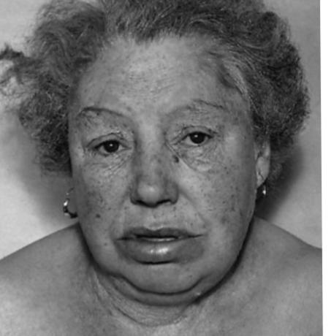
Myxoedema coma
The signs and symptoms of hypothyroidism are accentuated.
The facial appearance is typical-supraclavicular puffiness, a malar flush and a yellow tinge to the skin.
Myxoedema coma is characterised by altered mental state, hypothermia and a precipitating medical condition, for example cardiac failure or infection.
Hypoglycemia
Altered mentation
Hyponatremia
Hypotention
Bradycardia

Slide 31
Treatment Of Myxoedema.

Slide 32
Thyroid in Pregnancy
Normal pregnancy:: Trimester-specific reference ranges should be used to interpret thyroid function test results in pregnancy
Iodine deficiency::lodine requirements increased in pregnancy. (WHO) recommends a minimum intake of 250 µg/day
Iodine deficiency lead to Impaired cognitive development in children
Hypothyroidism::Impaired cognitive development in the offsprings. •Levothyroxine dose requirements: increase by 30-50% from early in pregnancy. Monitor TSH
Gestational thyrotoxicosis: associated with multiple pregnancies and hyperemesis gravidarum.
Graves' disease: the most common cause of sustained thyrotoxicosis in pregnancy.
Antithyroid drugs: PTU should be used in the first trimester, with carbimazole substituted in the second and third trimesters.
Post-partum thyroiditis Screening: not recommended for every woman thyroid function should be tested 4-6 weeks post-partum in those with a personal history of thyroid disease.

Slide 33
Thyroid Neoplasia
TOXIC ADENOMA:
solitary toxic nodule, a follicular ADENOMA which autonomously secretes excess thyroid hormones and inhibit endogenous TSH secretions with atrophy of gland
Female above 40 years of age
Diagnosis:Thyroid scintigraphy
Treatment :Radio active iodine ablation
Surgical Hemithyroidectomy

Slide 34
Thyroid Neoplasia
Differentiated Carcinoma
There are 5 main types of thyroid carcinomas

Slide 35
Management
Lobectomy with isthmectomy.
Patients less than 40 years who have nodules less than 1 cm, well defined, minimally invasive, and isolated may be treated with hemithyroidectomy and isthmectomy.
•If feasible, subtotal thyroidectomy. And total thyroidectomy
•Approximately 10% of patients who have had total thyroidectomy demonstrate cancer in the contralateral lobe. •Patients receive radioiodine four to six weeks after thyroidectomy to detect and destroy any metastases.
•Following thyroidectomy, patients will need to take thyroid replacement therapy.

Slide 36
Q No 1: A 41-year-old woman presents with palpitations and heat intolerance. On examination her pulse is 90/min and a small, diffuse goitre is noted which is tender to touch. Thyroid function tests show the following: Free T4 24pmol/l (11 to 21pmol/l) TSH < 0.05 mu/l (0.5 to 5mu/l)What is the most likely diagnosis? A)Graves disease B)de quervains thyroiditis C)sick thyroid syndrome D)hasimoto thyroiditis E)Struma ovari

Slide 37
Correct option
B

Slide 38
2:A 56-year-old female is admitted to ITU with a severe pneumonia. Thyroid function tests are most likely to show:
A. TSH normal; thyroxine high; T3 high
B. TSH normal / low; thyroxine low; T3 low
C. TSH high; thyroxine low; T3 low
D. TSH low; thyroxine high; T3 high
E. TSH high; thyroxine normal; T3 high

Slide 39
Explanation: The correct answer is B. In sick euthyroid syndrome (now referred to as non-thyroidal illness) it is often said that everything (TSH, thyroxine and T3) is low. In the majority of cases however the TSH level is within the normal range (inappropriately normal given the low thyroxine and T3) Changes are reversible upon recovery from the systemic illness.

Slide 40
Reference
https://www.acog.org/clinical/clinical-guidance/practice-bulletin/articles/2020/06/thyroid-disease-in-pregnancy
https://www.liebertpub.com/doi/full/10.1089/thy.2016.0457
https://www.liebertpub.com/doi/full/10.1089/thy.2016.0457

Slide 41
ARTIFICIAL INTELLIGENCE
THYROID SCAN REPORTING

Slide 42
Thank you

