Slide 1


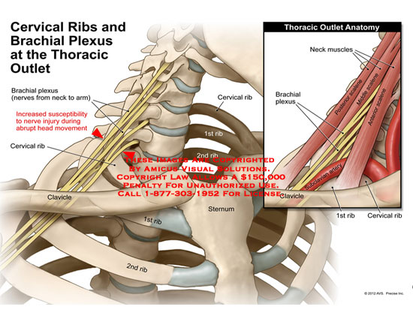
Thoracic Wall (Overview)
Cardiovascular System Module
1st Year MBBS SGD
August 2025
Dr Zeneara Saqib

Slide 2
Mission- Vision- Values
To impart evidence based research oriented medical education
To provide best possible patient care
To inculcate the values of mutual respect and ethical practice of medicine
Wisdom
Truth
Service

Slide 3
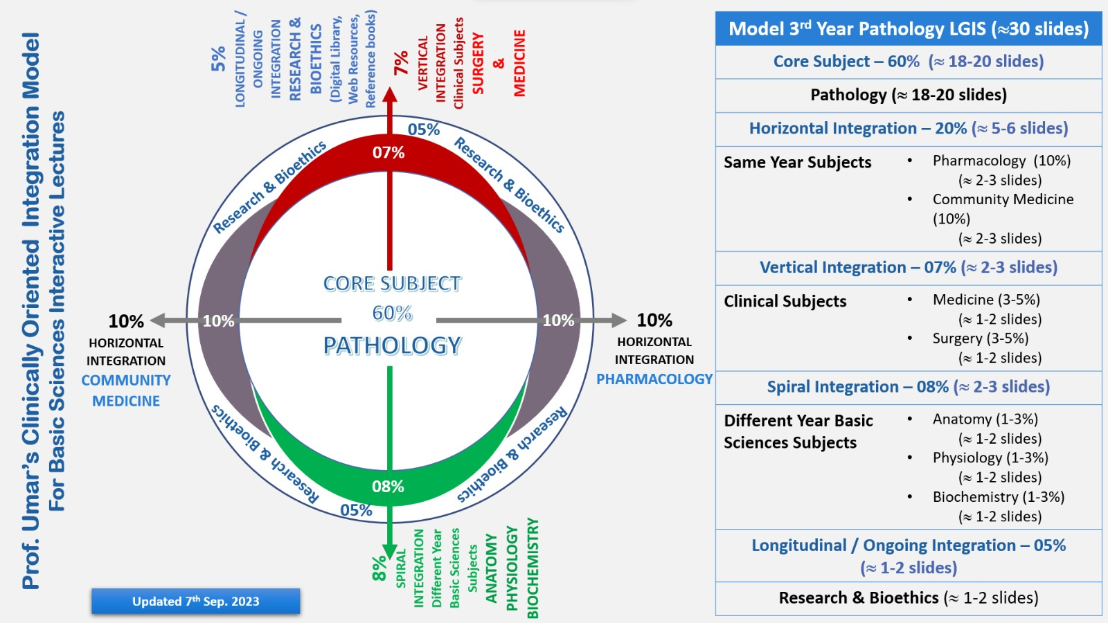
Professor Umar Model of Integrated Lecture

Slide 4
How To Access Digital Library
Go to the website of HEC National Digital Library.
On Home Page, click on the INSTITUTES.
A page will appear showing the universities from Public and Private Sector and other Institutes which have access to HEC National Digital Library HNDL.
Select your desired Institute.
A page will appear showing the resources of the institution
Journals and Researches will appear
You can find a Journal by clicking on JOURNALS AND DATABASE and enter a keyword to search for your desired journal.

Slide 5
Learning Objectives
• Define thorax
• Discuss components and shape of thoracic cavity
• Discuss the applied and the related clinical anatomy
• Classify Ribs
• Describe ribs
• Discuss the applied and the related clinical anatomy
• How to access HEC digital library
• How to read relevant research article

Slide 6
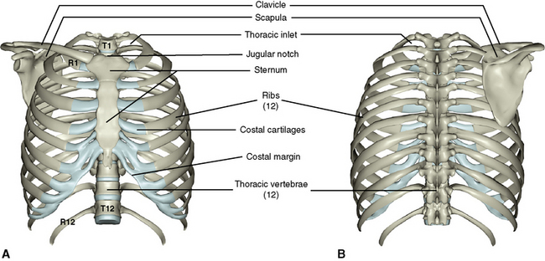
Thorax
Core Knowledge

Slide 7
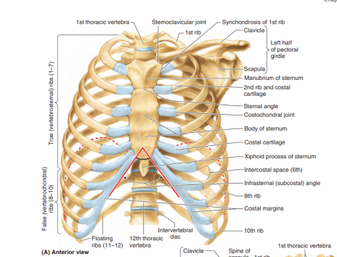
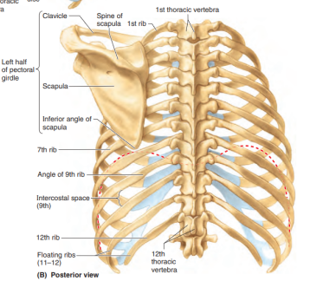

Slide 8
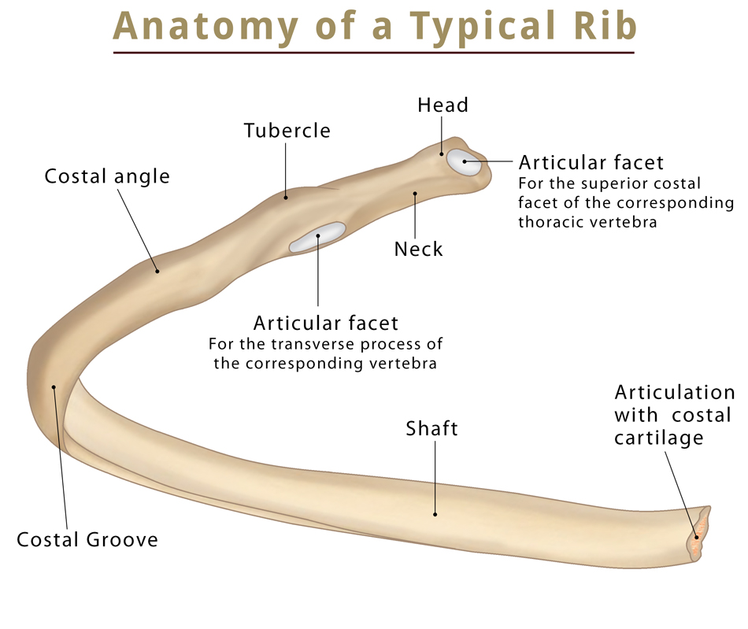
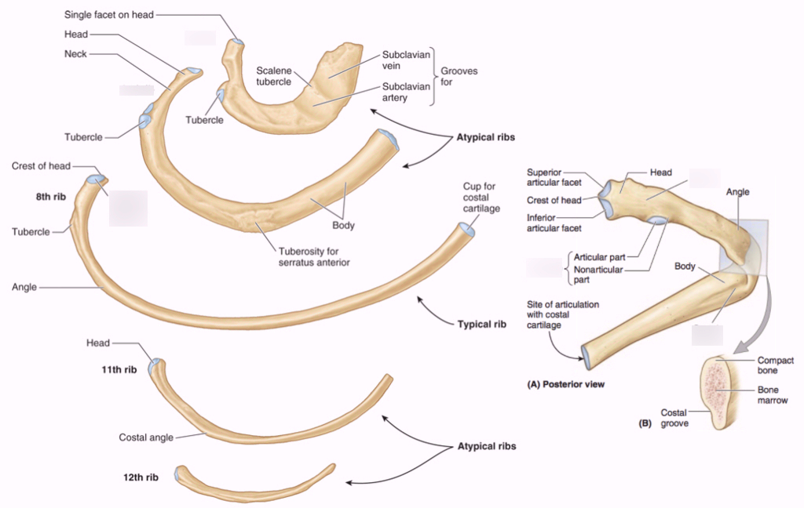
Core Knowledge

Slide 9
Classification of Ribs
Core Knowledge
A. According to features
1. Typical ribs: 3rd–9th.
2. Atypical ribs: 1st, 2nd, 10th, 11th, and 12th.
.
B. According to relation with the sternum
1. True ribs: 1st–7th (i.e., upper 7 ribs).
2. False ribs: 8th–12th (i.e., lower 5 ribs).
True ribs articulate with the sternum anteriorly, whereas
false ribs do not articulate with the sternum anteriorly.

Slide 10
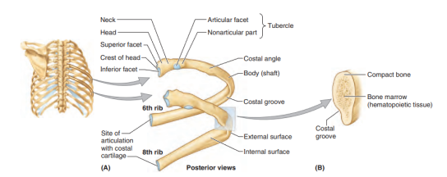
Typical Ribs
Core Knowledge

Slide 11
Core Knowledge
C. According to articulation
1. Vertebrosternal ribs: 1st–7th.
2. Vertebrochondral ribs: 8th–10th.
3. Vertebral (floating) ribs: 11th and 12th

Slide 12
Side Determination
Core Knowledge
The anterior end bears a concave depression. The posterior end bears a head, a neck and a tubercle.
The shaft is convex outwards and there is a costal groove situated along the lower part of its inner surface, so that the lower border is thin and the upperborder is rounded

Slide 13
Typical Ribs
Core Knowledge

Slide 14
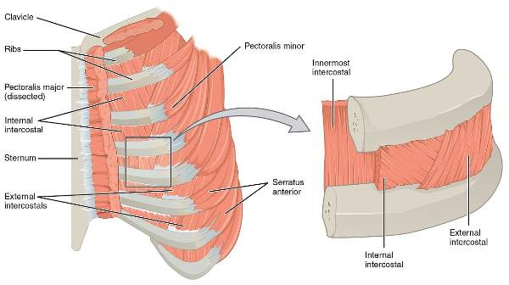
Attachment of a typical rib
Core Knowledge

Slide 15
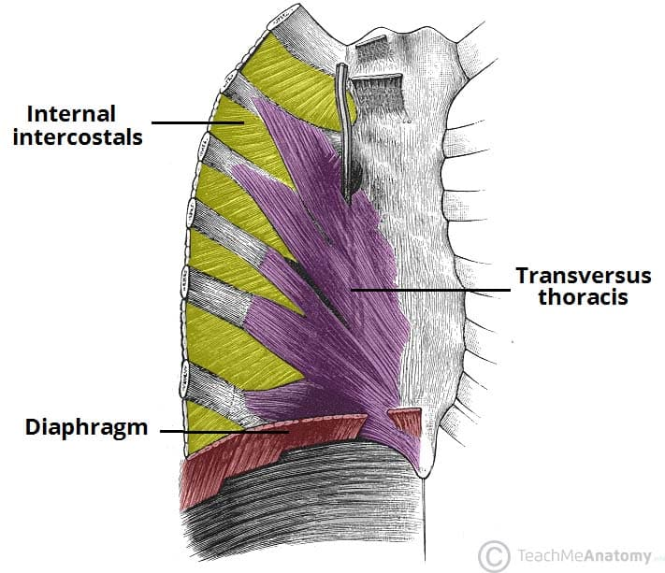
Core Knowledge

Slide 16
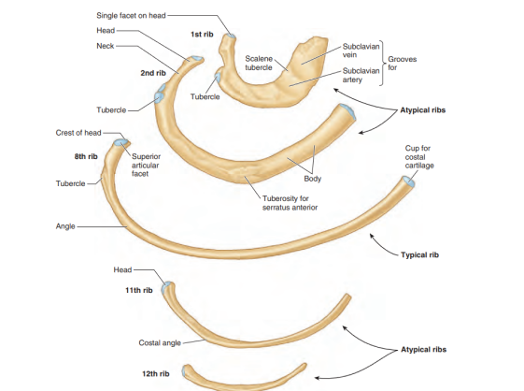
Core Knowledge

Slide 17
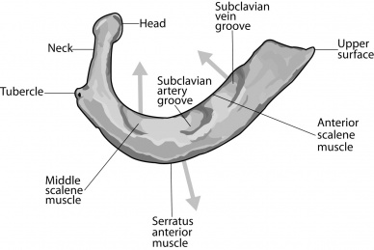
First Rib
Core Knowledge

Slide 18
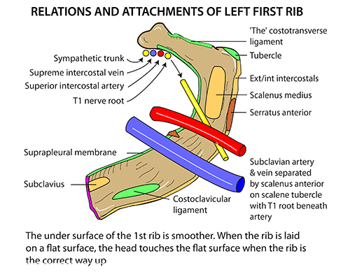
Relations
Core Knowledge

Slide 19
Core Knowledge

Slide 20
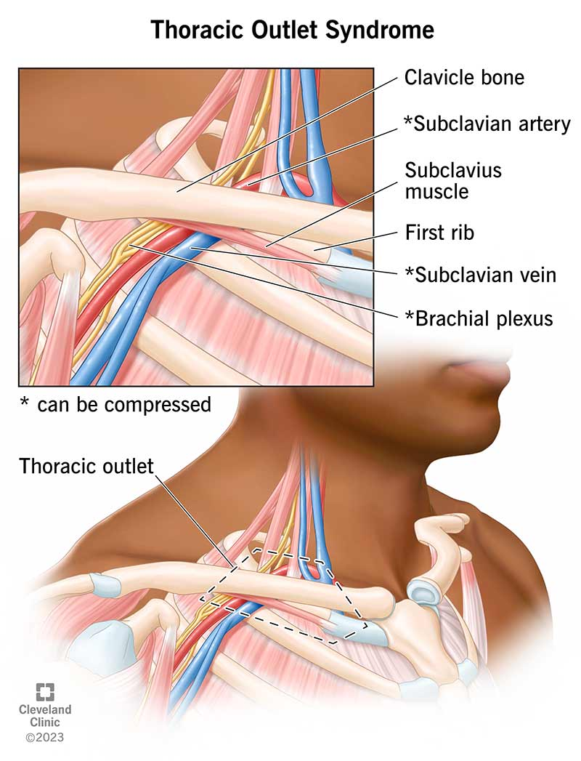
Vertical Integration
a term that refers to three related syndromes involving compression of the nerves, arteries, and veins in the lower neck and upper chest area.

Slide 21
Vertical Integration

Slide 22
Disc Prolapse
Vertical Integration

Slide 23
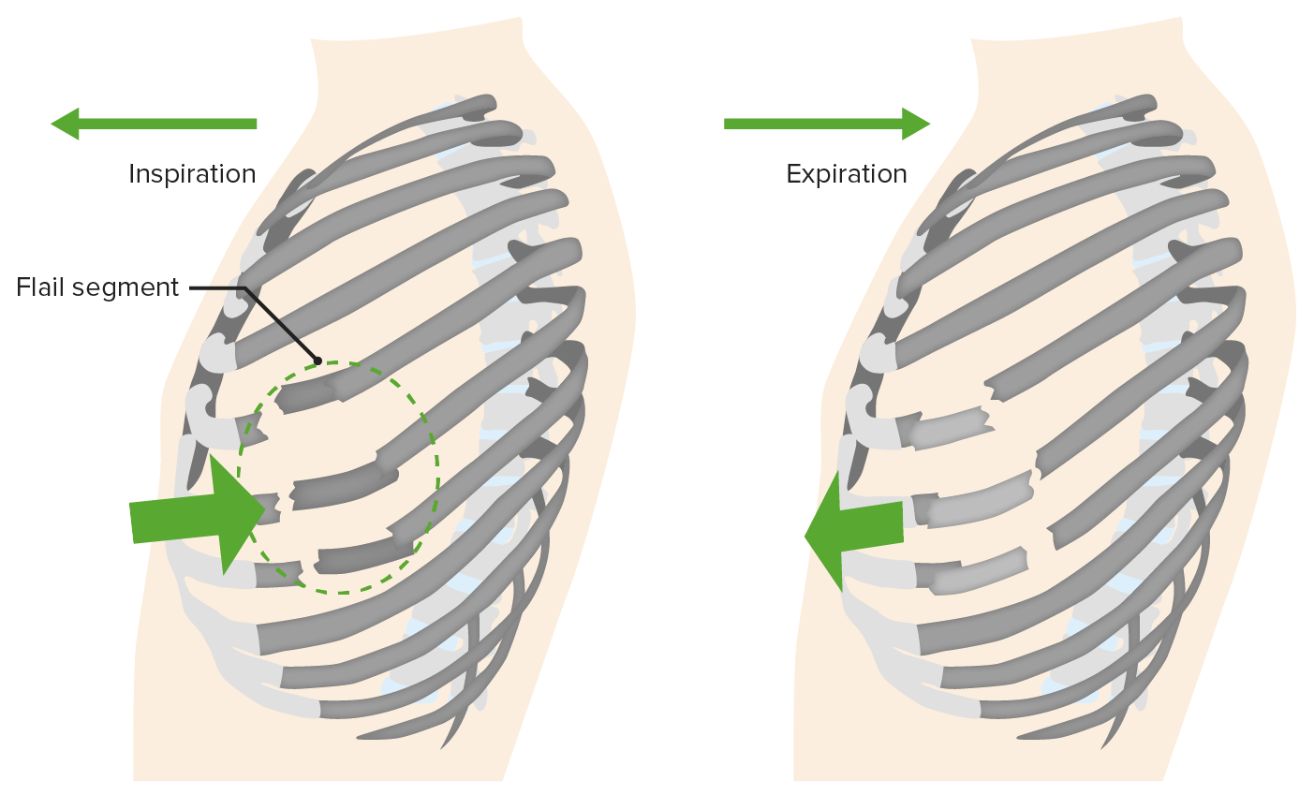
Flail Chest
Spiral Integration

Slide 24
Research Articles
https://www.ncbi.nlm.nih.gov/books/NBK534090/
Flail chest can lead to the following complications:
Severe pain
Chest wall deformity
Dyspnea
Loss of exercise endurance

Slide 25
Learning Resources
Clinically Oriented Anatomy 7th Edition
by Keith L. Moore (Author), Anne M. R. Agur (Author), Arthur F. Dalley (Author)
Gray's Anatomy: The Anatomical Basis of Clinical Practice 42nd Edition
www.google.com for pictures

Slide 26
Thank You

