Slide 2
ENDOCRINOLOGY MODULE 2ND YEAR MBBS LGIS MALE AND FEMALE REPRODUCTIVE HARMONES
Presenter: Dr. Rahat Date: --25
(APWMO)

Slide 3
Motto, Vision, Dream
To impart evidence based research oriented medical education
To provide best possible patient care
To inculcate the values of mutual respect and ethical practice of medicine
Wisdom
Truth
Service

Slide 4
Professor Umar Model of Integrated Lecture

Slide 5
Learning Objectives
At the end of this session students should be able to
Describe the male and female reproductive hormones i.e. Testosterone, Estrogen and Progesterone
Explain the mechanism of action of Testosterone, estrogen and progesterone
Understand their synthesis, functions and degradation

Slide 6
Interactive Session
A 24-year-old woman presents to the clinic with concerns about irregular periods for the past two years. She reports having a menstrual cycle every 40–60 days, with some months missing a period entirely. Additionally, she has noticed increased facial hair growth on her upper lip and chin, along with recent unexplained weight gain despite maintaining her usual diet and exercise routine. She also mentions occasional acne outbreaks.

Slide 7
The hypothalamus-pituitary-gonadal (HPG) axis
Reproductive hormone synthesis is controlled by the pulsatile release of hypothalamic gonadotropin-releasing hormone (GnRH)
At the pituitary gland, GnRH stimulates the release of luteinizing hormone (LH) and follicle-stimulating hormone (FSH) into the general circulation
LH then binds to its target cells (Leydig cells in males and theca cells in females) and increases the expression of steroidogenic acute regulatory protein (StAR)
StAR promotes the transfer of cholesterol to the inner mitochondrial membrane and initiates steroidogenesis.
This is the rate-limiting step of steroidogenesis in all tissues.
At the inner mitochondrial membrane, cholesterol is converted to pregnenolone by the action of P450scc.

Slide 8
ANDROGEN SYNTHESIS IN MALES
Androgens are steroid hormones that control the expression and maintenance of male sexual characteristics
Adrenal androgens DHEA and androstenedione are produced in the zona reticulata and zona fasciculata of the adrenal cortex.
Testosterone is produced Leydig cells, which are found adjacent to the seminiferous tubules of the testes
In Leydig cells, LH initiates the production of pregnenolone
Pregnenolone is then converted to DHEA in a two-step process mediated by 17,20-lyase (17α-hydroxylase)
Because Leydig cells express high levels of 3β-HSD and 17β-HSD, DHEA is rapidly converted to testosterone via the intermediates androstenediol and androstenedione
Testosterone is converted to dihydrotestosterone (DHT) by the action of 5α-reductase in target tissues; although it is about one-tenth as abundant as testosterone, it accounts for most of testosterone’s biological action

Slide 9
Androgen synthesis in females
Although androgens are typically considered the male hormones, they also play important physiologic roles in females
Active androgens are largely created from circulating precursors in their target tissues, where they both act and are metabolized
Androgen precursors present in females include:
DHEA sulfate (DHEAS), produced by the zona reticularis of the adrenal glands;
DHEA, produced by the zona reticularis, ovarian theca cells, and peripherally from circulating DHEAS;
Androstenedione, produced by the zona fasiculata of the adrenal glands, the ovarian stroma, and peripherally from circulating DHEA
About 50% of testosterone in females is produced from circulating precursor molecules, with the other half synthesized in the zona reticularis and the ovarian stroma
DHT is also produced in females, but circulates in low concentrations in serum and is largely produced in peripheral target tissues
Testosterone, but not DHT, is converted to estradiol by the action of aromatase (P450aro) in certain peripheral tissues, and may be an important source of estrogens in postmenopausal women.

Slide 10
Estrogen synthesis in females
Estrogens are a class of steroid hormones which control the development and maintenance of female sexual characteristics
Glandular estrogen synthesis: occurs in the granulosa and theca cells of the ovaries, as well as the corpus luteum
The granulosa cells are stimulated by LH to produce pregnenolone
Pregnenolone diffuses out of these cells to adjacent theca cells
Theca cells express 17,20-lyase and 3β-HSD, which mediate the conversion of pregnenolone to androstenedione via DHEA
Most androstenedione returns to the granulosa cells and is converted to estrone by aromatase, which is then converted to estradiol by 17β-HSD
The expression of aromatase and 17β-HSD is controlled by FSH stimulation
Extraglandular synthesis: Aromatase is expressed in non-gonadal sites and facilitates peripheral aromatization of androgens to estrone.
Fat cells: increases serum estrogens by converting androgen to estrone.
Bone: converts testosterone to local estrogen to help mature the epiphyses

Slide 11
Estrogen synthesis in males
Although estrogens are responsible for female sexual characteristics, they are also synthesized in males.
Certain peripheral target tissues express aromatase, which facilitates the conversion of circulating testosterone to estradiol and androstenedione to estrone.
These estrogens are thought to act locally and be metabolized in target tissues, which limits their systemic effects.
Sites of aromatase expression in the male include the reproductive tract, particularly in Leydig cells, Sertoli cells, and mature spermatocytes; the bone, particularly osteoblasts and chondrocytes; and in adipose tissues.

Slide 12
PROGESTRIN SYNTEHSIS
Progesterone is synthesized from pregnenolone by action of 3β-HSD in the corpus luteum, by the placenta during pregnancy; as well as by the adrenals, as a step in androgen and mineralocorticoid synthesis.
Its actions are primarily mediated by an intracellular progesterone receptor, whose numbers increase in the presence of estrogen.
The products of hormone synthesis vary with the menstrual cycle; estradiol is the main product during follicular maturation, whereas progesterone is the main product in the luteal phase following ovulation.

Slide 14
Reproductive hormone regulation

Slide 15
The HPG axis and hormonal feedback in males
The pulsatile release of GnRH from the hypothalamus causes the secretion of the gonadotropins LH and FSH (to a lesser extent) into the circulation.
LH stimulates the release of testosterone from Leydig cells.
Testosterone feeds back negatively on pituitary LH and hypothalamic GnRH.
This effect may be mediated by estradiols generated by peripheral aromatisation of testosterone.
FSH stimulates the release of inhibin from Sertoli cells.
Inhibin feeds back only on anterior pituitary release of FSH.

Slide 16
The HPG axis and hormonal feedback in females
Core Knowledge

Slide 17
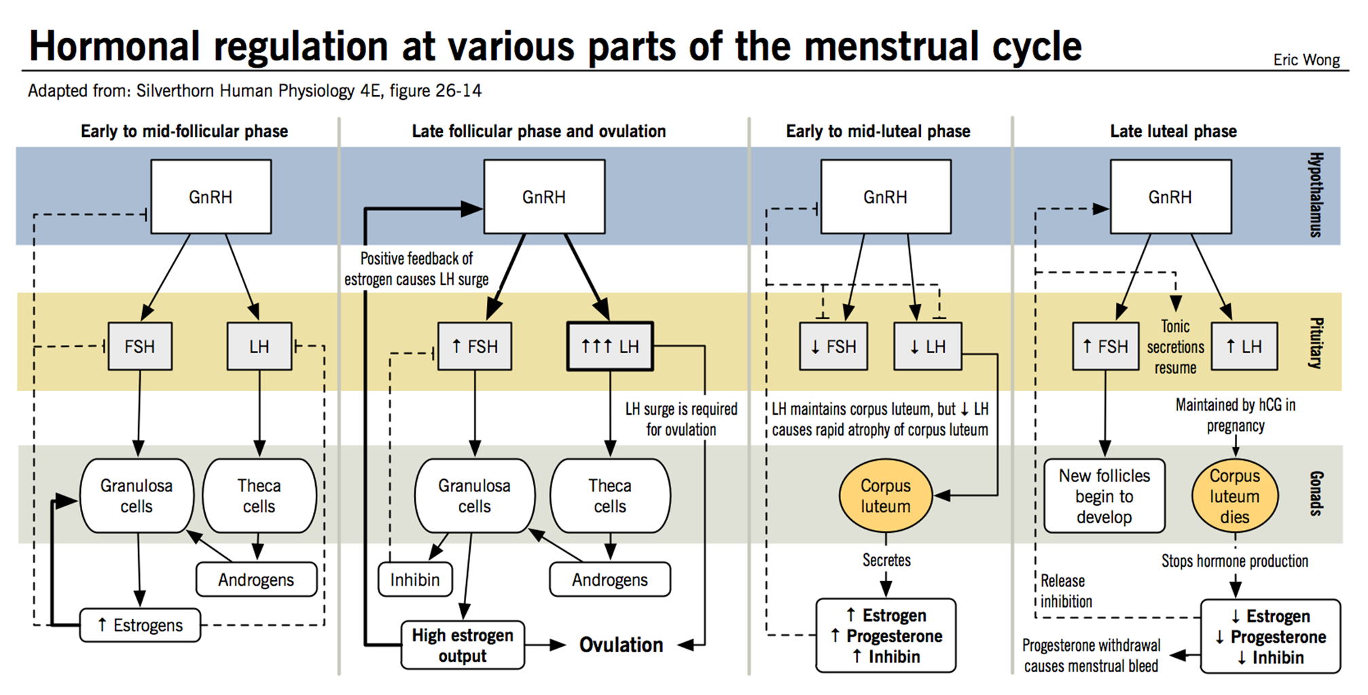
Core Knowledge

Slide 19
Estrogens
Core Knowledge
Estrogens have a variety of effects on both the reproductive organs and diverse target tissues. Although they play different roles in normal male and female physiology, they do in some cases have analogous activities in both sexes.

Slide 20
Effect | Men | Women
Female sexual characteristics: estrogens promote the development of breast tissue and the growth and differentiation of the sexual organs. | Men with liver disease who have an excess of estrogen because of the inability of their liver to metabolize it develop gynecomastia, palmar erythema, and spider angiomas. | Estrogen expression is responsible for female primary and secondary sexual characteristics. Estradiol promotes epithelial cell proliferation in the uterine endometrium and mammary glands of the breasts. In the absence of progesterone, endometrial thickening will proceed unopposed, potentially leading to endometrial hyperplasia and cancer. High exposure to estadiol has also been shown to increase risk for certain breast cancers.
Energy homeostasis and metabolism: estrogen deficiency can result in development of the metabolic syndrome. | In men, aromatase deficiency has been associated with the development of metabolic derangement characterized by increased circulating LDL, decreased glucose tolerance, hyperinsulinemia, and hepatic steatosis. | In women, estrogen deficiency has been associated with an increase in adipose cell volume and the growth of peripheral fat pads.
Prevention of bone loss: estrogens act on osteoblasts and osteoclasts to decrease resorption of bone through: (1) increasing expression of factors on osteoblasts which promote osteoclast apoptosis; (2) increasing osteoprotegrin expression and decreasing RANK-RANK ligand signalling | Men with estrogen insensitivity or aromatase deficiency are at increased risk of loss in bone density and osteoporosis. | Menopause is thought to cause an increase risk of osteoporosis.
Vasoprotection: estrogens may decrease the risk of atherogenesis in males and females. | Case studies have demonstrated premature atherogenesis in aromatase-deficient men. | Animal studies have demonstrated a role for estrogen in preventing the formation of new atherosclerotic plaques, but this role has not yet been demonstrated in humans.

Slide 21
Androgens
Core Knowledge
Testosterone, along with dihydrotestosterone, is responsible for the development of male primary and secondary sexual characteristics. In women, hyperandrogenism can result in aberrant expression of male sexual characteristics; however, a certain level of androgen activity is also needed for normal female physiology.

Slide 22
Effect | Men | Women
Male sexual characteristics: testosterone promotes the development of the male sexual organs as well as secondary sexual characteristics | Testosterone and DHT are important for sexual development as well as secondary sexual characteristics such as thick skin and male-pattern hair growth. | Hyperandrogenism in women causes hirsutism, which is the excessive growth of body hair in areas associated with male-pattern growth such as the chin and upper lip.
Mood, sexual drive and desire: testosterone has a stimulatory effect on libido in both women and men. | In men, increased testosterone is associated with an increase in sexual drive and the drop in testosterone with age is associated with a decreasing libido. | In women with adrenal insufficiency and consequent low androgen levels, replacement with DHEA has been found to increase energy and improve libido and sexual thoughts.
Bone formation: testosterone is thought to increase bone thickness and periosteal bone formation. | The effect of testosterone on bone, via aromatisation to estrogen, is thought to account for increased bone strength in men over women. | Testosterone increased bone mineral density in women with hypopituitarism but this may have been due to the effects of aromatization to estrogen.
Metabolism: testosterone has an important role in metabolism and muscle deposition. | Testosterone increases basal metabolic rate and muscle mass. | In women with hypopituitarism, testosterone supplementation increased fat-free mass and muscle.
Erythropoiesis: testosterone promotes red blood cell formation and protects against anemia. | Replacing testosterone in males with hypogonadism results in increases in red blood cell mass. | Low levels of testosterone in older women may increase the risk of anemia.
Estrogen precursor: testosterone and androstenedione can be aromatized to form estrogens. | In men, peripheral aromatization of testosterone plays an important role in estrogen production in bones and the reproductive tract, where it plays an important role in normal physiology. | In postmenopausal women, aromatization of circulating androgens is an important source of estrogens and may help to ameliorate some of the consequences of menopause.

Slide 23
Females
Core Knowledge
Progesterone
Progesterone has several well-defined roles in females.
Progesterone is secreted by ovarian follicular cells prior to ovulation; it is also secreted in larger amounts by the corpus luteum, which forms from follicular granulosa cells following ovulation.
The corpus luteum will grow for 10-12 days and then regress if fertilization does not occur; if fertilization does occur, the corpus luteum is maintained for the first 2-3 months of pregnancy.
Progesterone plays several important actions in the normal female reproductive cycle:
Prepares the uterus for pregnancy by shifting the endometrium from proliferation to secretion.
Withdrawal of progesterone in the absence of pregnancy leads to organized shedding (menstruation).
Helps mediate sexual response in the brain.

Slide 24
Core Knowledge
After fertilization, progesterone:
Organizes the vasculature of the endometrium to prepare for implantation
Promotes enzymatic digestion of the zona pellucida to allow the oocyte to implant into the uterine wall
Inhibits contractions of the uterine myometrium (smooth muscle layer) and counteracts the effects of oxytocin on contractility
Promotes lobuloalveolar growth in the breasts to prepare for lactation, but suppresses premature milk protein synthesis prior to parturition
Some of the effects of progesterone may be related to its ability to antagonize estrogen by decreasing expression of estrogen receptors, e.g. the ability of progesterone to inhibit estrogen-mediated endometrial proliferation
Progesterone also has a potent effect as an antagonist of the mineralocorticoid receptor, reducing sodium retention when present, and increasing sodium retention when progesterone is withdrawn.

Slide 25
Males
Core Knowledge
The role of progesterone in males is less clear, but it is believed to play a role in activating sperm in the female reproductive tract. It has also been implicated as a modulator of male sexual response and behavior

Slide 26
Vertical Integration

Slide 27
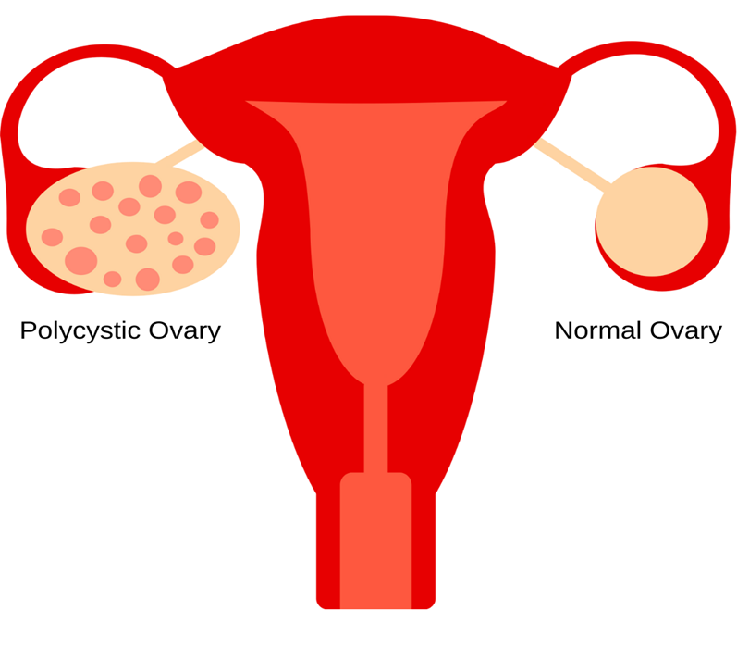

Slide 29
Spiral Integration Family Medicine
Family Medicine plays important role in following manner:
Diagnosis: Family physician plays a crucial role in recognizing the signs and symptoms such as developmental delays, muscle weakness, and neurological abnormalities.
Education: Family physicians educate patients and their families about Leigh syndrome, including its underlying genetic cause, clinical manifestations, prognosis, and available treatment options.
Multidisciplinary Care Coordination: Family physicians collaborate with a multidisciplinary team of health care professionals, including neurologists, genetic counselors, physical therapists, occupational therapists, and social workers, to provide comprehensive care for individuals with Leigh syndrome.
Community Support: Family physicians advocate for individuals with Leigh syndrome and their families within the healthcare system and the broader community.
Refer to Specialists: Family physicians refer to patient to the specialist for further treatment

Slide 30
Spiral Integration Artificial Intelligence
Artificial Intelligence plays role in following aspects:
AI algorithms can assist in the early detection of Leigh syndrome by analyzing medical imaging data such as MRI scans, aiding clinicians in making a timely diagnosis.
AI can help analyze genetic data to identify mutations associated with Leigh syndrome
AI-driven drug discovery platforms can identify potential therapies for Leigh syndrome. By analyzing vast amounts of biological data, including molecular pathways involved in the disease

Slide 31
Suggested Research Article
Links:
https://pubmed.ncbi.nlm.nih.gov/34767778/
Journal Name:
PubMed Central
Title:
Advancing reproductive neuroendocrinology through research on the regulation of GnIH and on its diverse actions on reproductive physiology and behavior
Author Name:
Kazuyoshi tsutsui

Slide 32
Spiral Integration
Bioethics
Genetic Testing and Counseling
Prenatal Diagnosis and Reproductive Choices
Treatment Decision-Making
Research Ethics
Access to Healthcare and Support Services

Slide 33
Learning Resources
Guyton and Hall Textbook of Medical Physiology (Guyton Physiology) 14th Edition, chapter 81 and 82, Page 1018 onwards
Lippincott Biochemistry Eighth Edition chapter 33, Page#562

