Slide 1
Approach to patients with Pituitary Disorders
Dr. SAIMA AMBREEN
ASSOCIATE PROF MEDICINE
HOD,MU1 HFH

Slide 3
Vertical Integration

Slide 4
Vertical Integration

Slide 5
Vertical Integration

Slide 6
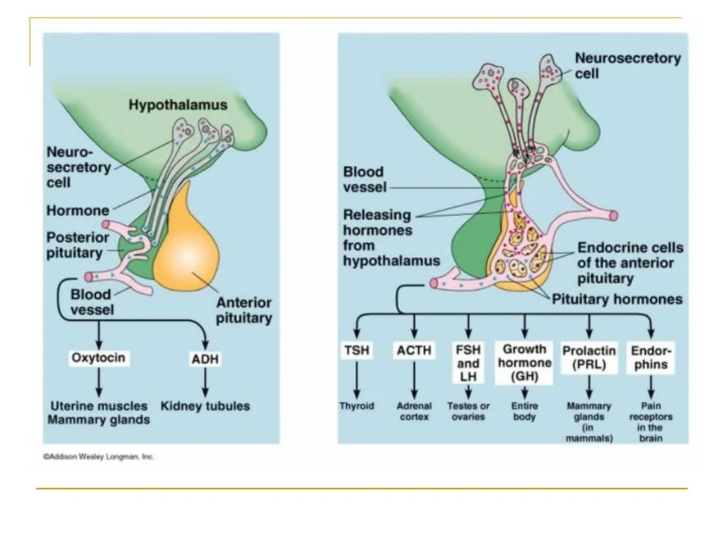
Vertical Integration

Slide 7
Vertical Integration

Slide 8
Vertical Integration

Slide 9
Core subject

Slide 10
Core subject

Slide 11
Core subject
Excess prolactin secretion is a common clinical problem in women and causes galactorrhea amenorrhea.
The amenorrhea caused by inhibition of hypothalamic release of GnRH with a decrease in LH and FSH secretion. Prolactin inhibits the LH surge that causes ovulation.
Hyperprolactinemia can be seen in physiologic states :pregnancy, nursing, hypoglycemia, exercise, stress,sleep, cirrhosis, and chronic renal failure (due to PRL clearance).

Slide 12
Core subject
Diagnosis.(exclude states such as pregnancy, lactation,hypothyroidism and medications)
Prolactin >100 ng/mL suggests probable pituitary adenoma
Prolactin level should be commensurate with tumor size
Prolactin 100 ng/mL correlates with tumor of 1cm
Prolactin 200 ng/mL correlates with tumor of 2 cm

Slide 13
Management
Treat initially with cabergoline or bromocriptine (dopamine-agonist), which will reduce prolactin level. Dopamine normally inhibits prolactin release.
Reserve surgery only for those adenomas not responsive to cabergoline/bromocriptine or associated with compressive neurologic effects.
Surgery is more effective for microadenomas than macroadenomas
Use radiation therapy if drug therapy and surgery are ineffective at reducing tumor size and prolactin level.
Core subject
Management. Treat initially with cabergoline or bromocriptine (a dopamine-agonist), which will reduce prolactin level in hyperprolactinemia. Dopamine normally inhibits prolactin release. About 90% of patients treated with cabergoline have a drop in prolactin to <10% of pretreatment levels. Reserve surgery only for those adenomas not responsive to cabergoline/bromocriptine or associated with significant compressive neurologic effects. Surgery is more effective for microadenomas than macroadenomas (only 30% of macroadenomas can be successfully resected, with long-term recurrence >50%). Use radiation therapy if drug therapy and surgery are ineffective at reducing tumor size and prolactin level.Management. Treat initially with cabergoline or bromocriptine (a
dopamine-agonist), which will reduce prolactin level in
hyperprolactinemia. Dopamine normally inhibits prolactin release.
About 90% of patients treated with cabergoline have a drop in
prolactin to <10% of pretreatment levels.
Reserve surgery only for those adenomas not responsive to
cabergoline/bromocriptine or associated with significant
compressive neurologic effects.
Surgery is more effective for microadenomas than
macroadenomas (only 30% of macroadenomas can be
successfully resected, with long-term recurrence >50%).
Use radiation therapy if drug therapy and surgery are ineffective at
reducing tumor size and prolactin level.

Slide 14
Core subject

Slide 15
Core subject

Slide 16
Core subject

Slide 17
Core subject

Slide 18
Core subject
Diagnosis:
The best initial test is IGF-1 level,which is significantly elevated.
The confirmatory test is GH measurement after 100 g of glucose is given orally; if GH remains high (>5 ng/mL), it is positive and suggests acromegaly. Normally,glucose load should completely suppress levels of GH.
Radiology: MRI is superior to CT in that it will show a tumor in 90% of people with acromegaly.

Slide 19
[8/22, 3:18 AM] Fariha: Transsphenoidal surgery provides a rapid response. Hypopituitarism can result in 10–20%. Primary treatment is surgery. Somatostatin analogues are the drugs of choice. Octreotide and lanreotide reduce GH values (70% of patients) and cause partial [8/22, 3:19 AM] Fariha: tumor regression (20–50% of patients). Octreotide is the best medical therapy for acromegaly. The main side effect of concern with somatostatin analogues is cholestasis, leading to cholecystitis. [8/22, 3:20 AM] Fariha: Pegvisomant is a growth hormone analogue which antagonizes endogenic GH (2nd line agent) [8/22, 3:21 AM] Fariha: Radiotherapy if surgery and hormonal therapy fails
Treatment:
Primary treatment is surgery.....Transsphenoidal surgery provides a rapid response, Hypopituitarism can result in 10–20%.
Somatostatin analogues are the drugs of choice. (Octreotide and lanreotide).
Octreotide is the best medical therapy for acromegaly. The main side effect is cholestasis, leading to cholecystitis.
Pegvisomant is a growth hormone analogue which antagonizes endogenic GH (2nd line agent)
Radiotherapy if surgery and hormonal therapy fail.
Core subject

Slide 20
Core subject

Slide 21
Core subject

Slide 22
Causes:
Large pituitary tumors, or cysts, as well as hypothalamic tumors (craniopharyngiomas, meningiomas, gliomas).Pituitary adenomas are the most common cause of panhypopituitarism.
Sheehan postpartum necrosis
Infiltrative diseases including hemochromatosis and amyloidosis
Stroke can cause central diabetes insipidus .
Core subject

Slide 23
Core subject
Pituitary apoplexy is an acute
hemorrhagic infarction of a preexisting pituitary adenoma, and manifests as severe headache, nausea or vomiting, and depression of consciousness. It is a medical and neurosurgical emergency.
Inflammatory diseases can lead to hypopituitarism: granulomatous diseases (sarcoidosis, tuberculosis [TB], syphilis), eosinophilic granuloma,
Trauma, radiation, surgery, infections, and hypoxia may also damage both the pituitary and hypothalamus.

Slide 24
Clinical Finding:
Gonadotropin deficiency (LH and FSH) can lead to amenorrhea, genital atrophy, infertility, decreased libido.In men, decreased LH and FSH results in impotence, testicular atrophy, infertility, decreased libido,
GH deficiency occurs next...manifest increased sensitivity to insulin (hypoglycemia), decrease in muscle, bone, and heart mass. In children results in growth failure and short stature.
Core subject

Slide 25
Core subject
Thyrotropin (TSH) deficiency results in hypothyroidism with fatigue, weakness, hyperlipidemia, cold intolerance, and puffy skin without goiter.

Slide 26
Core subject
ACTH deficiency occurs last, and results in secondary adrenal insufficiency caused by pituitary disease. There is decreased cortisol, which results in fatigue, decreased appetite, weight loss, decreased skin and nipple pigment, and decreased response to stress (as well as fever, hypotension, and hyponatremia).

Slide 27
Core subject
Diagnosis
measure GH, TSH, LH, and IGF-1. The most reliable stimulus for GH secretion is insulin-induced hypoglycemia. After injecting 0.1 μ/kg of regular insulin, blood glucose declines, in normal conditions that will stimulate GH levels to >10 mgL and exclude GH deficiency.
Random GH and IGF levels are not sensitive enough to diagnose GH deficiency.
Arginine infusion can also stimulate growth hormone. This is less dangerous because it does not lead to hypoglycemia.

Slide 28
Core subject
Management
Management of hypopituitarism involves treating the underlying causes. Multiple hormones must be replaced, but the most important is cortisol.

Slide 29
Horizontal Integration

Slide 30
Core subject

Slide 31
Vertical Integration

Slide 32
Vertical Integration

Slide 33
DIAGNOSIS
1.BLOOD OSMOLALITY TEST;
>295 msom in central,gestational and nephrogenic DI
Normal in psychogenic DI
2.WATER DEPRIVIATION TEST
No drinking for few hours
Then hourly measurement of urine
Volume
Osmolality
Desmopressin may raise urine osmolality to normal values for central and gestational DI
Slight increase by desmopressin (Nephrogenic DI)

Slide 34
TREATMENT
1.CENTRAL DI
ADH Analogs Desmopressin
2.NEPHROGENIC DI
Thiazide diuretics ,increase excretion of sodium
3.PSYCHOGENIC DI
Behavioral therapy

Slide 35
Vertical Integration

Slide 36
Core subject
Diagnosis:
Hyponatremia <130 mEq/L Posm <270 mOsm/kg Urine sodium concentration >20 mEq/L (inappropriate natriuresis) Maintained hypervolemia Suppression of renin–angiotensin system Low blood urea nitrate (BUN), low creatinine, low serum uric acid, and low albumin

Slide 37
Core subject
Management.
Treat underlying causes. Restrict fluid to 800–1000mL/d to increase serum Na
Demeclocycline which inhibits ADH action at the collecting duct [V2]). Conivaptan and tolvaptan are V2 receptor blockers indicated for moderate to severe SIADH. Symptomatic patients (severe confusion convulsions, or coma) use hypertonic saline (3%) 200–300 mL in 3–4 h. The rate of correction should be 0.5–1 mmol/L/h serum Na.

Slide 38
Q1. Which of the following hormone is not secreted by pituitary gland?
Tsh
Acth
TRh
Fsh

Slide 39
Ans: C

Slide 40
Which of the following is the disorder of posterior pituitary gland
A acromegaly
B dwarfism
C gigantism
D SIADH

Slide 41
Ans: D

Slide 42
Size of pituitary Microadenoma is
a <10cm
B <10mm
C < 5mm
D <5cm

Slide 43
Ans: B

Slide 44
Galactorrhea is caused by
A overproduction of prolactin
B undersecretion of prolactin
C overproduction of FSH
D underproduction of TSH

Slide 45
Ans: A

Slide 46
Which of the following drug can be used for management of acromegaly?
Levothyroxine
Carbimazole
Octreotide
Bromocripine

Slide 47
Ans: C

Slide 48
Hyperpigmentation is associated with hyper secretion of which hormone
A FSH
B TSH
C ACTH
D GH

Slide 49
Vertical Integration
Researches and References
https://patient.info/hormones/pituitary-gland-disorders
https://medlineplus.gov/pituitarydisorders.html
https://endocrinology.medicine.ubc.ca/endocrine-conditions/pituitary-disorders/
Davidson’s Principles and Practice of Medicine
Current Medical Diagnosis and Treatment 2022
Harrison’s Principles of Internal Medicine
The Oxford Textbook of Medicine

