Slide 1
Parasitic infestations requiring surgical interventions
By Dr. Faryal Azhar
Assistant Professor
Surgical unit 2 HFH.

Slide 2
A parasitic infection is an infection caused or transmitted by a parasite. Many parasites do not cause diseases. Parasitic infection can affect practically al living organisms, including plants and animals.

Slide 3
Commensalism: One symbiont benefits, other unaffected
Symbiosis: Living together
Mutualism: Both symbionts benefit
Parasitism: One symbiont benefits, other is damaged
07-08-2014
Dr . ASIF IQBAL
3

Slide 4
Each causes different symptoms and different infections.
Roundworms Tapeworms Hook worms Heart worms Amoeba
Flies, Fleas, Lice, Mites , Ticks, and Spiders.

Slide 7
Parasitic infestation is common in developing countries, especially in Africa. Children are often more vulnerable to these infections. Many health problems result from these infestations, including malnutrition, iron-deficiency anemia, surgical morbidities, and even impaired cognitive function and educa- tional achievement.

Slide 8
Surgical intervention may be needed to treat serious complications caused by some of these parasites. Amoebic colitis and liver abscess caused by protozoan infections; intestinal obstruction, biliary infestation with cholangitis and liver abscess, and pancreatitis caused by Ascaris lumbricoides; biliary obstruction caused by Faschiola; hepatic and pulmonary hydatid cysts caused by Echinococcus granuloses and multilocularis are examples

Slide 9
Figure 23.1

Slide 10
Some parasites must migrate to certain locations within the host in order to complete their life cycle
Non-human parasites, in humans, often fail to migrate properly and become “dead-end infections”

Slide 11
------ An association which is beneficial to both living things.
Lichen and fungus - lichen (plants lookalike or algae) would survive with the fungus by attaching itself on rock and absorbs in nutrients. in return the lichen uses the nutrients made by the fungus to produce carbon dioxide so the fungus can photosynthesize.

Slide 12
------ Both partners are able to lead indepenent lives, but one may gain advantage from the association when they are together and least not damage to the other.
Fig. A female pea crab in the mantle cavity of its mussel host. The crab does not damage the mussel and uses its shell purely for protection

Slide 13
------ An association which is beneficial to one partner and harmful to the other partner.
The former that is beneficial to is called parasite, the latter that is harmful to is called host.

Slide 14
Human parasites are divided into endoparasites, which cause infection inside the body, and ectoparasites, which cause infection superficially within the skin.

Slide 15
Endoparasites
Protozoan organisms
Helminths organisms (worms)
Tapeworms Flukes Roundworms
Other organisms

Slide 16
Protozoa
Plasmodium spp. - causes Malaria
Entamoeba - causes amoebiasis, amoebic dysentery
Giardia - causes Giardiasis
Trypanosoma brucei - causes African sleeping sickness
Helminths organisms (worms)
Pinworm - causes Enterobiasis
Guinea Worm - also known as Dracunculiasis Hookworm
Tapeworm

Slide 17
Bedbug
Head louse - Pediculosis Bodylouse - Pediculosis Scabies
Demodex - Demodicosis Flea etc

Slide 21
CAUSES
MODE OF TRANSMISSION
INCUBATION PERIOD LIFE CYCLE SYMPTOMS TREATMENT

Slide 23
ENTAMOEBA HYSTOLYTICA
Causes amoebic dysentery
About 50 million people worldwide are affected
Carried asymptomatically in the
digestive tracts of humans
No animal reservoir exists

Slide 24
CAUSES :Infection occurs most often by drinking water contaminated with feces containing cysts; can be transmitted through contaminated food.
MODE OF TRANSMISSION: Ingestion of fecally contaminated water and food (raw vegetables), by fecally contaminated hands of foodhandlers
INCUBATION PERIOD: Variable, from a few days to several months; usually 2-4 weeks

Slide 25
SYMPTOMS: Abdominal pain, diarrhea, fatigue, fever, vomiting, bloody stool, weight loss
TREATMENT: Susceptible to metronidazole, tinidazone, ornidazole, deloxanide furoate, chloroquine, tetracycline

Slide 26
Found in intestinal tracts of animals and in the
environment
Causative agent of giardiasis
Common gastrointestinal disease in the world.
Range from asymptomatic infection to gastrointestinal
disease
The parasite multiplies in the small intestines
Symptoms: diarrhea, abdominal cramps, vomiting, fever Prevention: use of filtered water

Slide 27
Figure 23.8

Slide 28
TRANSMISSION :Giardia infection can occur through ingestion of dormant microbial cysts in contaminated water, food, or by the faecal-oral route .
INCUBATION PERIOD: 1 to 3 weeks after exposure to the parasite.
TREATMENT : Human infection is conventionally treated
with metronidazole, tinidazole or nitazoxanide. Although metronidazole is the current first-line therapy.

Slide 29
Malaria
Plasmodium
Causative agent of malaria
Around 216 million cases of malaria worldwide; 1.2 million
deaths.(WHO 2012)
Four species cause malaria
P. falciparum, P. vivax, P. ovale, and P. malariae
Malaria is endemic throughout the tropics and subtropics
Mosquitoes (Anapholes) are vector for Plasmodium
The Plasmodium life cycle has three prominent stages

Slide 34
Plasmodium
Some genetic traits increase malaria resistance in
endemic areas
Sickle-cell trait
Sickle-shaped cells resist penetration by Plasmodium
Hemoglobin C
Two genes for hemoglobin C protect against malaria

Slide 35
Malaria
Symptoms of malaria depend on cycle of parasite:
High fever, joint pain, vomiting, weakness, renal failure, confusion, seizures
Cerebral malaria results in tissue death in the brain (P.
falciparum)
Immunity develops if victim survives acute stage
Periodic episodes become less severe over time

Slide 36
Treatment
Various antimalarial medication
– type depends on severity of
case
Prevention
Avoid getting bitten
Use anti-malaria medication (prophylaxis) – chloroquine, mefloquine, primaquine

Slide 37
Leishmania
Causes leishmaniasis, transmitted by sand fly bites
Endemic in parts of the tropics and subtropics
Wild and domestic dogs and small rodents are common
hosts
2 million new cases yearly around the world Symptoms:
* weight loss, low blood count, fever, dark skin
pigmentation, renal failure, skin ulcers, etc.
Treatment – medication Prevention – prevention of being
bitten

Slide 41
CAUSE: It is a parasitic disease of humans and other animals, caused by protozoa of the species Trypanosoma brucei and transmitted by the tsetse fly.
SYMPTOMS: Characterized by fever, headaches, joint pains, and itching.Invasion of the circulatory and lymphatic systems by the parasites is associated with severe swelling of lymph nodes.
Disruption of the sleep cycle is a leading symptom of this stage and is the one that gave the disease the name 'sleeping sickness.'

Slide 42
TREATMENT: Currently there are few medically related prevention options for Trypanosomiasis (i.e. no vaccine exists for immunity). Although the risk of infection from a tsetse fly bite is minor (estimated at less than 0.1%), the use of insect repellants, wearing long-sleeved clothing, avoiding tsetse-dense areas are best preventing option.

Slide 45
Helminths are macroscopic, multicellular, eukaryotic worms
Life cycles are complex
Intermediate hosts are often needed to support larval stages
Three groups of helminthes Cestodes (tapeworm) Trematodes (fluke) Nematodes (roundworm)

Slide 46
Tapeworm Infestation is the infection of the digestive
tract by adult parasitic flatworms called cestodes
or tapeworms. Live tapeworm larvae are sometimes ingested by consuming undercooked food. Once inside the digestive tract, a larva can grow into a very large adult tapeworm.

Slide 47
Mode of Infection: Most common tapeworms in humans are the pork tapeworm (T. solium), the beef tapeworm (T. saginata), the fish tapeworm and the dwarf tapeworm
Incubation period: It takes about 5 to 12 weeks for the worm to mature into adulthood in the human intestine

Slide 49
SYMPTOMS:
Although tapeworms in the intestine usually cause no symptoms, some people experience upper abdominal discomfort, diarrhea, and loss of appetite. Anemia may develop in people with the fish tapeworm. Infection is generally recognized when the infected person passes segments of proglottids in the stool (looks like white worms), especially if a segment is moving.
Rarely, worms may cause obstruction of the intestine. And very rarely, T. solium larvae can migrate to the brain causing severe headaches, seizures and other neurological problems. This condition is
called neurocysticercosis. It can take years of development before the patient has those symptoms of the brain.

Slide 50
Tapeworms are treated with medications taken by mouth, usually in a single dose. The drug of choice for tapeworm infections is praziquantel.
Niclosamide can also be used.

Slide 51
Ascariasis is a disease of humans caused by the parasitic roundworm Ascaris lumbricoides.
CAUSE : Infection occurs by swallowing food contaminated with Ascaris eggs from feces.
The larvae hatch in the intestine, burrow through the gut wall, and migrate to
the lungs through the blood system.

Slide 52
MODE OF TRANSMISSION: The source of transmission is from soil and vegetation on which fecal matter containing eggs has been deposited. Ingestion of infective eggs from soil contaminated with human feces or transmission and contaminated vegetables and water is the primary route of infection.

Slide 53
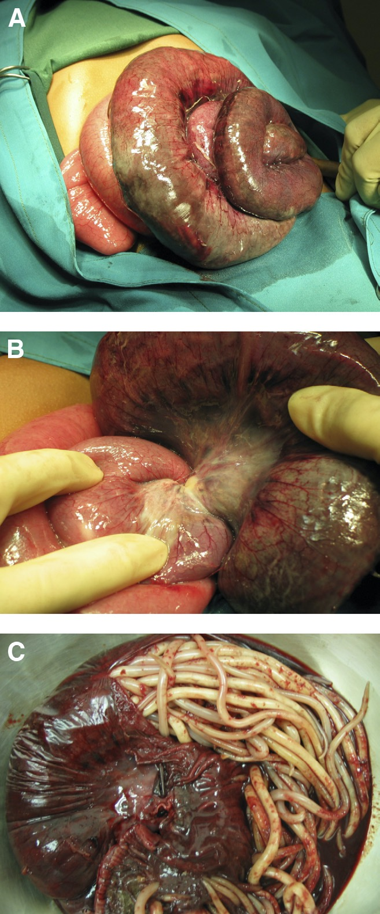

Slide 54
INCUBATION PERIOD: 4-8 weeks
SYMPTOMS :As larval stages travel through the body, they may cause visceral damage, peritonitis and inflammation, enlargement of the liver or spleen, and a verminous pneumonitis. The
worms in malabsorption to malnutrition
the intestine and anorexia
may which
cause contribute

Slide 55
Prevention : Use of toilet facilities; safe excreta disposal; protection of food from dirt and soil; thorough washing of produce; and hand washing. Food dropped on the floor should never be eaten without washing or cooking, particularly in endemic areas. Fruits and vegetables should always be washed thoroughly before consumption.
Treatment: Mebendazole, Albendazole, Piperazine etc.

Slide 56
It is a parasitic filarial nematode (roundworm) spread by a mosquito vector. It cause lymphatic filariasis, an infection of the lymphatic system by filarial worms.

Slide 58
INCUBATION PERIOD: The incubation period is variable and often difficult to determine. Both microfilaria and adult worms have been observed in patients as early as 6 months and as late as 12 months after infection

Slide 59
If the infection is left untreated, it can develop into a chronic disease called elephantiasis.
Limited treatment modalities exist and no vaccines have been developed.

Slide 60
TREATMENT : The severe symptoms caused by the parasite can be avoided by cleansing the skin, surgery, or the use of therapeutic drugs, such
as diethylcarbamazine (DEC), ivermectin,
or albendazole. The drug of choice, however, is diethylcarbamazine.

Slide 61
It is the parasitic infestation of the body of a live mammal by fly larvae (maggots) that grow inside the host while feeding on its tissue.

Slide 62
MODE OF TRANSMISSION:There are three main fly families causing economically important myiasis in livestock and also, occasionally in humans:
Calliphoridae (blowflies) Oestridae (botflies) Sarcophagidae (fleshflies)

Slide 63
SYMPTOMS: Myiasis varies widely in the forms it takes and its effects on the victims. Such variations depend largely on the fly species and where the larvae are located.
Some flies lay eggs in open wounds, other larvae may invade unbroken skin or enter the body through the nose or ears, and still others may be swallowed if the eggs are deposited on the lips or on food

Slide 64
First response to cutaneous myiasis once the breathing hole has formed, is to cover the air hole thickly with petroleum jelly. Lack of oxygen then forces the larva to the surface, where it can more easily be dealt with. In a clinical or veterinary setting there may not be time for such tentative approaches, and the treatment of choice might be more direct, with or without an incision. First the larva must be eliminated through pressure around the lesion and the use of forceps. Secondly the wound must be cleaned and disinfected.

Slide 65
Textbook of oral pathology- Shafer
oral diseases in tropics- Prabhu , Daftari shear
Textbook of general medicine – Davidson General medicine – P.J.Mehta
Internet resources

