Slide 2
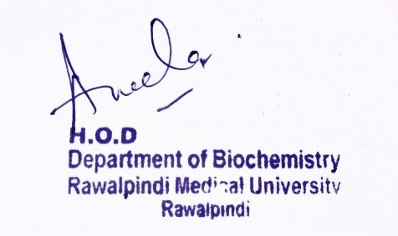
2nd Year MBBS Gastrointestinal Tract Module Large Group Interactive Session (LGIS) Nutrition
Date: 14-02-2023
Delivering Date: 21-03-2024
31-01-2025
Dr. Rahat Afzal
Biochemistry Department

Slide 3
Motto Vision; The Dream/Tomorrow
To impart evidence based research oriented medical education
To provide best possible patient care
To inculcate the values of mutual respect and ethical practice of medicine
Wisdom
Truth
Service

Slide 4
Professor Umar Model of Integrated Lecture

Slide 5
Learning Objectives
At the end of the lecture, students will be able to:
Explain:
What is balanced diet
What are proteins
Determination of comparative nutritional efficiency of proteins.
Protein Energy Malnutrition (PEM.)

Slide 6
Core Knowledge
Balanced Diet:
A diet consisting of a variety of different types of food and providing adequate amounts of all the essential nutrients necessary for normal growth and development of human body.
Five major food groups:
Fruits and vegetables
Starchy food:
Potatoes, bread, rice, pasta, and other carbohydrates
3. Proteins:
Beans, pulses, fish, eggs, meat and other proteins.
4. Dairy
5. Fats:
Oils and spreads.

Slide 7
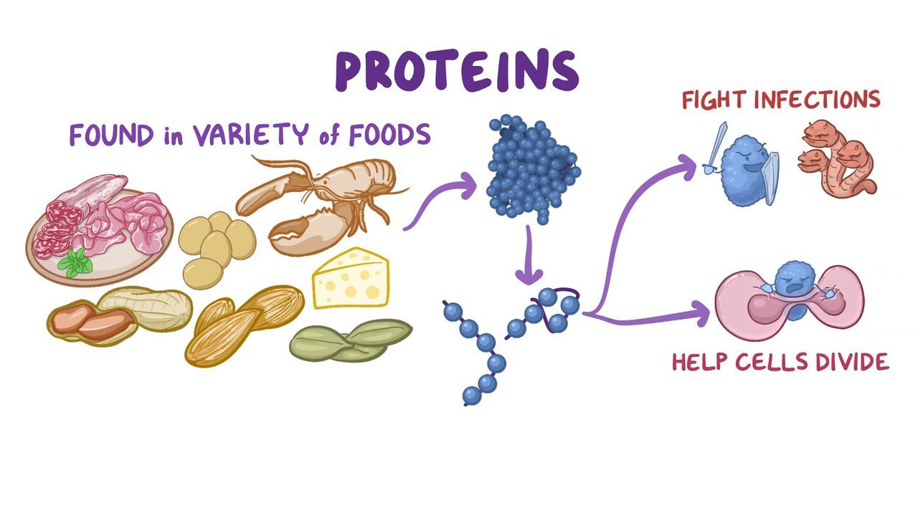
Proteins:
Core Knowledge
Building stones.
Required for growth.
Required to build proteins in wear and tear loss and to build new tissues after wasting illness.
Supply amino acids required for synthesis of enzymes.
Proteinous hormones.

Slide 8
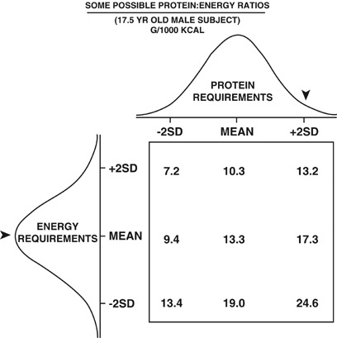
Determination of Comparative Nutritional Efficiency of Dietary Proteins:
Core Knowledge
Done by finding out certain values:
Net Protein Utilization (NPU) of proteins:
NPU= $\frac{Proteins digested and assimilated in gms}{protein intake in diet in gms}$ x 100
Increased NPU= Higher will be the nutritional value of protein
Protein Ratio:
Ratio of grams of body weight
gain to grams of proteins
consumed.

Slide 9
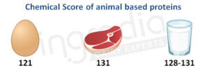
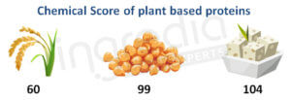
Core Knowledge
3. Chemical Score of a protein:
Content of essential amino acids of a protein is matched with that of egg protein(100%) to obtain its chemical score (c.s.)
Wheat flour protein c.s. = 40
Animal Protein (G1):
Plant Protein (G2):

Slide 10
Kwashiorkor
Core Knowledge
Protein Energy Malnutrition
Kwashiorkor is characterized by severe deficiency of good quality of protein.
It occurs in tropics and sub-topics where diet of young children lacks animal proteins.

Slide 11
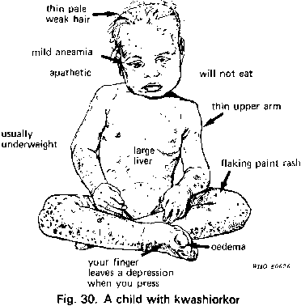
Core Knowledge
Features:
Growth failure, atrophy of muscles, weakness, nervous irritability.
Skin rashes.
Hair are thin, weak, and red.
Chilosis, xerophathalmia, stomatitis, diarrhea and cachexia.
Edema, moon face and large belly
Enlarged fatty liver
Rickets and scurvy.

Slide 12
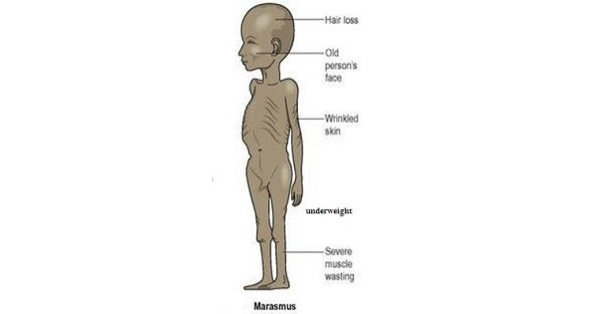
Marasmus
Core Knowledge
It is an extremely severe type of nutrition disorder in which thee is significant wasting of fats, muscles and tissues of the body.
Causes
Chronic starvation.
Adulterated water.
Inadequate food intake.
Vitamin deficiencies.
Low birth weight.

Slide 13
Vertical Integration
KWASHIORKOR | MARASMUS
Develops in children whose diets are deficient in proteins. | It is characterized by a deficiency of proteins and calories
Children of age: 6 months to 3 years. | Infants under 1 year of age.
Subcutaneous fat is preserved. | Subcutaneous fat is lost.
Edema is present. | Edema is absent.
Enlarged fatty liver. | No fatty liver.
Ribs are not prominent. | Ribs are prominent.

Slide 14
Spiral Integration
Family Medicine
Family Medicine plays important role in preventing and treating PEM in following manner:
Preventive care and education.
Early detection and screening.
Diagnostic evaluation.
Treatment planning and management.
Monitoring and follow-up.
Community out-reach and advocacy.

Slide 15
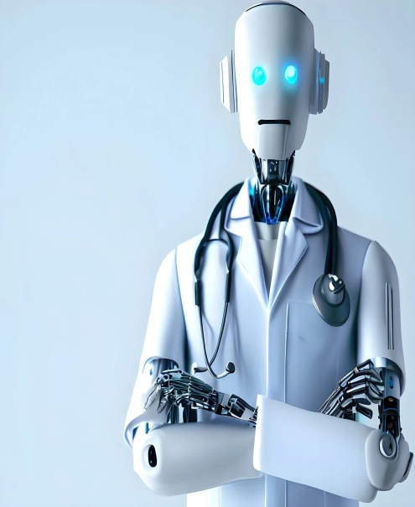
Artificial Intelligence
Spiral Integration
Artificial Intelligence plays role in following aspects to address the nutrition related issues such as PEM:
Data analysis and prediction.
Early detection and diagnosis.
Personalized treatment planning.
Remote monitoring and support.
Decision support tools.
Public health surveillance and intervention.
Research and innovation.
Community engagement and education.

Slide 16
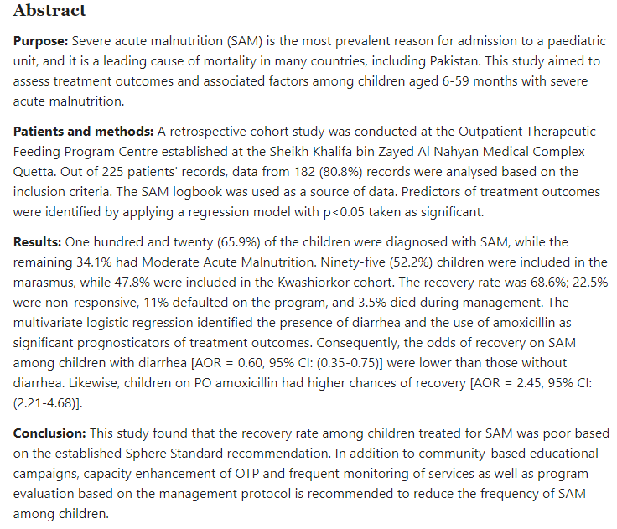
Suggested Research Article
Spiral Integration
Link: https://pubmed.ncbi.nlm.nih.gov/37753341/

Slide 17
Bioethics
Spiral Integration
Appropriate Information :
To the patient and his family about the disease
Counselling

Slide 18
How To Access Digital Library
Steps to Access HEC Digital Library
Go to the website of HEC National Digital Library
On Home Page, click on the INSTITUTES
A page will appear showing the universities from Public and Private Sector and other Institutes which have access to HEC National Digital Library HNDL
Select your desired Institute
A page will appear showing the resources of the institution
Journals and Researches will appear
You can find a Journal by clicking on JOURNALS AND DATABASE and enter a keyword to search for your desired journal

Slide 19
Learning Resources
Textbook of Biochemistry, Lippincott 8th edition, chapter no.27, page no. 717-753.
Google scholar
Google images

