Slide 1




Slide 2


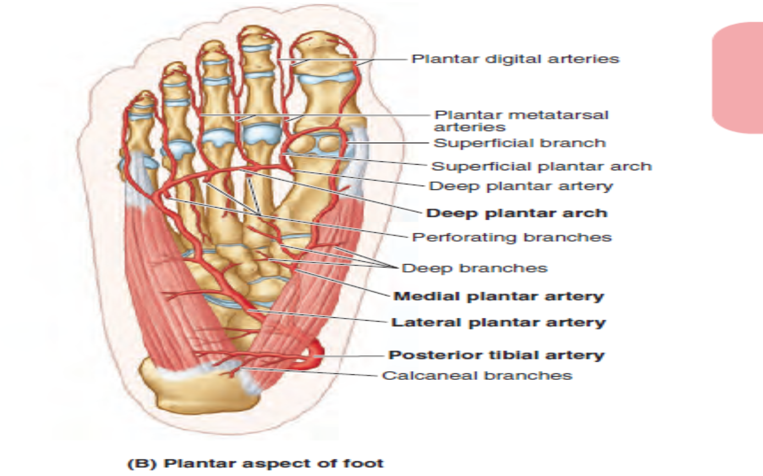
Sole Of Foot(Neurovascular)
Blood And Immunity Module
1st Year MBBS SGD
April 2025
Dr Zeneara Saqib

Slide 3
Mission- Vision- Values
To impart evidence based research oriented medical education
To provide best possible patient care
To inculcate the values of mutual respect and ethical practice of medicine
Wisdom
Truth
Service

Slide 4
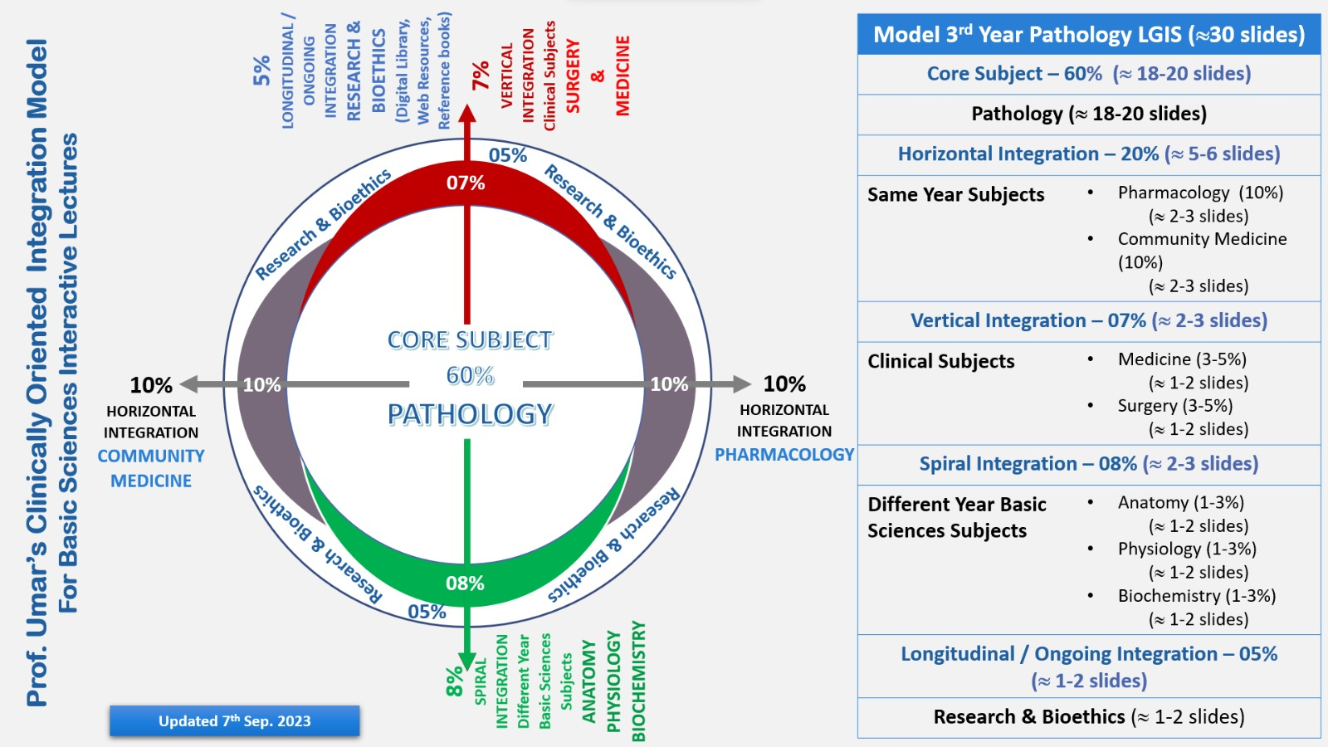
Professor Umar Model of Integrated Lecture

Slide 5
How To Access Digital Library
Go to the website of HEC National Digital Library.
On Home Page, click on the INSTITUTES.
A page will appear showing the universities from Public and Private Sector and other Institutes which have access to HEC National Digital Library HNDL.
Select your desired Institute.
A page will appear showing the resources of the institution
Journals and Researches will appear
You can find a Journal by clicking on JOURNALS AND DATABASE and enter a keyword to search for your desired journal.

Slide 6
Learning Objectives
Describe blood supply and nerve supply
Discuss cutaneous innervation of sole of foot Discuss other clinicals related to the sole of the foot
How to use digital library
Read a research article

Slide 7
Core Concept(Nerve Supply)

Slide 8

Median Planter Nerve

Slide 9
Medial And Lateral Planter Arteries

Slide 10
Arteries Of Sole Of Foot

Slide 11
Arteries Of Foot

Slide 12
Venous Drainage

Slide 13
Venous Drainage(Sole Of Foot)

Slide 14
Lymphatic Drainage

Slide 15
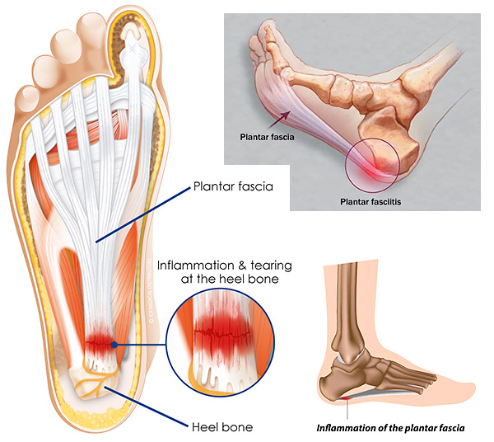
Plantar Fasciitis
Vertical Integration

Slide 16
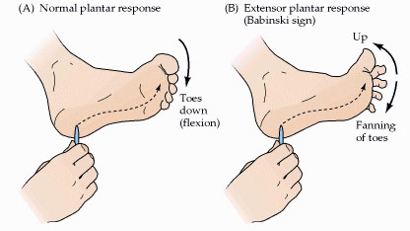
Planter Reflex
Vertical Integration

Slide 17
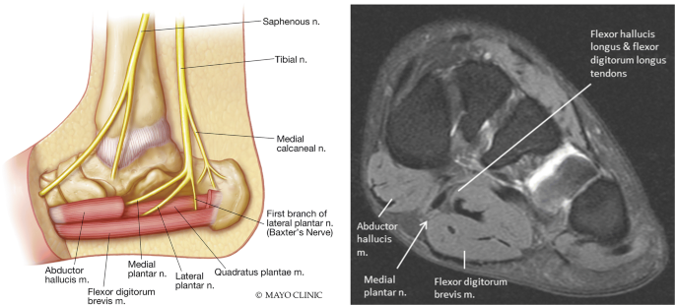
Jogger Foot
Vertical Integration

Slide 18
Research Article
https://www.ncbi.nlm.nih.gov/pmc/articles/PMC7369968/

Slide 19
Evaluation of the Lower Limb Muscles’ Electromyographic Activity during the Leg Press Exercise and Its Variants: A Systematic Review
Abstract
The aim of this study was to analyze the literature on muscle activation measured by surface electromyography (sEMG) of the muscles recruited when performing the leg press exercise and its variants. The Preferred Reporting Items of Systematic Reviews and Meta-Analyses (PRISMA) guidelines were followed to report this review. The search was carried out using the PubMed, Scopus, and Web of Science electronic databases. The articles selected met the following inclusion criteria: (a) a cross-sectional or longitudinal study design; (b) neuromuscular activation assessed during the leg press exercise, or its variants; (c) muscle activation data collected using sEMG; and (d) study samples comprising healthy and trained participants. The main findings indicate that the leg press exercise elicited the greatest sEMG activity from the quadriceps muscle complex, which was shown to be greater as the knee flexion angle increased. In conclusion, (1) the vastus lateralis and vastus medialis elicited the greatest muscle activation during the leg press exercise, followed closely by the rectus femoris; (2) the biceps femoris and the gastrocnemius medialis showed greater muscular activity as the knee reached full extension, whereas the vastus lateralis and medialis, the rectus femoris, and the tibialis anterior showed a decreasing muscular activity pattern as the knee reached full extension; (3) evidence on the influence of kinematics modifications over sEMG during leg press variants is still not compelling as very few studies match their findings.

Slide 20
Learning Resources
Clinically Oriented Anatomy 7th Edition
by Keith L. Moore (Author), Anne M. R. Agur (Author), Arthur F. Dalley (Author)
Gray's Anatomy: The Anatomical Basis of Clinical Practice 42nd Edition
www.google.com for pictures

Slide 21
Thank you

