Slide 1
Neural tube defect

Slide 2
contents
Introduction
Embryology
Patho-physiology
Etiology
Classification
Clinical presentation

Slide 3
Cont….
Investigations
Management
Post-operative complications
Result of some new researches
Take home messages

Slide 4
introduction
An estimated 303000 newborns die every years, worldwide due to congenital anomalies. Among them neural tube defects are second most common cause. The incidence of NTDs in the general population varies from 1 per 1000 pregnancies to 12 per 1000.

Slide 5
Cont…
Neural tube defects(NTD) encompass a variety of congenital anomalies ranging from anencephaly to spina bifida and arise due to defects in the morphogenesis of the neural tube. It happens in the first month of pregnancy, often before a women even knows that she is pregnant.
The two most common neural tube defects are SPINA BIFIDA and ANENCEPHALY.
There are geographical variations in the incidence of NTDs

Slide 6
etiology
The exact cause of neural tube defects are not known.
Genetic
Nutritional factors-folic acid, vit-B 12,zinc deficiencies
Obese women
Diabetic mother
Alcohol abuse
Antenatal radiation exposure
Intake of anti epileptic drug during pregnancy

Slide 7
Embryological background
The neural plate appears on the 3rd week of gestation as a thickening of the embryonic ectoderm.
By the end of 3dr week, lateral edges of the neural plate become more elevated to form neural folds, and depressed mid region forms the neural groove.
Gradually , neural folds fuse to form neural tube.
Fusion begins at the cervical junction first-proceeds cranially then caudally

Slide 8
Cont….
Until fusion is completed, the cephalic and caudal ends of neural tube communicate with the amniotic cavity by cranial and caudal neuropores.
Closure of cranial occurs at 25th day and caudal neuropore at 27th day
Depending on the point of interruption in neural tube formation , NTDs may affect the brain(anencephaly) and spinal cord(spina bifida)

Slide 9
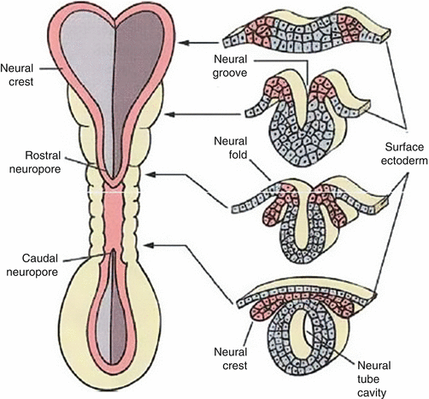

Slide 10
classification
Neural tube defect
craniospinal
cranial
spinal
craniorachischisis
anencephaly
Spina bifida cystica
Spina bifida occulta
encephalocele
meningocele
iniencephaly
myelomeningocele

Slide 11
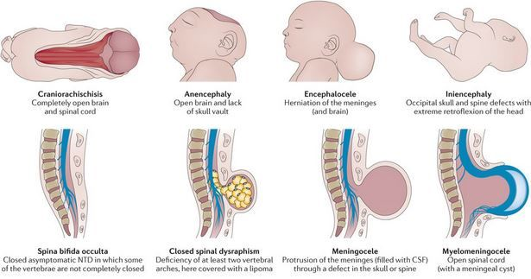

Slide 12
Brain defects

Slide 13
Cont…

Slide 14
Common types of spina bifida
MYELOMENINGOCELE is the one of the most common and most severe form of spina bifida. In this the unfused portion of spinal column allows the spinal cord to protrude through an opening , forming a sac enclosing the spinal elements, such as meninges ,CSF , parts of spinal cord and nerve roots.
MYENINGOCELE is skin covered sac formed by meninges filled with CSF usually associated with posterior arch defect of vertebra

Slide 15
Cont….
SPINA BIFIDA OCCULTA which is the mildest form of NTDs not accompanied by the extrusions of the contents of the vertebral column .Occasionally, it may cause neurological deficit because of a tethering of spinal cord. Some patients may have external evidence such as dimple ,sinus , tuft of hair or hamartomatous lesions.

Slide 16
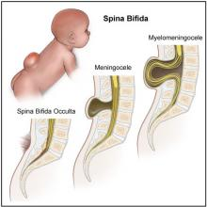

Slide 18
Clinical presentations
Swelling/dimple/tuft of hair/sinus etc. over the spinal area
Loss of bowel /+bladder control
Loss of sensation below the level of lesion
Weakness or paralysis below the lesion
Others associated condition
club foot
hydrocephalus -38%
congenital heart defect
chiari II malformation

Slide 19
Diagnostic tests
PRENATAL DIAGNOSIS
Alpha-fetoprotein in maternal serum
Ultrasonography
Amniocentesis
Postnatal tests
x-ray of spine
MRI of spine
USG /CT scan pf brain

Slide 20
Maternal usg

Slide 21
MRI

Slide 22
management
Once diagnosed antenatally, after proper Prenatal assessment by MRI and counseling , fetal surgery can be done. Now it is practiced in advanced country.
Medical care- newborn should be positioned in the prone or lateral position to prevent pressure on the defect.
Newborn with open NTDs should be kept warm and the defect should be covered with sterile wet saline and intravenous antibiotic should be initiated.
Monitor ICP and measure head circumfrence

Slide 23
Surgical management
EXCISION AND REPAIR OF THE DEFECT –
Positioning of the patient
An elliptical incision at the junction of the arachnoid membrane and the skin
Membrane is excised and neural plaque freed
The dura is dissected laterally from the underlying muscle
Dura and skin is closed in layer.

Slide 25
Post-operative complication
CSF leak
Wound infection and wound dehiscence
Paraplegia
Bowel and bladder incontinence

Slide 26
Prevention of neural tube defect
WHO recommend that all women of childbearing age take a daily supplement of 400 micrograms of folic acid
Educate mothers regarding intake of folic acid especially in periconception period and in first trimester as well
Women already had a pregnancy with NTD or diabetic or under anticonvulsant treatment should take a daily 5mg tablet of folic acid daily for at least one month before conception and then throughout the first 12 weeks of pregnancy
Genetic counseling or screening

Slide 27
Result of some new research
Rat spinal cords exposed to amniotic fluid in retinoic acid –induced spina bifida-CHILDREN’S HOSPITAL MEDICAL CENTER,USA
About 10% of fetuses from diabetic mother display congenital in various system,among which the NTDs are more frequenty demonstrated.-NATIONAL UNIVERSITY OF SINGAPORE
Low carbohydrate diets may increase risk of neural tube defect-NATIONAL BIRTH DEFECTS PREVENTION STUDY ,USA
Arsenic utilize folic acid for its metabolism..so arsenic poisoning increase the risk of NTDs-BOSTON UNIVERSITY

Slide 28
Take home messages
Though not established, folic acid supplementation reduce the incidence of NTDs.
Antenatal diagnosis and repair of the defects in utero(fetal surgery) can reduce the neurological deficit.

Slide 29
Thank you

