Slide 2
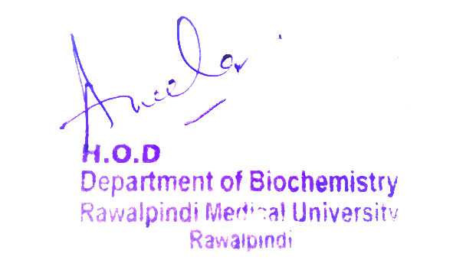
2nd Year MBBS Gastrointestinal Tract Module Large Group Interactive Session (LGIS) Vitamin C
Presenter: Dr. Almas Ajaz

Slide 3
Motto, Vision, Dream
To impart evidence based research oriented medical education
To provide best possible patient care
To inculcate the values of mutual respect and ethical practice of medicine
Wisdom
Truth
Service

Slide 4
Professor Umar Model of Integrated Lecture

Slide 5
Learning Objectives
At the end of this session students should be able to
At the end of this session students will be able to know
Vit c structure and metabolism
Biochemical functions of vitamin c
Sources of Vitamin c
Deficiency symptom's of vitamin c

Slide 6
Interactive Session
A 4-year-old boy was brought to the clinic with symptoms of hematuria (blood in urine),
edema (swelling) of the lower extremities, and a swollen right leg.
He was the 12th child in a poor family, and his diet consisted mainly of cow's milk and
biscuits.
Over the past few months, he had shown irritability, poor appetite, and sweating.
Upon examination, the child was pale, malnourished, and had dry, cracked hair.
Clinical evaluation revealed no organomegaly (enlarged organs),
but there was gingival bleeding and only one tooth present.
Laboratory tests showed a low red blood cell count, low hemoglobin, and low serum
iron levels.
Radiological investigations indicated massive subperiosteal hematoma
(blood collection under the periosteum) on the right femur, dilated metaphyses,
and general osteoporosis.
Diagnosis: The child was diagnosed with scurvy (vitamin C deficiency).
The symptoms, dietary history, and radiological findings were consistent with this
diagnosis

Slide 9
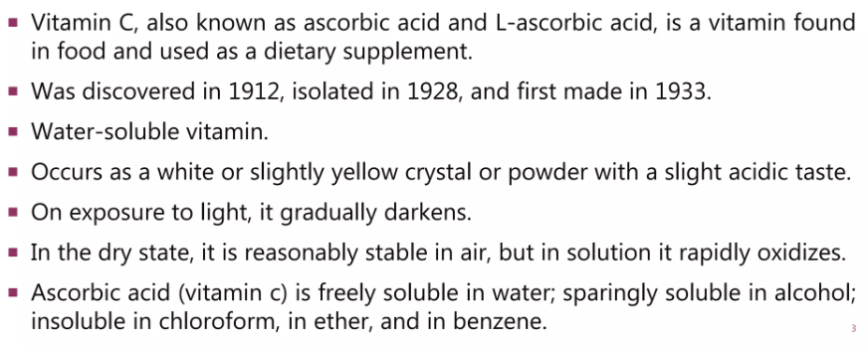
Vitamin C is a water-soluble vitamin, antioxidant, and essential co-factor for collagen biosynthesis, carnitine and catecholamine metabolism, and dietary iron absorption. Humans are unable to synthesize vitamin C, so they can only obtain it through dietary intake of fruits and vegetables

Slide 11
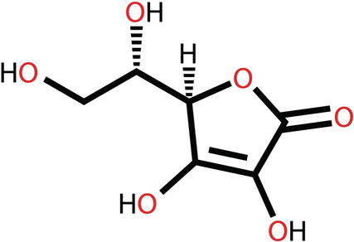
STRUCTURE

Slide 12
SOURCES OF VITAMIN C
The foods richest in vitamin C are
citrus fruits,
green peppers,
strawberries,
tomatoes,
broccoli,
white potatoes, and sweet potatoes.
Other good sources include dark leafy greens, cantaloupe, papaya, mango, watermelon, brussels sprouts, cauliflower, cabbage, red peppers, raspberries, blueberries

Slide 14
VITAMIN C – BIOCHEMICAL FUNCTION
Vitamin C has three major roles:
Firstly, it catalyzes the hydroxylation reactions especially prolyl and lysyl residues of collagen. Thus, promoting the formation of connective tissues and bones.
Secondly, it actively participates in anti-oxidation. It is very powerful reductant.
Thirdly, it helps in the absorption of iron from the intestine.

Slide 15
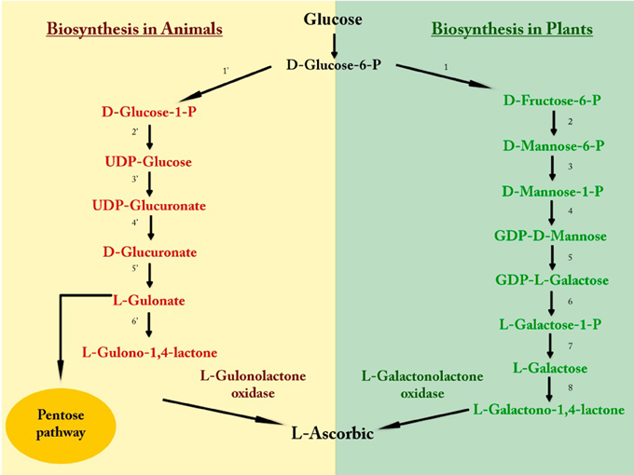
Biosynthesis of Vitamin C

Slide 16
VITAMIN C – BIOCHEMICAL FUNCTION
Collagen formation:
Vitamin C catalyzes the post translational modification responsible for the hydroxylation of prolyl and lysyl residues of collagen fibres.
Bone consists of high percentage of collagen and requires vitamin C for proper formation.
Serotonin synthesis:
Vitamin C is responsible for hydroxylation reaction involved in synthesis of serotonin from tryptophan.
Folate metabolism:
Dihydrofolate reductase (DHFR) requires Vitamin C for its activity.
Therefore, Vitamin C has a role in synthesis of 5,10-methylene tetra hydro folate (THF) acid from7,8-dihydrofolate (DHF).
Cholesterol synthesis:
Enzyme 7-α-hydroxylase involved during cholesterol biosynthesis requires Vit.C.

Slide 17
Core Knowledge
VITAMIN C – BIOCHEMICAL FUNCTION
Haemoglobin synthesis:
Vitamin C help absorption of iron from intestine which is required for hemoglobin synthesis.
Steroid hormone synthesis:
Vitamin C catalyses the hydroxylation reaction involved during the biosynthesis corticosteroid hormones.
Adrenal gland and gonads:
Vitamin C is required in excessive amount for proper maintenance and functioning of adrenal gland and gonads.
Prevention of diseases:
Vitamin C along with Vit-A and E delays the onset of cataract.
Vitamin C has been associated for the prevention of coronary heart diseases and tumor formation along with Vit-A and E.
Antioxidants:
Vitamin C has a sparing action on Vitamin A and E and also some vit-B and prevent their oxidation.
Vit-C prevent the oxidation of cellular components by the effect of free radicals, peroxides, superoxides etc.

Slide 19
Vertical Integration
Vitamin C deficiency results in scurvy , anemia, swollen joints and fragile blood vessel.

Slide 20
Vertical Integration
Lack of adequate Vitamin C results in reduced immune-competence.
Vitamin C deficiency also results in sluggish hormonal function of adrenal gland and gonads.
Hemorrhage (due to deficient formation of intercellular substance) in the skin, mucous membranes, mucous membranes, and osteoporosis are caused by deficiency of Vitamin C.
impaired wound healing;
oedema;
haemorrhage (due to deficient formation of intercellular substance) in the skin,

Slide 22
RESEARCH ARTICLE
https://www.intechopen.com/chapters/56440
https://r.search.yahoo.com/_ylt=AwrErVIfd0Zkg9QIlhpXNyoA;_ylu=Y29sbwNiZjEEcG9zAzEEdnRpZAMEc2VjA3Ny/RV=2/RE=1682368416/RO=10/RU=https%3a%2f%2fpubmed.ncbi.nlm.nih.gov%2f29099763%2f/RK=2/RS=kHHUaWmFojm5eWHHOIeSVL6LA_8-

Slide 23
BIOCHEMISTRY NIACINAMIDE

Slide 24
LEARNING OBJECTIVES
At the end of this session students will be able to know
What niacinamide –Vit B3 is ?
Sources of Vitamin B3
Digestion, absorption, transport and storage of Vit B3
Biochemical function of niacinamide
Metabolism of niacinamide
Deficiency of Niacin

Slide 25
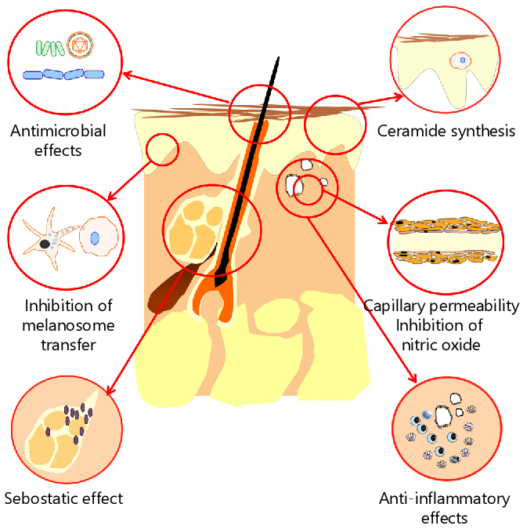
Horizontal integration (Anatomy and Physiology)

Slide 26
CORE CONCEPT

Slide 37
VERTICAL INTEGRATION : PELLAGRA

Slide 38
TOXICITY
It is unlikely to reach a toxic level of niacin from food sources alone. In the setting of very high intakes, the body will absorb less of the nutrient and flush out any excess amount through the urine. There is no established toxic level of niacin.

Slide 39
RESEARCH ARTICLES
https://r.search.yahoo.com/_ylt=AwrEadcJpEZk.AULTNVXNyoA;_ylu=Y29sbwNiZjEEcG9zAzEEdnRpZAMEc2VjA3Ny/RV=2/RE=1682379913/RO=10/RU=https%3a%2f%2fpubmed.ncbi.nlm.nih.gov%2f16029679%2f/RK=2/RS=G8Ca_N8GglsFRNTpb_sL8ioszTY-
https://r.search.yahoo.com/_ylt=AwrirUQWpEZk2mgLOBVXNyoA;_ylu=Y29sbwNiZjEEcG9zAzEEdnRpZAMEc2VjA3Ny/RV=2/RE=1682379926/RO=10/RU=https%3a%2f%2fpubmed.ncbi.nlm.nih.gov%2f24993939%2f/RK=2/RS=p9BdvUjpnldn4GGGv5Iv0QipBK8-

Slide 40
BIOCHEMISTRY THIAMINE

Slide 41
LEARNING OBJECTIVES
At the end of this session students will be able to know
Water soluble vitamin –B1
Know about biochemical functions of thiamine
Food sources
Thiamine digestion, absorption and inhibition
Deficiency diseases

Slide 42
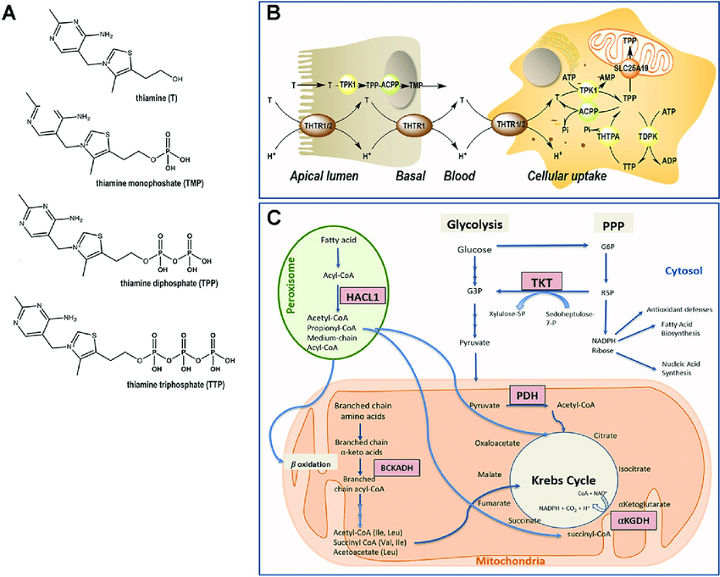
Horizontal integration (Anatomy and Physiology)

Slide 43
CORE CONCEPT

Slide 45
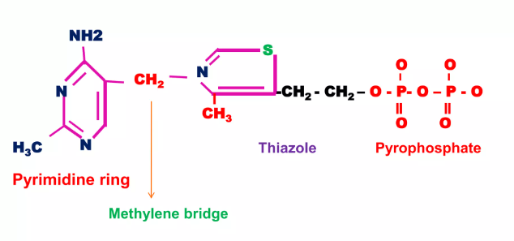
STRUCTURE

Slide 46
SOURCES

Slide 47
METABOLISM

Slide 48
BIOCHEMICAL FUNCTIONS

Slide 51
SOURCES

Slide 52
RDA

Slide 53
DEFICIENCY CAUSES

Slide 56
VERTICAL INTEGRATION – BERI BERI

Slide 58
It is characterized by edema of legs , face , trunk and serious cavities.

Slide 61
Family Medicine
Family physicians can provide essential nutritional counseling to families, emphasizing the importance of a balanced diet that includes adequate amounts of vitamins.
Patients with certain chronic conditions, such as malabsorption disorders, liver diseases, or pancreatic disorders, may be prone to vitamin deficiencies. Family physicians can monitor these patients closely, recommend appropriate supplementation, and adjust treatments as needed.
Family physicians can contribute to community education initiatives, raising awareness about the importance of vitamins and promoting healthy nutrition practices for all age groups.

Slide 62
Artificial Intelligence
Personalized Nutrition Guidance: AI enables tailored dietaryrecommendations based on individual factors, optimizing fat-soluble vitamin intake.
Early Deficiency Detection: Machine learning helps identify patterns in health data, facilitating early detection of potential fat-soluble vitamin deficiencies.
Remote Monitoring: AI supports remote tracking of nutritional adherence and vitamin status, enhancing accessibility to healthcare services.
Drug-Nutrient Interaction Analysis: Algorithms assist in recognizing potential interactions between medications and fat-soluble vitamins for safer prescribing.

Slide 63
Bioethics
Equitable Access to Supplements: Bioethics considerations involve ensuring fair distribution and access to vitamin supplements, particularly in vulnerable populations with limited resources.
Informed Consent for Genetic Testing: Ethical practices in nutritional genomics involve obtaining informed consent when utilizing genetic testing.
Cultural Sensitivity in Dietary Recommendations: Bioethics emphasizes cultural competence in providing dietary advice related to vitamins, respecting diverse beliefs and practices that influence food choices.
Transparent Communication on Supplementation: Ethical communication with patients involves transparent discussions about the risks and benefits of vitamin supplementation, respecting autonomy and ensuring informed decision-making.

Slide 64
How to access Digital Library
Open PC.
Open Internet.
Search HEC library.
Access public universities
Click on RMU
Read your desired article.

