Slide 1


Slide 2



2nd Year MBBS
Gastrointestinal Tract Module
Large Group Interactive Session (LGIS)
Folic Acid (B9), Vitamin K
Presenter: Dr. Almas Ajaz

Slide 3
Motto, Vision, Dream
To impart evidence based research oriented medical education
To provide best possible patient care
To inculcate the values of mutual respect and ethical practice of medicine
Wisdom
Truth
Service

Slide 4
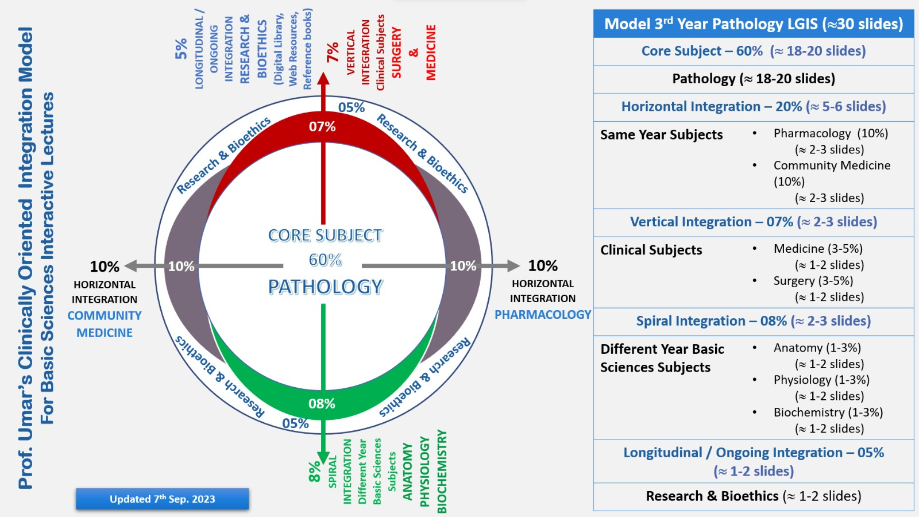
Professor Umar Model of Integrated Lecture

Slide 5
Learning Objectives
At the end of this session students should be able to
What is folic acid , sources biochemical functions , deficiency effects.
Vit K sources , biochemical functions

Slide 6
Interactive Session
Name: David Brown
Age: 44 years old
Gender: Male
Medical History: David has a history of chronic alcoholism and poor dietary habits. He has been experiencing fatigue, loss of appetite, muscle weakness, and emotional depression for several months.
Presentation: David visits his primary care physician complaining of persistent fatigue, loss of appetite, muscle weakness, and feelings of depression. He mentions that these symptoms have been progressively getting worse.

Slide 7
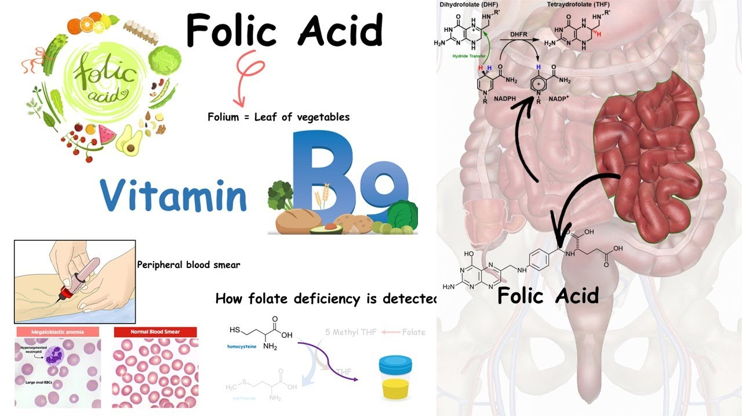
HORIZONTAL INTEGRATION (ANATOMY AND PHYSIOLOGY )

Slide 8
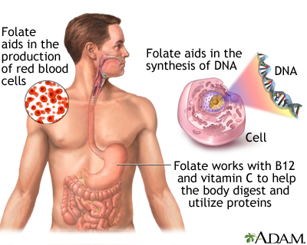

Slide 9
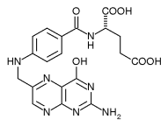
Vitamin B9 (Folic acid)
Folic acid also is known as vitamin B₉, folate or folacin .
Includes a group of compounds: Folic Acid (contains pterin, p-aminobenzoic acid and glutamic ) and folic acid.
Along with vitamin B₁₂ is essential for the formation of nucleic acids and thus for synthesis of DNA , participate in the transfer radicals and in all processes of cell division , it is important for cell division and tissue with high mitotic activity.
Absorbed in the proximal parts of the small intestine and when excess it is excreted in the urine.

Slide 10
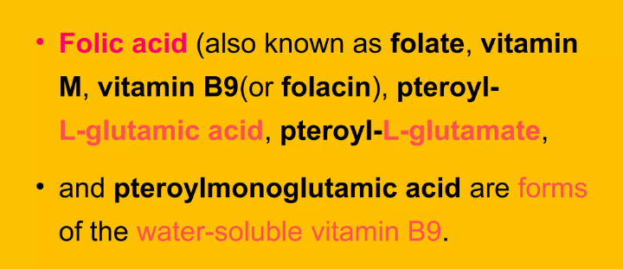

Slide 11
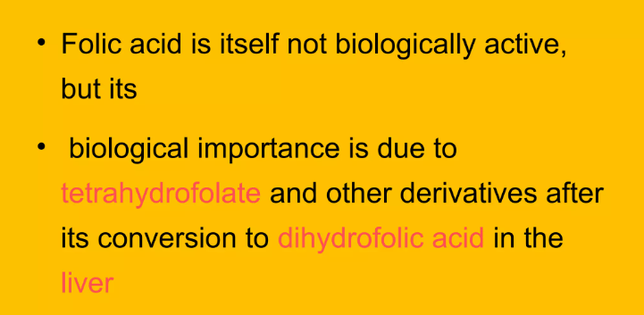

Slide 12
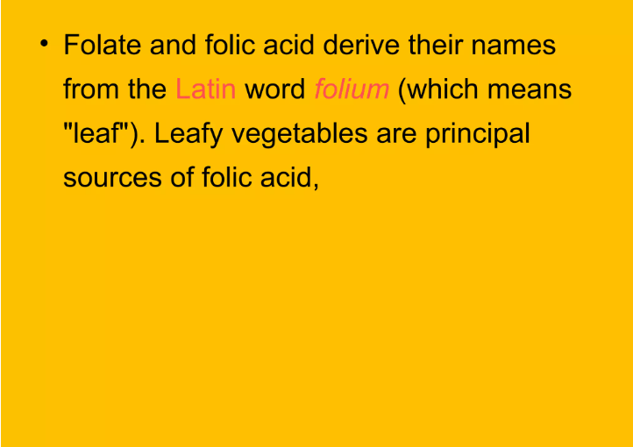

Slide 13
Folic Acid and its Active Form, Tetrahydrofolate
The water-soluble vitamin, folic acid (FA, folate, or pteroylglutamate), consists of a molecule of para-aminobenzoic acid (PABA), with its amino end attached to a pteridine, and its carboxyl group attached to the α-amino group of glutamic acid (Glu)). Tetrahydrofolate (THFA or H4 folate), the active cofactor form of FA, is formed by reduction of the pteridine ring at positions 5, 6, 7, and 8 by the enzyme, folic acid reductase THFA is an essential molecule in both prokaryotic and eukaryotic cell metabolism, donating one-carbon units and other small molecular building blocks to the biosynthesis of purines dTMP and selected amino acids, including methionine.

Slide 14
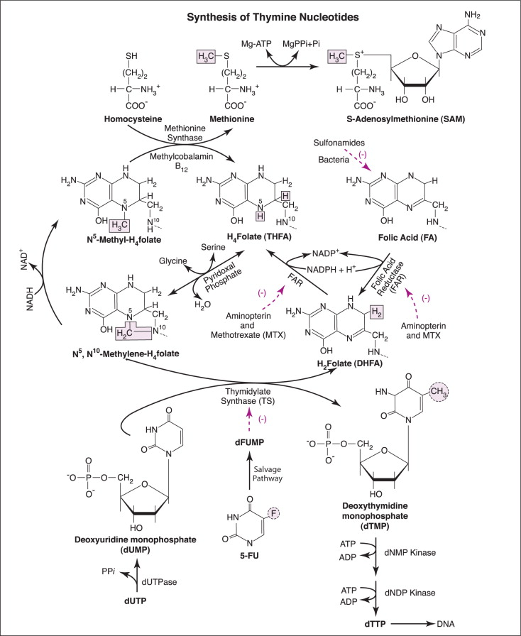
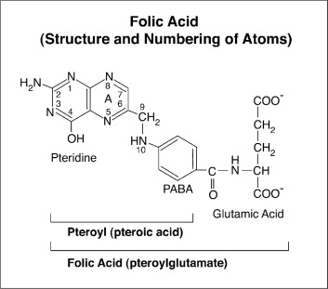

Slide 15
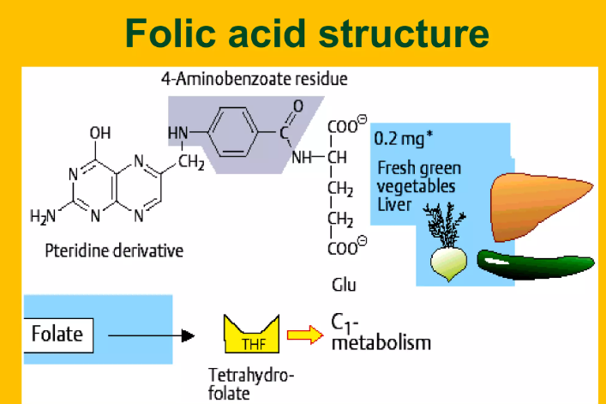

Slide 16
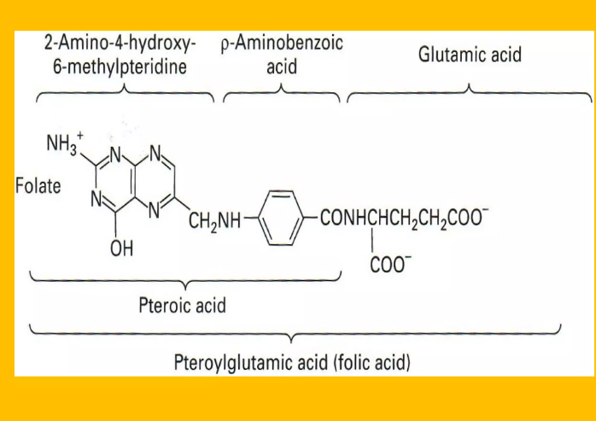

Slide 17
Core Knowledge
Sources
Liver, yeast, green leafy vegetables, as well as whole grain cereals, meat, milk, eggs and legumes.
The recommended daily adult dose: 400mg. In pregnancy, 600mg for prevention of congenital malformations (mainly cleft neural tube).

Slide 18
Core Knowledge
Coenzyme Forms Of Folic Acid
Tetrahydrofolic acid , FH4-
Folinic acid
Rhizopterin

Slide 19
Core Knowledge
Folate Antagonists
Sulpfonamides
Trimethoprim
Prymethamine
Aminopterin and Amethopterin
Methotraxate

Slide 20
Metabolic role
(one carbon metabolism)
Core Knowledge
FH4 is the coenzyme form of folic acid and it acts as coenzyme in transfer and utilization of one carbon moity (C1)
One carbon Donor and Acceptor Compounds

Slide 21
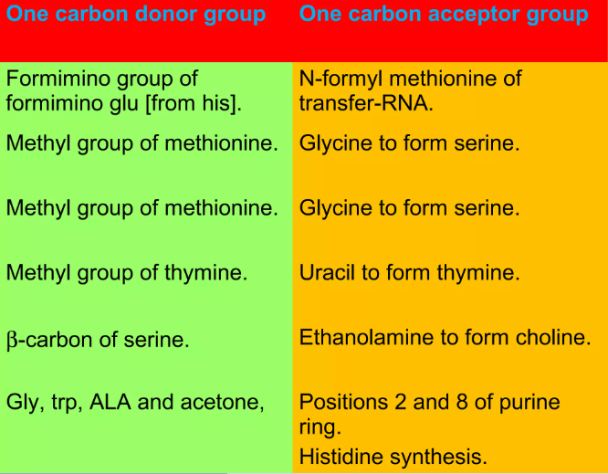

Slide 22
Folate is a coenzyme for single carbon transfers (addition or subtraction of single carbon molecule ).
This I critical for DNA metabolism.
A folate enzyme is necessary to synthesize nucleotides from their components , in order to make DNA as well as RNA.
A folate enzyme is also necessary for the synthesis of amino acid methionine.
Methionine is part of the chain of reactions leading to production od E-adnenosylmethionine (SAMe – Methl Donor

Slide 23
Biochemical functions of vitamin B₉
folic acid is crucial for proper brain function and plays an important role in mental and emotional health.
It aids in the production of DNA and RNA, the body's genetic material, and is especially important when cells and tissues are growing rapidly, such as in infancy, adolescence, and pregnancy.
Folic acid also works closely with vitamin B12 to help make red blood cells and help iron work properly in the body.
Vitamin B9 works with vitamins B6 and B12 and other nutrients to control blood levels of the amino acid homocysteine

Slide 24
Deficiency of vitamin B₉
Deficiency of vitamin B₉ occurs in low supply, absorption or increased need during pregnancy. There is a megaloblastic anaemia , which is characterized by the presence of abnormal precursors of red blood cells in the bone marrow. Compared with normal cells are cells arising from these abnormal precursors of different shape, larger size, reduced viability and reduced ability to transport oxygen . Along with the lack of iron is its lack of a significant cause of anaemia in developing countries. Deficiency during pregnancy causes spina neural tube in the fetus.
Laboratory evaluation: serum levels of folate, total homocysteine (increases in the absence, also in the absence of vitamin B₁₂)

Slide 25
Deficiency Symptoms
Folic acid deficiency can cause:
Poor growth
Tongue inflammation
Gingivitis
Loss of appetite
Shortness of breath
Diarrhea
Irritability
Forgetfulness
Mental sluggishness
Pregnant women need more folic acid to lower the risk of neural tube birth defects, including cleft palate, spina bifida, and brain damage. Neural tube defects are birth defects caused by abnormal development of the neural tube, a structure that eventually gives rise to the brain and spinal cord.

Slide 26
Birth defects
As mentioned, pregnant women who do not get enough folic acid are more likely to have children with birth defects. Pregnant women should get 600 mcg of folic acid per day. Women who plan to become pregnant should make sure to get the recommended 400 mcg per day since many neural tube defects can happen shortly after conception and before a woman even knows she is pregnant. Prenatal vitamins contain the needed amount of folic acid for pregnant women.
Studies show that women who take folic acid supplements before conception and during the first trimester may reduce their risk of having children with neural tube defects by 72 to 100%. Other studies suggest that in the setting of folic acid fortification of grains, folic acid supplementation does not appear to offer further benefit for preventing spina bifida.

Slide 27
Heart disease
Folate may help protect the heart through several methods. First, there is some evidence that getting enough folic acid in your diet can reduce your risk of heart disease, although this evidence is based on population studies and not more definitive clinical trials. There is not yet any evidence that taking folic acid supplements would help.
Also, many studies suggest that people with high levels of the amino acid homocysteine are roughly 1.7 times more likely to develop coronary artery disease, and 2.5 times more likely to have a stroke than those with normal levels. B complex vitamins, especially vitamins B9, B6, and B12, help lower homocysteine levels. However, there is no evidence that high homocysteine levels actually cause heart disease.
Most people who are concerned about heart disease should focus on getting enough B vitamins from healthy foods. In some cases, however, your doctor may recommend taking B vitamins to lower homocysteine levels. If you are worried about heart disease, ask your doctor whether taking a B vitamin supplement is right for you.

Slide 28
Age-related hearing loss
One study suggests that folic acid supplements help slow the progression of age-related hearing loss in elderly people with high homocysteine levels and low folate in their diet. It is not known whether healthy seniors would benefit.
Age-related macular degeneration (AMD)
One large study found that women who took 2,500 mcg of folic acid along with 500 mg of vitamin B6 and 1,000 mcg of cyanocobalamin (vitamin B12) daily reduced their risk of developing AMD, an eye disease that can cause vision loss.

Slide 29
Depression
The evidence about whether folic acid can help relieve depression is mixed. Some studies show that 15 to 38% of people with depression have low folate levels in their bodies, and those with very low levels tend to be the most depressed. One study found that people who did not get better when taking antidepressants had low levels of folic acid. A double-blind, placebo-controlled study found that taking 500 mcg of folic acid daily helped the antidepressant Prozac work better in women, but possibly not men. Another study found that taking folic acid and vitamin B12 was no better than placebo in relieving depression in older people.

Slide 30
Toxicokinetics
Folic acid is rapidly and nearly completely absorbed from the proximal portion of the gastrointestinal tract. Peak serum levels occur 30–60 min after oral administration. Only trace amounts of folate are usually found in the urine, but large doses of the vitamin may exceed renal reabsorption allowing excess folate to be excreted unchanged in the urine. Bioavailability of dietary folate is less than folic acid because the naturally occurring polyglutamate form of dietary folate has to be hydrolyzed to the monoglutamate form in the intestinal tract before absorption. Generally, folate monoglutamate is metabolized in the liver to 5-methyltetrahydrofolate, which is the form usually found in blood and the form taken up by tissues.

Slide 31
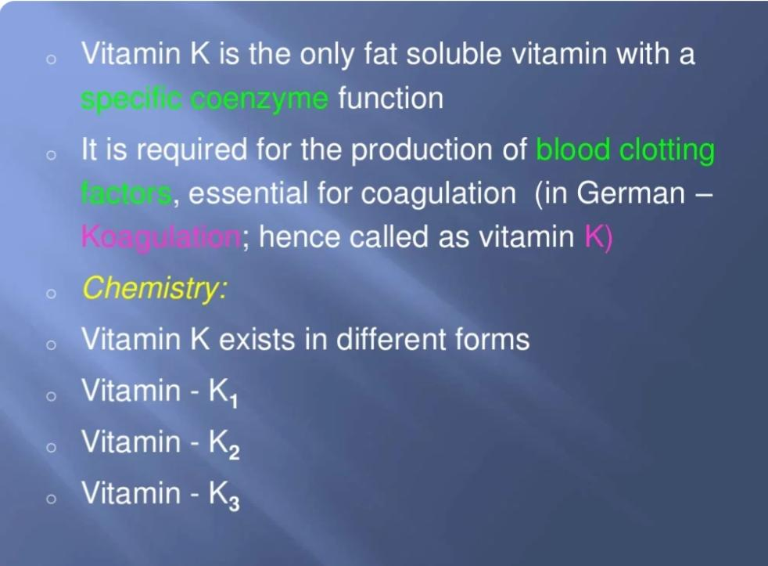
Vitamin K

Slide 32
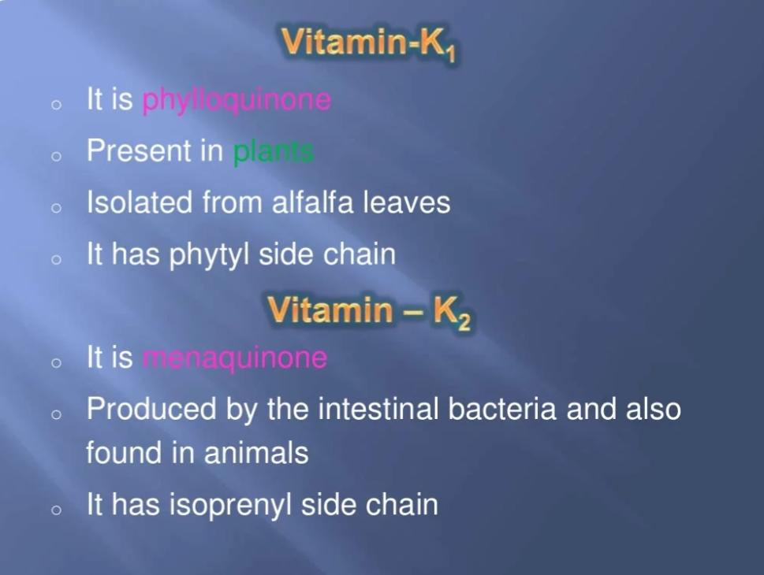

Slide 33
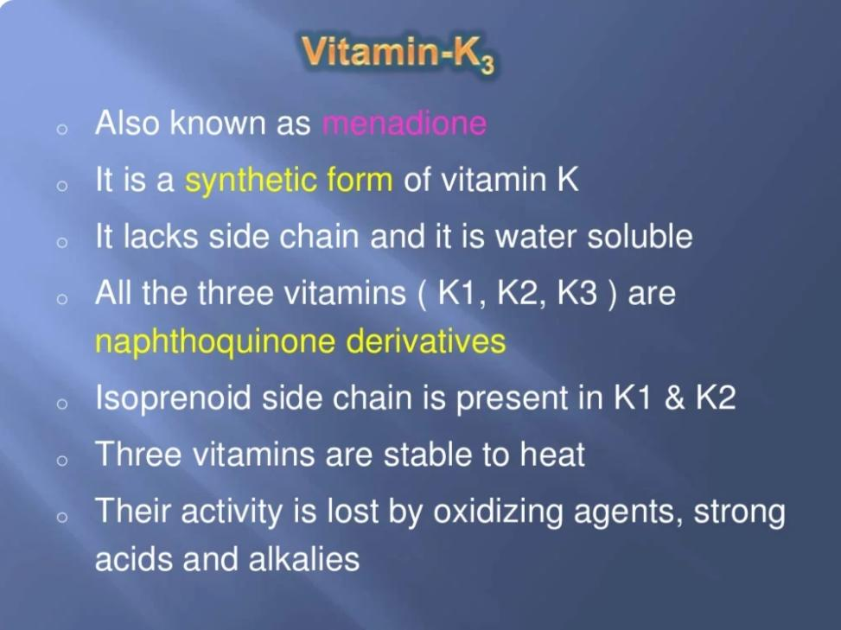

Slide 34
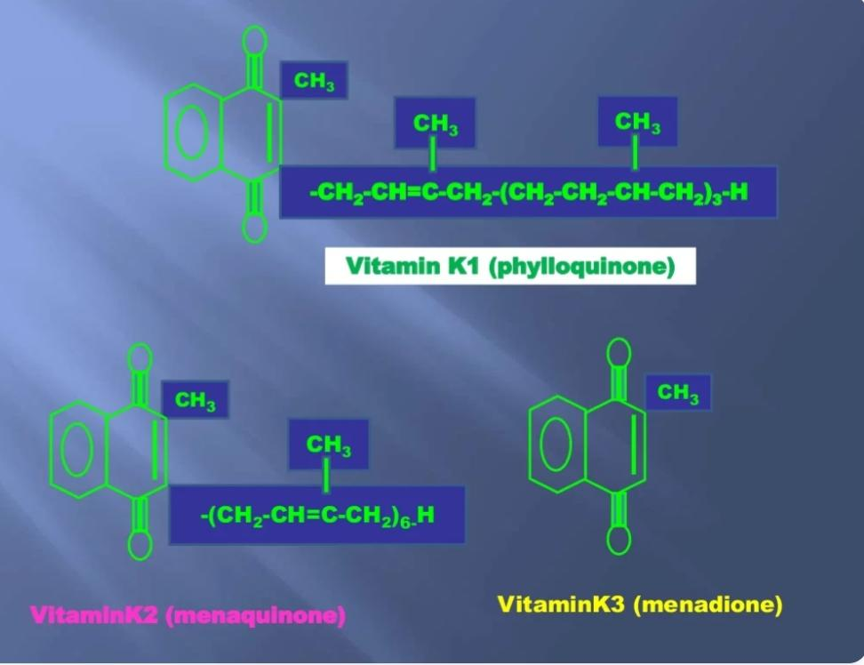

Slide 35
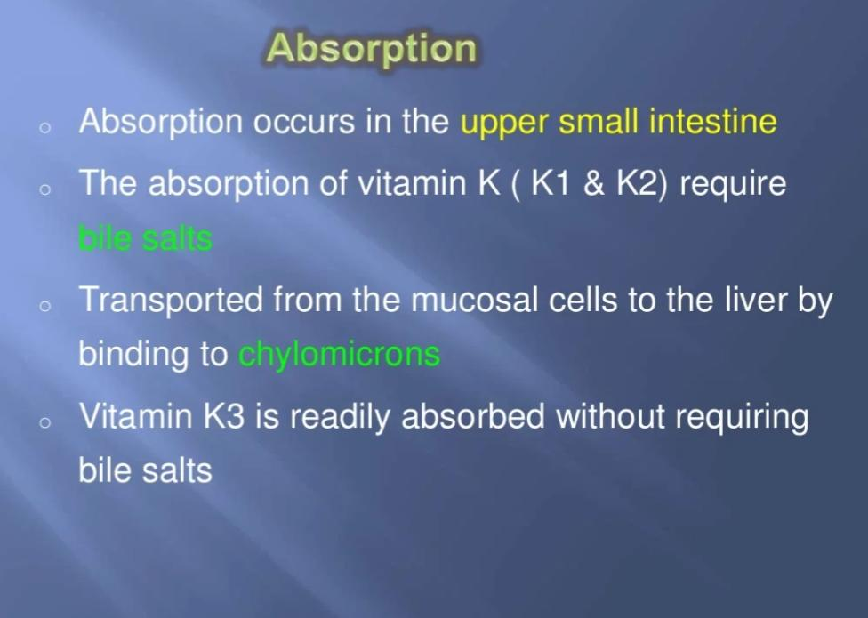

Slide 36
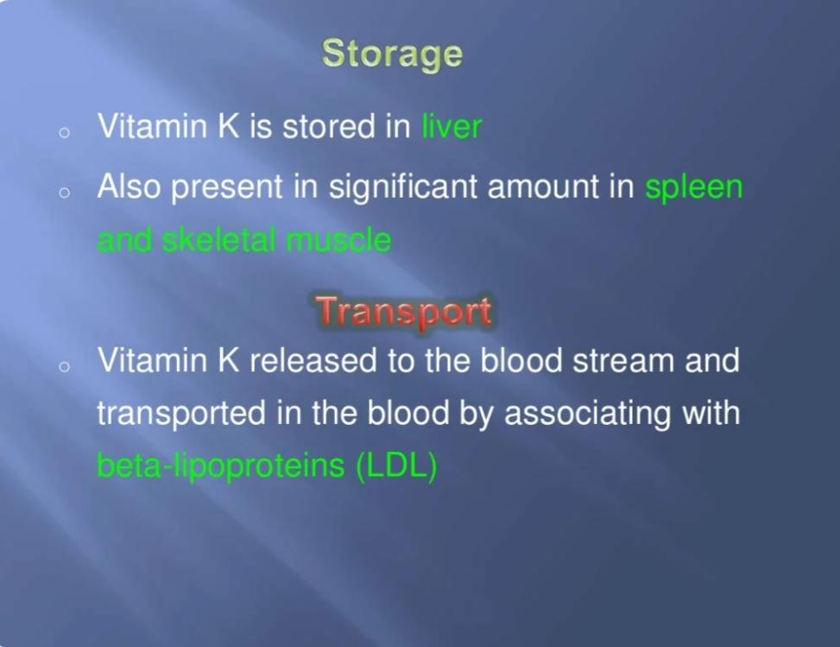

Slide 37
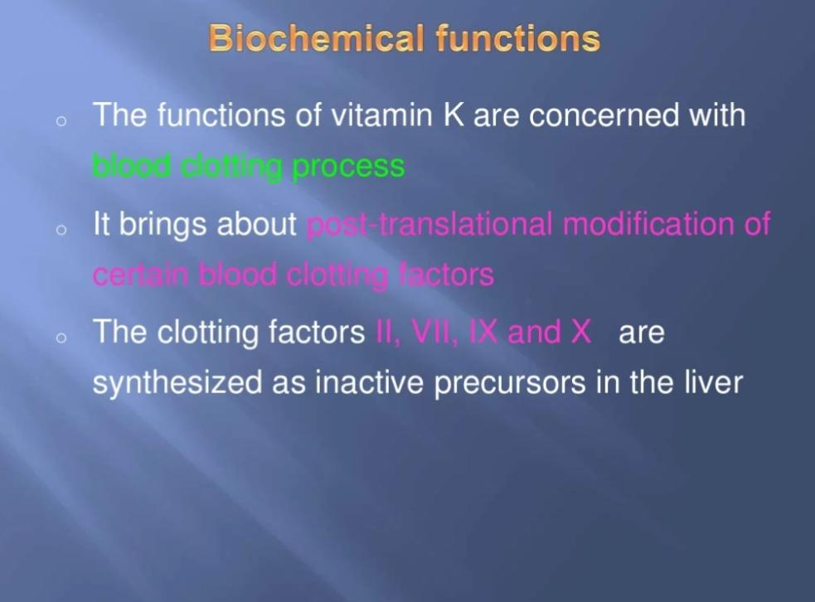

Slide 38
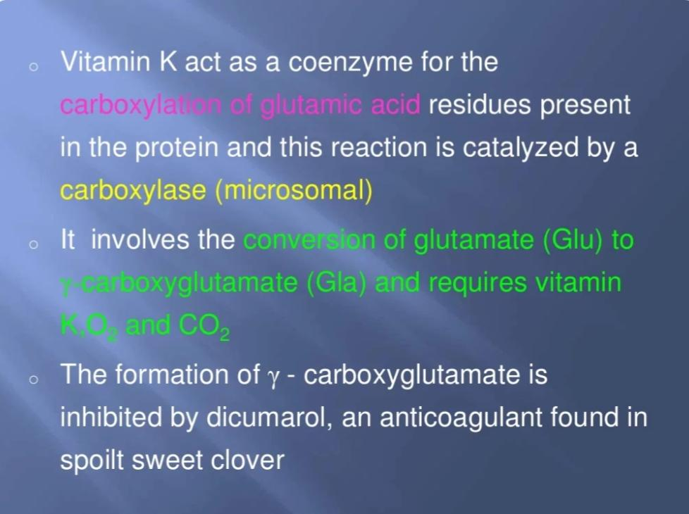

Slide 39
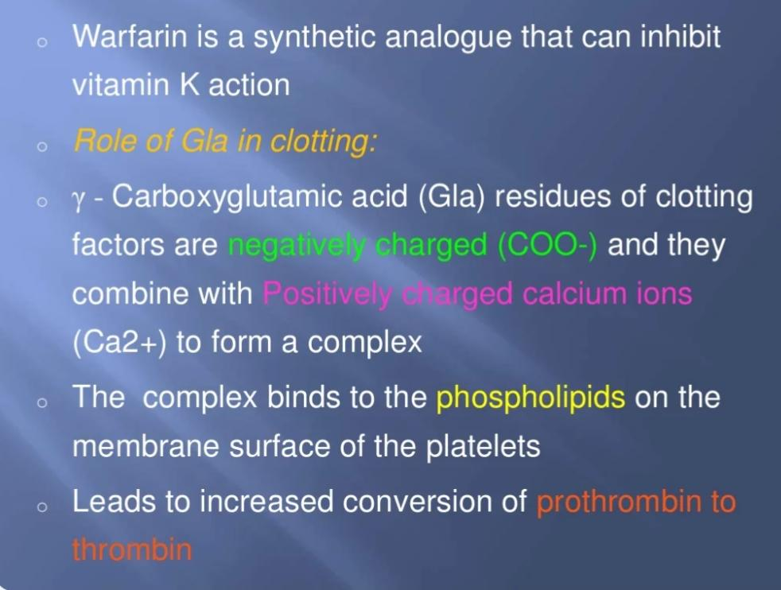

Slide 40
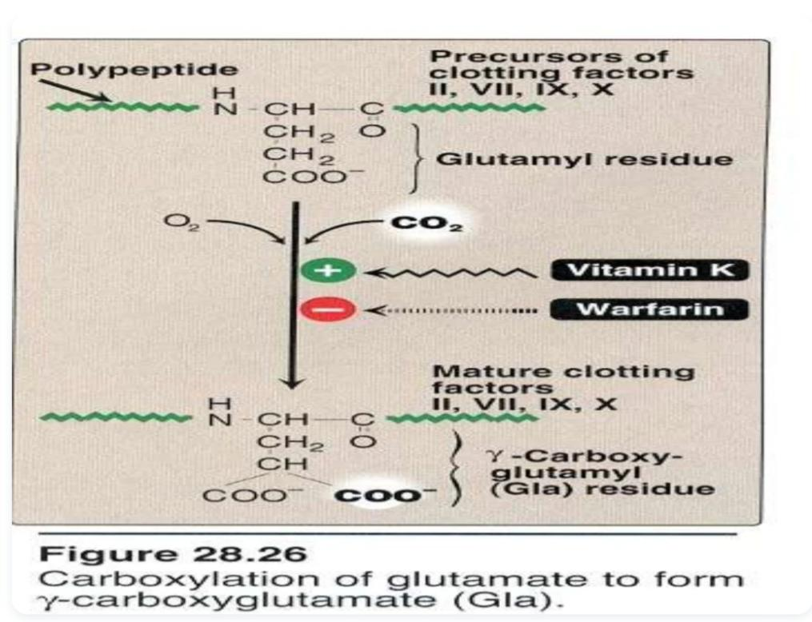

Slide 41
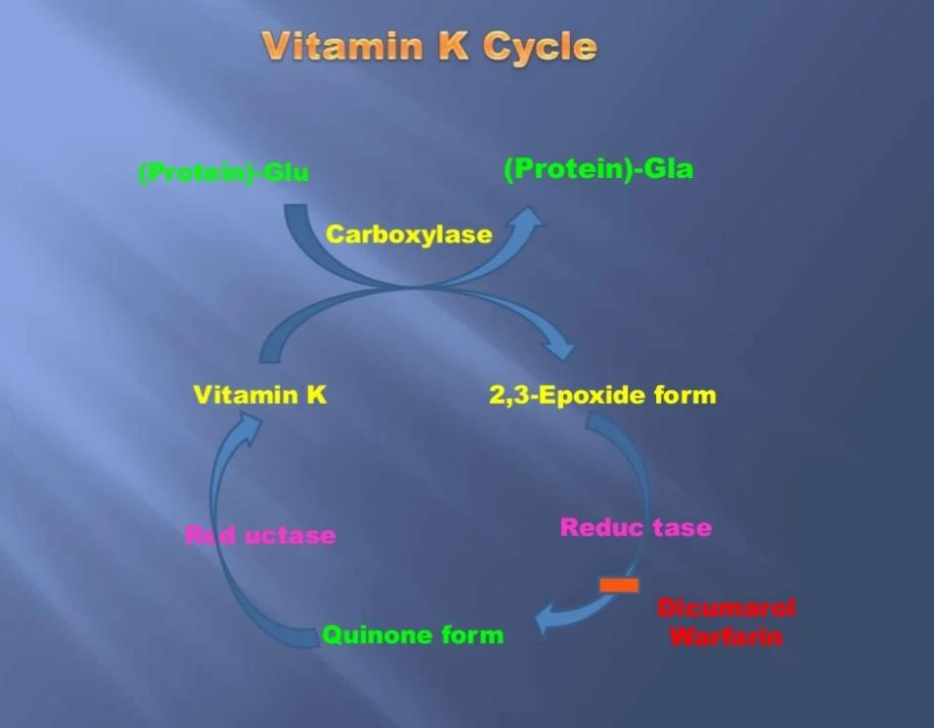

Slide 42
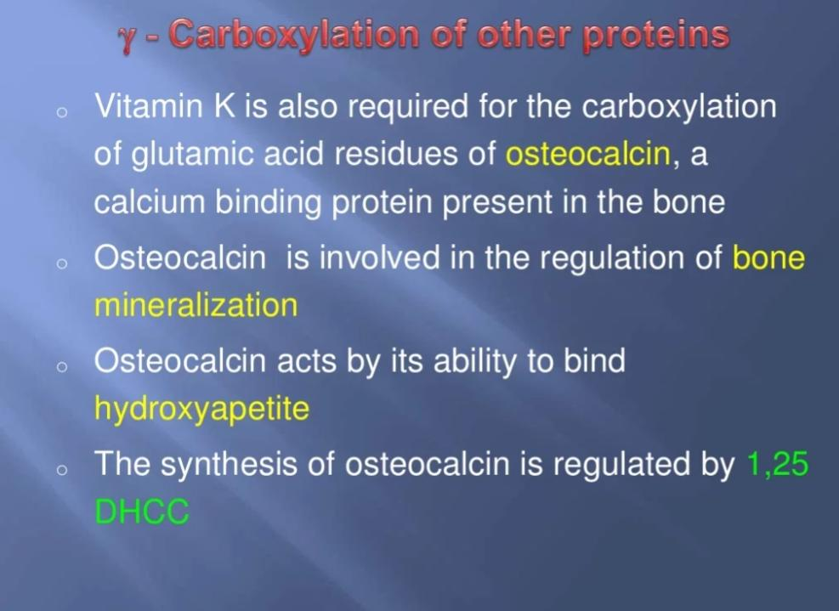

Slide 43
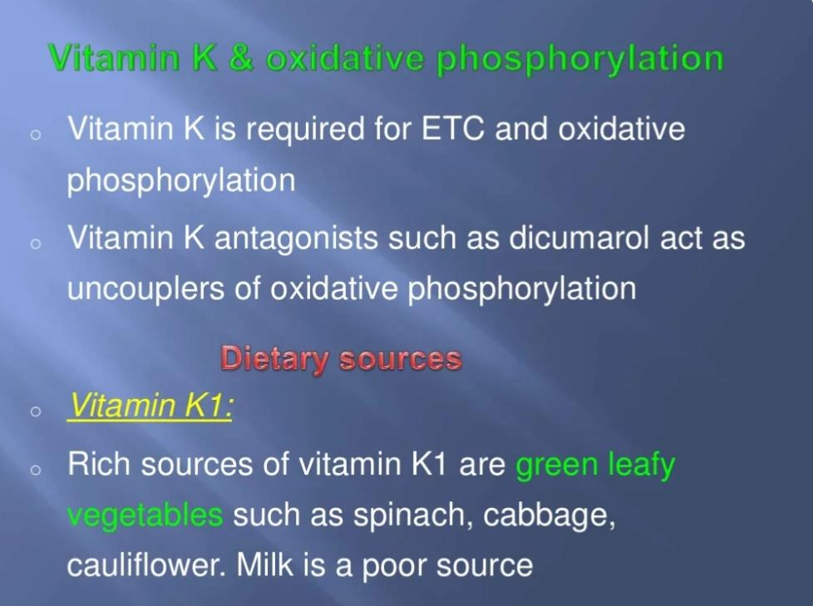

Slide 44
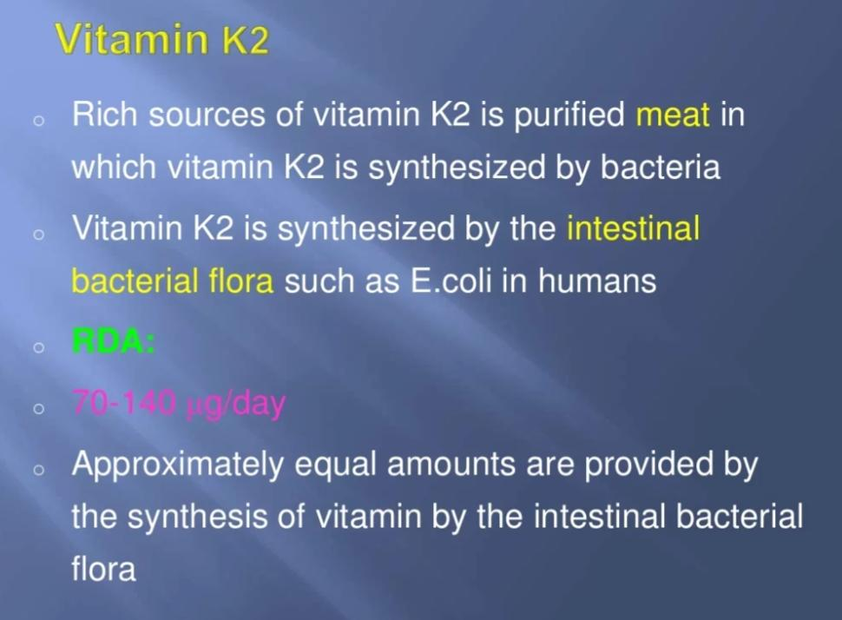

Slide 45
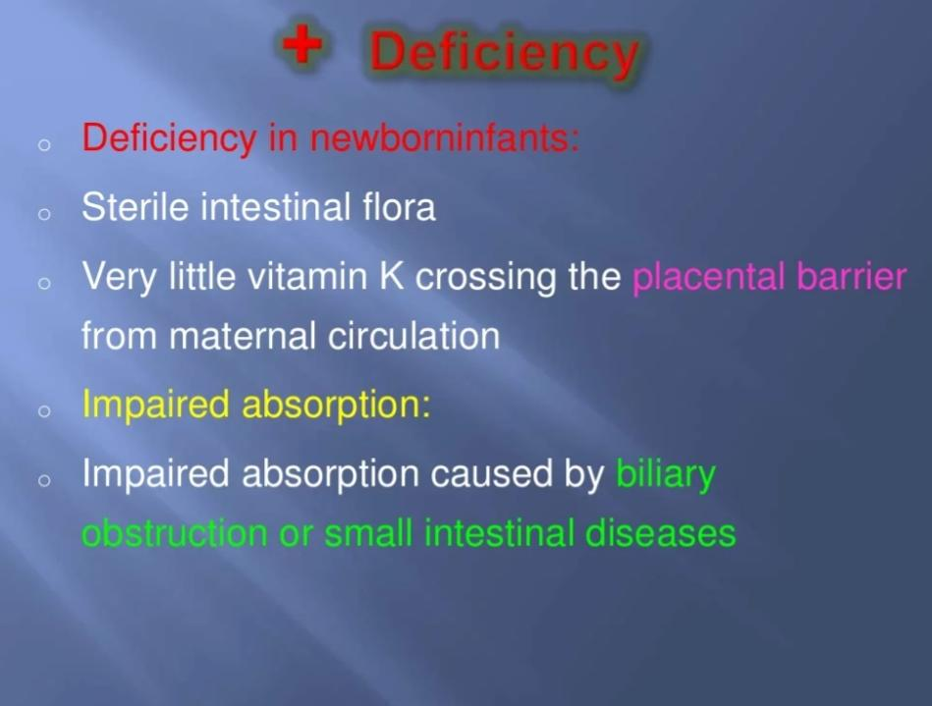

Slide 46
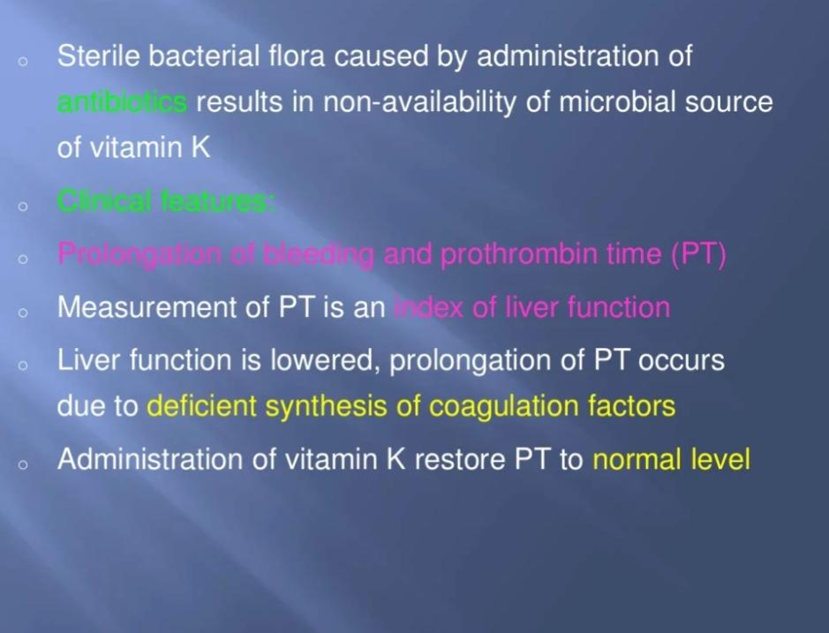

Slide 47
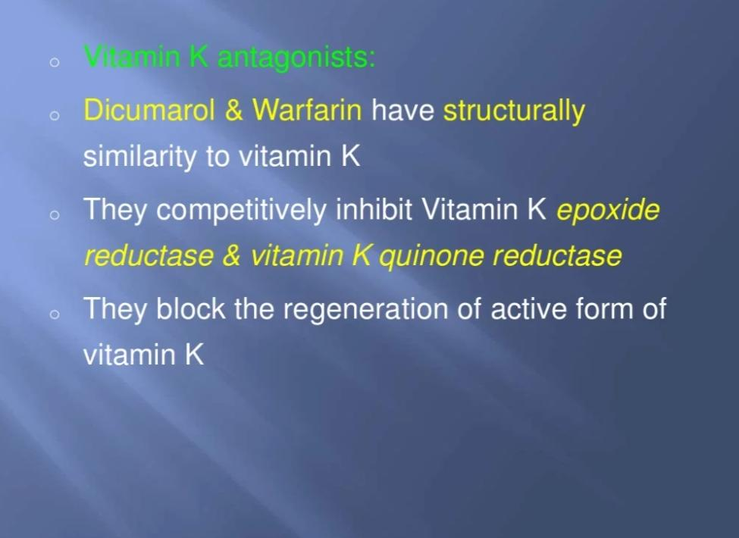

Slide 48
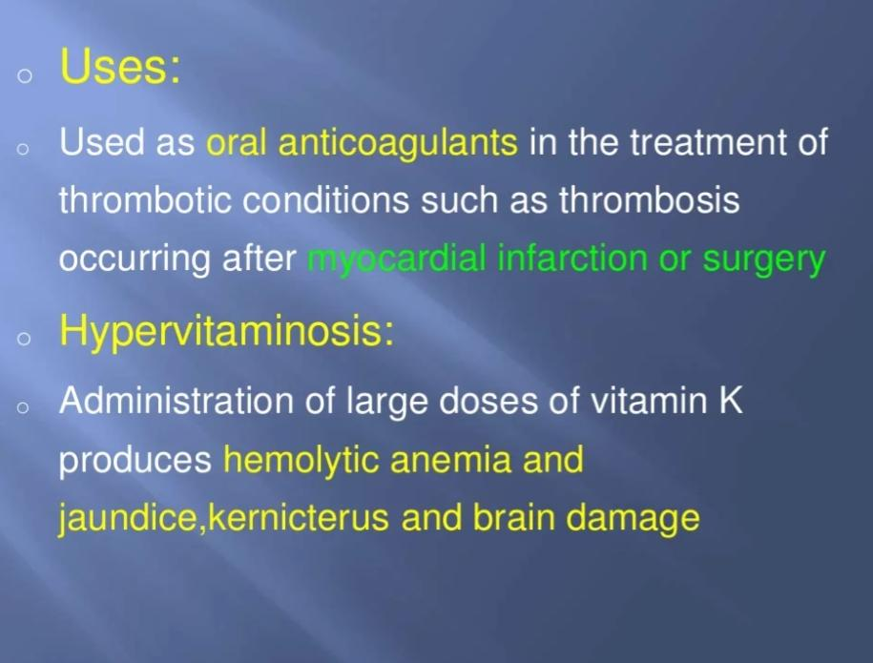

Slide 49
Family Medicine
Preventive Care: Understanding genetic predispositions and biochemical markers for early detection and preventive strategies in at-risk families.
Personalized Treatment: Tailoring treatments based on the patient's genetic profile, considering familial patterns of cancer to optimize outcomes.
Holistic Management: Addressing not just the biological aspects of cancer but also the psychological, social, and lifestyle impacts on patients and their families, providing comprehensive car

Slide 50
Artificial Intelligence
Predictive Analytics: AI models predict cancer progression and patient outcomes by analyzing genetic mutations and biochemical markers, enhancing personalized medicine approaches.
Diagnostic Support: AI algorithms improve the accuracy of diagnosing cancers through pattern recognition in genetic data and imaging, facilitating early detection.
Treatment Optimization: AI helps in developing targeted therapies by analyzing vast biochemical datasets, identifying potential drug targets, and predicting treatment responses, improving efficacy and reducing side effects.

Slide 51
Bioethics
Consent and Confidentiality: Addressing ethical concerns in genetic testing for hereditary cancers, ensuring patient consent, and maintaining confidentiality of genetic information.
Equity in Access: Ensuring equitable access to cancer diagnostic tools, treatments, and new technologies across different populations to prevent disparities in cancer care.
Ethical Implications of Research: Considering the ethical implications of cancer research, including the use of human subjects, and balancing the potential benefits against the risks and ethical concerns.

Slide 52
Suggested Research Article
https://www.statpearls.com/ArticleLibrary/viewarticle/21863
https://www.medicalnewstoday.com/articles/219853
https://www.tandfonline.com/doi/abs/10.1080/20014091084209

Slide 53
Learning Resources
Textbook of Biochemistry, Lippincott 10th edition, chapter no.28 , pages no. 432-436
Google scholar
Google images

Slide 54

How to access Digital Library
Open PC.
Open Internet.
Search HEC library.
Access public universities
Click on RMU
Read your desired article.

Slide 55


