Slide 1


Slide 2


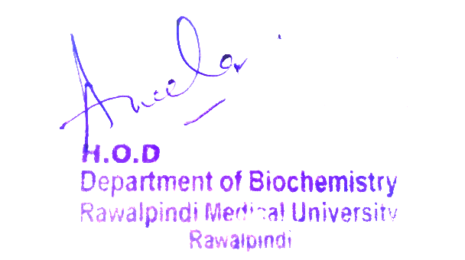
2nd Year MBBS
Gastrointestinal Tract Module
Large Group Interactive Session (LGIS)
Vitamin B12
Presenter: Dr. Almas Ajaz

Slide 3
Motto, Vision, Dream
To impart evidence based research oriented medical education
To provide best possible patient care
To inculcate the values of mutual respect and ethical practice of medicine
Wisdom
Truth
Service

Slide 4
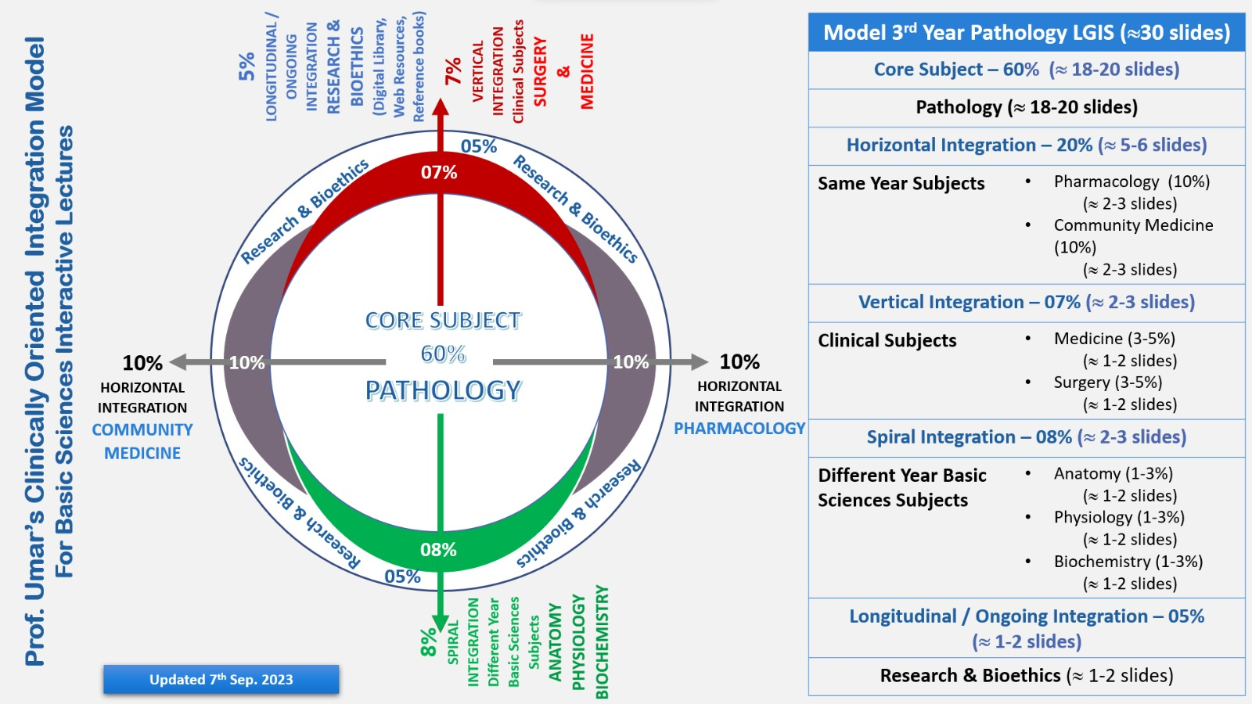
Professor Umar Model of Integrated Lecture

Slide 5
Learning Objectives
At the end of this session students should be able to
What is B12 , Source , its biochemical functions
Folate trap
Deficiency – causes and effects

Slide 6
Interactive Session
Name: John Smith
Age: 56 years old
Gender: Male
Medical History: John has a history of type 2 diabetes and hypertension. He has been experiencing numbness in his fingertips and feet, along with a decline in motor control and cognitive function over the past few months.
Presentation: John visits his primary care physician complaining of numbness in his fingers and feet, difficulty holding objects, and memory issues. He mentions that these symptoms have been progressively getting worse.
well.

Slide 7
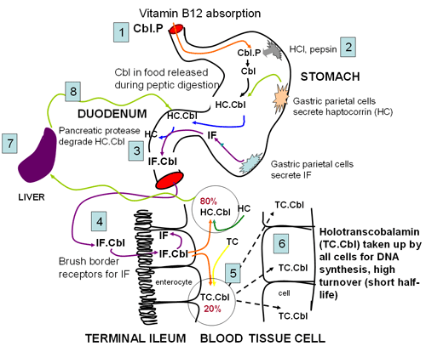
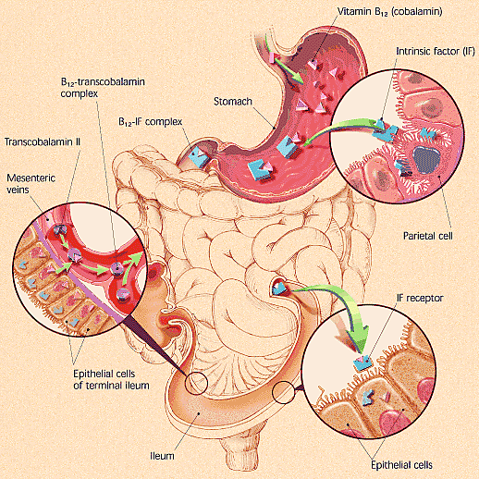
HORIZONTAL INTEGRATION (ANATOMY AND PHYSIOLOGY )

Slide 8
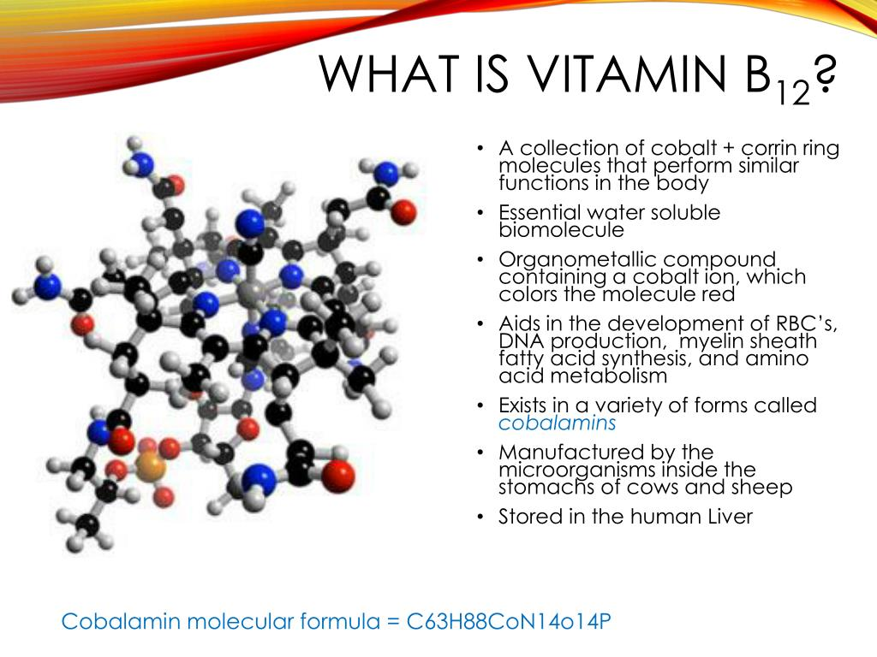

Slide 9
VIT B12
Vitamin B12, also known as cobalamin, is a water-soluble vitamin involved in metabolism. It is one of eight B vitamins.
It is important in the normal functioning of the nervous system via its role in the synthesis of myelin, and in the circulatory system in the maturation of red blood cells in the bone marrow.
Vitamin B12 is the most chemically complex of all vitamins, and for humans, the only vitamin that must be sourced from animal-derived foods or from supplements. Only some archaea and bacteria can synthesize vitamin B12.
Vitamin B-12 (cobalamin) plays an essential role in red blood cell formation, cell metabolism, nerve function and the production of DNA, the molecules inside cells that carry genetic information.

Slide 10
FORMS OF VITAMIN B12
Methylcobalamin and 5-deoxyadenosylcobalamin are the metabolically active forms of vitamin B12.
However, two others forms, hydroxycobalamin and cyanocobalamin, become biologically active after they are converted to methylcobalamin or 5-deoxyadenosylcobalamin .

Slide 11
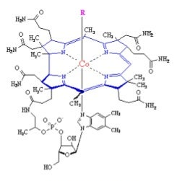
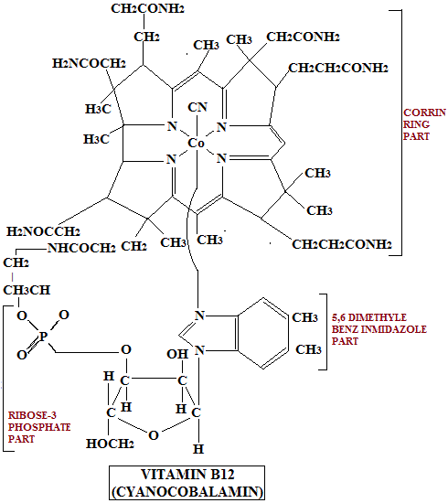
STRUCTURE OF VIT B12
The chemical structure of the molecule was determined by Dorothy Crowfoot Hodgkin and her team in 1956 ,based on crystallographic data.

Slide 12
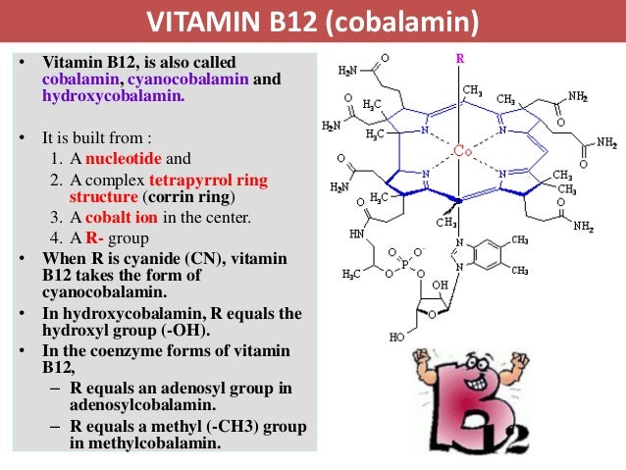

Slide 13
FUNCTIONS OF VIT B12
Vitamin B12 is required for the development, myelination, and function of the central nervous system; healthy red blood cell formation; and DNA synthesis.
Vitamin B12 functions as a cofactor for two enzymes, methionine synthase and L-methylmalonyl-CoA mutase.
Methionine synthase catalyzes the conversion of homocysteine to the essential amino acid methionine .
Methionine is required for the formation of S-adenosylmethionine, a universal methyl donor for almost 100 different substrates, including DNA, RNA, proteins, and lipids .
L-methylmalonyl-CoA mutase converts L-methylmalonyl-CoA to succinyl-CoA in the metabolism of propionate, a short-chain fatty acid .

Slide 14
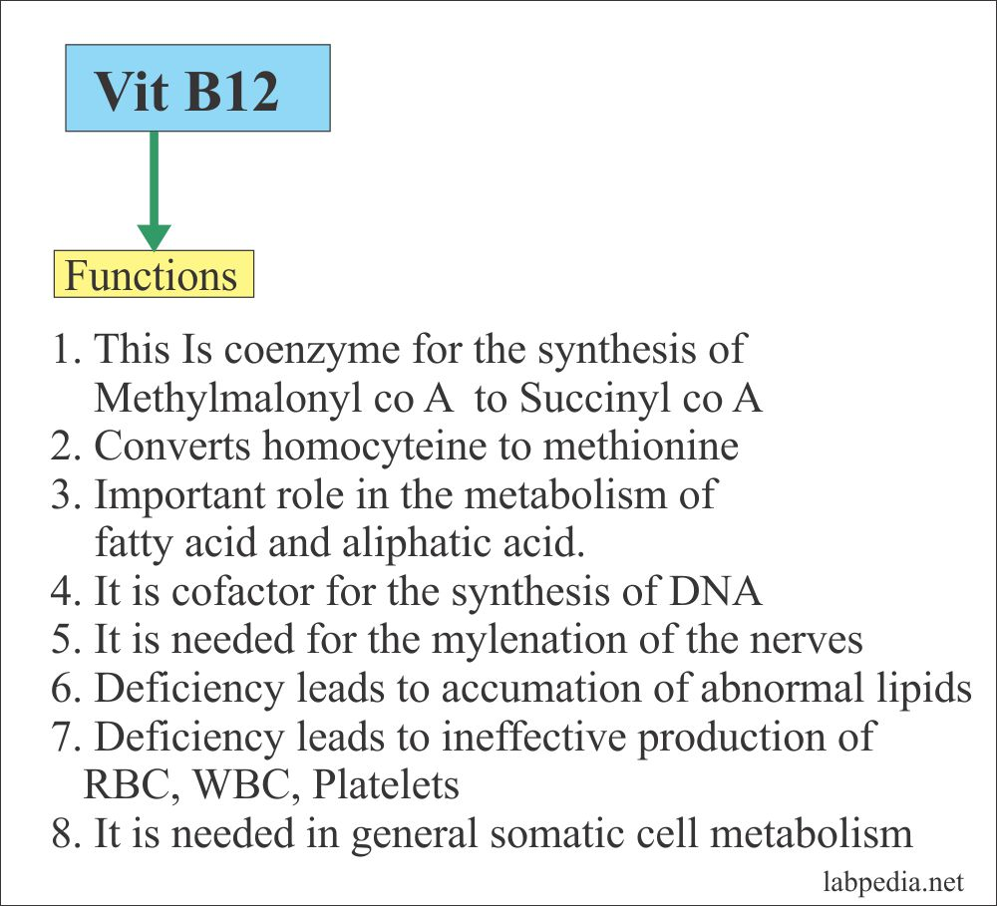

Slide 15
SOURCES OF VITAMIN B12
Vitamin B12 is naturally present in foods of animal origin, including fish, meat, poultry, eggs, and dairy products . In addition, fortified breakfast cereals and fortified nutritional yeasts are readily available sources of vitamin B12 that have high bioavailability .
The average vitamin B12 level in the breast milk of women with vitamin B12 intakes above the RDA is 0.44 mcg/L [14]. The U.S. Food and Drug Administration specifies that infant formulas sold in the United States must provide at least 0.15 mcg vitamin B12 per 100 kcal.
The estimated bioavailability of vitamin B12 from food varies by vitamin B12 dose because absorption decreases drastically when the capacity of intrinsic factor is exceeded (at 1–2 mcg of vitamin B12) . Bioavailability also varies by type of food source. For example, the bioavailability of vitamin B12 appears to be about three times higher in dairy products than in meat, fish, and poultry, and the bioavailability of vitamin B12 from dietary supplements is about 50% higher than that from food sources .

Slide 16
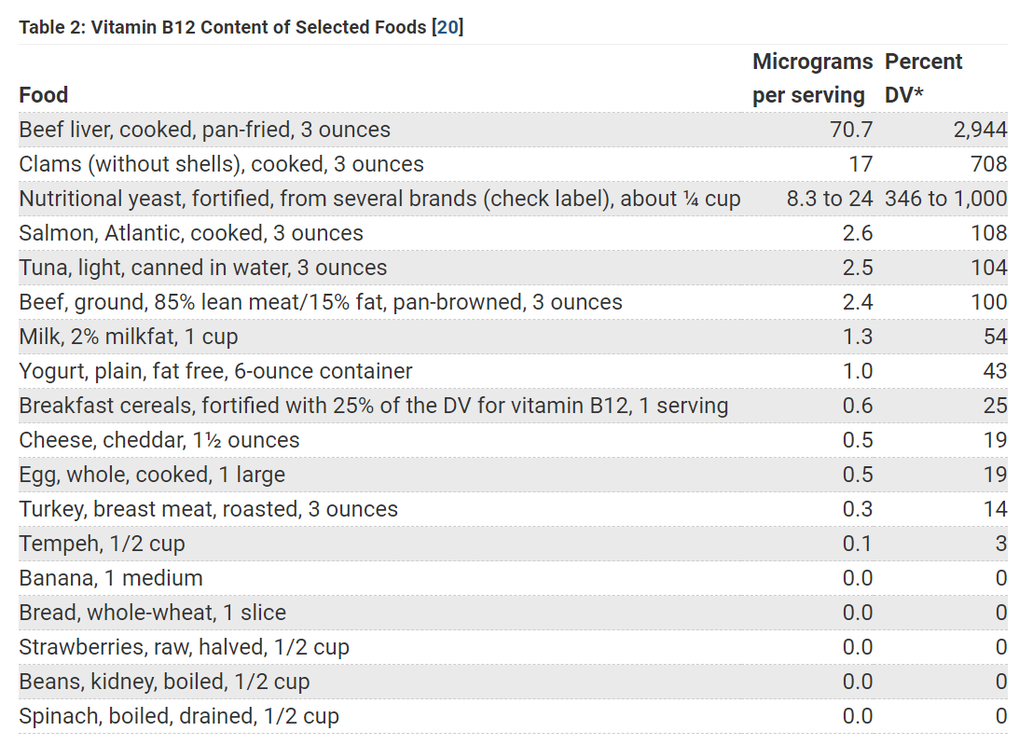

Slide 17
Core Knowledge
ABSORPTION OF VITAMIN B12
Vitamin B12 is bound to protein in food and must be released before it is absorbed.
The process starts in the mouth when food is mixed with saliva. The freed vitamin B12 then binds with haptocorrin, a cobalamin-binding protein in the saliva.
More vitamin B12 is released from its food matrix by the activity of hydrochloric acid and gastric protease in the stomach, where it then binds to haptocorrin .
In the duodenum, digestive enzymes free the vitamin B12 from haptocorrin, and this freed vitamin B12 combines with intrinsic factor, a transport and delivery binding protein secreted by the stomach’s parietal cells.
The resulting complex is absorbed in the distal ileum by receptor-mediated endocytosis . If vitamin B12 is added to fortified foods and dietary supplements, it is already in free form and therefore does not require the separation

Slide 18
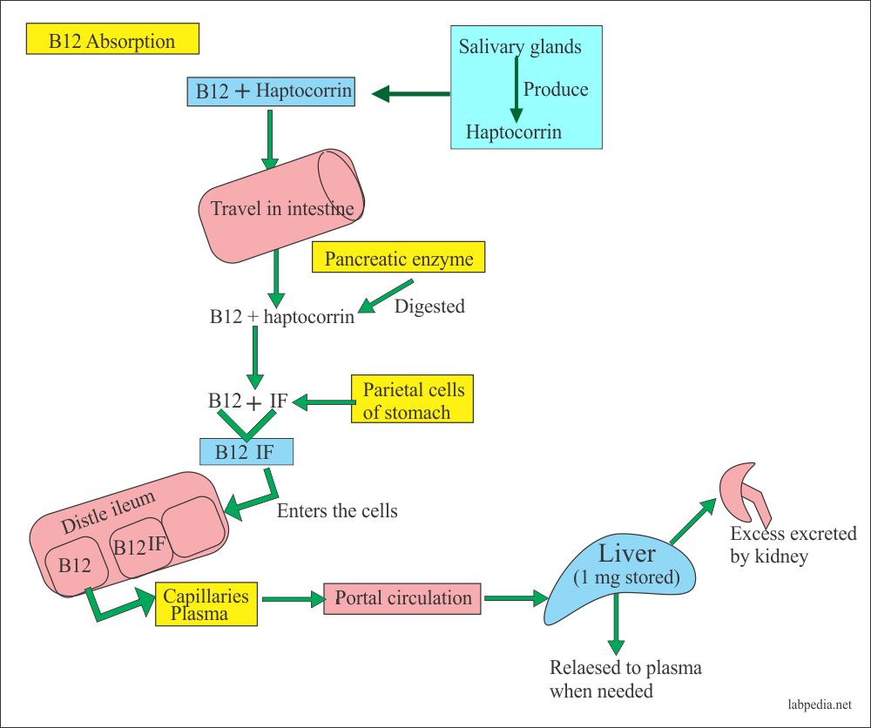
Core Knowledge

Slide 19
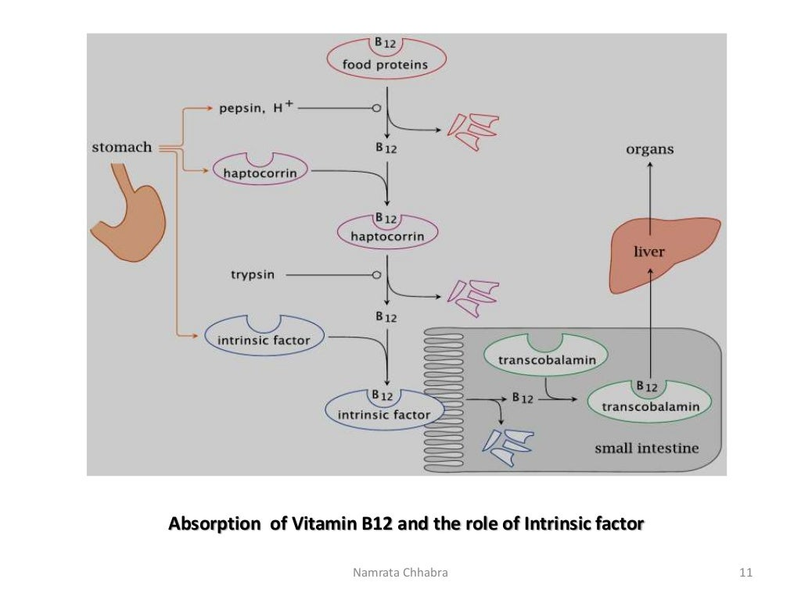
Core Knowledge

Slide 20
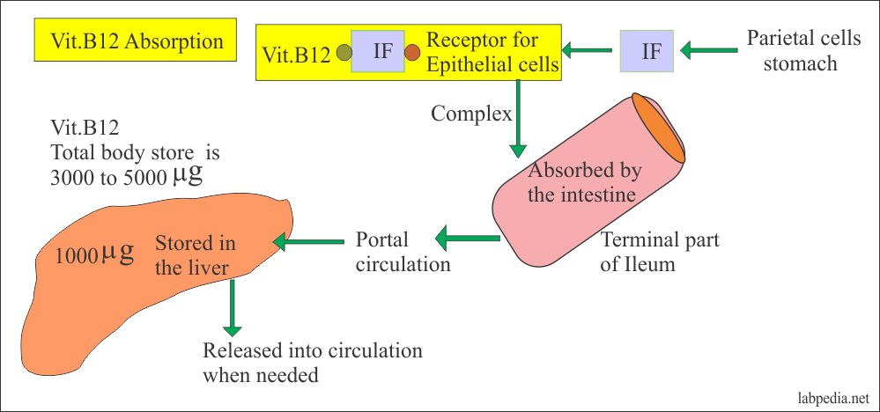
Core Knowledge

Slide 21
VERTICAL INTEGRATION
What are the symptoms of vitamin B12 deficiency?
Vitamin B12 deficiency can cause physical, neurological and psychological symptoms. The symptoms of vitamin B12 deficiency can develop slowly and can get worse over time. Some people may have no symptoms despite having a low level of vitamin B12 in their bodies. People with vitamin B12 deficiency can have neurological symptoms and/or damage without anemia (lack of red blood cells).

Slide 22
General physical symptoms of vitamin B12 deficiency can include:
Feeling very tired or weak.
Experiencing nausea, vomiting or diarrhea.
Not feeling as hungry as usual.
Weight loss.
Having a sore mouth or tongue.
Having yellowish skin.
Neurological symptoms of vitamin B12 deficiency can include:
Numbness or tingling in your hands and feet.
Vision problems.
Having a hard time remembering things or getting confused easily.
Having a difficult time walking or speaking like you usually do.
If neurological problems develop from vitamin B12 deficiency, they may not be reversible.

Slide 23
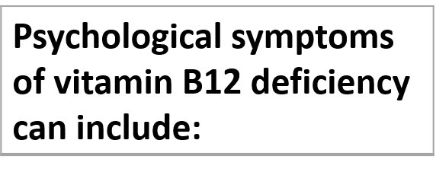
Feeling depressed.
Feeling irritable.
Experiencing a change in the way you feel and behave

Slide 24
FOLATE TRAP - THE SCIENCE BEHIND B12 DEFICIENCY
The deficiency of Vitamin B12 renders Folic acid (Vitamin B9) inactive, a phenomenon commonly called, “The Folate Trap”.
There are only two known biochemical reactions in our body that use Vitamin B12. The reaction we need to make ourselvesfamiliar for now, is the conversion of the amino acid Homocysteine to another amino acid, called Methionine, which is only structurally different from Homocysteine by one methyl group (CH3). This reaction is catalysed by an enzyme called “Methionine Synthase” which requires the presence of Vitamin B12 to function.
Now one of the chemical forms of Vitamin B12 is Methylcobalamin (The other one being the synthetic cyanocobalamin). The methyl group from methycobalamin gets transferred to Homocysteine, thus completing the reaction to Methionine. This reaction is important, because the active form of Methionine called S-Adenosyl Methionine, is required for important cellular functions like DNA synthesis.

Slide 25
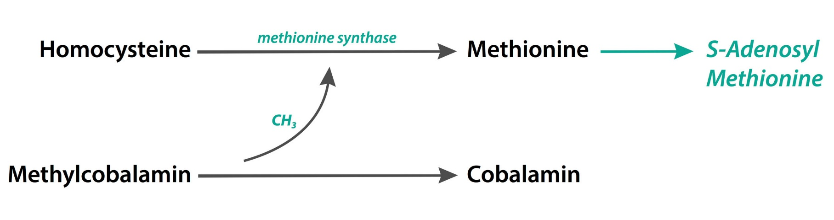
So after giving away it's methyl group, we are left with plain cobalamin now. Understandably, this form is pretty much useless.
This is where folate comes in. Now folate is significant here because it's one of our body's most important “one carbon donors”. Folate is like the Oprah Winfrey of biochemistry- “You get a carbon, you get a carbon, everybody gets a carbon”. But usually, folate is in its inactive polyglutamate forms in circulation.
One of the active form of folate, methyl-tetrahydrofolate, is the molecule of significance here, as it donates a methyl group to the now useless Cobalamin, converting it back to Methylcobalamin, thus making it capable of participating in Methionine synthesis again.

Slide 26
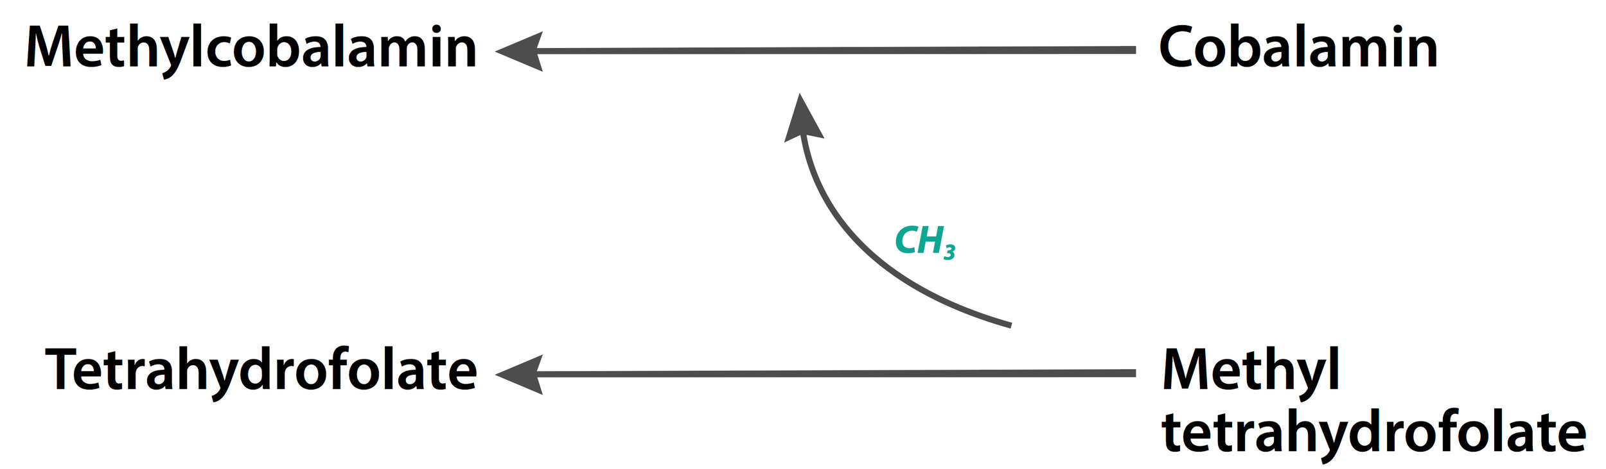
But unlike cobalamin, the folate after donating its carbon atom isn’t completely useless. It gets shunted to another very important reaction, a reaction required for the de novo synthesis of nucleic acids (synthesised from scratch), which ultimately is required for DNA synthesis.

Slide 27
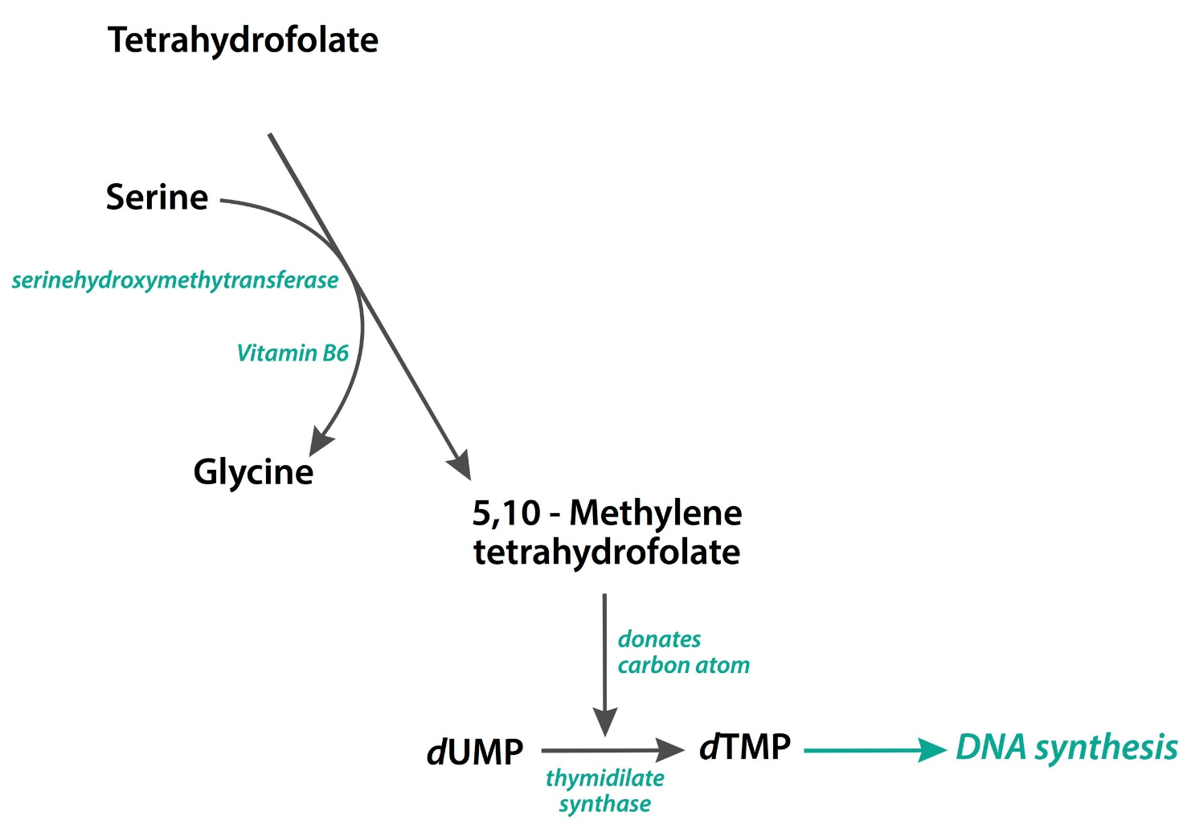
The form of folate that comes out of this reaction gets recycled back to methyltetrahydrofolate using another vitamin, Riboflavin, only to take part in this cycle all over again.

Slide 28
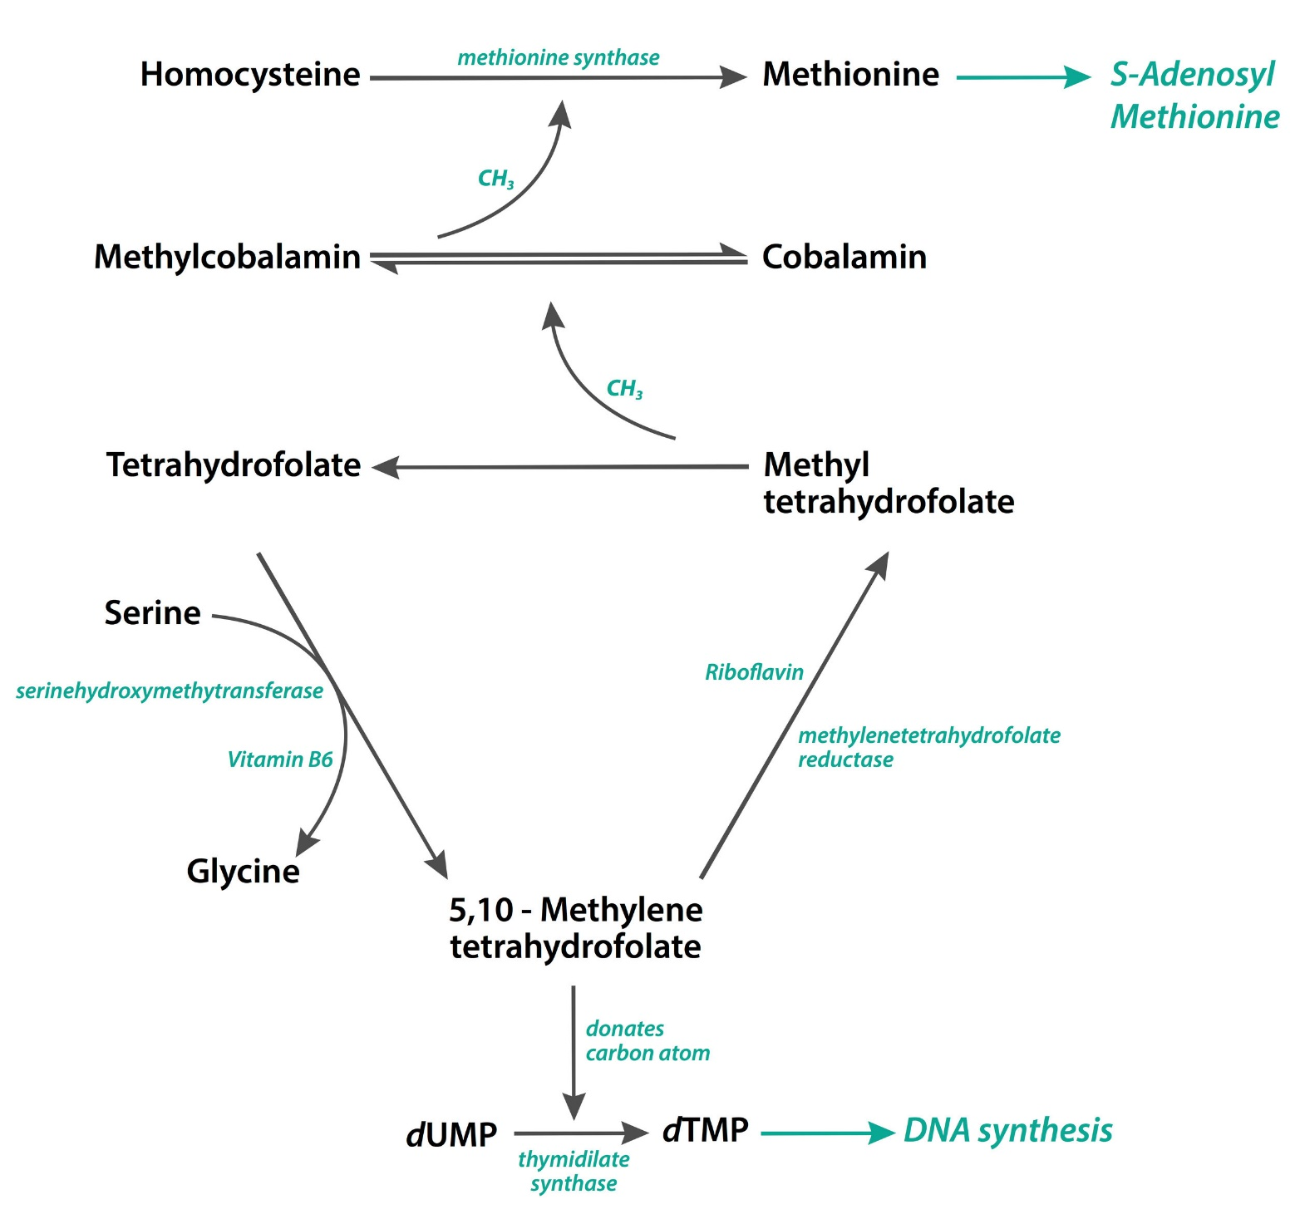

Slide 29
VITAMIN B12 DEFICIENCY
Vitamin B12 deficiency happens if you are not eating enough vitamin B12 or your body is not absorbing the vitamin B12 you consume properly. Situations or conditions that can cause vitamin B12 deficiency include:
Lack of vitamin B12 in your diet: People who don't eat enough foods that naturally have vitamin B12 or don't eat foods fortified with vitamin B12 can develop vitamin B12 deficiency.
Gastritis: Gastritis is inflammation of the stomach lining, and it’s a common cause of vitamin B12 deficiency. It can cause vitamin B12 deficiency due to a lack of hydrochloric acid in your stomach, which is needed for vitamin B12 absorption.
Pernicious anemia: People who have pernicious anemia, a rare medical condition, are not able to make intrinsic factor, a protein made by your stomach. You need intrinsic factor so that your body can absorb B12 vitamin. People with pernicious anemia have a B12 vitamin deficiency.
Digestive diseases: Diseases that affect the digestive system, like Crohn’s disease and celiac disease, can prevent your body from fully absorbing vitamin B12.
Surgery: People who have gastrointestinal surgery, such as a gastric bypass (weight loss surgery), can have difficulty absorbing vitamin B12.
Alcohol use disorder: This condition can damage your digestive system and cause vitamin B12 deficiency.
Transcobalamin II deficiency: This is a rare genetic disorder that impairs the transport of vitamin B12 (also known as cobalamin) within the body.

Slide 30
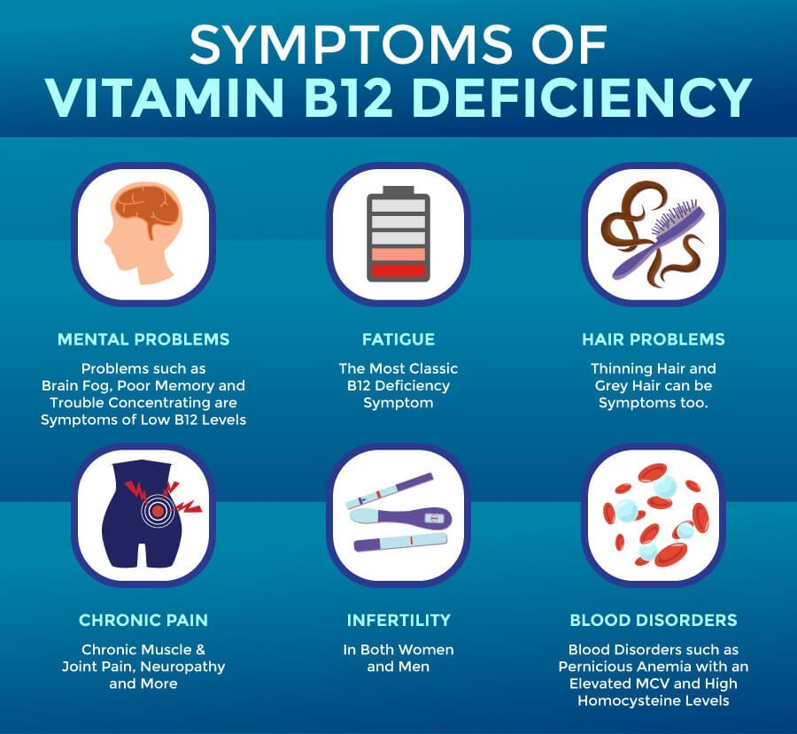

Slide 31
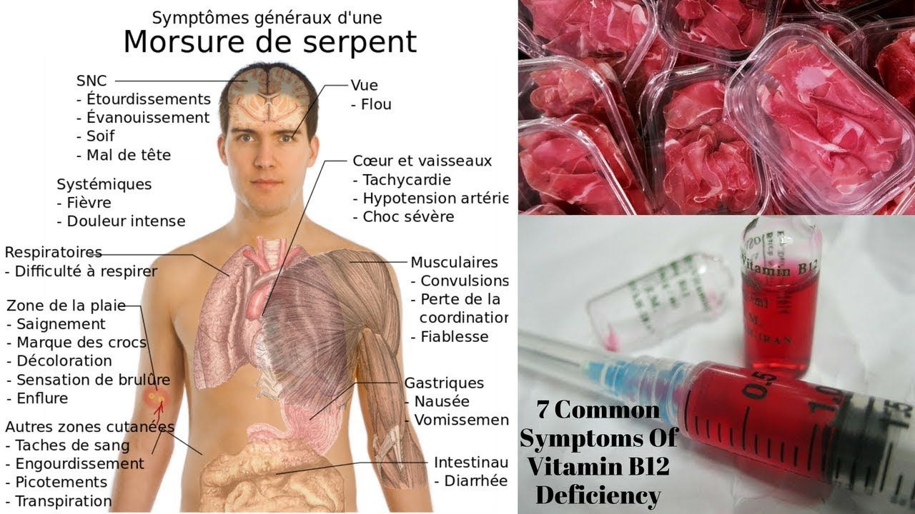

Slide 32
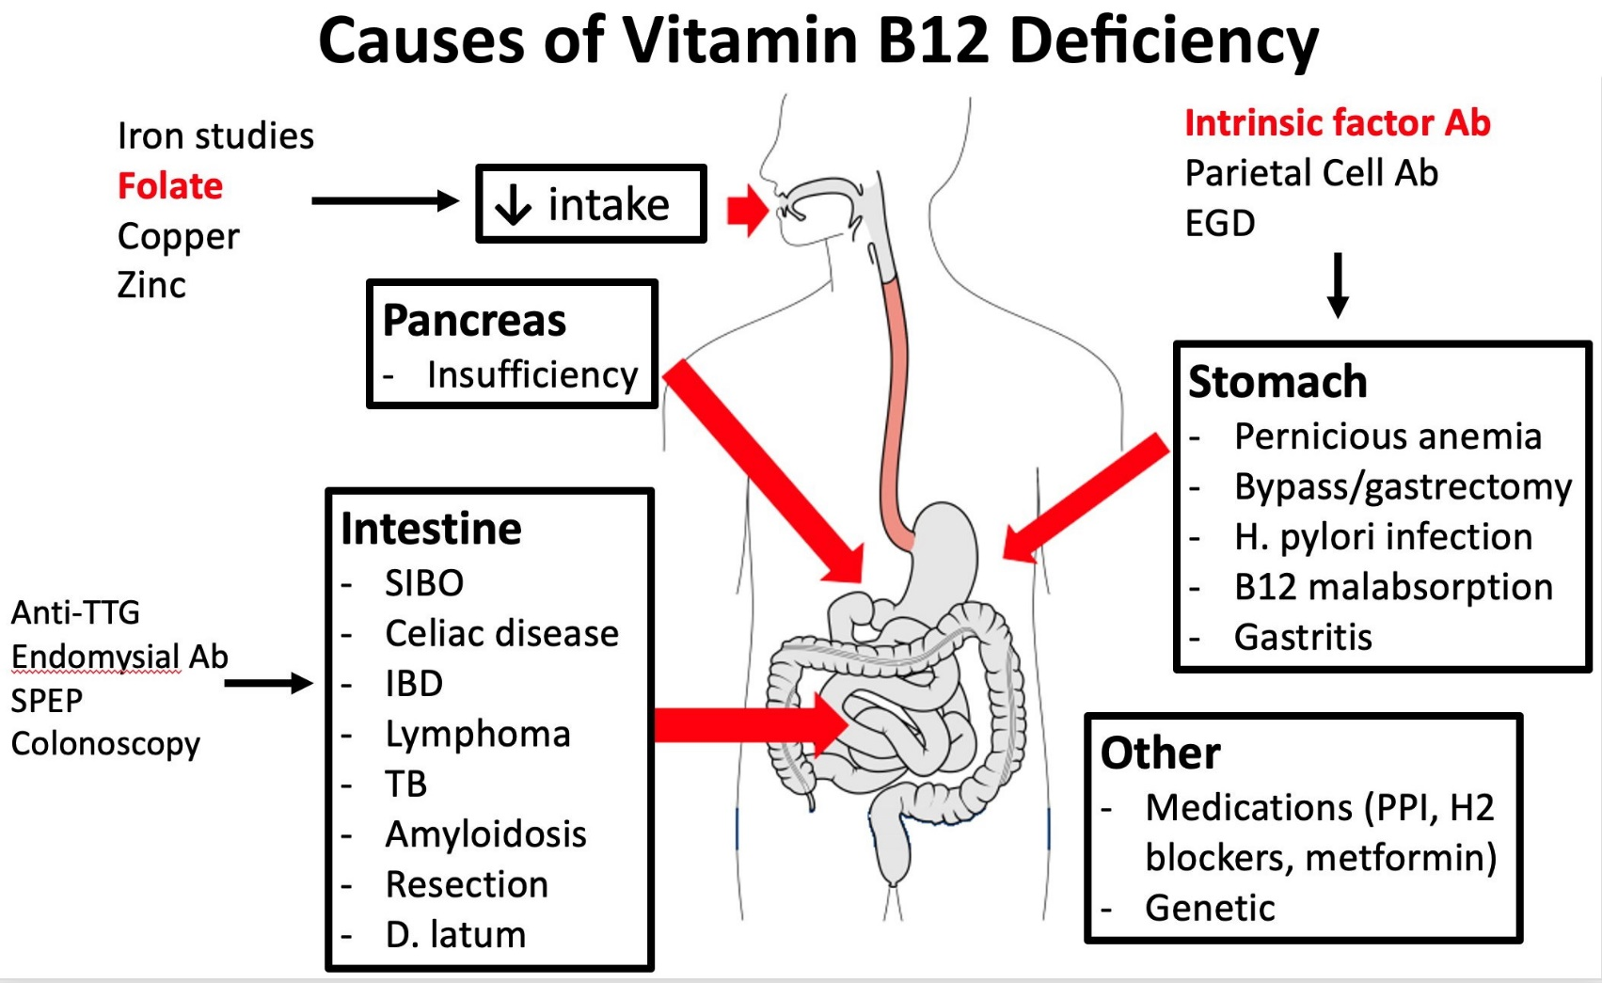

Slide 33
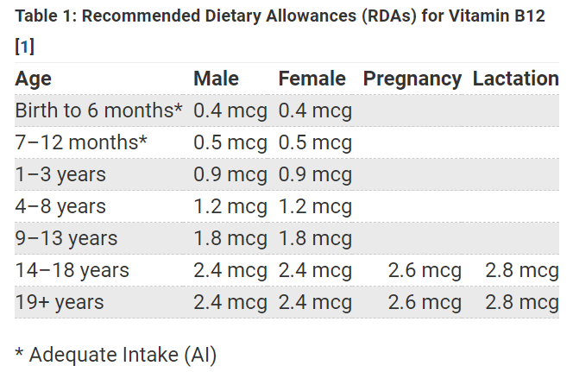

Slide 34
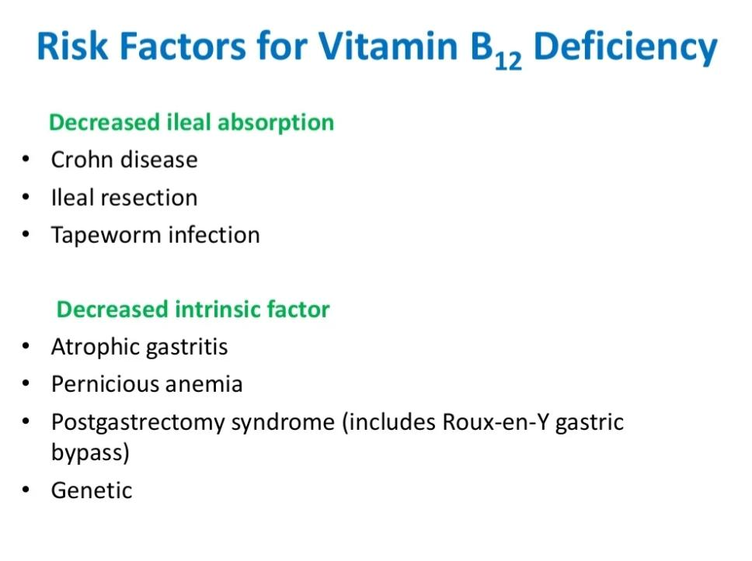

Slide 35
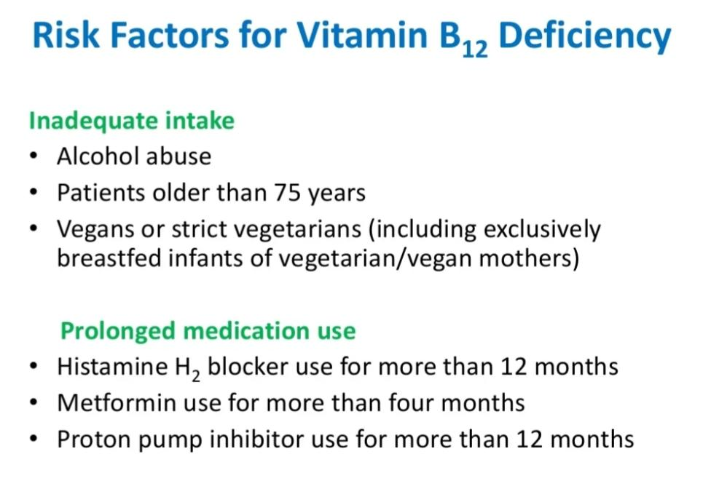

Slide 36
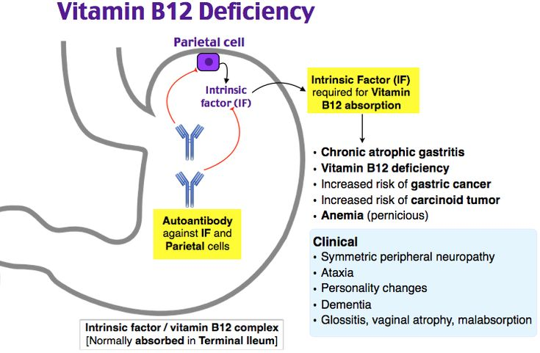

Slide 37
Family Medicine
Preventive Care: Understanding genetic predispositions and biochemical markers for early detection and preventive strategies in at-risk families.
Personalized Treatment: Tailoring treatments based on the patient's genetic profile, considering familial patterns of cancer to optimize outcomes.
Holistic Management: Addressing not just the biological aspects of cancer but also the psychological, social, and lifestyle impacts on patients and their families, providing comprehensive car

Slide 38
Artificial Intelligence
Predictive Analytics: AI models predict cancer progression and patient outcomes by analyzing genetic mutations and biochemical markers, enhancing personalized medicine approaches.
Diagnostic Support: AI algorithms improve the accuracy of diagnosing cancers through pattern recognition in genetic data and imaging, facilitating early detection.
Treatment Optimization: AI helps in developing targeted therapies by analyzing vast biochemical datasets, identifying potential drug targets, and predicting treatment responses, improving efficacy and reducing side effects.

Slide 39
Bioethics
Consent and Confidentiality: Addressing ethical concerns in genetic testing for hereditary cancers, ensuring patient consent, and maintaining confidentiality of genetic information.
Equity in Access: Ensuring equitable access to cancer diagnostic tools, treatments, and new technologies across different populations to prevent disparities in cancer care.
Ethical Implications of Research: Considering the ethical implications of cancer research, including the use of human subjects, and balancing the potential benefits against the risks and ethical concerns.

Slide 40
Suggested Research Article
https://www.statpearls.com/ArticleLibrary/viewarticle/21863
https://www.medicalnewstoday.com/articles/219853
https://www.tandfonline.com/doi/abs/10.1080/20014091084209

Slide 41
Learning Resources
Lippincott Illustrated reviews of biochemistry 8th edition
Harpers illustrated biochemistry 32 edition
Used digital library

Slide 42

How to access Digital Library
Open PC.
Open Internet.
Search HEC library.
Access public universities
Click on RMU
Read your desired article.

Slide 43


