Slide 1



Slide 2

Dr Muhammad Arif
Associate Professor Medicine
RMU/HFH
HYPERTENSION AND PREGNANCY

Slide 3

Mission Statement: To impart evidence based research oriented health professional education in order to provide best possible patient care and inculcate the values of mutual respect, ethical practice of healthcare and social accountability.
Vision: Highly recognized and accredited centre of excellence in Medical Education, using evidence-based training techniques for development of highly competent health professionals, who are lifelong experiential learner and are socially accountable.
Values: Merit ,Pursuit of Excellence, Integrity ,Diversity & Inclusivity ,Social Impact
MOTO: Service Truth Wisdom

Slide 4
SEQUENCE OF LGIS
Learning Objectives
Introduction /Etiology/ Classification of Hypertension in Pregnancy (Core Concept)
Related Pathophysiology(Horizontal Integration)
Diagnosis and Management of Hypertension in Pregnancy ( Core Concept)
Complications of Hypertension in Pregnancy(Vertical Integration)
Family Medicine/Research/MDM/Ethics

Slide 5
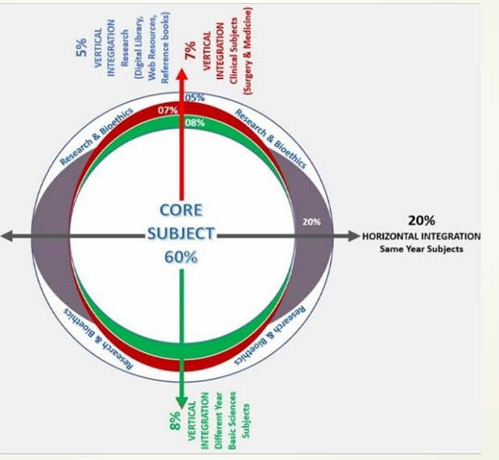
Prof Umer Model of Integrated Lecture

Slide 6
LEARNING OBJECTIVES
CORE CONCEPT
Recall Etiology, pathophysiology of Hypertension in pregnancy
Identify the risk factors and populations at risk for developing Hypertension in pregnancy
Classification of Hypertension in pregnancy
Discuss the diagnostic criteria
Explain the maternal and fetal complications associated with Hypertension in pregnancy
Describe the lifestyle modifications recommended for management.
Compare the pharmacological options available for management.
Explain the importance of postpartum screening and lifestyle interventions
to prevent future complications.
Identify public health strategies/MDM for early detection and management in at-
risk populations.

Slide 7
INTRODUCTION
CORE CONCEPT
Hypertension is the most common medical problem encountered during pregnancy complicating up to 10% of pregnancies.
In the United States from 2017 to 2019 prevalence of hypertensive disorders in pregnancy at delivery rose from 13.3% to 15.9%.
Hypertensive disorders during pregnancy are classified into 4 categories as recommended by the National High Blood Pressure Education Program Working Group on High Blood Pressure in Pregnancy
Chronic hypertension
Preeclampsia-eclampsia
Preeclampsia superimposed on chronic hypertension
Gestational hypertension/pregnancy-induced hypertension (PIH)

Slide 8
PHYSIOLOGICAL CHANGES DURING PREGNANCY
VERTICAL INTEGRATION
Pregnancy is associated with vasodilation of the systemic vasculature and the maternal kidneys.
The systemic vasodilation of pregnancy occurs as early as at 5 weeks and there is a substantial decrease in peripheral vascular resistance.
It decreases to a nadir during the middle of the second trimester with a subsequent plateau or slight increase for the remainder of the pregnancy.
The decrease is ≈35% to 40% of baseline.
By 2 weeks after delivery maternal hemodynamics have largely returned to nonpregnant levels.

Slide 9
PHYSIOLOGICAL CHANGES DURING PREGNANCY
VERTICAL INTEGRATION
Preconception | Pregnancy |  |  |  | Labor
Baseline |  | First Trimester | Second Trimester | Third Trimester
Hemodynamic | CO | ↑ | ↑↑ | ↑↑ | ↑↑↑↑
 | SVR | ↓ | ↓↓ | ↓↓
 | HR | ↑ | ↑↑ | ↑↑↑ | ↑↑↑↑
 | BP | ↓ | ↓ | ↔ | (Pain)
Neurohumoral |  | ↑ Sympathetic activity
 |  | ↑ Estrogen/progesterone/relaxin
Renin/angiotensin | Plasma volume* | ↑↑ | ↑↑↑ | ↑↑↑↑ | ↑↑↑↑↑
RBC changes | RBC mass | ↑ | ↑↑ | ↑↑ | (Autotransfusion)
Structural changes | LV wall mass | ↑ | ↑ | ↑
 | Chamber sizes | 4-Chamber enlargement
 | Aorta | Increased distensibility

Slide 10
CLASSIFICATION OF HYPERTENSION IN PREGNANCY
CORE CONCEPT
Chronic hypertension is defined as blood pressure exceeding 140/90 mm Hg before pregnancy or before 20 weeks' gestation.
Gestational hypertension refers to hypertension with onset in the latter part of pregnancy (>20 weeks' gestation) without any other features of preeclampsia and followed by normalization of the blood pressure postpartum.
Pre-eclampsia is a multi-system disorder unique to human pregnancy characterised by hypertension and involvement of one or more other organ systems and/or the fetus.
Raised blood pressure is commonly but not always the first manifestation.

Slide 11
CLASSIFICATION OF HYPERTENSION IN PREGNANCY
CORE CONCEPT
Preeclampsia is defined as the presence of :
A systolic blood pressure (SBP) greater than or equal to 140 mm Hg or a diastolic blood pressure (DBP) greater than or equal to 90 mm Hg or higher, on two occasions at least 4 hours apart in a previously normotensive patient
OR
SBP greater than or equal to 160 mm Hg or a DBP greater than or equal to 110 mm Hg or higher
In addition to the blood pressure criteria :
Proteinuria of greater than or equal to 0.3 grams in a 24-hour urine specimen
A protein (mg/dL)/creatinine (mg/dL) ratio of 0.3 or higher or a urine dipstick protein of 1+ (if a quantitative measurement is unavailable) is required to diagnose preeclampsia

Slide 12
PREECLAMPSIA WITH SEVERE FEATURES
CORE CONCEPT
It is defined as the presence of one of the following symptoms or signs in the presence of preeclampsia :
SBP of 160 mm Hg or higher or DBP of 110 mm Hg or higher, on two occasions at least 4 hours apart
Impaired hepatic function as indicated by abnormally elevated blood concentrations of liver enzymes (to double the normal concentration)
Severe persistent upper quadrant or epigastric pain that does not respond to pharmacotherapy
Progressive renal insufficiency (serum creatinine concentration >1.1 mg/dL or a doubling of the serum creatinine concentration in the absence of other renal disease)
New-onset cerebral or visual disturbances
Pulmonary edema
Thrombocytopenia (platelet count < 100,000/μL)

Slide 13
CLASSIFICATION OF HYPERTENSION IN PREGNANCY
CORE CONCEPT
In a patient with new-onset hypertension without proteinuria the new onset of any of the following is diagnostic of preeclampsia:
Platelet count below 100,000/μL
Serum creatinine level above 1.1 mg/dL or doubling of serum creatinine in the absence of other renal disease
Liver transaminase levels at least twice the normal concentrations
Pulmonary edema
Cerebral or visual symptoms

Slide 14
CLASSIFICATION OF HYPERTENSION IN PREGNANCY
CORE CONCEPT
Eclampsia is defined as seizures that cannot be attributable to other causes in a woman with preeclampsia.
Superimposed preeclampsia on chronic hypertension is characterized by:
New-onset proteinuria (≥300 mg/24 h) in a woman with hypertension but no proteinuria before 20 weeks' gestation
Sudden increase in proteinuria or BP or a platelet count of less than 100,000/mm³ in a woman with hypertension and proteinuria before 20 weeks' gestation.

Slide 15
CLASSIFICATION OF HYPERTENSION IN PREGNANCY
CORE CONCEPT
HELLP syndrome (hemolysis, elevated liver enzyme, low platelets) may be an outcome of severe preeclampsia although some believe it to have an unrelated etiology.
This syndrome has been associated with particularly high maternal and perinatal morbidity and mortality rates and may be present without hypertension or in some cases without proteinuria.

Slide 16
ETIOLOGY AND PATHOGENESIS
HORIZONATL INTEGRATION
The exact cause remains unclear but factors include abnormal placental development
Placental Ischemia leading to the release of antiangiogenic factors into maternal circulation
Endothelial Dysfunction which results in vasoconstriction and increased blood pressure
Maternal immunologic intolerance
Abnormal placental implantation
Genetic, nutritional, and environmental factors
Cardiovascular and inflammatory changes

Slide 17
MATERNAL PERSONAL RISK FACTORS FOR PREECLAMPSIA
HORIZONATL INTEGRATION
First pregnancy
New partner/paternity
Age younger than 18 years or older than 35 years
History of preeclampsia
Family history of preeclampsia in a first-degree relative
Black race
Obesity (BMI ≥30)
Interpregnancy interval less than 2 years or longer than 10 years

Slide 18
MATERNAL MEDICAL RISK FACTORS FOR PREECLAMPSIA
HORIZONATL INTEGRATION
Chronic hypertension especially when secondary to such disorders like hypercortisolism, hyperaldosteronism , pheochromocytoma, or renal artery stenosis
Preexisting diabetes (type 1or type 2) especially with microvascular disease
Renal disease
Systemic lupus erythematosus
Obesity
Thrombophilia
History of migraine
Use of selective serotonin uptake inhibitor antidepressants (SSRIs) beyond the first trimester

Slide 19
PLACENTAL RISK FACTORS FOR PREECLAMPSIA
HORIZONATL INTEGRATION
Multiple gestations
Hydrops fetalis
Gestational trophoblastic disease
Triploidy

Slide 20
EVALUATION OF HYPERTENSION IN PREGNANCY
CORE CONCEPT
Differentiating chronic hypertension or preeclampsia is sometimes a challenge
Hypertension before 20 weeks' gestation is almost always due to chronic hypertension
New-onset or worsening hypertension after 20 weeks' gestation should lead to a careful evaluation for manifestations of preeclampsia.
Preeclampsia is rare before the third trimester
The diagnosis of severe hypertension or preeclampsia in the first or early second trimester necessitates exclusion of gestational trophoblastic disease and/or molar pregnancy
Preeclampsia in a previous pregnancy is strongly associated with recurrence in subsequent pregnancies

Slide 21
PHYSICAL FINDINGS IN PATIENTS WITH PRECLAMPSIA
CORE CONCEPT
Preeclampsia with severe features display end-organ effects and may complain of the following:
Headache
Visual disturbances: Blurred, scintillating scotomata
Altered mental status
Blindness: May be cortical or retinal
Dyspnea
Edema
Epigastric or right upper quadrant abdominal pain
Weakness or malaise , evidence of hemolytic anemia

Slide 22
LABORATORY EVALUATION
CORE CONCEPT
All women who present with new-onset hypertension should have the following laboratory tests:
Complete blood cell (CBC) count
Serum alanine aminotransferase (ALT) and aspartate aminotransferase (AST) levels
Serum creatinine
Urine testing for protienuria documentation
Uric acid
A peripheral smear
Serum lactate dehydrogenase (LDH) levels
Coagulation profile (prothrombin time [PT], activated partial [aPTT], and fibrinogen)
The presence of schistocytes, burr cells, or echinocytes on peripheral smears, or elevated indirect bilirubin and low serum haptoglobin levels may be used as evidence of hemolysis in diagnosing HELLP syndrome
Ultrasound for fetal wellbeing / CTG

Slide 23
MANAGEMENT OF PREECLAMPSIA
CORE CONCEPT
The optimal management of a woman with preeclampsia depends on gestational age and disease severity.
Because delivery is the only cure for preeclampsia clinicians must try to minimize maternal risk while maximizing fetal maturity.
The primary objective is the safety of the mother and then the delivery of a healthy newborn.
Obstetric consultation should be sought early to coordinate transfer to an obstetric floor as appropriate.
Patients with preeclampsia without severe features are often induced after 37 weeks' gestation.

Slide 24
MANAGEMENT OF PREECLAMPSIA
CORE CONCEPT
Before this the immature fetus is treated with expectant management with corticosteroids to accelerate lung maturity in preparation for early delivery
In patients with preeclampsia with severe features induction of delivery should be considered after 34 weeks' gestation
In the emergency setting control of BP and seizures should be priorities

Slide 25
CRITERIA FOR DELIVERY
CORE CONCEPT
Nonreassuring fetal testing including nonreassuring nonstress test, biophysical profile score, and/or persistent absent or reversed diastolic flow on umbilical artery Doppler velocimetry
Ruptured membranes
Uncontrollable BP (unresponsive to medical therapy)
Oligohydramnios, with amniotic fluid index (AFI) of less than 5 cm
Severe intrauterine growth restriction in which the estimated fetal weight is less than 5%
Oliguria (< 500 mL/24 hours)
Serum creatinine level of at least 1.5 mg/dL
Pulmonary edema
Shortness of breath or chest pain with pulse oximetry of < 94% on room air
Headache that is persistent and severe
Right upper quadrant tenderness
Development of HELLP (hemolysis, elevated liver enzyme, low platelets) syndrome
Eclampsia
Platelet count less than 100,000/μL
Placental abruption
Unexplained coagulopathy

Slide 26
SEIZURE TREATMENT AND PROPHYLAXIS
CORE CONCEPT
The American College of Obstetricians and Gynecologists (ACOG) support the short-term (usually < 48 hours) use of magnesium sulfate in obstetric care for conditions and treatment durations that include the following:
Prevention and treatment of seizures in women with preeclampsia or eclampsia
Fetal neuroprotection before anticipated early preterm (< 32 weeks of gestation) delivery
Short-term prolongation of pregnancy (≤48 hours) to allow for the administration of antenatal corticosteroids in pregnant women who are at risk of preterm delivery within 7 days
The basic principles of airway, breathing, and circulation (ABC) should always be followed as a general principle of seizure management.

Slide 27
SEIZURE TREATMENT AND PROPHYLAXIS
CORE CONCEPT
Active seizures should be treated with intravenous magnesium sulfate as a first-line agent.
A loading dose of 4 g should be given by an infusion pump over 5-10 minutes followed by an infusion of 1 g/h maintained for 24 hours after the last seizure.
Recurrent seizures should be treated with an additional bolus of 2 g or an increase in the infusion rate to 1.5 g or 2 g per hour.
Prophylactic treatment with magnesium sulfate is indicated for all patients with severe preeclampsia.
For eclamptic seizures that are refractory to magnesium sulfate, lorazepam and phenytoin may be used as second-line agents.

Slide 28
TREATMENT OF ACUTE HYPERTENSION IN PREGNANCY
Acute severe hypertension in pregnancy is a medical emergency.
Treatment required to lower blood pressures within 30 minutes of confirmation to reduce risk of maternal stroke.
According to the February 2015 ACOG Committee Opinion “Emergent Therapy for Acute-Onset, Severe Hypertension During Pregnancy and the Post-Partum Period,”:
First line options for treatment include oral immediate-release nifedipine, IV labetalol, and IV hydralazine.

Slide 29
TREATMENT OF ACUTE HYPERTENSION IN PREGNANCY
Diuretics should be avoided
Aggressive volume resuscitation may lead to pulmonary edema
Patients should be fluid restricted when possible, at least until the period of postpartum diuresis
Central venous pressure (CVP) or pulmonary artery pressure monitoring may be indicated in critical cases
A CVP of 5 mm Hg in women with no heart disease indicates sufficient intravascular volume, and maintenance fluids alone are sufficient
Total fluids should generally be limited to 80 mL/hr or 1 mL/kg/hr

Slide 30
POSTPARTUM CARE HORIZONTAL INTEGRATION
Many patients will have a brief (up to 6 hours) period of oliguria following delivery
Magnesium sulfate seizure prophylaxis is continued for 24 hours postpartum
Liver function tests and platelet counts must document decreasing values prior to hospital discharge
Elevated BP may be controlled with nifedipine or labetalol postpartum
If a patient is discharged with BP medication reassessment and a BP check should be performed at the latest 1 week after discharge
Unless a woman has undiagnosed chronic hypertension, in most cases of preeclampsia, the BP returns to baseline by 12 weeks postpartum
Patients should be carefully monitored for recurrent preeclampsia which may develop up to 4 weeks postpartum and for eclampsia that has occurred up to 6 weeks after delivery

Slide 31

COMPLICATIONS OF PREECLAMPSIA
VERTICAL INTEGRATION
Maternal Complications
Neurological
  Recurrent seizures (status epilepticus)
  Cerebral edema
  Intracranial hemorrhage (stroke)
  Cortical blindness
Cardiovascular
  Hypertensive crisis
  Myocardial infarction
  Pulmonary edema
  Disseminated intravascular coagulation (DIC)
Renal
  Acute kidney injury (AKI)
  Oliguria or anuria
  Proteinuria progression
Hepatic
  Liver rupture or hemorrhage
  Elevated liver enzymes (HELLP syndrome)
Hematologic
  DIC (excessive clotting and bleeding)
  Thrombocytopenia

Slide 32
COMPLICATIONS OF PREECLAMPSIA
VERTICAL INTEGRATION
Obstetric Compliactions
Placental abruption
Postpartum hemorrhage (PPH)
Uterine atony
Eclampsia remains a leading cause of maternal mortality globally.
Fetal Complications
Intrauterine Growth Restriction (IUGR)
Preterm Birth
Fetal Distress
Stillbirth or Intrauterine Fetal Demise (IUFD)
Neonatal Hypoxia & Neurodevelopmental Delay

Slide 33
Preventive Strategies /Public Health
VERTICAL INTEGRATION
Advise pregnant women at high risk of pre-eclampsia to take 75 mg to 150 mg of aspirin daily from 12 weeks until the birth of the baby. Women at high risk are those with any of the following
hypertensive disease during a previous pregnancy
chronic kidney disease
autoimmune disease such as systemic lupus erythematosus or antiphospholipid syndrome
type 1 or type 2 diabetes
chronic hypertension
Preconception Care & Early Identification
Screening for Risk Factors
Optimizing Maternal Health
Preconception Counseling

Slide 34
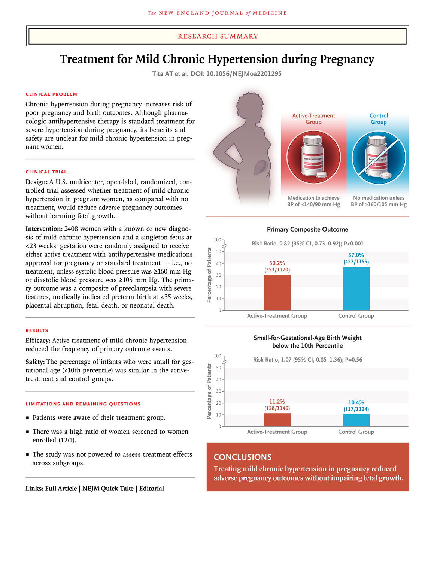
RECENT ADVANCES/RESARCH ARTICLE
Treatment for Mild Chronic Hypertension during Pregnancy
N Engl J Med 2022;386:1781-1792 DOI: 10.1056/NEJMoa2201295 VOL. 386 NO. 19

Slide 35
MULTIDISCIPLINARY APPROACH
VERTICAL/HORIZONTAL INTEGRATION
The management of hypertension in pregnancy requires a vertically integrated, multidisciplinary approach, beginning with an understanding of the underlying pathophysiology ,risk factors, and diagnosis.
Effective management involves collaboration among obstetricians, neurologist, pediatricians, nutritionists, and internal medicine specialists along with the integration of lifestyle modifications, pharmacological treatment, and obstetric monitoring
Additionally, postpartum follow-up and public health interventions play a crucial role in preventing long-term complications for both the mother and child.

Slide 36

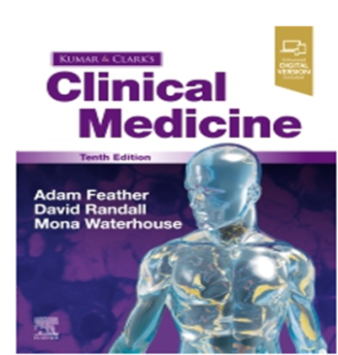
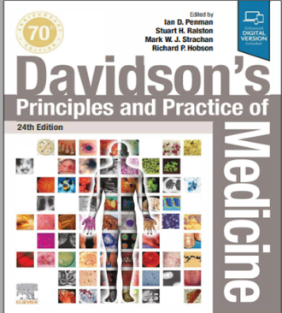

Resources/References
MEDSCAPE
RCOG Guidelines
RCOG GUIDELINES

