Slide 1
.

Slide 2
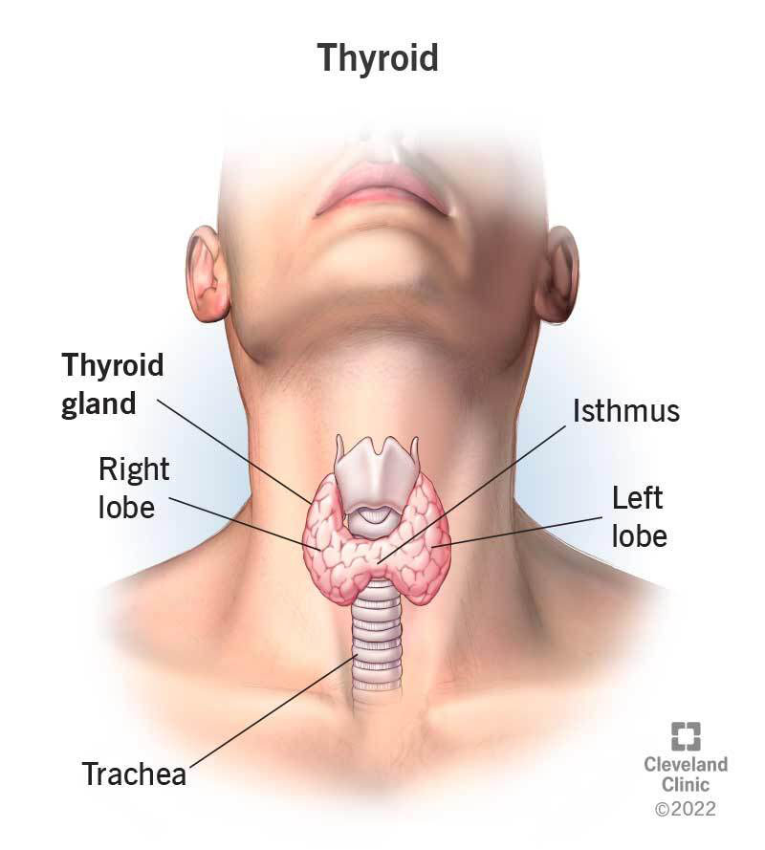
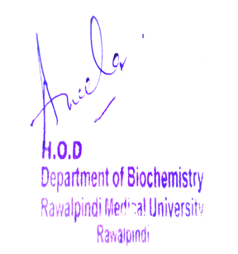
Endocrinology Module 2nd Year MBBS(LGIS) THYROID HORMONE
Date: 00-00-2025
PRESENTOR: Dr. RAHAT

Slide 3
Motto, Vision, Dream
Wisdom
Truth
Service
To impart evidence based research oriented medical education
To provide best possible patient care
To inculcate the values of mutual respect and ethical practice of medicine

Slide 4
Professor Umar Model of Integrated Lecture

Slide 5
Learning Objectives
At the end of this session student should be able to:
1- Discuss the Synthesis of Thyroid Hormone
2- Understand the Regulation of Plasma level of T3, T4
3- Describe the Mechanism of Action of Thyroxin
4- Explain the Functions of Thyroid Hormone in the body
5- Explain & correlate the clinical aspects of the core concept.
6- Appreciate term Beneficence (Bioethics)
7- Correlate and build core knowledge on the basis of latest research

Slide 6
HORIZONTAL INTEGRATION

Slide 7
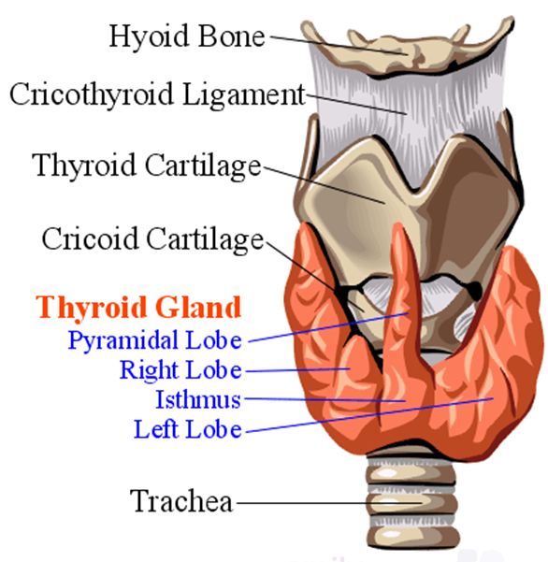
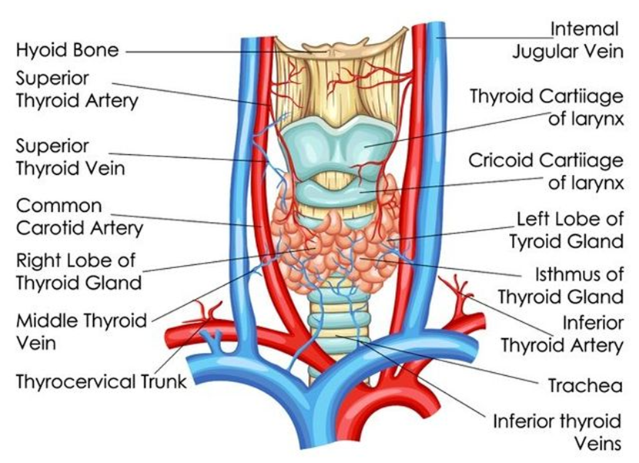
Anatomical Aspects
HORIZONTAL INTEGRATION

Slide 8
Correlation with Physiology
HORIZONTAL INTEGRATION

Slide 9
CORE KNOWLEDGE

Slide 10
What is a hormone?
CORE KNOWLEDGE
Hormone is a chemical messenger produced by glands in the body. It travels through the blood stream to tissues and organs, regulating various bodily functions such as growth, metabolism, reproduction and mood.
Examples:
Oxytocin
Prolactin
Triiodothyronine and tetra iodothyronine
Estrogen
Testosterone

Slide 11
Thyroid Hormone
CORE KNOWLEDGE

Slide 12
,
CORE KNOWLEDGE

Slide 13
/
CORE KNOWLEDGE

Slide 14
.
CORE KNOWLEDGE

Slide 15
Normal Plasma Levels
CORE KNOWLEDGE

Slide 16
Regulation of Plasma Levels
CORE KNOWLEDGE

Slide 17
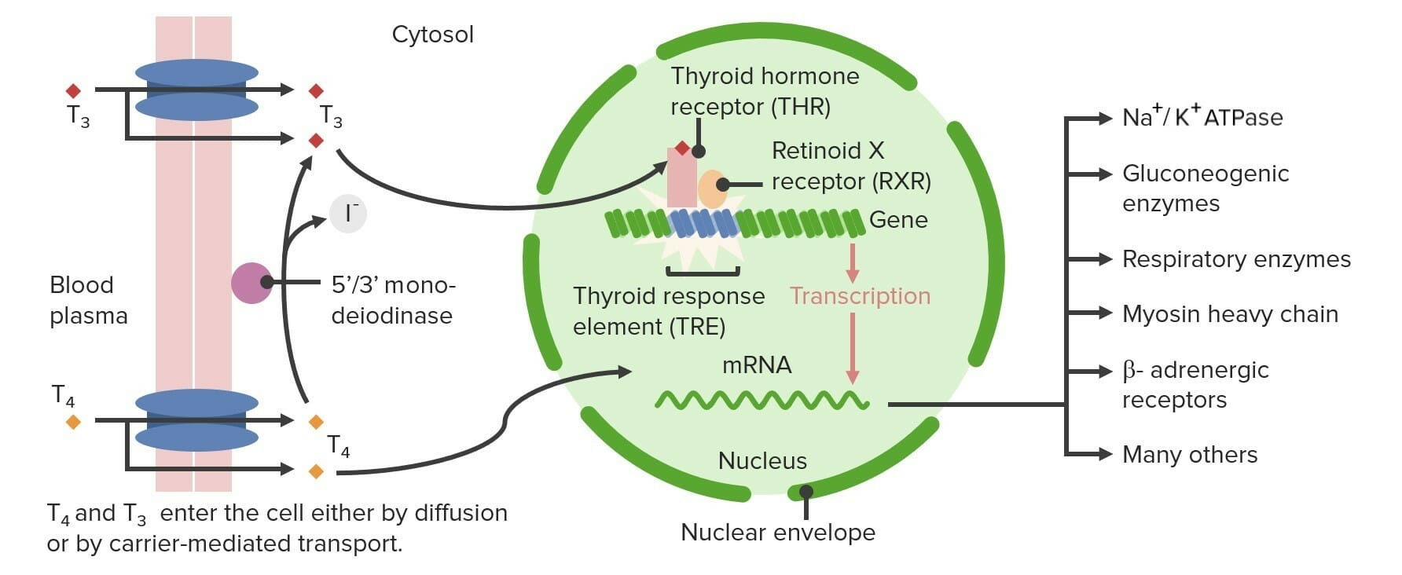
Mechanism of Action Of Thyroxine (Intranuclear receptor)
CORE KNOWLEDGE

Slide 18
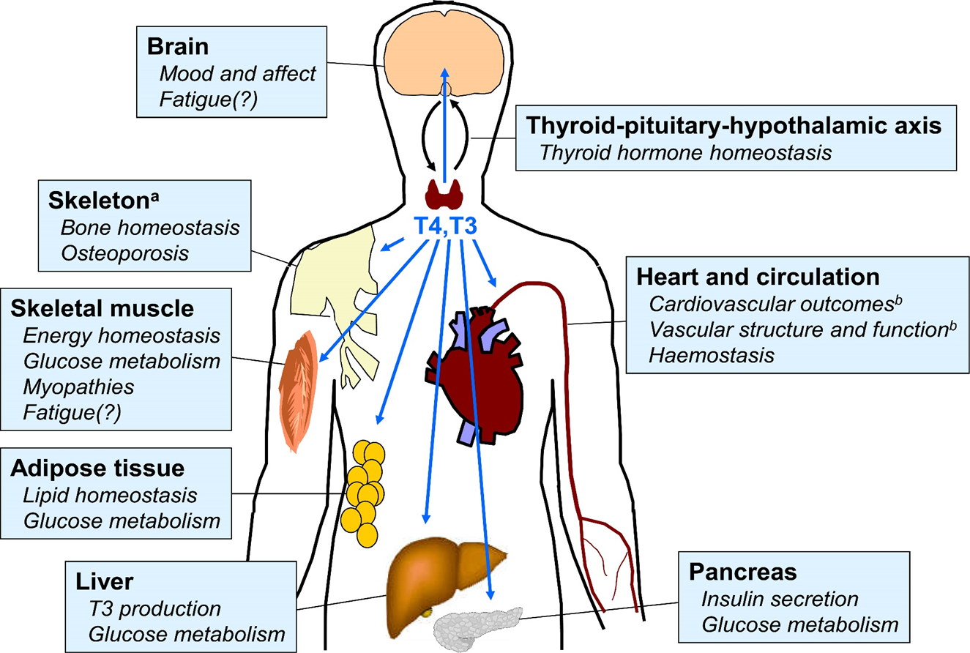
Function Of Thyroid Hormones in the Body
CORE KNOWLEDGE
.

Slide 19
Effect Of T3,T4 on The Body
CORE KNOWLEDGE

Slide 20
.
CORE KNOWLEDGE

Slide 21
.
CORE KNOWLEDGE

Slide 22
Thyroid Function Tests
CORE KNOWLEDGE

Slide 23
Calcitonin
CORE KNOWLEDGE

Slide 24
Summary
CORE KNOWLEDGE

Slide 25
VERTICAL INTEGRATION

Slide 26
Hyperthyroidism
VERTICAL INTEGRATION
Hyperactivity of thyroid gland leading to raised calcitonin, free T4,free T3 levels in blood and in result of negative feedback reduced TSH levels.
Causes:
Primary Hyperthyroidism
Graves Disease
Toxic adenoma
Iodine excess
Secondary Hyperthyroidism
Pituitary adenoma

Slide 27
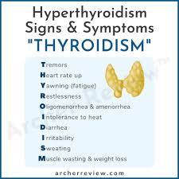
Hyperthyroidism Signs And Symptoms
VERTICAL INTEGRATION

Slide 28
Treatment
VERTICAL INTEGRATION
Medication:
Anti thyroid substances
Radioactive iodine
Surgical intervention
Partial or subtotal thyroidectomy
Total thyroidectomy
(Ligation of superior thyroid artery near the gland to prevent damage to recurrent laryngeal nerve)

Slide 29
2.Hypothyroidism
VERTICAL INTEGRATION
Underactivity of thyroid gland leading to Low free T4 levels resulting in raised TSH levels.
Causes:
Hashimoto thyroiditis
Autoimmune disease
Iodine deficiency
Radiation
Infections
Pituitary tumors

Slide 30
Signs And Symptoms
VERTICAL INTEGRATION

Slide 31
Prevention
VERTICAL INTEGRATION
Adequate iodine in diet
Low exposure to radiation
Avoid self medication
Avoid gluten
Keep stress and anxiety in order by doing yoga and exercise

Slide 32
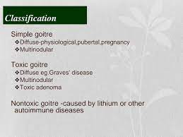
3. Goiter
VERTICAL INTEGRATION

Slide 33
SPIRAL INTEGRATION

Slide 34
Family Medicine
SPIRAL INTEGRATION
Family Medicine plays important role in following manner:
Diagnosis: Family physician plays a crucial role in recognizing the signs and symptoms such as developmental delays, muscle weakness, and neurological abnormalities.
Education: Family physicians educate patients and their families about Leigh syndrome, including its underlying genetic cause, clinical manifestations, prognosis, and available treatment options.
Multidisciplinary Care Coordination: Family physicians collaborate with a multidisciplinary team of health care professionals, including neurologists, genetic counselors, physical therapists, occupational therapists, and social workers, to provide comprehensive care for individuals with Leigh syndrome.
Community Support: Family physicians advocate for individuals with Leigh syndrome and their families within the healthcare system and the broader community.
Refer to Specialists: Family physicians refer to patient to the specialist for further treatment

Slide 35
Artificial Intelligence
SPIRAL INTEGRATION
Artificial Intelligence plays role in following aspects:
AI algorithms can assist in the early detection of Leigh syndrome by analyzing medical imaging data such as MRI scans, aiding clinicians in making a timely diagnosis.
AI can help analyze genetic data to identify mutations associated with Leigh syndrome
AI-driven drug discovery platforms can identify potential therapies for Leigh syndrome. By analyzing vast amounts of biological data, including molecular pathways involved in the disease

Slide 36
SPIRAL INTEGRATION
Bioethics
Genetic Testing and Counseling
Prenatal Diagnosis and Reproductive Choices
Treatment Decision-Making
Research Ethics
Access to Healthcare and Support Services

Slide 37
Beneficence
SPIRAL INTEGRATION
The principle of beneficence is the obligation of physician to act for the benefit of the patient and supports a number of moral rules to protect and defend the right of others, prevent harm, remove conditions that will cause harm, help persons with disabilities, and rescue persons in danger. It is worth emphasizing that, the language here is one of positive requirements. The principle calls for not just avoiding harm, but also to benefit patients and to promote their welfare.

Slide 38
Suggested Research Article
SPIRAL INTEGRATION
https://www.ncbi.nlm.nih.gov/books/NBK482216/
https://www.ncbi.nlm.nih.gov/pmc/articles/PMC1476727/

Slide 39
HEC DIGITAL LIBRARY
Steps to Access HEC Digital Library
Go to the website of HEC National Digital Library.
On Home Page, click on the INSTITUTES.
A page will appear showing the universities from Public and Private Sector and other Institutes which have access to HEC National Digital Library HNDL.
Select your Desired Institute.
A page will appear showing the Resources Of The Institution
Journals and Researches will appear
You can find a Journal by clicking on JOURNALS AND DATABASE and enter a Keyword to search for your desired journal.

Slide 40
Learning Resources
Textbook of Biochemistry, Lippincott 8th edition, chapter no 09, page no 120
Google scholar
Google images

Slide 41
.

