Slide 1
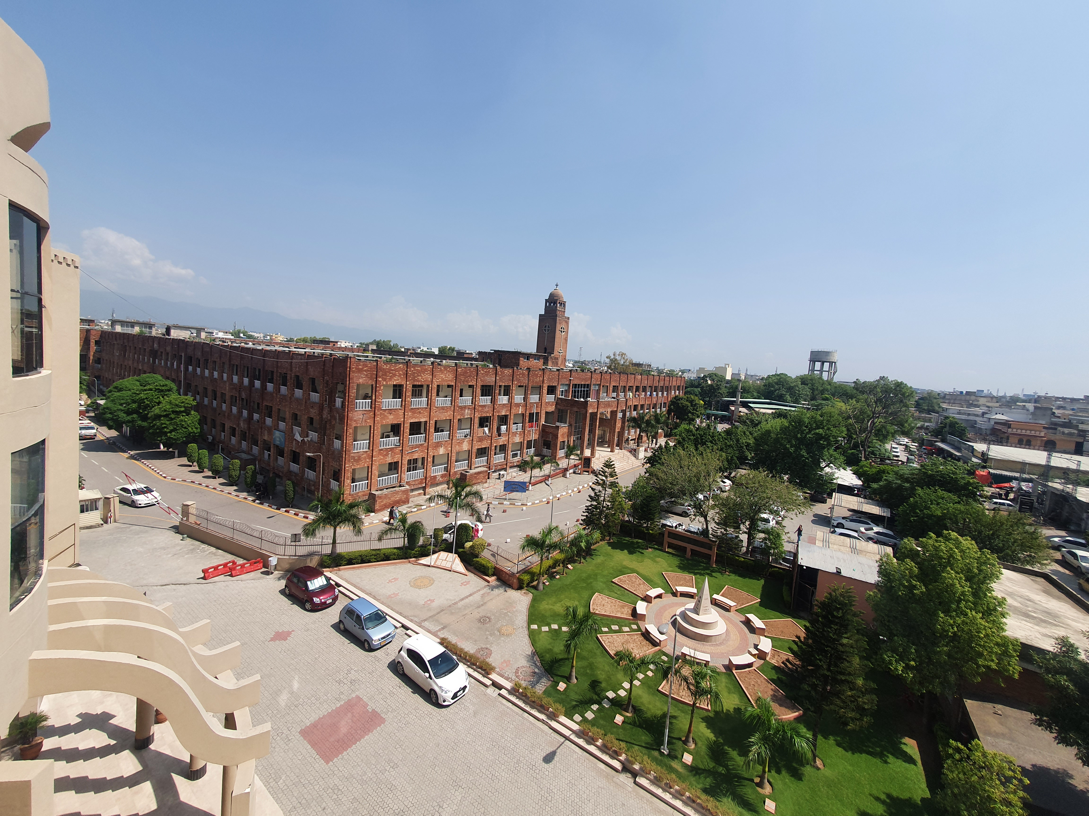
Stable Angina Pectoris
Prof. Dr. Saima Ambreen
Professor of Medicine
HOD Medical Unit-1, Holy Family Hospital
Rawalpindi Medical University

Slide 2
Prof. Dr. Umer Model of integrated lecture

Slide 3
Learning Objectives
Definition of Stable angina and its etiology
Atherosclerosis and its phases
The Canadian Cardiovascular Society (CCS) classification of angina severity
Atypical symptoms of angina
Factors aggravating myocardial ischemia
Clinical examination and Diagnostic workup for angina
Medical management of angina
Surgical Interventions for Chronic Angina

Slide 4
Definition
Stable angina is chest pain or discomfort that occurs predictably with physical activity or emotional stress due to reduced blood flow to the heart muscle and is relieved by rest or nitroglycerin.

Slide 5
Etiology
Atherosclerosis is the most common cause of Stable angina.
Patients with a fixed coronary atherosclerotic lesion of at least 50% show myocardial ischemia during physical activity or stress
Fixed atherosclerotic lesions of at least 90% almost completely abolish the flow reserve patients with these lesions may experience angina at rest

Slide 6
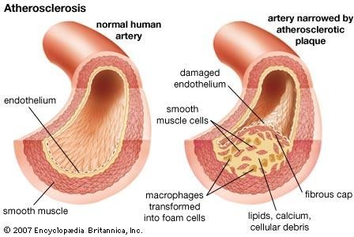
Atherosclerosis

Slide 7
The phases in atherosclerosis
Fatty streaks — The first phase in atherosclerosis histologically presents as focal thickening of the intima with an increase in smooth muscle cells and extracellular matrix
Fibrous plaque — The fibrous plaque evolves from the fatty streak via accumulation of connective tissue with an increased number of smooth muscle cells filled with lipids
Advanced lesions — develop a microvasculature from both the luminal and medial aspects, and often contain a necrotic lipid rich core

Slide 8
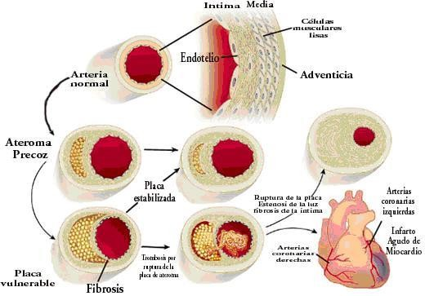
PATHWAY OF ATEROSCLEROSIS

Slide 9
Nonatherosclerotic Causes
Fixed
Congenital anomalies
Myocardial bridges
Vasculitides
Aortic dissection
Granulomas
Tumors
Scarring from trauma,
radiation
Transient Vasospasm Embolus Thrombus in situ

Slide 10
Coronary flow reserve (CFR)
The ability of the coronary arteries to increase blood flow in response to increased cardiac metabolic demand
The maximal coronary blood flow after full dilation of the coronary arteries is roughly 4-6 times the resting coronary blood flow
CFR depends on at least 3 factors: large and small coronary artery resistance, extravascular (ie, myocardial and interstitial) resistance, and blood composition

Slide 11
Pathophysiology
Myocardial ischemia is the result of an imbalance between myocardial oxygen supply and demand
This causes myocardial cells to switch from aerobic to anaerobic metabolism, with a progressive impairment of metabolic, mechanical, and electrical functions
Angina pectoris is caused by chemical and mechanical stimulation of sensory afferent nerve endings in the coronary vessels and myocardium

Slide 12
Pathophysiology
Studies have shown that adenosine may be the main chemical mediator of anginal pain
During ischemia, ATP is degraded to adenosine, which, diffuses to the extracellular space
Adenosine induces angina mainly by stimulating the A1 receptors in cardiac afferent nerve endings

Slide 13
Angina pectoris - the major criteria of pain
The character: pain is a deep visceral pressure or squeezing sensation
Localization : always has some substernal component
Radiation: from the thorax to the jaw, neck, or arm
Precipitated: by exertion, emotional upset
Duration: transient, lasting between 2 - 30 min
Pain relief : after rest, or s/l Nitroglycerine

Slide 14
The Canadian Cardiovascular Society (CCS) classification of angina severity
Class I - Angina only during strenuous or prolonged physical activity
Class II - Slight limitation, with angina only during vigorous physical activity
Class III - Symptoms with everyday living activities, ie, moderate limitation
      Class IV - Inability to perform any activity without angina or angina at rest, ie, severe limitation

Slide 15
Atypical symptom of angina pectoris
Dyspnea may be the patient's only symptom during myocardial ischemia, or it may overshadow the chest pain in the patient's mind

Slide 16
Factors that Can Aggravate Myocardial Ischemia
Increased myocardial oxygen demand
Tachycardia
Hypertension
Thyrotoxicosis
Heart failure
Valvular heart disease
Catecholamine analogues (eg, bronchodilators, tricyclic antidepressants)
Reduced myocardial oxygen supply
Anemia
Carbon monoxide poisoning
Hypotension
Tachycardia

Slide 17
Physical Examination
is often not helpful in the diagnosis of chronic ischemic heart disease
many patients with chronic ischemic heart disease have no physical findings related to the disease, or if they do, the findings are not specific for coronary artery disease

Slide 18
Diagnostic Studies:
Exercise Stress Test (Treadmill Test - TMT)
It evaluates for inducible ischemia by monitoring ECG changes, symptoms, and exercise capacity.

Slide 19
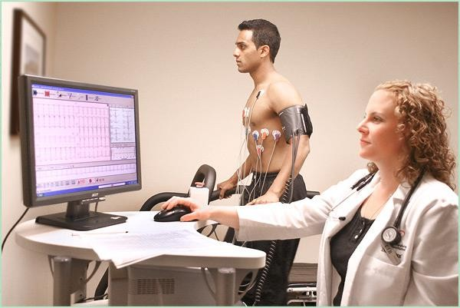

Slide 20
Bicycling is an alternative form of exercise
Patient may become fatigued on the bicycle before myocardial ischemia is induced, resulting in lower diagnostic yields
On the other hand, bicycle exercise can be performed in the supine position, which facilitates some myocardial ischemia detection methods such as echocardiography

Slide 21
Pharmacologic stress testing
Patients who cannot perform leg exercises.
Synthetic catecholamine dobutamine, that mimic exerciseis is preferred for wall motion imaging.
Vasodilator drugs, such as dipyridamole and adenosine, that, by producing profound vasodilatation, increase heart rate and stroke volume, thereby raising myocardial oxygen demand is preferred for myocardial perfusion imaging.

Slide 22
Sress test: ECG
Horizontal or down-sloping ST segment depression, achieving at least 0.1 mV at 80 ms beyond the J point (junction of the QRS and the ST segment)
This criterion provides the highest values of sensitivity and specificity
Accuracy is highest when ECG changes are in the lateral precordial leads (V4, V5, V6) instead of the inferior leads (II, III, aVF)

Slide 23
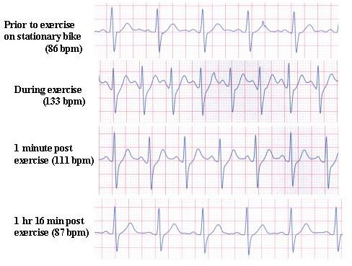

Slide 24
CORONARY ANGIOGRAPHY
is the standard for evaluating the anatomy of the coronary artery tree
It is best at evaluating the large epicardial coronary vessels that are most frequently diseased in coronary atherosclerosis
Experimental studies suggest that lesions that reduce the lumen of the coronary artery by 70% or more in area (50% in diameter) significantly limit flow, especially during periods of increased myocardial oxygen demand
If such lesions are detected, they are considered compatible with symptoms or other signs of myocardial ischemia

Slide 25
Magnetic resonance imaging (MRI)
can also be used to assess left ventricular wall motion during pharmacologic stress testing, but there is relatively little experience with this technique

Slide 26
Myocardial Perfusion Scanning
This method detects differences in regional myocardial perfusion rather than ischemia.
There is a high correlation between abnormal regional perfusion scans and the presence of significant coronary artery occlusive lesions
Treadmill exercise is the preferred stress modality for myocardial perfusion imaging
Pharmacologically induced stress with dipyridamole or adenosine produces nearly as good results and is an acceptable alternative in the patient who cannot exercise

Slide 27
Target of treatment
increasing supply or reducing demand—or both
Heart rate is a major determinant of myocardial oxygen demand
most coronary blood flow occurs during diastole, the longer the diastole, the greater the coronary blood flow

Slide 28
Non pharmacological treatment
risk reduction measures
Smoking cessation
Physical activity
Weight loss
Control of hypertension
Control of glycaemia
Management of stress

Slide 29
Aspirin
All individuals diagnosed with stable angina should be given low dose anti-platelet therapy.
Aspirin 75-150 mg daily unless contraindicated

Slide 30
Beta Blockers
First line therapy for the relief of symptoms in stable angina pectoris
Work by improving coronary flow
Contraindicated in bradycardia, a history of asthma or bronchospasm, severe hypotension, severe peripheral arterial disease and uncontrolled heart failure

Slide 31
Statins
Lipid lowering effect
Reduced mortality, subsequent myocardial infarction, coronary revascularisation and stroke

Slide 32
Additional pharmacologic treatment
Nitrates
Calcium Channel Blockers
Potassium Channel Activators

Slide 33
Nitrates
reduce preload/venous pooling and afterload/BP, which results in increased coronary perfusion
Sublingual – aerosol spray has a longer life, whereas tablet can be removed once attack relieved
Long-acting mononitrates – an oral form of nitrate with good bioavailability

Slide 34
Calcium Channel Blockers
Calcium-channel blockers reduce afterload and coronary artery spasm by inducing smooth muscle relaxation
Shown to be as effective as beta blockers in minimising angina symptoms
The choice of specific drug will be influenced by contraindications, side effects and the presence of comorbidities

Slide 35
Potassium Channel Activators
Nicorandil significantly reduces unplanned admissions, morbidity and mortality from coronary heart disease in individuals with angina
The drug acts by relaxing smooth muscle, causing venous and arterial (including coronary) vasodilatation

Slide 36
Surgical Interventions for Chronic Angina: revascularization
Percutaneous Intervention Procedures
Coronary Artery Bypass Graft
Indications
Failure of medications to control the patient's symptoms
Drug-refractory angina pectoris

Slide 37
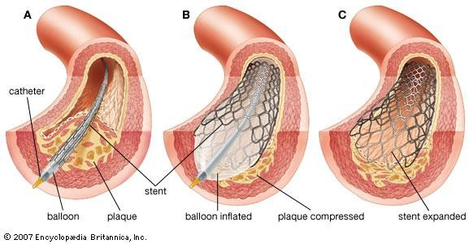

Slide 38

This Photo by Unknown Author is licensed under CC BY-SA

