Slide 1
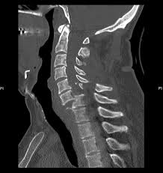
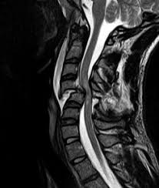
Spinal Trauma

Slide 2
Objectives
Basic Anatomy and physiology of spine
Evaluate a patient with suspected spinal injury
Identify the common type of spinal injuries and their x-ray features
Appropriately treat patients with spinal injury during first hour after injury

Slide 3
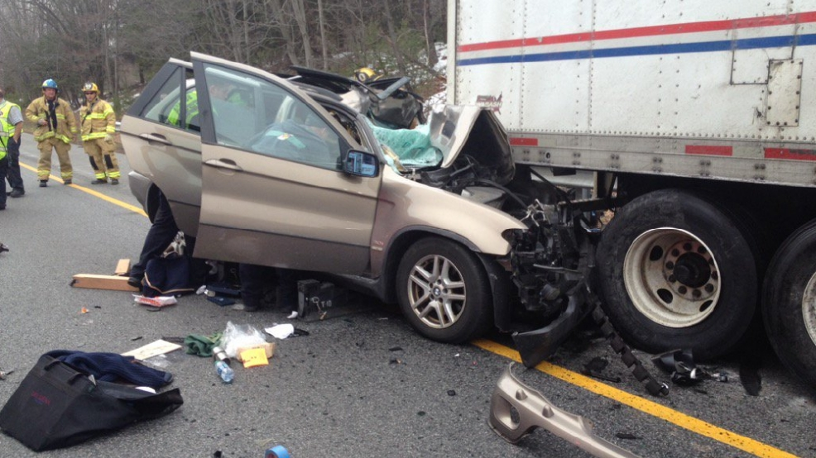
Spinal injury with or without neurologic deficits, must always be considered in patients with multiple injuries.
Approx 5% of patients with brain injury have an associated spinal injury

Slide 4
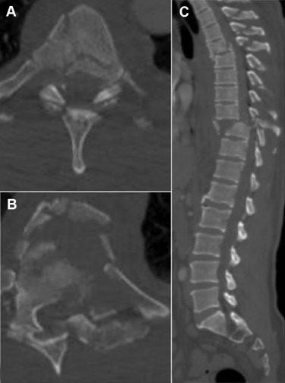
10% of patients with a cervical spine fracture have a second, noncontiguous vertebral column fracture

Slide 5
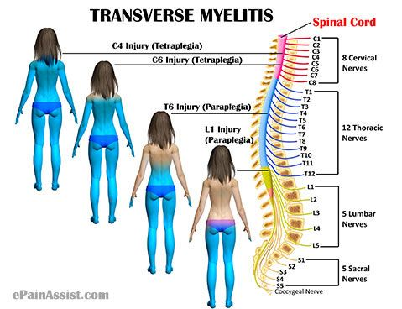
Spinal injuries
55% - cervical region
15% - Thoracic region
15% - Thoracolumbar junction
15% - Lumbosacral region

Slide 6
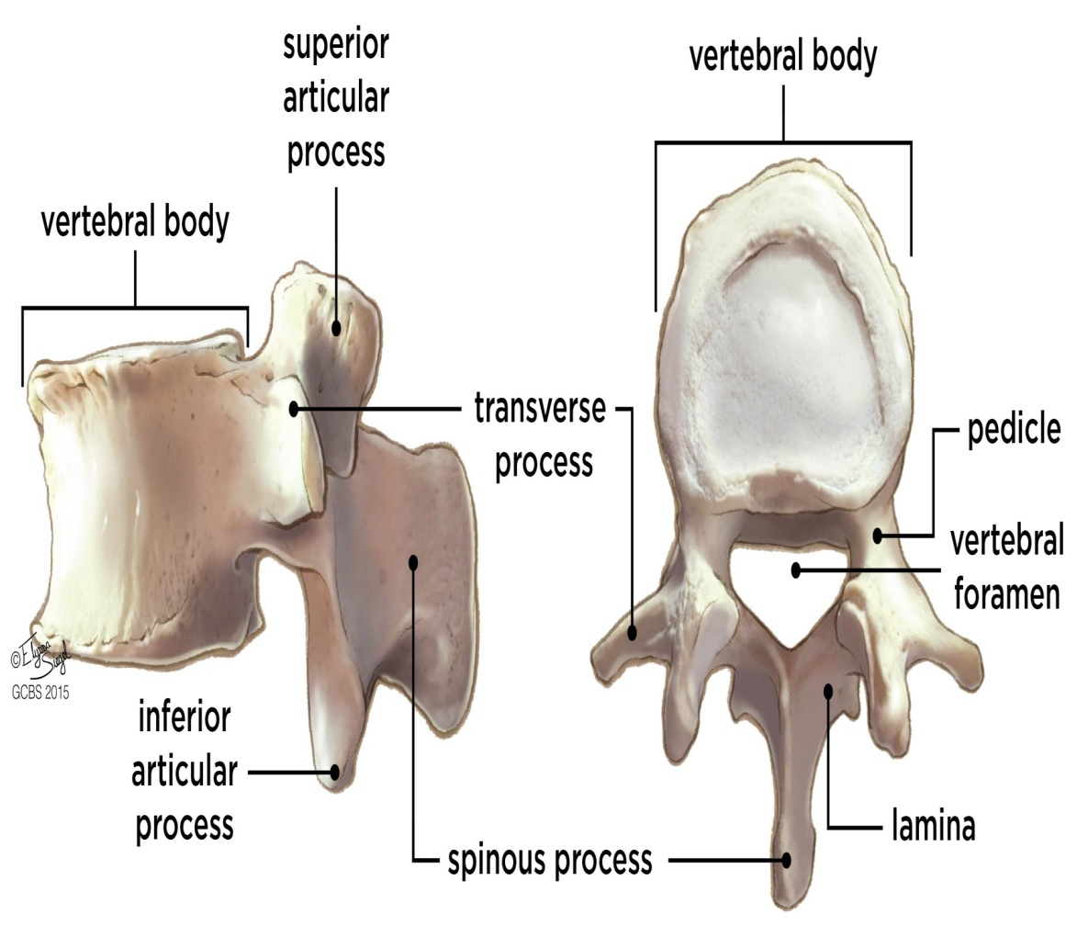
Spine Anatomy

Slide 7
Spinal cord Anatomy

Slide 9
Spinal Cord Syndromes

Slide 10
Central cord syndrome

Slide 11
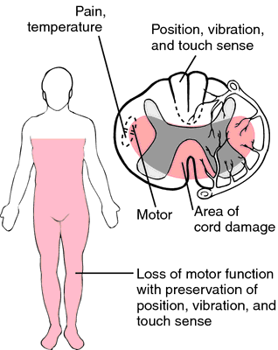
Anterior cord syndrome

Slide 12
Brown sequard syndrome

Slide 13
Complete spinal cord injury
No demonstrable sensory or motor function below a certain level
Prognosis= poor

Slide 14
Incomplete spinal cord injury
Any degree of motor or sensory function remains
Prognosis= Better
Sacral sparing
Voluntary anal sphincter contraction
Voluntary toe flexion

Slide 15
Assessment of patients neurologic status

Slide 16
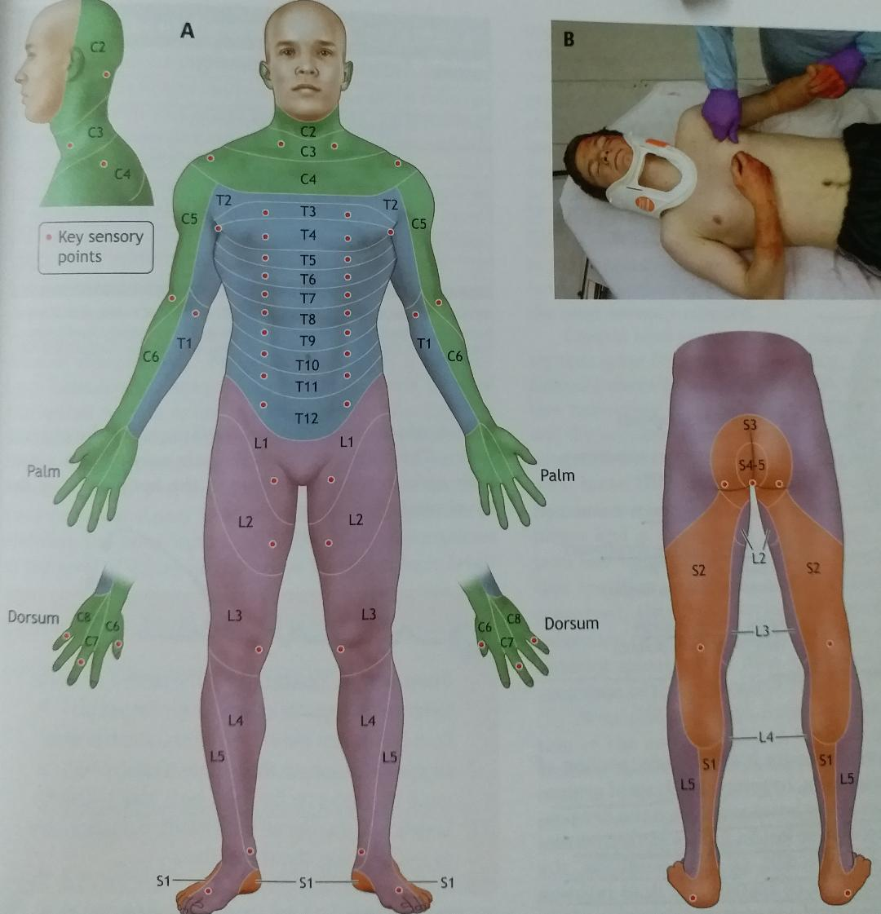
Sensory Examination

Slide 17
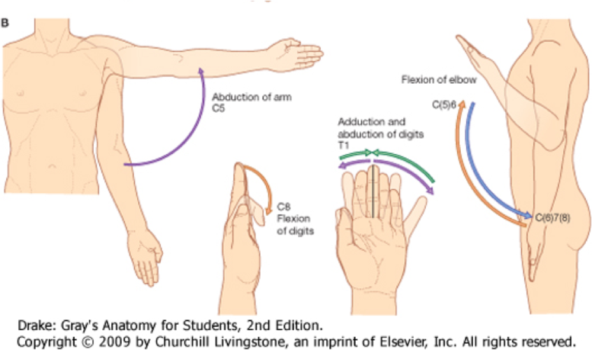
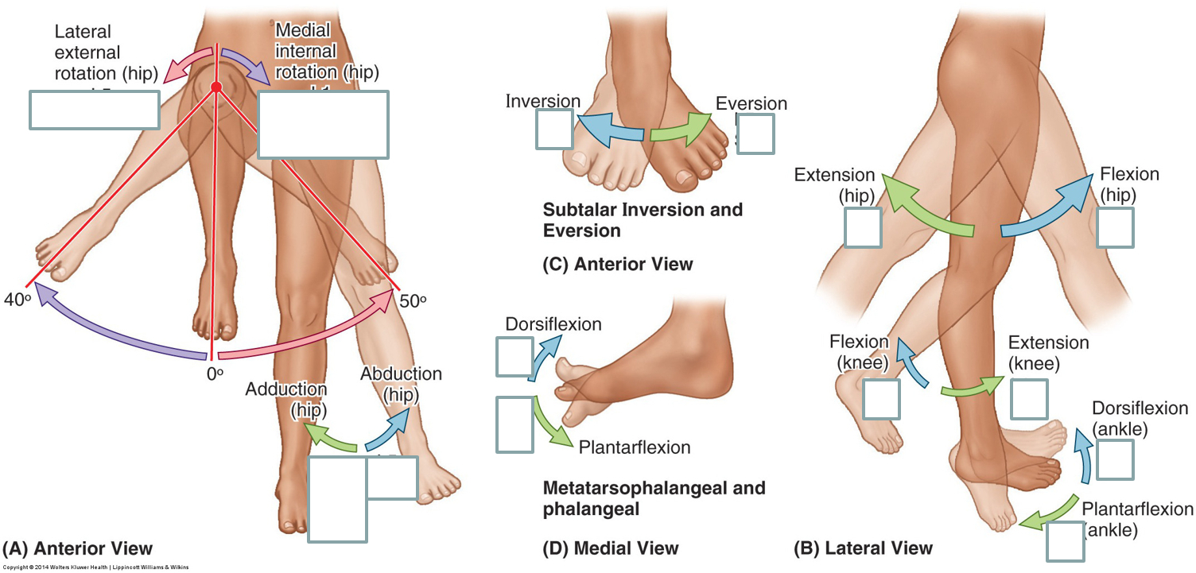
Motor Examination

Slide 18
Neurogenic shock vs. Spinal shock

Slide 19
Neurogenic shock
Impairment of decending sympathetic pathways in cervical or upper thoracic spinal cord
Loss of vasomotor tone
Loss of Sympathetic innervation to heart

Slide 20
Spinal shock
Flacidity (loss of muscle tone)
Loss of reflexes

Slide 21
How to protect spine during evaluation, management and transport?

Slide 22
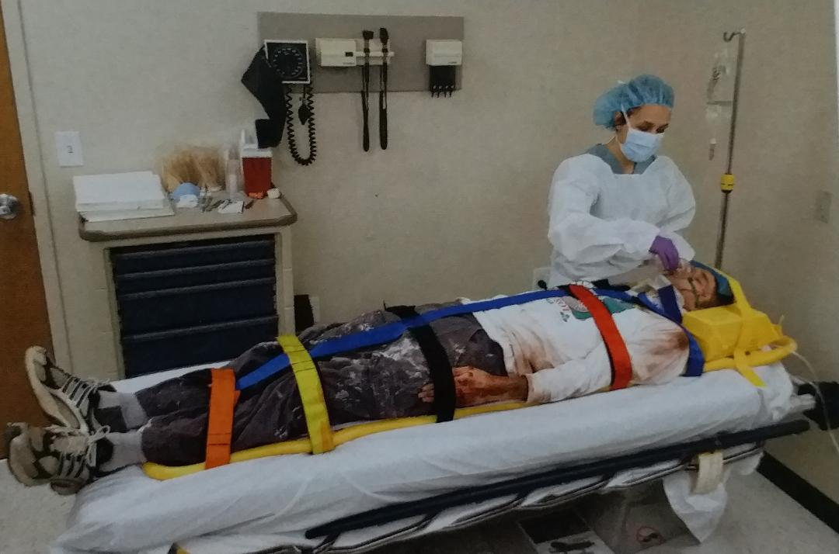
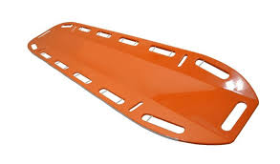
Immobilization
Neutral position
Donot reduce any obvious deformity
Flexion and extension must be avoided
Intubation in neutral position
Removal of spine board
Logrolling

Slide 24
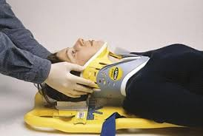
As long as the patients spine is protected, evaluation of the spine and exclusion of spinal injury may be safely deferred, especially in the presence of systemic instability, such as hypotension and respiratory inadequacy

Slide 25
The inability to perceive pain may mask a potential serious injury elsewhere in the body, such as the usual signs of acute abdomen

Slide 26
Specific types of spinal injuries
Axial loading
Flexion
Extension
Rotation
Lateral bending
Distraction

Slide 27
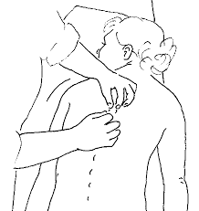
Neurologically intact patient
Absence of pain and tenderness along the spine
Virtually excludes the presence of significant spinal injury

Slide 28
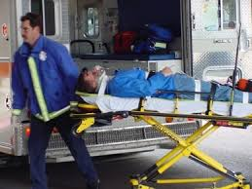
Comatose patient
Obtain the appropriate x-ray films to exclude spinal injury
If x-rays inconclusive
Patients spine should remain protected until further testing can be performed

Slide 29
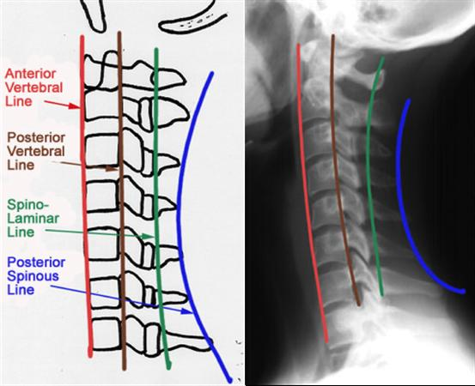
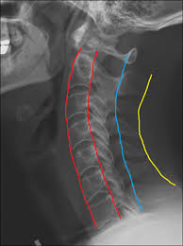
How do we confirm the presence or absence of spinal injury
ABCs

Slide 33
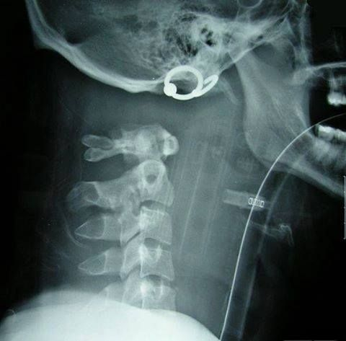
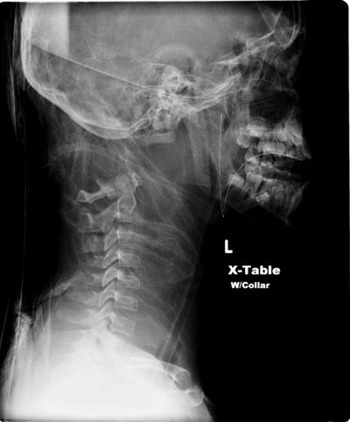
Atlantooccipital Dislocation
Uncommon
Severe traumatic flexion and distraction
Brainstem destruction, apnea or have profound neurologic impairments

Slide 34
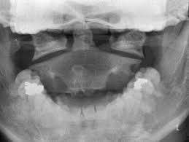
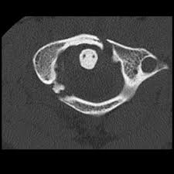
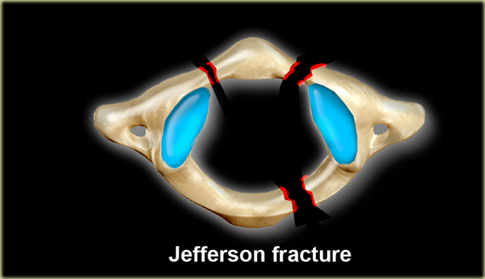
Atlas C1 fracture
5% of cervical fractures
40% associated with fracture of axis
Jeffersons fracture

Slide 35
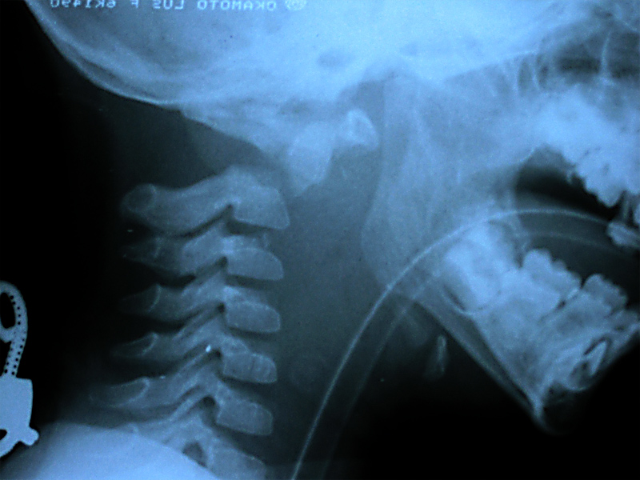
Axis C2 fracture
Largest cervical vertebra
18% of cervical injuries
60% C2 fractures involve odontoid

Slide 36
Hangmans fracture
Poaterior elements of C2 – Pars interarticularis
20% of axis fractures
Extension

Slide 37
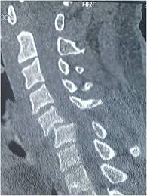
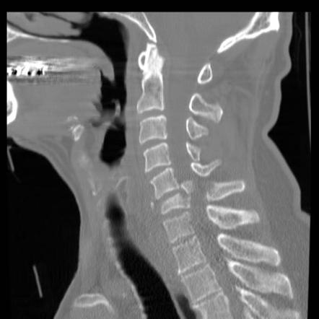
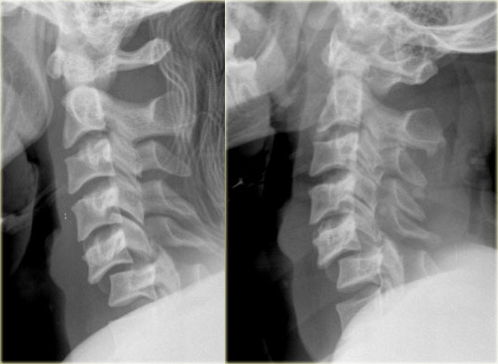
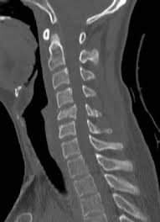
Fracture and dislocations (C3 –C7)
C3 # uncommon
C5 most common level
Subluxation most common C5-C6

Slide 38
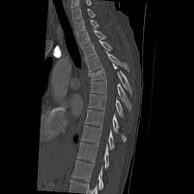
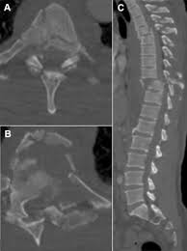
Thoracic fractures (T1- T10)
Anterior wedge compression
Burst injuries
Chance fracture
Fracture dislocation

Slide 39
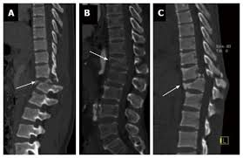
Thoracolumbar junction Fractures (T11 –L1)
Acute hyper flexion and rotation
Particularly vulnerable to rotational movement
Logrolling with extreme care

Slide 40
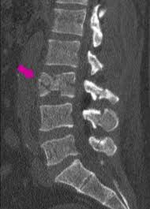
Lumbar fractures
Caudaequina is involved, the probability of complete neurologic deficit is much less

Slide 41
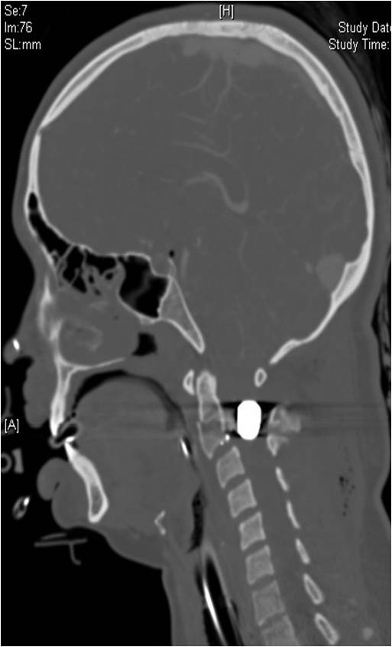
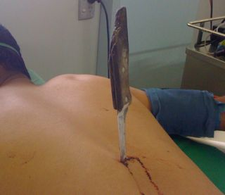
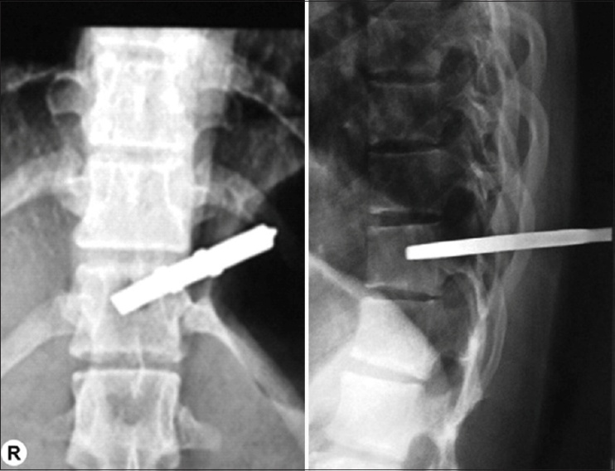
Penetrating injuries
Gunshots or stabbing
Determine the path
Usually stable injuries unless large portion of vertebrae is destroyed

Slide 42
Intravenous fluids
Usual resuscitation
No active hemorrhage detected ,persistent hypotension
Neurogenic shock
Fluid challenge
Vasopressors
Urinary catheter

Slide 43
Medications
Analgesics
Antibiotics
No sufficient evidence for use of steroids

