Slide 1
Limb Sarcomas
By Dr Faryal Azhar

Slide 4
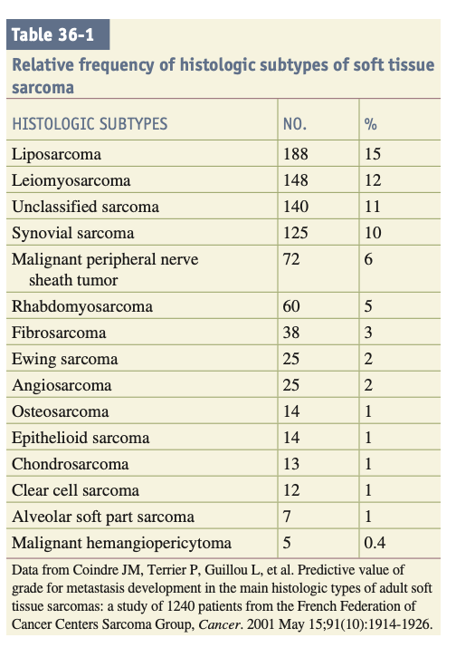

Slide 5
MOLECULAR PATHOGENESIS
Translocation-Associated Sarcomas
Amplification-Associated Sarcomas
Oncogenic Mutations
Complex Genomic Rearrangements

Slide 6
INITIAL ASSESSMENT
The clinical behavior of most soft tissue sarcomas is determined by anatomic location (depth in relation to the investing fascia),
histologic subtype and grade of aggressiveness, and size.
The dominant pattern of metastasis is hematogenous, primarily to the lungs. Lymph node metastasis is rare

Slide 7
Clinical Presentation
Extremity sarcomas may present as a deep venous thrombosis, particularly in patients without significant risk factors for thrombosis.
Tumors in the distal extremities are generally smaller, whereas tumors in the proximal extremities can grow quite large before becoming apparent.

Slide 8
Tumors often grow centrifugally and can compress surrounding normal structures. Infrequently, tumor impingement on bone or neurovascular bundles produces pain, edema, and swelling.
Often an extremity mass is discovered after a traumatic event that draws attention to a pre-existing lesion.

Slide 9
Differential Diagnosis
The differential diagnosis of a soft tissue mass should include consideration of
lipoma (which is 100 times more common than sarcoma),
lymphangioma
leiomyoma
neurinoma
primary or metastatic carcinoma
melanoma
lymphoma.

Slide 10
D/D
Superficial small lesions (<5 cm) that are new or that are not enlarging as indicated by clinical history can be observed
Enlarging masses and masses larger than 5 cm or deep to the fascia should be evaluated with a history, imaging, and biopsy.

Slide 12
Diagnostic Imaging
ULTRASONOGRAPHY
MRI SCAN
CT SCAN
PET SCAN

Slide 13
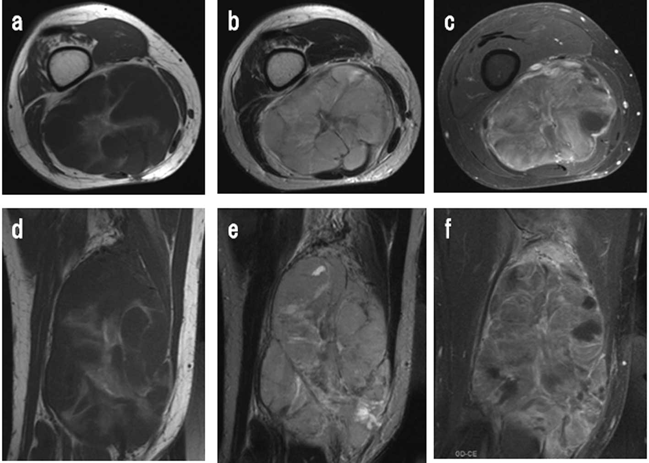

Slide 14
Biopsy Techniques
FNAC
TRUCUT BIOPSY
INCISIONAL BIOPSY
EXCISIONAL BIOPSY

Slide 15
Pathologic Assessment and Classification
Guidelines for the pathologic reporting of sarcoma have been established. Included in the report should be the primary diagnosis.
anatomic site
depth
size

Slide 16
histologic grade
presence or absence of necrosis
status of excision margins and lymph nodes, TNM stage, and additional features of the tumor (i.e., mitotic rate and presence or absence of vascular invasion).

Slide 17
Staging and Prognostic Factors
Sarcomas have classically been stratified into two size groups; T1 lesions are 5 cm or smaller, and
T2 lesions are larger than 5 cm

Slide 18
NODAL METASTASIS.
Rare
N1 disease represents stage 3 and 4
DISTANT METASTASIS
LUNGS

Slide 19
TREATMENT OF EXTREMITY SARCOMA
The overall 5-year survival rate for patients with all stages of soft tissue sarcoma is 50% to 60%. For patients with extremity sarcomas, a multidisciplinary treatment approach has resulted in local control rates exceeding 90% and 5-year survival rates exceeding 70%.

Slide 20
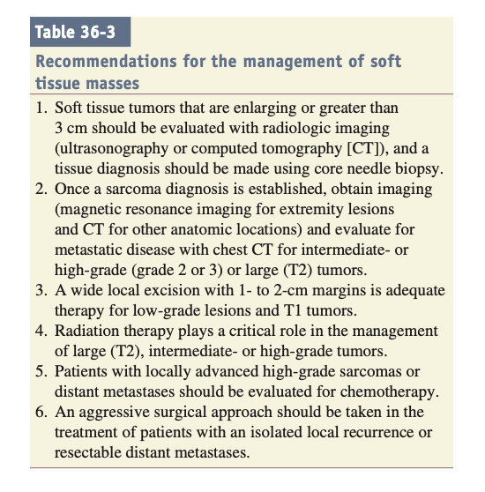

Slide 21
Surgery
WIDE LOCAL EXCISION
LYMPHADENECTOMY
AMPUTATION

Slide 22
Radiation Therapy
Until recently, the standard treatment guidelines required radiation therapy after surgery for all patients with intermediate- or high-grade tumors of any size. However, small tumors (≤5 cm) have not generally been associated with local recurrence, and radiation therapy for such tumors may not be necessary.

Slide 23
Systemic Therapy
Adjuvant chemotherapy
Targeted therapy
Neoadjuvant therapy

Slide 24
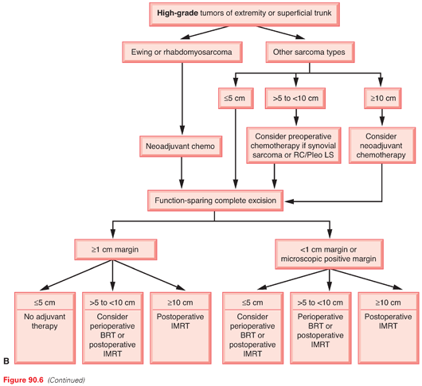

Slide 25
Posttreatment Surveillance
Currently, posttreatment surveillance is recommended for all patients with soft tissue sarcomas.
based on a few reports involving small numbers of patients, indicating that local recurrence can be successfully treated with radical re-excision with or without radiation therapy.

