Slide 1
Case Based Learning(CBL) Shoulder Joint
Musculoskeletal System I First Year MBBS Batch 51
Zeneara
02 April 2024
Dr. Zeneara Saqib
Demonstrator Anatomy

Slide 2
Vision; The Dream/Tomorrow
Motto
To impart evidence based research oriented medical education
To provide best possible patient care
To inculcate the values of mutual respect and ethical practice of medicine
Wisdom
Truth
Service

Slide 3
Professor Umar Model of Integrated Lecture
60%
CORE SUBJECT
20%
HORIZONTAL
INTEGRATION
Physiology
biochemistry
8%
VERTICAL INTEGRATION
Pathology
pharmacology
7%
VERTICAL INTEGRATION
Clinical integration
5%
VERTICAL INTEGRATION
Research, professionalism
Ethics
Digital library

Slide 4
Learning Objectives

Slide 5
Case Presentation(CBL)
During a protest session, a 23-year-old man was forcefully dragged away by the arm by the police. While the police car was on its way to the station, he complained of pain in the shoulder and inability to move his arm. On examination, a deformity of the shoulder joint was visible. A depression was easily palpable under the acromion. Humeral head was palpable through the axilla. After reduction of the dislocation, the patient complained of numbness on the lateral aspect of the forearm, and weakness on the biceps muscle function compared to the uninvolved side. Basic lab work was normal. Radiography revealed depression fracture of the posterolateral articular surface of the humeral head. Axillary view of the glenohumeral joint showed humeral head to be anterior to the glenoid fossa

Slide 6
Diagnosis:
Shoulder Dislocation

Slide 7
Core Concept
No Of Slides……………… 18

Slide 8
Shoulder joint
The glenohumeral (shoulder) joint is a ball-and-socket type of synovial joint.

Slide 9
Articulation Of Glenohumeral Joint

Slide 11
Joint Capsule Of Glenohumeral Joint

Slide 12
Glenoid Cavity

Slide 13
Glenohumeral Joint Ligaments

Slide 14
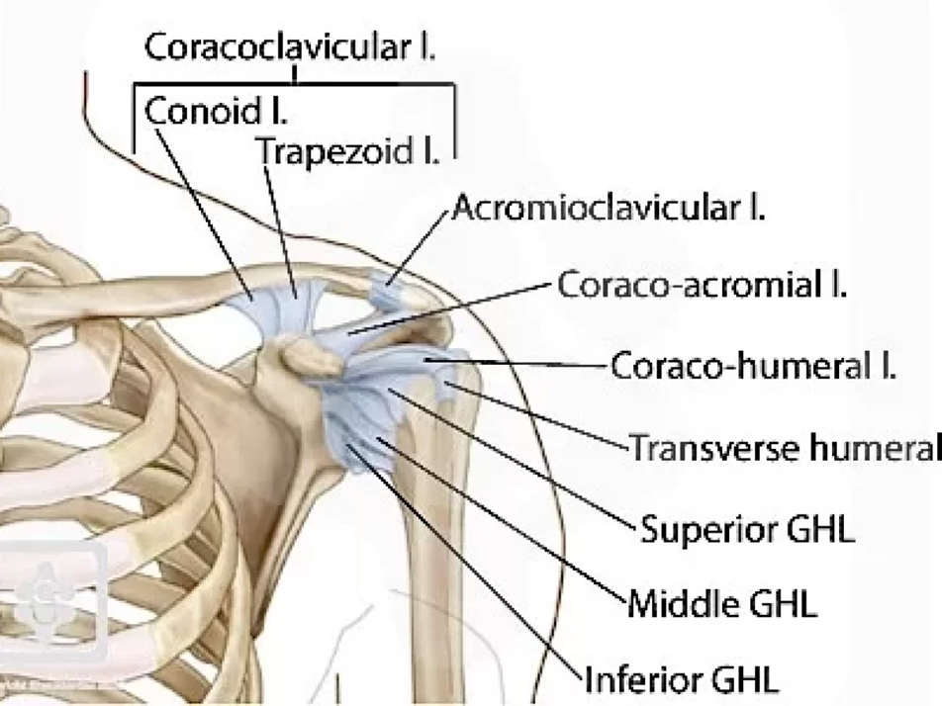
Glenohumeral ligaments
Glenohumeral ligaments (superior, middle and inferior) – extend from the humerus to the glenoid fossa, reinforcing the joint capsule. They act to stabilize the anterior aspect of the joint.

Slide 15
Glenohumeral Joint Ligaments

Slide 16
Coracohumeral Ligament
Extends from the base of the coracoid process to the greater tubercle of the humerus.
It supports the superior part of the joint capsule.

Slide 17
Transverse Humeral Ligament

Slide 18
Coracoacromial Ligament

Slide 19
Glenohumeral Joint Ligaments

Slide 20
Ligaments Of Shoulder Joint

Slide 21
Ligaments

Slide 22
Bursae

Slide 24
Movements At Glenohumeral Joint

Slide 25
Movements At Glenohumeral Joint

Slide 26
Glenohumeral Joint

Slide 27
Vertical Integration

Slide 28
Radiograph

Slide 30
Dislocation

Slide 32
Dislocation

Slide 34
Axillary Nerve Injury

Slide 35
Glenoid Labrum Tear

Slide 38
Spiral Integration

Slide 39
Family Medicine(Presentation Of Shoulder Dislocation)

Slide 41
Artificial Intelligence

Slide 42
Research Article
https://www.ncbi.nlm.nih.gov/books/NBK459125/
Shoulder Dislocations Overview

Slide 43
Abstract

Slide 44
Assessment
Most Common dislocation of shoulder joint is
Anterior
Posterior
Medial
Superior
None of above
Which includes rotator cuff
Joint capsule
Pectoralis group
Infraspinatus
Teres muscles
Orbicular muscles

Slide 45
Shoulder dislocation can injure
A. vagus nerve
B. facial nerve
C. Axillary nerve
D. Radial nerve
E. medial cutaneous nerve
Shoulder joint is
A. Ball and Socket
B. Hinge
C. Gliding
D. Syndesmosis
E. None of above

Slide 46
Prime Extensor Of Glenohumeral joint
Spinal part of deltoid
Pectoralis major
Subscapularis
Latissimus dorsi
Teres major

Slide 47
KEY
1. A
2. C
3. C
4. A
5. A

Slide 48
Learning Resources
1.Clinically Oriented Anatomy by Keith Moore 9th edition.
2.Cunningham’s Manual of Practical Anatomy by G.J. Romanes, 16th edition, Vol-I, II and III
3.http://www.anatomyzone.com 3D anatomy
https://teachmeanatomy.info

Slide 49
Take Home Message

Slide 50
Thank You

