Slide 2
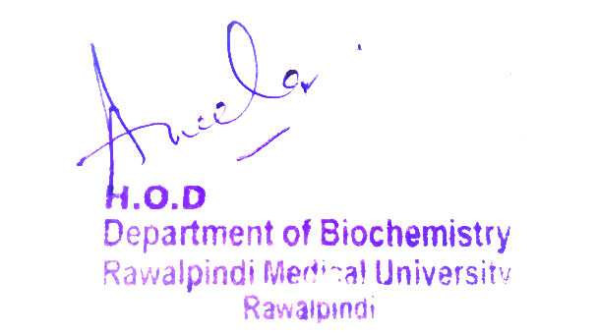
2nd Year MBBS Gastrointestinal Tract Module Large Group Interactive Session (LGIS) Saliva
Presenter: Dr. Almas Ajaz

Slide 3
Motto, Vision, Dream
To impart evidence based research oriented medical education
To provide best possible patient care
To inculcate the values of mutual respect and ethical practice of medicine
Wisdom
Truth
Service

Slide 4
Professor Umar Model of Integrated Lecture

Slide 5
Learning Objectives
At the end of this session students should be able to
Understand the composition of saliva, including its water content , electrolytes, enzymes and proteins
Explain the funtions of saliva
Identify factors influencing saliva secretion, including food stimuli, emotional factors and neuronal pathways

Slide 6
Interactive Session
Patient: Jane Doe, a 45-year-old female
Chief Complaint: Persistent dry mouth (xerostomia) for the past 6 months
Medical History: Jane has a history of rheumatoid arthritis and is currently on medication that includes anticholinergic drugs. She also reports frequent dental caries and difficulty swallowing.
Clinical Findings: Upon examination, Jane's salivary flow rate is significantly reduced. Her oral mucosa appears dry, and she has multiple dental caries.

Slide 8
Functions of Saliva Include:
Moistening and lubrication
Initiation of carbohydrate digestion
Buffering action
Antibacterial properties
Mucus Secretion
Protection of Oral Mucosa

Slide 9
Core Concept
Salivary Glands
There are 3 main pair of Salivary glands
Parotid Gland (Serous section)
Submandibular Gland (Serous and mucus secretion)
Sublingual Gland (mostly mucus secretion)
There are also minor buccal glands which secrete mucus.
These minor glands are located at tip of tongue or in oral mucosa

Slide 11
Nerve supply
The salivary glands are supplied by both sympathetic ADRENERGIC and parasympathetic CHOLINERGIC fibers but secretion is mainly controlled by parasympathetic fibers. Parasympathetic stimulation mediated by acetylcholine results in excessive production of saliva and can be blocked by atropine.
Sympathetic stimulation results in production of small amount of thick saliva from submaxillary glands having no effect on parotid secretion.

Slide 12
Saliva
Saliva is a clear and watery fluid produced by the salivary glands in the oral cavity. It is essential for various physiological functions, including moistening the mouth, initiating the digestion of food, maintaining oral hygiene, and facilitating speech and swallowing.
Daily Secretion: 800-1500 ml
Ph: 6-7

Slide 13
Composition
Water: Comprising about 99% of saliva.
Electrolytes: Saliva contains essential ions such as sodium, potassium, chloride, and bicarbonate.
Enzymes: The primary enzyme in saliva is amylase, which initiates the digestion of carbohydrates.
Mucus: Mucus provides lubrication and protection of oral mucosa.
Antibacterial Compounds: Saliva contains substances like lysozyme and immunoglobulins, which have antibacterial properties.

Slide 14
Mechanism of Secretion of Saliva
Saliva is secreted from acini into ducts from where there is active or passive secretion and reabsorption.
K and HCO3 are secreted and Na and Cl are reabsorbed.

Slide 15
Salivary Amylase
Salivary amylase, produced by salivary glands, is released during chewing to kickstart carbohydrate digestion.
It Catalyzes the breakdown of starch into maltose and oligosaccharides by cleaving glycosidic bonds between glucose units.
Works best in the slightly acidic to neutral pH of the mouth; activity limited by inactivation in the stomach's more acidic environment.

Slide 16
Salivation
Secretion of Saliva is called Salivation
Amount of saliva secreted daily is 1000-1500ml
Parasympathetic stimulation from Facial (CNVII) and Glossopharyngeal nerve (CNIX) stimulate saliva secretion
Stimulation of sympathetic system leads to dryness of mouth

Slide 17
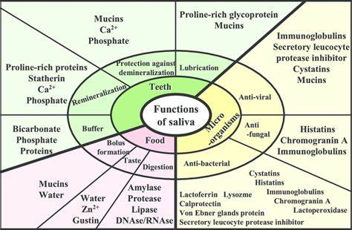
Core Knowledge
Functions of Saliva
Secondary bile acids are reabsorbed in the terminal ileum and returned to the liver via the portal circulation, completing the enterohepatic circulation. This recycling mechanism allows for efficient use of bile acids.

Slide 18
FUNCTIONS OF SALIVA
Lubrication: It is the most important function and is due to its content MUCIN. Chewing is facilitated and along with movements of tongue the moistened and masticated food is converted into bolus. This lubrication also helps in swallowing. Lubrication of oral cavity also helps in talking.
Solvent action: by dissolving certain food contents the saliva stimulates the taste buds and also stimulates appetite and increases further flow of saliva as well as gastric juice.
Cleansing action: constant salivary secretion inhibits bacterial growth in oral cavity so maintain good oral hygeine. The lysozyme also suppress bacterial growth. Saliva also retards the development of dental caries.

Slide 19
Functions of Saliva:
Digestive function: salivary amylase helps in digestion of carbohydrates.
Excretory function: saliva is a vehicle for excretion of certain drugs like ethanol, morphine, penicillin of inorganic ions like K, Ca and HCO₃, thiocynate, iodine and IgA.
Several types of viruses like that of polio, rabies, mumps are also excreted in saliva.
Urea in Chronic Renal Failure and Glucose in Diabetes are also excreted in saliva.
Regulation of water intake: in Dehydration secretion of saliva is suppressed and dryness of oral and pharyngeal mucosa produces sensation of thirst.

Slide 20
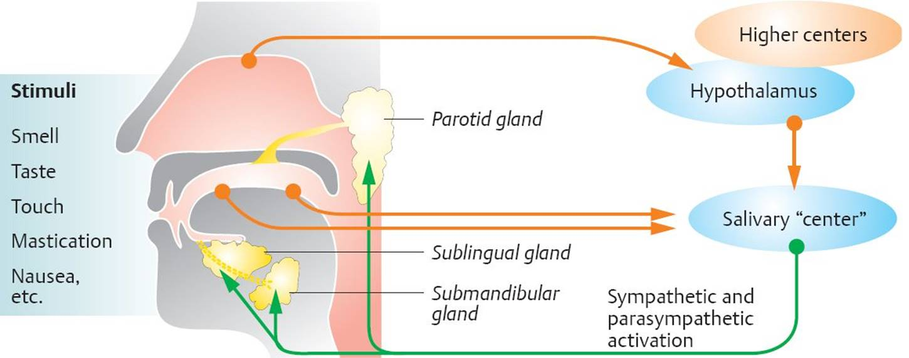
Neural Control of Salivation
Pancreatic juice is a fluid secreted by the pancreas, an organ located behind the stomach in the abdominal cavity.
This clear alkaline fluid plays a crucial role in digestion, particularly in the breakdown of carbohydrates, proteins, and fats in the small intestine.

Slide 21
Secretion due to Conditioned Reflexes
Secretion due to conditioned reflexes occur in an empty mouth from senses of sight and smell. Nausea and vomiting are also associated with increased salivation.

Slide 22
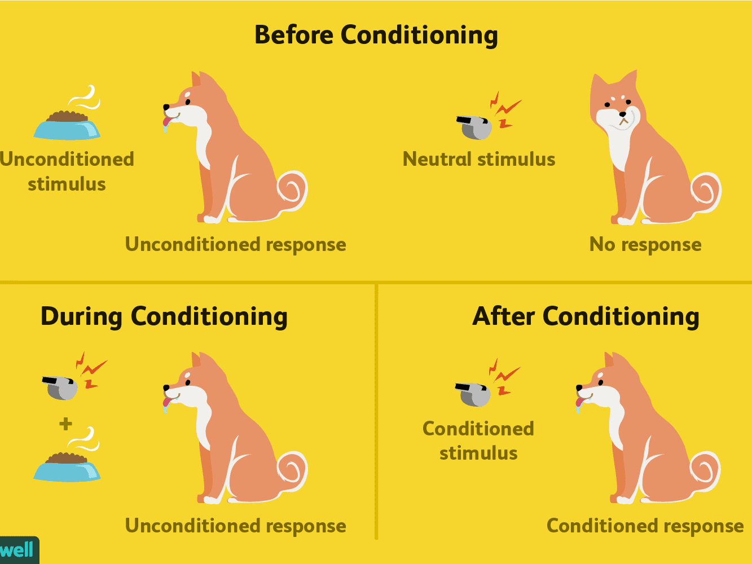

Slide 23
Vertical Integration
Sialolithiasis is a benign condition involving the formation of stones within the ducts of salivary glands. In some cases it can obstruct the salivary ducts leading to inflammation. The symptoms of sialolithiasis include swelling and decreased salivary flow.
Sjogren’s syndrome is a chronic autoimmune disorder that happens when the immune system attacks the glands that make moisture in the eyes, mouth, and other parts of the body

Slide 24
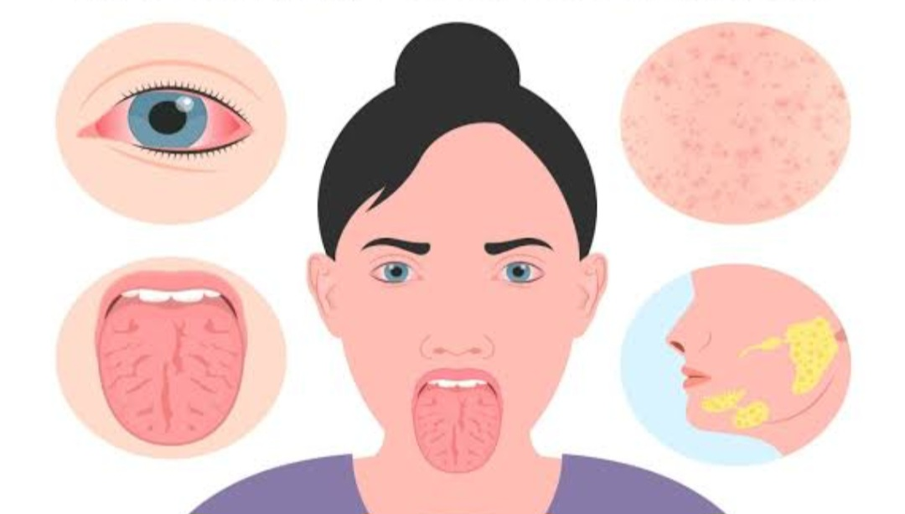
Sjorgens Syndrome

Slide 25
Family Medicine
Family Medicine plays important role in following manner:
Diagnosis: They may inquire about symptoms such as dry mouth, difficulty swallowing, or changes in taste, and conduct a brief oral examination to identify potential issues.
Education: Family physicians can explain how saliva helps prevent tooth decay, aids in digestion, and has antimicrobial properties.
Monitoring: Family medicine practitioners are vigilant in monitoring patients with conditions like Sjögren's syndrome
Refer to Specialists: When necessary, family medicine practitioners can refer patients to oral health specialists, such as dentists or oral surgeons

Slide 26
Artificial Intelligence
Artificial Intelligence plays role in following aspects:
AI can help in personalized nutrition plan for patients
AI can help in diagnosis of salivary problems like xerostomia or Sjogren syndrome
AI can help in specific food recommendations
AI can help in development of new drugs

Slide 27
Bioethics
Highlight the valuable insights saliva provides for research and diagnostics.
Emphasize the ethical necessity of obtaining informed consent for saliva sample collection.
Address the critical need to protect participant privacy and maintain confidentiality in handling saliva-based genetic information.
Briefly touch upon ethical challenges associated with emerging saliva-based technologies and stress the importance of regulatory oversight.

Slide 28
Suggested Research Article
Link:https://pubmed.ncbi.nlm.nih.gov/38192116/
Title:Molecular mechanisms of saliva secretion and hyposecretion
Author Name: Eun-Ah Christine Song
Abstract:
The exocrine salivary gland secretes saliva, a fundamental body component to maintain oral homeostasis. Saliva is composed of water, ions, and proteins such as amylase, mucins, and immunoglobulins that play essential roles in the digestion of food, lubrication, and prevention of dental caries and periodontitis. An increasing number of people experience saliva hyposecretion due to aging, medications, Sjögren's syndrome, and radiation therapy for head and neck cancerHowever, current treatments are mostly limited to temporary symptomatic relief. This review explores the molecular mechanisms underlying saliva secretion and hyposecretion to provide insight into putative therapeutic targets for treatment

Slide 29
Assessment
1. What is the primary function of saliva in the digestive system?
a) To transport nutrients
b) To break down carbohydrates
c) To filter toxins
d) To store water
2. Which enzyme present in saliva helps in the digestion of starch?
a) Lipase
b) Amylase
c) Protease
d) Sucrase

Slide 30
Assessment
3. What is the average pH of saliva in the human mouth?
a) Acidic
b) Neutral
c) Alkaline
d) Variable
4. Saliva plays a crucial role in:
a) Sight
b) Smell
c) Taste
d) Hearing

Slide 31
Assessment
5. Which component in saliva helps in preventing tooth decay by neutralizing acids in the mouth?
a) Mucus
b) Water
c) Bicarbonate
d) Amylase

Slide 32
Key
1-b) To break down carbohydrates
2-b) Amylase
3- c) Alkaline
4-c) Taste
5-c) Bicarbonate

Slide 33
Learning Resources
Text book of Biochemistry, Lippincott 8th edition, chapter 7 , page 95.
Google scholar
Google images

