Slide 1
SEPSIS
Dr. Waqas Anjum
Assisstant Professor
Dept. of Anaesthesiology
Benazir Bhutto Hopital
RMU and Allied

Slide 4
Sequence of LGIS
Learning Objectives:
Sepsis, Pathophysiology, Diagnosis, Managment
CORE knowledge 70%
Microbiology/Antibiotic Selection
Vertical Integration 15%
Radiology(CXR), Surgery(Source control), ICU care
Horizontal Integration 10%
Research article related to topic 3%
Ethics 2%

Slide 5
Learning Objectives
Understand the definitions of sepsis, severe sepsis, and septic shock.
Learn the pathophysiology behind sepsis & multi-organ failure.
Identify key diagnostic tools and emerging biomarkers.
Apply sepsis management strategies, including fluid resuscitation, vasopressors, and antibiotics.
Interpret sepsis scoring systems (qSOFA, SOFA) for risk assessment.
Recognize the latest advancements in sepsis treatment

Slide 6
1. Which of the following is a key diagnostic criterion for sepsis?
A) Hyperthermia above 38.5°C
B) Persistent hypotension despite adequate fluid resuscitation
C) Tachycardia greater than 90 bpm
D) Positive blood culture for any pathogen
Answer: B) Persistent hypotension despite adequate fluid resuscitation
---
2. Which of the following is NOT a part of the Sepsis-3 definition of sepsis?
A) Life-threatening organ dysfunction
B) Acute respiratory failure
C) Infection with confirmed pathogen
D) Increase in Sequential Organ Failure Assessment (SOFA) score of 2 or more
Answer: C) Infection with confirmed pathogen

Slide 7
3. In septic shock, the primary pathophysiological mechanism causing hypotension is:
A) Hypovolemia due to excessive fluid loss
B) Vasodilation and increased vascular permeability
C) Reduced cardiac output due to myocardial depression
D) Renal hypoperfusion
Answer: B) Vasodilation and increased vascular permeability
---
4. What is the first-line vasopressor agent recommended in septic shock?
A) Epinephrine
B) Dopamine
C) Norepinephrine
D) Vasopressin
Answer: C) Norepinephrine

Slide 8
5. Which of the following laboratory findings is MOST commonly associated with sepsis?
A) Hyperkalemia
B) Elevated lactate levels
C) Low white blood cell count (leukopenia)
D) Decreased C-reactive protein (CRP) levels
Answer: B) Elevated lactate levels
---
6. Which of the following is the preferred initial fluid resuscitation in patients with sepsis or septic shock?
A) Normal saline
B) Lactated Ringer’s solution
C) Albumin
D) Dextrose solutions
Answer: B) Lactated Ringer’s solution

Slide 9
5. Which of the following laboratory findings is MOST commonly associated with sepsis?
A) Hyperkalemia
B) Elevated lactate levels
C) Low white blood cell count (leukopenia)
D) Decreased C-reactive protein (CRP) levels
Answer: B) Elevated lactate levels
---
6. Which of the following is the preferred initial fluid resuscitation in patients with sepsis or septic shock?
A) Normal saline
B) Lactated Ringer’s solution
C) Albumin
D) Dextrose solutions
Answer: B) Lactated Ringer’s solution

Slide 10
9. Which of the following scoring systems is used to assess organ dysfunction in sepsis?
A) APACHE II
B) SOFA
C) MELD
D) GCS
Answer: B) SOFA
---
10. The administration of antibiotics in sepsis should be:
A) Delayed until the infection source is identified
B) Initiated within 1 hour of recognition of sepsis
C) Given only after confirmation of a positive culture
D) Administered as a single dose at the time of fluid resuscitation
Answer: B) Initiated within 1 hour of recognition of sepsis

Slide 11
Definition
Sepsis is a life threatning organ dysfunction caused by a dysregulated host response to infection
Organ Dysfunction
Organ dysfunction is defined as an increase in the Sequential Organ Failure Assessment (SOFA score) by equal/greater than 2

Slide 12
Systemic Inflammatory Response Syndrome (SIRS)
SIRS is a generalized inflammatory response that occurs in infections, trauma, burns, and pancreatitis.
SIRS Criteria (≥2 of the following):
Temperature >38°C or <36°C
Heart Rate >90 bpm
Respiratory Rate >20/min or PaCO₂ <32 mmHg
WBC Count >12,000 or <4,000 or >10% immature bands

Slide 13
Septic Shock
A subset of sepsis with circulatory, cellular, and metabolic abnormalities that significantly increase mortality.
Defined as sepsis with persistent hypotension requiring vasopressors to maintain MAP ≥65 mmHg and serum lactate >2 mmol/L despite adequate fluid resuscitation.

Slide 14
Pathogenesis of Sepsis
Sepsis is caused by excessive immune activation in response to an infectious insult leading to systemic inflammation, endothelial dysfunction, coagulation abnormalities, and multi-organ failure.
Key Steps in Sepsis Pathogenesis
Infectious Trigger & Immune Activation
Pathogen-Associated Molecular Patterns (PAMPs) like lipopolysaccharide (LPS) from Gram-negative bacteria and peptidoglycan from Gram-positive bacteria activate Toll-Like Receptors (TLRs) on immune cells.

Slide 15
Activation of TLRs triggers the release of pro-inflammatory cytokines
TNF-α: Increases vascular permeability
IL-1 & IL-6: Mediate fever and inflammation
IL-10: Anti-inflammatory cytokines
Endothelial Dysfunction & Capillary Leak
Pro-inflammatory cytokines cause vasodilation → hypotension.
Increased vascular permeability → capillary leak syndrome → interstitial edema.

Slide 16
Coagulation Activation (Sepsis-Induced DIC)
Tissue Factor (TF) activation → widespread microvascular thrombosis.
Consumption of coagulation factors → Disseminated Intravascular Coagulation (DIC).
Cellular Dysfunction & Multi-Organ Failure
Mitochondrial dysfunction → ATP depletion → cellular apoptosis.
Leads to shock, hypoxia, and multi-organ dysfunction.

Slide 17
3. ETIOLOGY OF SEPSIS
Sepsis can be caused by bacterial, viral, fungal, or parasitic infections.
Common Pathogens

Slide 18
DIAGNOSIS OF SEPSIS
Clinical Criteria for Sepsis Diagnosis
Quick SOFA (qSOFA) Score (Bedside Screening)
Sequential Organ Failure Assessment (SOFA) Score (ICU Tool)

Slide 19
qSOFA (Quick Sepsis Screening
Criteria (1 point each)
Altered mental status (GCS < 15)
Respiratory rate ≥ 22/min
Systolic BP ≤ 100 mmHg
Interpretation
qSOFA ≥ 2: High risk of sepsis and poor outcomes
qSOFA < 2: Low risk, but monitor closely
A rapid bedside tool for early sepsis detection.

Slide 20
SOFA (Sequential Organ Failure Assessment)
ICU Tool for Organ Dysfunction in Sepsis
A SOFA score increase of ≥2 suggests significant organ dysfunction.
SOFA ≥2 indicates high suspicion of sepsis.
Higher SOFA scores correlate with increased mortality.
Used to monitor disease progression in critically ill patients.

Slide 21
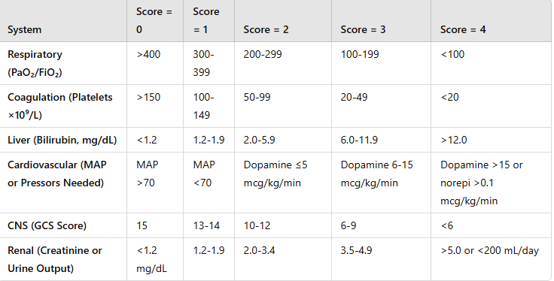

Slide 22
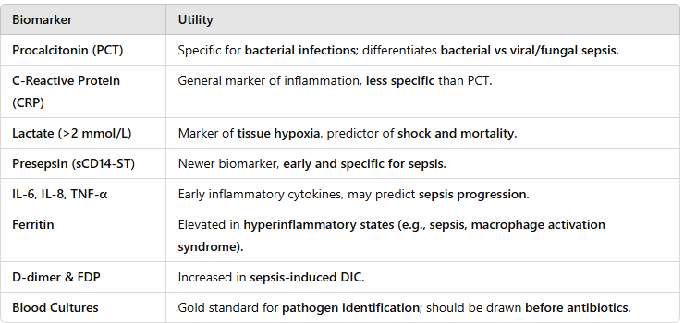
Biomarkers for Sepsis (New & Established)

Slide 23
MANAGEMENT OF SEPSIS (Surviving Sepsis Campaign 2021)
Initial Resuscitation ("Golden Hour")
IV Fluids: 30 mL/kg IV crystalloid within 3 hours.
Reassess fluid responsiveness using:
Dynamic tests: Passive Leg Raise (PLR), Stroke Volume Variation (SVV), Inferior Vena Cava (IVC) diameter variation.
Targets: Mean Arterial Pressure (MAP ≥65 mmHg), Urine Output ≥0.5 mL/kg/hr
Avoid excess fluids in patients at risk of pulmonary edema(ARDS)

Slide 24
Vasopressor Support (If Fluid-Resistant Hypotension)
First-line: Norepinephrine (0.05-1.0 mcg/kg/min) to maintain MAP ≥65 mmHg.
Second-line: Vasopressin (0.03 U/min) or Epinephrine if norepinephrine is insufficient.
Dobutamine for septic cardiomyopathy (Low EF & persistent hypoperfusion)

Slide 25
Early Antibiotic Therapy
Initiate broad-spectrum IV antibiotics within 1 hour of sepsis recognition.
De-escalate antibiotics based on culture results & clinical improvement.
Combination Therapy (For Septic Shock):
Piperacillin-Tazobactam + Vancomycin (empirical Gram-negative + MRSA coverage)
Meropenem + Linezolid (for MDR organisms, ICU

Slide 26
Source Control (Within 6-12 Hours)
Drain abscesses, remove infected catheters, surgery for perforations
Adjunctive Therapies
Corticosteroids (IV Hydrocortisone) if refractory shock.
Vitamin C & Thiamine (under investigation).

Slide 27
Mechanical Ventilation & ARDS Management
Low tidal volume (6 mL/kg PBW) to prevent ventilator-induced lung injury.
PEEP & prone positioning for severe ARDS (PaO₂/FiO₂ <100).
Avoid excessive IV fluids once the patient is hemodynamically stable
Glycemic Control in Sepsis
Target blood glucose 140-180 mg/dL (avoid tight control to prevent hypoglycemia

Slide 28
DIC & Coagulopathy Management
DIC in sepsis is characterized by increased PT, aPTT, D-dimer, low platelets.
Management:
FFP, cryoprecipitate, platelet transfusion (if bleeding or platelet count <20,000)
Nutritional Support
Enteral nutrition within 48 hours to maintain gut integrity.
Avoid TPN unless prolonged gut dysfunction

Slide 29
CONCLUSION
Early recognition & aggressive management of sepsis improve survival.
The Sepsis-3 criteria provide a more precise definition than SIRS.
Sepsis bundles (fluids, antibiotics, source control) reduce mortality.

Slide 30
Bioethics
Respecting the patient’s right to accept or refuse treatment, especially in cases of advanced sepsis and end-of-life care.
Informed consent for invasive procedures (e.g., mechanical ventilation, dialysis)

Slide 31
References
Morgan and Mikhail_s Clinical Anesthesiology
Miller_s Basics of Anesthesia

Slide 32
Research
Singer, M., et al. (2016). The Third International Consensus Definitions for Sepsis and Septic Shock (Sepsis-3). JAMA, 315(8), 801-810. DOI: 10.1001/jama.2016.0287
Evans, L., et al. (2021). Surviving Sepsis Campaign: International Guidelines for Management of Sepsis and Septic Shock 2021. Critical Care Medicine, 49(11), e1063-e1143. DOI: 10.1097/CCM.0000000000005337
Rhodes, A., et al. (2017). Surviving Sepsis Campaign: International Guidelines for Management of Sepsis and Septic Shock 2016. Intensive Care Medicine, 43(3), 304-377. DOI: 10.1007/s00134-017-4683-6

