Slide 2
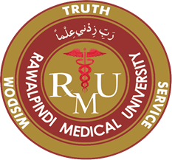
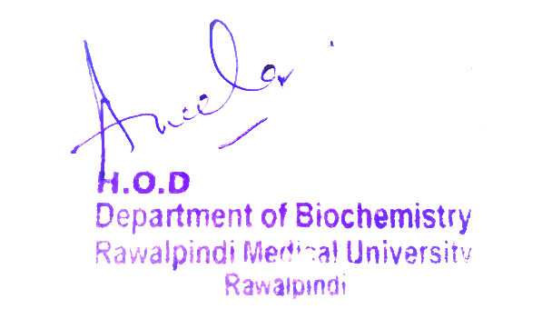
2nd Year MBBS Gastrointestinal Tract Module Large Group Interactive Session (LGIS) Riboflavin, Biotin
Presenter: Dr. Almas Ajaz

Slide 3
Motto, Vision, Dream
To impart evidence based research oriented medical education
To provide best possible patient care
To inculcate the values of mutual respect and ethical practice of medicine
Wisdom
Truth
Service

Slide 4
Professor Umar Model of Integrated Lecture

Slide 5
Learning Objectives
At the end of this session students should be able to
Explain dietary sources and role of riboflavin and biotin

Slide 6
Interactive Session
A 45-year-old woman, named Sarah, visits her primary care physician with complaints of fatigue, hair thinning, and brittle nails. She mentions that she has been taking over-the-counter biotin supplements (10 mg daily) for the past six months to improve her hair and nail health. Her medical history is unremarkable, and she is otherwise healthy.

Slide 9
CORE CONCEPT
Riboflavin, also known as vitamin B2, is a vitamin found in food and sold as a dietary supplement.
It is essential to the formation of two major coenzymes, flavin mononucleotide and flavin adenine dinucleotide.
These coenzymes are involved in energy metabolism, cellular respiration, and antibody production, as well as normal growth and development.
The coenzymes are also required for the metabolism of niacin, vitamin B6, and folate.
It is a starting compound in the synthesis of the coenzymes flavin mononucleotide (FMN, also known as riboflavin-5'-phosphate) and flavin adenine dinucleotide (FAD). FAD is the more abundant form of flavin, reported to bind to 75% of the number of flavin-dependent protein encoded genes in the all-species genome (the flavoproteome) and serves as a co-enzyme for 84% of human-encoded flavoproteins.

Slide 10
A. A flavin with a sugar alcohol (ribitol) side chain
B. Somewhat soluble to water
C. Stable to heat and oxidizing agents
D. Sensitive to alkaline solutions
E. Yellow, decomposed by visible and ultraviolet light
F. Coenzyme derivatives
1. FMN: flavin mononucleotide
2. FAD: flavin adenine dinucleotide
G. In metabolic reactions, flavins accept a pair of H atoms

Slide 11
STRUCTURE

Slide 13
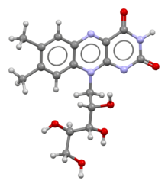
CHEMICAL STRUCTURE

Slide 14
FUNCTIONS
Riboflavin is essential to the formation of two major coenzymes, FMN and FAD.
These coenzymes are involved in energy metabolism, cell respiration, antibody production, growth and development. R
iboflavin is essential for the metabolism of carbohydrates, protein and fats.
FAD contributes to conversion of tryptophan to niacin (vitamin B3) and the conversion of vitamin B6 to the coenzyme pyridoxal 5'-phosphate requires FMN.
Riboflavin is involved in maintaining normal circulating levels of homocysteine; in riboflavin deficiency, homocysteine levels increase, elevating the risk of cardiovascular diseases.

Slide 15
REDOX REACTIONS
Redox reactions are processes that involve the transfer of electrons. The flavin coenzymes support the function of roughly 70-80 flavoenzymes in humans (and hundreds more across all organisms, including those encoded by archeal, bacterial and fungal genomes) that are responsible for one- or two-electron redox reactions which capitalize on the ability of flavins to be converted between oxidized, half-reduced and fully reduced forms.
FAD is also required for the activity of glutathione reductase, an essential enzyme in formation of the endogenous antioxidant, glutathione.

Slide 16
MICRONUTRIENT METABOLISM
Riboflavin, FMN, and FAD are involved in the metabolism of niacin, vitamin B6, and folate.
The synthesis of the niacin-containing coenzymes, NAD and NADP, from tryptophan involves the FAD-dependent enzyme, kynurenine 3-monooxygenase. Dietary deficiency of riboflavin can decrease the production of NAD and NADP, thereby promoting niacin deficiency.
Conversion of vitamin B6 to its coenzyme, pyridoxal 5'-phosphate synthase, involves the enzyme, pyridoxine 5'-phosphate oxidase, which requires FMN.
An enzyme involved in folate metabolism, 5,10-methylenetetrahydrofolate reductase, requires FAD to form the amino acid, methionine, from homocysteine.

Slide 17
Core Knowledge
SYNTHESIS
Biosynthesis takes place in bacteria, fungi and plants, but not animals.
The biosynthetic precursors to riboflavin are ribulose 5-phosphate and guanosine triphosphate.
The former is converted to L-3,4-dihydroxy-2-butanone-4-phosphate while the latter is transformed in a series of reactions that lead to 5-amino-6-(D-ribitylamino)uracil.
These two compounds are then the substrates for the penultimate step in the pathway, catalysed by the enzyme lumazine synthase in reaction

Slide 18
In the final step of the biosynthesis, two molecules of 6,7-dimethyl-8-ribityllumazine are combined by the enzyme riboflavin synthase in a dismutation reaction.
This generates one molecule of riboflavin and one of 5-amino-6-(D-ribitylamino) uracil. The latter is recycled to the previous reaction in the sequence.

Slide 20
MECHANISMS OF ACTION OF RIBOFLAVIN
Formation of Coenzymes:
Riboflavin is converted into two active coenzymes: flavin mononucleotide (FMN) and flavin adenine dinucleotide (FAD).
These coenzymes are essential for a variety of enzymatic reactions in the body.
Energy Metabolism:
FMN and FAD are key components of the electron transport chain, which is a critical part of cellular respiration.
They facilitate the transfer of electrons and protons, contributing to the generation of adenosine triphosphate (ATP), the primary energy currency of cells.
Metabolism of Carbohydrates, Fats, and Proteins:
Riboflavin coenzymes are involved in the metabolism of carbohydrates, fats, and proteins.
They participate in various enzymatic reactions that break down these macronutrients and convert them into energy or building blocks for the body.

Slide 21
Antioxidant Activity:
Riboflavin indirectly contributes to antioxidant defenses in the body. The coenzymes FMN and FAD are required for the activation of the antioxidant enzyme, glutathione reductase.
This enzyme helps maintain the antioxidant molecule glutathione in its reduced form, which is necessary for protecting cells from oxidative damage.
Tissue Growth and Repair:
Riboflavin is important for the maintenance and repair of tissues, including the skin, eyes, and nervous system.
It plays a role in collagen production and can support the healing of wounds and the health of the cornea.
Red Blood Cell Production:
Riboflavin is involved in the synthesis of heme, a component of hemoglobin, the protein in red blood cells responsible for carrying oxygen.
Adequate riboflavin is necessary for the formation and maturation of red blood cells

Slide 22
Conversion of Tryptophan:
Riboflavin is necessary for the conversion of the amino acid tryptophan into niacin (vitamin B3), which is essential for various metabolic processes.
Methylation Reactions:
Riboflavin is involved in methylation reactions, where it acts as a cofactor for enzymes that transfer a methyl group (CH3) from one molecule to another.
Methylation reactions are critical for various processes in the body, including DNA synthesis, neurotransmitter synthesis, and detoxification.

Slide 23
ABSORPTION, METABOLISM, EXCRETION
More than 90% of riboflavin in the diet is in the form of protein-bound FMN and FAD.Exposure to gastric acid in the stomach releases the coenzymes, which are subsequently enzymatically hydrolyzed in the proximal small intestine to release free riboflavin.
Absorption occurs via a rapid active transport system, with some additional passive diffusion occurring at high concentrations.
Bile salts facilitate uptake, so absorption is improved when the vitamin is consumed with a meal.
One small clinical trial in adults reported that the maximum amount of riboflavin that can be absorbed from a single dose is 27 mg.
The majority of newly absorbed riboflavin is taken up by the liver on the first pass, indicating that postprandial appearance of riboflavin in blood plasma may underestimate absorption.
Three riboflavin transporter proteins have been identified: RFVT1 is present in the small intestine and also in the placenta; RFVT2 is highly expressed in brain and salivary glands; and RFVT3 is most highly expressed in the small intestine, testes, and prostate.

Slide 24
ABSORPTION, METABOLISM, EXCRETION
Riboflavin is reversibly converted to FMN and then FAD. From riboflavin to FMN is the function of zinc-requiring riboflavin kinase; the reverse is accomplished by a phosphatase. From FMN to FAD is the function of magnesium-requiring FAD synthase; the reverse is accomplished by a pyrophosphatase. FAD appears to be an inhibitory end-product that down-regulates its own formation.
When excess riboflavin is absorbed by the small intestine, it is quickly removed from the blood and excreted in urine.
Urine color is used as a hydration status biomarker and, under normal conditions, correlates with urine specific gravity and urine osmolality.

Slide 25
DEFICIENCY
A riboflavin deficiency is very rare in the United States. Disorders of the thyroid can increase the risk of a deficiency. A riboflavin deficiency most often occurs with other nutrient deficiencies, such as in those who are malnourished. Symptoms may include:
Cracked lips
Sore throat
Swelling of the mouth and throat
Swollen tongue (glossitis)
Hair loss
Skin rash
Anemia
Itchy red eyes
Cataracts in severe cases

Slide 26
Vertical Integration
Ariboflavinosis: This is a condition resulting from severe riboflavin deficiency. It can manifest with various symptoms, including sore throat, redness and swelling of the lining of the mouth and throat, cracks or sores on the outsides of the lips (cheilosis), inflammation and redness of the tongue (magenta tongue), and a moist, scaly skin inflammation (seborrheic dermatitis).
Photophobia: Riboflavin deficiency can lead to light sensitivity or photophobia, making it uncomfortable to be in bright light.
Eye Disorders: Riboflavin deficiency may cause eye problems, including red, itchy, and watery eyes, as well as blurred vision.
Migraine Headaches: Some individuals with riboflavin deficiency may experience an increased frequency of migraine headaches.

Slide 27
BIOTIN (vitamin B₇)
Students will be able to learn :
dietary sources
Absorption and metabolism
understand metabolic functions of biotin in body

Slide 28
HORIZONTAL INTEGRATION (ANATOMY AND PHISOLOGY )

Slide 29
BIOTIN
Biotin (also known as vitamin B7 or vitamin H) is one of the B vitamins.
It is involved in a wide range of metabolic processes, both in humans and in other organisms, primarily related to the utilization of fats, carbohydrates, and amino acids.
The name biotin, borrowed from the German Biotin, derives from the Ancient Greek word βίοτος (bíotos; 'life') and the suffix "-in" (a suffix used in chemistry usually to indicate 'forming')

Slide 30
WHAT IS BIOTIN?
Biotin is a B-complex vitamin that helps your body break down food into energy. You can get biotin from eating meats, eggs, fish, seeds, nuts, and some vegetables, or by taking a daily supplement.
The name “biotin” comes from the Greek word “biotos,” which means “sustenance” or “life-giving.”
Biotin, also known as vitamin B7, supports many of your body’s systems, including your nervous system, liver, eyes, hair, and skin. It helps the enzymes in your body carry out their jobs and keeps cells working as they should.

Slide 31
CHEMICAL DESCRIPTION
Biotin is classified as a heterocyclic compound, with a sulfur-containing tetrahydrothiophene ring fused to a ureido group.
A C5-carboxylic acid side chain is appended to the former ring. The ureido ring, containing the −N−CO−N− group, serves as the carbon dioxide carrier in carboxylation reactions.
Biotin is a coenzyme for five carboxylase enzymes, which are involved in the catabolism of amino acids and fatty acids, synthesis of fatty acids, and gluconeogenesis.
Biotinylation of histone proteins in nuclear chromatin plays a role in chromatin stability and gene expression.

Slide 32
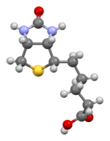
STRUCTURE

Slide 33
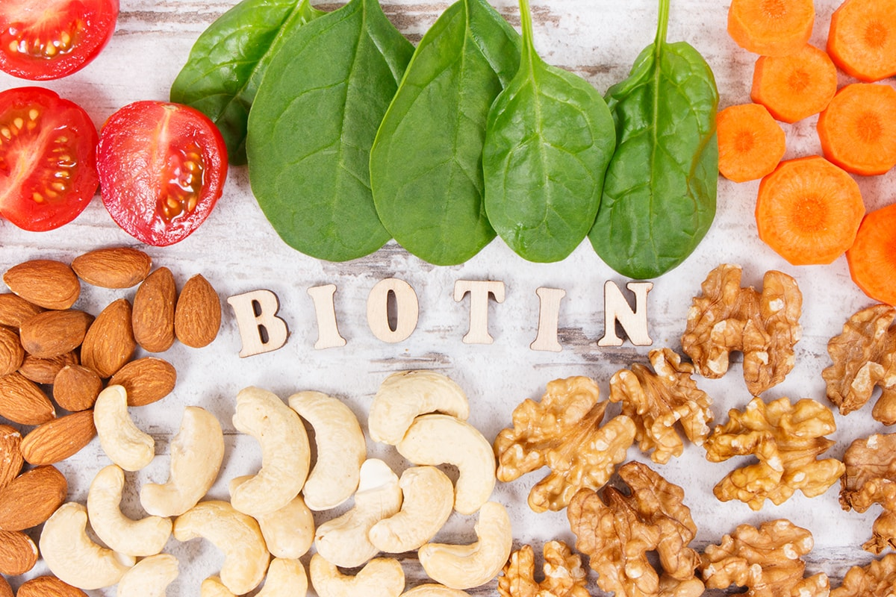
FOODS WITH BIOTIN
Biotin is a water-soluble vitamin, which means your body can't store it like fat-soluble vitamins. Instead, you have to replace it daily. Bacteria in your gut can create biotin, though researchers aren't sure what role this plays in your overall biotin levels.

Slide 34
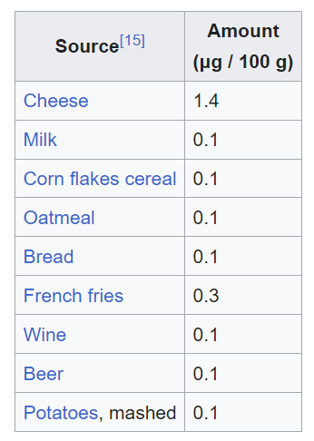
SOURCES

Slide 35
FUNCTIONS
Carbohydrate, Fat, and Protein Metabolism:
Biotin is a coenzyme that plays a critical role in the enzymatic reactions responsible for the breakdown of carbohydrates, fats, and proteins.
For carbohydrates, it helps in converting glucose from the breakdown of starches and sugars into a form that can be used for energy production.
In fat metabolism, biotin is essential for the synthesis of fatty acids and their incorporation into cellular membranes or as a source of energy.
In protein metabolism, biotin assists in the breakdown of amino acids and their conversion into forms that can be used for various bodily functions, including the synthesis of new proteins.

Slide 36
Gluconeogenesis:
Biotin is involved in the process of gluconeogenesis, where the body produces glucose from non-carbohydrate sources like amino acids and glycerol.
This is particularly important during fasting or when there is a low intake of carbohydrates, as it helps maintain blood sugar levels and provides energy for vital functions.
Fatty Acid Synthesis:
Biotin is a coenzyme for the enzyme acetyl-CoA carboxylase, which is essential for the synthesis of fatty acids.
Fatty acids are crucial for the production of cell membranes, energy storage in the form of triglycerides, and various physiological processes.
Amino Acid Metabolism:
Biotin is involved in the catabolism (breakdown) of certain amino acids.
It also plays a role in the conversion of amino acids into forms that can be used for energy or for the synthesis of other molecules.

Slide 37
Keratin Production:
Biotin is essential for the health of hair, skin, and nails because it is involved in the synthesis of keratin, a fibrous protein that provides structure and strength to these tissues.
Gene Expression:
Biotin is involved in the regulation of gene expression, particularly genes related to metabolism.
It helps control the activity of enzymes and proteins that are essential for various metabolic pathways in the body.
Cell Growth and Repair:
Biotin is required for the growth and repair of cells in various tissues throughout the body.
This includes maintaining healthy skin, nerve cells, and muscle tissues.

Slide 38
Immune System Support:
While the exact mechanisms are still under investigation, biotin is believed to play a role in supporting a healthy immune system.
It may contribute to immune function by participating in various metabolic processes that provide energy and building blocks for immune cells.
Pregnancy and Fetal Development:
Biotin is crucial during pregnancy as it is involved in embryonic development.
Pregnant women may require higher biotin intake to support the growing fetus, as biotin plays a role in organ and tissue development.
Neurological Function:
Biotin deficiency, while rare, can lead to neurological symptoms such as depression, lethargy, and hallucinations.
Biotin is vital for maintaining healthy nerve function and proper signaling between nerve cells.

Slide 39
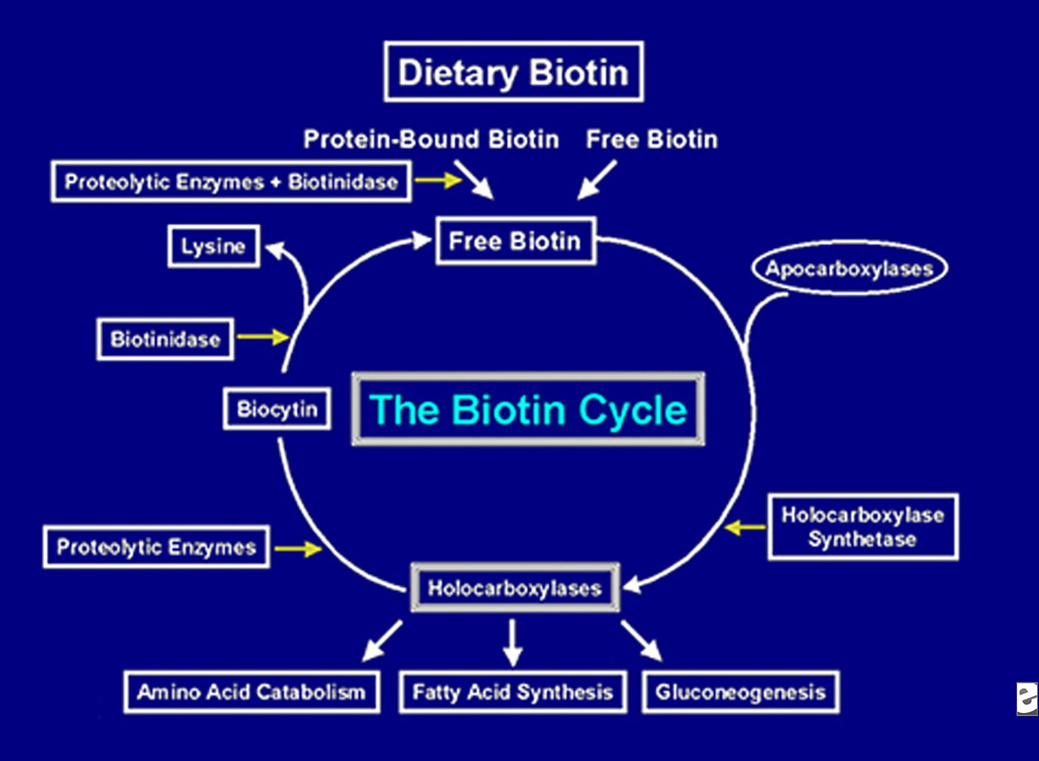

Slide 40
ABSORPTION
Biotin in food is bound to proteins. Digestive enzymes reduce the proteins to biotin-bound peptides. The intestinal enzyme biotinidase, found in pancreatic secretions and in the brush border membranes of all three parts of the small intestine, frees biotin, which is then absorbed from the small intestine.
When consumed as a biotin dietary supplement, absorption is nonsaturable, meaning that even very high amounts are absorbed effectively. Transport across the jejunum is faster than across the ileum.
The large intestine microbiota synthesize amounts of biotin estimated to be similar to the amount taken in the diet, and a significant portion of this biotin exists in the free (protein-unbound) form and, thus, is available for absorption.
How much is absorbed in humans is unknown, although a review did report that human epithelial cells of the colon in vitro demonstrated an ability to uptake biotin.

Slide 41
METABOLISM AND EXCRETION
Biotin catabolism occurs via two pathways.
In one, the valeric acid sidechain is cleaved, resulting in bisnorbiotin.
In the other pathway, the sulfur is oxidized, resulting in biotin sulfoxide.
Urine content is proportionally about half biotin, plus bisnorbiotin, biotin sulfoxide, and small amounts of other metabolites

Slide 42
VERTICAL INTEGRATION
Dermatitis: Biotin deficiency can cause skin issues such as red, scaly rashes (dermatitis), often around the eyes, nose, mouth, and genitals.
Alopecia (Hair Loss): Hair loss, or alopecia, is a common symptom of biotin deficiency. This can result in thinning hair or complete hair loss.
Brittle Nails: Biotin deficiency can lead to weak and brittle nails, making them prone to breakage and splitting.
Conjunctivitis: Inflammation of the conjunctiva, the clear tissue that covers the white part of the eye, can occur in cases of severe biotin deficiency.
Neurological Symptoms: Severe biotin deficiency can cause neurological symptoms such as depression, lethargy, hallucinations, and numbness and tingling in the extremities.
Muscle Pains: Biotin deficiency may lead to muscle pains and cramps.
Fatigue: General fatigue and weakness are common symptoms of biotin deficiency.

Slide 43
RESEARCH ARTICLES
https://www.statpearls.com/ArticleLibrary/viewarticle/21863
https://www.medicalnewstoday.com/articles/219853
https://www.tandfonline.com/doi/abs/10.1080/20014091084209

Slide 45
LEARNING RESOURCES
Lippincott Illustrated reviews of biochemistry 8th edition
Harpers illustrated biochemistry 32 edition
Used digital library

Slide 46
Family medicine
Biotin is commonly used to improve hair and nail strength and growth.
It's often included in supplements marketed for these purposes.
Metabolism: Biotin helps the body convert food into energy, supporting overall
metabolism.
Skin Health: It may help with certain skin conditions, such as dermatitis and
acne scarring.
Prenatal Care: Biotin is important for a healthy pregnancy, and some pregnant
women may need supplements to prevent deficiencies.

Slide 47
Ethics
Academic Integrity : should always submit own work and not cheat in any way.
Respect: There should be respect for fellow students and facilitator.
Confidentiality: There should be respect of privacy of fellow students and facilitator.
Honesty : Students should be honest about their knowledge and understanding of material being covered.

Slide 48
Artificial Intelligence
Gene Regulation: AI is being used to study how biotin influences gene
expression and metabolic pathways. Researchers are using machine
learning algorithms to analyze large datasets and identify patterns in
biotin-related gene regulation.
Metabolic Disorders: AI models are helping to predict and understand
metabolic disorders related to biotin deficiency or excess. By analyzing
genetic and metabolic data, AI can help identify individuals at risk and
suggest personalized treatment plans.
Nutritional Research: AI is being used to analyze dietary patterns and
biotin intake in different populations. This helps in understanding the role of
biotin in overall health and developing dietary recommendations.
Drug Development: AI is aiding in the discovery of new drugs that can
modulate biotin metabolism or mimic its effects. This could lead to
new treatments for conditions related to biotin deficiency or
over-supplementation.

