Slide 1


1st Year MBBS SGD
Bones of the Forearm
(Radius and Ulna)
MSK-1 Module
18th April 2024
Dr. Sajjad Hussain
Senior Demonstrator

Slide 2
Vision; The Dream/Tomorrow
Motto
To impart evidence based research oriented medical education
To provide best possible patient care
To inculcate the values of mutual respect and ethical practice of medicine
Wisdom
Truth
Service

Slide 3

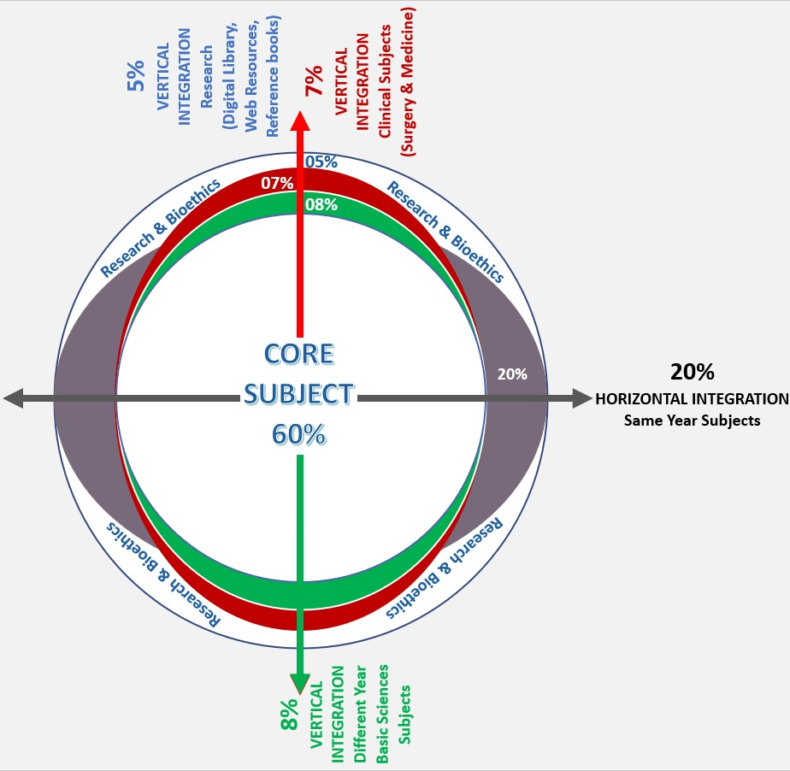
Professor Umar Model of Integrated Lecture
60%
CORE SUBJECT
20%
HORIZONTAL
INTEGRATION
Physiology
biochemistry
8%
VERTICAL INTEGRATION
Pathology
pharmacology
7%
VERTICAL INTEGRATION
Clinical integration
5%
VERTICAL INTEGRATION
Research, professionalism
Ethics
Digital library

Slide 4
Learning Objectives
Determine the side.
Demonstrate the anatomical position.
Discuss general features, attachments, and articulations
Describe ossification.
Elaborate on the interosseous membrane and its importance.
Correlate with the clinical conditions.
Focus on the provision of curative and preventive healthcare measures.
Practice principles of bioethics.
Apply strategic use of AI in healthcare.
Read a relevant research article.

Slide 5
Core Concept
No of Slides - 13

Slide 6
Anatomical Position And Side Determination
Radius
The side of the radius can be determined by keeping the
bone vertically in such a way that:
1. The narrow disc-shaped end (head) is directed upwards.
2. The sharpest border (interosseous border) of the shaft is kept medially.
3. The styloid process at the lower end is directed laterally and the prominent tubercle (Lister’s tubercle) at the lower end faces dorsally.
4. The convexity of the shaft faces laterally, and the concave
anterior surface of the shaft faces anteriorly.

Slide 7
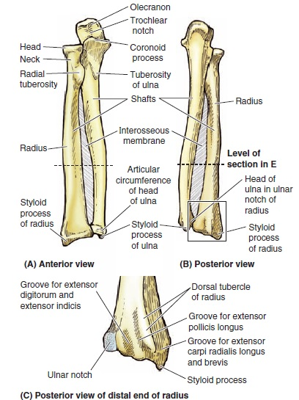

Slide 8
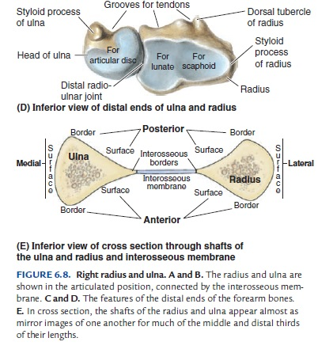

Slide 9
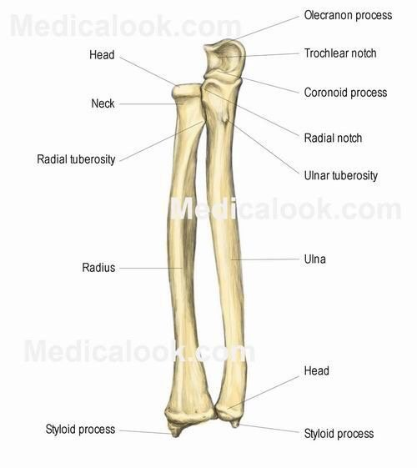
Features
Upper End
Head
Neck
Radial tuberosity
Shaft
3 borders (Anterior, posterior, medial, or interosseous borders)
3 surfaces (Anterior, posterior, lateral surfaces)

Slide 10
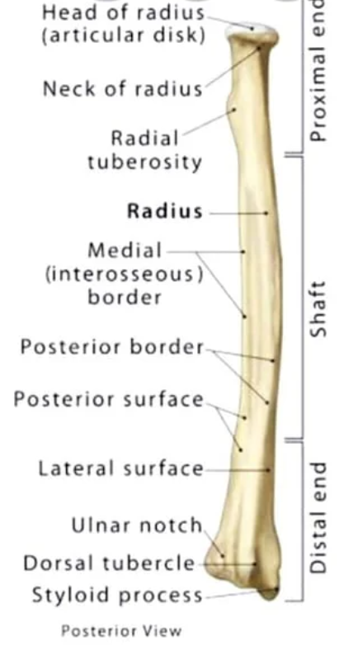
Cont.
Lower end
5 surfaces (anterior, posterior, medial, lateral, and inferior surfaces)
The radial artery is palpated against the anterior surface.
The medial surface has an ulnar notch.
The posterior surface has a dorsal tubercle and four grooves.
The lateral surface is prolonged downwards to form a radial styloid process.
The inferior surface has a lateral triangular area and a medial quadrangular area.

Slide 11
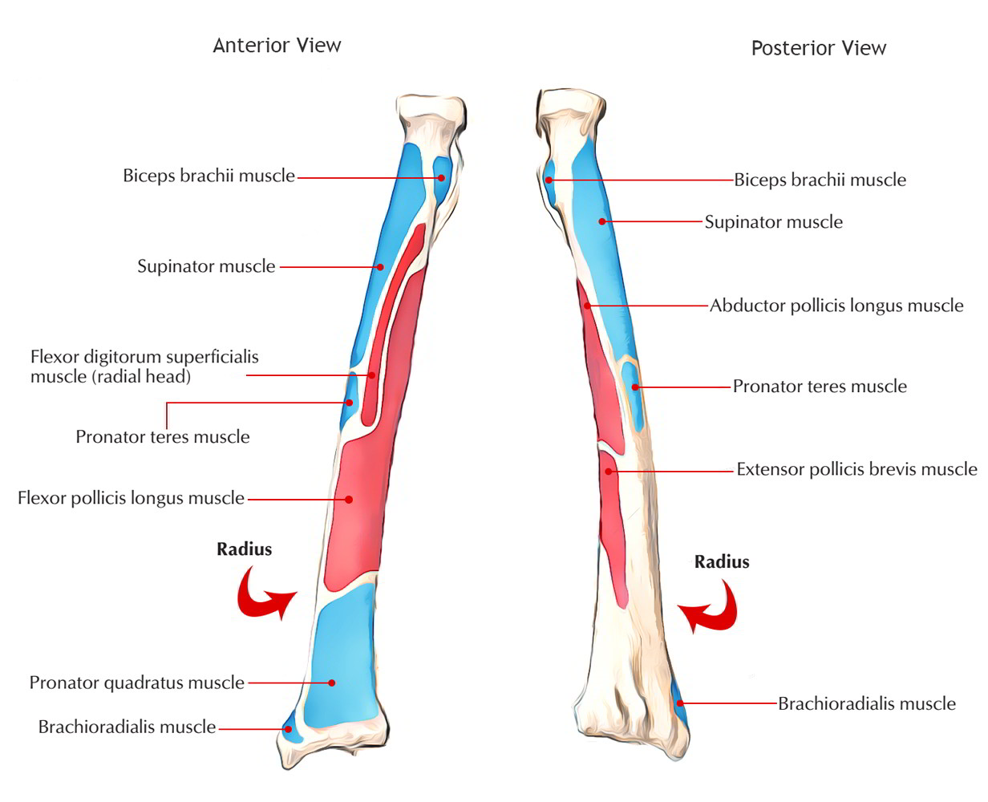
Attachments

Slide 12
Ossification
The radius ossifies from the following three centers:
One primary center appears in the mid-shaft during the 8th week of 1UL.
Two secondary centers, one for each end:
(a) Centre for lower end appears at the age of first year.
(b) Centre for upper end appears during the fifth year.
The upper epiphysis fuses at the age of 12 years.
The lower epiphysis fuses at the age of 20th year.

Slide 13
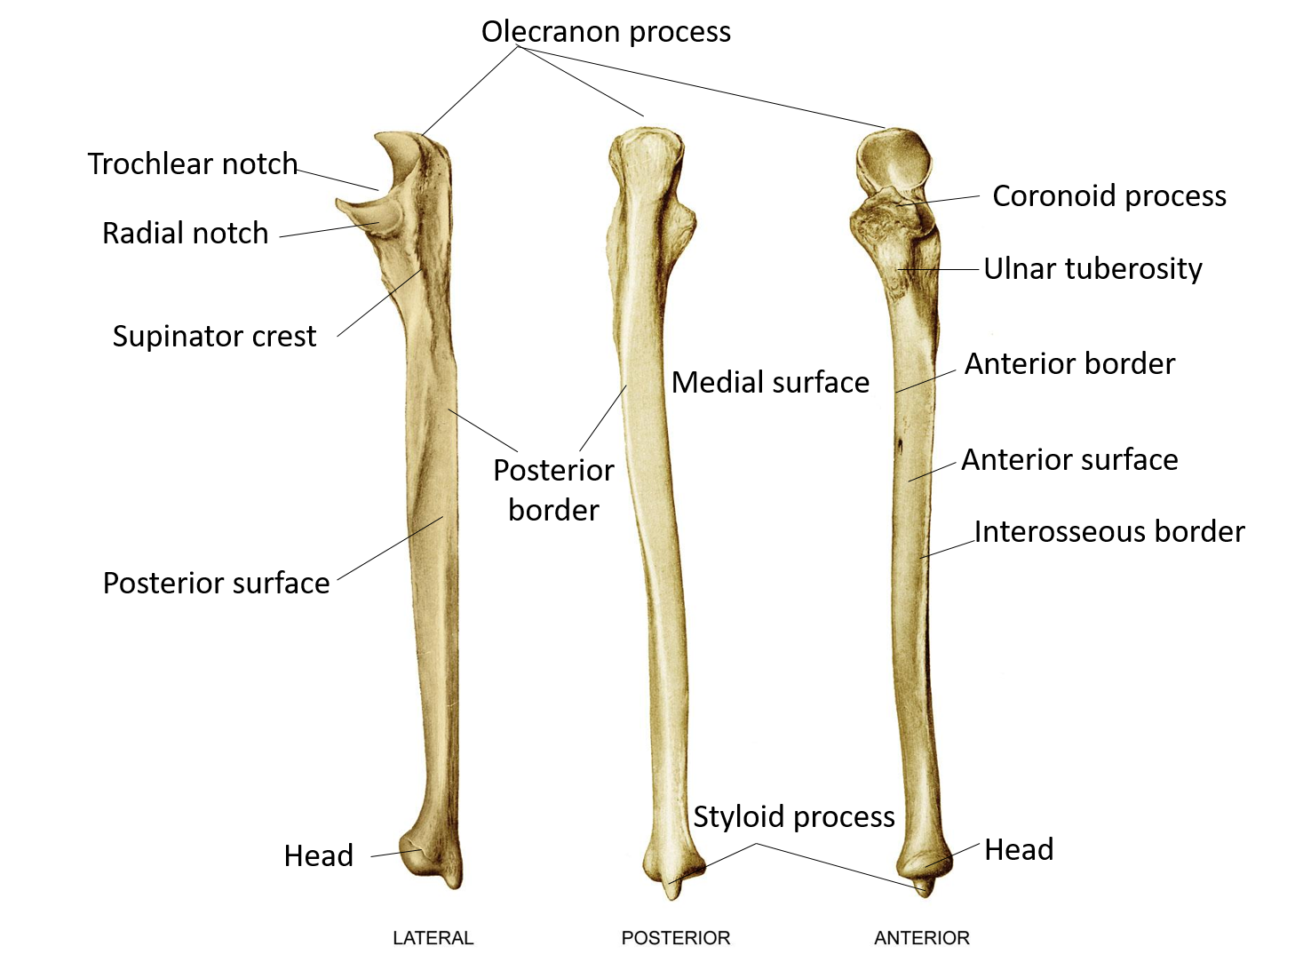
Ulna
Side Determination
The upper end is hook-like, with its concavity directed forwards.
The lateral border of the shaft is sharp and crest-like.
Pointed styloid process lies posteromedial to the rounded head of ulna at its lower end.

Slide 14
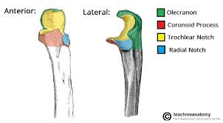
Features
Upper end
Olecranon process
Coronoid process
Trochlear notch
Radial notch

Slide 15
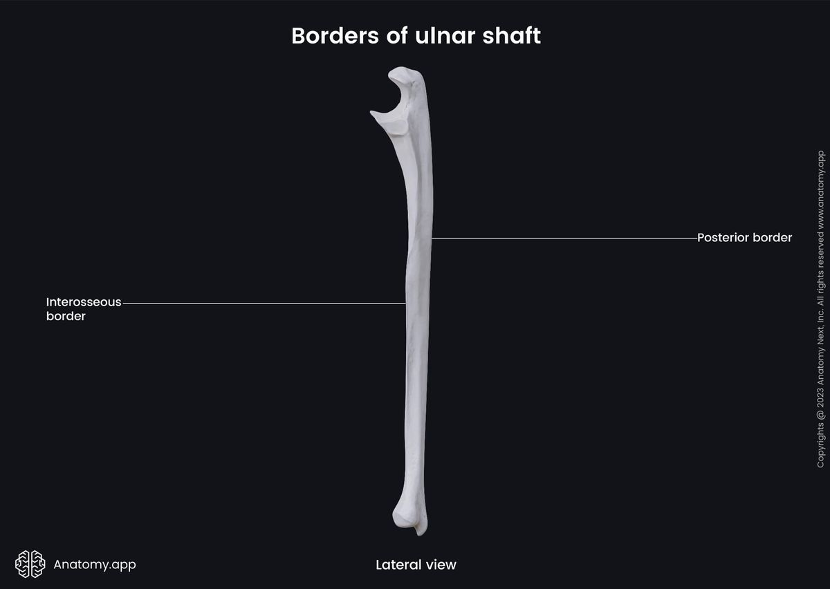
Cont
Shaft
3 borders (interosseous/lateral, anterior, posterior borders)
3 surfaces (anterior, posterior, medial surfaces)

Slide 16
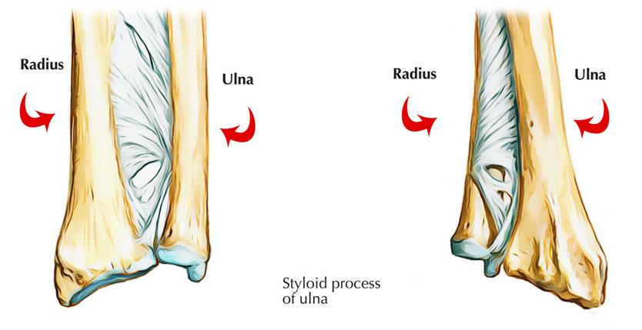
Cont.
Lower end
Head articulates with the ulnar notch of the radius to form a distal radio-ulnar joint and is separated from the wrist joint by the articular disc.
The styloid process projects downwards from the posteromedial side of the lower end.
Posteriorly between the styloid and head lies a groove for the tendon of the extensor carpi ulnaris.

Slide 17
Attachments

Slide 18
Ossification
The shaft and most of the upper end ossify from a primary center which appears during the 8th week of development.
The superior part of the olecranon process ossifies from a secondary center which appears during the 10th year which joins the rest of the bone by the 16th year.
The lower end ossifies from a secondary center which appears during the 5th year and joins with the shaft by the 18th year.

Slide 19
Interosseous Membrane
The interosseous border of the radius or ulna connects to the thin, fibrous interosseous membrane of the forearm. The majority of the fibers of the interosseous membrane run an oblique course, passing inferiorly from the radius as they extend medially to the ulna they are positioned to transmit forces received by the radius (via the hands) to the ulna for transmission to the humerus.

Slide 21
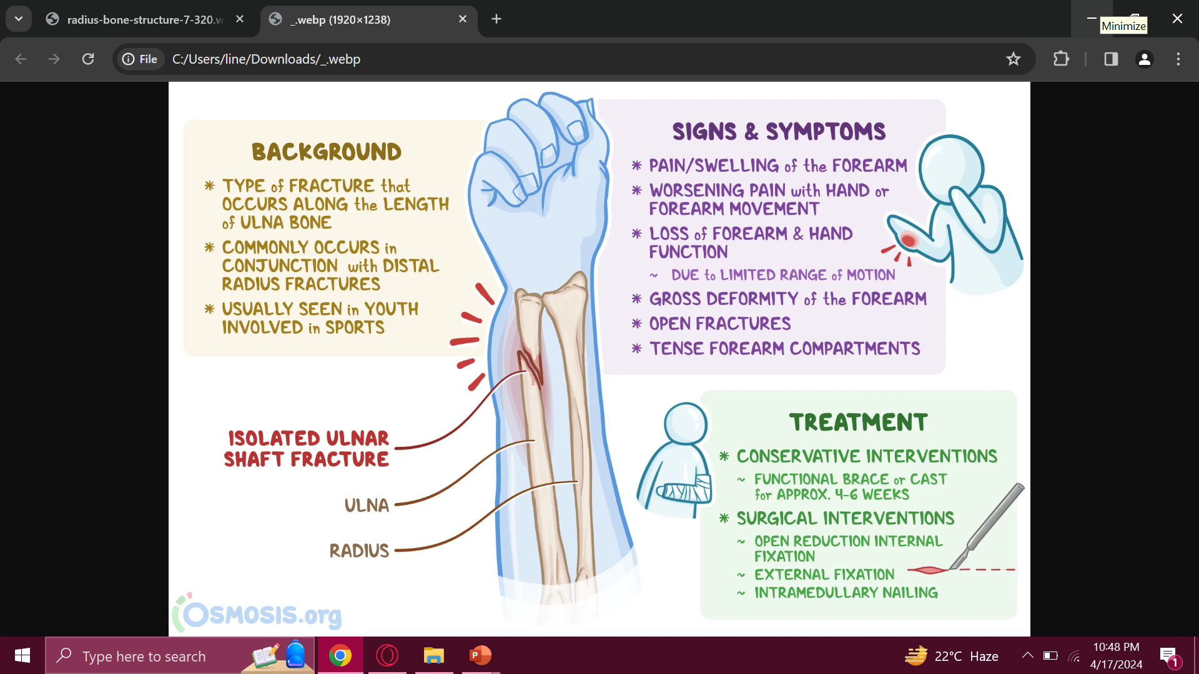

Slide 22
Vertical Integration
No of Slides - 7

Slide 23
Fractures of Radius
Colles Fracture (Distal end of radius)
A complete transverse fracture of the distal 2cm of the radius, called a Colles fracture, is the most common fracture of the forearm.
The distal fragment is displaced dorsally and is often comminuted (broken into pieces). The fracture results from forced dorsiflexion of the hand as falling on an outstretched hand (FOOSH). (ref: KLM)
Dinner fork deformity.

Slide 24
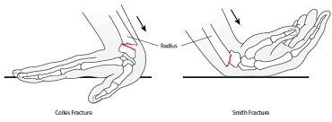
Cont.
Smith’s Fracture
It is a fracture of the distal end of the radius and occurs from a fall on the back of the hand.
It is a reversed colles fracture because the distal fragment is displaced anteriorly.

Slide 26
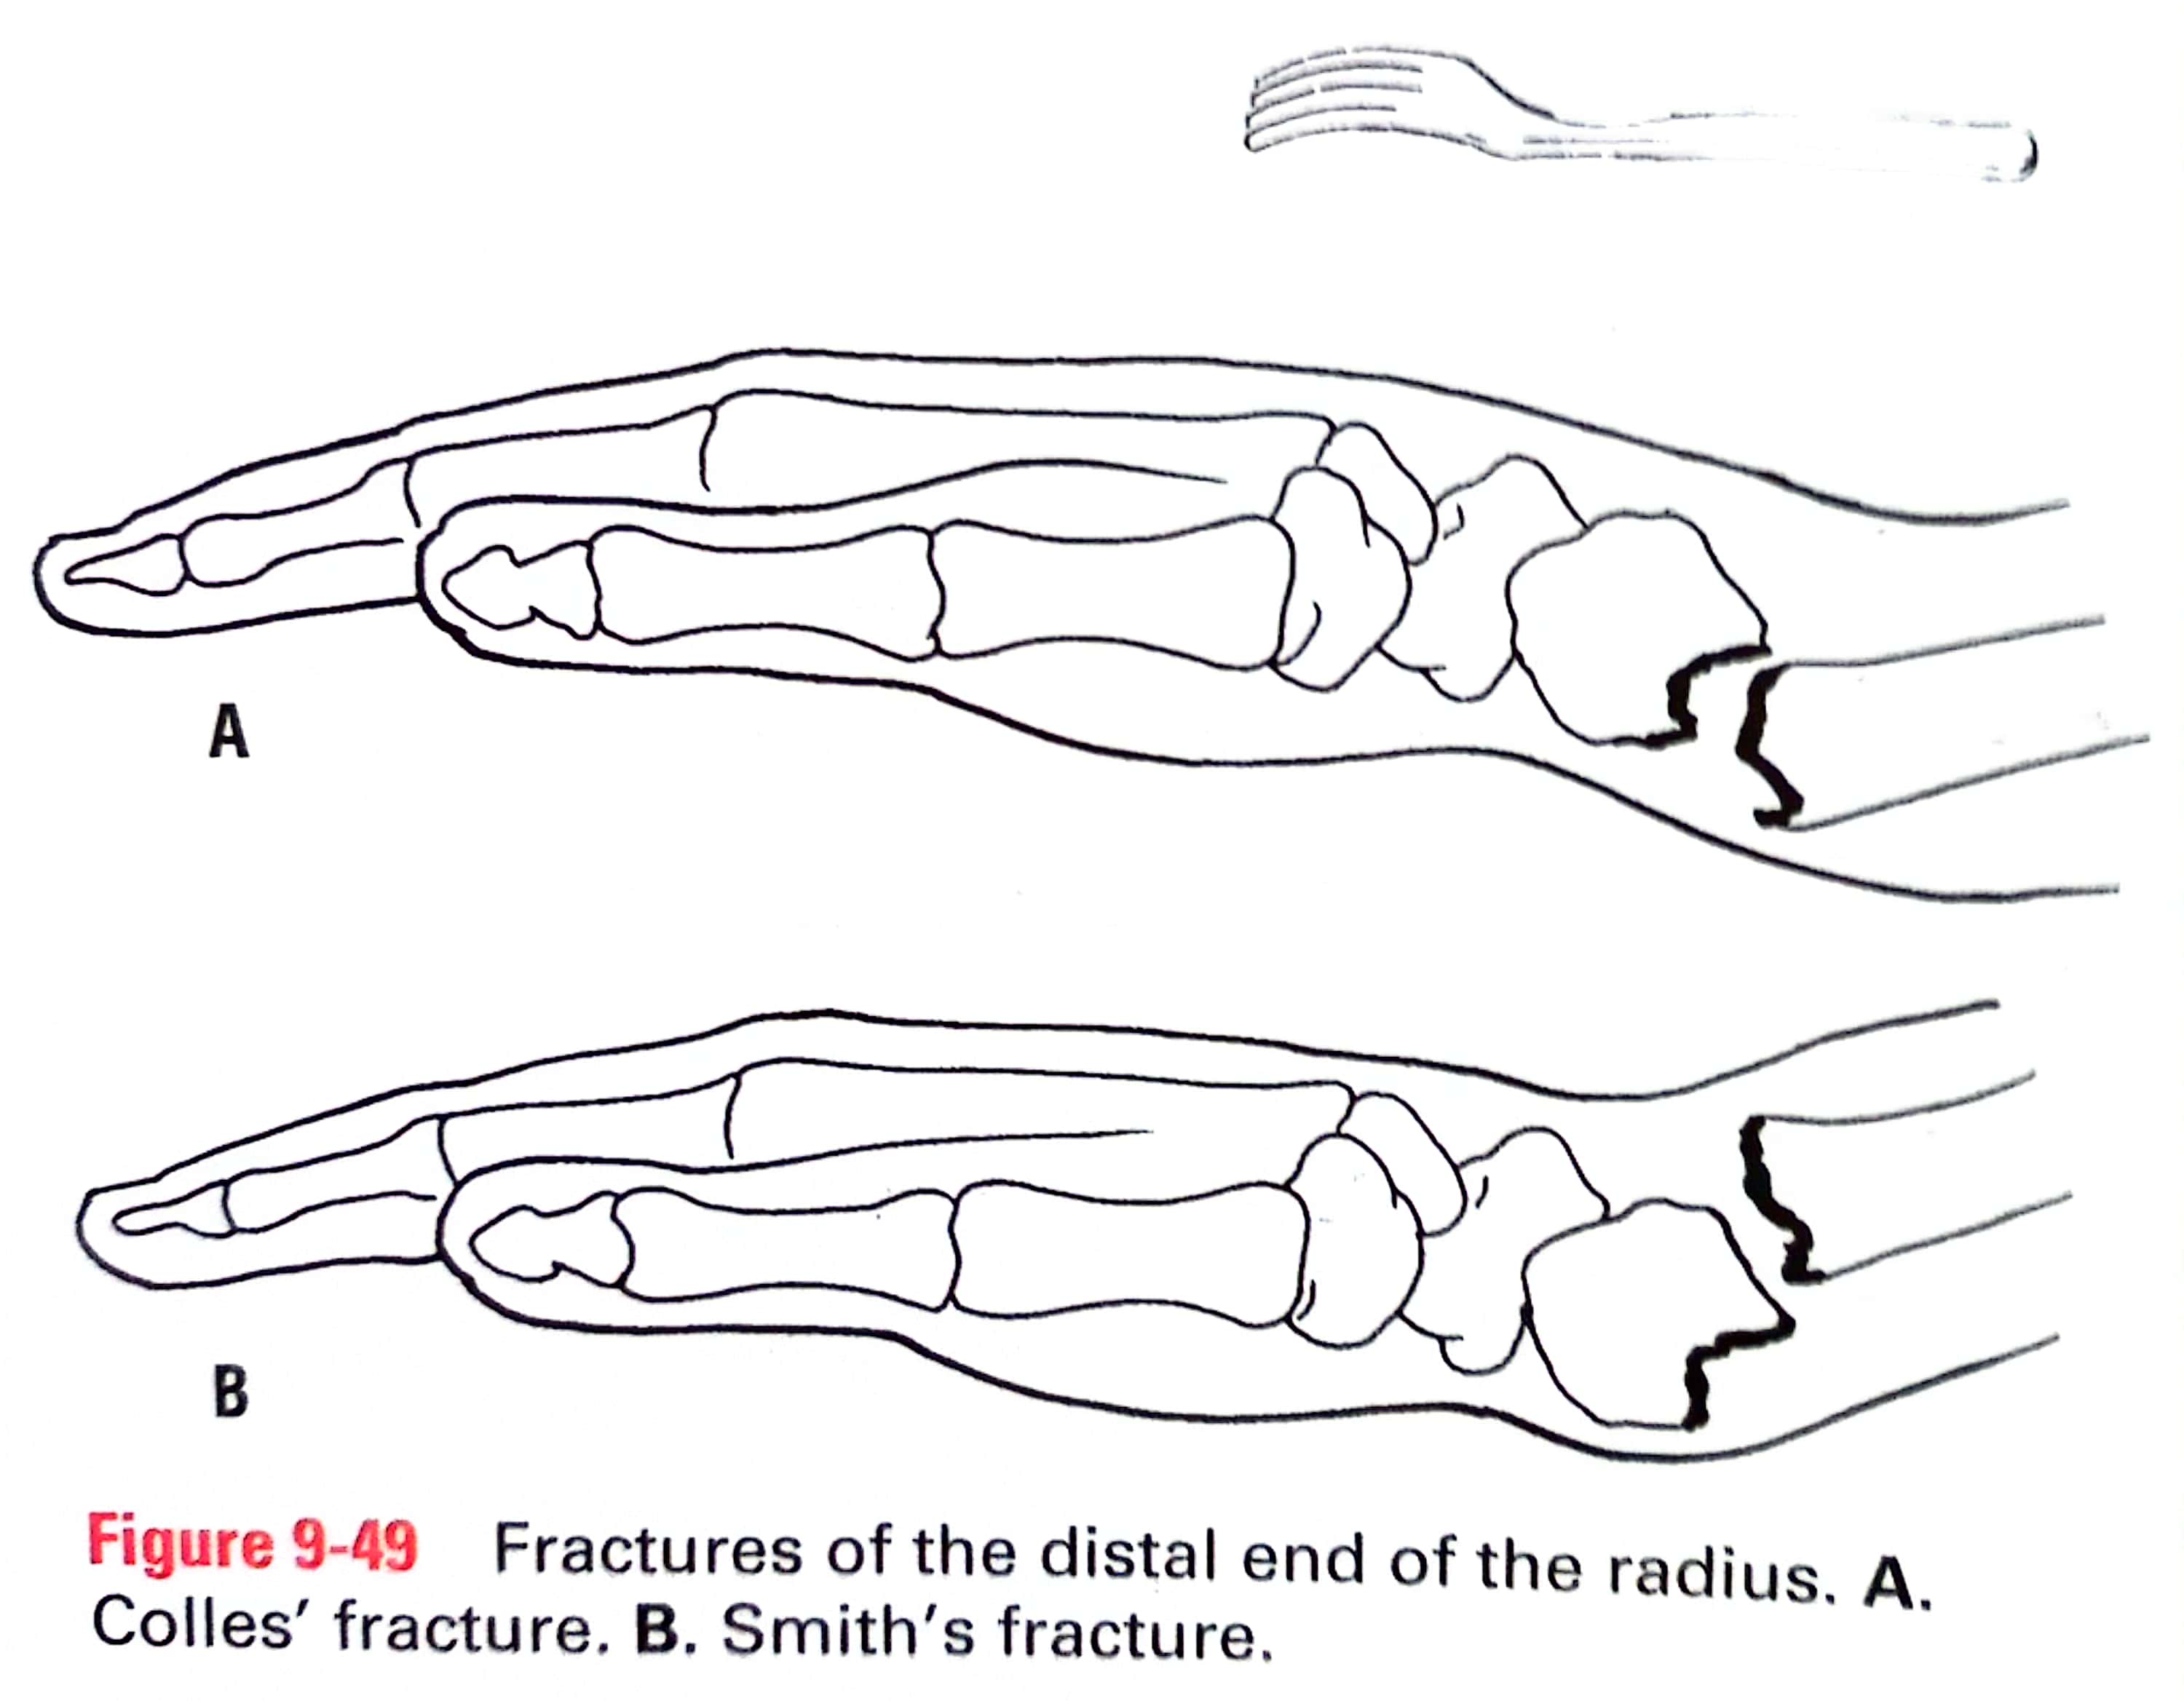

Slide 27
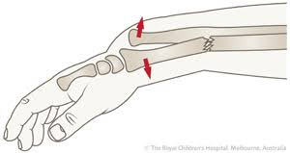
Cont.
Galeazzi’s Fracture
Fracture of the proximal third of the radius.
Dislocation of the distal radio-ulnar joint.

Slide 28
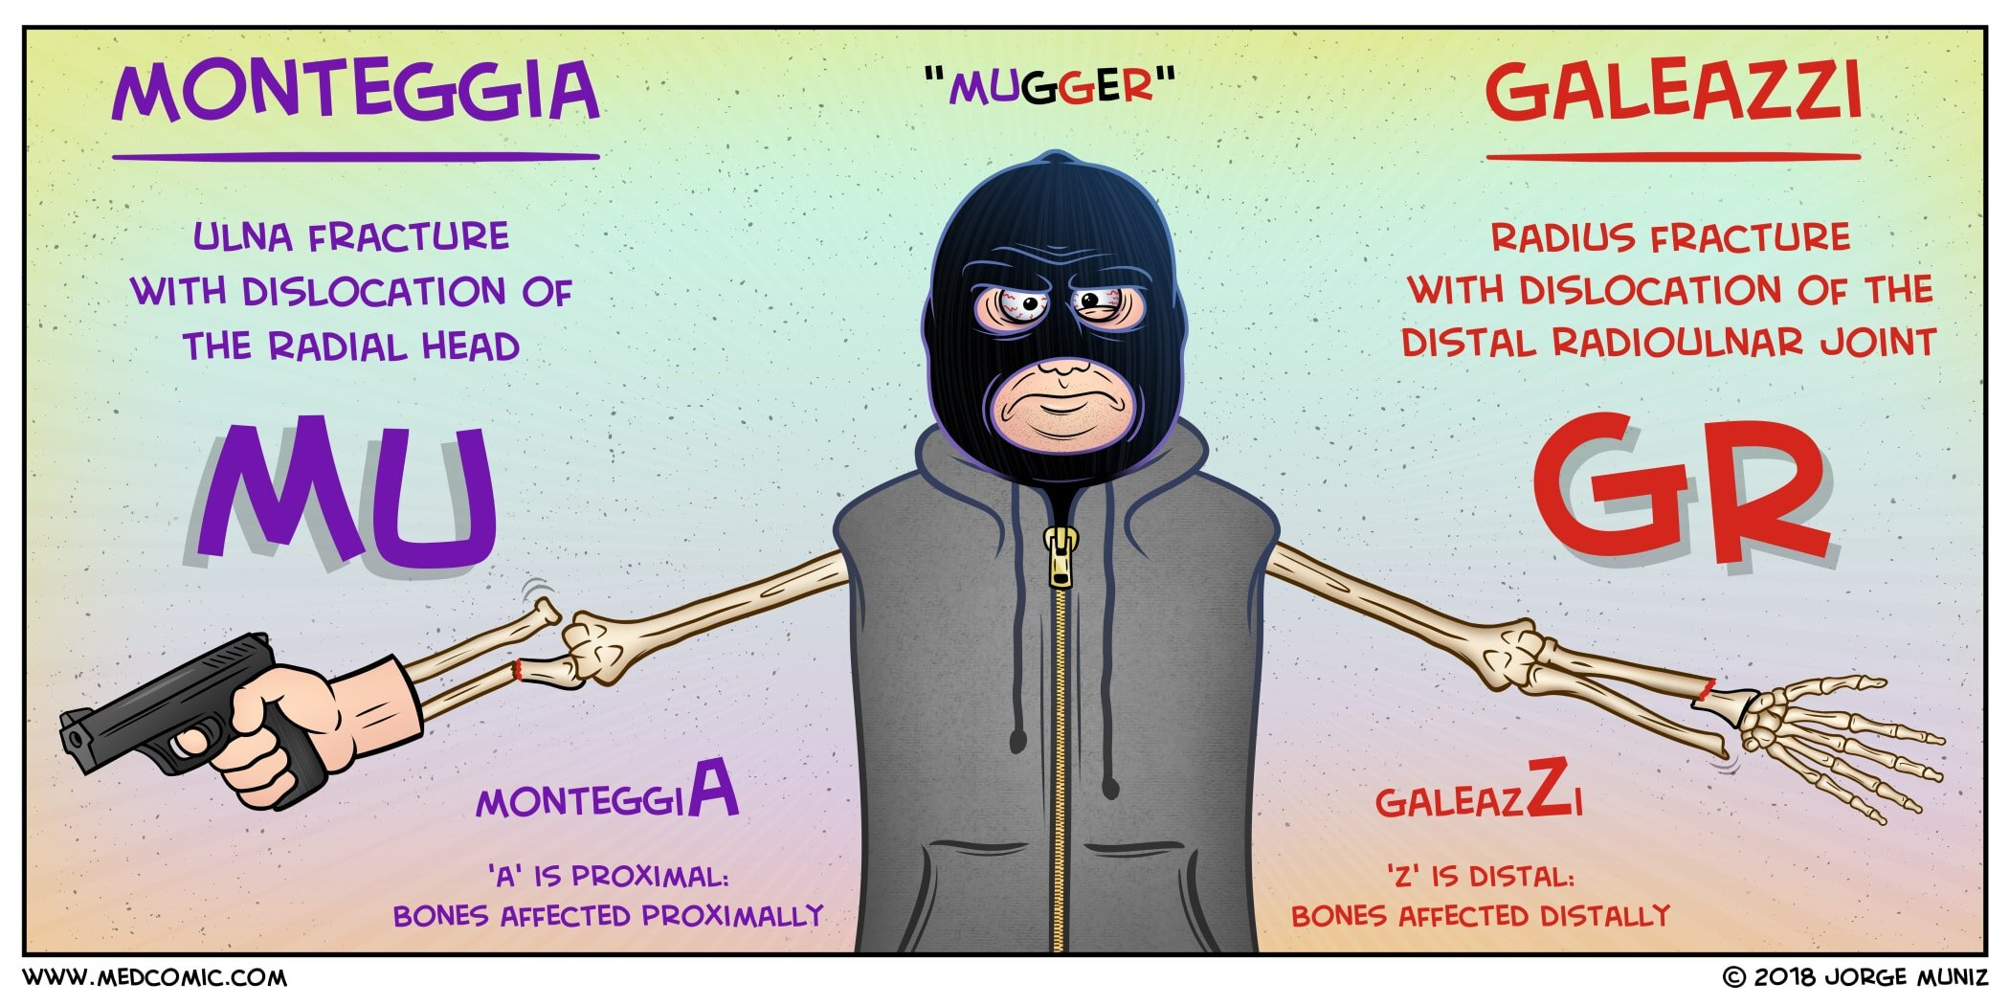

Slide 29
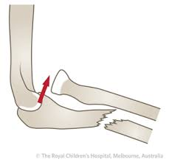
Fractures of Ulna
Monteggia’s Fracture
The ulnar shaft is fractured by a force applied form behind.
There is bowing forward of the ulnar shaft and anterior dislocation of the radial head with rupture of annular ligament.

Slide 30
Spiral Integration
No of Slides - 4

Slide 31
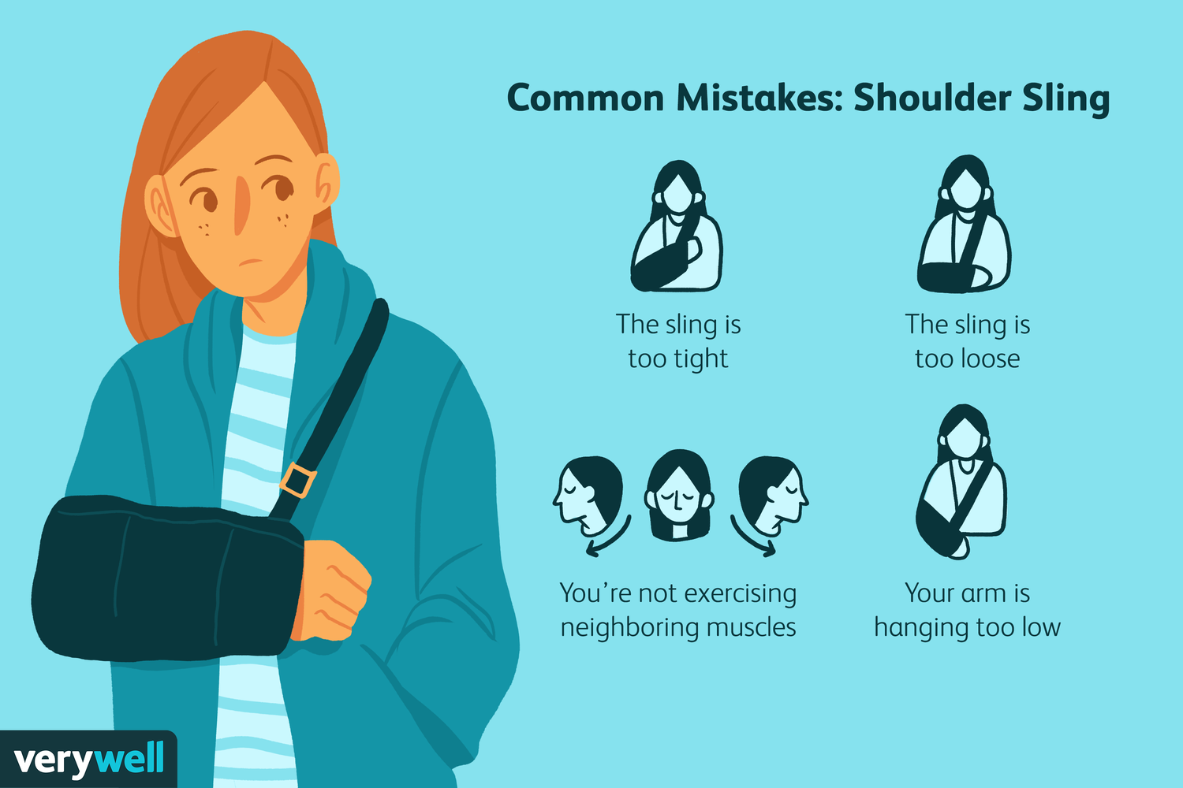
Family Medicine
Initial Assessment: Family physicians play a crucial role in the initial assessment of radius and ulna fractures, providing immediate medical attention, diagnosing the severity of the injury, and initiating appropriate treatment plans.
Referral and Coordination: They facilitate referrals to orthopedic specialists if necessary, ensuring patients receive specialized care for complex fractures. Additionally, they coordinate with radiologists for timely imaging, aiding in accurate diagnosis and treatment planning.
Follow-up Care: Family physicians provide ongoing monitoring and management of fractures, overseeing the healing process, adjusting treatment as needed, and addressing any complications or concerns that may arise during recovery.

Slide 32
Biomedical Ethics
Biomedical ethics in the context of radius and ulna fractures involve ensuring patient autonomy in treatment decisions, such as choosing between surgical intervention and conservative management.
Physicians must uphold beneficence by prioritizing patient well-being, opting for treatments that optimize long-term function and quality of life.
Additionally, ethical considerations include maintaining patient confidentiality regarding sensitive medical information related to the injury and treatment process.

Slide 33
Artificial Intelligence
AI aids in fracture detection through advanced imaging analysis, assisting radiologists in accurately identifying and categorizing radius and ulna fractures from X-rays or scans.
Additionally, AI-powered systems can help predict fracture healing times and outcomes based on patient-specific factors, guiding treatment decisions for optimal recovery.
Furthermore, AI algorithms contribute to the development of personalized rehabilitation plans, enhancing post-fracture care by tailoring interventions to individual patient needs and progress.

Slide 34
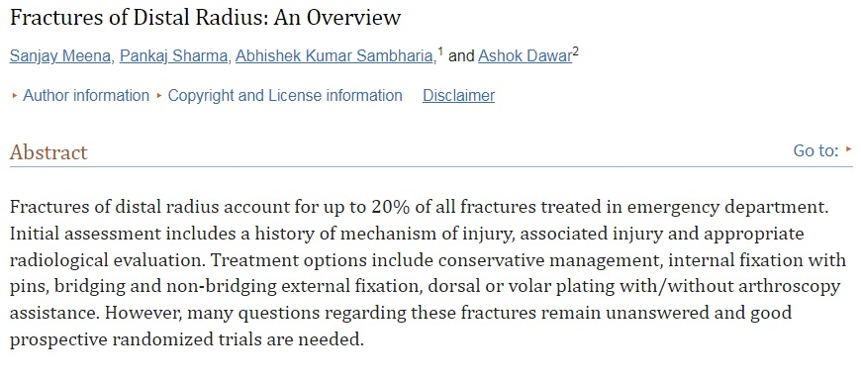
Research Article

Slide 35
Assessment
Colle’s fracture is associated with _____
Femur
b) Ulna
c) Radius
d) Humerus
2. What is the name of the joint that connects the radius and ulna bones in the forearm?
a) Radioulnar joint
b) Humeroulnar joint
c) Elbow joint
d) Wrist joint
3. In Smith’s fracture there is,
a) volar displacement of fractured radius
b) volar displacement of fractured ulna
c) distal displacement of fractured radius
d) distal displacement of fractured ulna
4. In Colle’s fracture there is,
a) volar displacement of fractured radius
b) volar displacement of fractured ulna
c) dorsal displacement of fractured radius
d) dorsal displacement of fractured ulna

Slide 36
Key
Colle’s fracture is associated with _____
Femur
b) Ulna
c) Radius
d) Humerus
2. What is the name of the joint that connects the radius and ulna bones in the forearm?
a) Radioulnar joint
b) Humeroulnar joint
c) Elbow joint
d) Wrist joint
3. In Smith’s fracture there is,
a) volar displacement of fractured radius
b) volar displacement of fractured ulna
c) distal displacement of fractured radius
d) distal displacement of fractured ulna
4. In Colle’s fracture there is,
a) volar displacement of fractured radius
b) volar displacement of fractured ulna
c) dorsal displacement of fractured radius
d) dorsal displacement of fractured ulna

Slide 37
Learning Resources
1.Clinically Oriented Anatomy by Keith Moore 9th edition.
2.Cunningham’s Manual of Practical Anatomy by G.J. Romanes, 16th edition, Vol-I, II and III
3. http://www.anatomyzone.com 3D anatomy
https://teachmeanatomy.info

Slide 38
Take Home Message
Mastering the anatomy of the radius and ulna is essential for diagnosing and treating fractures accurately. Knowledge of their biomechanics and variations in fracture patterns empowers healthcare providers to deliver tailored treatment plans for optimal patient care.

Slide 39
Use of Digital Library
1. Go to the website of HEC National Digital Library.
2. On the Home Page, click on the INSTITUTES.
3. A page will appear showing the universities from the Public and Private Sector and other Institutes that have access to HEC National Digital Library HNDL.
4. Select your desired Institute.
5. A page will appear showing the resources of the institution
6. Journals and Research will appear
7. You can find a Journal by clicking on JOURNALS AND DATABASE and entering a keyword to search for your desired journal.

Slide 40
Thank You!

